Slide 1

Exploring the Depths of 'The Boy at the Top of the Mountain'
A Comprehensive Analysis of Themes, Characters, and Symbolism in the Novel

Slide 2


Table of contents
Introduction to The Boy at the Top of the Mountain
Understanding Themes in The Boy at the Top of the M…
Symbolism in The Boy at the Top of the Mountain
Historical Context of The Boy at the Top of the Mou…
Character Analysis: Pierrot
Character Analysis: Herr Zimmer
Interactive Activity: Theme Mapping
Interactive Activity: Symbolism Scavenger Hunt
Writing Activity: Reflective Essay
Assessment and Evaluation
Conclusion and Next Steps
Resources and References
Extension Activities
01
02
03
04
05
06
07
08
09
10
11
12
13

Slide 3
Table of contents
Parent Engagement
Safety Considerations
Reflection Questions
Next Steps and Follow-up Lessons
Conclusion and Final Thoughts
14
15
16
17
18

Slide 4
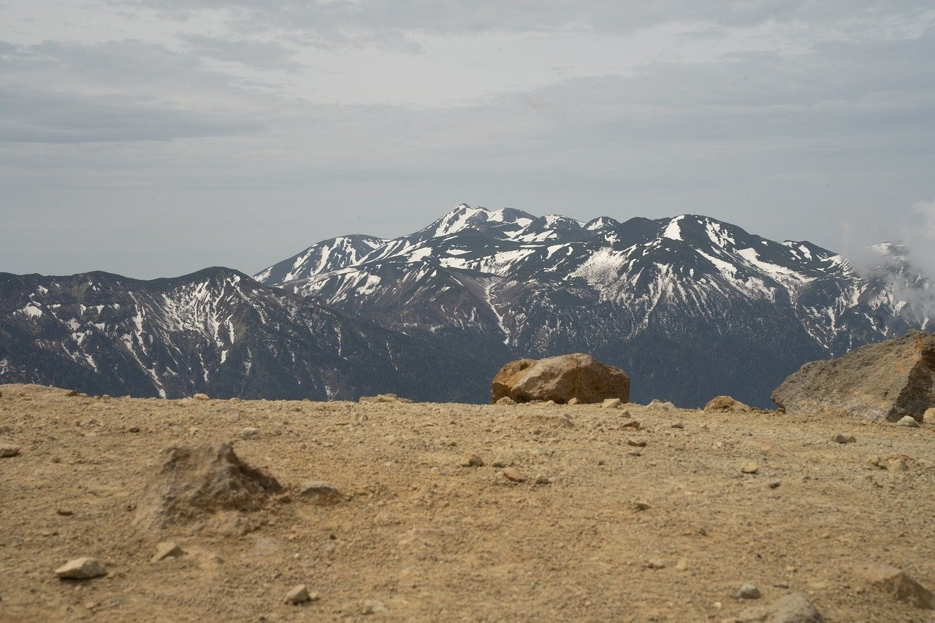
Introduction to The Boy at the Top of the Mountain
Complex Themes
Pierrot's Journey
Critical Analysis
The novel delves into themes of identity, belonging, and the impact of war.
Symbolism plays a crucial role in conveying deeper meanings throughout the story.
Pierrot is a young boy navigating the challenges of life during World War II.
His experiences in Germany shape his understanding of family and loyalty.
Students will engage in discussions to unpack the novel's themes and symbols.
Activities will foster critical thinking and empathy towards the characters' experiences.
1
Exploring the Depths of 'The Boy at the Top of the Mountain'

Slide 5

Understanding Themes in The Boy at the Top of the Mountain
Identity Journey
Loyalty's Cost
Pierrot's journey reflects the struggle of self-discovery amidst external influences.
His transformation highlights the impact of environment on personal identity.
The novel emphasizes the weight of loyalty in times of conflict.
Betrayal is portrayed as a painful yet sometimes necessary choice.
Moral Complexity
Empathetic Connection
Moral choices in wartime are depicted as fraught with ambiguity.
The characters face dilemmas that challenge their ethical beliefs.
Readers can relate to Pierrot's feelings of isolation and confusion.
His experiences evoke a sense of shared humanity in the face of adversity.
2
Exploring the Depths of 'The Boy at the Top of the Mountain'

Slide 6

Symbolism in The Boy at the Top of the Mountain
Mountain's Significance
Uniform's Impact
Forest's Role
The mountain symbolizes the challenges and obstacles in Pierrot's journey.
It represents both a physical and metaphorical ascent towards understanding and self-discovery.
The Nazi uniform represents oppression and the loss of individuality.
It affects the characters by instilling fear and enforcing conformity in a time of turmoil.
The forest serves as a sanctuary and a place of refuge for Pierrot.
It symbolizes the connection to nature and the innocence that contrasts with the harsh realities of the world.
3
Exploring the Depths of 'The Boy at the Top of the Mountain'

Slide 7
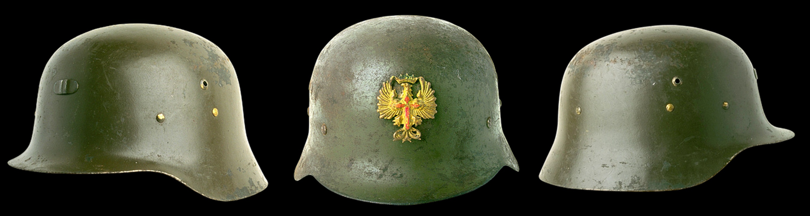
Historical Context of The Boy at the Top of the Mountain
War Events
Life in Germany
Holocaust Representation
World War II was marked by significant events such as the invasion of Poland and the D-Day landings.
The novel reflects on the consequences of the war, including loss, displacement, and the impact on families.
Life in Nazi Germany was characterized by strict control, propaganda, and fear among the populace.
The novel illustrates the daily struggles and moral dilemmas faced by individuals living under a totalitarian regime.
The novel addresses the Holocaust by highlighting the atrocities committed against the Jewish people.
It conveys a message of remembrance and the importance of acknowledging history to prevent future horrors.
4
Exploring the Depths of 'The Boy at the Top of the Mountain'

Slide 8

Character Analysis: Pierrot
Motivations
Relationships
Growth
Pierrot is driven by a deep desire for acceptance and love, which influences his choices throughout the story.
His actions often reflect a longing to connect with others, revealing his vulnerability.
Pierrot's interactions with other characters highlight his emotional struggles and aspirations.
The dynamics of his relationships significantly impact his self-perception and growth.
Throughout the novel, Pierrot undergoes significant personal development, learning to embrace his identity.
His journey illustrates the importance of self-discovery and resilience in overcoming challenges.
5
Exploring the Depths of 'The Boy at the Top of the Mountain'

Slide 9

Character Analysis: Herr Zimmer
Character Representation
Motivational Drivers
Thematic Significance
Herr Zimmer represents the complexities of human nature, embodying both wisdom and folly.
His relationship with Pierrot highlights the generational divide and the struggle for understanding.
Herr Zimmer is driven by a desire for redemption and a longing to connect with Pierrot.
His actions are influenced by past regrets, which propel the narrative forward.
Herr Zimmer's character conveys the theme of reconciliation between past and present.
His journey reflects the broader societal changes and the quest for identity within the novel.
6
Exploring the Depths of 'The Boy at the Top of the Mountain'

Slide 10

Interactive Activity: Theme Mapping
Visual Theme Mapping
Theme Analysis Discussion
Ask students to create a theme map that visually represents the novel's themes using different colors, symbols, and images for each idea.
Lead a discussion for students to analyze their theme maps and connect themes to the plot.
7
Exploring the Depths of 'The Boy at the Top of the Mountain'

Slide 11

Interactive Activity: Symbolism Scavenger Hunt
Find and Analyze Symbols
Present and Discuss Findings
Identify key symbols in the novel. Use specific examples from the text to support your analysis.
Share your insights with the class. Explore how the identified symbols connect to the main themes and plot developments.
8
Exploring the Depths of 'The Boy at the Top of the Mountain'

Slide 12

Writing Activity: Reflective Essay
Essay Analysis
Theme Discussion
Write a reflective essay analyzing the novel's themes and symbolism, using specific text examples for support.
Share your essays with classmates and discuss how the themes relate to real-life experiences.
9
Exploring the Depths of 'The Boy at the Top of the Mountain'

Slide 13

Assessment and Evaluation
Engagement Metrics
Assignment Analysis
Discussion Insights
Evaluate student participation through observations and surveys.
Track attendance and active involvement in class activities.
Analyze written assignments to determine students' understanding of key themes.
Assess reflective essays for depth of analysis on symbolism.
Evaluate presentations for critical thinking and clarity of ideas.
Promote diverse perspectives during class discussions.
10
Exploring the Depths of 'The Boy at the Top of the Mountain'

Slide 14

Conclusion and Next Steps
Key Takeaways
Upcoming Activities
Analyzing themes and symbolism in 'The Boy at the Top of the Mountain' enhances our understanding of the narrative.
Recognizing these elements is crucial for deeper literary analysis and appreciation.
Future lessons will delve into the historical context surrounding the story.
Students will create multimedia presentations to express their insights and analyses.
11
Exploring the Depths of 'The Boy at the Top of the Mountain'

Slide 15

Resources and References
Novel Exploration
Analytical Worksheets
Supplementary Resources
The Boy at the Top of the Mountain by John Boyne serves as the primary text for the lesson.
It offers a rich and complex exploration of themes and symbolism.
Literary analysis worksheets provide guided questions for students.
These prompts help students delve into the novel's themes and symbolism.
A collection of online resources includes articles, videos, and websites.
These resources offer additional information and context on the novel and its historical setting.
12
Exploring the Depths of 'The Boy at the Top of the Mountain'

Slide 16

Extension Activities
Debate Topics
Creative Writing
Book Club Discussion
Encourage students to debate the morality of war as depicted in the novel.
Discuss the importance of loyalty among characters and its implications.
Prompt students to write a short story inspired by the novel's themes.
Encourage poetry that reflects the symbolism found within the text.
Facilitate a discussion on the novel's central themes and their relevance today.
Explore character motivations and their development throughout the story.
13
Exploring the Depths of 'The Boy at the Top of the Mountain'

Slide 17

Parent Engagement
Conference Scheduling
Volunteer Opportunities
Schedule a conference to discuss lesson objectives and activities.
Share insights on student progress during the meeting.
Invite parents to assist with classroom activities.
Encourage parents to support students during lessons.
14
Exploring the Depths of 'The Boy at the Top of the Mountain'

Slide 18

Safety Considerations
Emotional Support
Sensitive Topics
Acknowledge students' emotional needs and ensure access to counseling services for effective coping.
Provide trigger warnings for sensitive topics such as war and violence.
Encourage respectful discussions while being mindful of students' feelings.
15
Exploring the Depths of 'The Boy at the Top of the Mountain'

Slide 19

Reflection Questions
Themes & Symbolism
Critical Thinking Growth
Future Learning Goals
I learned that the novel explores themes of identity and resilience.
The symbolism of the journey reflects personal growth and self-discovery.
The lesson encouraged me to analyze characters' motivations and actions.
I developed empathy by understanding different perspectives presented in the story.
I would like to explore more about the author's background and influences.
I am interested in discussing how the themes relate to contemporary issues.
16
Exploring the Depths of 'The Boy at the Top of the Mountain'

Slide 20

Next Steps and Follow-up Lessons
Exploring Historical Context
Creating a Multimedia Presentation
Writing a Comparative Essay
Investigate how historical events influence narratives.
Analyze various sources for deeper historical insights.
Develop captivating presentations using multimedia tools.
Incorporate visuals, audio, and video to enrich storytelling.
Analyze and contrast diverse texts or ideas.
Organize essays to effectively highlight similarities and differences.
17
Exploring the Depths of 'The Boy at the Top of the Mountain'

Slide 21

Conclusion and Final Thoughts
Key Takeaways
Encouragement to Explore
Analyzing themes and symbolism in 'The Boy at the Top of the Mountain' enhances our understanding of the characters and their motivations.
Recognizing the historical context and its impact on the narrative deepens our appreciation of the story.
Continue to delve into the novel's themes, as they resonate with real-world issues and personal experiences.
Engage with the text critically, and share your insights with peers to enrich your learning experience.
18
Exploring the Depths of 'The Boy at the Top of the Mountain'

