Slide 1

Introduction to Sentence Structures for Young Learners
Building Foundational Communication Skills through Engaging Activities

Slide 2
Table of Contents
Welcome to Sentence Structures!
What is a Sentence?
Subject and Predicate
Basic Sentence Construction
Fun Activities to Learn Sentence Structures
Sentence Building Blocks
Picture Sentence Writing
Role-Playing Interviews
Sentence Scavenger Hunt
Assessment and Evaluation
Extension Activities
Parent Engagement
Safety Considerations
04
05
06
07
08
09
10
11
12
13
14
15
16

Slide 3
Table of Contents
Conclusion
Teaching Tips and Reflection Questions
Next Steps
Final Thoughts
References and Resources
17
18
19
20
21

Slide 4

Welcome to Sentence Structures!
Introduction to Sentence Structures
Lesson Plan Overview
Effective Communication Skills
Introduction to sentence structures for 5-year-old students.
Importance of understanding basic sentence structures for effective communication.
Overview of the lesson plan and activities.
Focus on engaging and age-appropriate methods.
Building foundational skills for clear expression.
Encouraging young learners to form simple sentences.
4
Introduction to Sentence Structures for Young Learners

Slide 5

What is a Sentence?
Definition of a Sentence
Example of a Sentence
A group of words that expresses a complete thought.
This is the fundamental definition of a sentence.
"The cat sleeps."
This illustrates how a sentence conveys a complete thought.
5
Introduction to Sentence Structures for Young Learners

Slide 6

Subject and Predicate
Understanding the Subject
Defining the Predicate
Example of Subject and Predicate
The subject is the person, place, or thing that the sentence is about.
It identifies who or what is performing the action or being described.
The predicate is the part of the sentence that tells us something about the subject.
It includes the verb and provides information about what the subject is doing or experiencing.
In the sentence 'The cat sleeps,' 'cat' is the subject.
The word 'sleeps' serves as the predicate, describing the action of the subject.
6
Introduction to Sentence Structures for Young Learners

Slide 7

Basic Sentence Construction
Understanding Sentence Structure
Key Components of a Sentence
Combining a subject and a predicate to form a sentence.
Example: "The dog runs."
A sentence requires both a subject and a predicate.
This combination conveys a complete thought.
7
Introduction to Sentence Structures for Young Learners

Slide 8
Fun Activities to Learn Sentence Structures
Sentence Building Blocks
Picture Sentence Writing
Role-Playing Interviews
Sentence Scavenger Hunt
Explore the foundational elements of sentence construction.
Understand how words come together to form meaningful sentences.
Use images as prompts to create descriptive sentences.
Enhance creativity and sentence structure skills through visual aids.
Engage in interactive role-playing to practice sentence formation.
Develop conversational skills and sentence fluency in a fun way.
Search for and identify sentences in various contexts.
Learn sentence structures through an engaging and exploratory activity.
8
Introduction to Sentence Structures for Young Learners

Slide 9

Sentence Building Blocks
Using Blocks for Sentence Construction
Using blocks or magnetic letters to build simple sentences.
Example: Building the sentence 'The cat sleeps' using blocks.
Teacher Demonstration Tips
Tips for teachers: Demonstrate how to use the blocks.
Have students work in pairs to practice sentence building.
Interactive Learning Approach
Encourage hands-on activities for better understanding.
Pair work fosters collaboration and enhances learning.
9
Introduction to Sentence Structures for Young Learners

Slide 10

Picture Sentence Writing
Introduction to Picture Sentence Writing
Writing simple sentences about pictures.
Example: Writing a sentence about a picture of a dog.
Encouraging Descriptive Writing
Tips for teachers: Encourage students to use descriptive words.
Incorporate verbs to make sentences more dynamic.
Practical Application
Students can practice by observing and describing various pictures.
This helps in improving both vocabulary and sentence structure.
10
Introduction to Sentence Structures for Young Learners

Slide 11

Role-Playing Interviews
Conducting Interviews
Encouraging Complete Sentences
Role-Playing Practice
Conducting simple interviews using complete sentences.
Example: Asking a student about their favorite food.
Tips for teachers: Encourage students to use question words.
Respond in complete sentences.
Role-playing interviews help students practice communication.
This activity builds confidence in using language effectively.
11
Introduction to Sentence Structures for Young Learners

Slide 12

Sentence Scavenger Hunt
Activity Overview
Teacher Tips
Engagement Strategy
Finding and reading simple sentences in the classroom or school.
Example: Finding a sentence on a poster or sign.
Tips for teachers: Create a list of sentences for students to find.
Have them work in pairs to complete the activity.
Encourage students to explore their environment actively.
This helps them connect learning with real-world contexts.
12
Introduction to Sentence Structures for Young Learners

Slide 13
Assessment and Evaluation
Summative Assessments
Summative Assessments
Tips for Teachers
Formative assessments include observations, quizzes, and class discussions.
These methods help teachers gauge ongoing student understanding and engagement.
Summative assessments involve sentence building tests, picture description, and sentence completion.
These are used to evaluate students' overall learning outcomes at the end of a unit or term.
Teachers are encouraged to use a variety of assessment methods.
This approach ensures a comprehensive evaluation of student understanding.
13
Introduction to Sentence Structures for Young Learners

Slide 14

Extension Activities
Advanced Sentence Building
Creating a Sentence Journal
Tips for Teachers
Advanced sentence building using conjunctions and descriptive words.
This activity helps students enhance their writing skills.
Creating a sentence book or journal.
This encourages students to document and reflect on their learning.
Encourage students to use their imagination and creativity.
This fosters a more engaging and dynamic learning environment.
14
Introduction to Sentence Structures for Young Learners

Slide 15

Parent Engagement
Regular Updates and Newsletters
Parent-Child Activity Nights
Volunteer Opportunities in the Classroom
Regular updates and newsletters keep parents informed about school activities.
They serve as a bridge between the school and families, fostering transparency.
Parent-child activity nights provide opportunities for families to bond.
These events encourage collaboration and strengthen the school community.
Volunteer opportunities in the classroom allow parents to engage directly with their child's education.
This hands-on involvement helps parents better understand the learning environment.
15
Introduction to Sentence Structures for Young Learners

Slide 16

Safety Considerations
1
Creating a Safe Learning Environment
Ensuring a safe and healthy learning environment is crucial for effective teaching.
It helps in fostering trust and focus among students.
2
Accident Prevention Strategies
Preventing accidents and injuries should be a priority in educational settings.
Teachers can minimize risks by identifying potential hazards early.
3
Emergency Preparedness Tips
Conduct regular safety checks and have a plan in place for emergencies.
These measures ensure quick and effective responses during unforeseen situations.
16
Introduction to Sentence Structures for Young Learners

Slide 17

Conclusion
Key Points Recap
Practical Application
Summary of key points learned in the lesson.
Importance of practicing and applying sentence structures in real-life situations.
Importance of practicing and applying sentence structures in real-life situations.
Summary of key points learned in the lesson.
17
Introduction to Sentence Structures for Young Learners

Slide 18

Teaching Tips and Reflection Questions
Storytelling as a Teaching Tool
Interactive Learning Techniques
Teacher Reflection and Improvement
Using storytelling as an introduction to sentence structures.
This method engages students and makes learning relatable.
Incorporating movement activities and visual aids.
These strategies cater to diverse learning styles and enhance understanding.
Reflection questions for teachers: Evaluating the effectiveness of the lesson and identifying areas for improvement.
This practice fosters continuous growth and better teaching outcomes.
18
Introduction to Sentence Structures for Young Learners

Slide 19

Next Steps
1
Basic Punctuation
Lesson on basic punctuation.
Understanding the rules and applications of punctuation marks.
2
Expanding Sentences
Lesson on expanding sentences using conjunctions and descriptive words.
Enhancing sentence structure for clarity and detail.
3
Types of Sentences
Lesson on sentence types: declarative, interrogative, and imperative sentences.
Exploring the functions and forms of different sentence types.
19
Introduction to Sentence Structures for Young Learners

Slide 20
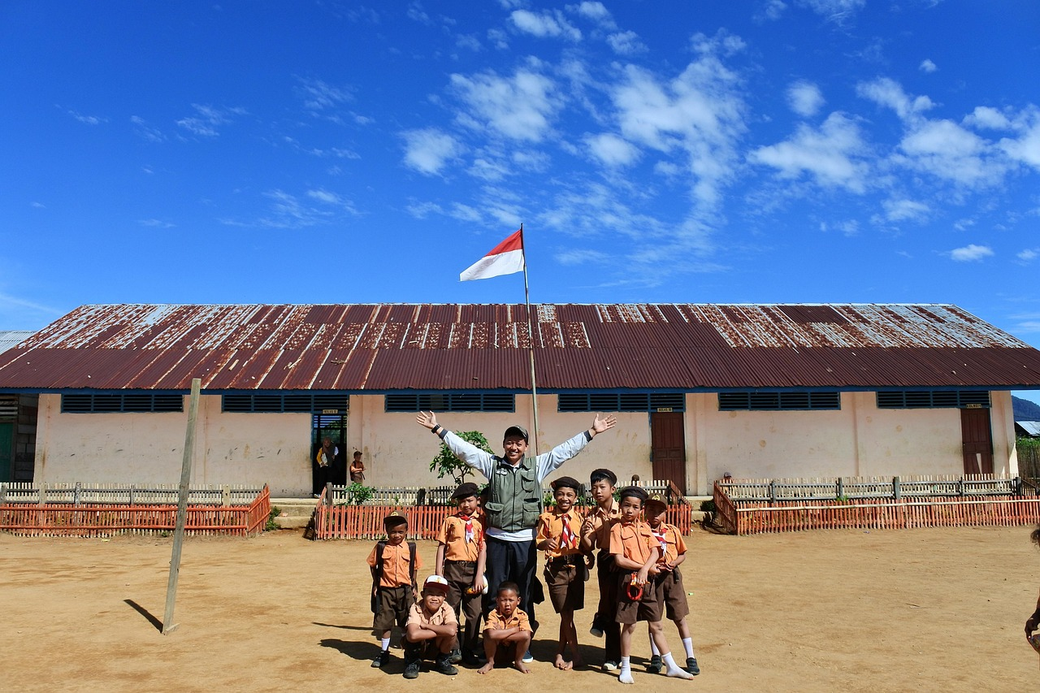
Final Thoughts
Making Learning Fun
Encouraging Real-Life Practice
Importance of making learning fun and engaging for 5-year-old students.
Encouragement to continue practicing and applying sentence structures in real-life situations.
Importance of making learning fun and engaging for 5-year-old students.
Encouragement to continue practicing and applying sentence structures in real-life situations.
20
Introduction to Sentence Structures for Young Learners

Slide 21
References and Resources
Recommended Books and Resources
Interactive Online Tools
Teaching Tips for Educators
List of recommended books and resources for teaching sentence structures.
These materials provide foundational knowledge and innovative approaches for educators.
Online games and activities for practicing sentence structures.
These tools make learning engaging and interactive for students.
Tips for teachers: Using a variety of resources to support teaching and learning.
Diversifying resources can enhance both teaching effectiveness and student understanding.
21
Introduction to Sentence Structures for Young Learners

