Slide 1


Comprehensive Guide to Digital Marketing
Strategies, Tools, and Best Practices for Success in the Digital Age

Slide 2
Comprehensive Guide to Digital Marketing
2
Table of Contents
Slide 1: Introduction to Digital Marketing
Slide 2: Importance of Digital Marketing
Slide 3: Types of Digital Marketing
Slide 4: Social Media Marketing
Slide 5: Search Engine Optimization (SEO)
Slide 6: Email Marketing
Slide 7: Digital Marketing Campaigns
Slide 8: Digital Marketing Metrics
Slide 9: Digital Marketing Tools
Slide 10: Digital Marketing Careers
Slide 11: Digital Marketing Tips
Slide 12: Common Digital Marketing Mistakes
Slide 13: Digital Marketing Best Practices
04
05
06
07
08
09
10
11
12
13
14
15
16

Slide 3
Comprehensive Guide to Digital Marketing
3
Table of Contents
Slide 14: Digital Marketing Resources
Slide 15: Conclusion
Slide 16: Final Thoughts
Slide 17: Additional Resources
Slide 18: Glossary of Terms
Slide 19: Frequently Asked Questions
Slide 20: Final Quiz
17
18
19
20
21
22
23

Slide 4
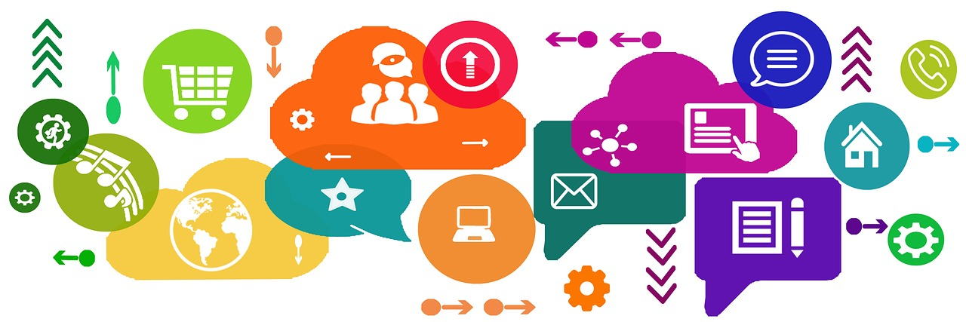
Comprehensive Guide to Digital Marketing
4
Slide 1: Introduction to Digital Marketing
Definition of Digital Marketing
Key Components of Digital Marketing
Importance of Digital Marketing
Digital marketing refers to the promotion of products, services, or ideas using digital channels such as social media, email, and search engines.
It involves using digital technologies to reach and engage with target audiences, build brand awareness, and drive website traffic and sales.
Effective digital marketing strategies involve a combination of creativity, technical skills, and data-driven decision making.
These strategies are essential for achieving business goals and maximizing the impact of digital campaigns.
Digital marketing plays a crucial role in modern business by enabling companies to connect with their audiences in a more targeted and measurable way.
It helps businesses stay competitive in an increasingly digital world.

Slide 5

Comprehensive Guide to Digital Marketing
5
Slide 2: Importance of Digital Marketing
Reaching Target Audiences
Digital marketing is a crucial aspect of modern business, enabling companies to reach their target audience and promote their products or services through various online channels.
It allows businesses to increase brand awareness, drive website traffic, and generate leads and sales.
Cost-Effective Strategies
Digital marketing provides a cost-effective and measurable way to reach a wider audience.
This makes it an essential tool for businesses of all sizes.
Enhancing Business Growth
Through digital marketing, companies can effectively expand their reach and improve their market presence.
It plays a vital role in fostering business growth in today's competitive landscape.

Slide 6

Comprehensive Guide to Digital Marketing
6
Slide 3: Types of Digital Marketing
Search Engine Optimization (SEO)
Email Marketing
Social media marketing involves using platforms like Facebook, Instagram, and Twitter to promote products, services, or ideas.
It helps businesses engage with their audience and build brand awareness effectively.
SEO focuses on optimizing website content to rank higher in search engine results pages.
This strategy increases organic traffic and improves online visibility for businesses.
Pay-Per-Click (PPC) Advertising
Pay-Per-Click (PPC) Advertising
Email marketing uses targeted email campaigns to promote products, services, or ideas.
It is a cost-effective way to reach specific audiences and nurture customer relationships.
PPC advertising involves creating and publishing online ads that are paid for each time a user clicks on them.
This method allows businesses to target specific demographics and measure ad performance effectively.

Slide 7

Comprehensive Guide to Digital Marketing
7
Slide 4: Social Media Marketing
Engaging Target Audiences
High-Quality Content Creation
Expanding Reach with Paid Advertising
Social media marketing involves creating and sharing content on social media platforms to engage with target audiences and build brand awareness.
It requires a deep understanding of each platform's unique features, audience demographics, and advertising options.
Effective social media marketing strategies involve creating high-quality content.
Engaging with followers is essential to build a strong online presence.
Using paid advertising options helps reach a wider audience.
This approach complements organic efforts to maximize brand visibility.

Slide 8
Comprehensive Guide to Digital Marketing
8
Slide 5: Search Engine Optimization (SEO)
Understanding SEO
Key Components of SEO
Building Backlinks
SEO involves optimizing website content to rank higher in search engine results pages (SERPs).
It requires using keywords, meta tags, and other optimization techniques to improve website visibility and drive organic traffic.
Effective SEO strategies involve conducting keyword research.
They also include optimizing website content and structure to enhance search engine rankings.
High-quality backlinks are essential for improving website authority.
They play a crucial role in driving organic traffic and boosting SEO performance.

Slide 9

Comprehensive Guide to Digital Marketing
9
Slide 6: Email Marketing
Purpose of Email Marketing
Strategies for Effective Email Marketing
Key Components of Email Campaigns
Email marketing involves using email to promote products, services, or ideas to target audiences.
It requires creating and sending email campaigns that are personalized, relevant, and engaging.
Effective email marketing strategies involve building a strong email list and creating high-quality content.
Using personalization and automation techniques can improve engagement and conversion rates.
Personalization ensures that email campaigns resonate with the target audience.
Automation helps streamline the process and enhances the efficiency of email marketing efforts.

Slide 10

Comprehensive Guide to Digital Marketing
10
Slide 7: Digital Marketing Campaigns
Coordinated Digital Efforts
Comprehensive Planning
Measuring and Optimizing Results
A digital marketing campaign involves a coordinated series of digital marketing efforts aimed at achieving specific business objectives.
It requires a clear understanding of the target audience, marketing goals, and digital marketing strategies.
Effective digital marketing campaigns involve creating a comprehensive plan.
Executing the plan is essential to ensure alignment with the defined objectives.
Measuring the results of the campaign is crucial to assess its effectiveness.
Optimization based on the results ensures continuous improvement and success.

Slide 11

Comprehensive Guide to Digital Marketing
11
Slide 8: Digital Marketing Metrics
Understanding Digital Marketing Metrics
Optimizing Campaigns with Metrics
The Role of ROI in Digital Marketing
Digital marketing metrics involve measuring and analyzing data to evaluate the effectiveness of digital marketing campaigns.
Common metrics include website traffic, engagement rates, conversion rates, and return on investment (ROI).
Effective digital marketing strategies involve using metrics to inform decision making.
These strategies help optimize campaigns and improve overall performance.
Return on investment (ROI) is a key metric for assessing the success of campaigns.
It provides insights into the financial impact of marketing efforts.

Slide 12
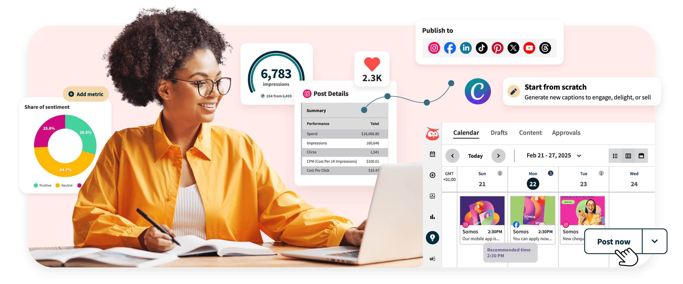
Comprehensive Guide to Digital Marketing
12
Slide 9: Digital Marketing Tools
Social Media Management Tools
Email Marketing Software
Hootsuite, Buffer, and Sprout Social are popular tools for managing social media accounts.
They help schedule posts, analyze performance, and engage with audiences effectively.
Mailchimp, Constant Contact, and Marketo are leading platforms for email marketing campaigns.
These tools enable businesses to design, automate, and track email communications.
SEO Optimization Tools
PPC Advertising Platforms
Google Analytics, SEMrush, and Ahrefs are essential for improving website visibility.
They provide insights into traffic, keywords, and competitor strategies.
Google Ads, Facebook Ads, and LinkedIn Ads are powerful platforms for pay-per-click advertising.
They allow businesses to target specific audiences and measure campaign success.

Slide 13
Comprehensive Guide to Digital Marketing
13
Slide 10: Digital Marketing Careers
Roles in Digital Marketing
Skills for Success
Continuous Learning
Digital marketing careers involve working in roles such as social media manager, SEO specialist, content creator, and digital marketing manager.
These roles are essential for building and maintaining a brand's online presence.
These careers require a combination of technical skills, creativity, and data-driven decision making.
Professionals must balance analytical thinking with innovative strategies to achieve marketing goals.
Effective digital marketing professionals involve staying up-to-date with the latest trends and developments in the industry.
They must continuously develop their skills and knowledge to remain competitive.

Slide 14

Comprehensive Guide to Digital Marketing
14
Slide 11: Digital Marketing Tips
Engaging Content Creation
Social Media Strategy
Search Engine Optimization
Create high-quality, engaging content that resonates with your target audience.
This ensures your message connects effectively and builds trust with your audience.
Use social media platforms to build brand awareness and engage with your audience.
Leverage these platforms to foster meaningful interactions and grow your online presence.
Optimize your website for search engines to improve visibility and drive organic traffic.
This enhances your site's discoverability and attracts more potential customers.

Slide 15

Comprehensive Guide to Digital Marketing
15
Slide 12: Common Digital Marketing Mistakes
Understanding Your Audience
Data-Driven Decisions
Staying Current
Not having a clear understanding of the target audience and marketing goals.
This can lead to ineffective campaigns and wasted resources.
Not using metrics to inform decision making and optimize campaigns.
This results in missed opportunities for improvement and growth.
Not staying up-to-date with the latest trends and developments in the industry.
This can cause businesses to fall behind competitors and lose relevance.

Slide 16

Comprehensive Guide to Digital Marketing
16
Slide 13: Digital Marketing Best Practices
Comprehensive Digital Marketing Plan
Create a comprehensive digital marketing plan that aligns with your business objectives.
This ensures that your marketing efforts are focused and effective.
Diverse Marketing Strategies
Use a combination of digital marketing strategies to reach your target audience.
This approach maximizes your chances of engaging with potential customers.
Campaign Optimization
Continuously monitor and optimize your digital marketing campaigns to improve performance.
Regular adjustments help you stay competitive and achieve better results.

Slide 17

Comprehensive Guide to Digital Marketing
17
Slide 14: Digital Marketing Resources
Online Learning Platforms
Blogs and Websites for Insights
Social Media Communities
Industry Events and Conferences
Explore digital marketing through platforms like Coursera, Udemy, and LinkedIn Learning.
These resources offer structured courses and tutorials for all skill levels.
Stay updated with industry trends by following Moz, HubSpot, and Search Engine Journal.
These platforms provide valuable articles and tools for digital marketers.
Join Facebook Groups, LinkedIn Groups, and Reddit communities to connect with peers.
These groups foster discussions and share tips on digital marketing strategies.
Attend events like SXSW, Adobe Summit, and MarketingProfs to network and learn.
These conferences showcase the latest innovations and best practices in digital marketing.

Slide 18
Comprehensive Guide to Digital Marketing
18
Slide 15: Conclusion
The Role of Digital Marketing
Principles and Best Practices
Achieving Business Goals
Digital marketing is a crucial aspect of modern business, enabling companies to reach their target audience and promote their products or services through various online channels.
Effective digital marketing strategies involve a combination of creativity, technical skills, and data-driven decision making.
By understanding the principles and best practices of digital marketing, businesses can improve their online presence, drive website traffic, and generate leads and sales.
Effective strategies ensure that businesses stay competitive in the digital landscape.
Digital marketing empowers businesses to connect with their audience in meaningful ways.
This connection translates into tangible outcomes like increased sales and customer engagement.

Slide 19

Comprehensive Guide to Digital Marketing
19
Slide 16: Final Thoughts
The Ever-Changing Landscape of Digital Marketing
The Importance of Staying Informed
Adapting for Competitive Advantage
Digital marketing is a constantly evolving field, with new technologies and platforms emerging all the time.
Staying up-to-date with the latest trends and developments in the industry is essential for success.
Staying up-to-date with the latest trends and developments in the industry is essential for success.
By continuously learning and adapting, businesses can stay ahead of the competition and achieve their marketing goals.
By continuously learning and adapting, businesses can stay ahead of the competition and achieve their marketing goals.
Digital marketing is a constantly evolving field, with new technologies and platforms emerging all the time.

Slide 20

Comprehensive Guide to Digital Marketing
20
Slide 17: Additional Resources
Recommended Books
Books: "Digital Marketing for Dummies", "Inbound Marketing", "Content Chemistry".
These books provide foundational knowledge and advanced strategies for digital marketing.
Top Online Courses
Online courses: "Digital Marketing Specialization" on Coursera, "Digital Marketing Course" on Udemy.
These courses offer structured learning paths for mastering digital marketing skills.
Informative Websites
Websites: "Digital Marketing Institute", "American Marketing Association", "MarketingProfs".
These websites are excellent resources for staying updated on industry trends and best practices.
Engaging Podcasts
Podcasts: "The Digital Marketing Podcast", "The Marketing Companion", "The Social Media Marketing Podcast".
These podcasts provide insights and discussions on the latest in digital marketing.

Slide 21

Comprehensive Guide to Digital Marketing
21
Slide 18: Glossary of Terms
Digital Marketing
Social Media Marketing
Digital marketing refers to the promotion of products, services, or ideas using digital channels.
It encompasses a wide range of strategies and platforms to reach audiences online.
Social media marketing involves using social media platforms to promote products, services, or ideas.
It is a powerful tool for engaging with audiences and building brand awareness.
Search Engine Optimization (SEO)
Pay-Per-Click (PPC) Advertising
Search engine optimization focuses on optimizing website content to rank higher in search engine results pages.
This strategy helps increase organic traffic and visibility for websites.
Pay-per-click advertising involves creating and publishing online ads that are paid for each time a user clicks on them.
It is an effective way to drive targeted traffic to websites and generate leads.

Slide 22

Comprehensive Guide to Digital Marketing
22
Slide 19: Frequently Asked Questions
Understanding Digital Marketing
Digital marketing is the promotion of products, services, or ideas using digital channels.
It encompasses various strategies to reach and engage audiences online.
Getting Started with Digital Marketing
Start by creating a comprehensive digital marketing plan that aligns with your business objectives.
This plan should include goals, target audience, and preferred digital channels.
Benefits of Digital Marketing
The benefits of digital marketing include increased online visibility, improved brand awareness, and higher conversion rates.
These advantages help businesses grow and connect with their audience effectively.

Slide 23

Comprehensive Guide to Digital Marketing
23
Slide 20: Final Quiz
Understanding Digital Marketing Goals
Reaching Your Audience on Social Media
The Role of Metrics in Digital Marketing
What is the primary goal of digital marketing?
A) To increase brand awareness B) To drive website traffic C) To generate leads and sales D) All of the above
What is the most effective way to reach your target audience on social media?
A) By creating high-quality content B) By using paid advertising options C) By engaging with your audience D) All of the above
What is the importance of metrics in digital marketing?
A) To measure the effectiveness of campaigns B) To inform decision making and optimize campaigns C) To improve overall performance D) All of the above

