Slide 1


Introduction to Creative Writing for Young Minds
Exploring the Importance, Elements, and Process of Creative Writing for 11-Year-Old Students

Slide 2
Table of Contents
Welcome to Creative Writing!
What is Creative Writing?
Why is Creative Writing Important?
Lesson Objectives
Key Elements of Creative Writing
Writing Process
Guided Writing Exercise
Sharing and Feedback
Journaling Activity
Conclusion
Assessment and Evaluation
Extension Activities
Parent Engagement
04
05
06
07
08
09
10
11
12
13
14
15
16

Slide 3
Table of Contents
Safety Considerations
Reflection Questions
Next Steps
Conclusion and Final Thoughts
17
18
19
20

Slide 4
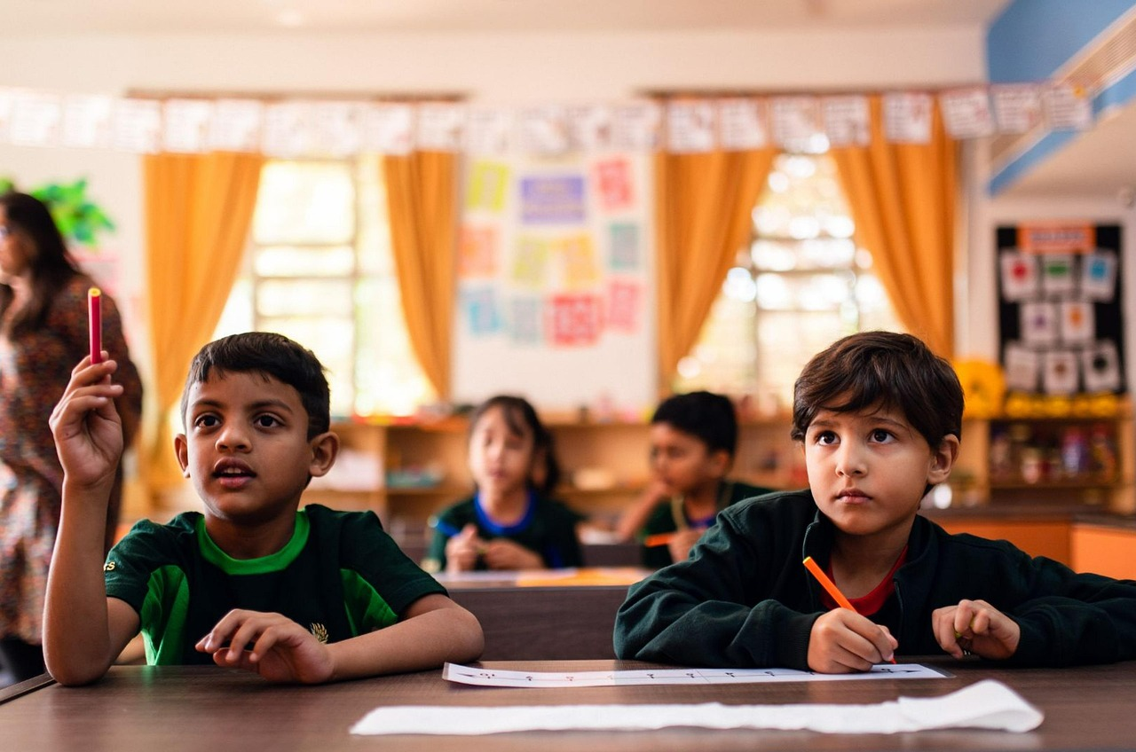
Welcome to Creative Writing!
Introduction to Creative Writing
Importance of Creative Writing
Overview of the Lesson Plan
Creative writing is a vital skill for young minds to explore their imagination.
This lesson focuses on its importance for 11-year-old students.
Creative writing helps students express their thoughts and emotions effectively.
It fosters creativity and enhances their communication skills.
The lesson plan introduces students to the basics of creative writing.
It includes engaging activities tailored for 11-year-olds.
4
Introduction to Creative Writing for Young Minds

Slide 5

What is Creative Writing?
Definition of Creative Writing
Types of Creative Writing
Creative writing is a form of writing that goes beyond the bounds of professional, journalistic, academic, or technical forms of literature.
It focuses on narrative craft, character development, and the use of literary tropes.
Creative writing encompasses various forms such as fiction, nonfiction, and poetry.
Each type allows for unique expressions and storytelling techniques.
Benefits of Creative Writing
Examples of Creative Writing
Engaging in creative writing improves language skills and enhances imagination.
It also provides a valuable outlet for self-expression and emotional exploration.
Examples of creative writing include short stories, journal entries, and poetry.
These forms showcase the diversity and flexibility of creative expression.
5
Introduction to Creative Writing for Young Minds

Slide 6

Why is Creative Writing Important?
Language and Imagination
Self-Expression and Growth
Critical Thinking Skills
Develops language skills and imagination.
This fosters creativity and enhances communication abilities.
Provides an outlet for self-expression and emotional growth.
It allows individuals to explore and articulate their emotions.
Enhances critical thinking and problem-solving skills.
This helps in analyzing situations and generating innovative solutions.
6
Introduction to Creative Writing for Young Minds

Slide 7

Lesson Objectives
Defining Creative Writing
Key Elements of Creative Writing
Students will be able to define creative writing and its importance.
This foundational understanding sets the stage for exploring its elements and applications.
Students will be able to identify and explain the key elements of creative writing (character, plot, setting, theme).
These elements are crucial for crafting compelling narratives.
Creating Engaging Stories
Understanding the Writing Process
Students will be able to create their own engaging story or journal entry.
This activity encourages creativity and personal expression.
Students will be able to demonstrate an understanding of the writing process (brainstorming, drafting, revising, editing).
Mastery of this process enhances the quality and coherence of their writing.
7
Introduction to Creative Writing for Young Minds

Slide 8

Key Elements of Creative Writing
01
Character Development
Character encompasses traits, motivations, and backstory.
These elements help in creating relatable and multidimensional personas.
02
Plot Structure
Plot includes exposition, rising action, climax, falling action, and resolution.
It serves as the backbone of the narrative, guiding the story's progression.
03
Setting and Context
Setting involves time, place, culture, and social context.
It provides the environment in which the story unfolds, influencing its tone and direction.
04
Exploring Themes
Theme represents the underlying message or idea of the story.
It adds depth and meaning, connecting the narrative to universal truths.
8
Introduction to Creative Writing for Young Minds

Slide 9

Writing Process
Brainstorming
Drafting
Generating ideas and getting started.
This is the initial phase of the writing process.
Writing the first draft.
This step involves putting ideas into a structured format.
Revising
Editing
Making changes and improvements.
This phase focuses on refining the content and structure.
Finalizing and polishing the writing.
This is the last step to ensure clarity and correctness.
9
Introduction to Creative Writing for Young Minds

Slide 10

Guided Writing Exercise
Introduction to the Exercise
Example Journal Entry
Purpose of the Exercise
Introduction to the exercise: writing a journal entry from the perspective of a character
Instructions: use descriptive language, imagine the character's thoughts and feelings
Example: sample journal entry from a character's perspective
This serves as a guide to understand how to approach the task effectively.
The exercise aims to enhance creative writing skills.
It encourages participants to delve into the mindset of a character.
10
Introduction to Creative Writing for Young Minds

Slide 11

Sharing and Feedback
The Role of Sharing and Feedback
Guidelines for Effective Feedback
Examples of Feedback Practices
Sharing and feedback are crucial elements in the writing process.
They help writers refine their ideas and improve their work through collaboration.
Respect, specificity, and constructiveness are key when giving and receiving feedback.
These principles ensure that feedback is helpful and promotes growth.
Peer feedback and self-assessment are practical methods to enhance writing skills.
They encourage reflection and provide diverse perspectives on the work.
11
Introduction to Creative Writing for Young Minds

Slide 12
Journaling Activity
Introduction to Journaling
Instructions for Journaling
Example Journal Entry
Introduction to journaling: benefits and importance
Journaling helps in self-reflection and emotional well-being.
Instructions: write a journal entry about a personal experience or memory
Focus on expressing your thoughts and feelings authentically.
Example: sample journal entry
Provides a template to guide your own journaling process.
12
Introduction to Creative Writing for Young Minds

Slide 13

Conclusion
Summary of Key Points
Final Thoughts
Summary of key points: creative writing, key elements, writing process
- Final thoughts: encouragement to continue writing and exploring imagination
Summary of key points: creative writing, key elements, writing process
- Final thoughts: encouragement to continue writing and exploring imagination
13
Introduction to Creative Writing for Young Minds

Slide 14

Assessment and Evaluation
Summative Assessment
Self-Assessment
Formative assessment involves ongoing evaluation and feedback.
It helps in monitoring student progress and guiding learning.
Summative assessment is the final evaluation and grading.
It provides a comprehensive measure of student achievement.
Peer Assessment
Peer Assessment
Self-assessment encourages student reflection and evaluation.
It fosters self-awareness and responsibility in learning.
Peer assessment involves feedback and evaluation from peers.
It promotes collaborative learning and diverse perspectives.
14
Introduction to Creative Writing for Young Minds

Slide 15

Extension Activities
Creative Writing Workshop
Creative writing workshop: sharing and feedback.
Participants engage in collaborative sessions to refine their writing.
Writing Contest
Writing contest: submitting work for evaluation and feedback.
Entrants receive constructive critiques to enhance their skills.
Author Study
Author study: analyzing and discussing published works.
Exploring literary techniques and themes from renowned authors.
15
Introduction to Creative Writing for Young Minds

Slide 16

Parent Engagement
1
Importance of Parent Involvement
Supporting student learning and creativity is crucial.
Parents play a key role in fostering a positive learning environment.
2
Strategies for Parent Engagement
Attending writing workshops and providing feedback are effective methods.
Encouraging writing at home further supports student development.
3
Resources for Parents
Writing prompts, writing guides, and online resources are valuable tools.
These resources help parents actively participate in their child's education.
16
Introduction to Creative Writing for Young Minds

Slide 17

Safety Considerations
Creating a Safe Learning Environment
Supportive Feedback Guidelines
Creating a safe and supportive learning environment
Guidelines for respectful and constructive feedback
Creating a safe and supportive learning environment
Guidelines for respectful and constructive feedback
17
Introduction to Creative Writing for Young Minds

Slide 18
Reflection Questions
1
2
3
Learning Insights
Challenges Encountered
Future Aspirations
What did you learn about creative writing?
Reflect on the new techniques or perspectives gained during the lesson.
What challenges did you face during the lesson?
Identify specific obstacles or difficulties experienced while engaging with the material.
What would you like to learn more about in future lessons?
Consider areas of interest or skills you wish to develop further.
18
Introduction to Creative Writing for Young Minds

Slide 19
Next Steps
1
Developing Characters and Plot
Lesson 2 focuses on the development of characters and plot.
Students will learn techniques to create engaging narratives.
2
Exploring Genre and Style
Lesson 3 delves into the exploration of genre and style.
This lesson helps students understand different storytelling approaches.
3
Publishing and Sharing Student Work
Lesson 4 emphasizes the importance of publishing and sharing.
Students will gain insights into presenting their work to an audience.
19
Introduction to Creative Writing for Young Minds

Slide 20

Conclusion and Final Thoughts
Summary of Key Points
Encouragement to Writers
Summary of key points: creative writing, key elements, writing process
Final thoughts: encouragement to continue writing and exploring imagination
Final thoughts: encouragement to continue writing and exploring imagination
Summary of key points: creative writing, key elements, writing process
20
Introduction to Creative Writing for Young Minds

