Slide 1
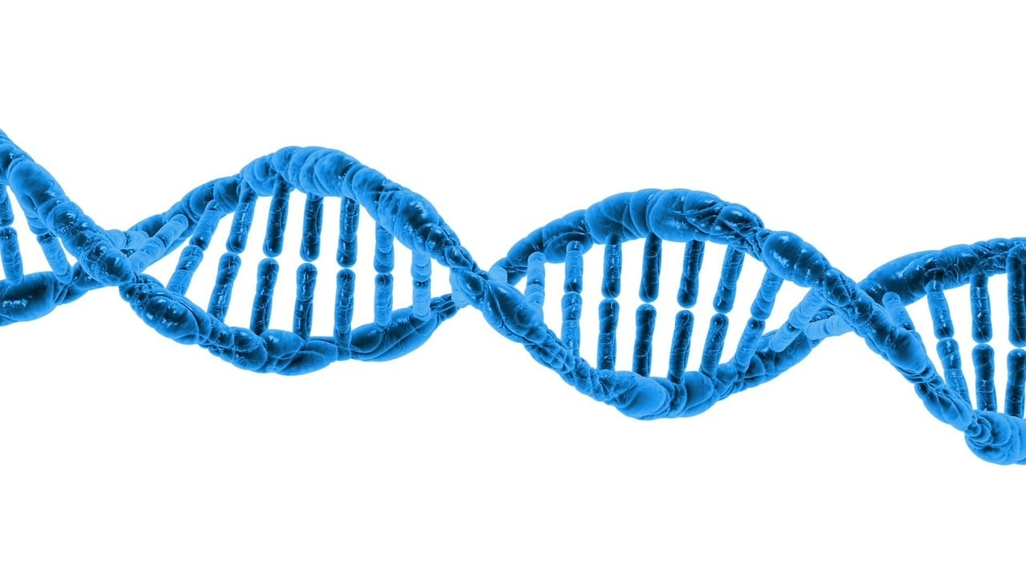
Unraveling the Genetic Code
Exploring the Wonders of DNA and Genetic Discoveries

Slide 2
Table of contents
01
02
03
04
05
06
07
08
09
10
11
Title Slide: Decoding Life's Blueprint
What is DNA?
DNA Molecular Structure
DNA Components
DNA Replication Process
Genetic Information Transfer
Real-World DNA Applications
Interactive Modeling Activity
Genetic Inheritance Patterns
Common Genetic Misconceptions
Emerging Genetic Technologies

Slide 3
Table of contents
12
13
14
15
16
17
18
19
20
Career Connections
Key Takeaways
Reflection Questions
Conclusion Slide
Design Recommendations
Suggested Color Palette
Typography
Export Requirements
Layout Recommendations

Slide 4
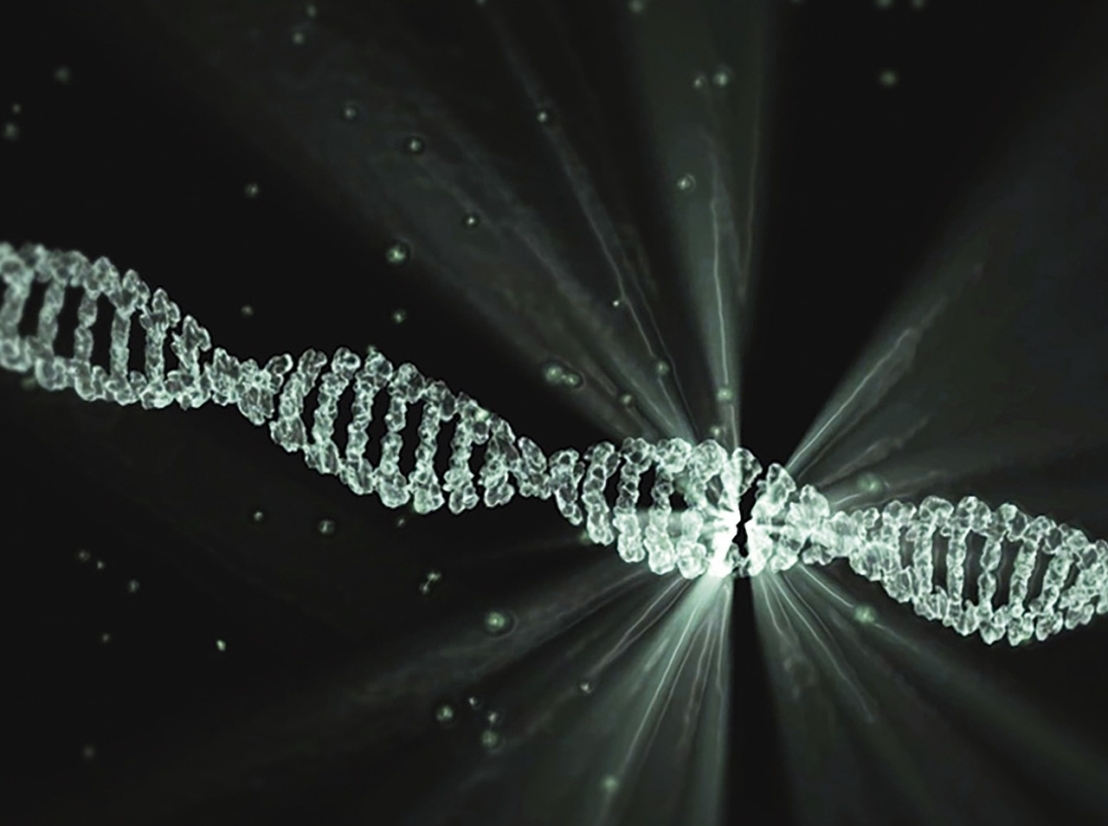
1
Title Slide: Decoding Life's Blueprint
Decoding Life's Blueprint: DNA Exploration
A Comprehensive Genetic Journey for Young Scientists
Unraveling the Genetic Code

Slide 5
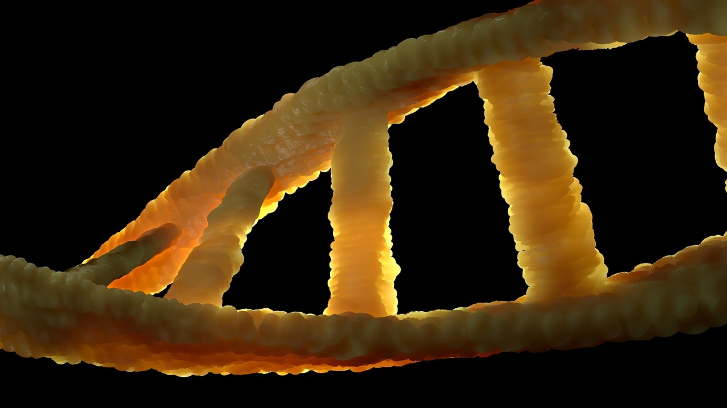
2
What is DNA?
What is DNA?
Definition: DNA = Molecular Instruction Manual of Life
Contains 3 billion base pairs
Determines biological characteristics
Fundamental to inheritance and cellular function
Unraveling the Genetic Code

Slide 6

3
DNA Molecular Structure
01
DNA Molecular Structure
02
Components
Detailed 3D DNA double helix diagram
Nucleotides
Base pairs (A-T, G-C)
Sugar-phosphate backbone
03
Color-coded molecular representation
Unraveling the Genetic Code

Slide 7
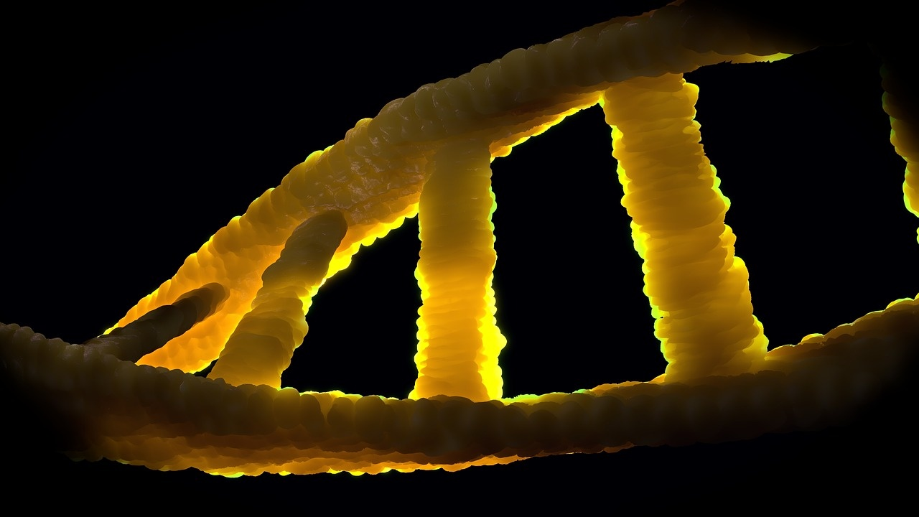
4
DNA Components
01
DNA Components
02
Nucleotide Building Blocks
Adenine (A)
Thymine (T)
Guanine (G)
Cytosine (C)
03
Base Pairing Rules
A pairs with T
G pairs with C
Unraveling the Genetic Code

Slide 8
5
DNA Replication Process
01
02
03
04
DNA Unwinding
Base Pair Matching
New Strand Creation
Key Enzymes
The double helix structure of DNA unwinds with the help of enzymes like helicase.
DNA Polymerase enzyme facilitates the matching of complementary nucleotides (A-T, G-C) on each strand.
As nucleotides are added, two identical DNA molecules are formed, each containing one original strand and one newly synthesized strand.
DNA Polymerase: Adds new nucleotides to the growing DNA strand.
Helicase: Unwinds the DNA double helix during replication.
Unraveling the Genetic Code

Slide 9
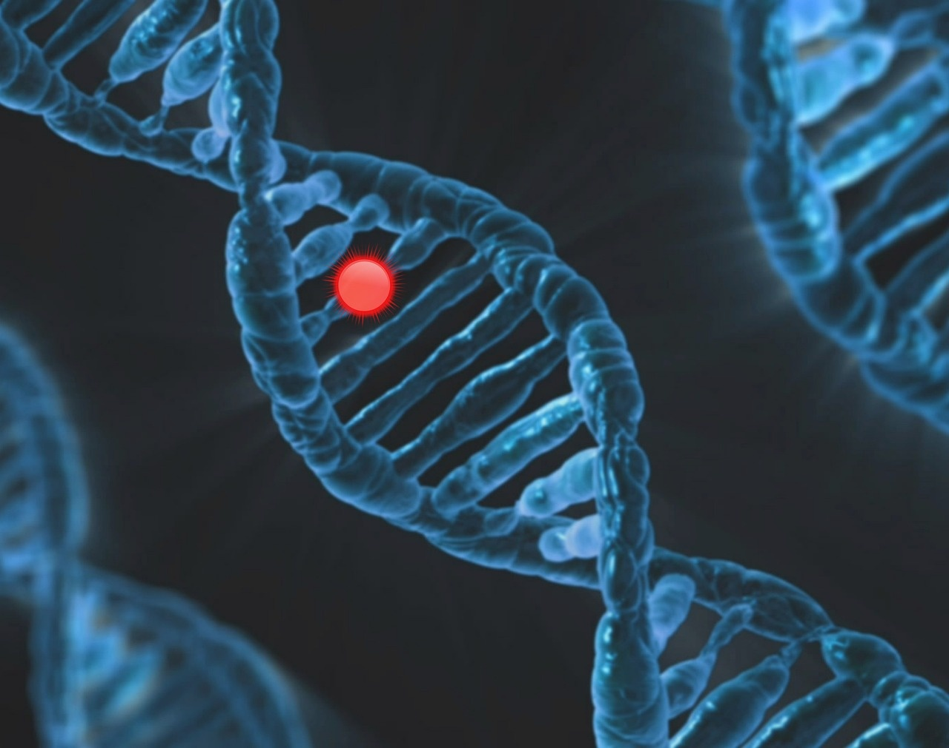
6
Genetic Information Transfer
01
Cell Division
02
Inheritance Mechanisms
Genetic information is transferred during cell division.
Process includes mitosis and meiosis.
Genetic information is passed from parents to offspring.
Inheritance patterns follow Mendelian genetics principles.
03
Precise Molecular Copying
04
Visualization of Genetic Transmission
DNA replication ensures accurate transfer of genetic information.
Errors in replication can lead to mutations.
Genetic information transfer can be visualized through pedigrees.
Understanding transmission patterns aids in studying genetic traits.
Unraveling the Genetic Code

Slide 10

7
Real-World DNA Applications
Real-World DNA Applications
Medical Research
Forensic Science
Genetic Counseling
Agricultural Innovations
Unraveling the Genetic Code

Slide 11
8
Interactive Modeling Activity
01
02
03
04
Interactive Modeling Activity
Learning Objectives
Materials Needed
Step-by-Step Guide
Engage students in building a physical representation of DNA
Enhance understanding of DNA structure and function
Understand the components of DNA
Explore the concept of base pairing
Demonstrate DNA replication process
Pipe cleaners (representing sugar-phosphate backbone)
Beads (nucleotide bases: A, T, G, C)
Instructions handout
String beads onto pipe cleaners to create base pairs
Twist pipe cleaners to form the double helix structure
Discuss the significance of base pairing
Demonstrate DNA replication with the model
Unraveling the Genetic Code

Slide 12
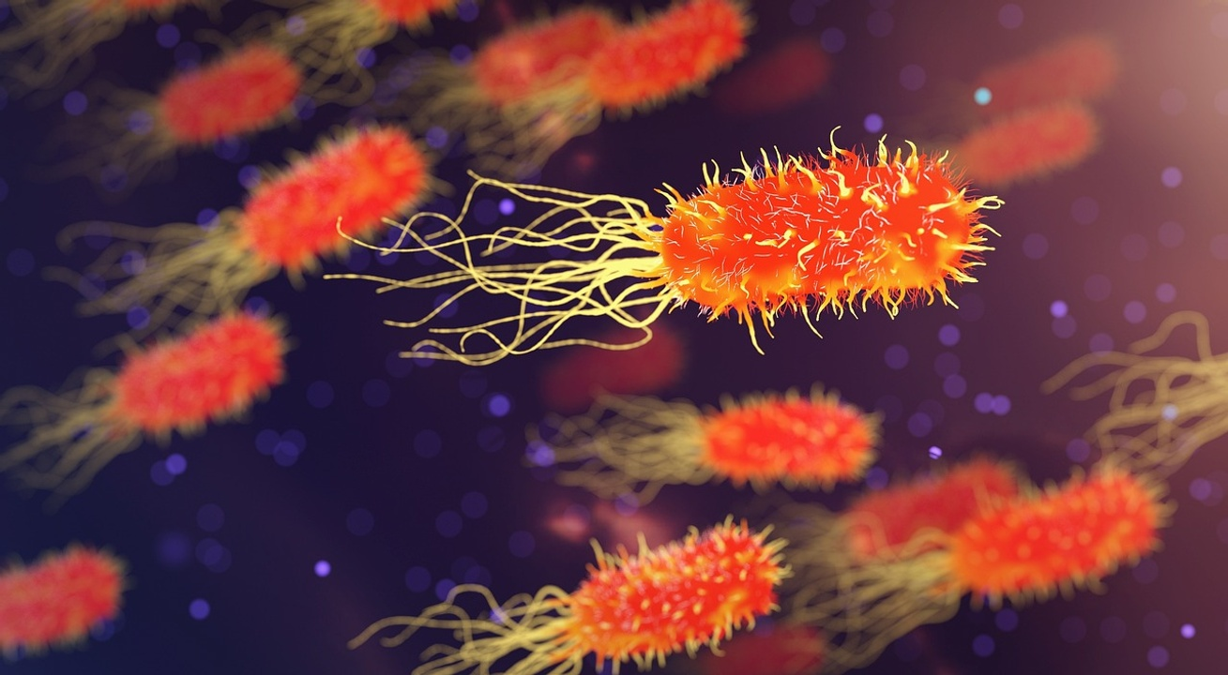
9
Genetic Inheritance Patterns
01
Dominant vs. Recessive Traits
02
Punnett Square Example
Dominant traits mask recessive traits in heterozygous individuals.
Recessive traits only manifest when both alleles are recessive.
Tool used to predict offspring genotypes and phenotypes.
Crosses parental genotypes to determine possible outcomes.
03
Inheritance Probability Visualization
Probability of inheriting specific traits from parents.
Understanding likelihood of trait expression in offspring.
Unraveling the Genetic Code

Slide 13

10
Common Genetic Misconceptions
01
Myth: DNA is unchanging
02
Myth: Mutations are always harmful
Reality: DNA can undergo mutations due to various factors like environmental influences, errors in replication, and exposure to mutagens.
Reality: While some mutations can be detrimental, others can be neutral or even beneficial, contributing to genetic diversity and evolution.
03
Myth: Genes determine everything
Reality: Genes play a significant role in shaping traits and predispositions, but environmental factors and epigenetic modifications also influence gene expression and outcomes.
Unraveling the Genetic Code

Slide 14
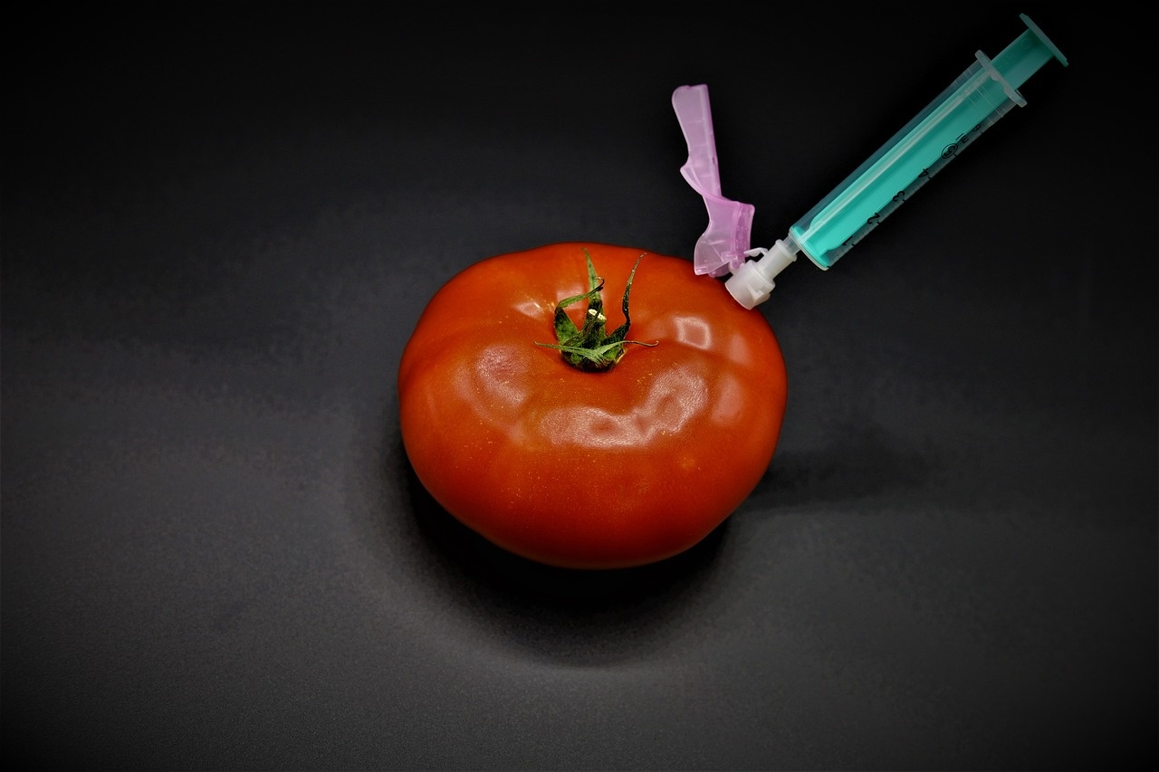
11
Emerging Genetic Technologies
01
CRISPR-Cas9 Gene Editing
02
Gene Therapy Advancements
Precision tool for modifying DNA
Potential for treating genetic disorders
Correcting faulty genes to treat diseases
Promising results in clinical trials
03
Personalized Medicine
04
Ethical Considerations
Tailoring treatments based on individual genetic makeup
Improving efficacy and reducing side effects
Balancing benefits with potential risks
Ensuring informed consent and privacy protection
Unraveling the Genetic Code

Slide 15
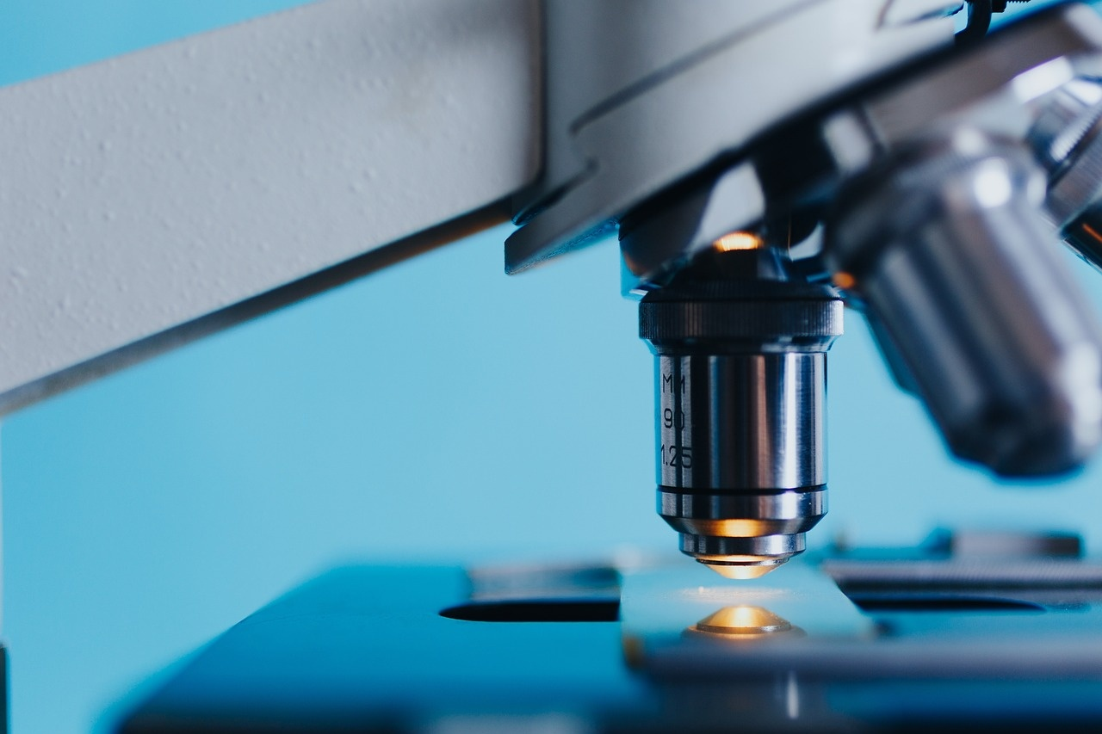
12
Career Connections
01
Genetic Counselor
02
Biotechnology Researcher
Provide guidance on genetic testing and inherited conditions
Assist individuals and families in understanding genetic risks
Conduct research on genetic engineering and biotechnology advancements
Develop new technologies for genetic analysis and modification
03
Forensic Scientist
04
Medical Geneticist
Analyze DNA evidence in criminal investigations
Help solve crimes through DNA profiling and matching
Diagnose and treat genetic disorders and diseases
Conduct research on the genetic basis of medical conditions
Unraveling the Genetic Code

Slide 16
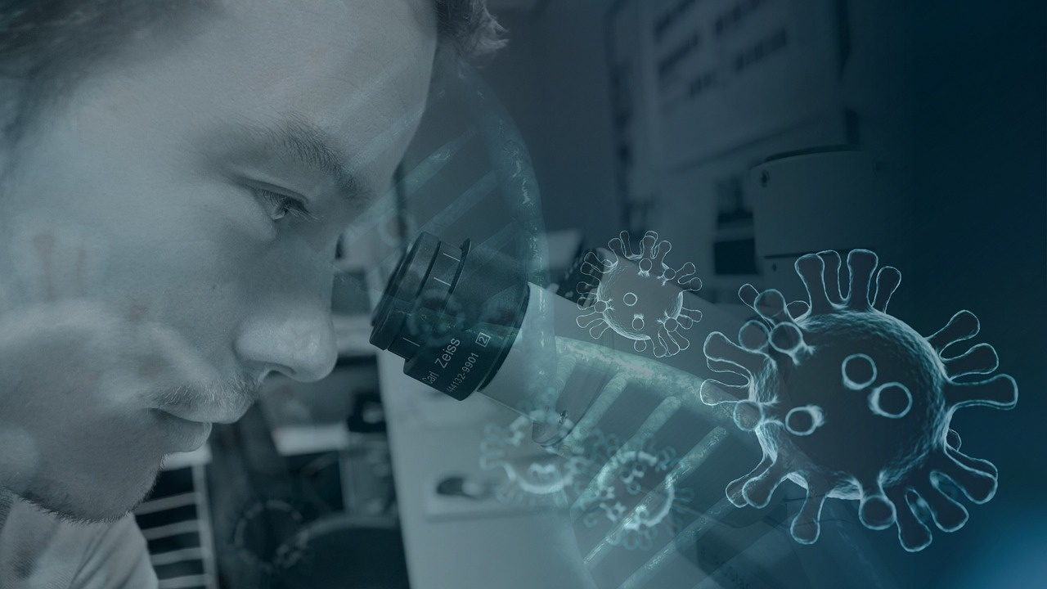
13
Key Takeaways
01
DNA as the Blueprint of Life
02
Transmission of Genetic Information
DNA contains vital genetic information.
Genetic information is transmitted through mechanisms like cell division and inheritance.
03
Interdisciplinary Significance of DNA
Understanding DNA is crucial in fields like medicine, forensics, and agriculture.
Unraveling the Genetic Code

Slide 17
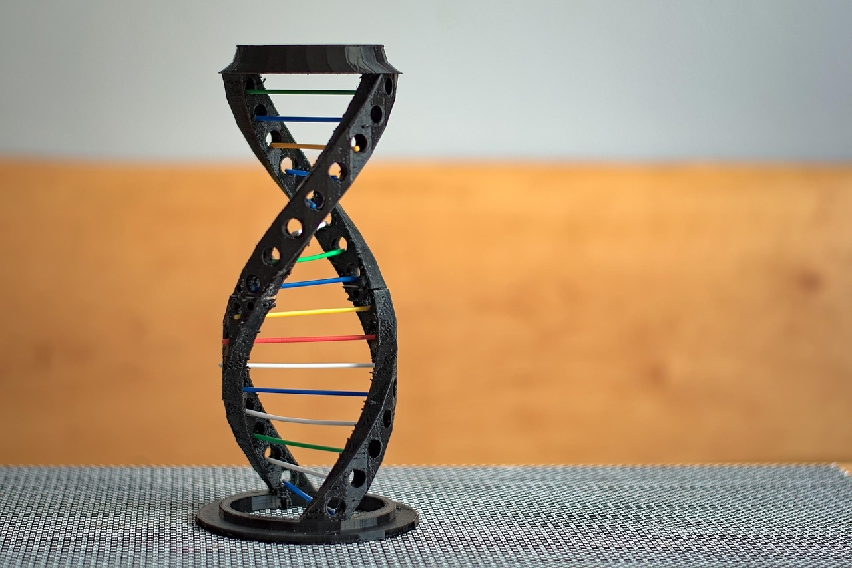
14
Reflection Questions
01
What surprised you about DNA?
02
How might genetic research impact your future?
The complexity and intricacy of DNA structures.
The vast amount of information encoded within such a small molecule.
The ability of DNA to replicate and repair itself with high fidelity.
Potential for personalized medicine tailored to individual genetic profiles.
Advancements in gene therapy to treat or prevent genetic disorders.
Ethical considerations and societal impacts of genetic modifications.
03
What questions do you still have?
How do environmental factors influence genetic expression?
What are the long-term effects of genetic modifications?
How can we ensure ethical use of genetic information?
Unraveling the Genetic Code

Slide 18
15
Conclusion Slide
DNA: The Blueprint of Life
Genetic Discoveries Await
Inspiring Quote
Recap of DNA's role as the molecular instruction manual of life.
Encouragement for further exploration and scientific inquiry.
"The more we learn, the more we realize how much we don't know." - Albert Einstein
Unraveling the Genetic Code

Slide 19
16
Design Recommendations
01
Consistent Color Scheme
02
Incorporate Scientific Imagery
03
Minimize Text, Maximize Visual Impact
Utilize blues and greens for a scientific and calming effect.
White background for clarity and focus.
Accent colors sparingly for highlighting key elements.
Use visuals like DNA double helix structures.
Include diagrams of molecular components for better understanding.
Focus on concise, impactful messaging.
Use visuals to convey complex concepts instead of lengthy text.
04
Utilize Animations for Complex Processes
05
Include Engaging, High-Quality Graphics
Employ step-by-step animations for processes like DNA replication.
Enhance engagement and comprehension through visual movement.
Use high-resolution images and illustrations.
Graphics should be relevant and visually appealing to captivate the audience.
Unraveling the Genetic Code

Slide 20

17
Suggested Color Palette
Suggested Color Palette
Blues and greens for a scientific and calm feel
White background for clarity and simplicity
Accent colors for highlighting important information
Unraveling the Genetic Code

Slide 21

18
Typography
01
Font Selection
02
Text Size
Headings: Sans-serif font for titles
Body Text: Clean, modern sans-serif font for readability
Headings: Large and prominent for emphasis
Body Text: Smaller for concise information
03
Consistency
04
Emphasis
Maintain consistent font style throughout the presentation
Ensure uniformity in text size for a professional look
Use bold or italics sparingly for highlighting key points
Avoid excessive use of different font styles for clarity
Unraveling the Genetic Code

Slide 22

19
Export Requirements
01
Regulatory Compliance
02
Documentation
Ensure adherence to international trade regulations
Verify export licenses for controlled goods
Prepare accurate commercial invoices
Include packing lists and certificates of origin
03
Shipping Logistics
04
Customs Clearance
Coordinate with freight forwarders for smooth transit
Optimize packaging for secure transportation
Provide detailed product descriptions
Facilitate customs inspections and declarations
Unraveling the Genetic Code

Slide 23
20
Layout Recommendations
01
Consistent Color Scheme
02
Scientific Imagery
03
Minimal Text, Maximum Visual Impact
Utilize blues and greens for a scientific and calm aesthetic.
White background to maintain clarity and focus.
Accent colors sparingly for highlighting key elements.
Incorporate visuals like DNA structures and molecular models.
Use diagrams and illustrations to enhance understanding.
Include high-quality graphics to engage the audience.
Keep text concise and to the point.
Use visuals to convey complex concepts.
Balance text and visuals for optimal comprehension.
04
Animations for Complex Processes
05
Engaging Graphics
Employ step-by-step animations for processes like DNA replication.
Enhance audience engagement with dynamic visuals.
Ensure animations are clear and enhance learning.
Include icons and images to represent concepts.
Use graphics to illustrate real-world applications of DNA.
Choose high-quality visuals to captivate the audience.
Unraveling the Genetic Code

