Slide 1
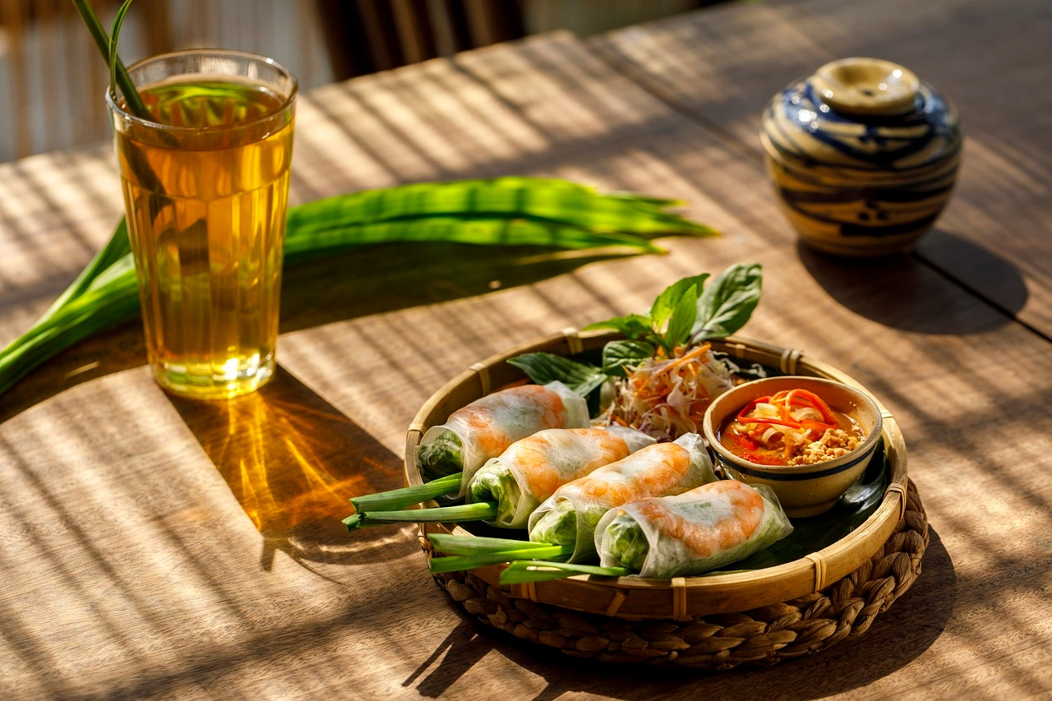
Culinary Connections: Exploring Global Food Cultures and Nutrition
A Journey Through Food, Culture, and Nutrition

Slide 2
Table of contents
01
02
03
04
05
06
07
08
09
10
11
Title Slide: Culinary Connections: Exploring Global Food Cu…
Learning Objectives
What is Food? Beyond Basic Nutrition
Nutritional Diversity - Global Perspectives
Nutritional Science Basics
Cultural Food Traditions
Dyslexia-Friendly Learning Strategies
Interactive Learning Activities
Technology in Nutrition
Personal Nutrition Journey
Sustainability and Food Systems

Slide 3
Table of contents
12
13
14
15
16
17
Common Nutritional Misconceptions
Key Takeaways
Next Steps and Further Exploration
Q&A and Reflection
Design Considerations
Technical Recommendations

Slide 4
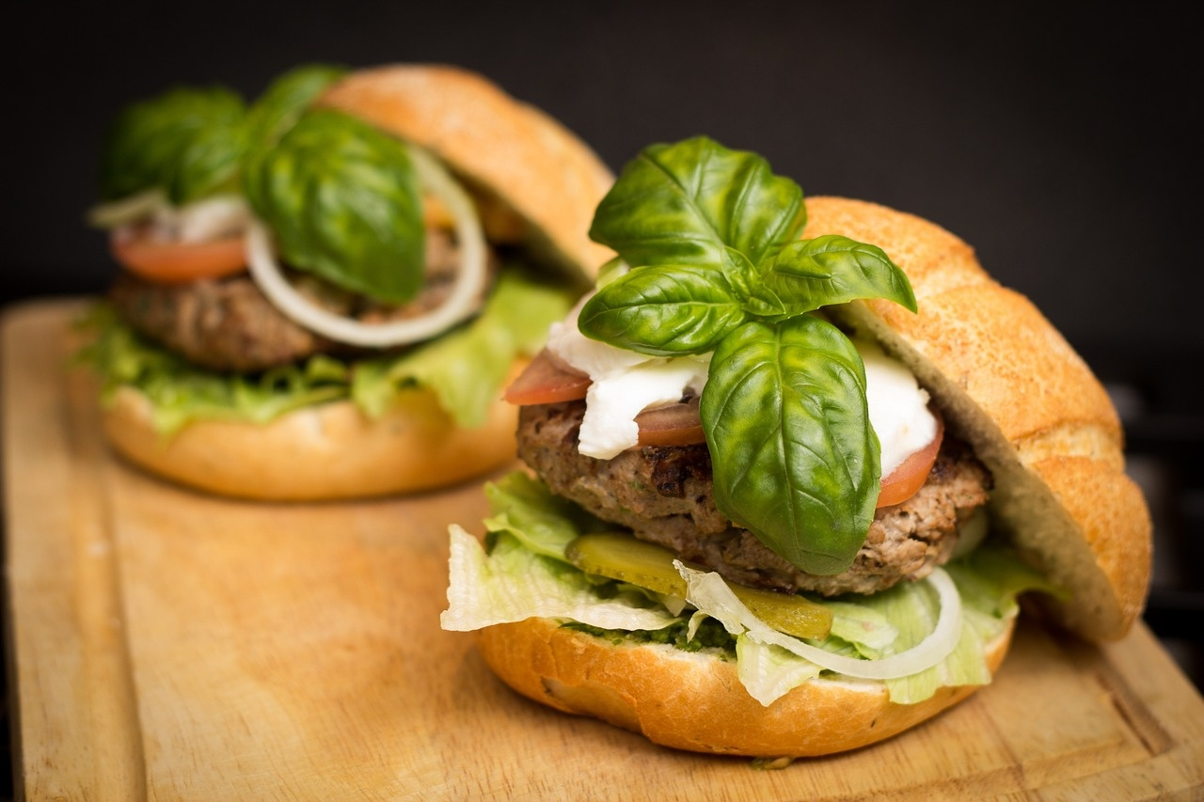
1
Title Slide: Culinary Connections: Exploring Global Food Cultures and Nutrition
Culinary Connections: Exploring Global Food Cultures and Nutrition
A Comprehensive Learning Journey for 14-Year-Old Learners
Culinary Connections: Exploring Global Food Cultures and Nutrition

Slide 5
2
Learning Objectives
01
Understand food as more than sustenance
02
Explore cultural diversity through nutrition
03
Develop critical thinking about dietary choices
Appreciate the cultural, social, and emotional aspects of food
Recognize the role of food in celebrations, traditions, and identity
Learn about different cuisines from around the world
Understand how cultural practices influence dietary choices
Analyze nutritional information and food labels
Evaluate the impact of food choices on health and well-being
04
Enhance personal health awareness
05
Build a global perspective on food systems
Identify key nutrients for optimal health
Learn about balanced diets and healthy eating habits
Explore the interconnectedness of food production and distribution
Understand the impact of globalization on food cultures and nutrition
Culinary Connections: Exploring Global Food Cultures and Nutrition

Slide 6
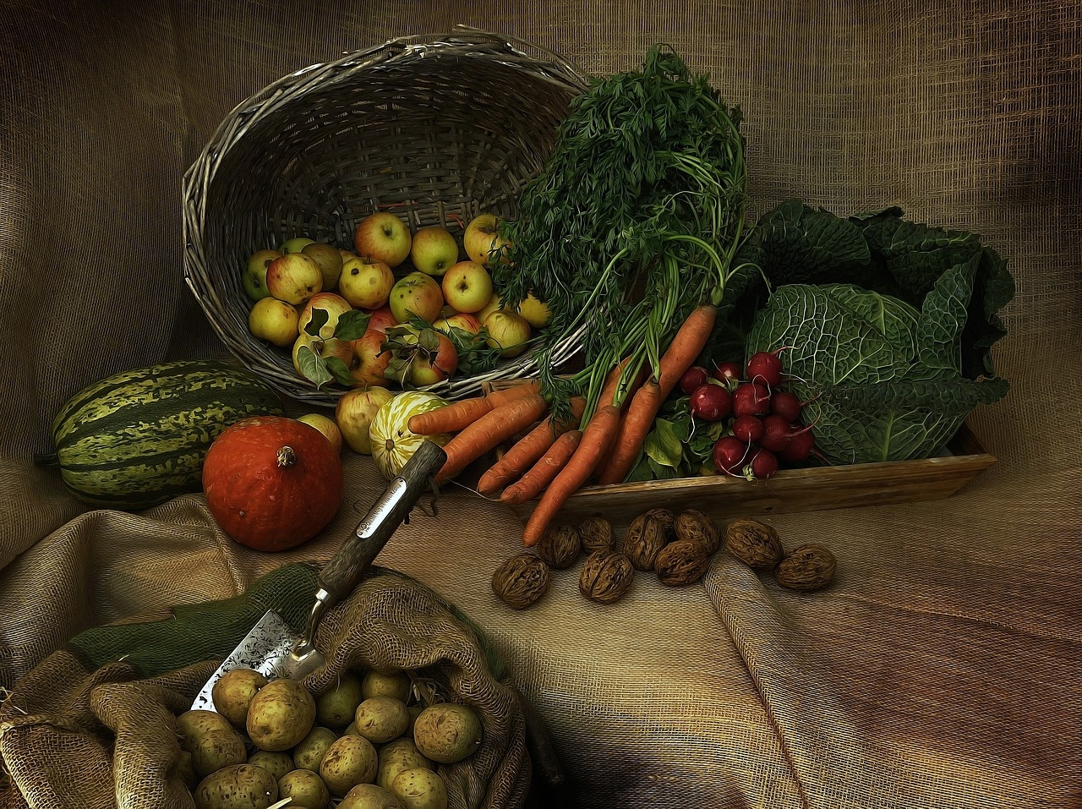
3
What is Food? Beyond Basic Nutrition
01
Cultural Identity
02
Scientific Innovation
Food as a reflection of cultural heritage
Traditional recipes passed down through generations
Food technology advancements
Molecular gastronomy and culinary creativity
03
Personal Health Management
04
Global Interconnectedness
Tailoring diets to individual health needs
Importance of balanced nutrition for overall well-being
Food trade and globalization
Influence of diverse cuisines on each other
Culinary Connections: Exploring Global Food Cultures and Nutrition

Slide 7

4
Nutritional Diversity - Global Perspectives
01
World Map Overview
02
Unique Dietary Practices
Color-coded nutritional traditions
Key regions highlighted for emphasis
Brief facts about diverse dietary practices
Examples of traditional diets from different regions
03
Infographic on Nutritional Variations
Visual representation of global nutritional diversity
Highlighting key differences in dietary patterns
Culinary Connections: Exploring Global Food Cultures and Nutrition

Slide 8

5
Nutritional Science Basics
Macronutrients Breakdown
Carbohydrates
Proteins
Fats
Culinary Connections: Exploring Global Food Cultures and Nutrition

Slide 9
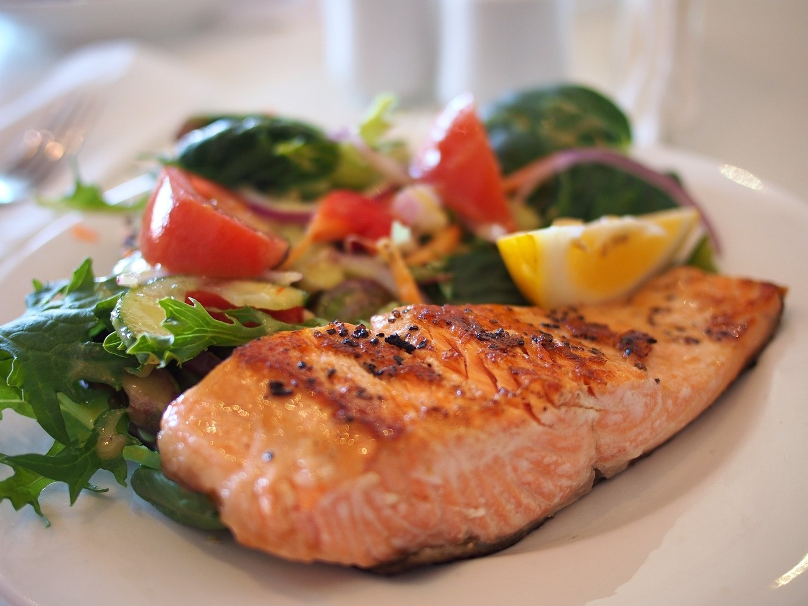
6
Cultural Food Traditions
01
Interactive World Cuisine Exploration
02
Global Food Culture Examples
Engage in a virtual journey through diverse global food cultures.
Explore traditional dishes from 4-6 regions around the world.
03
Nutritional Significance
04
Cultural Context Images
Understand the health benefits and nutritional value of these cultural foods.
Visual representations of the cultural settings where these food traditions originate.
Culinary Connections: Exploring Global Food Cultures and Nutrition

Slide 10
7
Dyslexia-Friendly Learning Strategies
01
Color-coded information systems
02
Simplified text layouts
03
Graphic-rich presentations
Use a consistent color scheme to categorize different types of information.
Utilize clear headings, bullet points, and short sentences for easy readability.
Incorporate visual aids, infographics, and diagrams to enhance understanding.
04
Multiple input methods
05
Visual learning support techniques
Offer various ways for learners to engage with the material, such as audio recordings or interactive activities.
Use images, charts, and videos to reinforce key concepts and aid comprehension.
Culinary Connections: Exploring Global Food Cultures and Nutrition

Slide 11
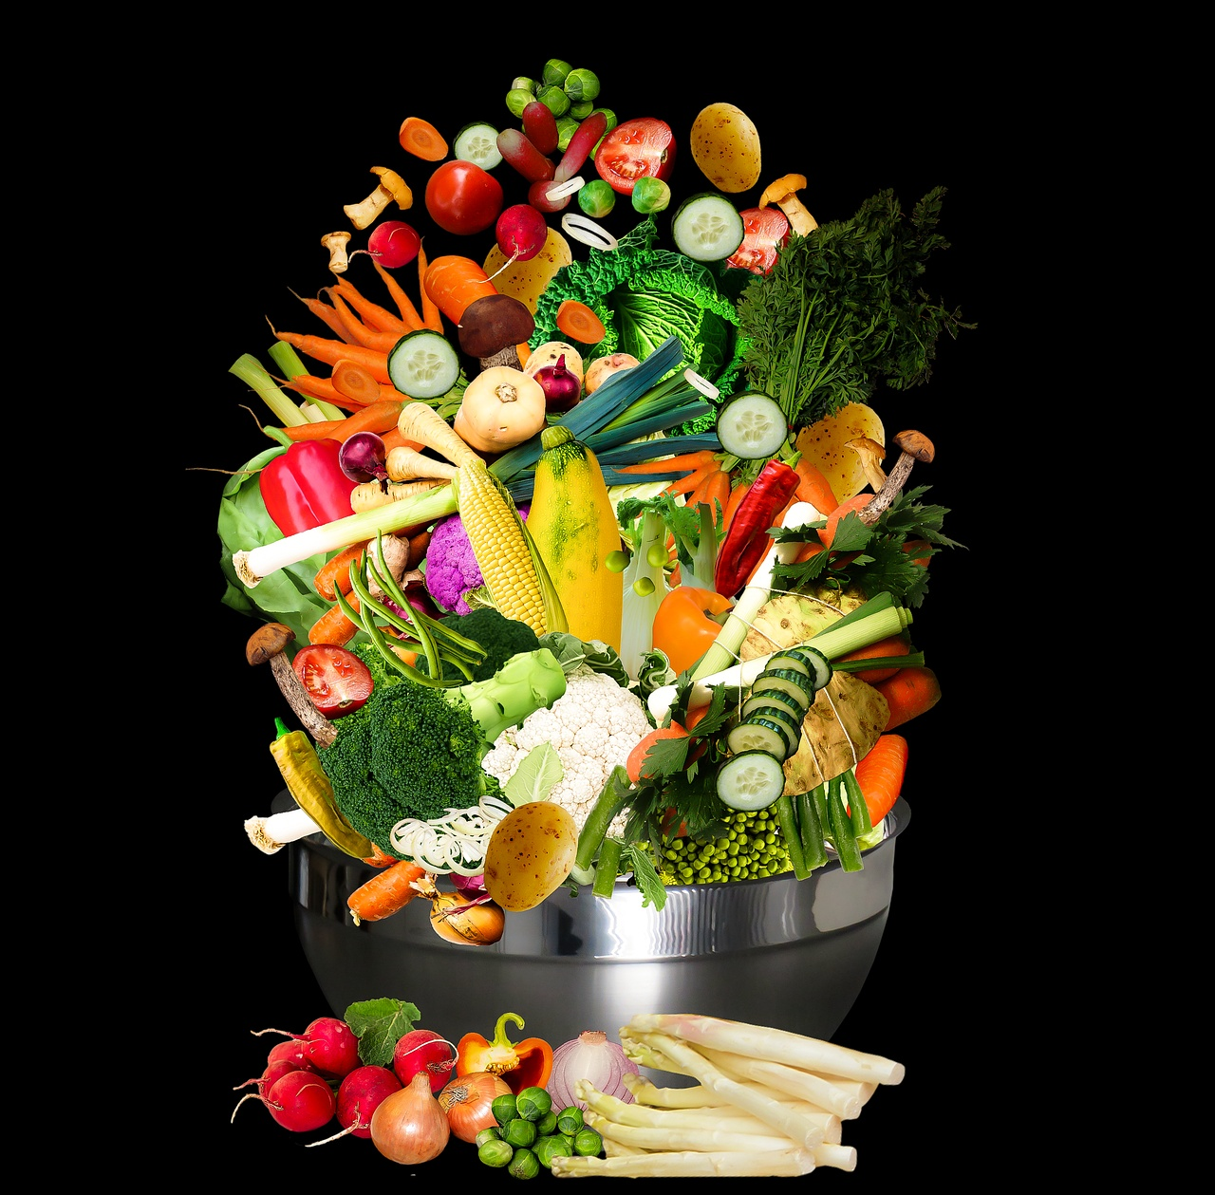
8
Interactive Learning Activities
01
Nutritional Mapping Journey
02
Cultural Food Composition Analysis
Explore global nutrition patterns
Identify key dietary differences
Interactive map interface
Analyze nutritional content of traditional dishes
Understand cultural significance of ingredients
Comparative study of food compositions
03
Sustainable Food Systems Exploration
04
Nutritional Interpretation Workshop
Investigate sustainable food practices worldwide
Learn about eco-friendly food production
Interactive scenarios on sustainable choices
Decode food labels and nutritional information
Practice interpreting dietary guidelines
Engage in hands-on nutritional analysis
Culinary Connections: Exploring Global Food Cultures and Nutrition

Slide 12
9
Technology in Nutrition
01
Digital Nutrition Tracking
02
Augmented Reality Food Scanning
03
Virtual Global Kitchen Tours
Utilize apps and software to monitor daily food intake.
Track macronutrient and micronutrient consumption for better health management.
Scan food items with AR technology to access nutritional information.
Enhance awareness of calorie content and ingredient details.
Explore diverse cuisines virtually to learn about different food cultures.
Gain insights into traditional recipes and cooking methods worldwide.
04
Interactive Nutrition Platforms
05
Screenshots of Technology Examples
Engage with interactive platforms for personalized nutrition guidance.
Receive tailored meal plans and dietary recommendations based on individual needs.
Showcase screenshots of popular nutrition apps and tools.
Highlight user-friendly interfaces and features for easy adoption.
Culinary Connections: Exploring Global Food Cultures and Nutrition

Slide 13
10
Personal Nutrition Journey
01
Self-Assessment Strategies
02
Tracking Personal Dietary Habits
03
Creating Personalized Nutrition Plans
Reflect on current eating habits
Identify areas for improvement
Keep a food journal
Monitor nutrient intake
Consult with a nutritionist
Set achievable goals
04
Reflective Learning Approaches
05
Motivational Graphics
Evaluate progress regularly
Adjust plans as needed
Visual reminders of goals
Encouraging quotes for inspiration
Culinary Connections: Exploring Global Food Cultures and Nutrition

Slide 14

11
Sustainability and Food Systems
01
Environmental Impact
02
Sustainable Agriculture Techniques
Carbon footprint of food production
Water usage in agriculture
Deforestation for farming
Organic farming practices
Crop rotation and diversification
Integrated pest management
03
Global Food Distribution Challenges
04
Innovative Food Production Methods
Food waste in supply chains
Access to nutritious food in underserved areas
Impact of transportation on food freshness
Vertical farming
Aquaponics and hydroponics
Cultured meat technology
Culinary Connections: Exploring Global Food Cultures and Nutrition

Slide 15
12
Common Nutritional Misconceptions
01
Protein Quantity Myths
02
Superfood Marketing
03
Caloric Oversimplification
Myth: More protein is always better for muscle growth.
Fact: The body can only utilize a certain amount of protein; excess is stored as fat.
Myth: Superfoods have magical health benefits.
Fact: While nutrient-dense, no single food can provide all essential nutrients.
Myth: All calories are equal, regardless of the source.
Fact: The quality of calories (nutrient content) matters for overall health.
04
Dietary Stereotypes
05
Myth vs. Fact Presentation Style
Myth: Carbs are always bad for weight management.
Fact: Carbohydrates are essential for energy; focus on whole grains and fiber.
Myth: Fad diets are sustainable for long-term health.
Fact: Balanced, varied diets are key for overall well-being and sustainability.
Culinary Connections: Exploring Global Food Cultures and Nutrition

Slide 16
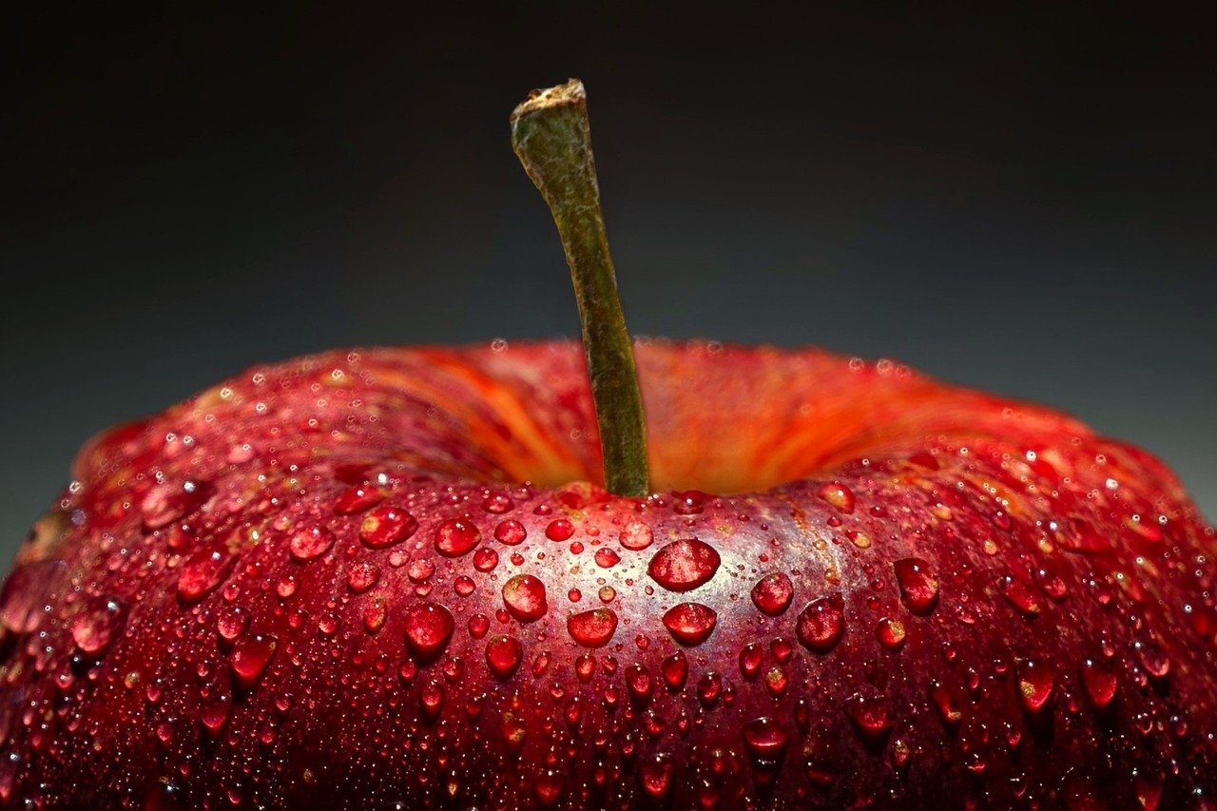
13
Key Takeaways
01
Global Food Interconnectedness
02
Personal Health Empowerment
Understanding the cultural exchange through culinary traditions.
Appreciating the diversity of global cuisines and their impact on societies.
Recognizing the importance of balanced nutrition for overall well-being.
Making informed dietary choices for a healthier lifestyle.
03
Sustainable Food Systems Awareness
Acknowledging the environmental implications of food production.
Supporting sustainable practices for a greener future.
Culinary Connections: Exploring Global Food Cultures and Nutrition

Slide 17

14
Next Steps and Further Exploration
01
Suggested Follow-Up Research
02
Additional Learning Resources
Explore traditional food preservation methods across different cultures.
Investigate the impact of globalization on local food traditions.
Study the relationship between food culture and social gatherings.
Online courses on global cuisine and nutrition.
Food documentaries showcasing diverse culinary practices.
Virtual tours of iconic food markets around the world.
03
Recommended Reading/Websites
04
Encouragement for Continued Learning
"Salt, Fat, Acid, Heat" by Samin Nosrat for a culinary journey.
National Geographic's "Food: Our Global Kitchen" for cultural insights.
FoodTank.com for sustainable food system articles and resources.
Join local cooking classes to experience new flavors.
Engage in community food events to broaden cultural understanding.
Experiment with cooking recipes from different regions to expand culinary skills.
Culinary Connections: Exploring Global Food Cultures and Nutrition

Slide 18

15
Q&A and Reflection
01
Reflection Questions
02
Suggested Discussion Topics
How has learning about global food cultures impacted your view on nutrition?
What connections have you made between different food traditions and personal health choices?
In what ways can understanding diverse food cultures contribute to a more sustainable food system?
Share a traditional dish from your culture and discuss its nutritional value.
Debate the importance of preserving cultural food traditions in a globalized world.
Discuss the role of food education in promoting health and well-being across different communities.
03
Contact Information
04
Inspirational Closing Quote
For further inquiries or feedback, please contact: [Email Address]
Stay connected with us on social media: [Social Media Handles]
"Food is our common ground, a universal experience." - James Beard
Culinary Connections: Exploring Global Food Cultures and Nutrition

Slide 19
16
Design Considerations
01
Font Selection
02
Color Scheme
03
Text Density
Utilize dyslexia-friendly sans-serif fonts for improved readability.
Opt for high-contrast color combinations to enhance visual clarity.
Maintain minimal text per slide to avoid overwhelming the audience.
04
Visual Elements
05
Graphic Design
Incorporate abundant visual aids to support understanding and engagement.
Use clear and simple graphics to convey information effectively.
Culinary Connections: Exploring Global Food Cultures and Nutrition

Slide 20
17
Technical Recommendations
01
Alt Text for Images
02
Downloadable Resources
03
Printable Companion Guide
Include descriptive alternative text for all images used in the presentation.
Provide links or QR codes for downloadable materials related to the content.
Create a printable guide summarizing key points and additional resources.
04
Color-Blind Friendly Design
05
Multiple Format Availability
Ensure color choices are accessible for individuals with color vision deficiencies.
Make slides available in various formats for different viewing preferences.
Culinary Connections: Exploring Global Food Cultures and Nutrition

