Slide 1

Mastering Relative Clauses: A Comprehensive Guide
Exploring the Fundamentals, Applications, and Importance of Relative Clauses in English Grammar

Slide 2
Table of Contents
Introduction to Relative Clauses
What are Relative Clauses?
Types of Relative Clauses
Relative Pronouns
Forming Relative Clauses
Examples of Relative Clauses
Importance of Relative Clauses
Common Errors
Practice Exercises
Guided Practice
01
02
03
04
05
06
07
08
09
10

Slide 3
Table of Contents
Independent Practice
Assessment and Feedback
Conclusion
Next Steps
Reflection and Evaluation
Additional Resources
Parent Engagement
Final Thoughts
11
12
13
14
15
16
17
18

Slide 4

Mastering Relative Clauses: A Comprehensive Guide
1
Introduction to Relative Clauses
Key Role
Additional Insights
Communication Skills
Relative clauses are essential in English as they provide specific details about nouns.
For example, in 'The car that is red is mine,' the clause 'that is red' identifies which car.
Understanding relative clauses enhances effective communication.
They are crucial for constructing sentences that convey detailed information.
Using relative clauses improves writing clarity and coherence.
For instance, 'The student who studies hard will succeed' offers more context than 'The student will succeed.'

Slide 5

Mastering Relative Clauses: A Comprehensive Guide
2
What are Relative Clauses?
Dependent Clauses
Relative Pronouns
A relative clause is a type of dependent clause that provides more information about a person, place, or thing.
It cannot stand alone as a complete sentence.
A relative clause begins with a relative pronoun such as who, which, or that.
These pronouns help connect the clause to the noun it describes.
Types of Clauses
Noun Descriptions
Relative clauses can be restrictive or non-restrictive.
Restrictive clauses are essential to the meaning of the sentence, while non-restrictive clauses add extra information.
Relative clauses are used to describe, explain, or provide additional information about a noun or pronoun.
They enhance the clarity and detail of the sentence.

Slide 6

Mastering Relative Clauses: A Comprehensive Guide
3
Types of Relative Clauses
Essential Clauses
Non-Essential Clauses
Descriptive Use
Restrictive relative clauses provide essential information about a noun or pronoun.
They help clarify which specific person or thing is being referred to.
Non-restrictive relative clauses provide non-essential information about a noun or pronoun.
They add extra details but can be removed without changing the main meaning of the sentence.
Relative clauses can be used to describe people, places, and things.
They enhance the sentence by providing additional context and information.

Slide 7

Mastering Relative Clauses: A Comprehensive Guide
4
Relative Pronouns
Who: People
Which: Things
Who refers specifically to individuals.
It is used to identify the subject in a sentence.
Which is used to specify particular items or concepts.
It helps to differentiate between options.
That: People or Things
Whom: Object Use
That can refer to both people and objects.
It is often used to connect clauses and provide essential information.
Whom functions as the object of a verb or preposition.
It is commonly found in more formal contexts.

Slide 8

Mastering Relative Clauses: A Comprehensive Guide
5
Forming Relative Clauses
Relative Pronouns
Verbs and Objects
Non-restrictive Clauses
Relative pronouns introduce relative clauses.
Examples include 'who', 'which', and 'that'.
A verb and an object complete the relative clause.
This combination clarifies the action.
Non-restrictive clauses add extra information to a sentence.
Use commas to set them off from the main clause.

Slide 9

Mastering Relative Clauses: A Comprehensive Guide
6
Examples of Relative Clauses
My Book
Mother in Red
This book, resting on the table, belongs to me.
It holds stories that inspire and entertain.
My mother is the woman in the striking red dress.
She radiates warmth and elegance wherever she goes.
Coastal City
Hardworking Student
This coastal city is a vibrant hub for tourists.
Its stunning beaches and lively atmosphere attract visitors year-round.
The diligent student dedicates hours to studying each day.
Their commitment ensures success in every exam they face.

Slide 10

Mastering Relative Clauses: A Comprehensive Guide
7
Importance of Relative Clauses
Clarifying Meaning
Enhancing Variety
Avoiding Ambiguity
Relative clauses provide essential details about a noun.
This specificity helps clarify the intended meaning of a sentence.
Relative clauses introduce different perspectives in writing.
They can transform simple sentences into more complex and engaging structures.
Relative clauses help eliminate confusion in communication.
They clearly indicate which specific person, place, or thing is being referenced.

Slide 11

Mastering Relative Clauses: A Comprehensive Guide
8
Common Errors
Mistakes with Relative Pronouns
The Role of Commas in Clarity
Using the wrong relative pronoun can confuse the reader.
Ensure the pronoun accurately corresponds to the noun it replaces.
Omitting commas can change a sentence's meaning significantly.
Commas are crucial for isolating non-restrictive clauses.
Common Misuses of Relative Clauses
The Importance of Relative Clauses
Incorrectly using relative clauses can muddle your writing.
Always check that the clause adds relevant information.
Neglecting relative clauses can omit essential details.
These clauses enhance the main idea by providing context.

Slide 12

Mastering Relative Clauses: A Comprehensive Guide
9
Practice Exercises
Identify Relative Clauses
Construct Sentences
Identify Relative Pronouns
Relative clauses give more details about nouns.
Identify the relative clause in the sentence: The book, which is on the table, is mine.
Create a complete sentence that includes the relative clause 'who lives in New York'.
For example, you could say: 'I have a friend who lives in New York.'
Relative pronouns link clauses to nouns or pronouns.
Identify the relative pronoun in the sentence: The woman, whom I met yesterday, is very friendly.

Slide 13
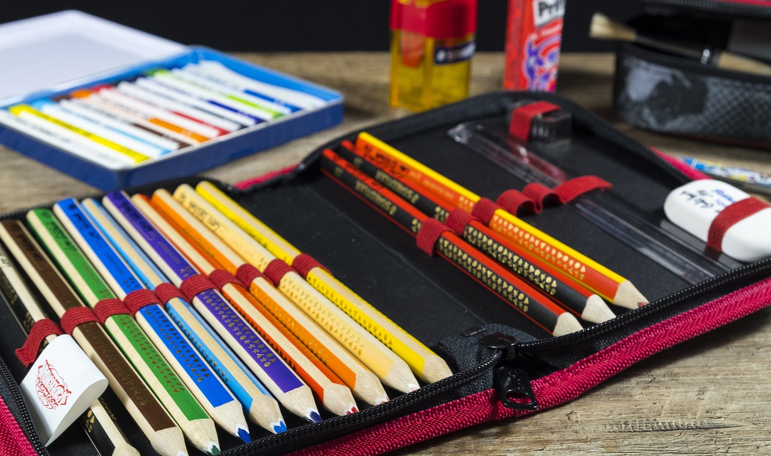
Mastering Relative Clauses: A Comprehensive Guide
10
Guided Practice
Pair Work
Worksheet Practice
Story Creation
Work in pairs to identify and construct relative clauses.
Share your sentences with your partner.
Use worksheets or quizzes to practice relative clauses.
Complete exercises to reinforce your understanding.
Create a short story or dialogue that includes relative clauses.
Make it engaging by using your learned skills.

Slide 14

Mastering Relative Clauses: A Comprehensive Guide
11
Independent Practice
Descriptive Writing
Visual Presentation
Analytical Essay
Write a descriptive paragraph about a person, place, or thing.
Incorporate vivid details and relative clauses to enhance the reader's experience.
Create a visual presentation that uses engaging images and examples.
Clearly explain the concept of relative clauses.
Write an analytical essay on a topic that utilizes relative clauses.
Support your arguments with clear examples.

Slide 15

Mastering Relative Clauses: A Comprehensive Guide
12
Assessment and Feedback
Engaging Assessments through Quizzes and Games
Essential Feedback Mechanisms
Promoting Reflection with Peer and Self-Assessment
Quizzes and games serve as effective tools for assessing understanding of relative clauses.
These interactive methods enhance student engagement and enjoyment in learning.
Providing constructive feedback on assignments and quizzes is crucial for student growth.
Timely and specific responses empower students to improve their comprehension.
Peer and self-assessment are valuable practices for evaluating understanding of relative clauses.
These approaches encourage students to reflect on their learning and deepen their insights.

Slide 16

Mastering Relative Clauses: A Comprehensive Guide
13
Conclusion
The Importance of Relative Clauses
Improving Communication Skills
The Path to Mastery
Relative clauses play a crucial role in enriching the English language.
They provide essential details that clarify and specify nouns.
Mastering relative clauses enhances overall grammar proficiency.
This improvement translates to clearer and more effective communication in both writing and speaking.
Consistent practice is vital for mastering the use of relative clauses.
Engaging in regular exercises fosters a deeper understanding and application of these grammatical structures.

Slide 17

Mastering Relative Clauses: A Comprehensive Guide
14
Next Steps
Subordinate Clauses
Combining Clauses
Relative Clauses
Subordinate clauses are essential for adding detail to sentences.
In this section, we will explore their structure and usage.
We will practice combining independent and dependent clauses.
This skill is important for creating more complex and varied sentences.
Relative clauses help us provide additional information about a noun.
For example, in the sentence, 'The book that I borrowed was fascinating,' the clause adds detail about the book.

Slide 18

Mastering Relative Clauses: A Comprehensive Guide
15
Reflection and Evaluation
Role of Relative Clauses
Understanding Assessment
Feedback for Growth
Relative clauses enhance clarity in communication.
They provide essential information about nouns.
Assessing the use of relative clauses is crucial for effective writing.
It helps in identifying strengths and weaknesses in language skills.
Constructive feedback is vital for improvement in language use.
It guides learners in applying relative clauses more effectively.

Slide 19

Mastering Relative Clauses: A Comprehensive Guide
16
Additional Resources
Online Practice
Grammar Guides
Interactive Learning
Explore dedicated websites that focus on practicing relative clauses.
These resources offer tailored exercises to sharpen your skills.
Consult comprehensive grammar textbooks for a deeper understanding of language rules.
These guides provide practical examples to clarify complex concepts.
Discover engaging educational apps that facilitate hands-on language practice.
These platforms make the learning process enjoyable and effective.

Slide 20

Mastering Relative Clauses: A Comprehensive Guide
17
Parent Engagement
Review Relative Clauses
Support Learning Resources
Join Learning Activities
Encourage parents to practice relative clauses with their children to reinforce understanding.
This engagement fosters a deeper grasp of the material.
Share unique resources that empower parents in their children's education.
Suggestions include interactive worksheets and engaging online platforms.
Encourage parents to take part in lessons and hands-on activities.
Active participation enhances comprehension and application of relative clauses.

Slide 21

Mastering Relative Clauses: A Comprehensive Guide
18
Final Thoughts
Practice Matters
Essential Communication
Dedication Pays Off
Mastering relative clauses takes time and practice.
Consistent effort leads to improvement.
Relative clauses are an essential aspect of effective communication.
They help clarify and add detail to our sentences.
With dedication and persistence, students can improve their grammar skills.
Becoming proficient in using relative clauses opens up new opportunities for expression.

