Slide 1

Mastering Inverse Operations in Mathematics
Exploring Concepts, Applications, and Teaching Strategies for Effective Learning

Slide 2
Table of Contents
Introduction to Inverse Operations and Basic M…
What are Inverse Operations?
Examples of Inverse Operations
Why are Inverse Operations Important?
Real-Life Applications of Inverse Operations
Problem-Solving Strategies
Teaching Tips
Key Takeaways
Reflection Questions
Next Steps
Conclusion
Homework
Extension Activities
04
05
06
07
08
09
10
11
12
13
14
15
16

Slide 3
Table of Contents
Parent Engagement
Safety Considerations
Final Thoughts
Summary
Assessment
Resources
Conclusion and Final Thoughts
17
18
19
20
21
22
23

Slide 4

Introduction to Inverse Operations and Basic Math Concepts
Welcome to the World of Math
Understanding Inverse Operations
Applying Math Concepts
Welcome to our exciting journey into the world of math!
This lesson will introduce you to the fascinating concept of inverse operations and basic math concepts.
In this lesson, we will explore the concept of inverse operations.
You will learn how these operations work and their significance in mathematics.
By the end of this lesson, you will understand how inverse operations can be applied.
This knowledge will help you in different mathematical contexts and problem-solving scenarios.
4
Mastering Inverse Operations in Mathematics

Slide 5
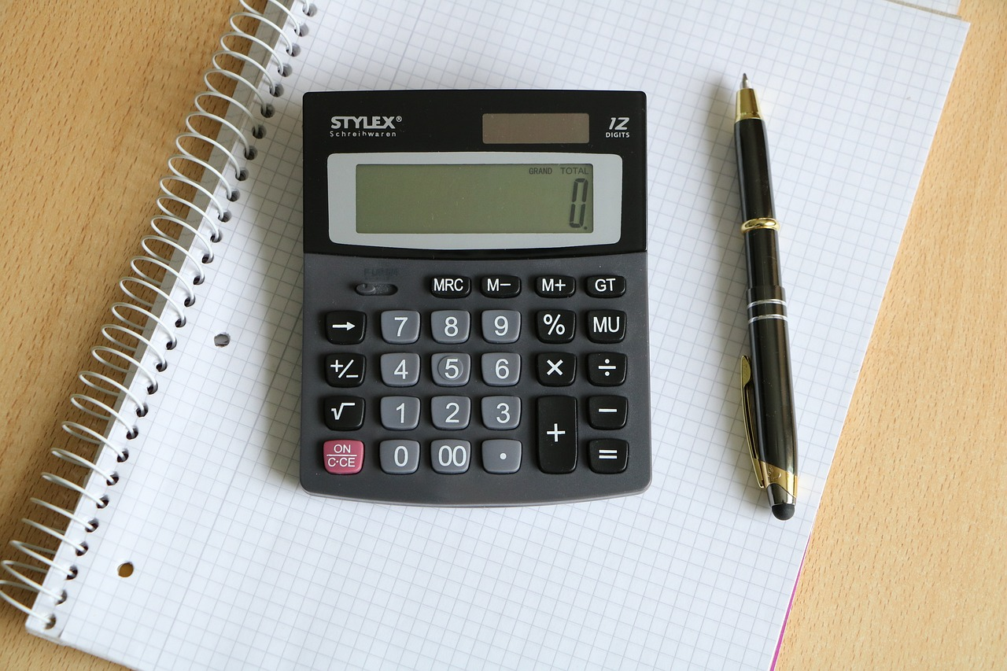
What are Inverse Operations?
Definition of Inverse Operations
Examples of Inverse Operations
Inverse operations are pairs of operations that "undo" each other.
They are fundamental in understanding mathematical relationships and problem-solving.
Addition and subtraction are inverse operations, as are multiplication and division.
These pairs demonstrate how one operation can reverse the effect of another.
5
Mastering Inverse Operations in Mathematics

Slide 6

Examples of Inverse Operations
Addition and Subtraction Relationship
Multiplication and Division Pairing
2 + 3 = 5 demonstrates addition.
5 - 3 = 2 illustrates subtraction as its inverse.
4 x 6 = 24 shows multiplication.
24 ÷ 6 = 4 represents division as its inverse.
Subtraction and Addition Connection
Multiplication and Division Example
7 - 2 = 5 highlights subtraction.
5 + 2 = 7 shows addition as its inverse.
9 x 3 = 27 illustrates multiplication.
27 ÷ 3 = 9 demonstrates division as its inverse.
6
Mastering Inverse Operations in Mathematics

Slide 7
Why are Inverse Operations Important?
Understanding Mathematical Relationships
Applications in Everyday Life
Importance in Problem Solving
Inverse operations help us solve equations and problems.
They help us understand the relationship between different mathematical operations.
Inverse operations are used in real-life scenarios.
Examples include shopping, cooking, and travel.
Inverse operations are crucial for solving mathematical problems.
They provide a method to find solutions effectively.
7
Mastering Inverse Operations in Mathematics

Slide 8

Real-Life Applications of Inverse Operations
Shopping Applications
Cooking Adjustments
Inverse operations are used in shopping to calculate the change returned after a purchase.
They also help in determining the total cost of items bought.
In cooking, inverse operations assist in measuring ingredients accurately.
They are also used to adjust recipes based on serving sizes.
Travel Calculations
Scientific Measurements
Travel planning often involves using inverse operations to calculate distances between locations.
They are also used to estimate travel times based on speed and distance.
In science, inverse operations are applied to measure quantities precisely.
They also aid in analyzing data to derive meaningful conclusions.
8
Mastering Inverse Operations in Mathematics

Slide 9

Problem-Solving Strategies
Understanding Inverse Operations
Real-Life Applications
Building Confidence Through Practice
Inverse operations are used to solve equations and problems effectively.
They involve reversing the operation applied to isolate the variable or find the solution.
Applying inverse operations can help solve practical problems encountered in daily life.
Examples include calculating discounts, determining original quantities, or balancing budgets.
Consistent practice of inverse operations enhances problem-solving skills.
It also builds fluency and confidence in handling various mathematical challenges.
9
Mastering Inverse Operations in Mathematics

Slide 10

Teaching Tips
Relating Inverse Operations to Real Life
Visual Aids and Manipulatives
Use real-life examples to make inverse operations more relatable.
This approach helps students connect mathematical concepts to their everyday experiences.
Utilize visual aids and manipulatives to help students understand.
These tools provide tangible ways to explore and grasp abstract ideas.
Storytelling and Gamification
Differentiated Instruction
Incorporate storytelling and gamification to make learning fun.
Engaging narratives and interactive games enhance student interest and retention.
Differentiate instruction to meet the needs of all students.
Tailoring teaching methods ensures inclusivity and addresses diverse learning styles.
10
Mastering Inverse Operations in Mathematics

Slide 11

Key Takeaways
Understanding Inverse Operations
Real-Life Applications
Building Confidence and Fluency
Inverse operations are pairs of operations that 'undo' each other.
They are fundamental concepts in mathematics and problem-solving.
Inverse operations are used in real-life scenarios.
These applications highlight their importance in practical problem-solving.
Practice and application are key to mastering inverse operations.
Consistent effort helps in developing confidence and fluency.
11
Mastering Inverse Operations in Mathematics

Slide 12

Reflection Questions
Understanding Inverse Operations
Applying Inverse Operations
Overcoming Challenges with Inverse Operations
What did you learn about inverse operations in this lesson?
Inverse operations are mathematical processes that undo each other, such as addition and subtraction or multiplication and division.
How can you apply inverse operations in your everyday life?
Inverse operations can be used to solve real-world problems, such as balancing budgets or calculating discounts.
What challenges did you face, and how can you overcome them?
Challenges may include understanding the concept or applying it correctly, which can be overcome through practice and seeking clarification.
12
Mastering Inverse Operations in Mathematics

Slide 13

Next Steps
1
Exploring Word Problems
Explore word problems and apply inverse operations to solve them.
This approach helps in understanding the practical application of mathematical concepts.
2
Introducing Multi-Digit Operations
Introduce multi-digit operations and build upon foundational knowledge.
This step is crucial for advancing mathematical skills and comprehension.
3
Practicing with Games and Puzzles
Use mathematical games and puzzles to practice and reinforce inverse operations.
Engaging activities enhance learning and retention of mathematical principles.
13
Mastering Inverse Operations in Mathematics

Slide 14

Conclusion
Understanding Inverse Operations
Building a Strong Foundation
Inverse operations are a fundamental concept in mathematics.
They allow for the reversal of mathematical processes, aiding in problem-solving and comprehension.
By understanding and applying inverse operations, you can build a strong foundation for future math learning.
This knowledge is essential for advancing in mathematical studies and applications.
14
Mastering Inverse Operations in Mathematics

Slide 15

Homework
Inverse Operations Worksheet
Complete the inverse operations worksheet.
This activity helps reinforce understanding of mathematical concepts.
Create Word Problems
Develop your own word problems using inverse operations.
This exercise encourages creativity and application of learned skills.
Engage with Math Games
Play a math game or puzzle that involves inverse operations.
Interactive activities make learning enjoyable and effective.
15
Mastering Inverse Operations in Mathematics

Slide 16

Extension Activities
1
Math-Themed Escape Room
Create a math-themed escape room that involves inverse operations.
Participants solve puzzles using inverse operations to progress through the room.
2
Board Game Design
Design a board game that applies inverse operations.
Players use their knowledge of inverse operations to advance and win the game.
3
Story Writing Challenge
Write a story that incorporates inverse operations in a real-life scenario.
The narrative demonstrates practical applications of inverse operations in everyday situations.
16
Mastering Inverse Operations in Mathematics

Slide 17

Parent Engagement
Encouraging Parental Participation
Encourage parents to participate in math activities with their child.
This involvement fosters a collaborative learning environment and strengthens the child's understanding of mathematical concepts.
Providing Progress Updates
Provide regular progress updates and feedback to parents.
This keeps them informed about their child's achievements and areas for improvement.
Inviting Parental Involvement
Invite parents to volunteer in the classroom or attend math events.
Such opportunities allow parents to engage directly with the educational process and support their child's learning journey.
17
Mastering Inverse Operations in Mathematics

Slide 18

Safety Considerations
1
2
3
Creating a Safe Learning Environment
Emotional Well-being of Students
Preventing Accidents and Injuries
Ensure a safe and supportive learning environment.
This includes fostering a space where students feel secure and valued.
Be mindful of students' emotional safety and well-being.
Recognize and address any concerns that may affect their mental health.
Take necessary precautions to prevent accidents and injuries.
Implement measures to ensure physical safety during activities.
18
Mastering Inverse Operations in Mathematics

Slide 19

Final Thoughts
Understanding Inverse Operations
Mastery and Applications
Inverse operations are a powerful tool for problem-solving and critical thinking.
They allow for a structured approach to tackling mathematical challenges.
By mastering inverse operations, you can unlock a deeper understanding of mathematics and its applications.
This understanding enhances both theoretical knowledge and practical problem-solving skills.
19
Mastering Inverse Operations in Mathematics

Slide 20

Summary
Understanding Inverse Operations
Applications in Real-Life Scenarios
Building Confidence and Fluency
Inverse operations are pairs of operations that 'undo' each other.
They are fundamental in mathematics and problem-solving contexts.
Inverse operations are utilized in various real-life situations.
They help in solving problems effectively and efficiently.
Practice and application are essential for mastering inverse operations.
These activities enhance one's confidence and fluency in using them.
20
Mastering Inverse Operations in Mathematics

Slide 21

Assessment
Quiz: Inverse Operations
Worksheet: Applying Inverse Operations
Project: Real-Life Application of Inverse Operations
This activity involves solving problems using inverse operations.
It is designed to test understanding and application of the concept.
This worksheet provides practice problems for mastering inverse operations.
It helps reinforce the theoretical knowledge through practical exercises.
This project encourages students to find and explain real-world examples of inverse operations.
It aims to connect mathematical concepts with everyday situations.
21
Mastering Inverse Operations in Mathematics

Slide 22

Resources
Math Games App
Explore interactive math games designed to enhance learning.
Engage with fun challenges suitable for various skill levels.
Khan Academy Kids
Discover educational resources tailored for young learners.
Access a variety of subjects including math, reading, and more.
Splash Math
Dive into engaging math activities for children.
Track progress and adapt learning to individual needs.
Math Worksheets and Activities
Utilize printable worksheets for hands-on practice.
Incorporate activities to reinforce mathematical concepts.
22
Mastering Inverse Operations in Mathematics

Slide 23

Conclusion and Final Thoughts
Understanding Inverse Operations
Building a Strong Foundation
Inverse operations are a fundamental concept in mathematics.
They allow for the reversal of mathematical processes, aiding in problem-solving and comprehension.
By understanding and applying inverse operations, you can build a strong foundation for future math learning.
This knowledge enhances problem-solving skills and prepares learners for advanced mathematical concepts.
23
Mastering Inverse Operations in Mathematics

