Slide 1

Engaging with Dutch: A Comprehensive Journey through Grammar and Pronunciation
Exploring Interactive Exercises, Cultural Insights, and Practical Applications

Slide 2
Table of Contents
Welcome to Interactive Dutch Grammar Exercises and …
Lesson Objectives
Dutch Grammar Basics
Pronunciation Practice
Conversation Role-Plays
Grammar Exercises
Pronunciation Games
Conversation Practice
Dutch Culture and Vocabulary
Assessment and Feedback
Resources and Support
Conclusion
Next Steps
01
02
03
04
05
06
07
08
09
10
11
12
13

Slide 3
Table of Contents
Reflection and Evaluation
Additional Resources
Final Thoughts
Appendix
References
Feedback and Evaluation
Conclusion and Next Steps
14
15
16
17
18
19
20

Slide 4

Welcome to Interactive Dutch Grammar Exercises and Pronunciation Practice
Dutch Grammar Basics
Interactive Learning
Foundation for Communication
Learn the basics of Dutch grammar and pronunciation.
Understanding grammar is crucial for effective communication in Dutch.
Engage in interactive exercises and activities to promote language learning and retention.
Enjoyable activities enhance the learning experience.
Build a strong foundation in Dutch grammar and pronunciation.
This will enhance your overall communication skills.
1
Engaging with Dutch: A Comprehensive Journey through Grammar and Pronunciation

Slide 5

Lesson Objectives
Dutch Grammar Basics
Correct Pronunciation
Understand and apply basic Dutch grammar rules.
Learn how to construct sentences correctly.
Pronounce Dutch words and phrases correctly.
Practice with native speakers for better accuracy.
Simple Conversations
Growth Mindset
Engage in simple conversations with native speakers.
Build confidence in everyday interactions.
Develop a growth mindset and confidence in language learning.
Embrace challenges as opportunities to improve.
2
Engaging with Dutch: A Comprehensive Journey through Grammar and Pronunciation

Slide 6

Dutch Grammar Basics
Present Tense Conjugation
Noun Declension
In Dutch, verbs are conjugated based on the subject. The present tense forms are straightforward and follow regular patterns.
Nouns in Dutch change form based on their role in a sentence. Understanding noun declension is essential for proper sentence structure.
Grammar Rules
Practice Exercises
Dutch grammar has specific rules that govern sentence construction. There are also exceptions that learners should be aware of.
Engaging in practice exercises helps reinforce grammar concepts. Regular practice is key to mastering Dutch grammar.
3
Engaging with Dutch: A Comprehensive Journey through Grammar and Pronunciation

Slide 7

Pronunciation Practice
Repeat Words
Audio-Video Practice
Sound Focus
Listening to and repeating Dutch words and phrases helps you articulate sounds more accurately.
This practice builds muscle memory for correct pronunciation.
Utilize audio and video resources to immerse yourself in authentic Dutch pronunciation.
These tools enhance your learning by providing context and real-life examples.
Concentrate on specific Dutch sounds, such as vowels and consonants, to improve clarity.
Pay attention to intonation patterns to sound more natural when speaking.
4
Engaging with Dutch: A Comprehensive Journey through Grammar and Pronunciation

Slide 8

Conversation Role-Plays
Basic Dutch Phrases
Self-Introduction Practice
Real-Life Listening Skills
Learn essential phrases for ordering food, asking for directions, and greeting people.
Practice phrases like 'Ik wil graag een koffie' (I would like a coffee) and 'Waar is het station?' (Where is the station?).
Practice introducing yourself with questions like 'Hoe heet je?' (What is your name?) and 'Waar kom je vandaan?' (Where are you from?).
This will help you feel more comfortable in social situations.
Engage in role-plays that simulate real-life conversations, such as shopping or traveling.
This will enhance your ability to understand spoken Dutch in various contexts.
5
Engaging with Dutch: A Comprehensive Journey through Grammar and Pronunciation

Slide 9

Grammar Exercises
Fill-in-the-Blank
Engage in fill-in-the-blank activities to test your grammar knowledge.
These exercises help reinforce understanding of key grammar concepts.
Grammar Quizzes
Take grammar quizzes to assess your skills and knowledge.
These quizzes provide immediate feedback on your performance.
Sentence Building
Participate in sentence-building exercises to enhance your writing skills.
These activities encourage creativity while applying grammar rules.
Feedback Opportunities
Utilize opportunities for feedback to improve your grammar usage.
Guidance from instructors can help clarify any misunderstandings.
6
Engaging with Dutch: A Comprehensive Journey through Grammar and Pronunciation

Slide 10
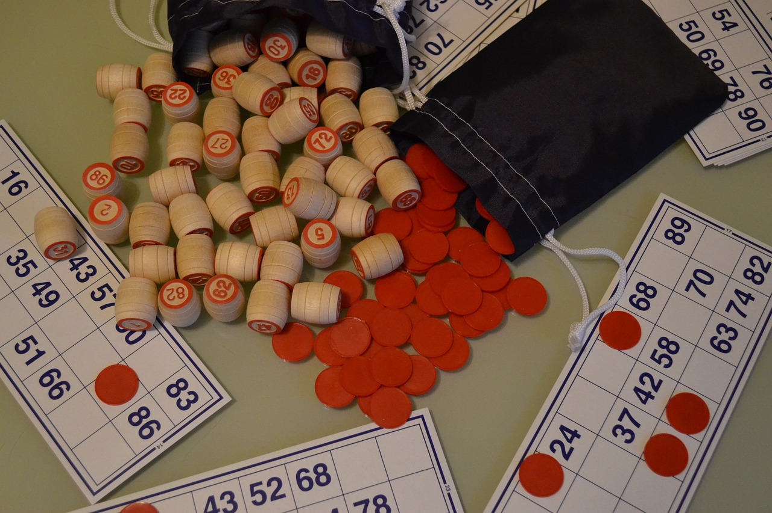
Pronunciation Games
Bingo Fun
Engage in pronunciation bingo and scavenger hunts.
They make learning enjoyable and promote practice.
Listen & Repeat
Join in listen and repeat games to enhance your pronunciation.
This method improves sound mimicry for accuracy.
Feedback Sessions
Take advantage of feedback opportunities during practice.
Constructive feedback helps identify improvement areas.
7
Engaging with Dutch: A Comprehensive Journey through Grammar and Pronunciation

Slide 11

Conversation Practice
Language Exchange
Find a language exchange partner.
Alternatively, practice speaking with a family member to build confidence.
Basic Phrases
Incorporate basic Dutch phrases into your conversations.
This will enhance your vocabulary and fluency.
Real-Life Practice
Engage in real-life interactions.
This will help you develop your listening and speaking skills.
8
Engaging with Dutch: A Comprehensive Journey through Grammar and Pronunciation

Slide 12

Dutch Culture and Vocabulary
Cultural Insights
Explore the rich traditions and customs of the Netherlands.
Understanding these cultural elements enhances language learning.
Vocabulary Exercises
Engage in interactive exercises to build your Dutch vocabulary.
These activities are designed to reinforce your learning.
Contextual Practice
Apply your vocabulary in real-life scenarios through practice.
This helps in retaining and using the language effectively.
Feedback Opportunities
Receive constructive feedback on your language use.
Guidance is provided to help you improve and grow.
9
Engaging with Dutch: A Comprehensive Journey through Grammar and Pronunciation

Slide 13

Assessment and Feedback
Regular Quizzes
Instructor Feedback
Self-Assessment
Regular quizzes reinforce learning and provide immediate feedback.
They help identify areas needing improvement.
Instructors offer critical guidance on assignments.
Their feedback aids in recognizing strengths and weaknesses.
Self-assessment promotes reflection on learning progress.
It enhances awareness of personal strengths and areas for growth.
10
Engaging with Dutch: A Comprehensive Journey through Grammar and Pronunciation

Slide 14

Resources and Support
Online Language Learning Platforms
Personalized Tutoring Options
Discover various online resources and mobile applications for language acquisition.
These tools effectively enhance vocabulary and comprehension skills.
Consider one-on-one instruction tailored to your learning style.
A personal tutor can provide focused support to improve your skills.
Essential Grammar Resources
Language Exchange Programs
Utilize grammar guides and textbooks for clear learning.
These materials are crucial for understanding language rules and structures.
Engage in conversation exchange opportunities for practical experience.
These programs allow you to practice speaking with native speakers.
11
Engaging with Dutch: A Comprehensive Journey through Grammar and Pronunciation

Slide 15

Conclusion
Key Concepts Recap
Practice Opportunities
Continued Learning
We have covered essential vocabulary and grammar rules.
These concepts form the foundation for your Dutch language skills.
Engage in conversation with native speakers to enhance your fluency.
Utilize online resources and exercises for additional practice.
Stay motivated by setting achievable language goals.
Explore advanced materials to deepen your understanding of Dutch.
12
Engaging with Dutch: A Comprehensive Journey through Grammar and Pronunciation

Slide 16

Next Steps
Grammar Fundamentals
Vocabulary Expansion
Comprehension Skills
Review basic Dutch grammar.
Focus on sentence structure and verb conjugation.
Daily practice is essential for vocabulary retention.
Engage in conversations to enhance skills.
Practice listening and reading comprehension exercises.
These will improve understanding of context and nuance.
13
Engaging with Dutch: A Comprehensive Journey through Grammar and Pronunciation

Slide 17

Reflection and Evaluation
Progress Review
Lesson Effectiveness
Feedback Opportunities
Reflect on the understanding of key concepts like [specific concepts].
Use targeted questions to gauge student comprehension.
Identify specific objectives targeted during the lesson, such as [specific objectives].
Evaluate student engagement through metrics like participation and feedback.
Create a structured format for gathering student feedback on lesson clarity.
Encourage students to suggest specific improvements for future lessons.
14
Engaging with Dutch: A Comprehensive Journey through Grammar and Pronunciation

Slide 18

Additional Resources
Language Apps
Grammar Texts
Explore online resources and innovative language learning apps.
These platforms include interactive features to enhance skills.
Utilize grammar guides and textbooks for structured learning.
These resources clarify rules and provide practical examples.
Exchange Programs
One-on-One Tutoring
Engage in language exchange programs for real conversation practice.
Speaking with native speakers boosts your language proficiency.
Consider personalized tutoring for focused language support.
Sessions can target your specific learning goals.
15
Engaging with Dutch: A Comprehensive Journey through Grammar and Pronunciation

Slide 19

Final Thoughts
Keep Practicing
Explore More Opportunities
Future Learning Tips
Continue to practice your Dutch skills regularly.
Consistency is key to mastering the language.
Look for language exchange partners or conversation groups.
Utilize online resources for additional practice and review.
Set specific goals for your language learning journey.
Stay curious and open to new learning methods.
16
Engaging with Dutch: A Comprehensive Journey through Grammar and Pronunciation

Slide 20

Appendix
Resource Support
Grammar Tools
Language Practice
Discover additional resources for language learners.
These resources include online courses, apps, and study groups that provide structured support.
Utilize recommended grammar guides like 'English Grammar in Use' and 'The Elements of Style.'
These textbooks offer clear explanations and practical exercises to enhance your grammar skills.
Participate in language exchange programs, such as Tandem or HelloTalk, to practice speaking with native speakers.
These programs facilitate real conversations, helping you gain confidence and improve fluency.
17
Engaging with Dutch: A Comprehensive Journey through Grammar and Pronunciation

Slide 21

References
Source List
Further Reading
Feedback Options
This lesson uses academic journals and reputable websites as sources.
These sources provide a solid foundation for understanding the topic.
Explore the recommended books and articles for deeper insights.
These resources will enhance your understanding of the subject.
We welcome your feedback on this lesson.
Your input helps improve our future content.
18
Engaging with Dutch: A Comprehensive Journey through Grammar and Pronunciation

Slide 22

Feedback and Evaluation
Feedback Opportunities
Lesson Effectiveness
Future Recommendations
Encourage students to share their thoughts on lessons through anonymous surveys.
Monitor student engagement and evaluate success using participation metrics.
Integrate interactive activities and diversify teaching methods to enhance engagement and cater to different learning styles.
19
Engaging with Dutch: A Comprehensive Journey through Grammar and Pronunciation

Slide 23

Conclusion and Next Steps
Key Concepts Recap
Practice Opportunities
Continue Learning
We have covered essential vocabulary and grammar rules in Dutch.
These concepts form the foundation for your language skills.
Consider joining a language exchange group to practice speaking.
Utilize online resources and apps for additional exercises.
Keep challenging yourself with new materials and topics.
Regular practice will help solidify your understanding of Dutch.
20
Engaging with Dutch: A Comprehensive Journey through Grammar and Pronunciation

