Slide 1

Mastering Communication: Strategies for Effective Engagement
Exploring Storytelling, Role-Playing, and Practical Techniques for Language Development

Slide 2
Table of Contents
Introduction to Developing Effective Communica…
Importance of Storytelling in Communication
Role-Playing as a Tool for Language Acquisition
Lesson Objectives
Teaching Script: Introduction and Icebreaker
Teaching Script: Role-Playing Activity
Teaching Script: Storytelling Session
Vocabulary Building
Conclusion and Feedback
Guided Practice: Story Sequencing
Guided Practice: Role-Play Scenarios
Independent Practice: Picture Description
Independent Practice: Short Story Writing
04
05
06
07
08
09
10
11
12
13
14
15
16

Slide 3
Table of Contents
Common Errors and Misconceptions
FAQs
Conclusion and Final Thoughts
Next Steps and Future Lessons
Reflection and Evaluation
Parent Engagement and Support
Safety Considerations and Classroom Environment
Teaching Tips and Strategies
Key Takeaways and Reflection Questions
17
18
19
20
21
22
23
24
25

Slide 4

Introduction to Developing Effective Communication Skills
Importance of Communication Skills
Methodologies for Language Learning
Lesson Plan Objective
Developing effective communication skills is crucial in today's globalized world.
These skills enable individuals to connect and collaborate across diverse cultures and contexts.
Storytelling and role-playing are key methodologies for language learning.
These approaches engage learners actively and foster practical language use.
This lesson plan aims to introduce 16-year-old students to the art of effective communication in English.
It focuses on equipping them with tools to express themselves clearly and confidently.
4
Mastering Communication: Strategies for Effective Engagement

Slide 5

Importance of Storytelling in Communication
Storytelling as a Communication Tool
Enhancing Language Learning Through Storytelling
Storytelling is a fundamental aspect of human communication.
It allows individuals to share experiences, convey emotions, and connect with others.
Storytelling provides a comprehensive approach to language learning.
It covers vocabulary, grammar, and pronunciation effectively.
Promoting Active Listening
Fostering a Supportive Environment
Storytelling encourages active listening.
This practice helps individuals engage more deeply with the content.
Storytelling fosters a supportive learning environment.
It creates a space where learners feel comfortable and motivated.
5
Mastering Communication: Strategies for Effective Engagement

Slide 6

Role-Playing as a Tool for Language Acquisition
Versatility of Role-Playing
Simulated Real-Life Context
Confidence and Problem-Solving
Role-playing is a versatile and effective method for language learners.
It provides opportunities to practice communication skills in diverse scenarios.
Role-playing allows students to practice communication skills in a simulated real-life context.
This approach enhances their ability to use language in practical situations.
Role-playing helps build confidence in using English.
It also develops problem-solving skills through interactive activities.
6
Mastering Communication: Strategies for Effective Engagement

Slide 7

Lesson Objectives
Confidence in English Expression
Storytelling and Role-Playing Importance
By the end of the lesson, students will be able to express themselves more confidently in English.
This will enhance their ability to communicate effectively in various contexts.
Students will understand the importance of storytelling and role-playing in language learning.
These methods provide engaging and practical ways to practice language skills.
Application in Real-Life Scenarios
Development of Essential Life Skills
Students will be able to apply their knowledge of storytelling and role-playing in real-life scenarios.
This application bridges the gap between theoretical learning and practical usage.
Students will develop essential life skills such as public speaking, teamwork, and creative thinking.
These skills are valuable for personal and professional growth.
7
Mastering Communication: Strategies for Effective Engagement

Slide 8

Teaching Script: Introduction and Icebreaker
Warm Welcome and Introduction
Icebreaker Activity
Guidance for Participation
Begin the lesson with a warm welcome and introduction.
Set a positive tone for the session by greeting students and outlining the day's activities.
Conduct an icebreaker activity where students share a brief story about their favorite book or movie.
This helps students to engage and feel comfortable participating in the class.
Encourage the use of simple English sentences and provide examples to guide them.
Offer support and feedback to ensure students feel confident in their contributions.
8
Mastering Communication: Strategies for Effective Engagement

Slide 9

Teaching Script: Role-Playing Activity
Group Formation and Scenario Assignment
Divide the students into small groups.
Assign each group a role-playing scenario.
Scenario Explanation and Activity Guidelines
Explain the scenario and emphasize the importance of using English to communicate.
Set a time limit for the activity.
Guidance and Feedback During Role-Play
As students engage in the role-play, move around the groups.
Provide guidance and feedback to the students.
9
Mastering Communication: Strategies for Effective Engagement

Slide 10

Teaching Script: Storytelling Session
Introduction to Storytelling Session
Choosing a Theme
Encouraging Descriptive Storytelling
Gather the students together for a storytelling session.
Create an engaging and inclusive environment for sharing stories.
Select a theme, such as travel experiences or favorite hobbies.
Encourage students to think about their personal experiences related to the theme.
Motivate students to use descriptive language in their stories.
Provide prompts to guide and inspire their storytelling process.
10
Mastering Communication: Strategies for Effective Engagement

Slide 11

Vocabulary Building
Introducing New Vocabulary
Utilizing Flashcards and Examples
Introduce new vocabulary related to the themes explored in the role-playing and storytelling activities.
This helps students connect new words to familiar contexts and enhances their understanding.
Use flashcards, provide definitions, and offer examples of how these words can be used in sentences.
These tools aid in visual and practical learning of the vocabulary.
Encouraging Active Usage
Practicing in Context
Encourage students to repeat the words and use them in their own sentences.
This practice reinforces memory and application of the vocabulary.
Provide opportunities for students to practice using the new vocabulary in context.
Contextual practice ensures that students can effectively use the vocabulary in real-life scenarios.
11
Mastering Communication: Strategies for Effective Engagement

Slide 12

Conclusion and Feedback
1
Gathering Student Feedback
Conclude the lesson by gathering feedback from the students.
Encourage them to share their thoughts on the learning experience.
2
Reflection on Learning
Ask students to reflect on what they learned and what they enjoyed most about the lesson.
Discuss any challenges they faced during the session.
3
Providing Performance Feedback
Provide feedback on their performance, highlighting strengths.
Identify areas for improvement to guide their future learning.
12
Mastering Communication: Strategies for Effective Engagement

Slide 13

Guided Practice: Story Sequencing
Activity Setup
Provide students with a set of picture cards depicting different scenes from a story.
These cards will serve as the basis for the sequencing activity.
Sequencing Task
Ask students to arrange the cards in chronological order.
This helps them understand the flow and structure of the story.
Guidance and Support
Circulate around the groups to offer guidance on vocabulary and grammar.
Ensure students are comfortable retelling the story in their own words.
13
Mastering Communication: Strategies for Effective Engagement

Slide 14

Guided Practice: Role-Play Scenarios
1
Scenario Preparation
Prepare scenario cards with different social situations, such as ordering food at a restaurant or making a complaint.
These cards will serve as prompts for the role-play activities.
2
Pair Activity
Divide students into pairs and assign each pair a scenario.
Have them act out the scenario to practice their social interaction skills.
3
Focus on Communication
Encourage the use of polite language and appropriate body language during the role-play.
This helps students develop effective and respectful communication habits.
14
Mastering Communication: Strategies for Effective Engagement

Slide 15

Independent Practice: Picture Description
Activity Overview
Vocabulary Focus
Success Criteria
Ask students to choose a picture from a magazine or the internet.
Write a short paragraph describing what they see.
Encourage the use of basic vocabulary related to objects, colors, and locations.
Support students in expanding their descriptive language skills.
Provide success criteria, such as including at least five descriptive words.
Ensure students demonstrate basic sentence structure in their writing.
15
Mastering Communication: Strategies for Effective Engagement

Slide 16

Independent Practice: Short Story Writing
1
2
3
Short Story Writing Task
Encouraging Descriptive Language
Success Criteria for Writing
Students are tasked with writing a short story of approximately 250 words.
The story should be based on a prompt provided by the teacher.
Students are encouraged to use descriptive language in their writing.
They should sequence events logically to create a coherent narrative.
The story should have a clear beginning, middle, and end.
Students should demonstrate good use of vocabulary and grammar.
16
Mastering Communication: Strategies for Effective Engagement

Slide 17

Common Errors and Misconceptions
Preparation and Practice
Inclusivity in Activities
Lack of preparation and practice can lead to discomfort during role-playing and storytelling activities.
Ensuring adequate preparation can enhance confidence and engagement in these activities.
Storytelling and role-playing are not only for extroverted students; they can be adapted for introverted students as well.
These activities can be tailored to suit diverse personality types and preferences.
Creativity and Spontaneity
Language Proficiency Misconception
Staying too focused on the script or the 'right' way to do things can limit creativity and spontaneity in role-playing.
Encouraging flexibility can foster a more dynamic and engaging experience.
Believing that one needs to be fluent in English to participate in storytelling and role-playing can be a misconception.
These activities can benefit students at all levels of English proficiency.
17
Mastering Communication: Strategies for Effective Engagement

Slide 18

FAQs
Improving Communication Skills
Everyone has a story to tell.
The goal is to practice and improve communication skills.
Enhancing Language Proficiency
Engage in activities, learn key phrases.
Practice using new language in context.
Learning Through Mistakes
Mistakes are part of the learning process.
Feedback is provided to help improve.
Exploring Cultures and Traditions
Storytelling and role-playing provide insights into various cultural practices.
These activities help understand different values.
18
Mastering Communication: Strategies for Effective Engagement

Slide 19

Conclusion and Final Thoughts
Enhancing Communication Skills
Fostering Essential Life Skills
Engaging Educational Strategies
Developing effective communication skills in English through storytelling and role-playing is a valuable approach to language learning.
This method provides a dynamic and interactive way to practice language use.
Storytelling and role-playing enhance essential life skills like teamwork, problem-solving, and creative thinking.
These activities encourage collaboration and innovative thinking among participants.
Incorporating storytelling and role-playing into the curriculum offers a comprehensive learning experience.
Educators can create an engaging and effective environment for students.
19
Mastering Communication: Strategies for Effective Engagement

Slide 20

Next Steps and Future Lessons
Advanced Storytelling Techniques
Student-Led Projects
Enhancing Communication Skills
Future lessons can focus on advanced storytelling techniques and role-playing in different contexts.
This will allow students to explore deeper aspects of narrative creation and character development.
Students can work on creating their own storytelling and role-playing projects, applying what they have learned.
These projects will encourage creativity and practical application of skills acquired during lessons.
The goal is to continue developing communication skills in a fun, interactive, and challenging way.
This approach ensures that learning remains engaging and effective for all participants.
20
Mastering Communication: Strategies for Effective Engagement

Slide 21

Reflection and Evaluation
Lesson Effectiveness Reflection
Student Progress Evaluation
Feedback Utilization
Reflect on the effectiveness of the lesson and identify areas for improvement.
Consider how the lesson objectives were met and what could be enhanced for future sessions.
Evaluate student progress and understanding through formative and summative assessments.
Analyze assessment results to determine areas where students excel and where additional support is needed.
Use feedback from students and peers to refine the teaching approach and materials.
Incorporate constructive suggestions to improve lesson delivery and resource quality.
21
Mastering Communication: Strategies for Effective Engagement

Slide 22

Parent Engagement and Support
Regular Progress Updates
Home Activities for Skill Reinforcement
Classroom and Event Participation
Encourage parents to engage with their child's learning by providing regular progress updates.
This helps parents stay informed and involved in their child's educational journey.
Offer suggestions for home activities that reinforce English communication skills, such as watching English movies or playing language games.
These activities provide enjoyable ways for children to practice and improve their language abilities.
Invite parents to volunteer in the classroom or participate in English language events to show support and interest in their child's education.
Such involvement demonstrates a commitment to their child's learning and fosters a supportive community.
22
Mastering Communication: Strategies for Effective Engagement

Slide 23
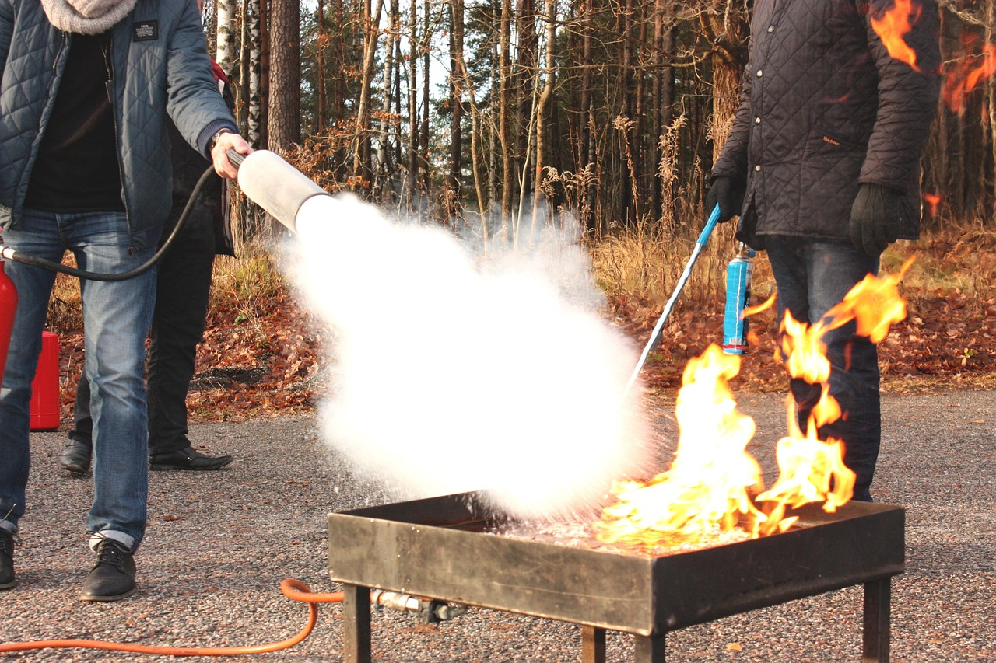
Safety Considerations and Classroom Environment
Classroom Rules for Respect and Inclusivity
Physical Safety in the Classroom
Emotional Safety for Sensitive Activities
Establish a set of classroom rules that promote respect, inclusivity, and active listening.
These rules should encourage positive interactions and create a supportive learning environment.
Ensure the physical safety of the classroom environment by removing hazards and providing enough space for activities.
This helps prevent accidents and allows students to engage comfortably in various tasks.
Consider the emotional safety of students, especially when sharing personal stories or engaging in role-playing that might touch on sensitive topics.
Creating a safe emotional space fosters trust and openness among students.
23
Mastering Communication: Strategies for Effective Engagement

Slide 24

Teaching Tips and Strategies
01
Active Participation
Encourage active participation and provide incentives for students to engage in activities.
This approach fosters engagement and helps students feel more involved in the learning process.
02
Visual and Real-Life Integration
Use visual aids and real-life scenarios to make the learning experience more relevant and engaging.
These methods help students connect theoretical concepts to practical applications.
03
Constructive Feedback
Provide constructive feedback that focuses on improvement rather than criticism.
This strategy supports student growth and encourages a positive learning environment.
04
Technology in Education
Incorporate technology to make the lesson more interactive and accessible.
Utilizing digital tools can enhance the learning experience and cater to diverse learning styles.
24
Mastering Communication: Strategies for Effective Engagement

Slide 25

Key Takeaways and Reflection Questions
Effective Communication through Storytelling
Reflection Questions for Lesson Evaluation
Adapting and Assessing Teaching Strategies
Developing effective communication skills in English through storytelling and role-playing is a multifaceted approach with numerous benefits.
This method engages students actively and fosters both linguistic and interpersonal skills.
Reflection questions can help teachers evaluate the lesson's effectiveness and identify areas for improvement.
These questions guide educators in assessing the impact of their teaching strategies.
Consider what strategies were most effective, how the lesson can be adapted for diverse learning needs, and what assessment methods can be used to evaluate student progress.
This ensures that the teaching approach remains inclusive and effective for all learners.
25
Mastering Communication: Strategies for Effective Engagement

