Slide 1

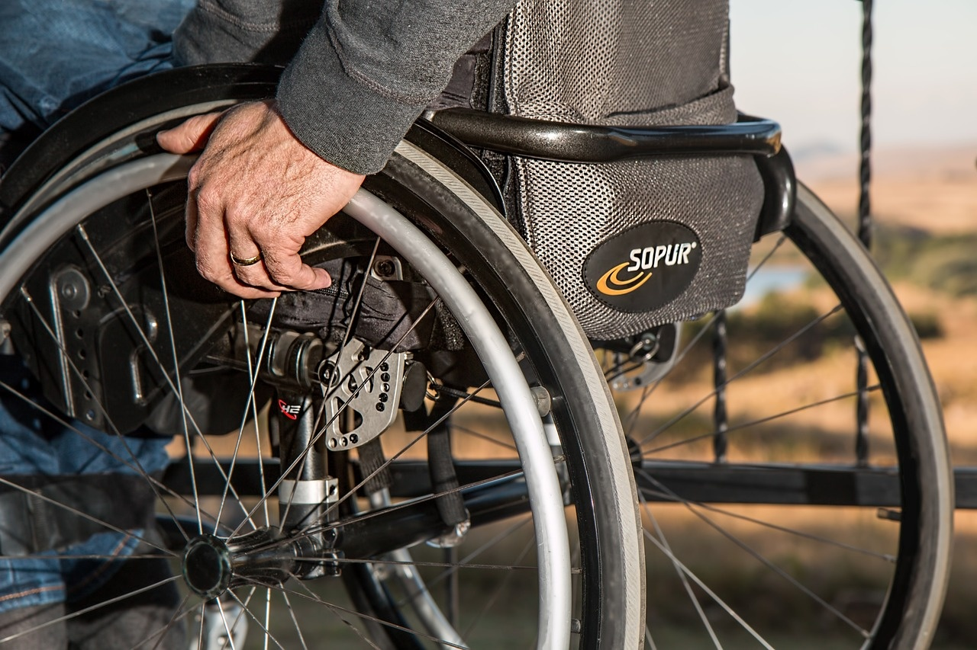
Empowering Elderly Residents: A Comprehensive Approach
Exploring Challenges, Solutions, and Future Directions for Enhanced Quality of Life

Slide 2
Table of contents
Introduction to Empowering Elderly Residents
Challenges Faced by Elderly Residents
Community Support Programs
Healthcare Access Improvement
Social Engagement Activities
Transportation Solutions
Case Study: Village X
Technology Integration
Volunteer Training Programs
SWOT Analysis of Empowerment Initiatives
Economic Impact of Empowerment
Policy Recommendations
Environmental Considerations
01
02
03
04
05
06
07
08
09
10
11
12
13

Slide 3
Table of contents
Success Stories
Intergenerational Programs
Milestones in Empowerment
Pyramid of Empowerment
Summary of Key Points
Future Directions
Conclusion
14
15
16
17
18
19
20

Slide 4
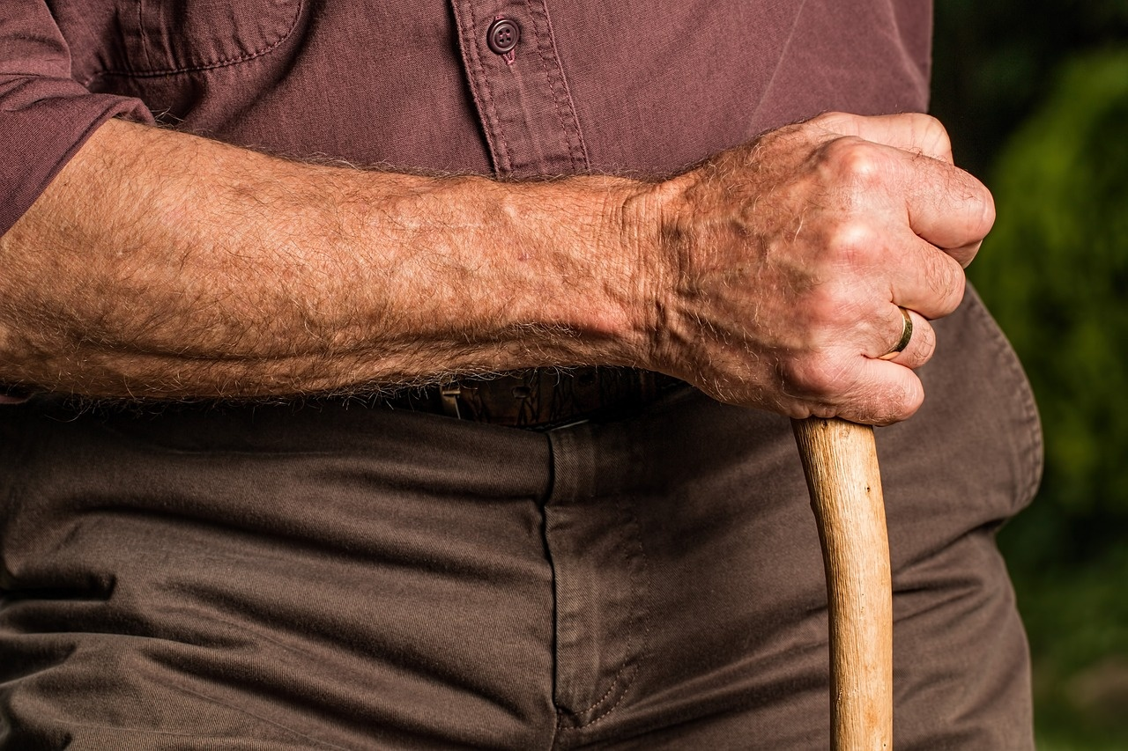
Introduction to Empowering Elderly Residents
Importance of Empowering Elderly Residents
Enhances Quality of Life
Promotes independence and self-esteem among elderly individuals.
Encourages active participation in community activities.
Empowering Elderly Residents: A Comprehensive Approach

Slide 5
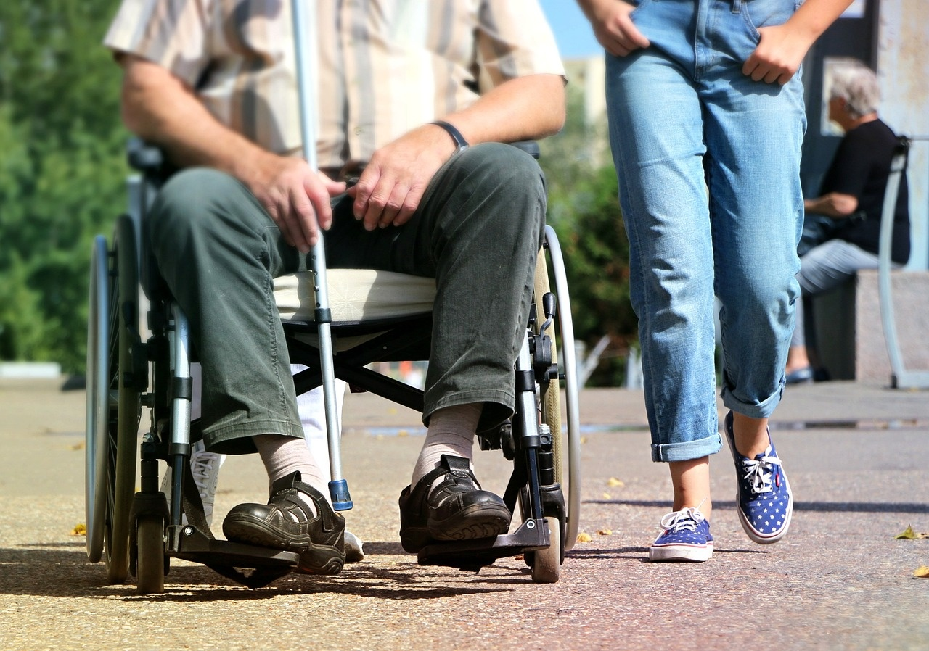
Challenges Faced by Elderly Residents
01
02
03
Social Isolation
Limited Access to Healthcare
Mobility Issues
Many elderly residents in small villages experience loneliness due to limited social interactions.
Example: Community programs that encourage regular gatherings can help foster connections.
Access to medical facilities and services is often restricted, leading to unmet health needs.
Example: Mobile health clinics can provide essential services directly to remote areas.
Physical limitations can hinder the ability to travel, impacting independence and access to resources.
Example: Implementing community transport services can enhance mobility for elderly residents.
Empowering Elderly Residents: A Comprehensive Approach

Slide 6
Community Support Programs
Identify Community Needs
Develop a Strategic Plan
Implement Support Initiatives
Evaluate and Adjust Programs
01
Conduct surveys and focus groups within small villages to assess the specific needs of elderly residents, such as transportation, healthcare access, and social engagement.
02
Create a comprehensive plan that outlines the goals, resources, and timelines for addressing the identified needs, ensuring community involvement in the planning process.
03
Launch targeted programs such as weekly social gatherings, transportation services, and health workshops, engaging local volunteers and organizations to facilitate these initiatives.
04
Regularly assess the effectiveness of the programs through feedback from participants and community members, making necessary adjustments to improve services and better meet the needs of elderly residents.
Empowering Elderly Residents: A Comprehensive Approach

Slide 7
Healthcare Access Improvement
Traditional Healthcare Access
Modern Telehealth Solutions
Limited Availability: Elderly residents in small villages often face long travel distances to reach healthcare facilities, with an average round trip of 30 miles, leading to missed appointments and delayed care.
Inflexible Hours: Many local clinics operate on strict schedules, making it difficult for elderly patients to access care outside of standard working hours, which can exacerbate health issues.
Convenient Access: Telehealth services allow elderly residents to consult with healthcare providers from the comfort of their homes, reducing travel time and increasing appointment adherence by up to 70%.
24/7 Availability: Telehealth platforms offer flexible scheduling, enabling elderly patients to receive care at any time, thus improving overall health management and timely interventions.
Empowering Elderly Residents: A Comprehensive Approach

Slide 8
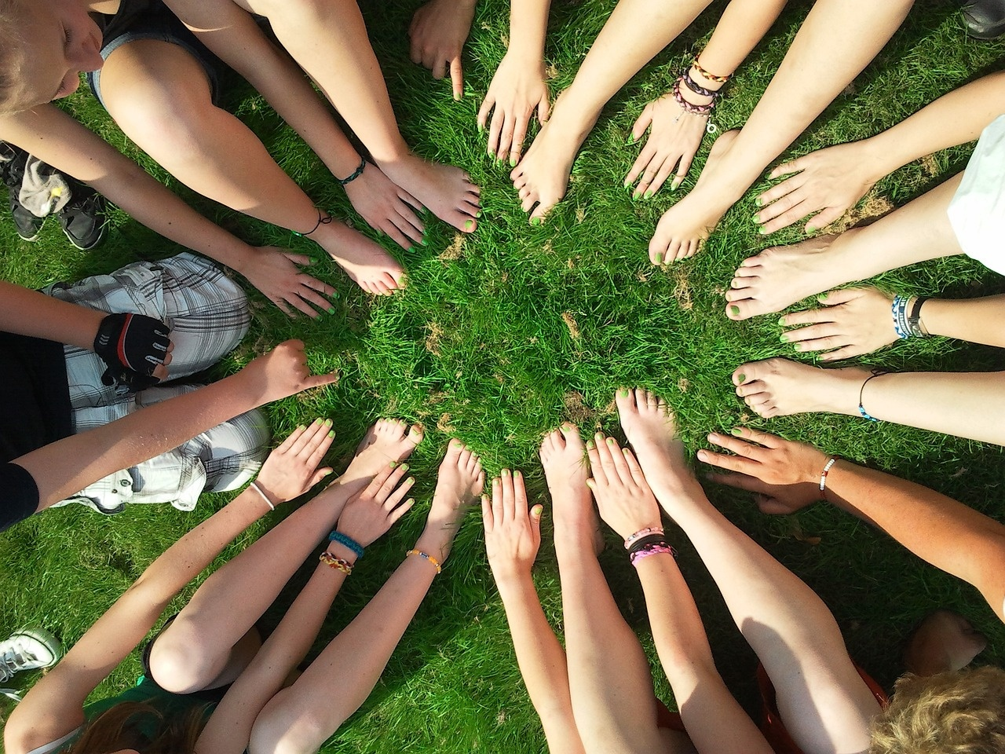
Social Engagement Activities
1
2
3
Community Gatherings
Hobby Clubs
Intergenerational Programs
Monthly village festivals to celebrate local culture and traditions.
Gardening club that meets weekly to share tips and grow plants together.
Partnership with local schools for storytelling sessions, fostering connections between youth and elderly.
4
5
Fitness and Wellness Classes
Art and Craft Workshops
Tai Chi sessions held twice a week to promote physical health and social interaction.
Monthly art classes where residents can express creativity and showcase their work in a community exhibition.
Empowering Elderly Residents: A Comprehensive Approach

Slide 9



Transportation Solutions
Assess Community Needs
Develop Tailored Transportation Options
Implement and Promote Services
Conduct surveys and focus groups within small villages to identify the specific transportation needs of elderly residents.
Determine frequency of travel, preferred destinations, and mobility challenges.
Create customized transportation solutions based on the assessment.
Options may include shuttle services, volunteer driver programs, or partnerships with local taxi services.
Ensure solutions cater to the unique needs of the elderly population.
Launch the transportation services with a community awareness campaign.
Utilize local events and social media to inform elderly residents about available options.
Provide information on schedules and how to access the services effectively.
Empowering Elderly Residents: A Comprehensive Approach

Slide 10
Case Study: Village X
2019: Launch of the Senior Support Program
2021: Digital Literacy Workshops
Initiated a program providing weekly health check-ups and social activities, benefiting over 100 seniors.
Implemented workshops attended by 75 seniors, enhancing their skills in using technology for communication and accessing services.
02
04
2018: Community Needs Assessment
2020: Establishment of the Elderly Advocacy Group
01
03
Conducted a comprehensive survey involving 150 elderly residents to identify key challenges and needs.
Formed a group of 20 elderly residents to represent their interests and facilitate communication with local authorities.
Empowering Elderly Residents: A Comprehensive Approach

Slide 11
Technology Integration
01
02
03
Smart Home Devices
Telehealth Services
Mobile Applications
Overview: Implementation of smart home technology to enhance safety and convenience.
Example: Smart sensors that alert caregivers when an elderly resident falls or requires assistance.
Overview: Utilizing telehealth platforms for remote medical consultations.
Example: Video calls with healthcare providers, reducing the need for travel, especially in small villages.
Overview: Development of user-friendly apps tailored for elderly users.
Example: Medication management apps that send reminders and track prescriptions, ensuring adherence to treatment plans.
Empowering Elderly Residents: A Comprehensive Approach

Slide 12
Volunteer Training Programs
Identify Community Needs
Develop Training Curriculum
Recruit and Train Volunteers
Implement and Evaluate Programs
01
Conduct surveys and focus groups in small villages to understand the specific needs of elderly residents, such as companionship, transportation, or assistance with daily activities.
02
Create a comprehensive training program that includes modules on communication skills, understanding elderly health issues, and effective engagement strategies tailored to the unique challenges faced by seniors in rural areas.
03
Launch a recruitment campaign targeting local community members, emphasizing the importance of volunteerism.
Organize training sessions to equip volunteers with the necessary skills and knowledge to support elderly residents effectively.
04
Roll out the volunteer programs in the community, ensuring regular check-ins and feedback sessions with both volunteers and elderly residents.
Use this feedback to continuously improve the training and support provided.
Empowering Elderly Residents: A Comprehensive Approach

Slide 13
SWOT Analysis of Empowerment Initiatives
Strengths
Weaknesses
Strong community ties and support networks among elderly residents, fostering a sense of belonging and mutual assistance.
Limited access to technology and digital literacy among elderly residents, hindering participation in modern empowerment programs.
SW
OT
Opportunities
Threats
Potential partnerships with local organizations and volunteers to create tailored workshops that enhance skills and promote social engagement.
Economic constraints and budget cuts in local government funding, which may reduce the availability of resources for empowerment initiatives.
Empowering Elderly Residents: A Comprehensive Approach

Slide 14
Economic Impact of Empowerment
Annual increase in local spending
Reduction in healthcare costs
Increase in volunteerism
€1.2 Million
25%
40%
Empowering elderly residents in small villages leads to an estimated €1.2 million increase in local spending, as seniors engage more in community activities and local businesses.
Communities that implement empowerment programs for the elderly experience a 25% reduction in healthcare costs, as active and engaged seniors tend to have better health outcomes.
Empowered elderly residents contribute to a 40% increase in volunteerism within their communities, fostering social cohesion and enhancing local services, which further stimulates the economy.
Empowering Elderly Residents: A Comprehensive Approach

Slide 15
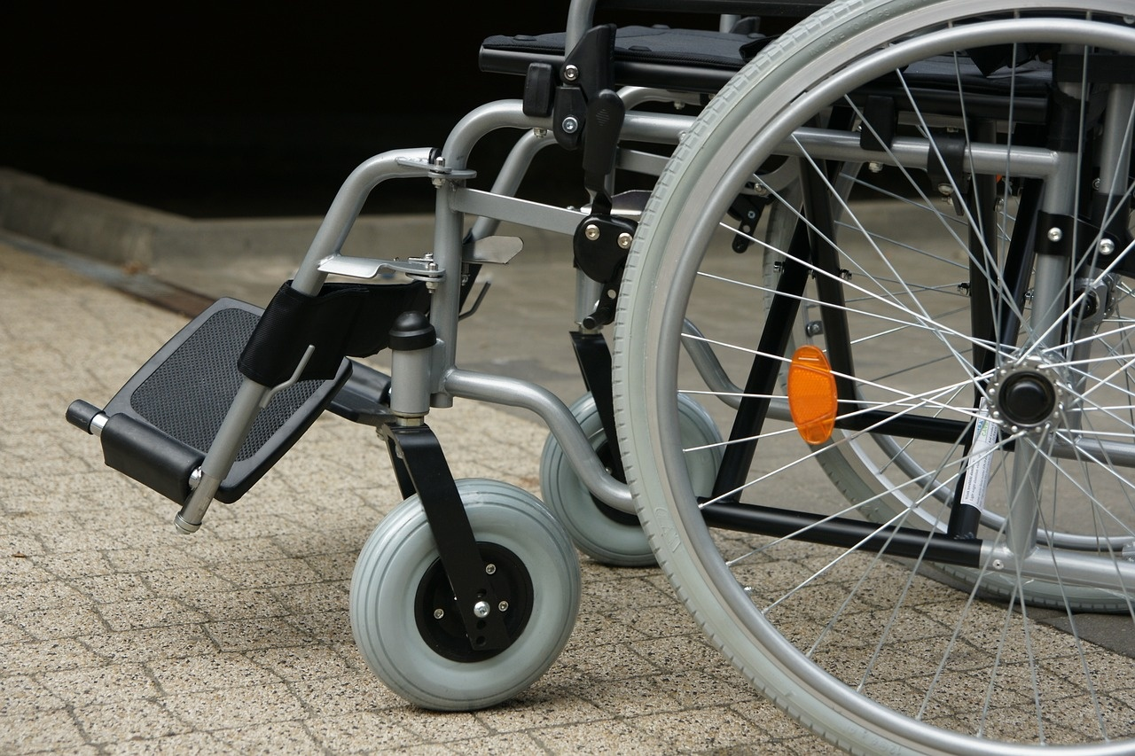
Policy Recommendations
01
02
Increase Funding for Elderly Programs
Enhance Infrastructure Accessibility
Allocate a minimum of 10% of local budgets to support initiatives aimed at elderly empowerment in small villages.
Implement universal design principles in public spaces to ensure mobility for elderly residents, including ramps and handrails in community centers.
01
02
Expand Healthcare Services
Promote Social Engagement Initiatives
Establish mobile health clinics that visit small villages bi-weekly, providing essential medical services and health education tailored for the elderly.
Create community programs that encourage intergenerational activities, such as mentorship programs between youth and elderly residents, fostering social connections and reducing isolation.
Empowering Elderly Residents: A Comprehensive Approach

Slide 16
Environmental Considerations
P
E
S
T
E
L
Political
Economic
Social
Technological
Environmental
Legal
Local government policies that support community development initiatives can enhance resources for elderly residents, such as funding for accessible transportation services.
Economic stability in small villages can lead to increased investment in local healthcare facilities, improving access to medical services for elderly residents.
Strong community networks and social programs can foster a sense of belonging and support for elderly residents, encouraging active participation in village life.
The introduction of telehealth services can empower elderly residents by providing them with easier access to healthcare consultations from their homes.
Sustainable practices, such as community gardens, can promote healthy eating and physical activity among elderly residents, enhancing their overall well-being.
Legislation that protects the rights of elderly residents, such as anti-discrimination laws, can ensure they receive fair treatment and access to necessary services in their communities.
Empowering Elderly Residents: A Comprehensive Approach

Slide 17
Success Stories
01
02
03
Community Gardening Initiative
Digital Literacy Workshops
Intergenerational Mentorship Program
Empowered elderly residents in the village of Agios Nikolaos to cultivate their own gardens.
Resulted in a 30% increase in physical activity and improved mental well-being among participants.
Launched in the village of Kato Karyes, focusing on teaching seniors how to use smartphones and the internet.
Over 50 seniors completed the program, leading to enhanced social connections and access to online services.
Implemented in the village of Palaiochora, pairing elderly residents with local youth for skill-sharing.
Fostered a sense of purpose for seniors and improved community cohesion, with 80% of participants reporting increased satisfaction in life.
Empowering Elderly Residents: A Comprehensive Approach

Slide 18
Intergenerational Programs
Intergenerational Programs
Traditional Elderly Care Programs
Foster relationships between elderly residents and younger generations
Promote mutual learning and support
Example: Local schools partner with senior centers for shared activities
Activities like gardening or storytelling reduce feelings of isolation by 40%
Focused on providing care and assistance
Often lack social interaction opportunities
Ensure basic needs are met
60% of elderly individuals report feelings of isolation in traditional care settings
Empowering Elderly Residents: A Comprehensive Approach

Slide 19
Milestones in Empowerment
2015
2017
2019
2021
2023
Launch of Community Engagement Programs: Initiated programs in small villages aimed at fostering social connections among elderly residents, enhancing their sense of belonging and community involvement.
Establishment of Health and Wellness Workshops: Introduced regular workshops focusing on physical health, mental well-being, and nutrition, empowering elderly residents to take charge of their health.
Implementation of Technology Training Sessions: Launched training sessions to help elderly residents learn to use smartphones and computers, bridging the digital divide and promoting independence.
Creation of Volunteer Support Networks: Developed a network of volunteers to assist elderly residents with daily tasks, ensuring they receive the support needed to maintain their independence at home.
Expansion of Transportation Services: Expanded accessible transportation options for elderly residents in small villages, facilitating their mobility and access to essential services and social activities.
Empowering Elderly Residents: A Comprehensive Approach

Slide 20
Pyramid of Empowerment
Community Leadership Development
Social Engagement Opportunities
Access to Healthcare Services
Basic Needs Fulfillment
Safety and Security Measures
Empowering Elderly Residents: A Comprehensive Approach

Slide 21
Summary of Key Points
Community Engagement Initiatives
Access to Healthcare Services
Transportation Solutions
Implementing local programs that encourage elderly residents to participate in community activities fosters social connections and reduces isolation.
Ensuring that elderly residents have easy access to healthcare facilities, including mobile clinics, significantly improves their overall well-being.
Developing reliable transportation options for elderly residents in small villages enhances their mobility and independence, allowing them to attend appointments and social events.
Technology Training Programs
Support Networks
Offering training sessions on digital tools empowers elderly residents to stay connected with family and access online resources, bridging the technology gap.
Establishing support groups for elderly residents provides a platform for sharing experiences and resources, promoting mental health and resilience within the community.
Empowering Elderly Residents: A Comprehensive Approach

Slide 22

Future Directions
01
02
03
Innovative Community Programs
Enhanced Accessibility Solutions
Holistic Health and Wellness Initiatives
Development of intergenerational programs that connect elderly residents with local youth for skill-sharing and companionship.
Example: A 'Tech Buddy' initiative in small villages where young volunteers teach seniors how to use smartphones and social media.
Implementation of smart home technologies to assist elderly residents in daily activities and improve safety.
Example: Installing voice-activated systems in homes to help seniors manage tasks independently.
Promotion of mental health resources and physical activity programs tailored for the elderly.
Example: Organizing weekly community exercise classes in village centers, focusing on low-impact activities suitable for seniors.
Empowering Elderly Residents: A Comprehensive Approach

Slide 23
Conclusion
Enhancing Quality of Life
Fostering Independence
Strengthening Community Bonds
Empowering elderly residents in small villages significantly improves their overall well-being and quality of life through community engagement and support.
Initiatives that promote independence, such as skill-building workshops, enable elderly individuals to maintain autonomy and actively participate in their communities.
By involving elderly residents in decision-making processes, communities foster stronger relationships and create a more inclusive environment that benefits all age groups.
Empowering Elderly Residents: A Comprehensive Approach

