Slide 1

Connecting Through Language
Exploring Greetings, Introductions, Pronouns, and Family Bonds

Slide 2
Table of contents
01
02
03
04
05
06
07
08
09
10
11
Title Slide: Greetings, Introductions & Family
Warm-Up Slide: Let's Meet Each Other!
Slide 1: Common Greetings
Slide 2: Making Introductions
Slide 3: Personal Pronouns
Slide 4: Family Members
Activity 1: Greeting Chain
Activity 2: Pronoun Points
Activity 3: Family Match
Gaming Activity: Family Feud Style Quiz
Reflection 1: What We Learned

Slide 3
Table of contents
12
13
14
15
Reflection 2: Self-Assessment
Next Steps 1: Practice at Home
Next Steps 2: Coming Up Next
Homework Assignment: Create Your Introduction Video!

Slide 4

1
Title Slide: Greetings, Introductions & Family
Greetings, Introductions & Family
Interactive Online English Lesson - 60 Minutes
Connecting Through Language

Slide 5

2
Warm-Up Slide: Let's Meet Each Other!
Let's Meet Each Other!
Students take turns unmuting to say 'Hi, I'm [name]'
Teacher demonstrates with enthusiasm
Quick poll: 'How many ways to say hello do you know?'
Include animated waving hand emoji
Connecting Through Language

Slide 6

3
Slide 1: Common Greetings
Common Greetings
Hello / Hi
Good morning/afternoon/evening
Hey there!
Connecting Through Language

Slide 7

4
Slide 2: Making Introductions
01
Introduction Phrases
02
Dialogue Examples
I am...
My name is...
Nice to meet you
Person A: "Hi, I'm Sarah." Person B: "Nice to meet you, Sarah. I'm Alex."
Person A: "My name is John." Person B: "Hello, John. How are you?"
03
Interactive Practice
Pair up with a classmate
Take turns introducing yourselves
Use the phrases learned
Connecting Through Language

Slide 8

5
Slide 3: Personal Pronouns
I
Used when referring to oneself.
You
Used when addressing someone directly.
He
Used when referring to a male.
She
Used when referring to a female.
It
Used when referring to a non-human or neutral gender.
Connecting Through Language

Slide 9

6
Slide 4: Family Members
Family Members
Mother/Father
Sister/Brother
Grandmother/Grandfather
Connecting Through Language

Slide 10
7
Activity 1: Greeting Chain
01
02
03
04
05
Step 1
Step 2
Step 3
Step 4
Step 5
Students form a virtual chain.
Each student greets the next person.
Different greeting used each time.
Encourages variety in greetings.
Promotes interactive communication.
Connecting Through Language

Slide 11

8
Activity 2: Pronoun Points
Display Family Photos
Teacher shows various family photos to the class.
Practice Pronouns
Students identify and use correct pronouns for each family member.
Quick Response Format
Interactive learning through quick response exercises.
Apply Pronouns in Sentences
Students create sentences using the correct pronouns.
Encourage Participation
Promote quick thinking and active participation among students.
Connecting Through Language

Slide 12
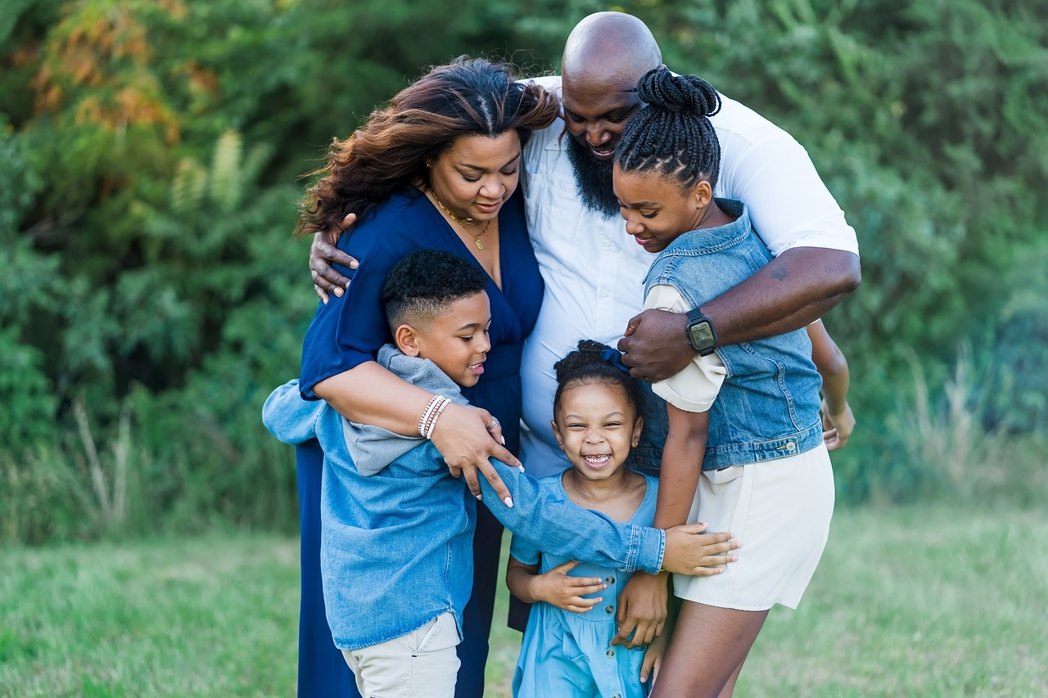
9
Activity 3: Family Match
01
Activity 3: Family Match
02
1. Match the following family words to the pictures:
- Mother
- Father
- Sister
- Brother
- Grandmother
- Grandfather
2. Students will work in pairs via breakout rooms to match the family words to the corresponding pictures.
03
3. After completing the activity, pairs will share their answers in the main room for discussion.
Connecting Through Language

Slide 13
10
Gaming Activity: Family Feud Style Quiz
2
15
All
Points
Teams
Minutes
Topics
Awarded
Class split into two teams for the quiz.
Duration of the Family Feud style quiz.
Questions cover all topics including greetings, introductions, personal pronouns, and family members.
Points are awarded for correct answers.
Connecting Through Language

Slide 14
11
Reflection 1: What We Learned
01
02
03
04
Key Vocabulary
Common Phrases
Important Points
Takeaways
Greetings: Hello, Hi, Good morning/afternoon/evening, Hey there
Introductions: I am..., My name is..., Nice to meet you, How are you?
Personal Pronouns: I, You, He, She, It, We, They
Family Members: Mother/Father, Sister/Brother, Grandmother/Grandfather
Practice using greetings and introductions in different scenarios
Understand the usage of personal pronouns in sentences
Identify and name different family members accurately
Building connections through language
Showing respect and politeness through greetings
Understanding relationships and connections within a family
Enhancing communication skills in English
Appreciating the significance of language in connecting with others
Setting a foundation for further language learning opportunities
Connecting Through Language

Slide 15
12
Reflection 2: Self-Assessment
01
02
03
Greeting Skills Evaluation
Pronoun Proficiency Check
Family Member Identification
Can I greet others confidently using different expressions?
Have I practiced various ways to say hello effectively?
Do I understand and use personal pronouns correctly in sentences?
Can I differentiate between different pronouns and apply them accurately?
Am I able to name and describe different family members in English?
Have I practiced using family-related vocabulary in conversations?
Connecting Through Language

Slide 16

13
Next Steps 1: Practice at Home
01
Watch English videos
02
Practice with family
Explore educational content on platforms like YouTube or language learning websites.
Focus on listening comprehension and mimic native speakers' pronunciation.
Engage in daily conversations with family members in English.
Practice greetings, introductions, and using personal pronouns in context.
03
Use new vocabulary daily
Create flashcards with new words and review them regularly.
Incorporate vocabulary into daily activities and conversations for reinforcement.
Connecting Through Language

Slide 17

14
Next Steps 2: Coming Up Next
Advanced Greetings
Learn formal and informal greetings
Practice cultural variations in greetings
Explore idiomatic expressions for greetings
Family Relationships
Study extended family terms
Discuss roles within the family
Understand cultural differences in family structures
Conversation Practice
Engage in role-playing scenarios
Practice dialogues with classmates
Receive feedback on conversational skills
Connecting Through Language

Slide 18
15
Homework Assignment: Create Your Introduction Video!
Write a Script
Recording Guidelines
Template for Script Writing
1
2
3
Introduce yourself with enthusiasm. Include at least 3 family members. Use greetings and pronouns learned.
Record a 1-2 minute video. Ensure clear audio and video quality. Practice before recording.
"Hi! I'm _______ I want to introduce my family. This is my _______ (he/she)... That is my _______ (he/she)..."
Connecting Through Language

