Slide 1












Exploring Marxist Perspectives on Education
A Critical Analysis of Power Structures, Social Inequalities, and Knowledge Transmission in Educational Institutions

Slide 2

Table of contents
Understanding Marxist Perspectives on Education
Lesson Introduction
Subject Knowledge
Marxist Theoretical Framework
Critical Analysis of Education
Social Institution
Power Structures
Relationship Between Education and Social Class
Economic Reproduction
Function of Educational Institutions
01
02
03
04
05
06
07
08
09
10

Slide 3
Table of contents
Capitalist Societies
Critical Thinking about Education
Dynamic Social Mechanism
Social Inequalities
Traditional Narratives about Education
Alternative Perspectives on Learning
Knowledge Transmission
Social Mobility
Karl Marx's Views on Education
Challenging Students to Examine Educational Systems
11
12
13
14
15
16
17
18
19
20

Slide 4



Understanding Marxist Perspectives on Education
Marxist Theoretical Framework
Social Class and Education
Economic Reproduction
Critical Examination
Key Takeaways
Marx viewed education as a tool used by the ruling class to maintain their power and perpetuate inequality.
Education is seen as a means of reproducing the existing class structure, with the dominant ideology of the ruling class being taught to students.
Marxists argue that education serves to reproduce the capitalist economic system by preparing students for their future roles in the workforce.
Students are encouraged to critically analyze how educational systems reflect and perpetuate societal power structures, fostering a deeper understanding of the role of education in society.
Education is not a neutral space but a dynamic social mechanism that reflects and potentially transforms social inequalities.
Questioning traditional narratives about education's purpose can lead to exploring alternative perspectives on learning, knowledge transmission, and social mobility.
01
02
03
04
05
Exploring Marxist Perspectives on Education

Slide 5

Lesson Introduction
Comprehensive Lesson
Critical Examination
Explores Karl Marx's critical analysis of education as a social institution.
Challenging students to critically examine how educational systems reflect and perpetuate societal power structures.
Complex Relationship
Nuanced Understanding
Critical Thinking
Unpacking the complex relationship between education, social class, and economic reproduction.
Developing a nuanced understanding of how educational institutions function within capitalist societies.
Provoking critical thinking about education not as a neutral space, but as a dynamic social mechanism.
Exploring Marxist Perspectives on Education

Slide 6

Subject Knowledge
Marxist Theoretical Framework
Social Class and Education
Knowledge Production and Ideology
Marx viewed education as a tool used by the ruling class to maintain their power and perpetuate inequality.
He believed that the education system serves to reproduce the existing social hierarchy by shaping individuals' beliefs and values in alignment with capitalist interests.
According to Marx, education plays a crucial role in legitimizing the unequal distribution of wealth and resources in society.
Marxist perspective emphasizes the role of social class in shaping educational opportunities and outcomes.
Working-class students are often disadvantaged within the education system, facing barriers such as limited access to resources and opportunities for advancement.
The reproduction of social class inequalities through education contributes to the perpetuation of a stratified society.
Marxists argue that knowledge production is influenced by the dominant ideology of the ruling class.
Educational curricula and materials are often designed to promote the values and beliefs that support the capitalist system.
Critical pedagogy seeks to challenge dominant ideologies and empower students to question and critique the status quo.
Exploring Marxist Perspectives on Education

Slide 7

Marxist Theoretical Framework
Historical Materialism
Base and Superstructure
Marx's theory that social structures and relationships are shaped by economic factors.
The economic base (means of production) determines the superstructure (institutions like education) in society.
Ideological State Apparatus
Alienation
Class Struggle
Education is seen as a tool used by the ruling class to maintain their power and perpetuate capitalist ideology.
Marx's concept of individuals feeling disconnected from their work and the products of their labor, which can be reflected in the education system.
The ongoing conflict between the bourgeoisie (owners of the means of production) and the proletariat (working class) influences education policies and practices.
Exploring Marxist Perspectives on Education

Slide 8
Critical Analysis of Education
Marxist Theoretical Framework
Social Reproduction Theory
Ideological State Apparatus
Hidden Curriculum
01
Marx viewed education as a tool used by the ruling class to maintain power and perpetuate social inequalities.
02
Education plays a crucial role in reproducing existing social structures and inequalities by preparing students for specific social roles based on their social class.
03
According to Marxist theory, educational institutions function as part of the state apparatus to indoctrinate students with the dominant ideology of the ruling class.
04
The hidden curriculum refers to the implicit lessons taught in schools that reinforce societal norms, values, and power dynamics, often favoring the dominant social groups.
Exploring Marxist Perspectives on Education

Slide 9
Social Institution
Role of Education in Social Reproduction
Power Dynamics in Educational Systems
Influence of Social Class on Educational Opportunities
01
Education serves as a mechanism for reproducing existing social structures and inequalities.
02
Examination of how power dynamics influence decision-making processes within educational institutions.
03
The impact of social class on access to quality education and opportunities for social mobility.
Exploring Marxist Perspectives on Education

Slide 10

Power Structures
Economic Power
Social Class Division
Ideological Control
In Marxist theory, economic power is central to understanding societal power structures.
Education plays a role in perpetuating social class divisions by providing unequal opportunities based on economic status.
Educational institutions can serve as tools for the ruling class to maintain ideological control over the masses.
Exploring Marxist Perspectives on Education

Slide 11
Relationship Between Education and Social Class
STRENGTHS
WEAKNESSES
Education as a tool for social mobility
Potential for critical consciousness and societal transformation
Reproduction of social inequalities
Emphasis on conformity and obedience to authority
S
W
OPPORTUNITIES
THREATS
O
T
Potential for education to challenge dominant ideologies
Spaces for alternative educational models promoting equity
Co-optation of education by capitalist interests
Reinforcement of class divisions through unequal access to quality education
Exploring Marxist Perspectives on Education

Slide 12
Economic Reproduction
Marxist Theoretical Framework
Social Class Reproduction
Role of Education in Economic Reproduction
01
Marx viewed education as a tool used by the ruling class to maintain their power and perpetuate the existing social and economic structures.
02
Education plays a crucial role in reproducing social class divisions by providing different levels of quality and access based on socioeconomic status.
03
Educational systems contribute to the reproduction of economic inequalities by preparing students for specific roles in the workforce based on their social background.
Exploring Marxist Perspectives on Education

Slide 13

Function of Educational Institutions
Social Reproduction
Ideological Control
Educational institutions play a crucial role in reproducing social inequalities by perpetuating existing class structures and power dynamics.
They serve as a tool for the ruling class to maintain control over the working class by shaping beliefs, values, and attitudes that align with the interests of the dominant group.
Economic Integration
Legitimization of Inequality
Class Consciousness
Educational systems prepare individuals for their future roles in the capitalist economy, providing the necessary skills and knowledge to contribute to the workforce.
By promoting meritocracy and individual achievement, educational institutions justify and legitimize the unequal distribution of resources and opportunities in society.
Marxist perspectives argue that education can also be a site for fostering critical consciousness among students, potentially leading to social change and resistance against oppressive structures.
Exploring Marxist Perspectives on Education

Slide 14

Capitalist Societies
Private Ownership of Means of Production
Profit-Driven Economic System
Wage Labor and Exploitation
Social Class Hierarchies
Emphasis on Individualism and Competition
Exploring Marxist Perspectives on Education

Slide 15
Critical Thinking about Education
Questioning Traditional Narratives
Exploring Alternative Perspectives
Analyzing Power Dynamics
Promoting Social Transformation
01
Encourage students to challenge conventional beliefs about the purpose and function of education in society.
02
Prompt students to explore diverse viewpoints on learning, knowledge transmission, and social mobility within educational systems.
03
Guide students in critically examining how educational institutions reflect and perpetuate societal power structures.
04
Inspire students to consider how education can be a catalyst for challenging and potentially transforming social inequalities.
Exploring Marxist Perspectives on Education

Slide 16

Dynamic Social Mechanism
Interconnected Systems
Reproduction of Inequalities
Education operates within a web of interconnected social, economic, and political systems, influencing and being influenced by societal dynamics.
Educational institutions can perpetuate existing social inequalities by reproducing class divisions and reinforcing power structures.
Potential for Transformation
Critical Reflection
Alternative Perspectives
Despite its role in maintaining the status quo, education also holds the potential to be a transformative force, challenging existing power dynamics and fostering social change.
Encouraging critical reflection on the purpose and function of education can lead to a deeper understanding of its role as a dynamic social mechanism.
Exploring alternative perspectives on education can offer insights into how it can be reimagined to promote equity, social justice, and empowerment.
Exploring Marxist Perspectives on Education

Slide 17

Social Inequalities
Structural Inequities
Access Disparities
Education system perpetuates and reinforces existing social hierarchies.
Unequal distribution of resources leads to disparities in educational opportunities.
Structural Inequities
Access Disparities
Education system perpetuates and reinforces existing social hierarchies.
Unequal distribution of resources leads to disparities in educational opportunities.
Exploring Marxist Perspectives on Education

Slide 18

Traditional Narratives about Education
Education as a Meritocracy
The belief that academic success is solely based on individual effort and ability.
Social Mobility through Education
The idea that education provides equal opportunities for all to improve their social and economic status.
Neutral Transmission of Knowledge
The notion that educational institutions are impartial entities focused solely on imparting knowledge.
Education as a Path to Success
The narrative that education is the key to achieving personal and professional success.
Exploring Marxist Perspectives on Education

Slide 19
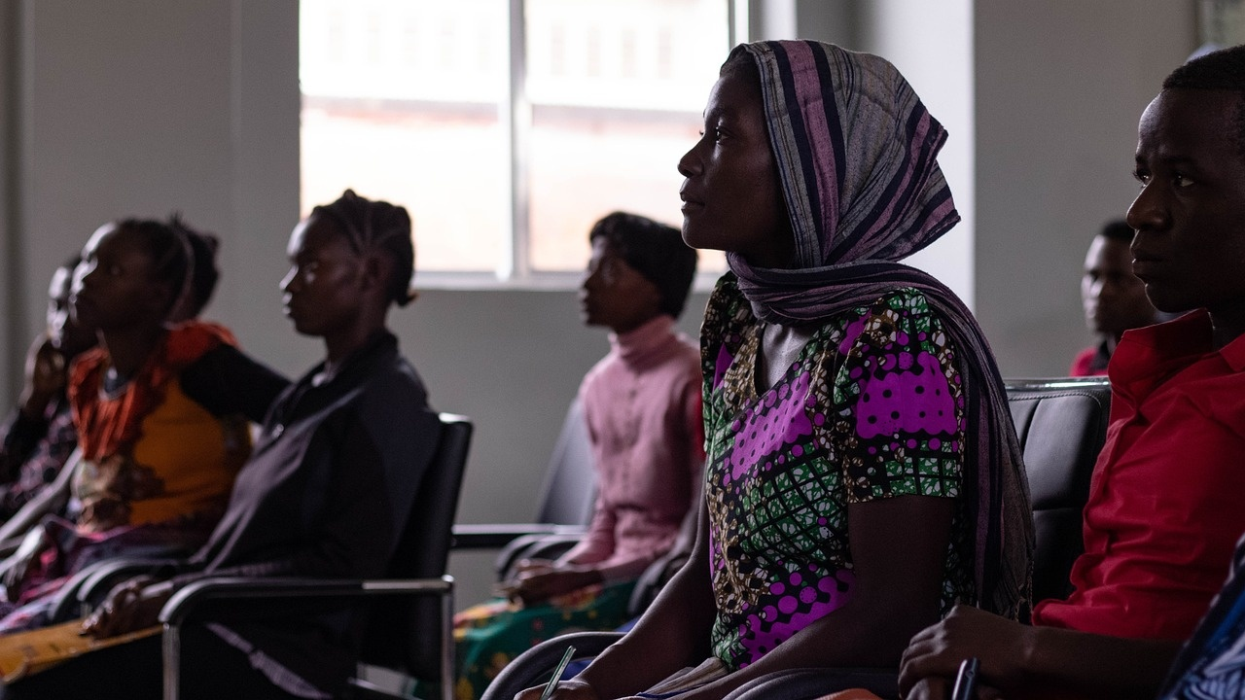
Alternative Perspectives on Learning
Critical Pedagogy
Freirean Approach
Emphasizes the importance of questioning societal norms and power structures within the educational system.
Based on the work of Paulo Freire, this approach focuses on dialogue, critical thinking, and empowerment of students.
Decolonizing Education
Feminist Pedagogy
Queer Theory in Education
Advocates for challenging colonial legacies in education, centering indigenous knowledge, and promoting cultural diversity.
Highlights the intersection of gender, race, and class in education, aiming to create inclusive and equitable learning environments.
Explores how LGBTQ+ perspectives can enrich educational practices and challenge heteronormative assumptions.
Exploring Marxist Perspectives on Education

Slide 20
Knowledge Transmission
STRENGTHS
WEAKNESSES
Marxist perspective on education highlights the role of social structures and power dynamics in shaping educational systems.
Provides a critical lens to analyze how education perpetuates societal inequalities and class divisions.
Critics argue that Marxist views on education oversimplify the complexities of educational institutions and their functions.
Some may find Marxist analysis too focused on economic factors, overlooking other important aspects of education.
S
W
OPPORTUNITIES
THREATS
O
T
Offers opportunities for reimagining education as a tool for social change and liberation from oppressive structures.
Encourages discussions on alternative educational models that prioritize equity and social justice.
Faces opposition from traditional educational paradigms and institutions resistant to challenging the status quo.
Risk of marginalization and dismissal within mainstream educational discourse, limiting the impact of Marxist perspectives on education.
Exploring Marxist Perspectives on Education

Slide 21

Social Mobility
Definition of Social Mobility
Marxist Perspective on Social Mobility
Social mobility refers to the ability of individuals or groups to move within or between social strata in a society, often based on factors such as education, occupation, and income.
Marxists argue that social mobility within capitalist societies is limited and often serves to maintain the existing class structure, rather than truly allowing for upward mobility for all individuals.
Definition of Social Mobility
Marxist Perspective on Social Mobility
Social mobility refers to the ability of individuals or groups to move within or between social strata in a society, often based on factors such as education, occupation, and income.
Marxists argue that social mobility within capitalist societies is limited and often serves to maintain the existing class structure, rather than truly allowing for upward mobility for all individuals.
Exploring Marxist Perspectives on Education

Slide 22
Karl Marx's Views on Education
Marxist Theoretical Framework
Role of Education in Capitalist Societies
Critique of Bourgeois Education
Emphasis on Social Transformation
01
Marx viewed education as a tool used by the ruling class to maintain power and control over the working class.
02
Education, according to Marx, serves to reproduce the existing class structure and perpetuate inequalities by providing unequal opportunities based on social class.
03
Marx criticized bourgeois education for promoting individualism, competition, and the values of the capitalist system, rather than fostering critical thinking and social change.
04
Marx believed that education should be a means of empowering the working class to challenge and ultimately overthrow the capitalist system, leading to a more equitable society.
Exploring Marxist Perspectives on Education

Slide 23

Challenging Students to Examine Educational Systems
Critical Analysis of Education
Social Class and Economic Reproduction
Encouraging students to critically analyze how educational systems reflect and perpetuate societal power structures.
Exploring the intricate relationship between education, social class, and the reproduction of economic inequalities.
Critical Analysis of Education
Social Class and Economic Reproduction
Encouraging students to critically analyze how educational systems reflect and perpetuate societal power structures.
Exploring the intricate relationship between education, social class, and the reproduction of economic inequalities.
Exploring Marxist Perspectives on Education

