Slide 1

Expressing Identity Through Fashion
A Journey into Descriptive Language and Personal Style

Slide 2


Table of contents
Introduction to Describing Myself and My Favorite C…
Why is Descriptive Language Important?
Basic Descriptive Vocabulary
Sentence Building
Describing My Favorite Clothes
Activity 1: Describe Your Favorite Outfit
Activity 2: Clothing Charades
Activity 3: My Favorite Clothes Sorting Game
Conclusion
Assessment
Extension Activity: Fashion Design
Extension Activity: Clothes-themed Story
Parent Engagement
01
02
03
04
05
06
07
08
09
10
11
12
13

Slide 3
Table of contents
Safety Considerations
Conclusion and Next Steps
Reflection Questions
Final Thoughts
Additional Resources
Credits and References
End of Presentation
14
15
16
17
18
19
20

Slide 4
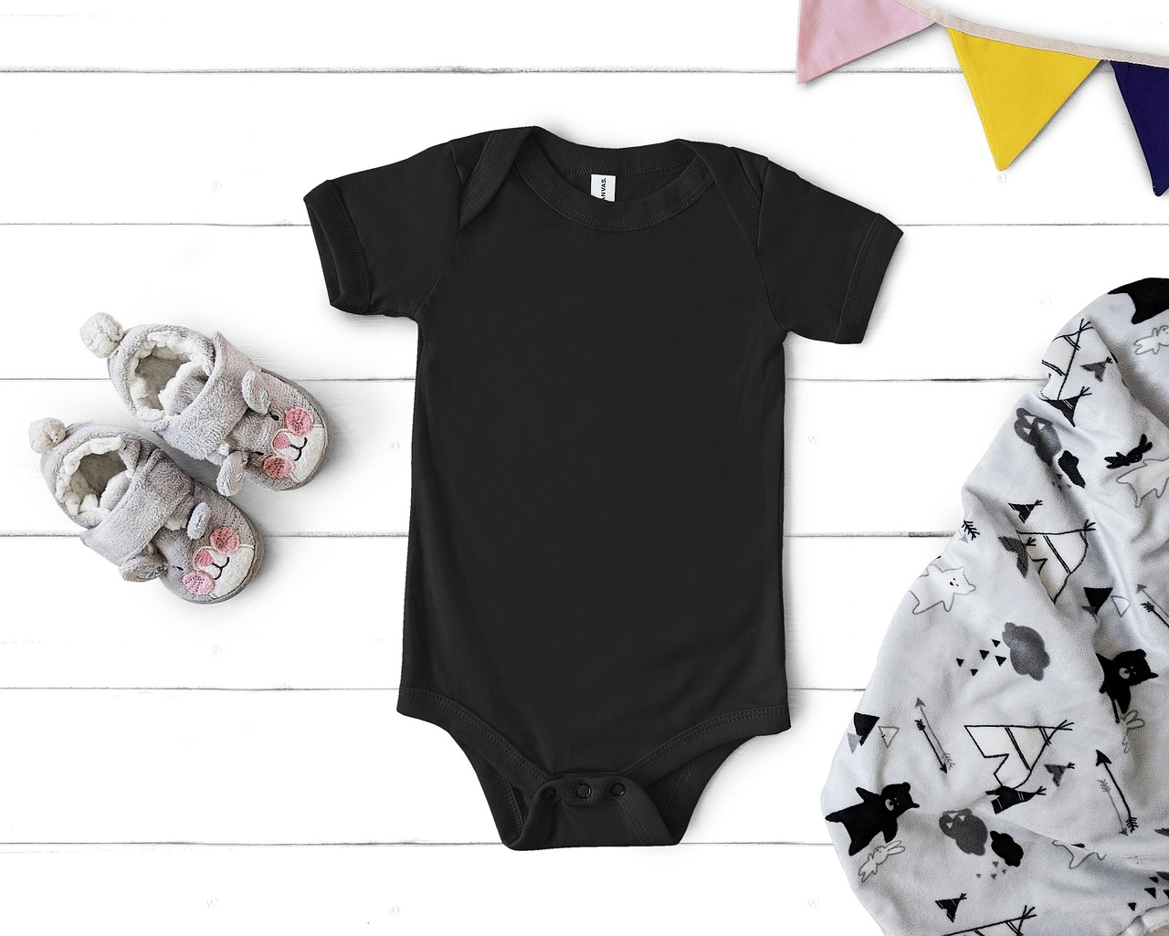
Introduction to Describing Myself and My Favorite Clothes
Descriptive Language
Fun Activities
Favorite Clothes
Descriptive language clarifies our thoughts.
It helps us paint a vivid picture with words.
We will engage in games that make learning enjoyable.
These activities reinforce our understanding.
Discussing favorite clothes shows our personality.
Sharing favorite clothes helps us express our style.
1
Expressing Identity Through Fashion

Slide 5
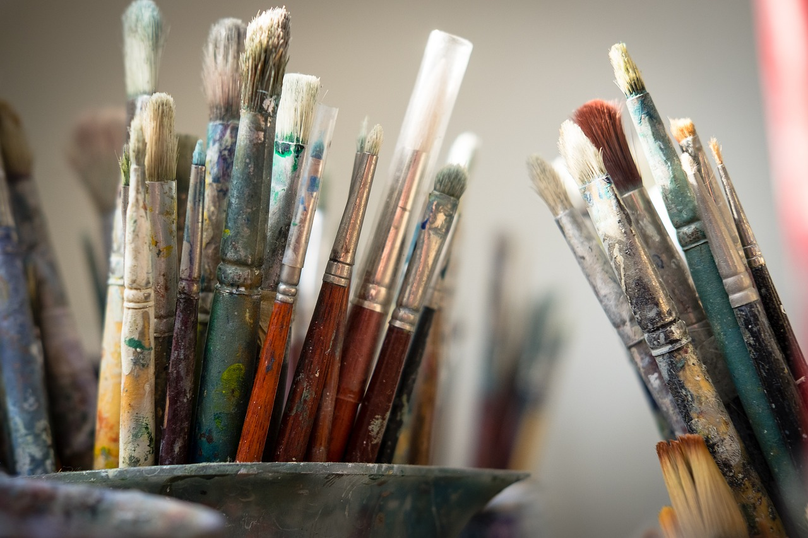
Why is Descriptive Language Important?
Engaging Conversations
Expressing Emotions
Vivid Imagery
Descriptive language enriches dialogue by creating vivid mental images.
This approach transforms mundane exchanges into captivating stories.
Descriptive language allows us to share our feelings with clarity and depth.
For example, recalling the warmth of a cherished sweater can evoke nostalgia and connection.
Using descriptive language helps the audience visualize ideas more effectively.
It turns abstract concepts into relatable experiences, enhancing understanding.
2
Expressing Identity Through Fashion

Slide 6
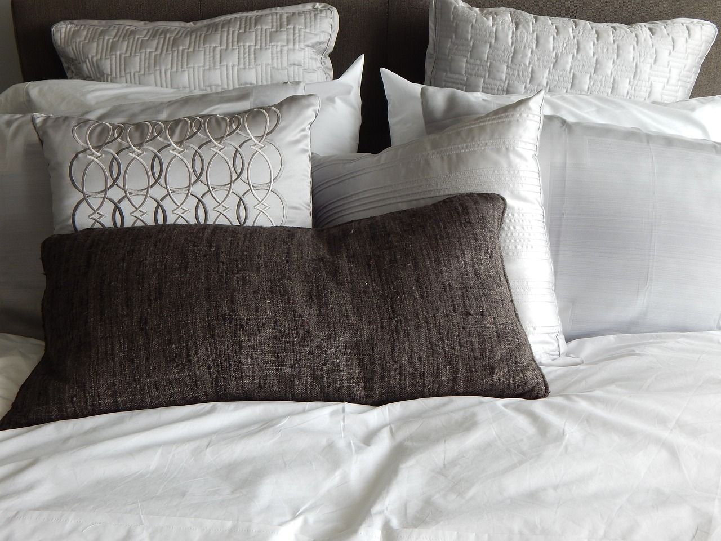
Basic Descriptive Vocabulary
Colorful
Comfortable
Stylish
The color palette is lively and energetic.
It brings excitement to any environment.
The space feels warm and inviting.
It encourages relaxation and ease.
The design is modern and sophisticated.
It reflects a sense of elegance and taste.
Bright
Joyful
The lighting is vibrant and enhances visibility.
It creates an uplifting atmosphere throughout the space.
The overall vibe is positive and uplifting.
It fosters a sense of happiness and contentment.
3
Expressing Identity Through Fashion

Slide 7
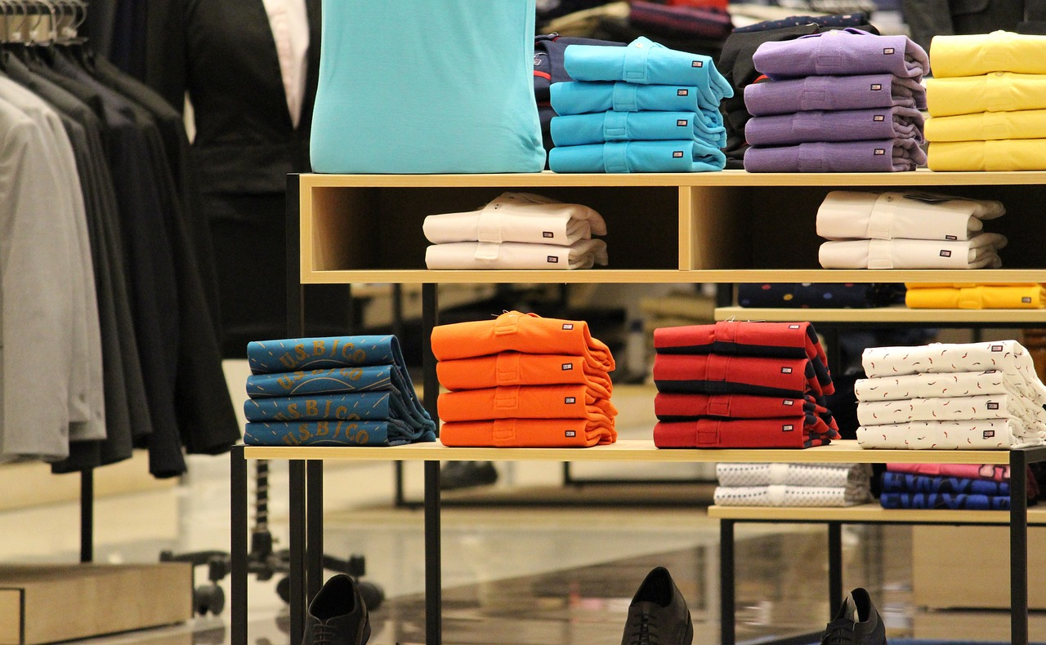
Sentence Building
Favorite Thing
Wearing Style
Sentence Creation
My favorite food is pizza.
I love it because I can customize it with toppings like spicy sausage or fresh basil.
I love wearing my sneakers because they're so comfortable.
I often wear them when I'm out with friends or running errands.
We can use sentence stems to create our own sentences!
For example, 'I believe that pizza is the best food because...' is a great way to start.
4
Expressing Identity Through Fashion

Slide 8
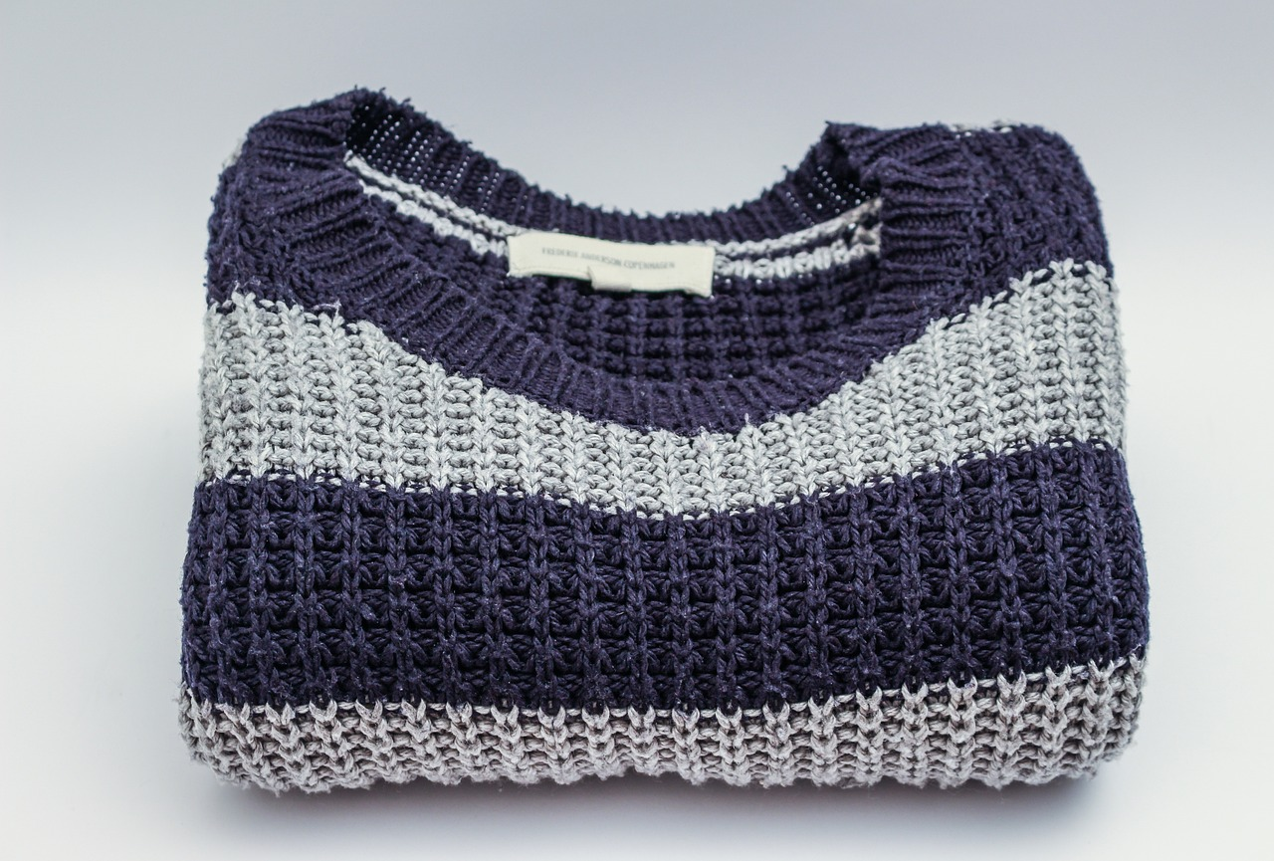
Describing My Favorite Clothes
Unique Features
Descriptive Language
Sharing Moments
My favorite clothes are crafted from soft, breathable fabric that combines comfort with style.
The vibrant patterns are inspired by nature, making each piece a unique expression of art.
The rich colors of my favorite shirt instantly lift my mood, creating a cheerful vibe.
Delicate stitching and thoughtful details enhance the overall elegance of the outfit.
Wearing my favorite outfit often leads to delightful conversations with friends and family.
I cherish the stories behind each piece, sharing memories of where I found them.
5
Expressing Identity Through Fashion

Slide 9
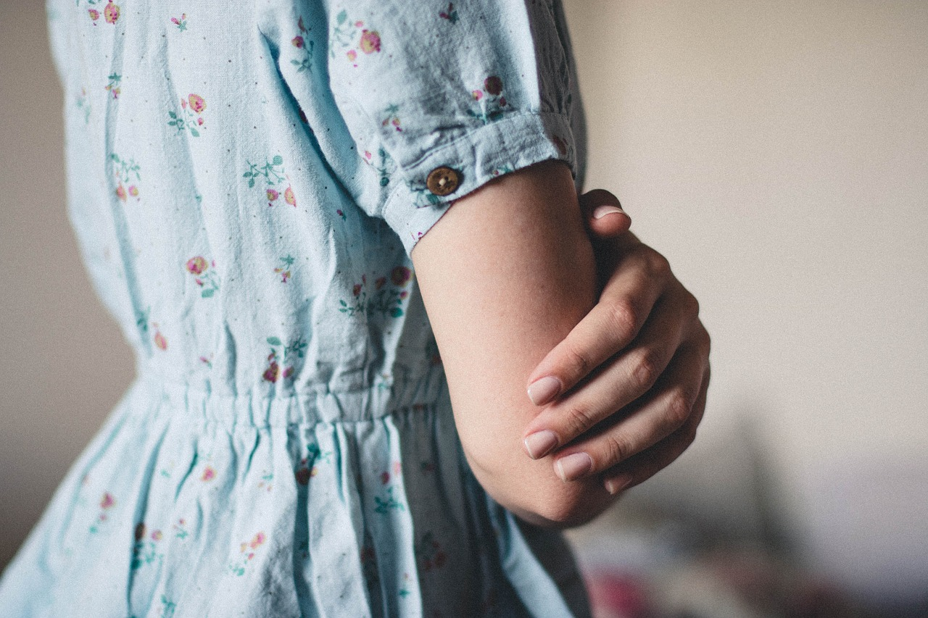
Activity 1: Describe Your Favorite Outfit
Outfit Illustration
Descriptive Paragraph
Vivid Vocabulary
Illustrate your favorite outfit, focusing on its unique features.
Write a short paragraph describing your outfit.
Include details about the colors and styles, and express how it makes you feel.
Use strong adjectives and adverbs to create vivid imagery.
Incorporate descriptive words that enhance your description.
6
Expressing Identity Through Fashion

Slide 10
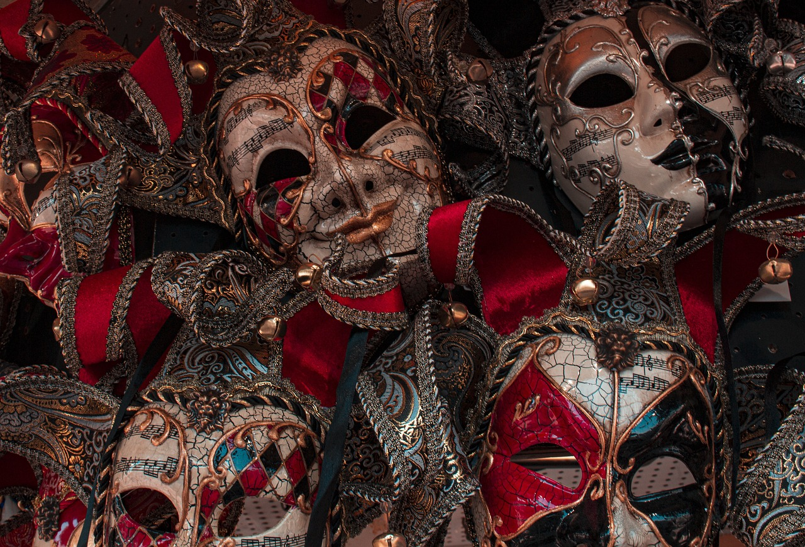
Activity 2: Clothing Charades
Act It Out
Guess the Clothing
Descriptive Clues
Silently mime a clothing item for your friends to guess.
Use gestures and expressions to convey the item.
Observe your friend's performance closely.
Guess based on their actions.
Give vivid hints about the clothing to spark creativity.
Encourage imaginative thinking with your clues.
7
Expressing Identity Through Fashion

Slide 11
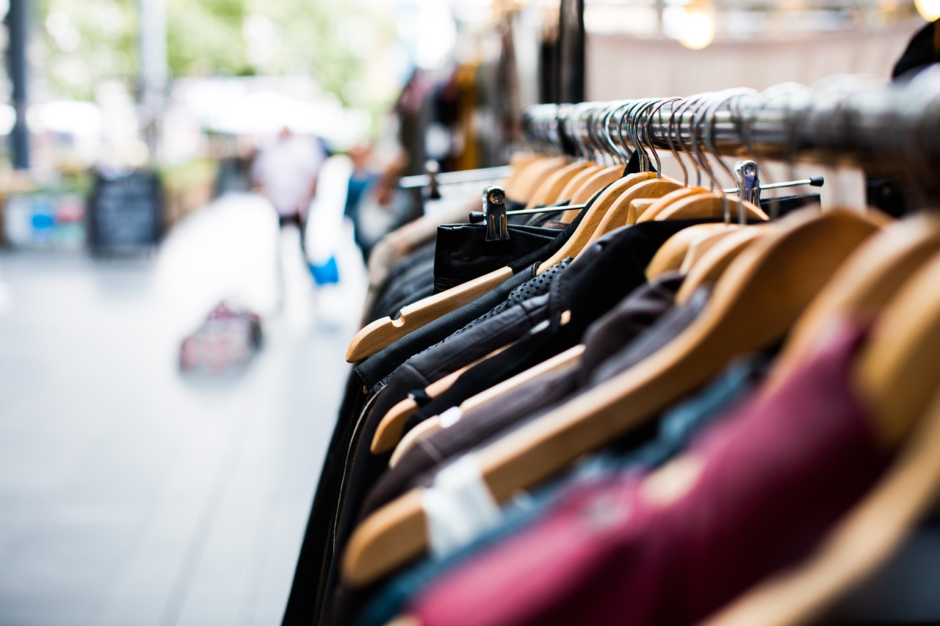
Activity 3: My Favorite Clothes Sorting Game
Clothing Categories
Descriptive Vocabulary
Creative Sorting
Sort clothes into categories like tops, bottoms, and outerwear.
This helps in organizing your wardrobe effectively.
Use specific terms to describe each category clearly.
This helps you appreciate clothing more.
Mix and match styles and colors for a fun experience.
Let your creativity shine in your outfit choices.
8
Expressing Identity Through Fashion

Slide 12

Conclusion
Descriptive Language Skills
Engaging Activities
Mastery Through Practice
We learned to use descriptive language to express ourselves and our favorite clothes.
This skill enhances our ability to convey thoughts and feelings vividly.
We practiced our skills through fun activities and games.
These engaging activities helped reinforce our skills in a fun way.
Keep practicing to become a master of descriptive language!
Regular practice is essential for improving your skills.
9
Expressing Identity Through Fashion

Slide 13

Assessment
Language Skills
Skill Demonstration
Enjoyable Assessment
We will assess your understanding of descriptive language.
This evaluation will help determine your proficiency.
You will have the chance to present your acquired skills.
This is an opportunity to apply what you have learned.
We aim to create a positive and engaging atmosphere.
Your involvement will enhance the overall experience.
10
Expressing Identity Through Fashion

Slide 14
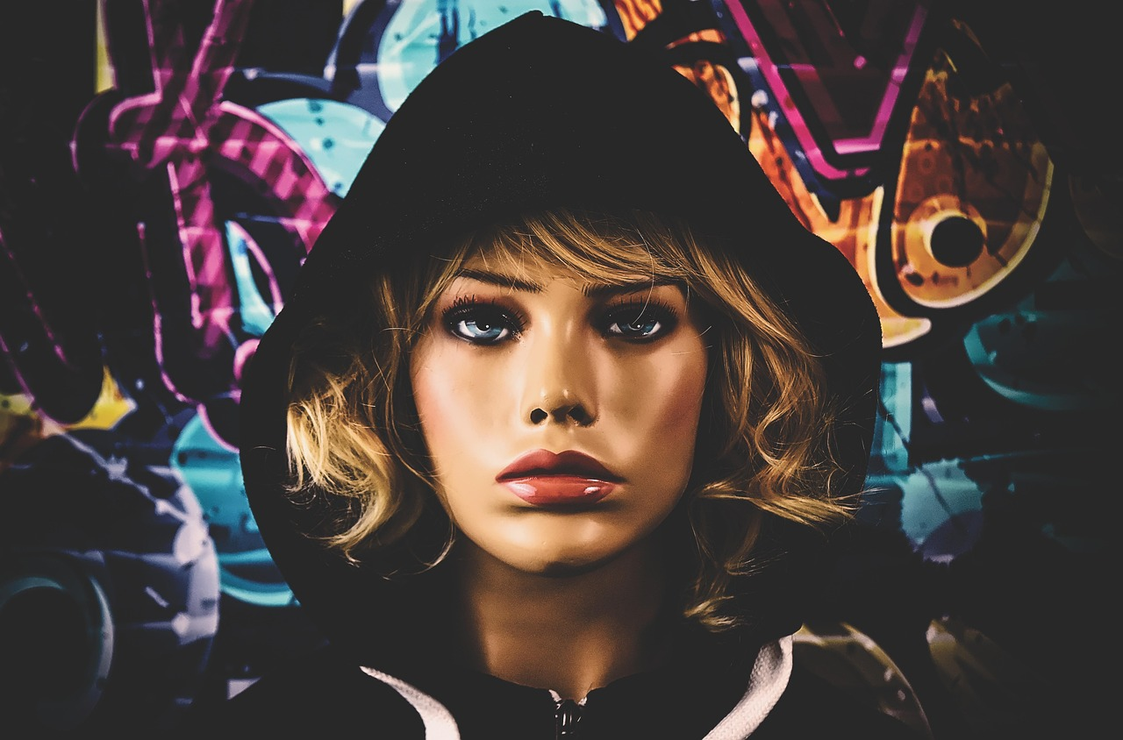
Extension Activity: Fashion Design
Create Your Outfit
Use Descriptive Language
Embrace Creativity
Design your outfit with paper and markers.
Allow your imagination to guide your choices.
Incorporate descriptive vocabulary to explain your design.
Use words that evoke colors and textures.
Be creative and have fun with your design process.
Experiment with different ideas and styles freely.
11
Expressing Identity Through Fashion

Slide 15
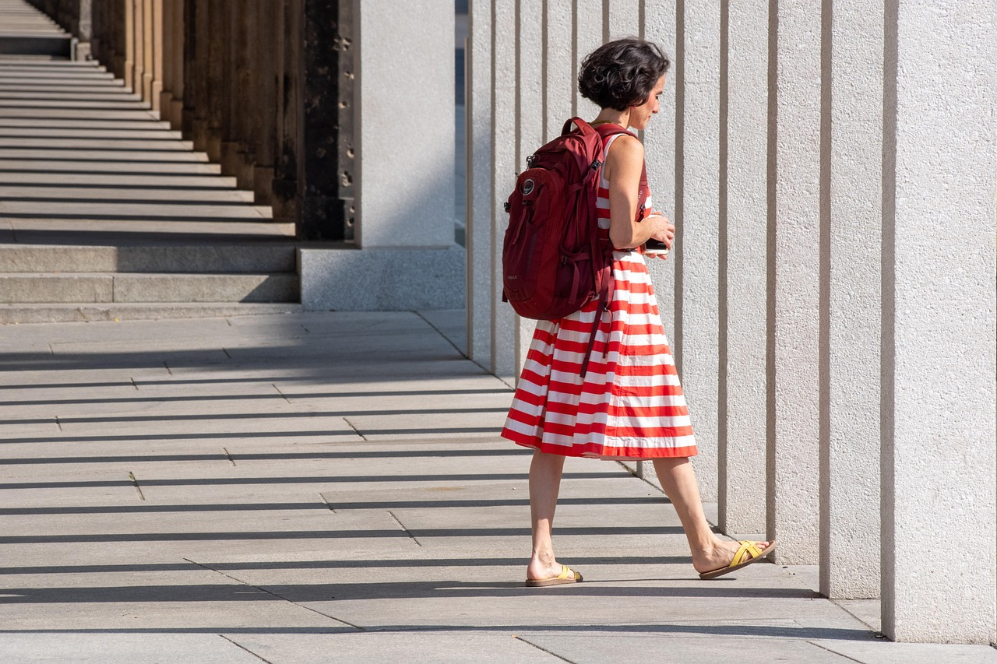
Extension Activity: Clothes-themed Story
Favorite Outfit Story
Descriptive Vocabulary
Share with Others
Write a short story about your favorite clothes.
Explain what makes them special to you.
Use vivid words to describe your outfit's colors and textures.
This will make your story engaging with sensory details.
Once finished, share your story with a friend or family member.
Discuss what you love about your outfit together.
12
Expressing Identity Through Fashion

Slide 16
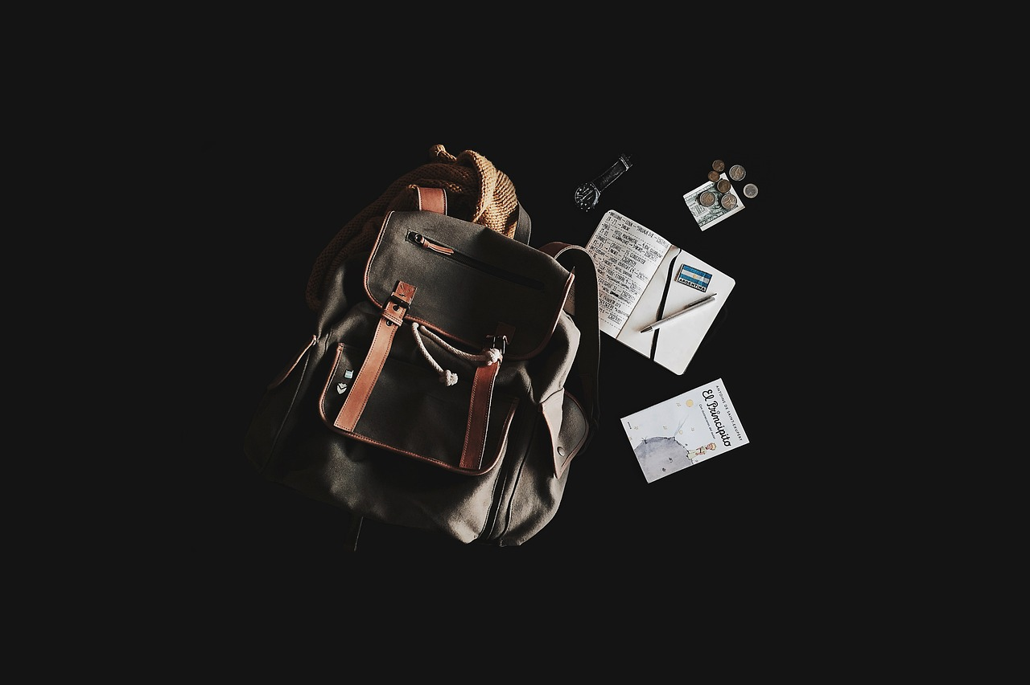
Parent Engagement
Homework Help
Clothing Exchange
Fashion Discussion
Ask your parents for help with difficult subjects.
Their support can boost your understanding and confidence.
Plan a clothing swap with your parents.
This can lead to fun conversations and strengthen your bond.
Talk to your parents about your favorite clothing items.
Discussing styles can help you discover new trends together.
13
Expressing Identity Through Fashion

Slide 17

Safety Considerations
Respect Opinions
Use Kind Words
Embrace Unique Styles
Always be respectful of others' opinions and preferences.
Listening to different viewpoints fosters a positive environment.
Use kind words and actions when describing others' clothes.
Positive language encourages confidence in personal style.
Remember, everyone has their own unique style!
Celebrating diversity in fashion enriches our community.
14
Expressing Identity Through Fashion

Slide 18

Conclusion and Next Steps
Exploring Descriptive Language
Practice Your Skills
Upcoming Lesson: Favorite Food
We had a great time learning about specific techniques in descriptive language, such as using vivid adjectives and sensory details.
These techniques helped us express our thoughts about our favorite clothes more clearly.
To improve your descriptive writing, try detailing your favorite outfit by focusing on its colors, textures, and styles.
This practice will boost your confidence and creativity in writing.
In our next lesson, we will dive into describing our favorite foods, focusing on flavors, textures, and personal memories.
Get ready to share what makes your favorite dish special!
15
Expressing Identity Through Fashion

Slide 19

Reflection Questions
Descriptive Language Insights
Everyday Applications
Favorite Lesson Activity
Descriptive language enhances writing by creating vivid imagery.
It helps readers visualize scenes and emotions.
Descriptive language engages listeners in storytelling.
It improves communication by making descriptions relatable.
The group storytelling exercise was my favorite activity.
Collaborating with peers made it enjoyable and insightful.
16
Expressing Identity Through Fashion

Slide 20

Final Thoughts
Descriptive Language
Practice Makes Perfect
Thank You!
Remember, descriptive language is fun and easy to use!
It adds color and depth to your writing.
Keep practicing and soon you'll be a master!
Regular practice will enhance your skills significantly.
Thanks for joining us on this lesson!
We look forward to seeing you next time!
17
Expressing Identity Through Fashion

Slide 21

Additional Resources
Website Lessons
Teacher Support
Explore Language
Visit our website for interactive lessons and engaging activities.
Access resources like worksheets and quizzes to enhance your learning.
Request specific help from your teacher on challenging topics.
Utilize resources such as study guides and practice tests they provide.
Practice using descriptive language in your writing assignments.
Try techniques like using metaphors and similes to enrich your descriptions.
18
Expressing Identity Through Fashion

Slide 22
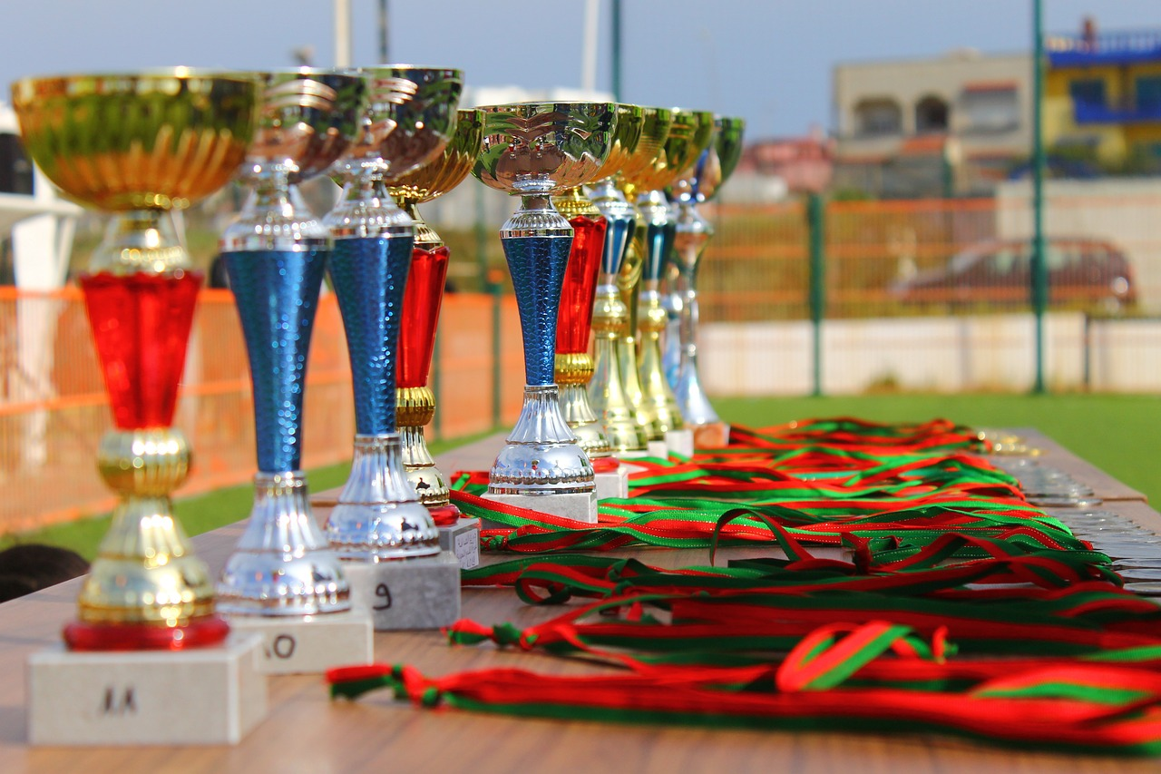
Credits and References
Team Acknowledgment
Contributor Thanks
Copyright Notice
We appreciate our team's hard work in developing this lesson.
Their dedication has been crucial to our success.
We are grateful to our contributors and reviewers for their support.
Their insights have significantly improved the quality of this lesson.
Copyright 2023, all rights reserved.
No part of this lesson may be reproduced without prior consent.
19
Expressing Identity Through Fashion

Slide 23
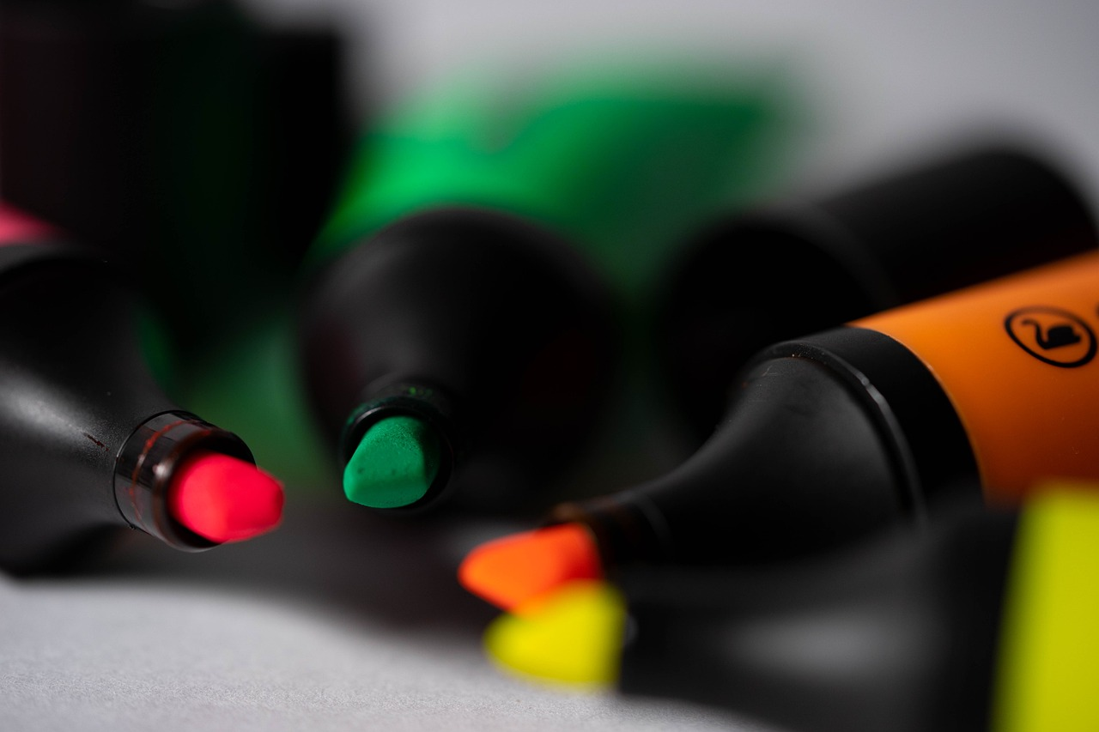
End of Presentation
End of Presentation
We appreciate your time and attention during this presentation.
We sincerely hope you found this experience enjoyable and informative.
20
Expressing Identity Through Fashion

