Slide 1


Exploring Shakespeare's Legacy
A Comprehensive Journey Through Shakespeare's Life, Works, and Impact

Slide 2
Table of contents
Lesson Introduction
Understanding Shakespeare's Final Years and Legacy
Exploring Shakespeare's Twilight Years
Shakespeare's Last Works
Family Life of William Shakespeare
Circumstances Surrounding Shakespeare's Death
Interactive Elements in the Lesson
Dramatic Readings in the Lesson
Historical Context of Shakespeare's Final Years
Appreciating Shakespeare's Impact on Literature
01
02
03
04
05
06
07
08
09
10

Slide 3
Table of contents
Developing Critical Thinking Skills
Connecting Shakespeare's Personal Story
Themes of Legacy in Shakespeare's Life
Family Relationships in Shakespeare's Life
Historical Context of Shakespeare's Era
Key Features of Shakespeare's Legacy
Benefits of Studying Shakespeare
Steps to Understanding Shakespeare's Legacy
Timeline of Shakespeare's Final Years
SWOT Analysis of Shakespeare's Legacy
11
12
13
14
15
16
17
18
19
20

Slide 4

Lesson Introduction
01
03
05
Exploring Shakespeare's Final Years
Last Works and Family Life
Interactive Elements and Dramatic Readings
02
04
Delve into the period from 1613 until his death in 1616.
Examine his final literary creations and personal relationships.
Engage with the lesson through interactive activities and dramatic interpretations.
Twilight Years in Stratford-upon-Avon
Circumstances Surrounding His Death
Discover how Shakespeare spent his final years in his hometown.
Understand the events leading up to Shakespeare's passing.
Exploring Shakespeare's Legacy
1

Slide 5
Life in Retirement
Understanding Shakespeare's Final Years and Legacy
Shakespeare retired to Stratford-upon-Avon after 1613
Focused on managing his properties and investments
01
Last Works
Wrote 'The Tempest,' 'Henry VIII,' and 'The Two Noble Kinsmen'
Showcased his continued creativity
02
Family Life
03
Daughter Susanna and her husband John Hall cared for him
Highlighted the importance of family bonds
Legacy and Impact
04
Passed away in 1616
Legacy endures through his works
Influenced literature, theater, and language for centuries
Exploring Shakespeare's Legacy
2

Slide 6
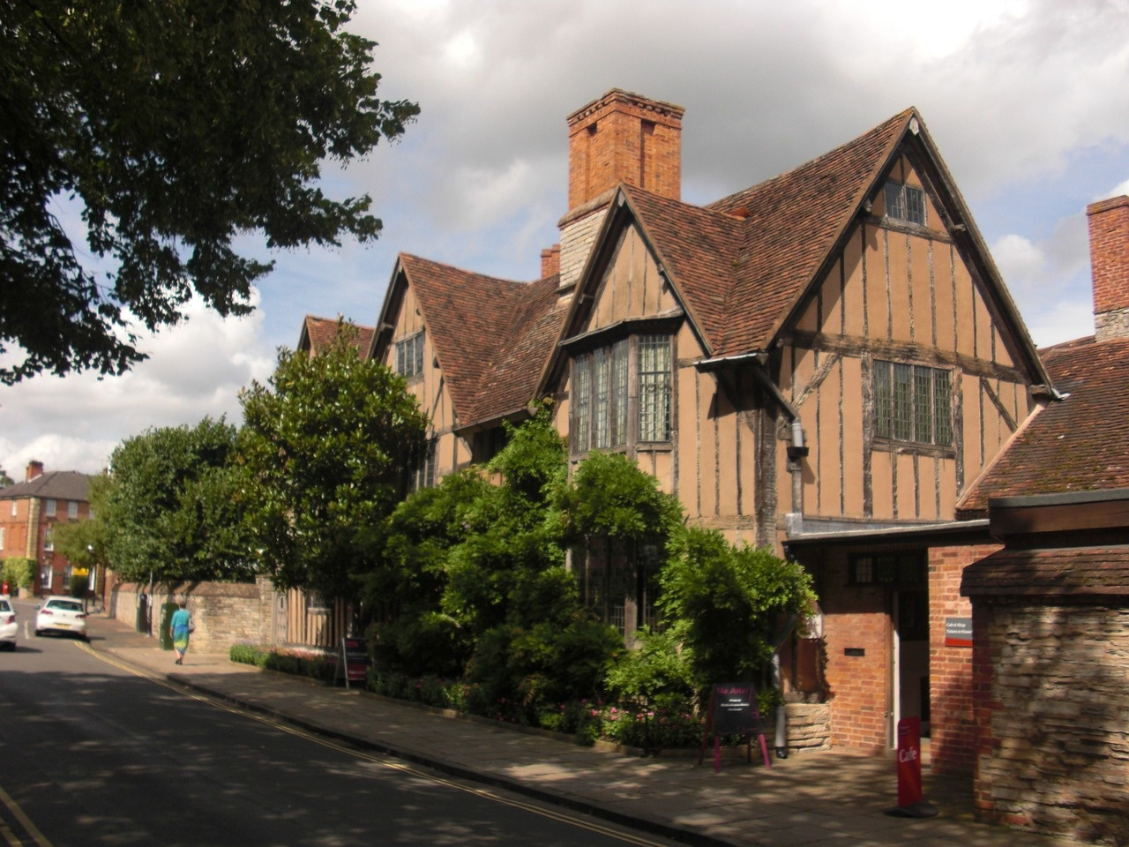
Exploring Shakespeare's Twilight Years
Retirement to Stratford-upon-Avon
After a successful career in London, Shakespeare retired to his hometown.
Exploring Shakespeare's Legacy
3

Slide 7

Shakespeare's Last Works
The Tempest (1611)
Considered one of Shakespeare's final plays
Explores themes of forgiveness, power, and magic
Henry VIII (1613)
Co-authored with John Fletcher
Depicts the reign of King Henry VIII
The Two Noble Kinsmen (1613)
Collaboration with John Fletcher
Based on Chaucer's "The Knight's Tale"
Cardenio (Lost)
Believed to be a lost play
Inspired by a story in "Don Quixote"
Legacy
Shakespeare's last works continue to be studied and performed worldwide
His final plays showcase his mastery of storytelling and language
Exploring Shakespeare's Legacy
4

Slide 8
Wife: Anne Hathaway
Family Life of William Shakespeare
Married in 1582
Age difference of 8 years
01
Children
Susanna
Hamnet
Judith
02
Stratford-upon-Avon
03
Family home: New Place
Shakespeare's retirement place
Relationship with Family
04
Managed business interests
Provided financial support
Exploring Shakespeare's Legacy
5

Slide 9

Circumstances Surrounding Shakespeare's Death
Date of Death
William Shakespeare passed away on April 23, 1616, in Stratford-upon-Avon, England.
Cause of Death
The exact cause of Shakespeare's death remains a mystery, with theories ranging from illness to a fever.
Burial
He was buried in the chancel of the Holy Trinity Church in Stratford-upon-Avon, where his grave can still be visited today.
Legacy
Despite his relatively modest burial, Shakespeare's legacy as the greatest playwright in the English language has endured for centuries.
Family
Shakespeare left behind his wife, Anne Hathaway, and their three children, Susanna, Hamnet, and Judith.
Exploring Shakespeare's Legacy
6

Slide 10
Interactive Elements in the Lesson
01
03
05
Virtual Tour of Shakespeare's Home
Character Role-Playing
Creative Writing Exercise
02
04
Explore Shakespeare's residence in Stratford-upon-Avon through a virtual tour.
Students take on roles of Shakespeare's family members to understand his personal life better.
Encourage students to write a short play inspired by Shakespeare's style.
Interactive Timeline
Quiz Game
Engage with a timeline showcasing key events in Shakespeare's final years.
Test knowledge with a fun quiz on Shakespeare's works and legacy.
Exploring Shakespeare's Legacy
7

Slide 11

Dramatic Readings in the Lesson
Introduction to Dramatic Readings
Engage students with excerpts from Shakespeare's plays performed with emotion and expression.
Interactive Participation
Encourage students to take on roles and act out scenes to understand characters and themes better.
Exploring Emotions
Analyze the language and tone of the text to convey different emotions effectively.
Historical Context
Connect the dramatic readings to the societal norms and values of Shakespeare's time for a deeper understanding.
Critical Thinking
Prompt students to reflect on the significance of Shakespeare's words and how they resonate with audiences today.
Exploring Shakespeare's Legacy
8

Slide 12

Historical Context of Shakespeare's Final Years
The Globe Theatre Fire (1613)
Retirement to Stratford-upon-Avon
In June 1613, the Globe Theatre, where many of Shakespeare's plays were performed, was destroyed by a fire caused by a cannon during a performance of "Henry VIII."
After the Globe Theatre fire, Shakespeare retired to his hometown of Stratford-upon-Avon, where he lived with his family and focused on his personal life and writing.
Last Works
Death and Legacy
During his final years, Shakespeare wrote plays such as "The Tempest," "Henry VIII," and "The Two Noble Kinsmen," showcasing his continued creativity and mastery of the craft.
Shakespeare passed away on April 23, 1616, leaving behind a legacy that would shape the future of literature and theater for centuries to come.
Exploring Shakespeare's Legacy
9

Slide 13

Appreciating Shakespeare's Impact on Literature
Pioneering Language
Shakespeare's innovative use of language, including inventing new words and phrases, has greatly enriched the English language.
Timeless Themes
His exploration of universal themes such as love, jealousy, ambition, and betrayal continues to resonate with audiences across generations.
Complex Characters
Shakespeare's multidimensional characters, like Hamlet and Lady Macbeth, have set a standard for character development in literature.
Influence on Theater
His plays have shaped the structure and conventions of theater, influencing playwrights and performers worldwide.
Exploring Shakespeare's Legacy
10

Slide 14
Developing Critical Thinking Skills
01
03
05
Analyzing Historical Context
Comparing Perspectives
Questioning Assumptions
02
04
Encourage students to research and understand the political, social, and cultural environment during Shakespeare's final years.
Prompt students to compare and contrast different accounts of Shakespeare's legacy from historians and scholars.
Foster a habit of questioning assumptions and biases present in historical narratives about Shakespeare's legacy.
Evaluating Primary Sources
Drawing Inferences
Teach students how to critically assess primary sources such as letters, documents, and artifacts related to Shakespeare's life.
Challenge students to draw logical conclusions based on the information available about Shakespeare's life and works.
Exploring Shakespeare's Legacy
11

Slide 15

Connecting Shakespeare's Personal Story
Early Life
Born in 1564 in Stratford-upon-Avon, England.
Married Anne Hathaway at age 18.
Career Highlights
Became a successful playwright and actor in London.
Wrote famous works like "Romeo and Juliet" and "Hamlet".
Family Tragedies
Experienced the loss of his son Hamnet at a young age.
Dealt with the death of his father and siblings during his lifetime.
Return to Stratford
Retired to Stratford-upon-Avon in his final years.
Continued to invest in property and business ventures.
Legacy
Shakespeare's works continue to be performed worldwide.
His influence on literature and language is profound.
Exploring Shakespeare's Legacy
12

Slide 16

Themes of Legacy in Shakespeare's Life
Literary Influence
Theatrical Impact
Shakespeare's works continue to inspire writers, filmmakers, and artists worldwide.
His plays are regularly performed in theaters globally, showcasing his enduring influence on the stage.
Cultural Significance
Educational Legacy
Shakespeare's language and characters have become ingrained in popular culture, shaping modern storytelling.
His works are studied in schools and universities, contributing to the ongoing exploration of literature and drama.
Exploring Shakespeare's Legacy
13

Slide 17

Family Relationships in Shakespeare's Life
Marriage to Anne Hathaway
Shakespeare married Anne Hathaway in 1582.
Age difference: Shakespeare was 18, while Anne was 26.
Children
The couple had three children: Susanna, Hamnet, and Judith.
Hamnet, Shakespeare's only son, died at the age of 11.
Absence from Family
Shakespeare spent much of his time in London for his theater career.
His absence from his family led to speculation about his relationships.
Inheritance
Shakespeare left most of his wealth to his eldest daughter, Susanna.
His wife, Anne, received his 'second-best bed' in his will.
Exploring Shakespeare's Legacy
14

Slide 18

Historical Context of Shakespeare's Era
Elizabethan England (1558-1603)
Jacobean Era (1603-1625)
Reign of Queen Elizabeth I
Golden Age of English history
Flourishing of arts, literature, and theater
Reign of King James I
Continued growth of English drama
Shakespeare's later works, including 'The Tempest' and 'The Winter's Tale'
The Globe Theatre
Social Hierarchies
Shakespeare's primary venue for performances
Open-air amphitheater in London
Importance of theater in society during that time
Class distinctions in society
Influence of royalty and nobility
Themes of power and authority in Shakespeare's plays
Exploring Shakespeare's Legacy
15

Slide 19

Key Features of Shakespeare's Legacy
Timeless Works
Shakespeare's plays and sonnets continue to be studied, performed, and celebrated worldwide.
Influence on Language
He coined numerous phrases and words that are still used in the English language today.
Universal Themes
His exploration of love, power, jealousy, and ambition resonates with audiences of all ages and backgrounds.
Cultural Impact
Shakespeare's works have inspired countless adaptations in various art forms, from films to novels to music.
Theatrical Innovations
His plays introduced new dramatic techniques and storytelling methods that revolutionized the theater industry.
Exploring Shakespeare's Legacy
16

Slide 20

Benefits of Studying Shakespeare
Cultural Understanding
Gain insight into Elizabethan England and societal norms of the time.
Language Skills
Enhance vocabulary, grammar, and comprehension through exposure to Shakespearean language.
Critical Thinking
Analyze complex themes, characters, and plots, fostering critical thinking skills.
Appreciation for Literature
Develop a deeper appreciation for classic literature and its enduring impact on modern storytelling.
Theatrical Appreciation
Understand the evolution of theater and the influence of Shakespeare's works on drama.
Exploring Shakespeare's Legacy
17

Slide 21
Explore Shakespeare's Works
Steps to Understanding Shakespeare's Legacy
Read and analyze a selection of Shakespeare's plays and sonnets.
Identify recurring themes, characters, and literary techniques used by Shakespeare.
01
Study Shakespeare's Life
Research key events in Shakespeare's life, including his upbringing, career in London, and retirement in Stratford-upon-Avon.
Examine how Shakespeare's personal experiences influenced his writing.
02
Examine Shakespeare's Influence
03
Investigate how Shakespeare's works have influenced literature, theater, and popular culture over the centuries.
Explore adaptations of Shakespeare's plays in different mediums, such as film and television.
Reflect on Shakespeare's Legacy
04
Discuss the enduring relevance of Shakespeare's themes and characters in modern society.
Consider how Shakespeare's legacy continues to shape the way we think about love, power, and human nature.
Exploring Shakespeare's Legacy
18

Slide 22

Timeline of Shakespeare's Final Years
1613
1614
Shakespeare retires from the theater and returns to Stratford-upon-Avon.
He revises his will, leaving various bequests to family and friends.
1616
Legacy
Shakespeare passes away on April 23rd at the age of 52.
His works continue to be performed and studied worldwide, solidifying his status as one of the greatest playwrights in history.
Exploring Shakespeare's Legacy
19

Slide 23

SWOT Analysis of Shakespeare's Legacy
Strengths
Weaknesses
Timeless themes in his works that resonate with audiences across generations
Influence on the English language and literary techniques
Global recognition and enduring popularity of his plays
Lack of diversity in characters and perspectives in his works
Complex language and outdated references can be barriers for modern audiences
Controversies surrounding authorship of some plays
Opportunities
Threats
Continued adaptation of his works in various forms of media, such as film and theater
Education initiatives to introduce Shakespeare to new audiences and younger generations
Exploration of different interpretations and adaptations to keep his legacy relevant
Decline in interest and understanding of classical literature among younger audiences
Competition from contemporary playwrights and entertainment options
Criticisms of his works for perpetuating stereotypes and outdated societal norms
Exploring Shakespeare's Legacy
20

