Slide 1

Navigating the Landscape of Conflict Resolution
Understanding, Strategies, and Community Engagement for Effective Solutions

Slide 2


Table of contents
Introduction to Conflict Resolution
What is Conflict?
Types of Conflicts
Conflict Resolution Strategies
Importance of Conflict Resolution
Case Study: Conflict in the Classroom
Group Activity: Analyzing a Conflict Case
Creating a Mural: Conflict Resolution
Discussion: Conflict Resolution in the Community
Game: Conflict Resolution Simulation
Independent Practice: Reflective Journaling
Assessment and Evaluation
Conclusion
01
02
03
04
05
06
07
08
09
10
11
12
13

Slide 3
Table of contents
Next Steps
14

Slide 4

Introduction to Conflict Resolution
Skill Development
Case Analysis
Resolution Strategies
Conflict resolution skills enable adolescents to manage social interactions and enhance relationships.
Analyzing conflict cases helps students understand different perspectives.
Students will identify root causes of conflicts through case studies.
Effective strategies include negotiation, mediation, and active listening.
Students will explore these strategies to resolve conflicts amicably.
1
Navigating the Landscape of Conflict Resolution

Slide 5
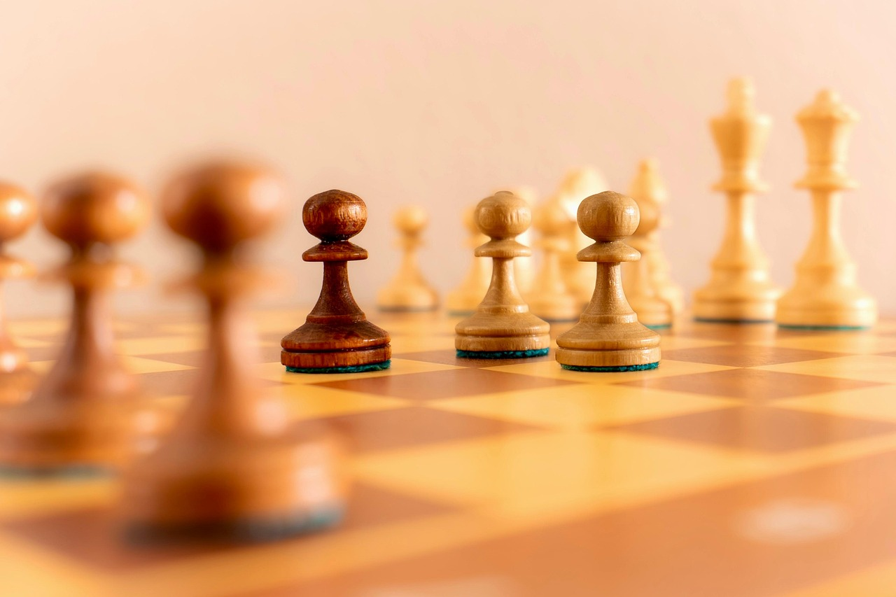
What is Conflict?
Types of Conflict
Internal vs External
Conflict is a situation where two or more parties have opposing interests or needs.
It can arise in various contexts, including personal relationships, workplaces, and communities.
Internal conflict occurs within an individual, often involving personal dilemmas or emotional struggles.
External conflict involves disagreements or clashes between individuals or groups, such as in negotiations or disputes.
2
Navigating the Landscape of Conflict Resolution

Slide 6

Types of Conflicts
Interpersonal
Group
Conflicts between individuals.
This can lead to misunderstandings and harm relationships.
Conflicts between groups or teams.
This can hinder collaboration and decrease productivity.
Cultural
Social
Conflicts between people from different cultural backgrounds.
This can result in miscommunication and a lack of respect.
Conflicts between individuals or groups with different social statuses.
This can perpetuate social tensions and divide communities.
3
Navigating the Landscape of Conflict Resolution

Slide 7

Conflict Resolution Strategies
Active Listening
Emotional Understanding
Mutual Solutions
Focus fully on the speaker, avoiding distractions.
Reflect back what you hear to ensure understanding.
Recognize and validate the feelings of others.
Share your own feelings to create a connection.
Engage in open dialogue to explore options.
Aim for a compromise that satisfies all parties.
4
Navigating the Landscape of Conflict Resolution

Slide 8

Importance of Conflict Resolution
Harmony Maintenance
Preventing Violence
Conflict resolution fosters understanding and cooperation, creating a peaceful environment for thriving relationships.
Addressing conflicts early prevents escalation into violence and promotes inclusivity, reducing social exclusion.
5
Navigating the Landscape of Conflict Resolution

Slide 9

Case Study: Conflict in the Classroom
Student Exclusion
Teacher Mediation
A student feels isolated from their peers, resulting in conflict.
This exclusion negatively impacts the student's emotional well-being and academic success.
The teacher can create an inclusive classroom by encouraging group activities.
Implementing empathy-building exercises can help students understand each other's perspectives.
6
Navigating the Landscape of Conflict Resolution

Slide 10

Group Activity: Analyzing a Conflict Case
Group Division
Case Analysis
Findings Presentation
Divide the class into groups for collaboration.
Assign each group a distinct case study to analyze.
Identify the key problems and parties involved in the case.
Develop a resolution strategy based on their analysis.
Present findings and strategies to the class.
Facilitate a discussion on the strategies proposed by each group.
7
Navigating the Landscape of Conflict Resolution

Slide 11

Creating a Mural: Conflict Resolution
Mural Creation
Symbolic Representation
Students will create a mural that represents conflicts and strategies for resolution.
They should include creative symbols, images, and quotes that showcase their understanding.
Encourage students to select symbols that represent specific conflicts and resolutions.
Each symbol should connect to their personal experiences or observations.
8
Navigating the Landscape of Conflict Resolution

Slide 12

Discussion: Conflict Resolution in the Community
Discussion: Conflict Resolution in the Community
Ask students to discuss the application of conflict resolution in their community.
Encourage students to explore strategies for addressing social issues like bullying and discrimination.
9
Navigating the Landscape of Conflict Resolution

Slide 13

Game: Conflict Resolution Simulation
Conflict Scenario
Resolution Strategies
Students examine a hypothetical conflict between two parties.
It emphasizes understanding diverse perspectives.
Students use negotiation techniques to find a solution that works for both parties.
Empathy helps bridge gaps and encourages collaboration.
10
Navigating the Landscape of Conflict Resolution

Slide 14

Independent Practice: Reflective Journaling
Conflict Reflection
Resolution Strategy
Write a reflective journal entry about a personal or professional conflict you have experienced or observed.
Analyze the conflict by identifying the key problems and the individuals involved.
List the specific issues that led to the conflict and their impact.
Outline actionable steps to effectively resolve the conflict and prevent future occurrences.
11
Navigating the Landscape of Conflict Resolution

Slide 15

Assessment and Evaluation
Understanding Evaluation
Participation Assessment
Assess student understanding using quizzes and discussions.
Employ rubrics to evaluate student participation and engagement in group activities.
12
Navigating the Landscape of Conflict Resolution

Slide 16
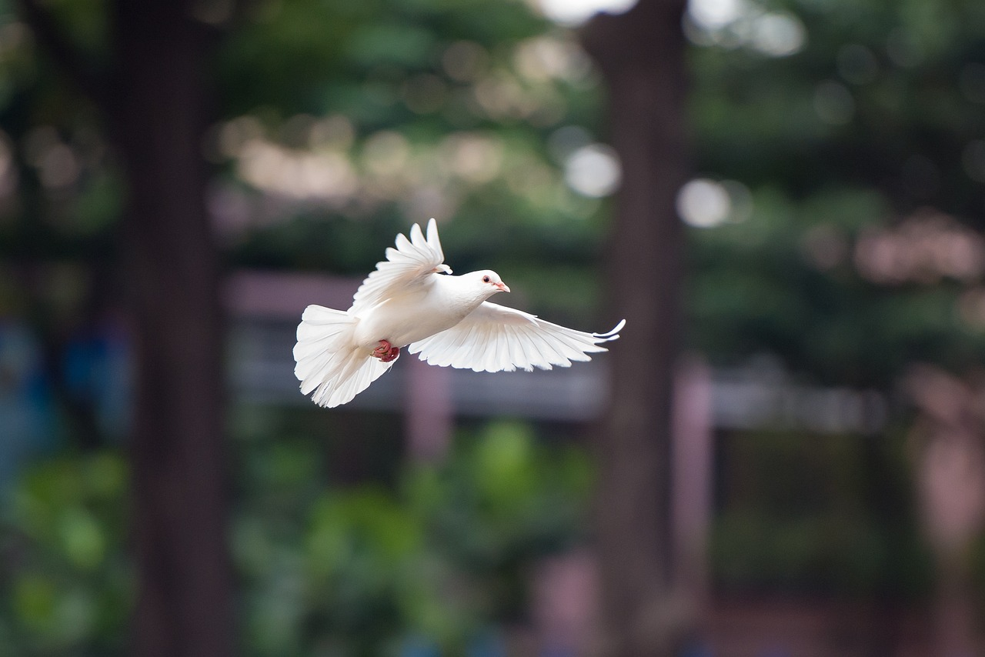
Conclusion
Essential Skill
Promoting Harmony
Conflict resolution is a crucial skill for adolescents to navigate complex social situations.
It helps them understand different perspectives and find common ground.
By applying conflict resolution strategies, students can maintain harmony and stability in their relationships and community.
This fosters a positive environment conducive to personal and social growth.
13
Navigating the Landscape of Conflict Resolution

Slide 17

Next Steps
Practice Strategies
Advanced Techniques
Continue to practice and apply conflict resolution strategies in daily life.
Explore more advanced conflict resolution techniques, such as mediation and negotiation.
14
Navigating the Landscape of Conflict Resolution

