Slide 1
Introduction to Practical SQL Queries
Mastering the Fundamentals of Data Retrieval and Manipulation with SQL

Slide 2
Table of Contents
Introduction to Practical SQL Queries
What is SQL?
Basic SQL Query Syntax
Data Types and Operators
Querying Data
Joining and Subqueries
Indexing and Optimization
Common Errors and Misconceptions
Real-World Applications
Best Practices
Conclusion
Next Steps
Additional Resources
04
05
06
07
08
09
10
11
12
13
14
15
16

Slide 3
Table of Contents
Final Thoughts
Assessment and Evaluation
Conclusion and Final Thoughts
Final Slide
17
18
19
20

Slide 4

Introduction to Practical SQL Queries
Welcome to SQL Queries
Mastering SQL Fundamentals
Exploring Data with SQL
Welcome to the world of SQL queries, where data meets insight.
In this lesson, we will explore the fundamentals of SQL queries for data retrieval and manipulation.
By the end of this lesson, you will be able to write efficient SQL queries.
Understand database concepts and apply these skills in real-world scenarios.
SQL queries are essential for uncovering insights from data.
This lesson will equip you with the tools to manipulate and retrieve data effectively.
4
Introduction to Practical SQL Queries

Slide 5

What is SQL?
Introduction to SQL
SQL Operations
Purpose of SQL
SQL, or Structured Query Language, is a programming language designed for managing and manipulating data in relational database management systems.
It is a standard language for accessing, managing, and modifying data in relational database management systems.
SQL is used to perform various operations, such as creating and modifying database structures.
It also allows inserting, updating, and deleting data, as well as querying data.
SQL serves as a tool for interacting with relational database management systems.
Its primary purpose is to manage and manipulate data effectively.
5
Introduction to Practical SQL Queries

Slide 6
Basic SQL Query Syntax
Introduction to SQL Query Syntax
Role of the SELECT Statement
Purpose of the FROM Clause
Function of the WHERE Clause
The basic syntax of a SQL query includes the SELECT statement, FROM clause, and WHERE clause.
These components form the foundation of retrieving and filtering data in SQL.
The SELECT statement specifies the columns to retrieve.
It determines the data that will be displayed in the query result.
The FROM clause specifies the tables to retrieve data from.
It identifies the source of the data for the query.
The WHERE clause filters data based on conditions.
It allows for precise control over which rows are included in the query result.
6
Introduction to Practical SQL Queries

Slide 7

Data Types and Operators
SQL Data Types Overview
Role of Operators in SQL
SQL supports various data types, including integer, string, date, and time.
Data types determine the type of data that can be stored in a column.
Each data type has its own set of operators, which are used to perform operations on the data.
Operators determine the operations that can be performed on the data.
Importance of Data Types
Significance of Operators
Understanding data types is essential for writing effective SQL queries.
Data types define the structure and constraints of the data in a database.
Understanding operators is crucial for manipulating and querying data effectively.
Operators enable users to perform calculations, comparisons, and transformations on data.
7
Introduction to Practical SQL Queries

Slide 8

Querying Data
Understanding Querying Data
Key SQL Commands for Querying
Querying data is the process of retrieving specific data from a database.
It involves using commands to extract relevant information from stored datasets.
SQL provides several commands for querying data, including SELECT, FROM, WHERE, and ORDER BY.
These commands help in filtering, organizing, and retrieving data efficiently.
Role of SELECT Command
Purpose of FROM Command
The SELECT command is used to specify the columns to retrieve.
It allows users to focus on particular attributes of the data.
The FROM command is used to specify the tables to retrieve data from.
It defines the source of the data for the query.
8
Introduction to Practical SQL Queries

Slide 9

Joining and Subqueries
Understanding Joining Tables
The Role of Subqueries
Joining tables is the process of combining data from two or more tables based on a common column.
This technique is fundamental for integrating data in relational databases.
Subqueries are used to nest one query inside another query.
They allow for more dynamic and flexible data retrieval.
Advanced SQL Concepts
Importance of Mastery
Joining and subqueries are advanced concepts in SQL, and are used to combine data from multiple tables and perform complex operations.
Mastering these concepts enables handling intricate database tasks.
Understanding joining and subqueries is essential for writing efficient SQL queries.
Proficiency in these areas leads to optimized and effective database management.
9
Introduction to Practical SQL Queries

Slide 10

Indexing and Optimization
Understanding Indexing
Indexing is the process of creating a data structure that improves the speed of data retrieval.
Indexing can be used to improve the performance of queries, especially those that retrieve large amounts of data.
The Role of Optimization
Optimization is the process of improving the performance of queries by reducing the amount of data that needs to be retrieved and processed.
Understanding indexing and optimization is essential for writing efficient SQL queries.
Indexing for Query Performance
Indexing can significantly enhance the efficiency of database queries.
It is particularly useful for handling large datasets and complex queries.
Optimization Techniques
Optimization focuses on minimizing the computational resources required for data processing.
This involves strategies to streamline data retrieval and reduce query execution time.
10
Introduction to Practical SQL Queries

Slide 11

Common Errors and Misconceptions
Incorrect Use of JOIN Clause
Issues with WHERE Clause
One common error is the incorrect use of the JOIN clause.
Understanding common errors and misconceptions is essential for writing efficient SQL queries.
Another common error is the missing or incorrect use of the WHERE clause.
By avoiding common errors and misconceptions, you can improve the performance and accuracy of your SQL queries.
Importance of Error Awareness
Impact on SQL Query Performance
Understanding common errors and misconceptions is essential for writing efficient SQL queries.
By avoiding common errors and misconceptions, you can improve the performance and accuracy of your SQL queries.
By avoiding common errors and misconceptions, you can improve the performance and accuracy of your SQL queries.
Understanding common errors and misconceptions is essential for writing efficient SQL queries.
11
Introduction to Practical SQL Queries

Slide 12

Real-World Applications
01
Applications in Data Analysis
SQL queries have many real-world applications, including data analysis, business intelligence, and data science.
SQL queries can be used to analyze customer data, sales data, and other types of data.
02
Practical Importance
Understanding real-world applications is essential for applying SQL queries in practical scenarios.
By applying SQL queries in real-world scenarios, you can gain valuable insights and make informed decisions.
03
Insights from Customer Data
SQL queries can be used to analyze customer data, sales data, and other types of data.
By applying SQL queries in real-world scenarios, you can gain valuable insights and make informed decisions.
04
Essential Knowledge
Understanding real-world applications is essential for applying SQL queries in practical scenarios.
SQL queries have many real-world applications, including data analysis, business intelligence, and data science.
12
Introduction to Practical SQL Queries

Slide 13

Best Practices
Enhancing Readability and Maintainability
Use meaningful table and column names to improve readability and maintainability.
This practice ensures that database structures are intuitive and easy to understand.
Boosting Query Performance
Use indexes to improve query performance.
Indexes help in quickly locating data, reducing the time taken for query execution.
Optimizing Data Retrieval
Optimize queries to reduce the amount of data that needs to be retrieved and processed.
Efficient queries minimize resource usage and enhance overall system performance.
Ensuring Accuracy and Efficiency
Test and debug queries to ensure accuracy and efficiency.
Thorough testing helps identify and resolve issues, ensuring reliable database operations.
13
Introduction to Practical SQL Queries

Slide 14
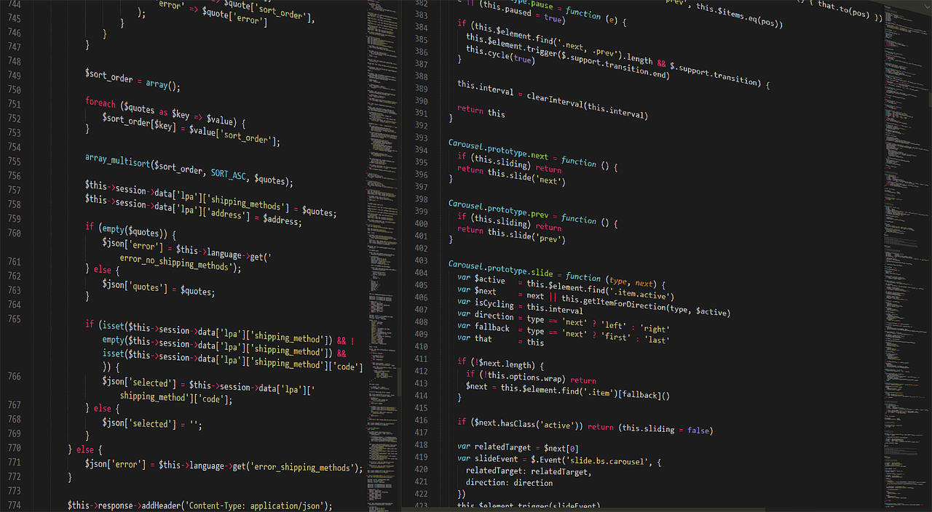
Conclusion
Power of SQL Queries
Mastering SQL Basics
Ensuring Query Accuracy
SQL queries are a powerful tool for data retrieval and manipulation.
They enable users to interact with databases effectively and efficiently.
Understanding data types, query syntax, and best practices is essential.
These fundamentals help in writing efficient SQL queries for real-world applications.
Always follow best practices and test your queries thoroughly.
Debugging ensures the accuracy and efficiency of your SQL queries.
14
Introduction to Practical SQL Queries

Slide 15
Next Steps
Advanced SQL Training
Real-World SQL Practice
Engage with SQL Communities
To continue building on the skills and knowledge gained in this lesson, consider taking additional courses or training on advanced SQL topics.
This will help deepen your understanding and open up new opportunities for growth in SQL.
Practice writing SQL queries and applying them in real-world scenarios to improve your skills and gain experience.
Hands-on experience is crucial for mastering SQL and becoming proficient in its application.
Join online communities or forums to connect with other SQL users and learn from their experiences.
These platforms provide valuable insights and support for continuous learning and problem-solving.
15
Introduction to Practical SQL Queries

Slide 16

Additional Resources
Online Communities for Support
Books and Articles on SQL
For additional resources and support, consider visiting online forums or communities, such as SQL Server Central or Stack Overflow.
These platforms provide a space to ask questions, share knowledge, and learn from experienced professionals.
Read books and articles on SQL and database management to deepen your knowledge and stay up-to-date on the latest developments.
This approach allows you to explore topics in greater depth and at your own pace.
Online Tutorials and Training
Engage in Online Discussions
Take advantage of online tutorials and training courses, such as those offered by Microsoft or Oracle.
These resources are designed to help you build your skills and gain practical experience.
Participate in online discussions and share your own experiences and knowledge with others.
Engaging with peers can provide new insights and foster a sense of community.
16
Introduction to Practical SQL Queries

Slide 17

Final Thoughts
The Importance of Practice
Seeking Support
Continuous Learning
Remember that practice and experience are key to becoming proficient in SQL queries.
Consistent effort and hands-on experience will help you master complex database operations.
Don't be afraid to ask for help or seek additional resources when needed.
Collaborating with peers or consulting experts can provide valuable insights and solutions.
Keep learning and stay up-to-date on the latest developments in SQL and database management to stay ahead in your career.
Staying informed about new tools and techniques ensures long-term success in the field.
17
Introduction to Practical SQL Queries

Slide 18
Assessment and Evaluation
Quiz and Project for SQL Mastery
Self-Evaluation for Growth
Feedback from Others
Guided Learning through Assessment
To assess your understanding of SQL queries, consider taking a quiz or completing a project.
These activities help apply SQL queries in a real-world scenario.
Evaluate your own knowledge and skills, and identify areas for improvement.
This reflection is crucial for personal development in SQL expertise.
Seek feedback from others, such as instructors or peers, to gain additional insights.
Their perspectives can provide valuable guidance for your learning journey.
Use assessment and evaluation to guide your learning and improve your skills in SQL queries.
This approach ensures continuous improvement and targeted skill enhancement.
18
Introduction to Practical SQL Queries

Slide 19
Conclusion and Final Thoughts
The Power of SQL Queries
Best Practices for SQL
Seeking Support and Resources
In conclusion, SQL queries are a powerful tool for data retrieval and manipulation.
By understanding the basics of SQL queries and applying them in real-world scenarios, you can gain valuable insights and make informed decisions.
Remember to always follow best practices when working with SQL queries.
Testing and debugging your queries is essential to ensure accuracy and efficiency.
Seek additional resources and support when needed to enhance your SQL skills.
Continuous learning and improvement are key to mastering SQL queries.
19
Introduction to Practical SQL Queries

Slide 20

Final Slide
Final Slide
Thank you for completing this lesson on Practical SQL Queries for Data Retrieval and Manipulation.
We hope you found it informative and engaging. Happy learning!
20
Introduction to Practical SQL Queries

