Slide 1

Analyzing Central Ideas in Historical American Speeches and Essays
Developing Critical Thinking and Understanding American History and Culture

Slide 2
Analyzing Central Ideas in Historical American Speeches and Essays
2
Table of Contents
Introduction to Analyzing Central Ideas
Why Analyze Historical American Speeches and E…
Key Concepts and Skills
Historical Context: The Gettysburg Address
Central Idea: The Gettysburg Address
Textual Evidence: The Gettysburg Address
Historical Context: The Declaration of Indepen…
Central Idea: The Declaration of Independence
Textual Evidence: The Declaration of Independe…
Comparing and Contrasting Historical American …
Evaluating the Credibility of Sources
Writing Persuasive Essays
Conclusion
04
05
06
07
08
09
10
11
12
13
14
15
16

Slide 3
Analyzing Central Ideas in Historical American Speeches and Essays
3
Table of Contents
Reflection Questions
Next Steps
Key Takeaways
Final Thoughts
References
Appendix
17
18
19
20
21
22

Slide 4

Analyzing Central Ideas in Historical American Speeches and Essays
4
Introduction to Analyzing Central Ideas
Importance of Analyzing Central Ideas
Benefits of Mastering Analytical Skills
Developing Critical Thinking
Analyzing central ideas in historical American speeches and essays is a crucial skill for 15-year-old students to develop.
This skill enables students to think critically about complex texts and evaluate the main arguments and themes presented.
By mastering this skill, students will be able to analyze complex texts, evaluate evidence, and develop well-supported arguments.
This ability is essential for academic success and informed citizenship.
Engaging with historical texts helps students understand the context and significance of ideas.
It fosters the ability to discern and articulate the underlying messages and implications.

Slide 5

Analyzing Central Ideas in Historical American Speeches and Essays
5
Why Analyze Historical American Speeches and Essays?
Understanding Historical Context
Exploring American Society
Gaining Insight into Cultural Development
Historical American speeches and essays provide a window into the past, offering insights into the thoughts, values, and beliefs of American society.
Analyzing these texts helps students understand the historical context in which they were written and the impact they had on American history.
By studying these texts, students can develop a deeper understanding of the complexities of American history and culture.
These writings reflect the evolution of societal norms and the challenges faced by the nation throughout its history.
Historical texts serve as a record of the intellectual and cultural development of the United States.
They allow students to explore the foundational ideas that have shaped the nation's identity.

Slide 6
Analyzing Central Ideas in Historical American Speeches and Essays
6
Key Concepts and Skills
Central Ideas and Arguments
Textual Evidence Analysis
Argument Evaluation
Critical Thinking Development
Identifying central ideas and main arguments is crucial for understanding the core message of a text.
This skill helps in discerning the primary focus and purpose of the material being analyzed.
Analyzing textual evidence supports a deeper comprehension of the text.
It involves examining specific details and examples to substantiate understanding.
Evaluating the strengths and weaknesses of arguments allows for a balanced perspective.
This process aids in recognizing the validity and reliability of presented claims.
Developing critical thinking skills enables consideration of multiple perspectives.
It also involves evaluating evidence to form well-rounded conclusions.

Slide 7
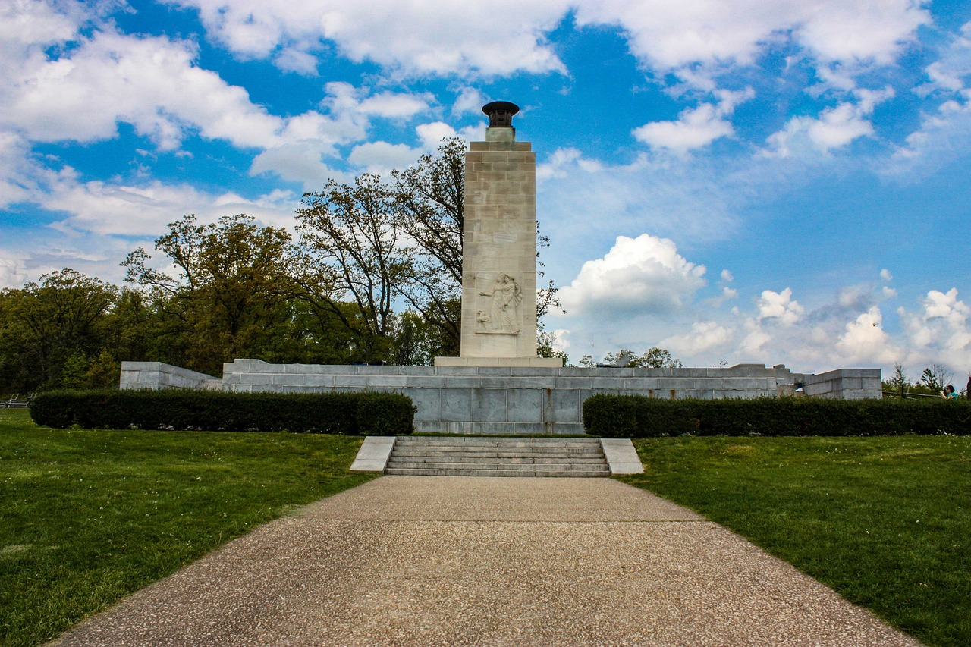
Analyzing Central Ideas in Historical American Speeches and Essays
7
Historical Context: The Gettysburg Address
Delivery of the Gettysburg Address
The Gettysburg Address was delivered by President Abraham Lincoln on November 19, 1863.
The speech was given during the American Civil War, at the dedication of the Soldiers' National Cemetery in Gettysburg, Pennsylvania.
Significance of the Speech
The speech is considered one of the most iconic speeches in American history.
Its central idea is that the Civil War is a test of whether a nation "conceived in liberty and dedicated to the proposition that all men are created equal" can long endure.
Historical Context
The Gettysburg Address was delivered amidst the American Civil War.
It was part of the dedication ceremony for the Soldiers' National Cemetery in Gettysburg, Pennsylvania.

Slide 8

Analyzing Central Ideas in Historical American Speeches and Essays
8
Central Idea: The Gettysburg Address
The Test of National Endurance
Preservation of the Union
Call to Action for Freedom
The Gettysburg Address emphasizes the Civil War as a test of the nation's ability to endure while upholding liberty and equality.
Lincoln highlights the foundational principles of the nation, questioning their sustainability amidst conflict.
Lincoln argues that the war is essential to preserve the Union and its democratic ideals.
He stresses the importance of maintaining a government that is truly representative of the people.
The speech serves as a rallying cry for Americans to continue striving for freedom and equality.
Lincoln inspires commitment to the values that define the nation's identity and purpose.

Slide 9

Analyzing Central Ideas in Historical American Speeches and Essays
9
Textual Evidence: The Gettysburg Address
Rhetorical Devices in the Gettysburg Address
Iconic Phrases from the Speech
Legacy of the Gettysburg Address
Lincoln employs rhetorical devices such as metaphor, allusion, and repetition.
These techniques effectively support his argument and enhance the speech's impact.
The Gettysburg Address includes memorable phrases like 'Four score and seven years ago' and 'government of the people, by the people, for the people.'
These phrases have become emblematic of American ideals and democracy.
The speech is considered a masterpiece of American oratory.
Its language and structure have been studied and emulated by generations of Americans.

Slide 10

Analyzing Central Ideas in Historical American Speeches and Essays
10
Historical Context: The Declaration of Independence
Adoption of the Declaration
Proclamation of Sovereignty
Core Principles of the Declaration
The Declaration of Independence was adopted by the Continental Congress on July 4, 1776.
This marked a pivotal moment in American history.
The document declared the 13 American colonies' independence from Great Britain.
It established the United States of America as a sovereign nation.
The Declaration is considered one of the most important documents in American history.
Its central idea is that all men are created equal and have the right to life, liberty, and the pursuit of happiness.

Slide 11

Analyzing Central Ideas in Historical American Speeches and Essays
11
Central Idea: The Declaration of Independence
Equality and Rights
Government's Power and Responsibility
Call to Action
The central idea of the Declaration of Independence is that all men are created equal.
It emphasizes the inherent rights to life, liberty, and the pursuit of happiness.
The document argues that governments derive their power from the consent of the governed.
It asserts that people have the right to alter or abolish their government if it becomes tyrannical.
The Declaration is a call to action for Americans to stand up for their rights.
It encourages them to fight for their freedom against oppression.

Slide 12

Analyzing Central Ideas in Historical American Speeches and Essays
12
Textual Evidence: The Declaration of Independence
Famous Phrases in the Declaration
Rhetorical Devices Employed
Impact and Legacy
The Declaration includes famous phrases such as "We hold these truths to be self-evident" and "life, liberty, and the pursuit of happiness."
These phrases encapsulate the core values and principles that the document aims to convey.
The document uses rhetorical devices such as allusion and repetition to support its argument.
These techniques enhance the persuasive power and clarity of the Declaration's message.
The Declaration is a masterpiece of American political philosophy, and its language and structure have been studied and emulated by generations of Americans.
Its influence extends beyond its immediate historical context, shaping political thought and discourse globally.

Slide 13

Analyzing Central Ideas in Historical American Speeches and Essays
13
Comparing and Contrasting Historical American Speeches and Essays
Central Ideas and Arguments
Students can compare and contrast the central ideas and main arguments of different historical American speeches and essays.
This activity allows for a detailed examination of the themes and perspectives presented in these texts.
Historical Context and Complexity
By analyzing multiple texts, students can develop a deeper understanding of the historical context and the complexities of American history and culture.
This approach provides insights into the societal and cultural dynamics of the time periods studied.
Critical Thinking Development
Comparing and contrasting texts can help students evaluate the strengths and weaknesses of different arguments and develop critical thinking skills.
This process encourages analytical reasoning and the ability to assess diverse viewpoints effectively.

Slide 14

Analyzing Central Ideas in Historical American Speeches and Essays
14
Evaluating the Credibility of Sources
Assessing Authorial Intent
Students should evaluate the credibility of sources by considering the author's purpose, audience, and historical context.
This approach helps in understanding the motivations and perspectives behind the creation of the source.
Recognizing Biases in Historical Texts
Students should consider the potential biases and limitations of historical American speeches and essays.
Acknowledging these factors allows for a more nuanced interpretation of historical narratives.
Understanding Historical Complexity
By evaluating the credibility of sources, students can develop a deeper understanding of the complexities of American history and culture.
This practice enriches their comprehension of the multifaceted nature of historical events and societal developments.

Slide 15

Analyzing Central Ideas in Historical American Speeches and Essays
15
Writing Persuasive Essays
Utilizing Historical Evidence
Enhancing Critical Thinking
Improving Communication Skills
Students can use evidence from historical American speeches and essays to support their arguments in persuasive essays.
This approach provides a foundation of credibility and relevance to their arguments.
By writing persuasive essays, students can develop their critical thinking skills and learn to evaluate evidence.
This process encourages the development of well-supported arguments.
Persuasive essays can help students develop their writing skills and learn to communicate their ideas effectively.
This skill is essential for academic and professional success.

Slide 16

Analyzing Central Ideas in Historical American Speeches and Essays
16
Conclusion
Importance of Analyzing Historical Texts
Analyzing central ideas in historical American speeches and essays is a crucial skill for 15-year-old students to develop.
This skill enables students to engage with significant historical and cultural narratives.
Benefits of Mastering Analytical Skills
By mastering this skill, students can develop a deeper understanding of American history and culture.
They also learn to think critically about complex texts, enhancing their intellectual growth.
Applications of Analytical Skills
Students can apply this skill to a variety of contexts, including writing persuasive essays.
Additionally, they can evaluate the credibility of sources effectively, fostering informed decision-making.

Slide 17
Analyzing Central Ideas in Historical American Speeches and Essays
17
Reflection Questions
Central Ideas and Arguments
Evaluating Credibility and Bias
Applying Skills to Various Contexts
What are the central ideas and main arguments presented in historical American speeches and essays?
This question encourages students to analyze and identify the key themes and messages conveyed in these texts.
How can students evaluate the credibility of sources and consider the potential biases and limitations of historical American speeches and essays?
This question prompts students to critically assess the reliability and perspective of the materials they study.
How can students apply the skills developed in this lesson to a variety of contexts, including writing persuasive essays and evaluating the credibility of sources?
This question highlights the transferability of analytical and evaluative skills to broader academic and real-world scenarios.

Slide 18

Analyzing Central Ideas in Historical American Speeches and Essays
18
Next Steps
Developing Critical Thinking Skills
Applying Skills in Various Contexts
Becoming Informed and Engaged Citizens
Students can continue to develop their critical thinking skills by analyzing complex texts and evaluating evidence.
This practice enhances their ability to understand and interpret information effectively.
Students can apply the skills developed in this lesson to a variety of contexts, including writing persuasive essays and evaluating the credibility of sources.
These applications demonstrate the versatility and importance of critical thinking in academic and real-world scenarios.
By continuing to develop their critical thinking skills, students can become more informed and engaged citizens.
This capability allows them to analyze complex information and make informed decisions in their personal and civic lives.

Slide 19
Analyzing Central Ideas in Historical American Speeches and Essays
19
Key Takeaways
Importance of Analyzing Historical Texts
Benefits of Mastering Analytical Skills
Applications of Analytical Skills
Analyzing central ideas in historical American speeches and essays is a crucial skill for 15-year-old students to develop.
This skill helps students engage with significant historical and cultural themes.
By mastering this skill, students can develop a deeper understanding of American history and culture.
They also learn to think critically about complex texts, enhancing their intellectual growth.
Students can apply this skill to a variety of contexts, including writing persuasive essays.
Additionally, they can evaluate the credibility of sources effectively.

Slide 20
Analyzing Central Ideas in Historical American Speeches and Essays
20
Final Thoughts
Understanding Historical Contexts
Developing Critical Thinking
Applying Analytical Skills
Analyzing central ideas in historical American speeches and essays is a valuable skill.
This helps students develop a deeper understanding of American history and culture.
By continuing to develop their critical thinking skills, students can become more informed and engaged citizens.
They become capable of analyzing complex information and making informed decisions.
This skill can be applied to a variety of contexts, including writing persuasive essays.
It also aids in evaluating the credibility of sources.

Slide 21

Analyzing Central Ideas in Historical American Speeches and Essays
21
References
The Gettysburg Address
The Declaration of Independence
Historical American Speeches and Essays
The Gettysburg Address is a speech delivered by Abraham Lincoln during the American Civil War.
It emphasizes the principles of human equality and the importance of preserving the Union.
The Declaration of Independence is a foundational document of the United States.
It asserts the colonies' separation from Britain and outlines the principles of individual rights and government by consent.
Various historical American speeches and essays have shaped the nation's identity.
These works reflect the values, struggles, and aspirations of the American people throughout history.

Slide 22

Analyzing Central Ideas in Historical American Speeches and Essays
22
Appendix
Additional Learning Resources
Student Work Examples
Glossary of Terms
Explore various materials and references to deepen your understanding.
These resources are curated to support extended learning opportunities.
Review projects and assignments completed by students to gain insights.
These examples showcase practical applications of concepts learned.
Understand key terms and concepts through a comprehensive glossary.
This glossary serves as a quick reference for important definitions.

