Slide 1

Understanding Early Psychosexual Development: The Oral and Anal Stages
Exploring Foundational Concepts, Case Studies, and Educational Strategies in Psychoanalytic Theory

Slide 2
Table of Contents
Introduction to Analyzing the Oral and Anal St…
Key Concepts: Oral Stage
Key Concepts: Anal Stage
Case Study Analysis: Oral Stage
Case Study Analysis: Anal Stage
Group Discussion: Oral and Anal Stages
Differentiated Activities for Mixed-Ability Gr…
Assessment and Evaluation
Conclusion and Next Steps
Reflection Questions for Teachers
Teaching Tips and Strategies
Key Takeaways
Final Thoughts and Recommendations
04
05
06
07
08
09
10
11
12
13
14
15
16

Slide 3
Table of Contents
References and Resources
Appendix: Case Studies and Group Discussion Gu…
Glossary of Key Terms
Index of Topics
Conclusion and Final Thoughts
Final Slide: Thank You
17
18
19
20
21
22

Slide 4
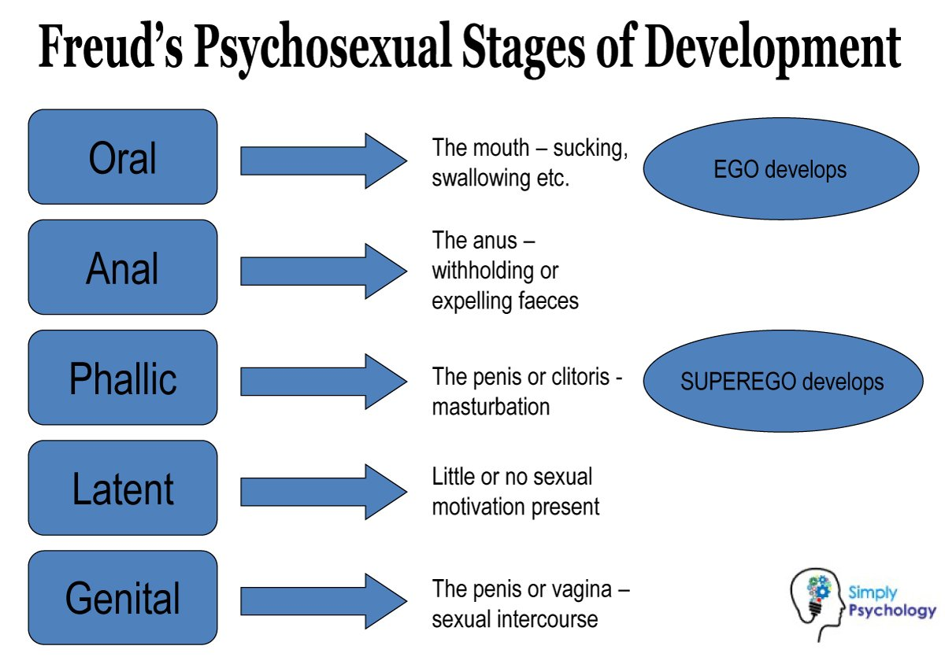
Introduction to Analyzing the Oral and Anal Stages
Overview of Psychosexual Development
Focus of the Presentation
Significance of the Oral and Anal Stages
The oral and anal stages are the first two stages of psychosexual development, as proposed by Sigmund Freud.
Understanding these stages is crucial for grasping the foundational concepts of psychoanalytic theory and its applications in psychology, education, and social work.
This presentation will explore the oral and anal stages through case studies and group discussions.
It will include differentiated activities designed for mixed-ability groups.
These stages form the basis for understanding human behavior and personality development.
They are essential for applying psychoanalytic theory in various professional fields.
4
Understanding Early Psychosexual Development: The Oral and Anal Stages

Slide 5

Key Concepts: Oral Stage
Duration of the Oral Stage
Role of the Mouth
The oral stage spans from birth to about 18 months.
This is the first stage in Freud's psychosexual development theory.
The mouth is the primary erogenous zone, providing pleasure and satisfaction through sucking and feeding.
This stage emphasizes the importance of oral activities in early development.
Impact of Weaning
Foundation for Relationships
Weaning can influence personality traits, such as dependency or independence.
The process of weaning plays a critical role in shaping future behaviors.
The oral stage lays the groundwork for future relationships and attachment styles.
Early experiences during this stage can affect emotional bonds later in life.
5
Understanding Early Psychosexual Development: The Oral and Anal Stages

Slide 6

Key Concepts: Anal Stage
Duration of the Anal Stage
Primary Focus of the Anal Stage
The anal stage occurs from about 18 months to 3 years.
This period is a critical phase in early childhood development.
The anus becomes the primary erogenous zone during this stage.
Toilet training plays a significant role in developing control and independence.
Traits Associated with the Anal Stage
Importance of Successful Navigation
The anal stage is linked to the development of traits such as neatness, orderliness, and stubbornness.
These traits emerge as children navigate the challenges of this developmental phase.
Successful navigation of the anal stage is crucial for developing a sense of control.
It also fosters self-efficacy, which is essential for personal growth.
6
Understanding Early Psychosexual Development: The Oral and Anal Stages

Slide 7

Case Study Analysis: Oral Stage
Unresolved Oral Stage Dependency
Influence on Adult Relationships
Student Analysis and Discussion
A 30-year-old man exhibits excessive dependency on others, which can be linked back to an unresolved oral stage.
This dependency highlights the long-term impact of early developmental stages on adult behavior.
The case study illustrates how the oral stage influences adult behaviors and relationships.
It provides insights into the connection between early experiences and interpersonal dynamics.
Students will analyze the case study and discuss how the individual's experiences during the oral stage might have influenced their development.
This exercise encourages critical thinking about the role of early childhood in shaping personality.
7
Understanding Early Psychosexual Development: The Oral and Anal Stages

Slide 8
Case Study Analysis: Anal Stage
Excessive Neatness and the Anal Stage
Impact of the Anal Stage on Personality
Discussion on Developmental Influences
A 25-year-old woman is excessively neat and orderly, which can be associated with the anal stage.
This highlights the connection between early developmental stages and adult personality traits.
The case study demonstrates how the anal stage impacts personality traits and behaviors.
It provides insights into the long-term effects of early childhood experiences.
Students will examine the case study and discuss how the individual's experiences during the anal stage might have influenced their development.
This encourages critical thinking about the relationship between early experiences and later behaviors.
8
Understanding Early Psychosexual Development: The Oral and Anal Stages

Slide 9

Group Discussion: Oral and Anal Stages
Analyzing Oral and Anal Stages
Encouraging Thought Sharing
Exploring Psychological Outcomes
Students will participate in a group discussion to analyze the implications of the oral and anal stages on adult behaviors and relationships.
The discussion will focus on how experiences during these stages might influence psychological outcomes and behaviors.
Students will be encouraged to share their thoughts and insights during the discussion.
The instructor will facilitate the discussion to ensure all students participate.
The group discussion aims to explore the connection between early developmental stages and adult psychological outcomes.
Students will analyze how these stages impact behaviors and relationships.
9
Understanding Early Psychosexual Development: The Oral and Anal Stages

Slide 10

Differentiated Activities for Mixed-Ability Groups
Tiered Case Studies
Tiered case studies will be provided to cater to different learning abilities.
This approach ensures that students engage with material suited to their individual skill levels.
Learning Centers for Oral and Anal Stages
Learning centers or stations will be set up to focus on various aspects of the oral and anal stages.
These stations will allow students to explore concepts in a hands-on and interactive manner.
Differentiated Graphic Organizers
Differentiated graphic organizers will be used to help students structure their thoughts and analyses.
These tools will support students in organizing their ideas effectively, regardless of their learning abilities.
Technology Integration for Support and Challenges
Technology integration will be incorporated to provide additional support and challenges.
This ensures that students can access resources tailored to their needs while engaging with advanced tools.
10
Understanding Early Psychosexual Development: The Oral and Anal Stages

Slide 11

Assessment and Evaluation
Assessment Methods
Students will be assessed through a written essay, case study presentation, and reflective journal.
The assessments will evaluate students' understanding of the oral and anal stages, their ability to analyze case studies, and their participation in group discussions.
Evaluation Criteria
The assessments aim to evaluate students' understanding of key concepts and their analytical skills.
Participation in group discussions will also be considered as part of the evaluation process.
Instructor Support
The instructor will provide feedback and guidance to support students' learning and development.
This support will help students improve their understanding and performance in assessments.
11
Understanding Early Psychosexual Development: The Oral and Anal Stages

Slide 12

Conclusion and Next Steps
Foundational Concepts in Psychoanalytic Theory
The oral and anal stages are foundational concepts in psychoanalytic theory, influencing psychological development and adult behaviors.
Understanding these stages is crucial for professionals in psychology, education, and social work.
Future Exploration of Psychoanalytic Stages
Future lessons will explore more complex aspects of psychoanalytic theory, including the phallic, latency, and genital stages.
These stages provide deeper insights into human psychological development.
Practical Implications for Professionals
Professionals in psychology, education, and social work benefit from understanding psychoanalytic stages.
This knowledge aids in addressing developmental and behavioral challenges effectively.
12
Understanding Early Psychosexual Development: The Oral and Anal Stages

Slide 13
Reflection Questions for Teachers
Engagement Through Activities
Understanding Developmental Stages
Catering to Mixed Abilities
How effective were the introductory activities and case studies in engaging students?
This question explores the impact of initial teaching strategies on student involvement.
To what extent did students demonstrate a clear understanding of the oral and anal stages?
This reflection focuses on assessing students' grasp of key psychological concepts.
How well did the differentiated activities cater to the needs of mixed-ability groups?
This inquiry evaluates the inclusivity and adaptability of teaching methods.
13
Understanding Early Psychosexual Development: The Oral and Anal Stages

Slide 14
Teaching Tips and Strategies
Encouraging Active Participation
Catering to Diverse Learning Styles
Facilitating Reflective Journaling
Enhancing Engagement with Technology
Encourage active participation through think-pair-share and group discussions.
These methods foster collaboration and deeper understanding among students.
Use diverse case studies to cater to different learning styles and interests.
This approach ensures inclusivity and keeps students engaged.
Facilitate reflective journaling to provide students with a safe space to process their thoughts and feelings.
This practice helps in personal growth and emotional well-being.
Incorporate visual aids and technology to enhance engagement and understanding.
These tools make learning more interactive and accessible.
14
Understanding Early Psychosexual Development: The Oral and Anal Stages

Slide 15
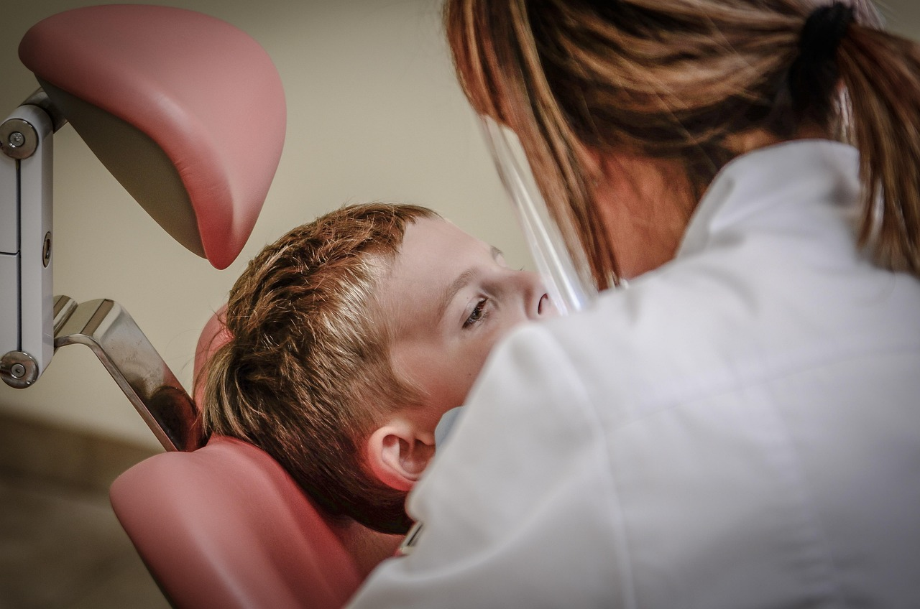
Key Takeaways
Influence of the Oral Stage
Impact of the Anal Stage
Application of Psychoanalytic Theory
The oral stage influences personality traits and behaviors, such as dependency or independence.
These traits are shaped during early childhood and have lasting effects on adult behavior.
The anal stage impacts the development of control and independence, and traits such as neatness and orderliness.
This stage plays a significant role in shaping an individual's approach to organization and self-discipline.
Understanding the oral and anal stages is crucial for applying psychoanalytic theory to real-life scenarios.
This knowledge supports human development by addressing foundational psychological traits.
15
Understanding Early Psychosexual Development: The Oral and Anal Stages

Slide 16

Final Thoughts and Recommendations
Psychoanalytic Development Stages
Differentiated Teaching Strategies
Foundational Knowledge Expansion
The oral and anal stages are essential concepts in psychoanalytic theory, influencing psychological development and adult behaviors.
Future lessons should build upon the foundational knowledge of the oral and anal stages, exploring more complex aspects of psychoanalytic theory.
Teachers should incorporate differentiated activities and assessments to cater to mixed-ability groups.
This approach ensures that all students can engage with and benefit from the material presented.
Future lessons should build upon the foundational knowledge of the oral and anal stages, exploring more complex aspects of psychoanalytic theory.
This progression allows for a deeper understanding of psychoanalytic concepts and their applications.
16
Understanding Early Psychosexual Development: The Oral and Anal Stages

Slide 17

References and Resources
Foundational Work on Sexuality
Understanding the Ego and Id
Supplementary Learning Materials
Freud, S. (1905). Three essays on the theory of sexuality.
This seminal work explores the development and dynamics of human sexuality.
Freud, S. (1923). The ego and the id.
This text delves into the structural model of the psyche, introducing key concepts of ego, id, and superego.
Additional resources, such as online articles and educational websites, will be provided to support further learning.
These materials aim to enhance understanding and provide diverse perspectives on the topics discussed.
17
Understanding Early Psychosexual Development: The Oral and Anal Stages

Slide 18

Appendix: Case Studies and Group Discussion Guidelines
Case Studies Overview
Group Discussion Guidelines
Encouraging Student Engagement
Case studies will be provided to illustrate the oral and anal stages.
These examples aim to deepen understanding of the developmental stages.
Group discussion guidelines will be established to ensure respectful and productive discussions.
These rules will foster an environment conducive to open dialogue.
Students will be encouraged to ask questions and seek clarification on any aspects of the case studies or discussions.
This approach aims to enhance comprehension and active participation.
18
Understanding Early Psychosexual Development: The Oral and Anal Stages

Slide 19
Glossary of Key Terms
Psychosexual Development
Oral Stage
Anal Stage
Erogenous Zone
The process by which the sexual instinct develops and matures through a series of stages from birth to adulthood.
This concept is foundational to understanding human psychological and sexual growth.
The first stage of psychosexual development, spanning from birth to about 18 months.
During this stage, the mouth is the primary focus of pleasure and exploration.
The second stage of psychosexual development, occurring from about 18 months to 3 years.
This stage emphasizes control and pleasure associated with bowel movements.
An area of the body that is particularly sensitive to stimulation and plays a significant role in sexual pleasure and development.
These zones shift focus depending on the stage of psychosexual development.
19
Understanding Early Psychosexual Development: The Oral and Anal Stages

Slide 20

Index of Topics
Exploring Developmental Stages
Introduction to the oral and anal stages.
Understanding the foundational aspects of early psychological development.
Interactive Learning Approaches
Case study analysis and group discussions.
Engaging methods to deepen comprehension and foster collaboration.
Tailored Educational Strategies
Differentiated activities for mixed-ability groups.
Adapting teaching methods to cater to diverse learning needs.
20
Understanding Early Psychosexual Development: The Oral and Anal Stages

Slide 21
Conclusion and Final Thoughts
Foundational Concepts in Psychoanalytic Theory
The oral and anal stages are foundational concepts in psychoanalytic theory, influencing psychological development and adult behaviors.
Understanding these stages is crucial for professionals in psychology, education, and social work.
Application of Knowledge in Professional Fields
By applying the knowledge and skills gained from this presentation, professionals can provide effective support and intervention to individuals and groups.
This understanding enhances their ability to address psychological and developmental challenges effectively.
Impact on Individual and Group Support
Professionals equipped with insights into psychoanalytic stages can tailor interventions to meet diverse needs.
Such targeted support fosters better outcomes in therapeutic and educational settings.
21
Understanding Early Psychosexual Development: The Oral and Anal Stages

Slide 22

Final Slide: Thank You
Final Slide: Thank You
Thank you for your attention, and we hope this presentation has provided valuable insights into the oral and anal stages.
22
Understanding Early Psychosexual Development: The Oral and Anal Stages

