Slide 1












Exploring London: A Comprehensive Journey
Unveiling the Rich History, Diverse Culture, and Vibrant Contemporary Life of London

Slide 2

Table of contents
Lesson Introduction
Discovering London: A First-Time Visitor's Guide
London's Rich History
Diverse Culture of London
Famous Landmarks in London
Practical Travel Tips for London
London's Royal Heritage
London's Role in World History
Vibrant Contemporary Culture of London
Public Transportation System in London
01
02
03
04
05
06
07
08
09
10

Slide 3
Lesson Introduction
Exploring London's Rich History
Discovering Diverse Culture
Famous Landmarks Await
Practical Travel Tips
01
Dive into the city's royal heritage
Learn about London's significant role in shaping world history
02
Uncover London's vibrant contemporary culture
Blend tradition with modernity
03
Explore the majestic Tower of London
Visit the cutting-edge Shard skyscraper
04
Navigate London's public transportation system efficiently
Equip students with essential travel knowledge
Exploring London: A Comprehensive Journey

Slide 4
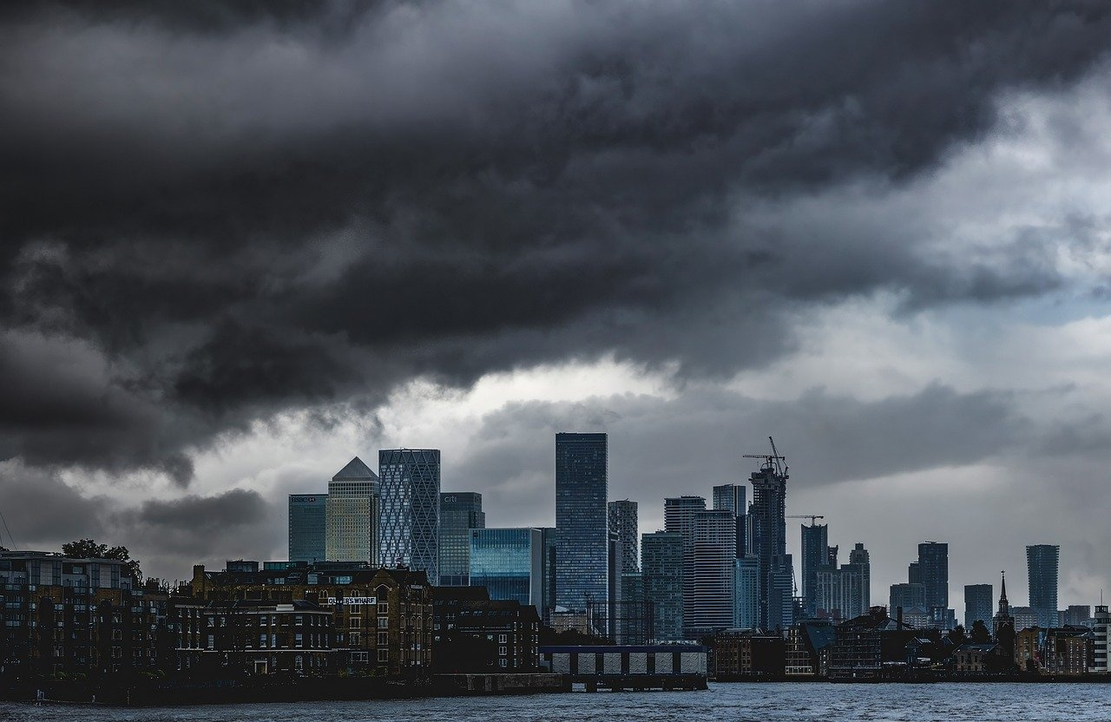
Discovering London: A First-Time Visitor's Guide
Introduction to London
Welcome to the vibrant city of London, known for its rich history and diverse culture.
London offers a unique blend of ancient landmarks and modern innovations.
Exploring London: A Comprehensive Journey

Slide 5



London's Rich History
Roman Origins
Medieval Era
Tudor Dynasty
Great Fire of London
Victorian Era
London was founded by the Romans around 50 AD as Londinium, a strategic settlement along the River Thames.
The Tower of London, built in the 11th century, served as a royal palace, prison, and fortress, shaping London's medieval history.
The reign of the Tudor monarchs, including Henry VIII and Elizabeth I, marked a significant period in London's history, with iconic landmarks like Hampton Court Palace.
In 1666, the city was devastated by a massive fire that destroyed much of the medieval city, leading to the architectural rebirth of London.
The Industrial Revolution transformed London into a global powerhouse, with landmarks like the Houses of Parliament and the iconic London Bridge.
01
02
03
04
05
Exploring London: A Comprehensive Journey

Slide 6
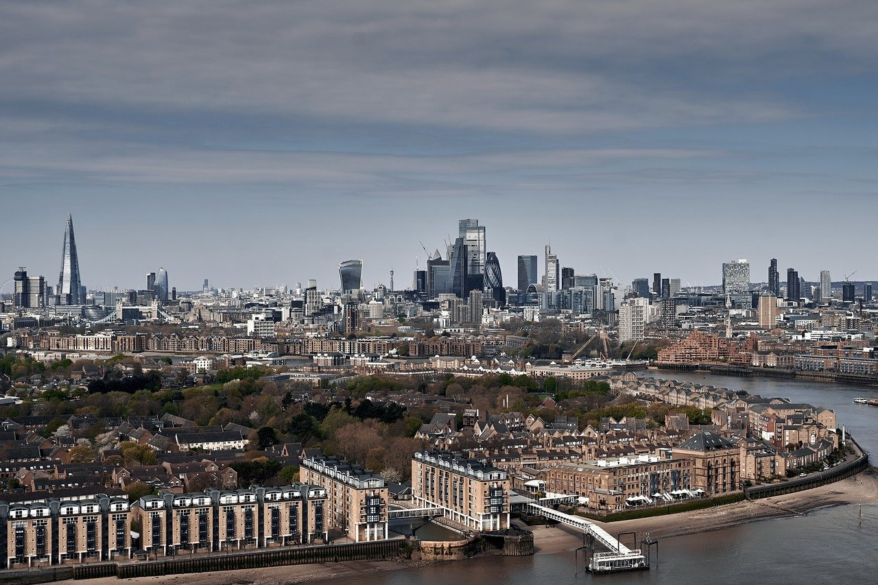
Diverse Culture of London
Historical Landmarks
Cultural Institutions
Explore the iconic Tower of London, a symbol of the city's rich history.
Visit Buckingham Palace, the official residence of the British monarch.
Immerse yourself in art at the Tate Modern and the National Gallery.
Experience the vibrant theater scene at West End's famous theaters.
Historical Landmarks
Cultural Institutions
Explore the iconic Tower of London, a symbol of the city's rich history.
Visit Buckingham Palace, the official residence of the British monarch.
Immerse yourself in art at the Tate Modern and the National Gallery.
Experience the vibrant theater scene at West End's famous theaters.
Exploring London: A Comprehensive Journey

Slide 7
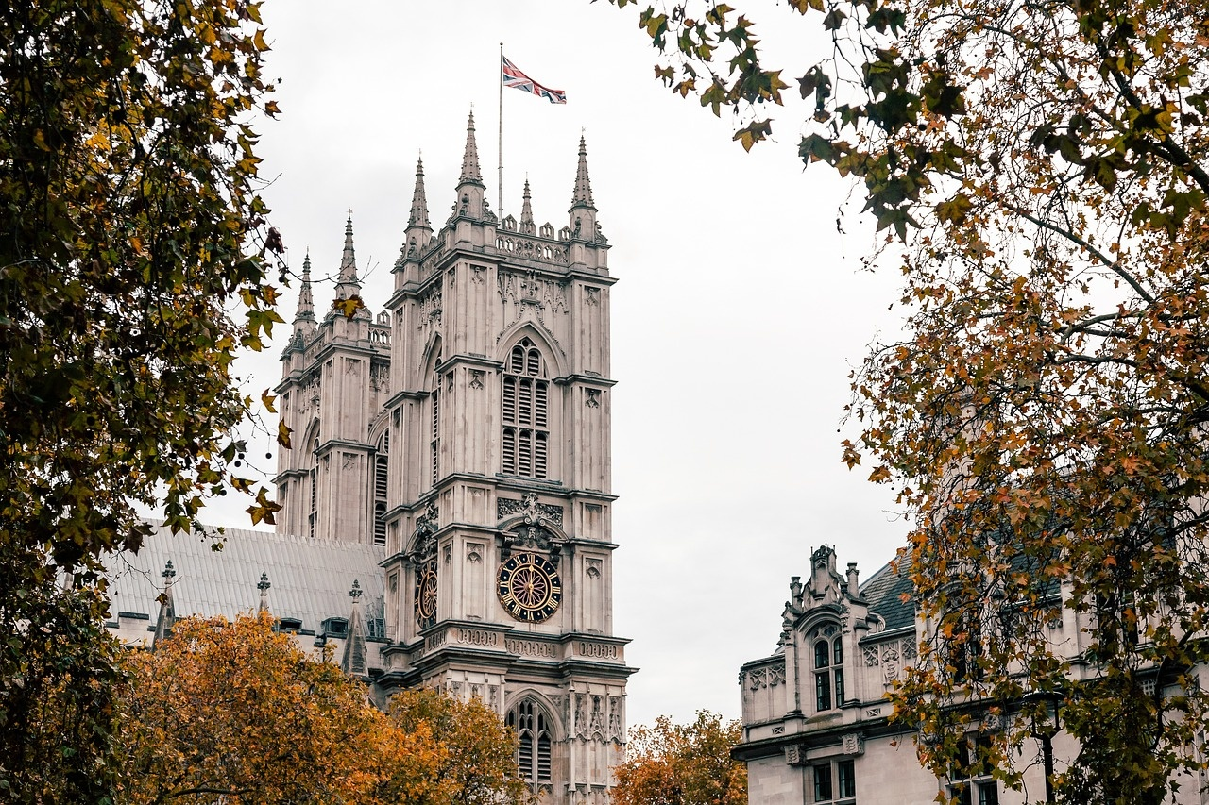
Famous Landmarks in London
Big Ben
Tower Bridge
Iconic clock tower located at the north end of the Palace of Westminster.
A combined bascule and suspension bridge over the River Thames.
Buckingham Palace
The London Eye
Westminster Abbey
The official residence of the British monarch in London.
A giant Ferris wheel on the South Bank of the River Thames.
A gothic abbey church where British monarchs are crowned and buried.
Exploring London: A Comprehensive Journey

Slide 8
Practical Travel Tips for London
Obtain an Oyster Card
Mind the Gap
Plan Your Routes
Check the Weather
Respect Queuing Etiquette
Purchase an Oyster Card for convenient access to London's public transportation system.
Pay attention to the warning signs and announcements when using the London Underground to avoid accidents.
Use apps like Citymapper or Google Maps to navigate the city efficiently and avoid getting lost.
London weather can be unpredictable, so be prepared for rain by carrying an umbrella or raincoat.
Follow the British tradition of queuing patiently, especially when waiting for buses or attractions.
01
02
03
04
05
Exploring London: A Comprehensive Journey

Slide 9

London's Royal Heritage
Tower of London
Buckingham Palace
Explore the historic fortress and former royal palace.
Home to the Crown Jewels and iconic Beefeaters.
Official residence of the British monarch.
Witness the Changing of the Guard ceremony.
Tower of London
Buckingham Palace
Explore the historic fortress and former royal palace.
Home to the Crown Jewels and iconic Beefeaters.
Official residence of the British monarch.
Witness the Changing of the Guard ceremony.
Exploring London: A Comprehensive Journey

Slide 10
London's Role in World History
Royal Heritage
Colonial Legacy
World Wars
Cultural Influence
01
London has been a seat of royal power for centuries, with iconic landmarks like Buckingham Palace and Westminster Abbey symbolizing the monarchy's influence.
02
As the capital of the British Empire, London played a pivotal role in shaping global colonization and trade routes, leaving a lasting impact on countries around the world.
03
London endured significant destruction during World War II, with the Blitz highlighting its resilience and the city's role in the Allied victory.
04
From Shakespearean theater to the British Invasion in music, London has been a cultural hub that has influenced art, literature, and music on a global scale.
Exploring London: A Comprehensive Journey

Slide 11
Vibrant Contemporary Culture of London
230
857
320
100+
Art Galleries
Theatres
Music Venues
Street Markets
Art galleries in London, showcasing a diverse range of contemporary art from around the world.
Theatres in London, offering a vibrant mix of traditional plays, musicals, and experimental performances.
Music venues in London, hosting live concerts spanning various genres from indie to electronic music.
Street markets in London, where visitors can experience the city's eclectic mix of food, fashion, and crafts.
Exploring London: A Comprehensive Journey

Slide 12
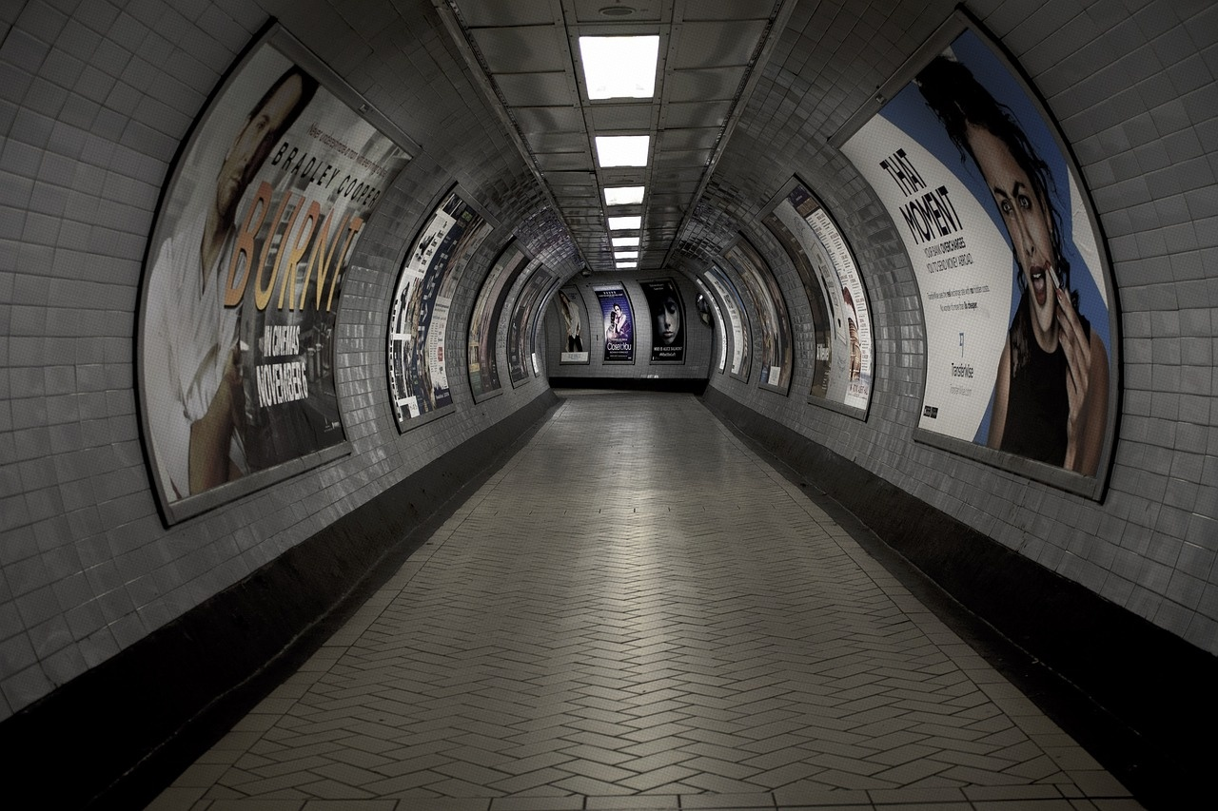
Public Transportation System in London
London Underground (The Tube)
London Buses
The oldest underground railway in the world.
11 lines covering 402 km of track.
Over 1 billion passenger journeys annually.
Red double-decker buses are iconic.
Extensive network covering all areas of the city.
Over 2 billion bus journeys made each year.
Docklands Light Railway (DLR)
London Overground
Trams
Automated light metro system serving East London.
Connects to the London Underground and London Overground.
Suburban rail service connecting Greater London.
112 stations across 7 lines.
Integrated with the Tube network.
Tramlink serves South London.
Trams run on designated tracks and share roads with other vehicles.
Exploring London: A Comprehensive Journey

