Slide 1












Crafting Immersive Worlds
Exploring Techniques and Elements for Engaging and Captivating Narratives

Slide 2

Table of contents
Lesson Introduction
Crafting Immersive Worlds
Narrative World Building
Creating Rich and Vibrant Worlds
Foundation for Captivating Stories
Crucial Skill for Writers
Constructing Immersive Environments
Engaging Readers with Fictional Worlds
Techniques for World Building
Elements of a Well-Developed World
01
02
03
04
05
06
07
08
09
10

Slide 3
Table of contents
Geography and Culture in Fiction
History and Magic Systems
Fully Realized Setting
Tools for Creating Compelling Worlds
Fascinating Characters and Thrilling Adventures
Aspiring Writers' Journey
Unique and Compelling Worlds
Populating Fictional Environments
Captivating Narratives
Immersive Storytelling
11
12
13
14
15
16
17
18
19
20

Slide 4



Lesson Introduction
Welcome to an exciting journey into the realm of narrative world building!
In this comprehensive lesson, we'll explore the intricate process of creating rich, vibrant, and believable fictional worlds that serve as the foundation for captivating stories.
World building is a crucial skill for aspiring writers, as it allows them to construct immersive environments that engage readers and bring their narratives to life.
Throughout this lesson, we'll delve into various techniques, elements, and considerations that go into crafting a well-developed fictional world.
From geography and culture to history and magic systems, we'll cover a wide range of aspects that contribute to a fully realized setting.
01
02
03
04
05
Crafting Immersive Worlds

Slide 5

Crafting Immersive Worlds
Welcome
Exploration
Welcome to an exciting journey into the realm of narrative world building!
Exploring the intricate process of creating rich, vibrant, and believable fictional worlds.
Construction
Techniques and Elements
Aspects Covered
Construct immersive environments that engage readers and bring narratives to life.
Delve into techniques, elements, and considerations for crafting a well-developed fictional world.
Covering aspects like geography, culture, history, and magic systems.
Crafting Immersive Worlds

Slide 6
Narrative World Building
Establishing Geography
Developing Cultures
Constructing History
Designing Magic Systems
Creating Believable Characters
Define the physical landscape of the world
Create maps to visualize different regions and terrains
Design unique customs, traditions, and societal norms
Explore how different cultures interact within the world
Outline key historical events that shape the world
Consider how past events influence the present narrative
Establish rules and limitations for magical abilities
Integrate magic seamlessly into the fabric of the world
Develop diverse and multi-dimensional characters
Ensure characters' backgrounds align with the world's lore
01
02
03
04
05
Crafting Immersive Worlds

Slide 7
Creating Rich and Vibrant Worlds
Establishing Geography
Developing Cultures
Constructing History
Designing Magic Systems
01
Define the physical landscape, including terrain, climate, and natural features.
02
Create diverse societies with unique customs, traditions, and belief systems.
03
Design a rich historical background with significant events, conflicts, and developments.
04
Integrate magical elements that enhance the world's depth and intrigue.
Crafting Immersive Worlds

Slide 8
Foundation for Captivating Stories
STRENGTHS
WEAKNESSES
Detailed geography and map creation for a realistic sense of place.
Rich cultural diversity and traditions to add depth to the world.
Well-defined history and lore to provide context and depth to the narrative.
Intricate magic systems for a sense of wonder and possibility.
Risk of overwhelming readers with excessive world-building details.
Maintaining consistency in the world's rules and logic throughout the story.
Balancing exposition with storytelling to avoid info-dumping.
Avoiding clichés and stereotypes in world-building elements.
S
W
OPPORTUNITIES
THREATS
O
T
Collaborating with artists for visual representations of the world.
Creating spin-off stories or prequels set in the same world.
Engaging with readers through interactive world-building exercises.
Exploring different genres within the established world for versatility.
Potential for inconsistencies or plot holes in the world-building.
Competing with established fictional worlds for reader attention.
Difficulty in maintaining originality in a saturated market.
Balancing world-building with character development for a cohesive narrative.
Crafting Immersive Worlds

Slide 9

Crucial Skill for Writers
Imagination
Attention to Detail
The ability to think creatively and envision unique worlds is essential for crafting immersive narratives.
Paying close attention to the specifics of your world, from small nuances to overarching themes, enhances the depth of your storytelling.
Consistency
Research
Character Integration
Maintaining consistency in the rules, logic, and characteristics of your world ensures a coherent and believable setting for your story.
Conducting research on various aspects such as historical contexts, cultural practices, and scientific principles can enrich the authenticity of your fictional world.
Integrating your characters seamlessly into the world you've created helps in building a cohesive and engaging narrative experience.
Crafting Immersive Worlds

Slide 10

Constructing Immersive Environments
Geography
Designing diverse landscapes, from towering mountains to sprawling forests, to create a sense of scale and wonder.
Culture
Developing unique customs, traditions, and societal norms that shape the behaviors and interactions of characters within the world.
History
Establishing a rich backstory filled with pivotal events, wars, and revolutions that have shaped the current state of the world.
Magic Systems
Creating rules and limitations for magical abilities to add depth and intrigue to the fantastical elements of the environment.
Technology
Integrating advanced or primitive technologies that influence how characters interact with their surroundings and each other.
Crafting Immersive Worlds

Slide 11
Engaging Readers with Fictional Worlds
Vivid Descriptions
Cultural Depth
Consistent Rules
Character Interaction
01
Paint a detailed picture of the world through descriptive language that appeals to the senses.
02
Develop unique customs, traditions, and societal norms to add depth and authenticity to the world.
03
Establish clear rules for how the world operates, including any magic systems or fantastical elements.
04
Showcase how characters navigate and interact with the world to make it feel alive and dynamic.
Crafting Immersive Worlds

Slide 12
Techniques for World Building
STRENGTHS
WEAKNESSES
Detailed Geography: Crafting diverse landscapes, from towering mountains to sprawling forests, enhances the visual appeal and realism of the world.
Rich Cultural Tapestry: Developing unique customs, traditions, and languages adds depth and authenticity to the societies within the world.
Intricate History: Establishing a compelling backstory with significant events and conflicts enriches the narrative and provides context for characters' actions.
Overcomplication: Excessive world-building details can overwhelm readers and detract from the main storyline.
Lack of Consistency: Inconsistencies in world-building elements, such as magic systems or technology, can break immersion and confuse audiences.
Stereotypical Tropes: Relying too heavily on clichés and common fantasy/sci-fi themes may result in a predictable and unoriginal world.
S
W
OPPORTUNITIES
THREATS
O
T
Interactive Media: Leveraging technology for interactive maps, online encyclopedias, and immersive experiences can enhance audience engagement.
Collaborative World-Building: Engaging with fans through forums, contests, and workshops can generate fresh ideas and foster a sense of community.
Transmedia Storytelling: Expanding the world across different mediums like books, games, and films can attract a wider audience and deepen the narrative experience.
Plagiarism: Unintentionally replicating existing worlds or concepts can lead to accusations of plagiarism and damage the creator's reputation.
Scope Creep: Continuously expanding the world without clear boundaries or direction may result in a convoluted and unfocused narrative.
Audience Disconnection: Failing to resonate with the target audience's preferences, values, or interests can lead to disinterest and disengagement with the world-building efforts.
Crafting Immersive Worlds

Slide 13
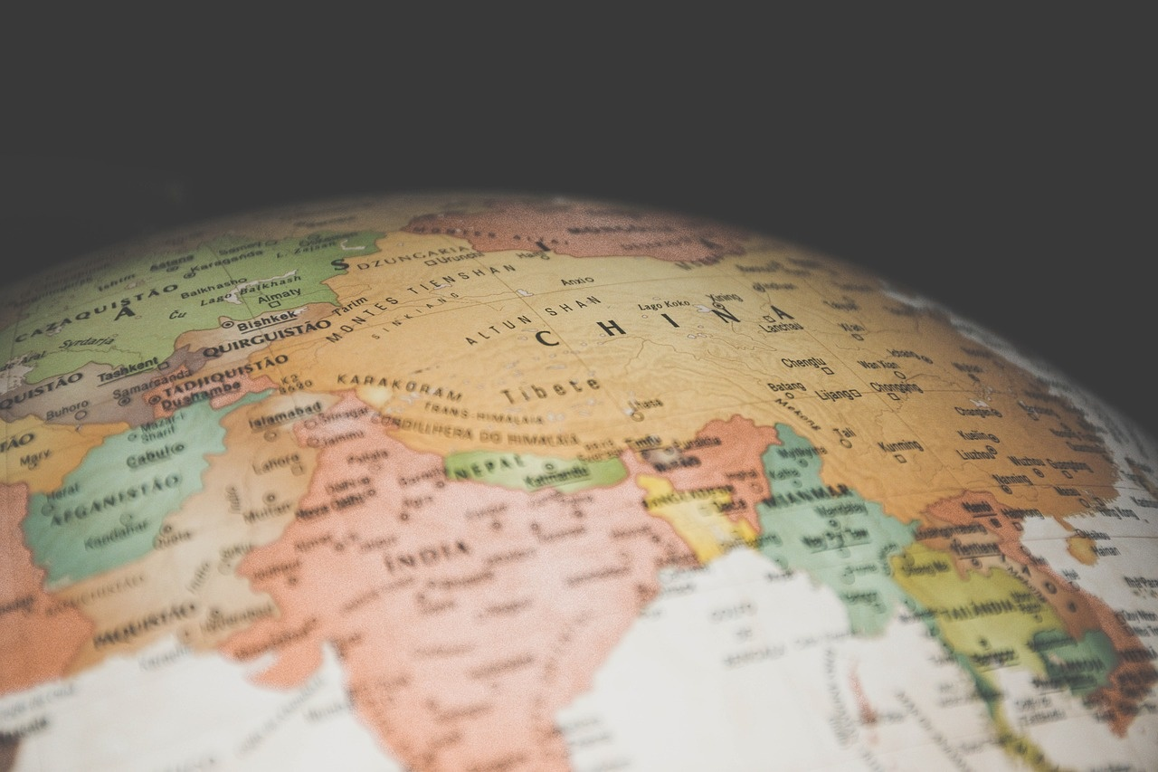
Elements of a Well-Developed World
Geography
Culture
Detailed maps and landscapes
Diverse ecosystems and climates
Unique landmarks and geographical features
Rich traditions and customs
Varied languages and dialects
Social hierarchies and norms
History
Magic Systems
Technology
Complex timelines and historical events
Legends and myths shaping the world
Impact of past conflicts and civilizations
Rules and limitations of magic
Different types of magical abilities
Influence of magic on society and individuals
Advancements and innovations
Impact on daily life and industries
Historical development and future possibilities
Crafting Immersive Worlds

Slide 14
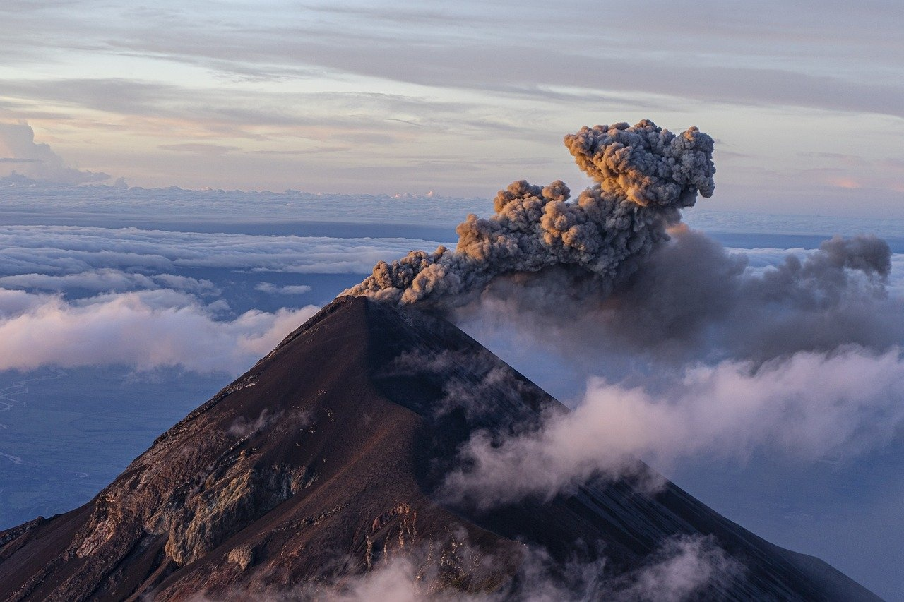
Geography and Culture in Fiction
Geography
Culture
Physical Landscapes: Mountains, forests, rivers, and deserts shape the terrain and influence the movement of characters.
Climate: Weather patterns, seasons, and natural disasters add depth to the world and impact the lives of inhabitants.
Mapping: Creating detailed maps helps visualize the world and maintain consistency in storytelling.
Social Structures: Hierarchies, customs, and traditions define societal norms and interactions.
Language: Developing unique languages or dialects adds authenticity and richness to different cultures.
Religion and Beliefs: Belief systems, rituals, and myths shape the worldview of characters and societies.
Geography
Culture
Physical Landscapes: Mountains, forests, rivers, and deserts shape the terrain and influence the movement of characters.
Climate: Weather patterns, seasons, and natural disasters add depth to the world and impact the lives of inhabitants.
Mapping: Creating detailed maps helps visualize the world and maintain consistency in storytelling.
Social Structures: Hierarchies, customs, and traditions define societal norms and interactions.
Language: Developing unique languages or dialects adds authenticity and richness to different cultures.
Religion and Beliefs: Belief systems, rituals, and myths shape the worldview of characters and societies.
Crafting Immersive Worlds

Slide 15

History and Magic Systems
Historical Timeline
Cultural Evolution
Develop a detailed timeline of significant events that have shaped the world's past, including wars, alliances, and key figures.
Explore how different cultures within the world have evolved over time, influencing traditions, beliefs, and societal norms.
Magic System Origins
Magic Rules and Limitations
Magic Schools or Orders
Define the origins of magic within the world, whether it stems from ancient deities, natural energies, or mystical artifacts.
Establish clear rules and limitations for the use of magic to maintain consistency and prevent it from becoming a deus ex machina.
Introduce various magical schools or orders that specialize in different types of magic, each with its own unique practices and philosophies.
Crafting Immersive Worlds

Slide 16

Fully Realized Setting
Geography
Culture
Detailed maps, landscapes, and ecosystems that shape the physical environment of the world.
Rich traditions, beliefs, languages, and societal norms that define the inhabitants of the world.
Geography
Culture
Detailed maps, landscapes, and ecosystems that shape the physical environment of the world.
Rich traditions, beliefs, languages, and societal norms that define the inhabitants of the world.
Crafting Immersive Worlds

Slide 17

Tools for Creating Compelling Worlds
World Map Generator Software
Character Development Worksheets
Utilize specialized software to design detailed and visually appealing maps for your fictional world.
Worksheets to help flesh out characters' backgrounds, motivations, and relationships within the world.
Timeline Tools
Culture and Language Guides
Magic System Builders
Keep track of historical events, character arcs, and plot points with timeline creation tools.
Develop unique cultures and languages for your world using guides and resources tailored for world builders.
Craft intricate and consistent magic systems with the help of specialized tools and frameworks.
Crafting Immersive Worlds

Slide 18

Fascinating Characters and Thrilling Adventures
Dynamic Characters
Create characters with depth, flaws, and motivations that drive the narrative forward.
Character Arcs
Develop compelling character arcs that show growth, change, and challenges throughout the story.
Exciting Plot Twists
Incorporate unexpected twists and turns to keep readers engaged and eager to uncover what happens next.
High-Stakes Adventures
Infuse your world with high-stakes adventures that push characters to their limits and test their resolve.
Emotional Resonance
Craft emotional moments that resonate with readers, evoking empathy, excitement, and connection.
Crafting Immersive Worlds

Slide 19
Aspiring Writers' Journey
Introduction to World Building
Elements of World Building
Techniques for Crafting Worlds
Creating Believable Settings
Bringing Characters to Life
Understand the importance of creating immersive fictional worlds.
Explore geography, culture, history, and magic systems.
Learn how to develop rich and vibrant environments.
Dive into the details that make a world come alive for readers.
Connect world building to character development for a cohesive narrative.
01
02
03
04
05
Crafting Immersive Worlds

Slide 20

Unique and Compelling Worlds
Intricate Geography
Diverse Cultures
From sprawling mountain ranges to vast oceans, the geography of a world shapes its landscapes and influences the lives of its inhabitants.
Rich cultural diversity adds depth and authenticity to a world, showcasing unique traditions, languages, and societal norms.
Intricate Geography
Diverse Cultures
From sprawling mountain ranges to vast oceans, the geography of a world shapes its landscapes and influences the lives of its inhabitants.
Rich cultural diversity adds depth and authenticity to a world, showcasing unique traditions, languages, and societal norms.
Crafting Immersive Worlds

Slide 21

Populating Fictional Environments
Creating Diverse Characters
Establishing Societal Structures
Develop a range of characters with unique backgrounds
Motivations and personalities to inhabit the world
Define social hierarchies
Political systems and cultural norms that shape interactions within the environment
Integrating Flora and Fauna
Designing Architectural Styles
Incorporating Local Traditions
Populate the world with a variety of plant and animal life
Enhance realism and provide ecological context
Craft distinct architectural styles for different regions
Reflect the cultural diversity within the fictional world
Infuse the environment with customs, rituals, and traditions
Add depth and authenticity to the setting
Crafting Immersive Worlds

Slide 22
Captivating Narratives
Establishing a Strong Foundation
Creating Compelling Characters
Weaving Intriguing Plotlines
Integrating Conflict and Resolution
Utilizing World-Building Details
Begin by defining the core elements of your world, including its geography, cultures, and societies.
Develop diverse and multi-dimensional characters that resonate with your audience and drive the narrative forward.
Craft engaging story arcs filled with twists, turns, and moments of suspense to keep readers hooked.
Introduce conflicts that challenge your characters and propel the story towards a satisfying resolution.
Pay attention to small details like language, customs, and technology to enhance the immersive experience for readers.
01
02
03
04
05
Crafting Immersive Worlds

Slide 23

Immersive Storytelling
Setting the Stage
Character Depth
Establishing a vivid and detailed backdrop for the narrative.
Developing complex and relatable characters to inhabit the world.
Plot Dynamics
World Consistency
Reader Engagement
Crafting engaging storylines that unfold within the immersive world.
Ensuring continuity and coherence in the fictional universe.
Inviting readers to emotionally invest in the story and its world.
Crafting Immersive Worlds

