Slide 1

Developing Reading Comprehension and Writing Skills for Diverse Learners
Effective Scaffolded Instruction and Support Strategies for ELL/ESL Students

Slide 2
Table of Contents
Introduction to Developing Reading Comprehensi…
Importance of Reading Comprehension and Writin…
Scaffolded Instruction for Diverse Learners
ELL/ESL Support Strategies
Reading Comprehension Strategies
Writing Workshop
Vocabulary Development
Text Analysis
Assessment and Feedback
Technology Integration
Conclusion
Next Steps
Reflection Questions
04
05
06
07
08
09
10
11
12
13
14
15
16

Slide 3
Table of Contents
References
Additional Resources
Final Thoughts
Evaluation and Feedback
Conclusion and Recommendations
17
18
19
20
21

Slide 4

Introduction to Developing Reading Comprehension and Writing Skills
Importance of Reading and Writing Skills
Support for Diverse Learners
Focus of the Presentation
Developing reading comprehension and writing skills is crucial for academic success and effective communication.
These skills form the foundation for learning across all subjects and enable students to express their ideas effectively.
Scaffolded instruction can support diverse learners, including English Language Learners (ELLs) and English as a Second Language (ESL) students.
This approach provides tailored support to meet the unique needs of each learner, fostering their growth and confidence.
This presentation will explore strategies for developing reading comprehension and writing skills through scaffolded instruction.
Attendees will gain insights into effective methods to enhance these essential skills in diverse educational settings.
4
Developing Reading Comprehension and Writing Skills for Diverse Learners

Slide 5

Importance of Reading Comprehension and Writing Skills
Academic Success and Communication
Life-Long Benefits
Reading comprehension and writing skills are essential for academic success and effective communication.
These skills are critical for navigating complex texts, expressing thoughts and ideas, and communicating with others.
Developing these skills can help students succeed in all areas of life.
They provide the foundation for personal and professional growth.
Support for All Students
Empowering Expression
ELL/ESL support strategies can help ensure that all students have an equal opportunity to succeed.
These strategies address the unique challenges faced by English language learners.
Strong reading and writing skills empower individuals to articulate their thoughts clearly.
This ability fosters better understanding and collaboration in diverse settings.
5
Developing Reading Comprehension and Writing Skills for Diverse Learners

Slide 6

Scaffolded Instruction for Diverse Learners
Temporary Support for Skill Development
Effectiveness for Diverse Learners
Strategies for Scaffolding
Scaffolded instruction provides temporary support and guidance to help students learn new skills.
This approach ensures learners can gradually achieve independence in their learning process.
This approach is particularly effective for diverse learners, including ELL/ESL students.
It addresses unique learning needs by tailoring support to individual requirements.
Scaffolded instruction can include strategies such as graphic organizers, sentence frames, and visual aids.
These tools help simplify complex concepts and make learning more accessible.
6
Developing Reading Comprehension and Writing Skills for Diverse Learners

Slide 7

ELL/ESL Support Strategies
Visual Aids and Organizers
Extra Support and Feedback
ELL/ESL support strategies can include visual aids, graphic organizers, and sentence frames.
These tools help students understand complex concepts and vocabulary.
Providing extra support and feedback can also help ELL/ESL students succeed.
This ensures they stay on track and build confidence in their learning.
Technology Integration
Comprehension Tools
Technology can provide additional support and resources for ELL/ESL students.
It offers interactive and engaging ways to reinforce learning.
Sentence frames and graphic organizers simplify learning for ELL/ESL students.
These tools break down information into manageable parts.
7
Developing Reading Comprehension and Writing Skills for Diverse Learners

Slide 8

Reading Comprehension Strategies
01
Identifying Key Elements
Reading comprehension strategies include identifying main ideas and supporting details.
These elements form the foundation for understanding texts effectively.
02
Critical Thinking Skills
Making inferences and summarizing texts are also critical reading comprehension skills.
These skills enable deeper engagement with the material.
03
Support for ELL/ESL Students
ELL/ESL students can benefit from explicit instruction and guided practice in these areas.
Tailored strategies can enhance their reading comprehension abilities.
04
Reinforcement Through Application
Providing opportunities for students to apply their learning can help reinforce reading comprehension skills.
Practical exercises ensure the retention and mastery of these strategies.
8
Developing Reading Comprehension and Writing Skills for Diverse Learners

Slide 9
Writing Workshop
Supportive Learning Environment
Skill Development
Collaborative Feedback
A writing workshop provides a supportive and collaborative learning environment.
Students can practice writing in response to a prompt and receive feedback from peers and the teacher.
Writing workshops can help students develop their writing skills and confidence.
They offer opportunities for structured practice and constructive feedback.
Students benefit from sharing their work and receiving insights from both peers and teachers.
This process fosters growth and enhances their ability to express ideas effectively.
9
Developing Reading Comprehension and Writing Skills for Diverse Learners

Slide 10
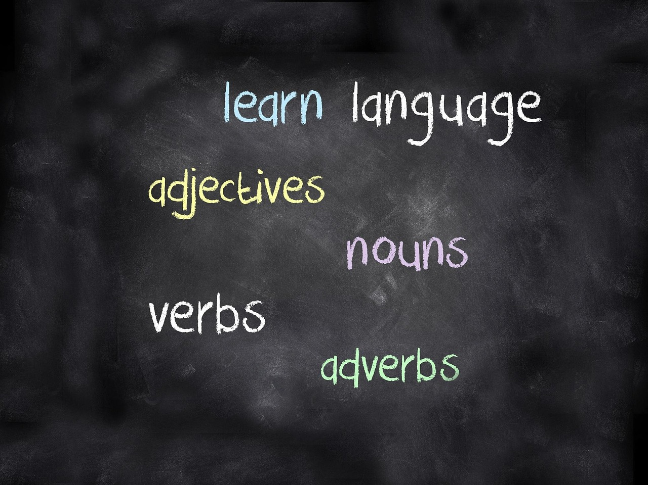
Vocabulary Development
Importance of Vocabulary Development
Support for ELL/ESL Students
Vocabulary development is critical for reading comprehension and writing skills.
It forms the foundation for effective communication and academic success.
ELL/ESL students can benefit from explicit instruction and practice in vocabulary development.
Tailored strategies can address their unique learning needs.
Decoding Strategies
Reinforcement Through Application
Strategies such as using context clues and prefixes/suffixes can help students decode unfamiliar words.
These techniques empower students to independently expand their vocabulary.
Providing opportunities for students to apply their learning can help reinforce vocabulary development.
Practical exercises and real-world applications solidify their understanding.
10
Developing Reading Comprehension and Writing Skills for Diverse Learners

Slide 11
Text Analysis
Key Components of Text Analysis
Support for ELL/ESL Students
Importance of Guided Practice
Reinforcement Through Application
Text analysis involves identifying main ideas and supporting details.
Making inferences and identifying author's purpose are also critical text analysis skills.
ELL/ESL students can benefit from explicit instruction and guided practice in these areas.
Providing opportunities for students to apply their learning can help reinforce text analysis skills.
Explicit instruction and guided practice are essential for mastering text analysis.
These methods help students understand and apply critical reading skills effectively.
Applying learned skills in real-world contexts reinforces text analysis abilities.
Such opportunities ensure students retain and utilize their knowledge effectively.
11
Developing Reading Comprehension and Writing Skills for Diverse Learners

Slide 12

Assessment and Feedback
1
Importance of Assessment and Feedback
Assessment and feedback are critical for student learning and progress.
Providing regular feedback and assessment can help students identify areas for improvement.
2
Tailored Support for ELL/ESL Students
ELL/ESL students can benefit from feedback and assessment that is tailored to their needs.
Providing customized feedback helps address their unique learning challenges.
3
Enhancing Student Growth
Regular assessment fosters a deeper understanding of subject material.
Feedback encourages students to actively engage in their learning journey.
12
Developing Reading Comprehension and Writing Skills for Diverse Learners

Slide 13
Technology Integration
Tools for Instructional Support
Enhancing ELL/ESL Learning
Reinforcing Learning Through Application
Multimedia for Skill Development
Technology can provide a range of tools and resources to support instruction.
Online graphic organizers, writing templates, and multimedia texts can support reading comprehension and writing skills.
ELL/ESL students can benefit from technology that provides additional support and practice.
These tools can help bridge language gaps and improve overall learning outcomes.
Providing opportunities for students to apply their learning can help reinforce technology integration.
Hands-on activities and real-world applications enhance understanding and retention.
Multimedia texts can support reading comprehension and writing skills.
They offer diverse formats to engage students and cater to different learning styles.
13
Developing Reading Comprehension and Writing Skills for Diverse Learners

Slide 14

Conclusion
Importance of Scaffolded Instruction
Opportunities for Application
Developing reading comprehension and writing skills through scaffolded instruction is crucial for diverse learners.
By incorporating ELL/ESL support strategies, teachers can help students succeed in all areas of life.
Providing opportunities for students to apply their learning is essential.
This approach ensures students are better prepared for success in all areas of life.
14
Developing Reading Comprehension and Writing Skills for Diverse Learners

Slide 15
Next Steps
Scaffolded Instruction for Skill Development
Feedback to Reinforce Learning
Inclusive Strategies for ELL/ESL Students
Teachers can continue to support the development of reading comprehension and writing skills through scaffolded instruction.
Providing opportunities for students to apply their learning and receive feedback can help reinforce skills.
Providing opportunities for students to apply their learning and receive feedback can help reinforce skills.
ELL/ESL support strategies can be incorporated into future lessons to ensure that all students have an equal opportunity to succeed.
ELL/ESL support strategies can be incorporated into future lessons to ensure that all students have an equal opportunity to succeed.
Teachers can continue to support the development of reading comprehension and writing skills through scaffolded instruction.
15
Developing Reading Comprehension and Writing Skills for Diverse Learners

Slide 16

Reflection Questions
1
Effective Strategies for ELL/ESL Support
What strategies were most effective in supporting ELL/ESL students?
Reflect on the methods that have shown the greatest impact in helping English language learners succeed.
2
Differentiating Instruction for Diverse Needs
How can I continue to differentiate instruction to meet the diverse needs of my students?
Consider ways to tailor teaching approaches to accommodate varying learning styles and abilities.
3
Opportunities for Application and Feedback
What opportunities can I provide for students to apply their learning and receive feedback?
Explore activities that allow students to demonstrate understanding and gain constructive insights.
16
Developing Reading Comprehension and Writing Skills for Diverse Learners

Slide 17
References
Effective Writing Instruction
Teaching English as a Second Language
National Council of Teachers of English. (2019). Principles of Effective Writing Instruction.
This reference outlines key principles for teaching writing effectively, emphasizing clarity and engagement.
TESOL International Association. (2020). Principles and Practices of Teaching English as a Second Language.
This resource provides strategies for teaching English to non-native speakers, focusing on inclusivity and adaptability.
17
Developing Reading Comprehension and Writing Skills for Diverse Learners

Slide 18
Additional Resources
Graphic Organizers and Writing Templates
Multimedia Texts and Educational Apps
Professional Development for Teachers
Online graphic organizers and writing templates can support reading comprehension and writing skills.
These tools are particularly useful for structuring ideas and improving clarity in writing.
Multimedia texts and educational apps can provide additional support and practice for ELL/ESL students.
They offer interactive and engaging ways to enhance language learning and comprehension.
Professional development opportunities can help teachers stay up-to-date on best practices in scaffolded instruction and ELL/ESL support.
These programs ensure educators are equipped with effective strategies to assist diverse learners.
18
Developing Reading Comprehension and Writing Skills for Diverse Learners

Slide 19

Final Thoughts
Importance of Scaffolded Instruction
Opportunities for Student Success
Developing reading comprehension and writing skills through scaffolded instruction is crucial for diverse learners.
By incorporating ELL/ESL support strategies, teachers can address the unique needs of students effectively.
Providing opportunities for students to apply their learning helps them succeed in all areas of life.
Teachers play a key role in empowering students to achieve their full potential.
19
Developing Reading Comprehension and Writing Skills for Diverse Learners

Slide 20

Evaluation and Feedback
1
2
3
Importance of Evaluation and Feedback
Tailored Feedback for ELL/ESL Students
Enhancing Student Progress
Evaluation and feedback are critical for student learning and progress.
Providing regular feedback and assessment can help students identify areas for improvement.
ELL/ESL students can benefit from feedback and assessment that is tailored to their needs.
This approach ensures that their unique challenges are addressed effectively.
Regular assessment highlights areas where students can improve.
It fosters a deeper understanding and supports continuous learning.
20
Developing Reading Comprehension and Writing Skills for Diverse Learners

Slide 21
Conclusion and Recommendations
Importance of Scaffolded Instruction
Strategies for Student Success
Developing reading comprehension and writing skills through scaffolded instruction is crucial for diverse learners.
This approach ensures that students receive the necessary support to build foundational skills effectively.
Teachers should incorporate ELL/ESL support strategies and provide opportunities for students to apply their learning.
These practices help students succeed in all areas of life by addressing their unique needs and fostering growth.
21
Developing Reading Comprehension and Writing Skills for Diverse Learners

