Slide 1
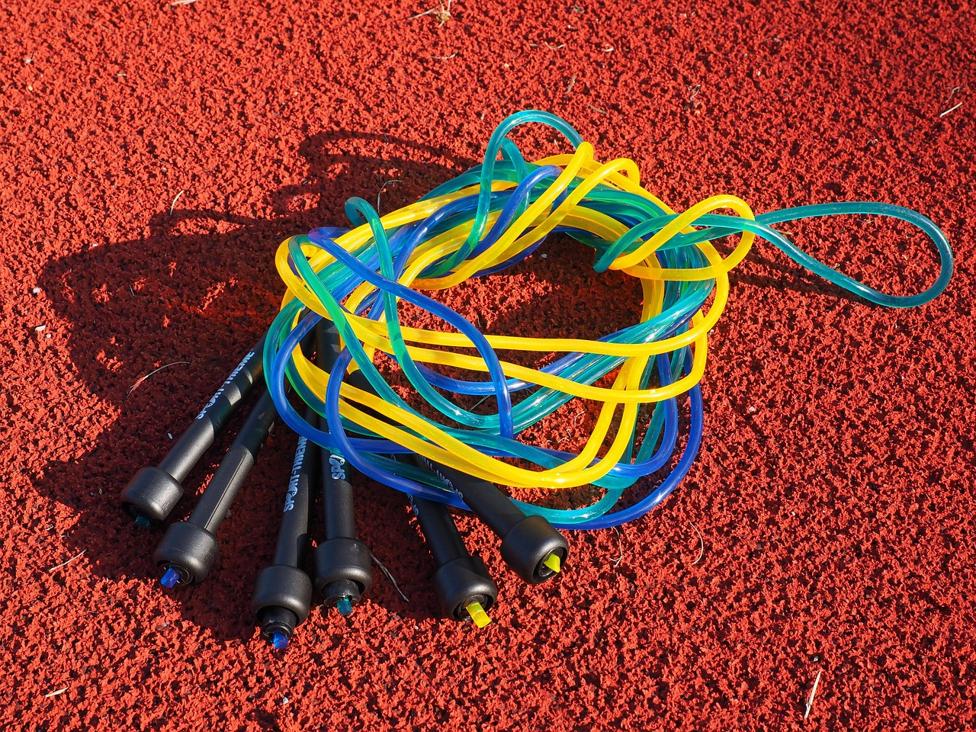
Engaging Young Learners: A Comprehensive Approach to Teaching Jabari Jumps
Strategies, Assessments, and Resources for Effective Literacy Instruction

Slide 2
Engaging Young Learners: A Comprehensive Approach to Teaching Jabari Jumps
2
Table of Contents
Introduction to Jabari Jumps
Lesson Objectives
Introduction to the Story
Teaching Script
Guided Practice
Independent Practice
Subject Knowledge
Extended Knowledge
Common Errors and Misconceptions
Common FAQ
Objectives and Vocabulary
Resources and Prior Knowledge
Differentiation Strategies
04
05
06
07
08
09
10
11
12
13
14
15
16

Slide 3
Engaging Young Learners: A Comprehensive Approach to Teaching Jabari Jumps
3
Table of Contents
Cross-Curricular Links
Group Activities and Digital Integration
Review and Formative Assessment
Summative Assessment and Example Questions
Homework and Extension Activities
Parent Engagement and Safety Considerations
Conclusion and Next Steps
Teaching Tips and Key Takeaways
Reflection Questions
17
18
19
20
21
22
23
24
25

Slide 4

Engaging Young Learners: A Comprehensive Approach to Teaching Jabari Jumps
4
Introduction to Jabari Jumps
Story Overview
Educational Objectives
Learning Outcomes
Jabari Jumps is a story about a young boy who must overcome his fears to jump off a diving board.
The narrative highlights themes of perseverance, courage, and the importance of trying new things.
This lesson plan is tailored for 7-year-old students to enhance their reading comprehension skills.
It also aims to develop storytelling abilities through the retelling of Jabari Jumps.
Students will learn valuable lessons about facing fears and embracing challenges.
They will also practice articulating the story's events and themes effectively.

Slide 5

Engaging Young Learners: A Comprehensive Approach to Teaching Jabari Jumps
5
Lesson Objectives
Retelling the Story
Character Analysis
Students will be able to retell the story in their own words.
This activity encourages comprehension and articulation of the narrative.
Students will identify the main characters and their motivations.
Understanding character motivations aids in deeper engagement with the story.
Plot Significance
Critical Thinking and Communication
Students will understand the plot and its significance.
This understanding helps in grasping the overarching themes and messages.
Students will develop their critical thinking and communication skills through the retelling and discussion of the story.
These skills are essential for effective analysis and collaborative learning.

Slide 6

Engaging Young Learners: A Comprehensive Approach to Teaching Jabari Jumps
6
Introduction to the Story
Jabari's Initial Hesitation
Father's Encouragement
Journey of Confidence
The story begins with Jabari standing on the diving board, feeling afraid to jump.
This moment sets the stage for his journey of overcoming fear.
Jabari's father encourages him to face his fears and try new things.
His support plays a crucial role in Jabari's development throughout the story.
The story explores Jabari's journey as he learns to overcome his fears.
Through this process, he develops confidence and a sense of accomplishment.

Slide 7

Engaging Young Learners: A Comprehensive Approach to Teaching Jabari Jumps
7
Teaching Script
Introduction to the Story
Reading Aloud
Discussion of Key Elements
Story Retelling Activity
Whole-Class Discussion
Introduce the story and its author, Gaia Cornwall.
This activity is scheduled for minutes 1-5.
Read the book aloud to the class.
Ask occasional questions to check for understanding during minutes 1-5.
Discuss the story's key elements, such as the main characters, setting, and plot.
This discussion takes place during minutes 6-10.
Have students retell the story in small groups using story sequencing cards.
This activity is planned for minutes 11-15.
Lead a whole-class discussion on the story's themes and messages.
This discussion is scheduled for minutes 16-20.

Slide 8

Engaging Young Learners: A Comprehensive Approach to Teaching Jabari Jumps
8
Guided Practice
Story Sequencing
Character Analysis
Retelling the Story
Making Connections
Discussion Forum
Have students work in pairs to put the events of the story in order.
This activity helps students understand the narrative structure and sequence of events.
Have students work in small groups to analyze the main characters and their motivations.
This encourages deeper comprehension of character development and their roles in the story.
Have students work in pairs to retell the story using a story map.
This reinforces their understanding of the plot and key events.
Have students think about a time when they faced a challenge or were afraid to try something new.
This activity fosters personal connections to the story and enhances empathy.
Have students prepare questions and comments about the story and participate in a class discussion.
This promotes critical thinking and collaborative learning.

Slide 9

Engaging Young Learners: A Comprehensive Approach to Teaching Jabari Jumps
9
Independent Practice
Story Retelling Activity
Character Diary Exercise
Alternative Ending Task
Story Summary Assignment
Author Study Project
Students will retell the story in their own words.
They will use a story map to organize their retelling.
Students will write a diary entry.
The entry will be from the perspective of one of the main characters.
Students will create an alternative ending to the story.
This encourages creative thinking and understanding of the story's structure.
Students will write a summary of the story.
This helps them practice condensing information and identifying key points.
Students will research the author Gaia Cornwall.
They will write a short biography based on their findings.

Slide 10

Engaging Young Learners: A Comprehensive Approach to Teaching Jabari Jumps
10
Subject Knowledge
The Importance of Perseverance
The Role of Family Support
Perseverance is the ability to continue trying hard despite difficulties or challenges.
It is a key trait that helps individuals overcome obstacles and achieve their goals.
Family support is crucial for children's development and well-being.
It provides a foundation of security and encouragement for growth and learning.
The Concept of Courage
The Significance of Trying New Things
Courage is the ability to do something that frightens or challenges you.
It enables individuals to face fears and take bold steps towards their aspirations.
Trying new things is essential for children's development and growth.
It fosters adaptability, creativity, and a broader understanding of the world.

Slide 11

Engaging Young Learners: A Comprehensive Approach to Teaching Jabari Jumps
11
Extended Knowledge
Perseverance and Grit
Exploration of Emotions and Empathy
Physical Education Insights
Character Education Themes
Literacy Development
Jabari's journey teaches students the importance of persistence and trying again.
This theme encourages resilience and determination in the face of challenges.
The story provides an opportunity to discuss and understand different emotions.
It fosters a deeper understanding of empathy and emotional intelligence.
The story offers a chance to extend knowledge in physical education, particularly in the area of swimming and diving.
This connection promotes physical activity and skill development.
The story can be used to teach character education, particularly in the areas of courage, self-confidence, and self-esteem.
These lessons are essential for personal growth and development.
The story provides an opportunity to extend knowledge in literacy, particularly in the areas of comprehension, vocabulary, and writing.
This enhances language skills and critical thinking.

Slide 12

Engaging Young Learners: A Comprehensive Approach to Teaching Jabari Jumps
12
Common Errors and Misconceptions
Misconception about Jabari's Autonomy
Assumption about Jabari's Fear
There is a common misconception that Jabari is being forced to jump off the diving board against his will.
This overlooks the personal agency and decision-making process Jabari undergoes in the story.
Some assume that Jabari's fear of jumping is irrational or unnecessary.
This perspective fails to acknowledge the natural and valid emotions associated with facing new challenges.
Misconception about the Role of Encouragement
Assumption about the Story's Theme
It is often misconceived that Jabari's success is solely due to his father's encouragement.
This view does not fully consider Jabari's own courage and determination in achieving his goal.
There is an assumption that the story is only about overcoming fear.
This interpretation misses the broader theme of the importance of trying new things and taking risks.

Slide 13

Engaging Young Learners: A Comprehensive Approach to Teaching Jabari Jumps
13
Common FAQ
Theme of Jabari Jumps
Supporting Students with Fears
Role of Jabari's Father
Incorporating Jabari Jumps in Physical Education
Assessing Student Understanding
The main theme of the story is the importance of perseverance, courage, and trying new things.
It highlights the journey of overcoming challenges and embracing growth.
Helping students overcome their fears and anxieties requires a supportive and non-judgmental approach.
Creating a safe environment for expression and encouragement is key.
Jabari's father plays a significant role in the story as a supportive and encouraging figure.
His presence helps Jabari build confidence and face his fears.
The story of Jabari Jumps can be incorporated into physical education classes by teaching students about the basics of diving.
It serves as a practical example to discuss overcoming challenges in physical activities.
There are several ways to assess student understanding of the story, including retelling the story in their own words.
This method allows educators to gauge comprehension and personal interpretation.

Slide 14

Engaging Young Learners: A Comprehensive Approach to Teaching Jabari Jumps
14
Objectives and Vocabulary
Learning Objectives Overview
Key Vocabulary Introduction
The learning objectives for this lesson are designed to align with Bloom's Taxonomy.
The four specific, measurable learning objectives are: Remembering, Understanding, Analyzing, and Creating.
Key vocabulary words include: perseverance, courage, diving board, fear, encouragement, success, challenge, determination, support, pride, anxiety, and achievement.
These words are integral to understanding the lesson's themes and will be explored in depth.
Vocabulary Usage in Context
Lesson Integration
Students will be encouraged to use the vocabulary words in their discussions and writings about the story.
This practice aims to enhance their comprehension and communication skills.
The vocabulary words will be defined and explained during the lesson.
This approach ensures that students grasp their meanings and applications effectively.

Slide 15

Engaging Young Learners: A Comprehensive Approach to Teaching Jabari Jumps
15
Resources and Prior Knowledge
Teaching Resources
Prerequisite Concepts
The following teaching resources will be used to support the lesson: copy of Jabari Jumps, whiteboard and markers, story sequencing cards, character map template, digital writing tool, and audio recording device.
These resources are essential for facilitating the lesson effectively and engaging students in the learning process.
Prior to diving into the story, students should possess certain prerequisite concepts, including an understanding of basic story structure and familiarity with basic literary vocabulary.
These foundational skills will enable students to better comprehend and analyze the story.
Inference and Emotional Intelligence
Assessment and Reinforcement
Students should also be able to make inferences based on textual evidence and understand emotional intelligence.
These skills are critical for interpreting the story's themes and character motivations.
These prior knowledge concepts will be assessed through class discussions and activities, and will be reinforced throughout the lesson.
This approach ensures that students are prepared and supported in their learning journey.

Slide 16

Engaging Young Learners: A Comprehensive Approach to Teaching Jabari Jumps
16
Differentiation Strategies
Visual Learning Support
Auditory Learning Enhancement
Kinesthetic Learning Activities
Support for Additional Needs
Challenges for Advanced Learners
To cater to visual learners, visual aids and graphic organizers are provided.
These tools help students understand and retain information effectively.
Audio support is offered for students who are auditory learners.
This approach ensures that auditory learners can engage with the lesson content.
Movement and action are incorporated into lessons for kinesthetic learners.
This strategy helps these students learn through physical engagement.
Extra help is provided for students who require additional support.
This ensures that all students can progress at their own pace.
Students who need extra stimulation are offered challenges.
This approach keeps advanced learners engaged and motivated.

Slide 17

Engaging Young Learners: A Comprehensive Approach to Teaching Jabari Jumps
17
Cross-Curricular Links
Physical Education Integration
Artistic Expression
The story of Jabari Jumps offers a connection to physical education.
Students can participate in activities that relate to the story, enhancing their physical skills.
The narrative inspires artistic endeavors in the classroom.
Students can create illustrations or paintings inspired by the story, fostering creativity.
Exploring Community in Social Studies
Comprehensive Learning Experience
Social studies can incorporate themes from Jabari Jumps.
Students can explore the concept of community and its relation to the story.
Jabari Jumps provides opportunities for cross-curricular integration.
This approach creates a comprehensive and engaging learning experience for students.

Slide 18

Engaging Young Learners: A Comprehensive Approach to Teaching Jabari Jumps
18
Group Activities and Digital Integration
Purpose of Group Activities
Types of Group Activities
The group activities for retelling Jabari Jumps are designed to promote collaboration, critical thinking, and creativity among 7-year-old students.
These activities aim to foster teamwork and enhance cognitive skills.
The activities include story sequencing, character analysis, story retelling, and theme discussion.
These tasks encourage students to engage deeply with the story's content.
Digital Integration Techniques
Benefits of the Activities
The digital integration activities include digital storytelling, online character analysis, virtual book club, digital illustrations, and audio retelling.
These methods incorporate technology to enrich the learning experience.
These activities will be used to enhance student learning and engagement.
They provide opportunities for students to demonstrate their creativity and self-expression.

Slide 19

Engaging Young Learners: A Comprehensive Approach to Teaching Jabari Jumps
19
Review and Formative Assessment
Review Strategies
Formative Assessment Techniques
The review strategies for the lesson include story recall, character review, theme reflection, self-evaluation, and peer review.
These methods aim to reinforce the material covered and ensure comprehension.
The formative assessment strategies include observation, check-in questions, peer feedback, and self-assessment.
These approaches help in gauging students' understanding and engagement.
Purpose of Strategies
Instructional Adjustments
These strategies will be used to monitor students' progress and understanding throughout the lesson.
They also provide feedback and guidance as needed to support learning.
The results of these assessments will be used to adjust instruction.
This ensures targeted support is provided to students who need it.

Slide 20

Engaging Young Learners: A Comprehensive Approach to Teaching Jabari Jumps
20
Summative Assessment and Example Questions
Summative Assessment Components
Example Questions for Assessment
The summative assessment for the lesson includes written retell, oral presentation, story sequencing, and illustrated retell.
These methods aim to evaluate students' comprehension and ability to express their understanding of the story.
Example questions can be used to assess students' understanding of the story and its key elements.
Questions include identifying the main character's name, Jabari's biggest challenge, and his motivation to jump off the diving board.
Purpose of Example Questions
Utilization of Assessment Results
These questions can be used to evaluate students' understanding of the story and its themes.
They also provide an opportunity to offer feedback and guidance to students as needed.
The results of these assessments will be used to evaluate the effectiveness of the lesson.
Additionally, they help identify areas for improvement in teaching and learning strategies.

Slide 21

Engaging Young Learners: A Comprehensive Approach to Teaching Jabari Jumps
21
Homework and Extension Activities
Homework Assignments
Extension Activities
The homework assignments for the lesson include Jabari's Journal, Story Sequencing, and Jabari's Courageous Act.
These tasks aim to reinforce the story's themes and provide a structured approach to learning.
The extension activities include Create a Comic Strip, Jabari's Diving Board Design, and Author Study.
These activities are designed to encourage creativity and self-expression among students.
Learning Objectives Reinforcement
Application of Themes
These activities will be used to reinforce the learning objectives.
They provide opportunities for students to demonstrate their understanding and skills.
The activities encourage students to apply the story's themes and messages to their own lives.
They also aim to develop critical thinking and problem-solving skills.

Slide 22

Engaging Young Learners: A Comprehensive Approach to Teaching Jabari Jumps
22
Parent Engagement and Safety Considerations
Parent Engagement Strategies
Safety Considerations for Water Activities
The parent engagement strategies for the lesson include Reading Together, Sharing Experiences, and Creating a Courageous Acts Jar.
These activities aim to foster collaboration and involvement between parents and students in the learning process.
The safety considerations for the lesson include being aware of any students who may have a fear of swimming or water.
Establishing clear rules and expectations for behavior during the lesson is essential to ensure a safe environment.
Addressing Allergies and Medical Conditions
Promoting Respect and Clear Instructions
The teacher should be prepared for any potential allergies or medical conditions that may be triggered by the story or activities.
This preparation ensures that all students can participate safely and comfortably in the lesson.
The teacher should ensure that all students understand the importance of respecting each other's feelings and opinions.
Providing clear instructions and demonstrations for any activities helps maintain a positive and inclusive classroom environment.

Slide 23

Engaging Young Learners: A Comprehensive Approach to Teaching Jabari Jumps
23
Conclusion and Next Steps
Summary of the Lesson
Next Steps in the Unit
The lesson on retelling Jabari Jumps by Gaia Cornwall offers a valuable opportunity for 7-year-old students to develop their reading comprehension, storytelling, and critical thinking skills.
This foundational lesson sets the stage for further exploration of these essential skills.
The next steps in this unit include two follow-up lessons that build on the learning progressions established in this lesson.
These lessons aim to deepen the students' understanding and application of the concepts introduced.
Focus of the First Follow-Up Lesson
Focus of the Second Follow-Up Lesson
The first follow-up lesson will focus on exploring different strategies for overcoming fears and challenges.
This will help students relate personally to the themes of the story and apply them to their own experiences.
The second follow-up lesson will focus on developing students' empathy and understanding towards others who may be facing similar challenges.
This lesson aims to foster a sense of community and support among the students.

Slide 24

Engaging Young Learners: A Comprehensive Approach to Teaching Jabari Jumps
24
Teaching Tips and Key Takeaways
Effective Teaching Strategies
Key Lesson Takeaways
The teaching tips for the lesson include using visual aids, encouraging active listening, promoting critical thinking, using story sequencing, and encouraging creative writing.
These strategies aim to enhance student engagement and understanding of the lesson content.
The key takeaways from the lesson include the importance of perseverance, courage, and trying new things.
These values are emphasized to inspire students to overcome challenges and embrace growth.
Empathy and Understanding
Skill Development Opportunities
Students learn the value of empathy and understanding towards others who may be facing similar challenges.
This aspect of the lesson fosters a supportive and inclusive classroom environment.
The lesson provides opportunities for students to develop their critical thinking and communication skills.
Students are encouraged to apply the story's themes and messages to their own lives, promoting personal growth.

Slide 25

Engaging Young Learners: A Comprehensive Approach to Teaching Jabari Jumps
25
Reflection Questions
Engagement and Participation
Achievement of Learning Objectives
Creativity and Self-Expression
How effectively did the lesson engage students and promote their participation in the activities and discussions?
Consider the strategies used to involve students actively and their impact on the overall learning experience.
How well did the lesson achieve its learning objectives, particularly in terms of students' ability to retell the story and understand its themes and messages?
Evaluate the alignment of the lesson's outcomes with its intended goals and the depth of students' comprehension.
What opportunities were provided for students to demonstrate their creativity and self-expression, and how can these opportunities be expanded in future lessons?
Reflect on the avenues for creative engagement and propose enhancements for future instructional designs.

