Slide 1

Mastering Decimal Operations: A Comprehensive Guide
Exploring Addition, Subtraction, and Effective Teaching Strategies

Slide 2


Table of contents
Introduction to Decimal Addition and Subtraction
Importance of Decimal Addition and Subtraction
Teaching Strategies
Decimal Addition
Decimal Subtraction
Real-World Applications
Games and Activities
Assessment and Evaluation
Conclusion
Extension Activities
Parent Engagement
Safety Considerations
Teaching Tips
01
02
03
04
05
06
07
08
09
10
11
12
13

Slide 3
Table of contents
Reflection Questions
Next Steps
14
15

Slide 4

Introduction to Decimal Addition and Subtraction
Key Concepts
Learning Strategies
Skill Development
Decimal addition and subtraction are crucial for everyday tasks like managing money and measuring.
Mastering these concepts is essential for effective problem-solving.
Students will learn specific strategies such as using number lines and visual aids to solve decimal problems.
Hands-on practice will reinforce these strategies through engaging exercises.
This lesson focuses on developing mathematical thinking and problem-solving skills.
Activities will include real-world scenarios to enhance critical thinking in decimal operations.
1
Mastering Decimal Operations: A Comprehensive Guide

Slide 5

Importance of Decimal Addition and Subtraction
Everyday Applications
Foundation for Future Learning
Real-World Problem Solving
Decimal addition and subtraction are essential for everyday tasks like calculating prices and measuring lengths.
These skills help individuals manage budgets and make informed financial decisions.
Mastering decimal addition and subtraction is crucial for success in more advanced math concepts.
A strong grasp of these basics lays the groundwork for future academic achievements.
Students will learn to apply decimal addition and subtraction to solve real-world problems.
This practical application enhances critical thinking and analytical skills.
2
Mastering Decimal Operations: A Comprehensive Guide

Slide 6

Teaching Strategies
Visual Aids
Individual Support
Utilize graphs and charts to illustrate decimal concepts effectively.
Enhance understanding through visual representation of data.
Provide personalized guidance tailored to each student's needs.
Focus on addressing specific challenges faced by individual learners.
Interactive Learning
Collaborative Discussion
Incorporate games and activities to make learning enjoyable.
Engage students through hands-on experiences and practical applications.
Encourage students to work together and share ideas.
Foster a classroom environment that values open dialogue and teamwork.
3
Mastering Decimal Operations: A Comprehensive Guide

Slide 7

Decimal Addition
Lining Up Decimals
Adding Corresponding Digits
Example Calculations
When adding decimals, it is essential to line them up vertically by their decimal points.
This ensures that each digit is in the correct place value.
After lining up the decimals, add the digits in each column starting from the right.
If the sum exceeds 10, carry over to the next column on the left.
For instance, 2.5 + 1.8 equals 4.3, demonstrating the addition of decimals.
Another example is 5.2 + 3.1, which results in 8.3.
4
Mastering Decimal Operations: A Comprehensive Guide

Slide 8
Decimal Subtraction
Lining Up Decimals
Subtracting Digits
Example Calculations
Align the decimal points when subtracting to match each digit with its corresponding place value.
Start subtracting from the rightmost digit. If necessary, borrow from the left.
Here are examples to illustrate the process of decimal subtraction:
5.5 - 2.2 = 3.3
8.8 - 4.4 = 4.4
5
Mastering Decimal Operations: A Comprehensive Guide

Slide 9
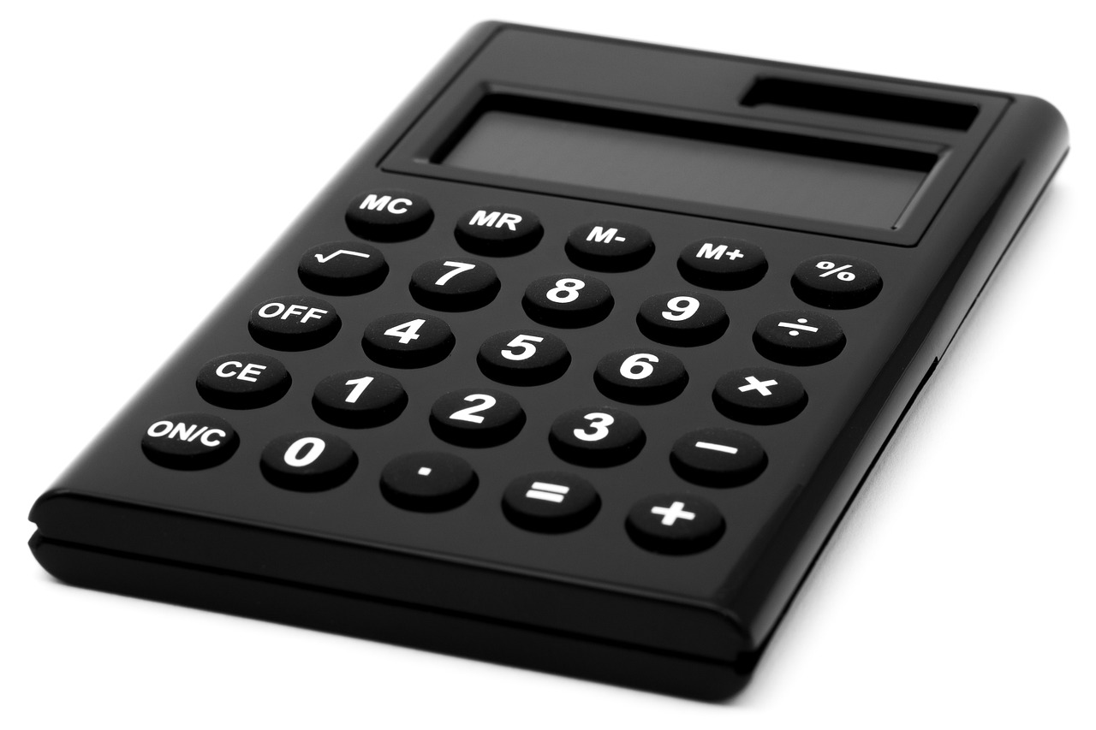
Real-World Applications
Shopping Costs
Length Measurement
Area Calculation
Calculate total costs using decimal addition and subtraction.
Apply these concepts to manage budgets effectively.
Measure lengths accurately for projects like construction or crafting.
Utilize decimals to compare and assess distances.
Determine the area of spaces like rooms or gardens.
Apply decimal concepts to solve area problems in real life.
6
Mastering Decimal Operations: A Comprehensive Guide

Slide 10

Games and Activities
Decimal War
Decimal Bingo
Decimal Scavenger Hunt
A card game where students compete to achieve the highest or lowest total by adding or subtracting decimals.
Players practice decimal addition and subtraction by marking their cards as problems are called out.
Students work in teams to find and solve decimal problems hidden around the classroom, enhancing collaboration and practical skills.
7
Mastering Decimal Operations: A Comprehensive Guide

Slide 11

Assessment and Evaluation
Quizzes & Tests
Projects & Presentations
Class Discussions
Assess students' understanding of decimal operations, identifying areas for targeted support.
Students create real-world applications of decimals, such as budgeting projects, and present their findings to enhance communication skills.
Discuss the importance of decimals in daily life and financial literacy, encouraging students to share personal experiences for better engagement.
8
Mastering Decimal Operations: A Comprehensive Guide

Slide 12
Conclusion
Decimal Operations
Problem-Solving Strategies
Math Thinking Development
Decimal addition and subtraction are essential math concepts that form the foundation for more advanced calculations.
Understanding these operations is crucial for everyday problem-solving.
Students have learned various strategies to tackle decimal problems effectively.
These strategies include estimation, breaking down numbers, and using visual aids.
This lesson has significantly developed students' math thinking and problem-solving skills.
Encouraging critical thinking helps students approach math challenges with confidence.
9
Mastering Decimal Operations: A Comprehensive Guide

Slide 13
Extension Activities
Decimal Games
Real-World Decimal Problems
Decimal Project Presentation
Design engaging games that enhance understanding of decimal concepts.
Include challenges that encourage teamwork and critical thinking.
Explore practical scenarios where decimals are used, such as managing a budget or measuring ingredients in cooking.
Discuss the impact of decimals in financial literacy and everyday decision-making.
Create an informative project that showcases the importance of decimals through real-life applications.
Utilize charts and graphs to effectively communicate findings and insights.
10
Mastering Decimal Operations: A Comprehensive Guide

Slide 14

Parent Engagement
Decimal Strategies
Practice Together
Learning Resources
Understand how decimals function in real-life scenarios.
Explore effective teaching methods for decimal concepts.
Engage in enjoyable decimal activities with your child.
Encourage regular practice to build confidence in decimals.
Discover interactive tools and games for decimal practice.
Access a variety of materials to aid your child's learning.
11
Mastering Decimal Operations: A Comprehensive Guide

Slide 15
Safety Considerations
Calculator Safety
Supportive Environment
Encourage Questions
Ensure students are trained on how to use calculators properly.
Monitor usage to prevent misuse and distractions.
Create a classroom atmosphere where students feel safe to express their thoughts.
Provide resources and support for students who may struggle with technology.
Foster an open dialogue where students can ask questions freely.
Reassure students that seeking help is a sign of strength, not weakness.
12
Mastering Decimal Operations: A Comprehensive Guide

Slide 16

Teaching Tips
Visual Aids
Individual Support
Engaging Activities
Utilize visual aids such as charts and diagrams to clarify decimal concepts.
Incorporate real-world examples to make the content relatable.
Offer personalized guidance to address each student's unique learning needs.
Encourage questions and provide feedback to foster understanding.
Integrate games and interactive activities to enhance student participation.
Use hands-on learning experiences to make lessons enjoyable.
13
Mastering Decimal Operations: A Comprehensive Guide

Slide 17

Reflection Questions
Student Struggles
Teaching Adaptations
Support Resources
Many students find decimal concepts challenging.
A common misconception is confusing tenths with hundredths.
Utilize visual aids, such as number lines and blocks, to clarify decimal concepts.
Incorporate real-life examples to make decimals relatable.
Offer online practice tools for extra learning.
Create interactive worksheets and engaging games that reinforce decimal skills.
14
Mastering Decimal Operations: A Comprehensive Guide

Slide 18
Next Steps
Decimal Review
New Math Concepts
Real-World Application
Practice decimal concepts with focused exercises.
Reinforce understanding of decimal place value.
Introduce multiplication and division with clear examples.
Utilize visual aids to enhance comprehension.
Apply decimal concepts in budgeting scenarios.
Engage with practical measurement challenges.
15
Mastering Decimal Operations: A Comprehensive Guide

