Slide 1

Exploring Advanced Agent Interaction Patterns in LangGraph
A Comprehensive Journey Through Language Graph Technology

Slide 2
Table of contents
01
02
03
04
05
06
07
08
09
10
11
Title Slide: Advanced Agent Interaction Patterns in LangGra…
Course Overview
What is LangGraph?
Conditional Routing Fundamentals
Persistent Memory Architecture
Complex Decision-Making Strategies
Technical Implementation
Practical Applications
Ethical Considerations
Performance Metrics
Challenges and Limitations

Slide 3
Table of contents
12
13
14
15
16
17
18
Future Perspectives
Learning Pathway
Recommended Resources
Conclusion
Q&A
Design Recommendations
Technical Notes

Slide 4

1
Title Slide: Advanced Agent Interaction Patterns in LangGraph
Advanced Agent Interaction Patterns in LangGraph
Mastering Intelligent Conversational Systems
Exploring Advanced Agent Interaction Patterns in LangGraph

Slide 5

2
Course Overview
Course Overview
Learning Objectives
1. Develop advanced LangGraph framework understanding
2. Master conditional routing techniques
3. Create sophisticated persistent memory strategies
4. Design complex decision-making algorithms
Exploring Advanced Agent Interaction Patterns in LangGraph

Slide 6

3
What is LangGraph?
01
Definition
02
Key Components
LangGraph is an advanced framework for intelligent agent interaction.
It enables sophisticated conversational systems with dynamic capabilities.
Conditional routing mechanisms for guiding interactions.
Persistent memory architecture for retaining context.
Dynamic decision-making algorithms for adaptive responses.
03
Visual
Computational graph illustration showcasing interconnected nodes.
Exploring Advanced Agent Interaction Patterns in LangGraph

Slide 7

4
Conditional Routing Fundamentals
01
Core Concept
02
Definition
Dynamic conversation path management
The ability to guide interactions based on contextual cues
03
Key Characteristics
04
Example Diagram
Context-aware navigation: Adapting responses based on user context
Multiple interaction pathways: Offering diverse routes for user engagement
Adaptive response generation: Tailoring responses dynamically
Decision tree visualization showcasing branching conversation paths
Exploring Advanced Agent Interaction Patterns in LangGraph

Slide 8

5
Persistent Memory Architecture
01
State Tracking Techniques
02
Contextual Information Preservation
Utilizing state variables to track user interactions
Monitoring conversation context for personalized responses
Storing relevant user data for continuity in conversations
Ensuring seamless transitions between different interaction points
03
Multi-Layered Memory Models
Implementing hierarchical memory structures for efficient data retrieval
Incorporating long-term and short-term memory components for adaptive responses
[Visual Representation: Memory Layer Illustration]
Exploring Advanced Agent Interaction Patterns in LangGraph

Slide 9

6
Complex Decision-Making Strategies
01
Probabilistic Reasoning
02
Machine Learning Integration
Utilizing probability theory to make informed decisions.
Incorporating machine learning algorithms for adaptive decision-making.
03
Adaptive Learning Mechanisms
Implementing systems that can learn and adapt based on outcomes.
Exploring Advanced Agent Interaction Patterns in LangGraph

Slide 10

7
Technical Implementation
01
Technical Implementation
02
LangGraph Framework Components
LangGraph Framework Components
Modular design
Flexible routing
Advanced state management
03
Code Snippet
Sample implementation example
Exploring Advanced Agent Interaction Patterns in LangGraph

Slide 11

8
Practical Applications
01
Healthcare Support Systems
02
Customer Service Agents
AI-driven diagnostics
Patient monitoring
Personalized treatment plans
24/7 customer support
Automated responses
Sentiment analysis
03
Educational Technology
04
Financial Consultation Platforms
Personalized learning paths
Automated grading
Virtual tutors
Investment advice
Risk assessment
Portfolio management
Exploring Advanced Agent Interaction Patterns in LangGraph

Slide 12

9
Ethical Considerations
01
Bias Mitigation
02
Transparency
Implementing algorithms to detect and reduce bias in agent interactions.
Ensuring clear communication of how LangGraph processes and decisions are made.
03
User Privacy
04
Responsible AI Design
Safeguarding user data and ensuring compliance with data protection regulations.
Incorporating ethical principles into the development and deployment of LangGraph.
Exploring Advanced Agent Interaction Patterns in LangGraph

Slide 13

10
Performance Metrics
01
Routing Complexity
02
Memory Retention
Measure of the intricacy of conversation paths
Factors in the number of decision points and branches
Evaluation of the system's ability to store and recall information
Considers the accuracy and completeness of stored data
03
Decision-Making Sophistication
04
Contextual Understanding
Assessment of the system's ability to make complex decisions
Includes the utilization of advanced algorithms and reasoning techniques
Gauge of how well the system comprehends and adapts to context
Reflects the system's capability to respond appropriately based on situational cues
Exploring Advanced Agent Interaction Patterns in LangGraph

Slide 14

11
Challenges and Limitations
01
Computational Complexity
02
Bias Detection
Managing intricate agent interactions requires significant computational resources.
Ensuring unbiased decision-making within the system poses a challenge.
03
Contextual Nuance
Capturing and responding to subtle contextual cues accurately remains a limitation.
Exploring Advanced Agent Interaction Patterns in LangGraph

Slide 15

12
Future Perspectives
01
Advanced Machine Learning Integration
02
Multi-Agent Systems
Incorporating cutting-edge ML techniques for enhanced agent capabilities.
Exploring collaborative interactions between multiple intelligent agents.
03
Cognitive Computing
04
Adaptive Intelligence
Leveraging cognitive technologies to simulate human thought processes.
Developing agents with the ability to learn and adapt in real-time.
Exploring Advanced Agent Interaction Patterns in LangGraph

Slide 16

13
Learning Pathway
Foundational Concepts
Intermediate Techniques
Advanced Implementation
Continuous Learning
Exploring Advanced Agent Interaction Patterns in LangGraph

Slide 17

14
Recommended Resources
Recommended Resources
**Online Courses**
- Advanced Agent Interaction Patterns in LangGraph
- Intelligent Conversational Systems Masterclass
**Technical Documentation**
- LangGraph Framework User Guide
Exploring Advanced Agent Interaction Patterns in LangGraph

Slide 18

15
Conclusion
Conclusion
LangGraph offers a transformative potential for intelligent agents in various domains.
Exploring Advanced Agent Interaction Patterns in LangGraph

Slide 19

16
Q&A
Enhancing Customer Service Interactions
LangGraph's advanced agent interaction patterns enable personalized responses and efficient issue resolution, enhancing the overall customer experience.
Exploring Advanced Agent Interaction Patterns in LangGraph

Slide 20
17
Design Recommendations
01
Consistent, Modern Color Scheme
02
Clean, Minimalist Design
03
High-Quality Graphics and Icons
Choose a palette that complements the theme of LangGraph
Focus on simplicity and clarity in visual elements
Opt for crisp, detailed images to enhance visual appeal
04
Clear, Readable Typography
05
Brief, Impactful Text
Select fonts that are easy to read, especially from a distance
Convey key messages concisely for maximum impact
Exploring Advanced Agent Interaction Patterns in LangGraph

Slide 21
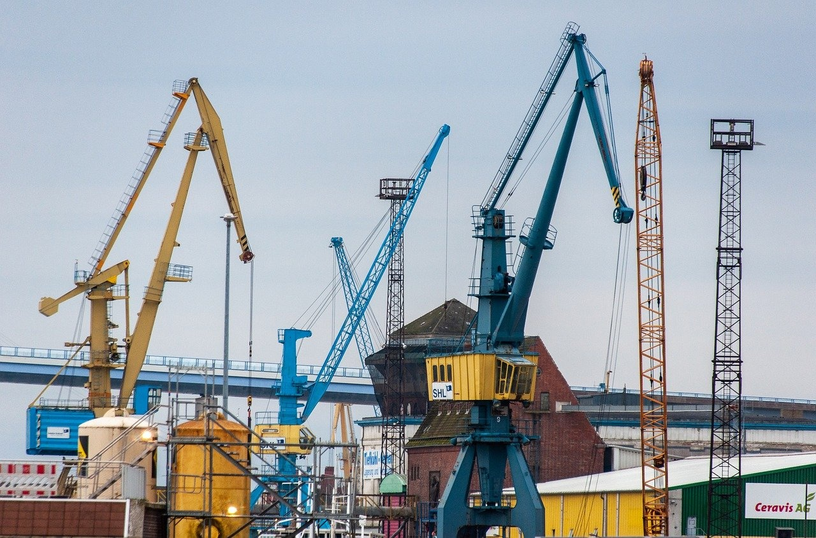
18
Technical Notes
Technical Notes
Ensure high-resolution graphics for clarity
Verify color contrast for optimal readability
Design slides for 16:9 widescreen format
Utilize professional and clean font styles
Exploring Advanced Agent Interaction Patterns in LangGraph

