Slide 1
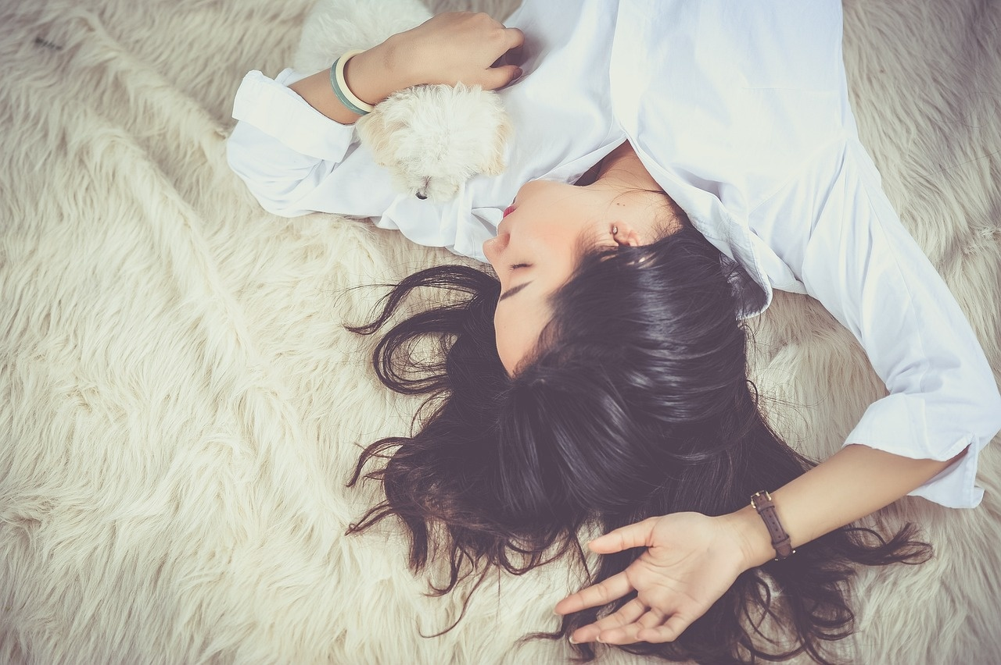
Sleeping Wonders of the Animal Kingdom
Exploring the Fascinating World of Animal Sleep Patterns

Slide 2
Table of contents
01
02
03
04
05
06
07
08
09
10
11
Title Slide: Weird Wildlife Slumbers
Introduction: Animal Sleep Patterns Exploration
Featured Animals: Our Sleep Explorers
Sloth Sleep Adaptation: Masters of Suspended Sleep
Dolphin Hemispheric Sleep: Half-Brain Sleeping Technique
Flamingo Balance Challenge: One-Legged Sleep Masters
Interactive Learning Moment: Animal Sleep Positions
Scientific Vocabulary: Sleep Science Vocabulary
Adaptation Strategies: Why Do Animals Sleep Differently?
Research Challenge: Your Animal Sleep Research Project
Reflection Questions: Let's Think Deeper

Slide 3
Table of contents
12
13
Conclusion: Nature's Sleep Secrets
Thank You/Q&A Slide: Questions? Explore. Discover. Wonder.

Slide 4
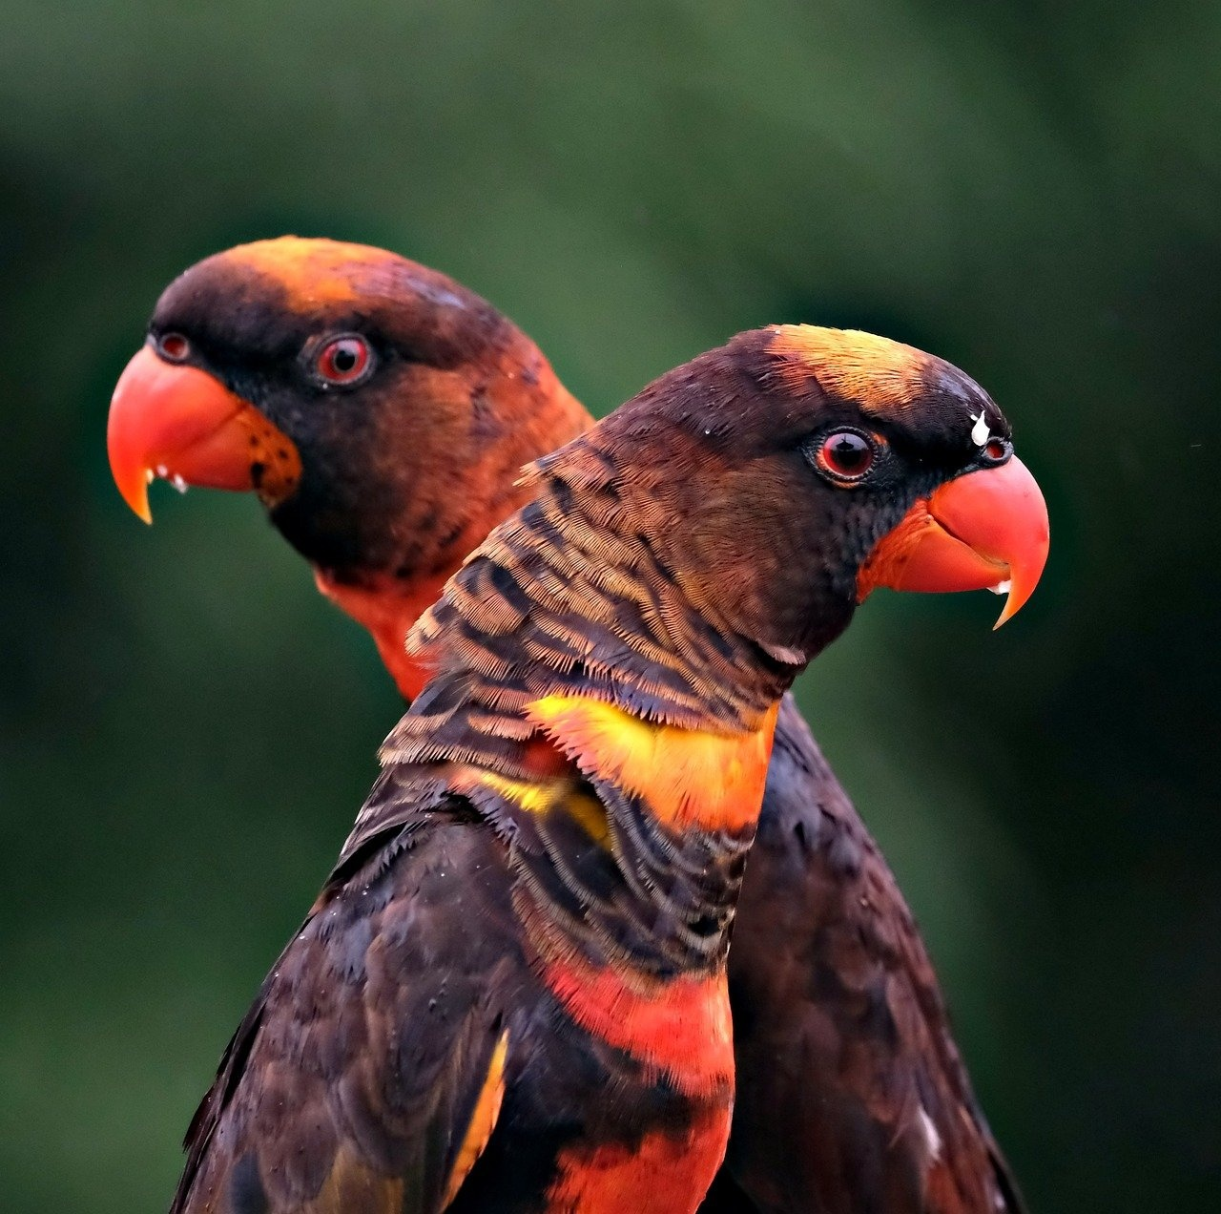
1
Title Slide: Weird Wildlife Slumbers
Weird Wildlife Slumbers: Animal Sleep Patterns Exploration
Discovering Extraordinary Sleep Adaptations in the Animal Kingdom
Sleeping Wonders of the Animal Kingdom

Slide 5
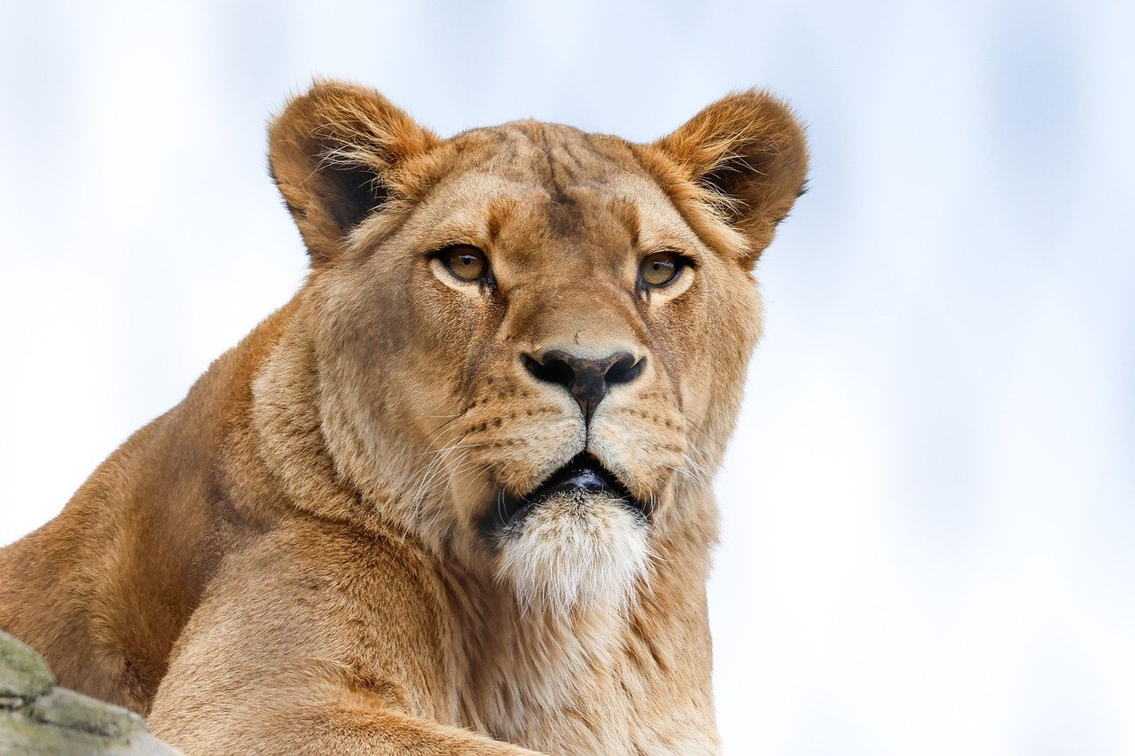
2
Introduction: Animal Sleep Patterns Exploration
Introduction: Animal Sleep Patterns Exploration
Have you ever wondered how different animals sleep?
Some animals never fully close their eyes
Some sleep hanging upside down
Some sleep while swimming!
Sleeping Wonders of the Animal Kingdom

Slide 6
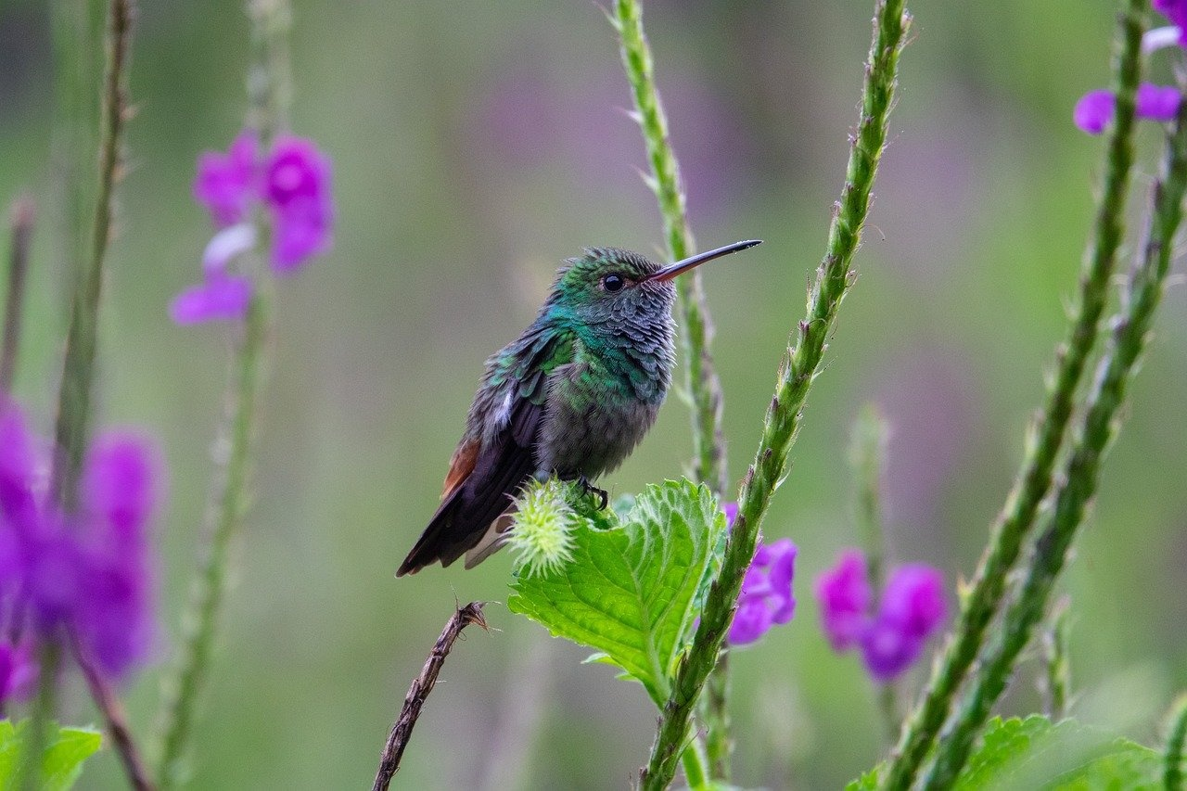
3
Featured Animals: Our Sleep Explorers
1
2
Sloths
Dolphins
Known for sleeping up to 20 hours daily. Hang from tree branches for extended periods.
Utilize half-brain sleeping technique. Remain partially conscious while swimming.
3
4
Armadillos
Platypuses
Burrow underground for safety during sleep. Employ deep sleep cycles for protection.
Rest in burrows near water sources. Alternate between deep sleep and alertness.
Sleeping Wonders of the Animal Kingdom

Slide 7
4
Sloth Sleep Adaptation: Masters of Suspended Sleep
20 hours
Suspended Sleep
Low Metabolism
Sloths have one of the longest sleep durations in the animal kingdom.
Their unique adaptation allows them to sleep suspended, conserving energy and avoiding predators.
Sloths have a slow metabolism, aiding in their ability to survive on minimal food intake.
Sleeping Wonders of the Animal Kingdom

Slide 8
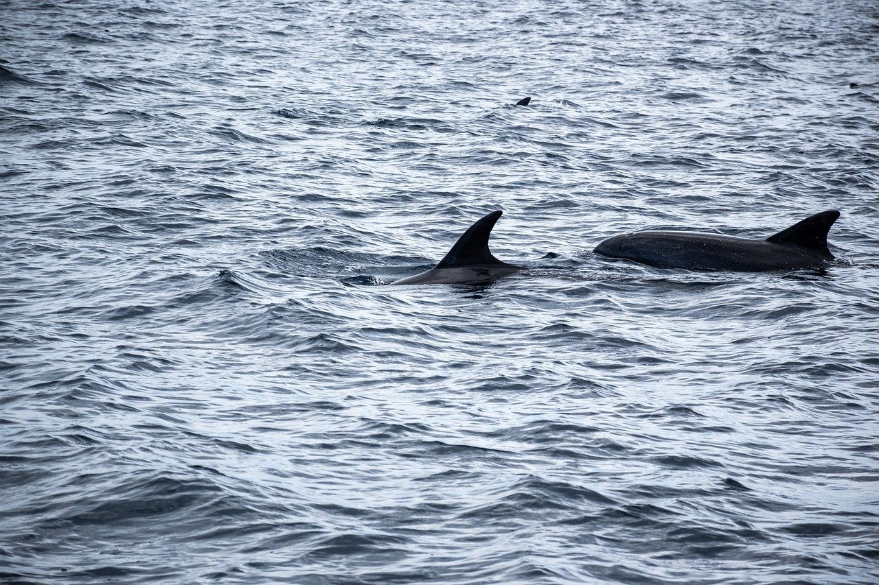
5
Dolphin Hemispheric Sleep: Half-Brain Sleeping Technique
01
One Brain Hemisphere Sleeps at a Time
02
Remain Partially Conscious
Dolphins engage in unihemispheric slow-wave sleep.
Allows dolphins to stay alert for predators and maintain basic functions.
03
Continue Swimming and Breathing
Essential for survival as they must surface to breathe.
Sleeping Wonders of the Animal Kingdom

Slide 9
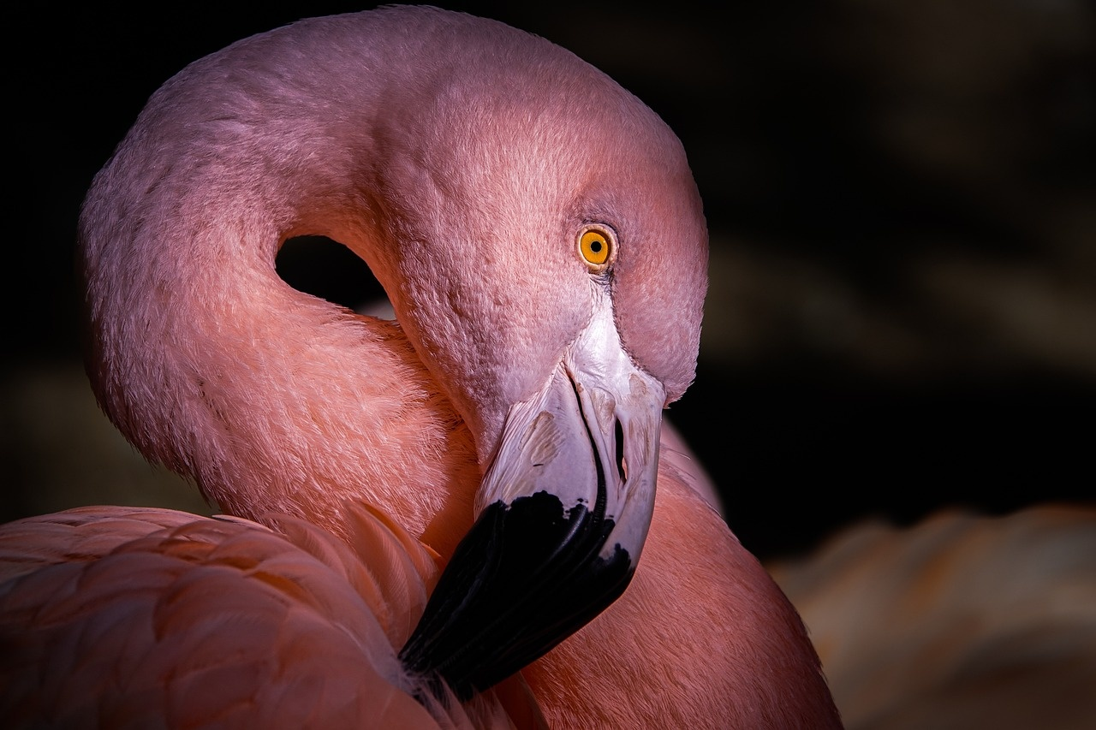
6
Flamingo Balance Challenge: One-Legged Sleep Masters
01
Flamingo Balance Challenge
02
Energy conservation strategy
Flamingos exhibit remarkable balance skills while sleeping.
They sleep standing on one leg, a unique behavior in the animal kingdom.
By resting on one leg, flamingos reduce muscle fatigue and conserve energy.
03
Unique muscular adaptation
Flamingos have specialized leg muscles that allow them to maintain this one-legged stance effortlessly.
Sleeping Wonders of the Animal Kingdom

Slide 10
7
Interactive Learning Moment: Animal Sleep Positions
Sloth Sleep Position
Flamingo Sleep Position
Hangs from tree branches
Sleeps up to 20 hours daily
Stands on one leg
Energy conservation strategy
Sleeping Wonders of the Animal Kingdom

Slide 11
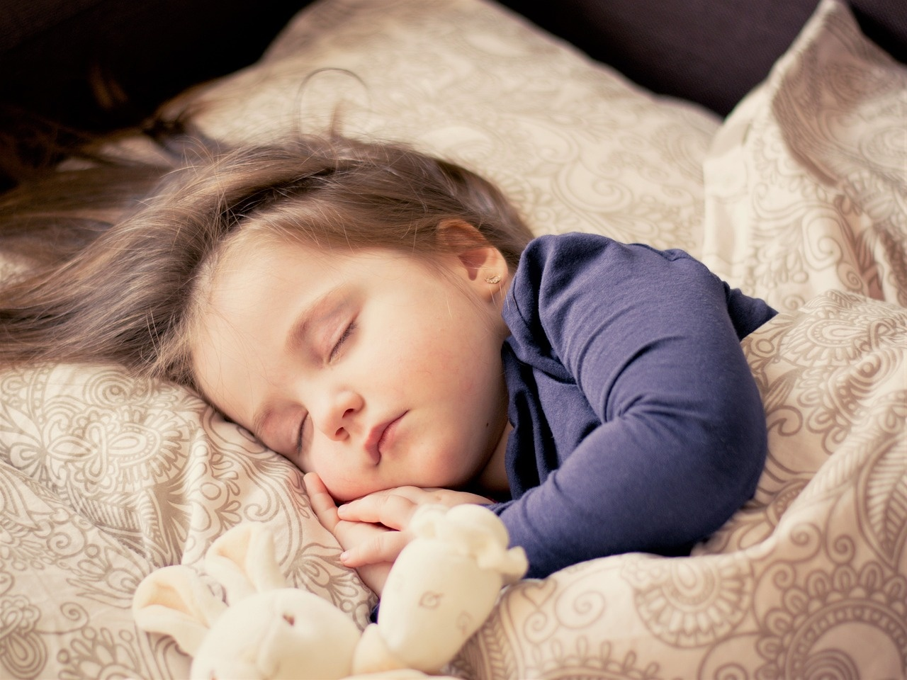
8
Scientific Vocabulary: Sleep Science Vocabulary
1
2
Hibernation
Unihemispheric Sleeping
A state of inactivity and metabolic depression in animals to conserve energy during harsh conditions.
A sleep pattern where one hemisphere of the brain is active while the other is asleep, allowing for continuous activity.
3
4
Nocturnal/Diurnal
REM Sleep
Nocturnal animals are active during the night, while diurnal animals are active during the day.
Rapid Eye Movement sleep stage characterized by vivid dreams and physiological changes like increased brain activity.
Sleeping Wonders of the Animal Kingdom

Slide 12
9
Adaptation Strategies: Why Do Animals Sleep Differently?
Survival
Energy Conservation
Animals adapt their sleep patterns to avoid predators during vulnerable states.
Efficient sleep strategies help animals conserve energy for essential activities like hunting or migration.
Sleeping Wonders of the Animal Kingdom

Slide 13
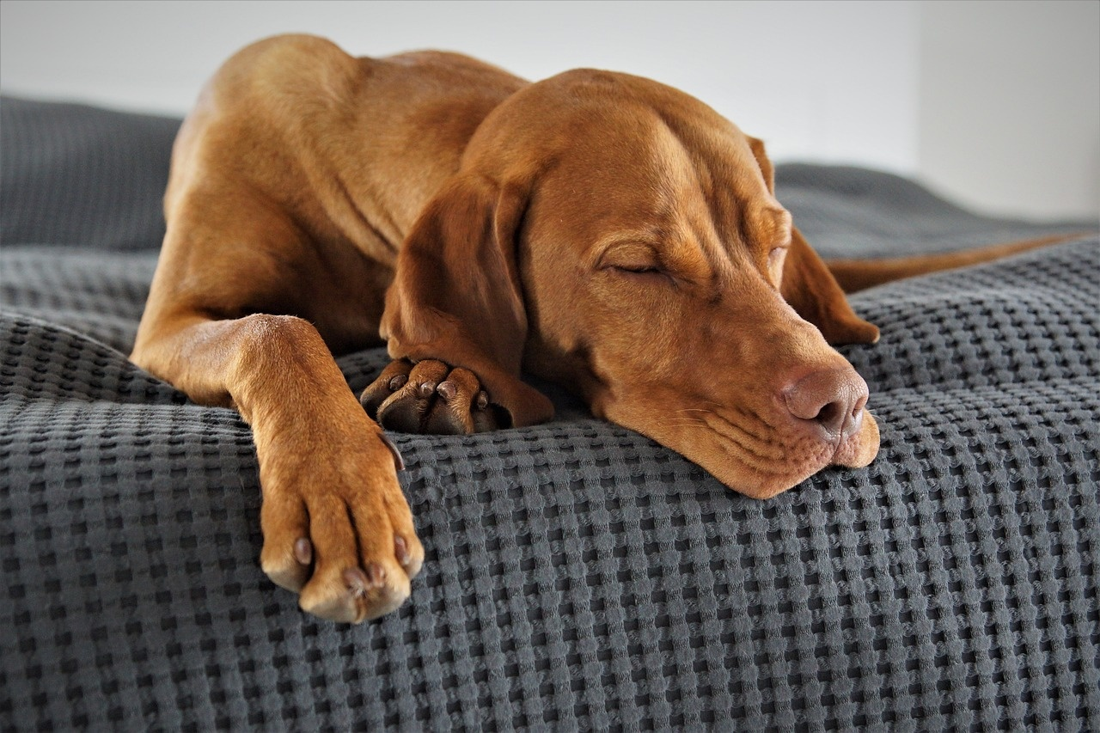
10
Research Challenge: Your Animal Sleep Research Project
1
2
Select an Animal
Investigate Sleep Patterns
Choose a unique animal species to study its sleep patterns. Consider selecting animals known for their interesting sleep behaviors.
Research how your chosen animal sleeps. Explore where and how they sleep, duration, and any unique adaptations.
3
4
Create a Presentation
Explain Survival Strategy
Develop a comprehensive presentation on your findings. Include visuals, data, and interesting facts about the animal's sleep habits.
Analyze how the animal's sleep patterns contribute to its survival. Discuss how their sleep behaviors help them thrive in their environment.
Sleeping Wonders of the Animal Kingdom

Slide 14
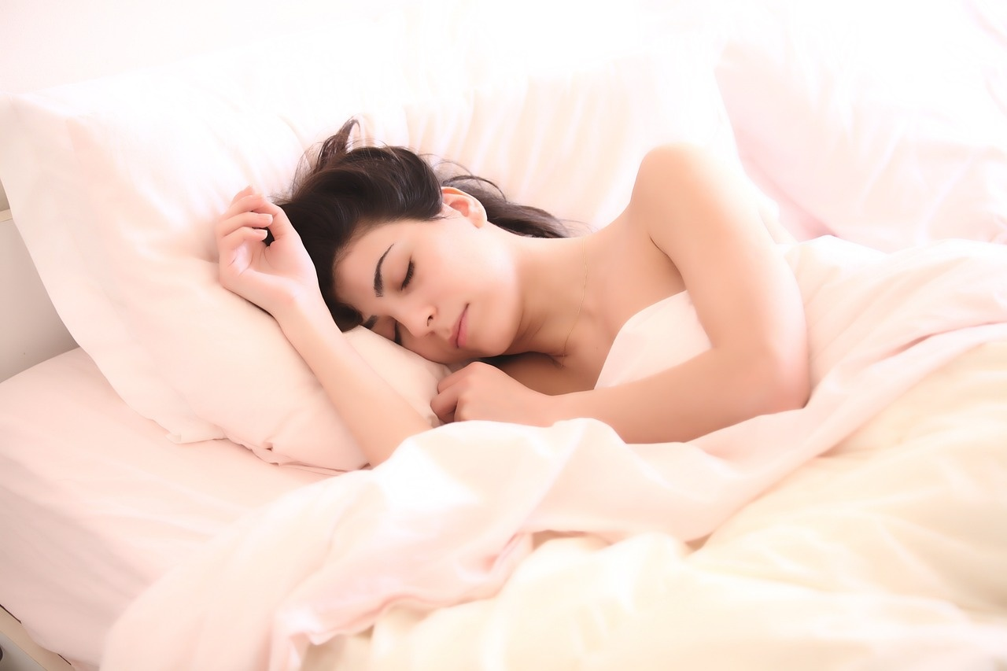
11
Reflection Questions: Let's Think Deeper
01
Differences in Sleep Duration and Patterns
02
Unique Sleep Adaptations
Animals have varying sleep durations, from a few minutes to over 20 hours.
Sleep patterns can be polyphasic (multiple short periods) or monophasic (one long period).
Environmental factors like predation risk and habitat influence sleep behavior.
Animals develop sleep adaptations to enhance survival and reproduction.
Some animals can sleep with one hemisphere of their brain while the other remains awake.
Hibernation and torpor are extreme adaptations to conserve energy during unfavorable conditions.
03
Surprising Facts About Animal Sleep
Dolphins can sleep while swimming by shutting down one hemisphere of their brain.
Some birds can sleep while flying during long migrations.
Certain species of fish and amphibians can sleep with their eyes open.
Sleeping Wonders of the Animal Kingdom

Slide 15
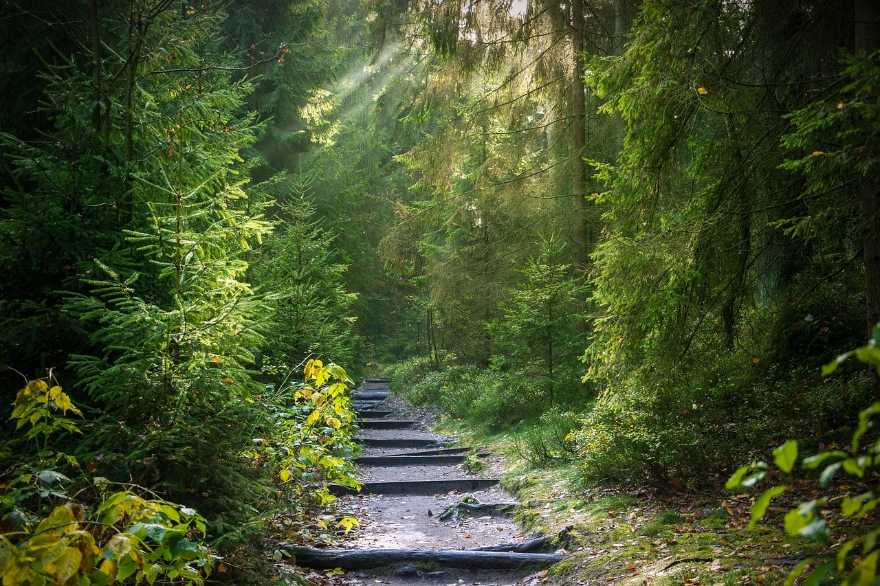
12
Conclusion: Nature's Sleep Secrets
Conclusion: Nature's Sleep Secrets
Sleep is diverse - Animals exhibit a wide range of sleep patterns and adaptations.
Sleeping Wonders of the Animal Kingdom

Slide 16
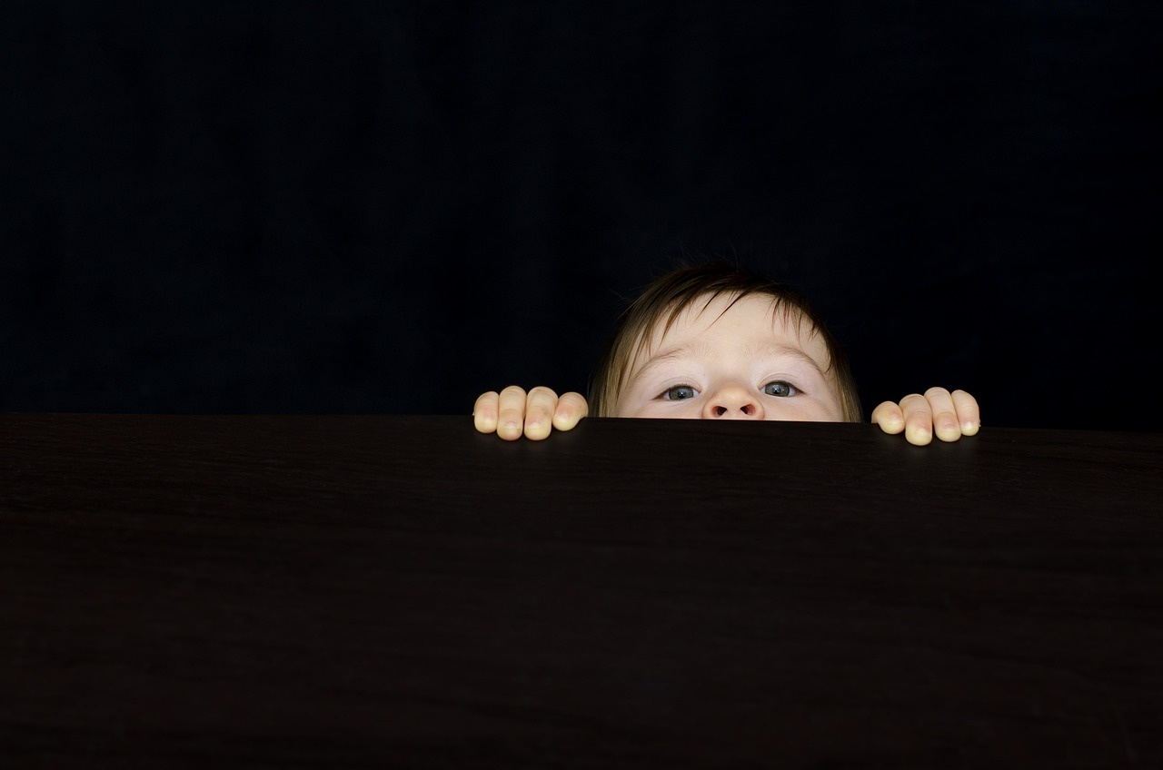
13
Thank You/Q&A Slide: Questions? Explore. Discover. Wonder.
Questions? Explore. Discover. Wonder.
Thank you for joining our exploration of the fascinating world of animal sleep patterns!
Sleeping Wonders of the Animal Kingdom

