Slide 1

Mastering Present Perfect Continuous
Exploring Usage, Challenges, and Strategies

Slide 2
Table of contents
01
02
03
04
05
06
07
08
09
10
11
Present Perfect Continuous Mastery
Learning Objectives
What is Present Perfect Continuous?
'For' vs 'Since' Time Markers
Linguistic Challenges
Practical Communication Contexts
Interactive Learning Strategies
Common Errors to Avoid
Grammatical Formation
Interdisciplinary Connections
Assessment Strategies

Slide 3
Table of contents
12
13
14
15
16
17
18
19
Digital Integration
Differentiation Approaches
Parent Engagement
Conclusion
Key Takeaways
Next Steps
Q&A / Contact
Design Recommendations

Slide 4

1
Present Perfect Continuous Mastery
01
Present Perfect Continuous Mastery
02
Structure
Understanding the ongoing nature of actions
Connects past actions to present relevance
Demonstrates actions that continue in the present
Have/Has + Been + Present Participle (-ing)
Example: 'I have been studying English for three years'
Mastering Present Perfect Continuous

Slide 5

2
Learning Objectives
01
Understand the structure of Present Perfect Continuous
02
Differentiate between 'for' and 'since' time expressions
Identify the use of "Have/Has + Been + Present Participle (-ing)"
'For': Indicates duration of time
'Since': Specifies the starting point
03
Develop practical communication skills using Present Perfect Continuous
04
Overcome language transfer challenges
Practice using the tense in various contexts
Enhance fluency in expressing ongoing actions
Address common difficulties faced by learners
Improve accuracy in using Present Perfect Continuous
Mastering Present Perfect Continuous

Slide 6

3
What is Present Perfect Continuous?
01
Definition
02
Structure
Bridges past actions and present relevance
Shows ongoing actions that continue in the present
Have/Has + Been + Present Participle (-ing)
03
Example
"I have been studying English for three years"
Mastering Present Perfect Continuous

Slide 7
4
'For' vs 'Since' Time Markers
'For'
'Since'
Indicates duration of time
Example: "I have been learning English for two years"
Specifies the starting point
Example: "I have been studying since 2021"
Mastering Present Perfect Continuous

Slide 8
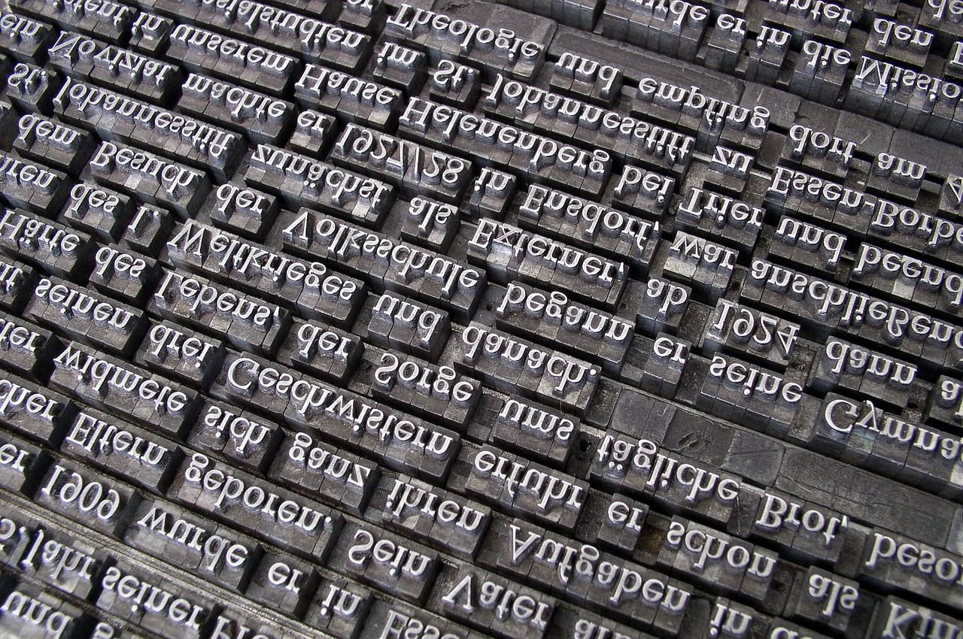
5
Linguistic Challenges
01
Linguistic Challenges - Romance Language Speakers
02
Translation Interference
Face difficulties due to different language structures
Struggle with temporal expressions nuances
Directly translating from native language
Leads to incorrect usage of Present Perfect Continuous
03
Temporal Expression Variations
04
Comparative Language Analysis
Varied structures in different languages
Pose challenges in mastering Present Perfect Continuous
Essential for understanding differences
Helps in overcoming linguistic challenges
Mastering Present Perfect Continuous

Slide 9

6
Practical Communication Contexts
01
Professional Scenarios
02
Academic Discussions
Utilizing Present Perfect Continuous in business meetings and reports.
Demonstrating ongoing projects or developments in a professional setting.
Engaging in debates or presentations where continuous actions are relevant.
Explaining research processes or academic pursuits using the tense.
03
Personal Storytelling
04
Skill Development Narratives
Sharing personal experiences over a period of time.
Narrating hobbies, interests, or achievements with a focus on duration.
Describing progress and improvement in various skills.
Reflecting on language learning journey and milestones achieved.
Mastering Present Perfect Continuous

Slide 10

7
Interactive Learning Strategies
01
Pair and Group Activities
02
Role-play Scenarios
Engage students in collaborative tasks to practice using Present Perfect Continuous.
Encourage students to act out real-life situations to apply the tense in context.
03
Digital Collaborative Tools
04
Multimedia Grammar Exploration
Utilize online platforms for interactive grammar exercises and virtual group work.
Incorporate videos, interactive quizzes, and visual aids to enhance understanding.
Mastering Present Perfect Continuous

Slide 11

8
Common Errors to Avoid
01
Misusing 'for' and 'since'
02
Incorrect verb conjugation
Incorrect usage of 'for' and 'since' can lead to confusion in indicating duration or specific starting points.
Failing to match the verb form with the subject in Present Perfect Continuous sentences can disrupt the sentence structure.
03
Mixing tense structures
04
Overusing simple present tense
Inconsistently blending Present Perfect Continuous with other tenses can create grammatical errors and confusion in conveying the intended meaning.
Overreliance on the simple present tense instead of Present Perfect Continuous can hinder the expression of ongoing actions or activities.
Mastering Present Perfect Continuous

Slide 12

9
Grammatical Formation
01
Basic Structure
02
Subject-Verb Agreement
Have/Has + Been + Verb (-ing)
Ensure the verb agrees with the subject in number and person.
03
Pronunciation Considerations
04
Practical Examples
Pay attention to stress patterns in continuous forms.
"She has been working on the project all day."
"They have been waiting for the bus since morning."
Mastering Present Perfect Continuous

Slide 13
10
Interdisciplinary Connections
Scientific Communication
Historical Narrative Techniques
Utilizing Present Perfect Continuous in research findings
Describing ongoing experiments and results
Using the tense for recounting historical events
Highlighting continuous actions in the past
Mastering Present Perfect Continuous

Slide 14

11
Assessment Strategies
Assessment Strategies
Written comprehensive grammar tests
Oral communication performances
Narrative composition
Multimedia presentation projects
Mastering Present Perfect Continuous

Slide 15

12
Digital Integration
Digital Integration
Interactive online platforms
Augmented reality grammar tools
Collaborative translation technologies
Multimedia content creation
Mastering Present Perfect Continuous

Slide 16

13
Differentiation Approaches
01
Tiered learning materials
02
Multiple intelligence integration
Tailoring content to different proficiency levels
Providing varied tasks based on student abilities
Recognizing diverse learning styles
Incorporating visual, auditory, and kinesthetic activities
03
Personalized digital learning
04
Collaborative learning structures
Adaptive online platforms
Customized assignments and feedback
Group projects and discussions
Peer-to-peer teaching and support
Mastering Present Perfect Continuous

Slide 17

14
Parent Engagement
01
Language learning partnership program
02
Digital learning portfolio
Collaborative approach between parents and educators
Encourages involvement in language acquisition process
Platform for parents to track student progress
Provides insights into language development
03
Multilingual family workshops
04
Transparent progress tracking
Workshops tailored for diverse language backgrounds
Promotes cultural exchange and language immersion
Clear communication on student achievements
Enhances parental understanding and support
Mastering Present Perfect Continuous

Slide 18
15
Conclusion
Language Learning
Contextual Grammar Instruction
Dynamic process requiring continuous practice and engagement.
Crucial for understanding and using Present Perfect Continuous effectively.
Confident Communication
Continuous Growth
Enhances overall language proficiency.
Achievable through consistent practice and exposure to diverse language contexts.
Mastering Present Perfect Continuous

Slide 19
16
Key Takeaways
Linguistic precision in temporal expression
Multilingual communication strategies
Mastering the nuances of time markers for accurate communication.
Developing skills to navigate language transfer challenges.
Interactive language acquisition
Practical communication skills
Engaging in practical communication scenarios for active learning.
Applying Present Perfect Continuous in professional and personal contexts.
Mastering Present Perfect Continuous

Slide 20

17
Next Steps
01
Advanced Temporal Expression Workshops
02
Comparative Language Analysis
Dive deeper into complex time expressions
Practice using Present Perfect Continuous in nuanced contexts
Contrast Present Perfect Continuous with other tenses
Analyze language structures across different languages
03
Practical Communication Projects
04
Continued Language Learning
Engage in real-life language tasks
Apply Present Perfect Continuous in authentic scenarios
Maintain language practice routines
Explore new language skills and concepts
Mastering Present Perfect Continuous

Slide 21

18
Q&A / Contact
01
Instructor Contact Information
02
Additional Resources
Email: englishinstructor@example.com
Phone: +1-123-456-7890
Online grammar guides
Language exchange platforms
Grammar exercise books
03
Recommended Study Materials
04
Encouragement for Continued Learning
"English Grammar in Use" by Raymond Murphy
"Practice Makes Perfect: English Verb Tenses" by Mark Lester
Online language learning platforms
Join language exchange programs
Practice speaking with native speakers
Set achievable language learning goals
Mastering Present Perfect Continuous

Slide 22

19
Design Recommendations
Design Recommendations
Use a clean, professional color scheme
Opt for a combination of neutral colors like white, gray, and blue
Incorporate language-related imagery
Include visuals of books, language symbols, or global communication icons
Maintain consistent typography
Mastering Present Perfect Continuous

