Slide 1
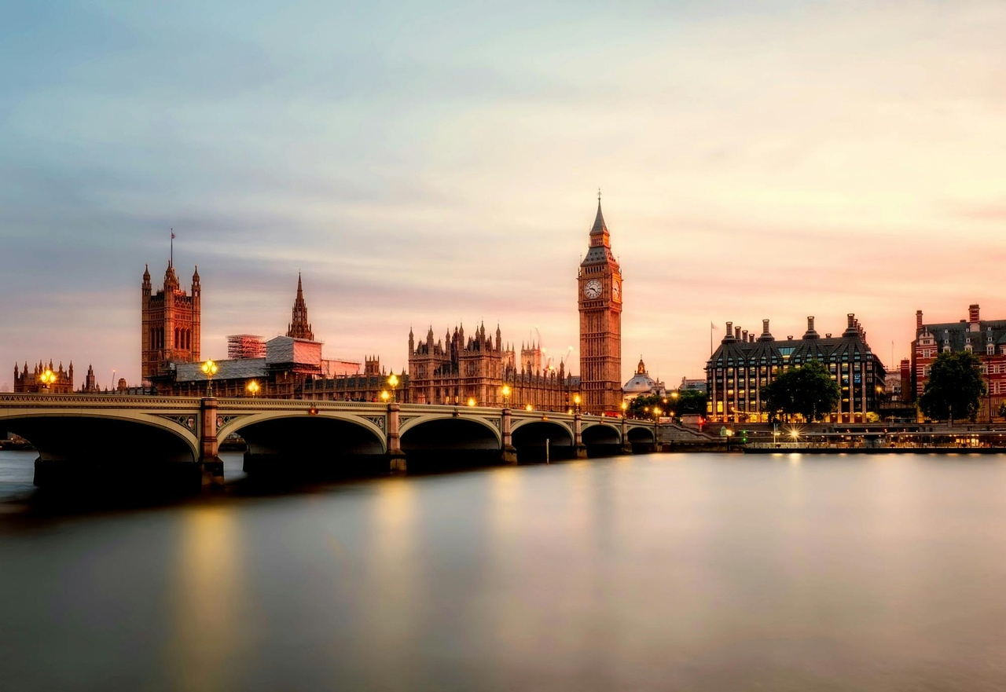
Exploring London: A Comprehensive Journey
Unveiling the Rich History, Diverse Culture, and Vibrant Contemporary Life of the Iconic City

Slide 2
Table of contents
Lesson Introduction
Discovering London: A First-Time Visitor's Guide
London's Rich History
Diverse Culture of London
Famous Landmarks of London
Practical Travel Tips for London
London's Royal Heritage
London's Role in World History
Vibrant Contemporary Culture of London
Public Transportation System in London
01
02
03
04
05
06
07
08
09
10

Slide 3
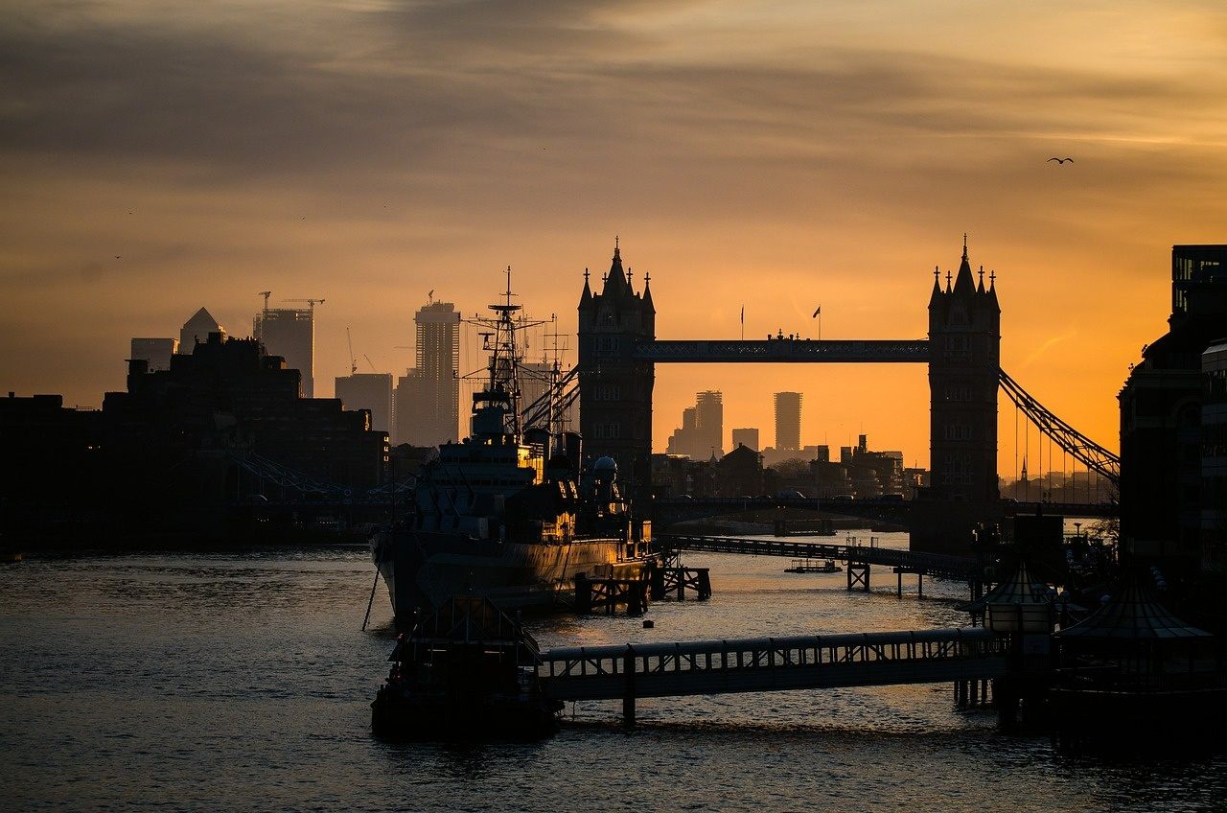
Lesson Introduction
Exploring London's Rich History
Diving into London's Diverse Culture
Discover the origins of London from Roman times to the present day.
Learn about key historical events that shaped the city.
Understand the significance of historical landmarks.
Experience the multicultural fabric of London.
Explore various cultural festivals and events.
Learn about the influence of different communities on London's culture.
Unveiling London's Famous Landmarks
Mastering Practical Travel Tips
Identify iconic landmarks such as the Tower of London, Buckingham Palace, and the London Eye.
Learn interesting facts and stories behind these landmarks.
Plan visits to must-see attractions.
Get tips on using London's public transportation system.
Learn about safety measures and emergency contacts.
Understand the basics of London etiquette and customs.
Exploring London: A Comprehensive Journey
1

Slide 4
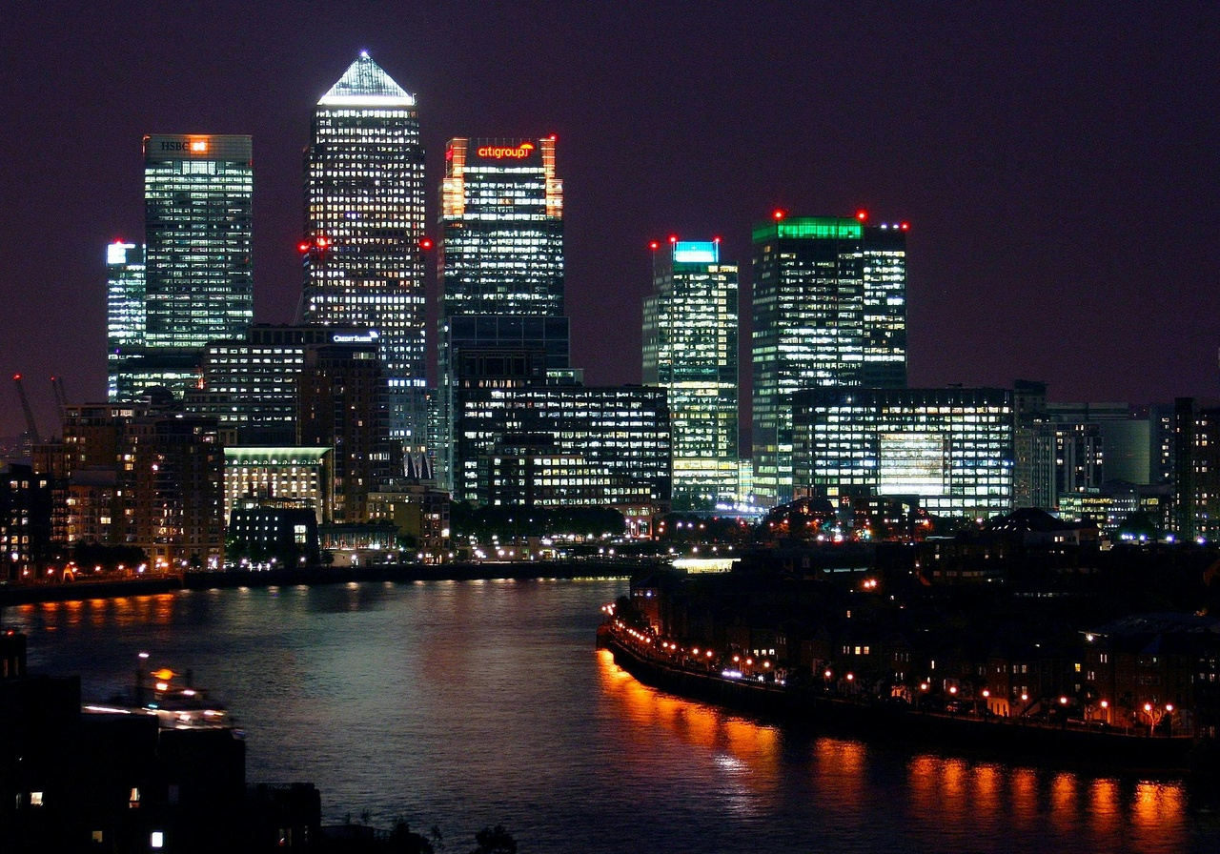
Discovering London: A First-Time Visitor's Guide
Welcome to the vibrant city of London, known for its rich history and diverse culture.
London offers a unique blend of ancient landmarks and modern innovations.
Exploring London: A Comprehensive Journey
2

Slide 5
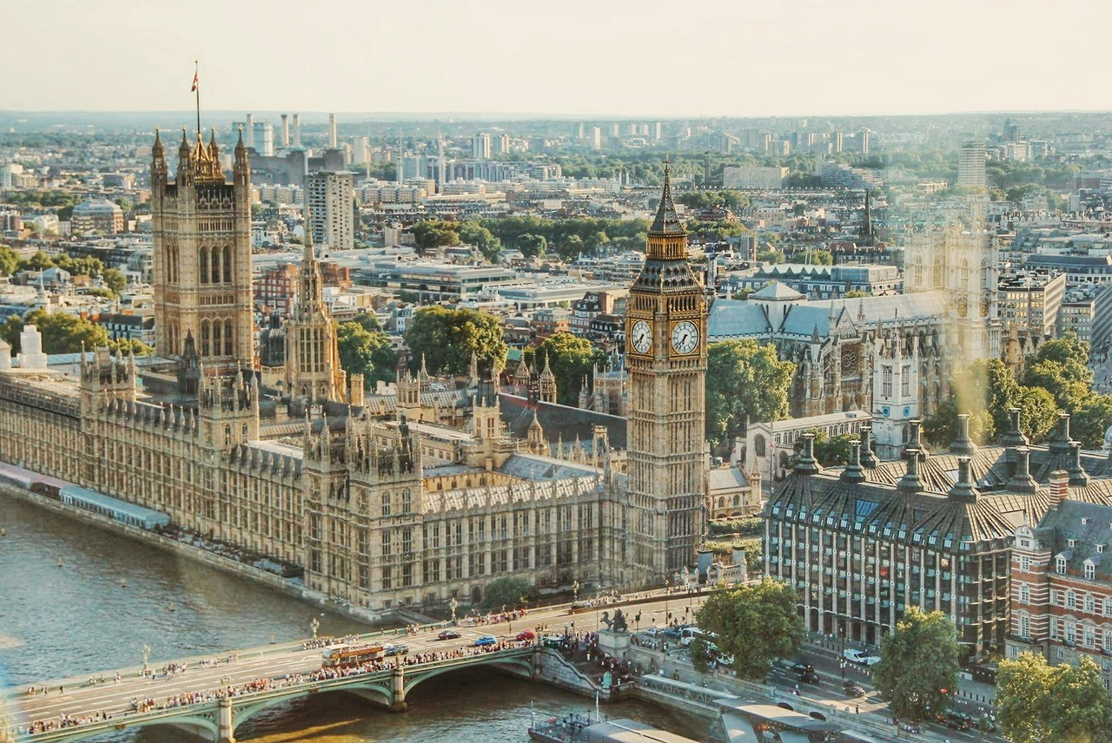
London's Rich History
2000+
11th Century
Years of History
The Tower of London
London's history dates back over two millennia, with evidence of Roman settlement, medieval monarchies, and modern developments shaping the city's narrative.
Built by William the Conqueror in the 11th century, the Tower of London has served as a royal palace, prison, and treasury, embodying centuries of historical significance.
1666
World War II
The Great Fire of 1666
The Blitz
In 1666, a devastating fire swept through London, destroying much of the city. This event led to the modernization and rebuilding of London, shaping its architectural landscape.
London endured significant damage during World War II, particularly during the Blitz. The resilience of Londoners and the city's subsequent reconstruction showcase its enduring spirit.
Exploring London: A Comprehensive Journey
3

Slide 6
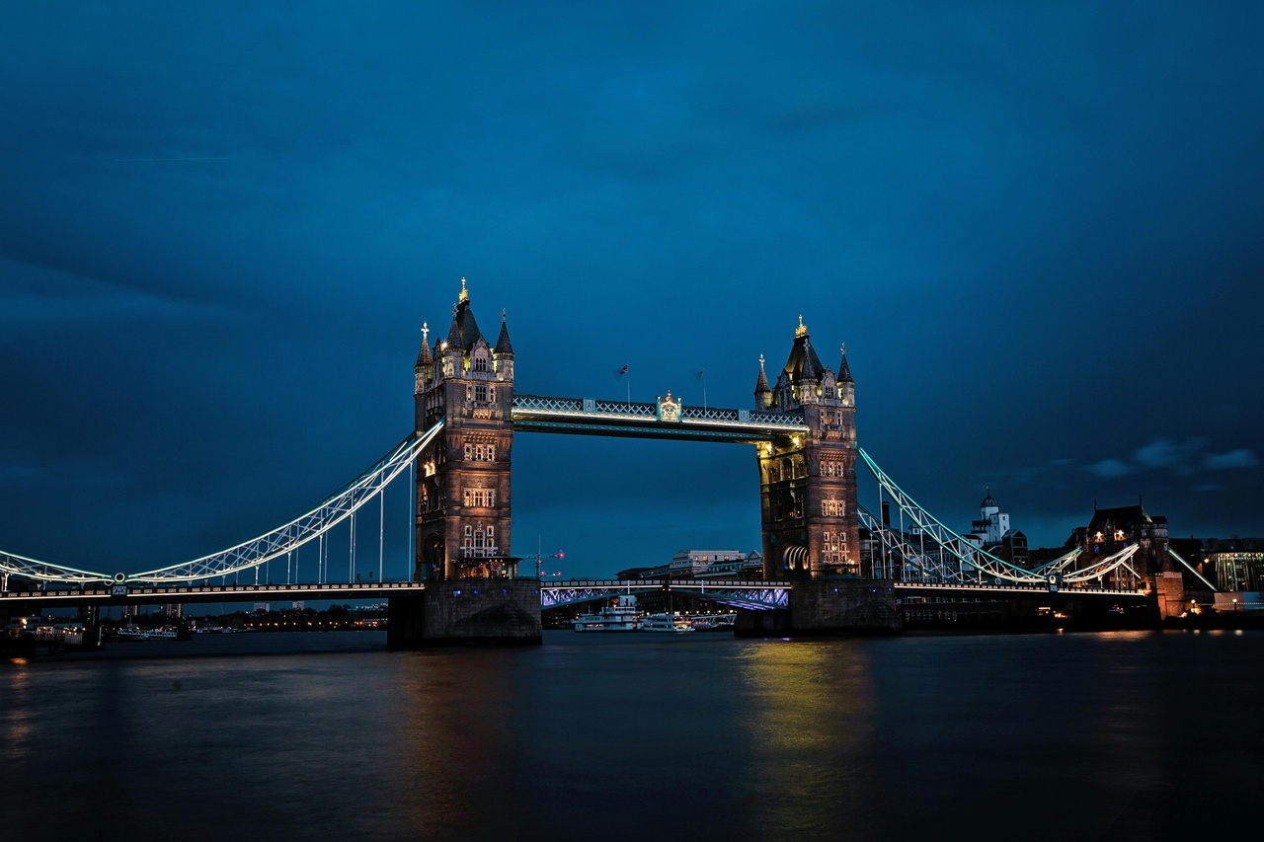
Diverse Culture of London
Historical Landmarks
Cultural Institutions
Explore the iconic Tower of London, a symbol of the city's rich history.
Visit Buckingham Palace, the official residence of the British monarch.
Immerse yourself in art at the Tate Modern and the National Gallery.
Experience the vibrant theater scene at West End's famous theaters.
Culinary Delights
Multicultural Neighborhoods
Indulge in diverse cuisines at Borough Market, offering a taste of global flavors.
Enjoy traditional English afternoon tea at historic establishments like The Ritz.
Wander through the colorful streets of Notting Hill, known for its diverse community.
Discover the vibrant markets and street art of Shoreditch in East London.
Exploring London: A Comprehensive Journey
4

Slide 7
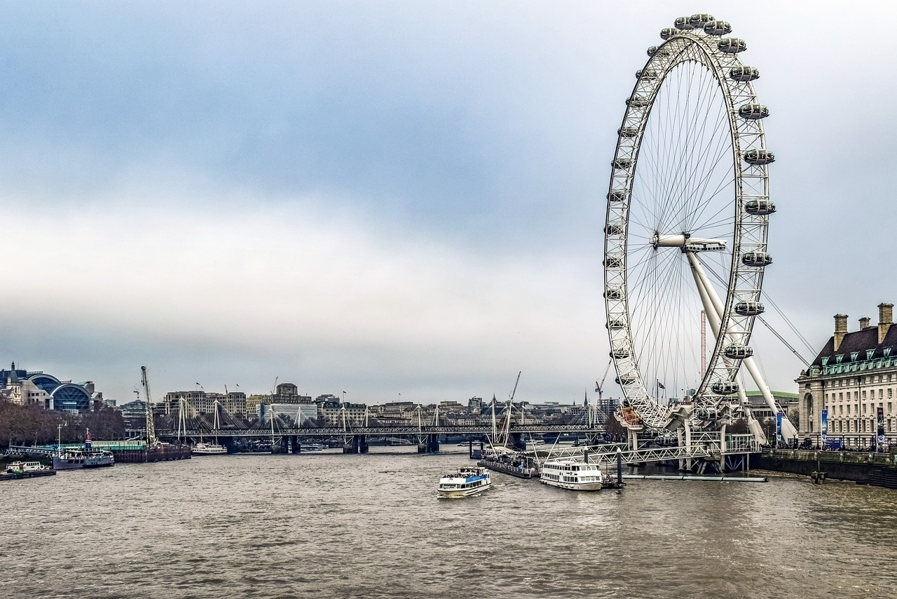
Famous Landmarks of London
316 feet
1894
Big Ben
Tower Bridge
Iconic Clock Tower
Historic Suspension Bridge
443 feet
1,016 feet
The London Eye
The Shard
Giant Ferris Wheel
Tallest Building in the UK
Exploring London: A Comprehensive Journey
5

Slide 8
Practical Travel Tips for London
01
02
03
04
05
Pack for the Weather
Use Public Transportation
Mind the Gap
Explore on Foot
Stay Connected
London weather can be unpredictable, so pack layers and a waterproof jacket.
Opt for the Oyster card for easy access to buses, trains, and the Tube.
Be cautious when boarding the Tube and mind the gap between the platform and the train.
Many attractions are within walking distance, so wear comfortable shoes and explore the city by foot.
Consider getting a local SIM card or using international roaming to stay connected during your trip.
Exploring London: A Comprehensive Journey
6

Slide 9
London's Royal Heritage
Tower of London
Buckingham Palace
Westminster Abbey
Kensington Palace
Hampton Court Palace
Explore the historic fortress that has served as a royal palace, prison, and treasury.
Witness the iconic Changing of the Guard ceremony outside the official residence of the British monarch.
Visit the coronation church of British monarchs and the final resting place of many royals and notable figures.
Discover the former residence of Queen Victoria and Princess Diana, now a museum showcasing royal fashion and history.
Step back in time at this Tudor palace once home to King Henry VIII, featuring stunning gardens and a famous maze.
Exploring London: A Comprehensive Journey
7

Slide 10
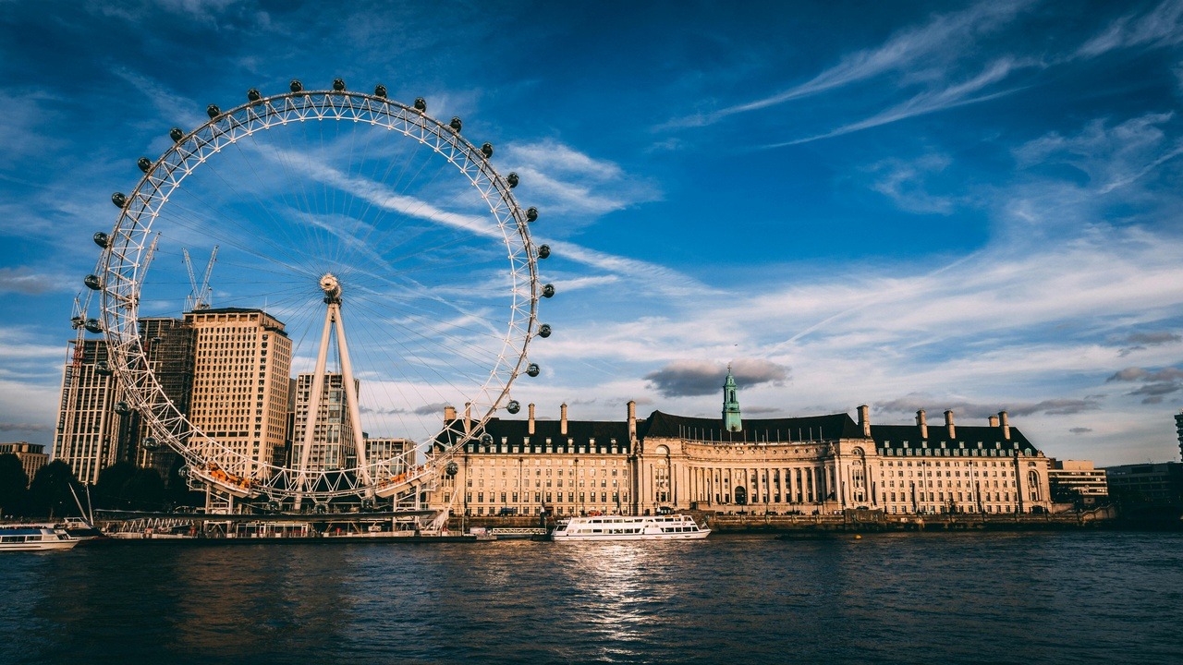
London's Role in World History
Royal Heritage
Colonial Legacy
London has been a seat of power for centuries, with iconic landmarks like Buckingham Palace symbolizing the monarchy's influence on world affairs.
The British Empire, with London as its hub, played a significant role in shaping global politics, trade, and culture during the colonial era.
World Wars
Cultural Influence
London endured the hardships of both World Wars, with the Blitz during World War II showcasing the city's resilience and determination.
London's cultural impact is felt worldwide through its literature, music, art, and fashion, influencing trends and movements across the globe.
Exploring London: A Comprehensive Journey
8

Slide 11
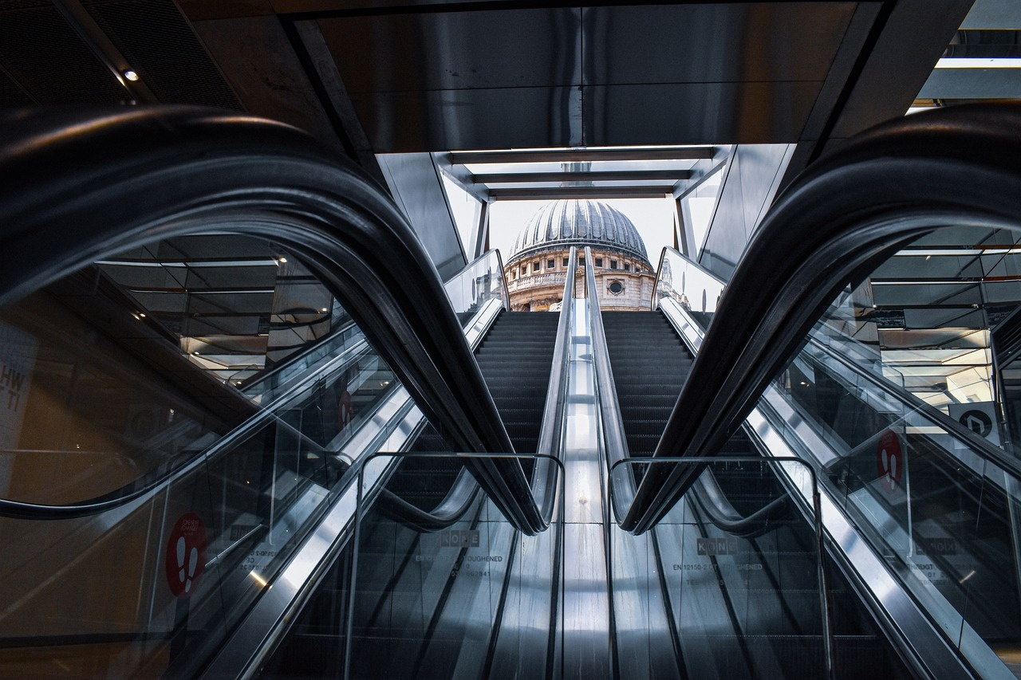
Vibrant Contemporary Culture of London
230
857
Art Galleries
Theatres
Art galleries in London, showcasing a diverse range of contemporary art from around the world.
Theatres in London, offering a vibrant theater scene with a mix of classic plays and innovative performances.
320
1000+
Music Venues
Restaurants
Music venues in London, hosting live performances spanning various genres from indie to electronic music.
Restaurants in London, representing a melting pot of cuisines reflecting the city's multiculturalism and culinary innovation.
Exploring London: A Comprehensive Journey
9

Slide 12
Public Transportation System in London
London Underground (The Tube)
London Buses
Docklands Light Railway (DLR)
London Overground
Trams
The oldest underground railway in the world.
11 lines covering 402 km of track.
Over 1 billion passenger journeys annually.
Red double-decker buses are iconic.
Extensive network covering all areas of the city.
Over 2 billion bus journeys made each year.
Automated light metro system serving East London.
Connects to the London Underground and London Overground.
Suburban rail service connecting Greater London.
112 stations across 7 lines.
Integrated with the Tube network.
Tramlink serves South London.
Trams run on designated tracks and share roads with other vehicles.
Exploring London: A Comprehensive Journey
10

