Slide 1


Mastering Fraction and Decimal Conversions
Understanding, Applying, and Solving Real-World Problems with Fractions and Decimals

Slide 2
Table of Contents
Introduction to Converting Between Fractions a…
What are Fractions and Decimals?
Converting Fractions to Decimals
Converting Decimals to Fractions
Equivalent Ratios
Real-World Applications
Problem-Solving Activities
Differentiated Activities
Technology Integration
Assessment and Feedback
Conclusion
Next Steps
Reflection Questions
04
05
06
07
08
09
10
11
12
13
14
15
16

Slide 3
Table of Contents
Key Takeaways
Homework Assignment
Extension Activities
Parent Engagement
Safety Considerations
Teaching Tips
17
18
19
20
21
22

Slide 4
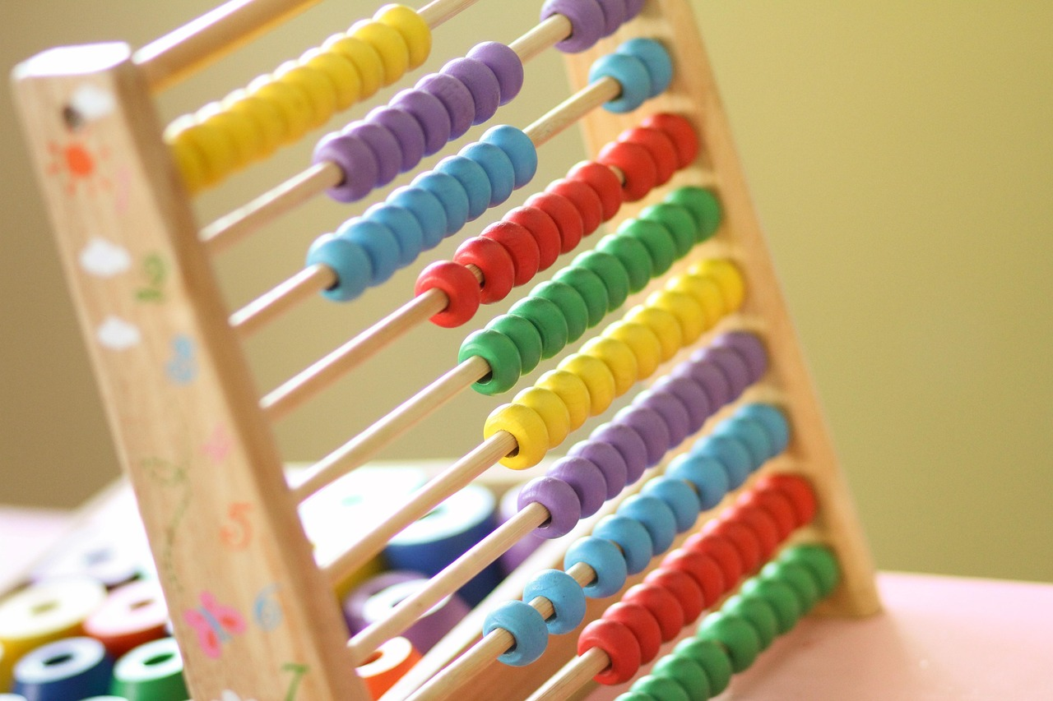
Introduction to Converting Between Fractions and Decimals
Importance of Converting Fractions and Decimals
Lesson Overview
Real-World Applications
Converting between fractions and decimals is a crucial skill in mathematics.
Fractions and decimals are used in various real-world applications, such as science, engineering, and finance.
This lesson will cover the concept of converting between fractions and decimals.
It includes practical applications and problem-solving activities to enhance understanding.
Fractions and decimals play a significant role in diverse fields like science and finance.
Understanding these conversions is essential for solving real-world problems effectively.
4
Mastering Fraction and Decimal Conversions

Slide 5
What are Fractions and Decimals?
Understanding Fractions
Understanding Decimals
Fractions: a way of representing a part of a whole, using a numerator and a denominator.
Fractions are used to express parts of a whole in mathematical terms.
Decimals: a way of representing a number using a point to separate the whole number part from the fractional part.
Decimals provide a precise way to represent numbers, especially in measurements and calculations.
5
Mastering Fraction and Decimal Conversions

Slide 6
Converting Fractions to Decimals
Understanding Fraction to Decimal Conversion
Example of Fraction Conversion
Practice Exercise for Mastery
To convert a fraction to a decimal, divide the numerator by the denominator.
This method ensures accurate decimal representation of the fraction.
Example: 1/2 = 0.5.
This demonstrates the division process for converting fractions to decimals.
Practice exercise: Convert 3/4 to a decimal.
This helps reinforce the concept and improve calculation skills.
6
Mastering Fraction and Decimal Conversions

Slide 7
Converting Decimals to Fractions
1
2
3
Understanding the Conversion Process
Example of Decimal to Fraction Conversion
Practice Exercise for Mastery
To convert a decimal to a fraction, write the decimal as a fraction with the decimal part as the numerator and the place value as the denominator.
This method ensures that the decimal is accurately represented as a fraction.
For example, 0.5 can be converted to the fraction 1/2.
This demonstrates the simplicity of the conversion process.
Try converting 0.75 to a fraction as a practice exercise.
This will help reinforce your understanding of the conversion process.
7
Mastering Fraction and Decimal Conversions

Slide 8
Equivalent Ratios
01
02
Definition of Equivalent Ratios
Example of Equivalent Ratios
Equivalent ratios are fractions that have the same value, but with different numerators and denominators.
They represent the same proportion or relationship despite having distinct numerical representations.
An example of equivalent ratios is 1/2 = 2/4 = 3/6.
These ratios demonstrate how different fractions can express the same value.
8
Mastering Fraction and Decimal Conversions

Slide 9

Real-World Applications
Cooking Applications
Scientific Calculations
Financial Uses
Fractions and decimals are used in cooking, such as measuring ingredients for a recipe.
Precise measurements ensure the recipe turns out as intended, highlighting the importance of these mathematical concepts.
In science, fractions and decimals are essential for accurate calculations and measurements.
They help scientists quantify observations and conduct experiments with precision.
Fractions and decimals play a key role in finance, such as calculating interest rates.
These calculations are crucial for managing investments and understanding loan terms.
9
Mastering Fraction and Decimal Conversions

Slide 10

Problem-Solving Activities
1
Collaborative Learning Approach
Students will work in pairs or small groups to complete problem-solving activities.
This encourages teamwork and enhances understanding through shared efforts.
2
Fraction and Decimal Conversion Tasks
Activities will involve converting fractions to decimals and vice versa.
These tasks help students apply mathematical concepts to practical scenarios.
3
Real-World Application Example
An example activity includes calculating the cost of materials for a construction project.
This demonstrates the relevance of math skills in everyday situations.
10
Mastering Fraction and Decimal Conversions

Slide 11

Differentiated Activities
1
Catering to Mixed-Ability Groups
Differentiated activities will be provided for mixed-ability groups.
These activities aim to address the diverse needs of students in the classroom.
2
Adapting to Learning Styles
Activities will cater to different learning styles and abilities, such as visual, auditory, and kinesthetic learners.
This ensures that every student has an opportunity to engage and succeed.
3
Support for Struggling Students
Example: providing extra support or scaffolding for students who are struggling.
This approach helps students overcome challenges and build confidence in their learning.
11
Mastering Fraction and Decimal Conversions

Slide 12
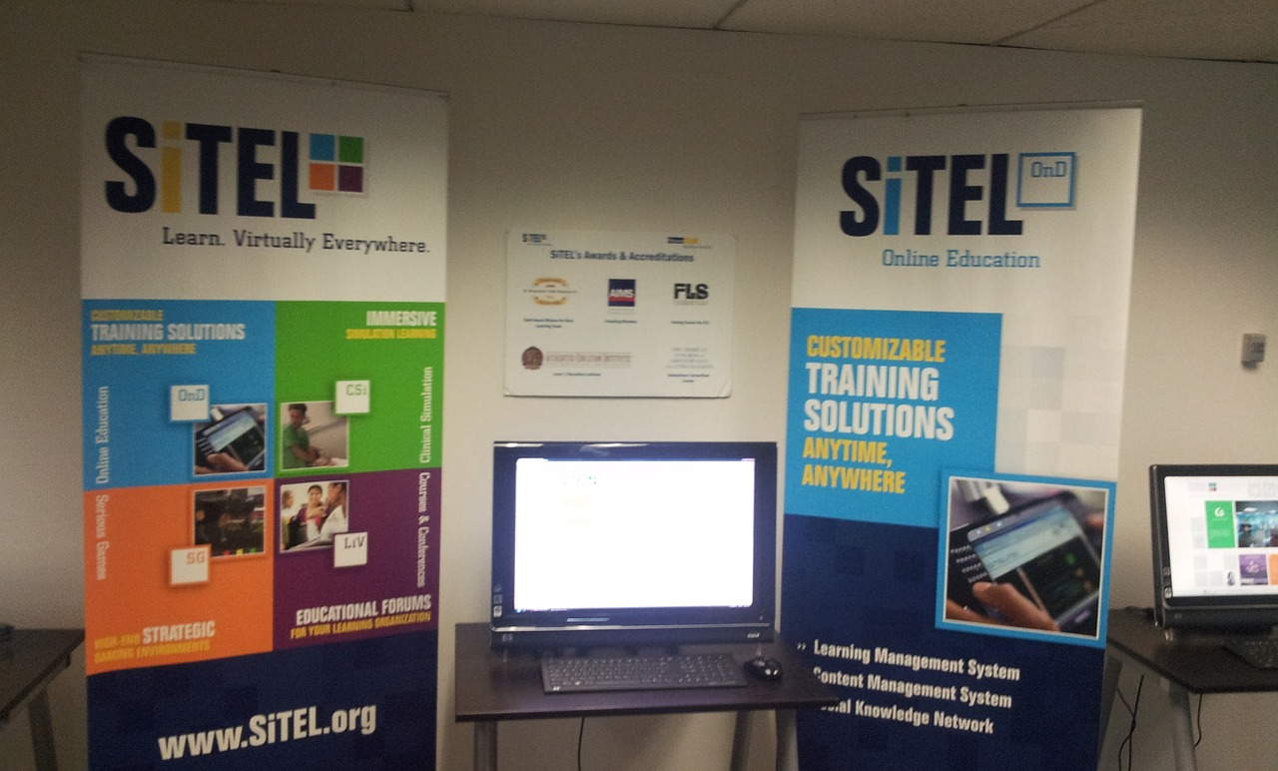
Technology Integration
Enhancing Instruction with Technology
Interactive Tools for Learning
Technology will be used to enhance instruction and increase student engagement.
Examples: online resources, interactive simulations, and educational software.
Examples include online resources that provide diverse learning materials.
Interactive simulations and educational software make learning engaging and effective.
12
Mastering Fraction and Decimal Conversions

Slide 13
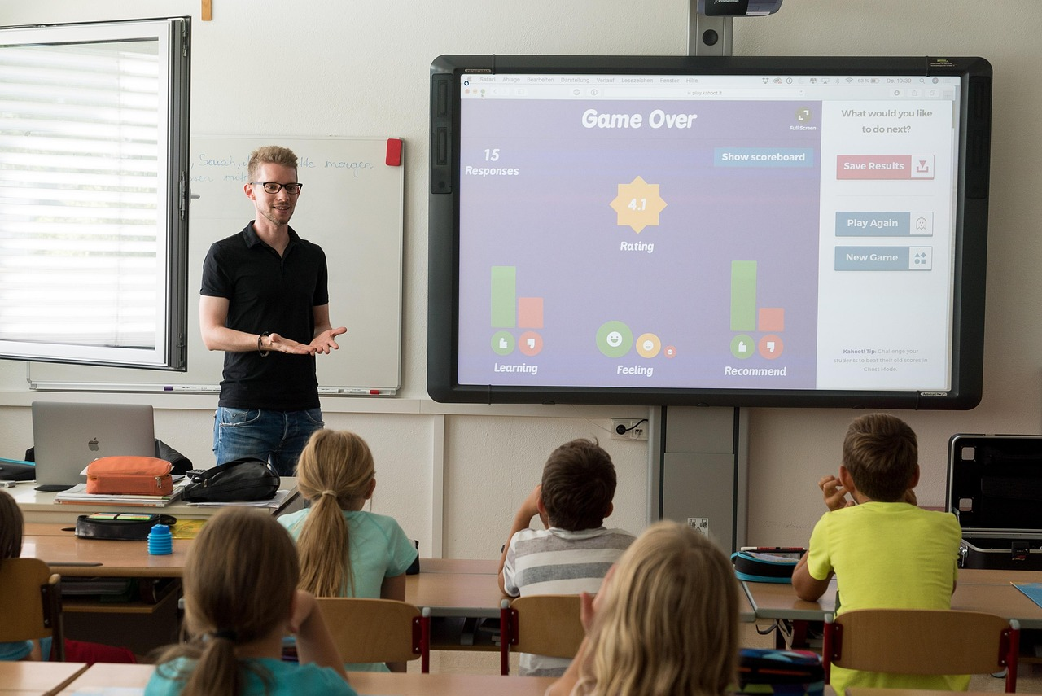
Assessment and Feedback
1
2
3
Regular Feedback and Assessment
Utilizing Rubrics for Evaluation
Interactive Class Discussions
Students will receive regular feedback and assessment on their understanding of the concept.
Feedback will be provided through quizzes, tests, and class discussions.
Example: using rubrics to evaluate student work.
Rubrics provide a structured way to assess student performance.
Class discussions serve as a platform for immediate feedback.
They encourage active participation and deeper understanding.
13
Mastering Fraction and Decimal Conversions

Slide 14

Conclusion
Importance of Fraction-Decimal Conversion
Real-World Applications and Problem-Solving
Converting between fractions and decimals is a crucial skill in mathematics.
This skill enables students to understand and manipulate numerical data effectively.
Students will be able to apply this skill to real-world problems.
Developing this ability enhances their problem-solving skills and mathematical proficiency.
14
Mastering Fraction and Decimal Conversions

Slide 15
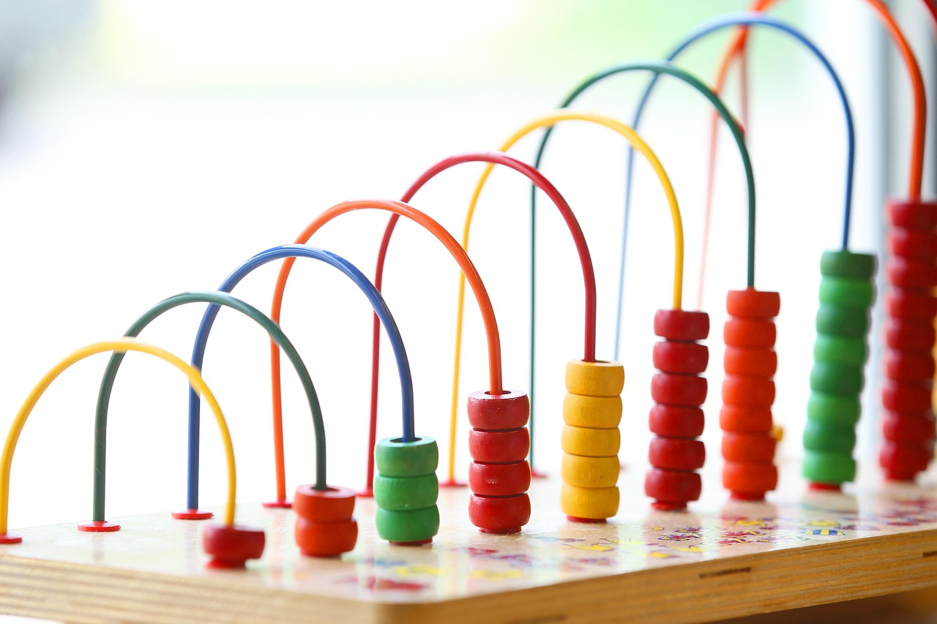
Next Steps
Building on Fractions and Decimals
Learning About Percentages
Real-World Applications
The next lesson will build on the concept of converting between fractions and decimals.
This foundational knowledge will be expanded to include percentages.
Students will learn about percentages and how to apply them to real-world problems.
This will include understanding their significance in various contexts.
An example of applying percentages is calculating interest rates.
This practical skill is essential for financial literacy.
15
Mastering Fraction and Decimal Conversions

Slide 16

Reflection Questions
Lesson Insights
Practical Applications
What did you learn from this lesson?
How can you apply the concept of converting between fractions and decimals to real-world problems?
What did you learn from this lesson?
How can you apply the concept of converting between fractions and decimals to real-world problems?
16
Mastering Fraction and Decimal Conversions

Slide 17
Key Takeaways
1
Importance of Conversion Skills
Converting between fractions and decimals is a crucial skill in mathematics.
This skill is foundational for understanding numerical relationships and solving problems.
2
Real-World Applications
Fractions and decimals are used in various real-world applications.
These include financial calculations, measurements, and data analysis.
3
Enhancing Problem-Solving Abilities
Students will be able to apply this skill to real-world problems.
Developing this skill fosters critical thinking and problem-solving capabilities.
17
Mastering Fraction and Decimal Conversions

Slide 18
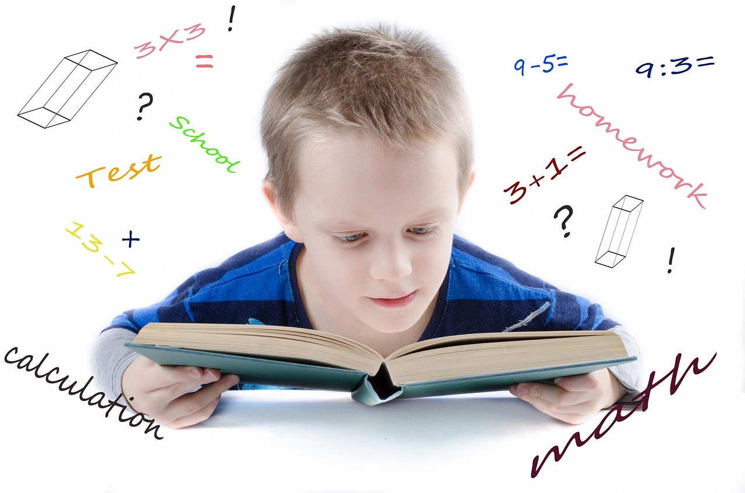
Homework Assignment
Fraction to Decimal Exercises
Real-World Applications
Complete a worksheet with exercises on converting fractions to decimals and vice versa.
Research and find real-world examples of how fractions and decimals are used in different contexts.
Complete a worksheet with exercises on converting fractions to decimals and vice versa.
Research and find real-world examples of how fractions and decimals are used in different contexts.
18
Mastering Fraction and Decimal Conversions

Slide 19
Extension Activities
1
Math Modeling for Real-World Problems
Create a math model to solve a real-world problem.
This activity encourages students to apply mathematical concepts to practical scenarios.
2
Exploring Fractions and Decimals in Real Life
Research and present on a real-world application of fractions and decimals.
Students will investigate how these concepts are used in everyday situations and share their findings.
3
Interactive Learning with Games and Simulations
Create a game or simulation to practice converting fractions to decimals and vice versa.
This hands-on activity helps reinforce understanding through engaging and interactive methods.
19
Mastering Fraction and Decimal Conversions

Slide 20

Parent Engagement
1
Supporting Learning at Home
Parents can support their child's learning by providing additional practice exercises.
This helps reinforce concepts taught in school and builds confidence in the child.
2
Engaging with Teachers
Parents can attend a parent-teacher conference to discuss their child's progress.
This fosters collaboration between parents and teachers to address the child's needs effectively.
20
Mastering Fraction and Decimal Conversions

Slide 21

Safety Considerations
1
Importance of Accuracy and Precision
Ensure that students understand the importance of accuracy and precision when working with fractions and decimals.
Highlight the role of careful calculations in achieving correct results.
2
Guidelines for Handling Complex Fractions
Provide guidelines on how to handle complex fractions and decimals.
Offer strategies to simplify and solve challenging numerical problems.
21
Mastering Fraction and Decimal Conversions

Slide 22
Teaching Tips
Visual Aids for Concept Illustration
Real-World Examples for Relevance
Technology for Enhanced Engagement
Use visual aids to illustrate the concept of converting between fractions and decimals.
These aids can include diagrams, charts, or interactive tools to simplify understanding.
Provide real-world examples to make the concept more relevant and interesting.
Examples can include scenarios like shopping discounts or measurements in recipes.
Use technology to enhance instruction and increase student engagement.
Interactive apps or online platforms can make learning more dynamic and appealing.
22
Mastering Fraction and Decimal Conversions

