Slide 1

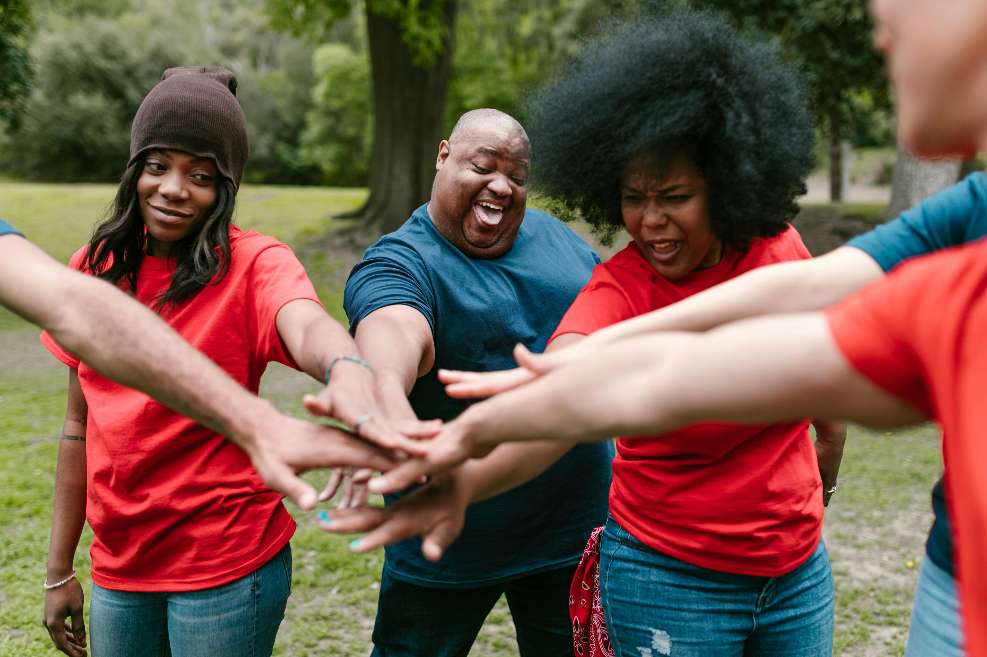
Understanding Cultural Diversity and Community Building
Fostering Inclusivity, Social Justice, and Stronger Communities

Slide 2
Table of Contents
Welcome to Understanding Cultural Diversity an…
What is Cultural Diversity?
Why is Cultural Diversity Important?
What is Community Building?
Why is Community Building Important?
Strategies for Promoting Cultural Diversity an…
Benefits of Cultural Diversity and Community B…
Challenges to Cultural Diversity and Community…
Overcoming Challenges to Cultural Diversity an…
Conclusion
Reflection Questions
Next Steps
Additional Resources
04
05
06
07
08
09
10
11
12
13
14
15
16

Slide 3
Table of Contents
Final Thoughts
Call to Action
17
18

Slide 4
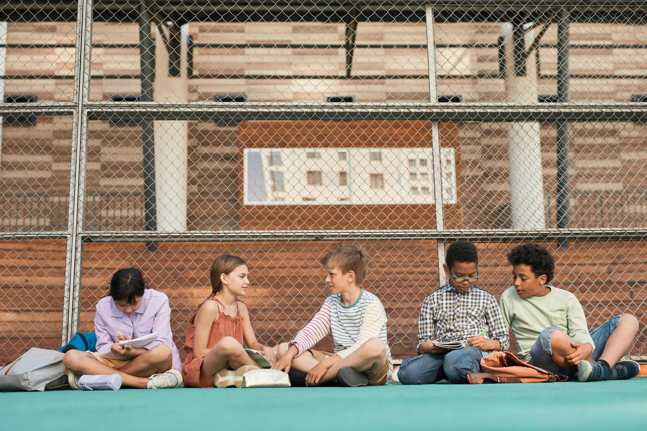
Welcome to Understanding Cultural Diversity and Community Building
Introduction to Cultural Diversity
Appreciating Community Diversity
Developing Essential Skills
This lesson plan is designed to introduce 14-year-old students to the importance of cultural diversity and community building.
The key learning focus is to equip students with the knowledge, attitudes, and skills necessary to navigate and appreciate cultural differences.
By exploring these themes, students will gain a deeper appreciation for the diversity within their own communities.
This understanding fosters a sense of belonging and respect for different cultural backgrounds.
Students will develop essential skills for effective communication and collaboration.
These skills are crucial for building harmonious and inclusive communities.
4
Understanding Cultural Diversity and Community Building

Slide 5
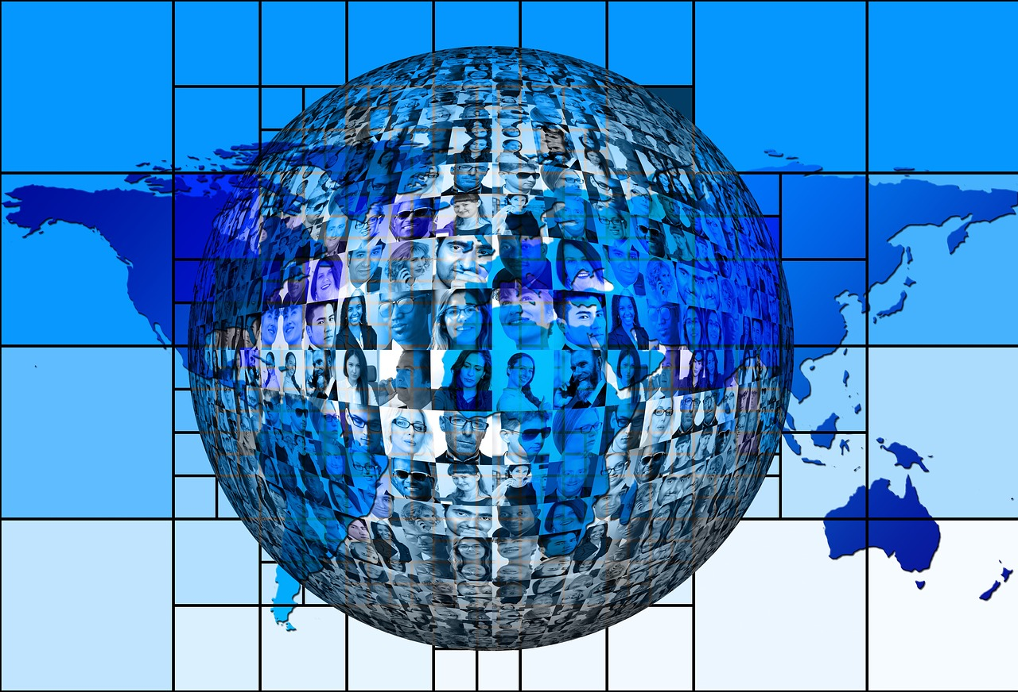
What is Cultural Diversity?
Definition of Cultural Diversity
Beyond Race and Ethnicity
Cultural diversity refers to the presence of different cultures, traditions, and practices within a community or society.
It is essential to recognize and appreciate cultural diversity, as it enriches our lives, promotes understanding and empathy, and fosters a sense of community.
Cultural diversity is not limited to race or ethnicity, but also includes differences in language, religion, customs, and values.
This broader perspective helps us understand the multifaceted nature of diversity in our societies.
Importance in a Globalized World
Benefits of Cultural Diversity
Understanding and appreciating cultural diversity is crucial in today's globalized world.
People from different backgrounds interact and collaborate on a daily basis, making cultural awareness essential.
Cultural diversity enriches our lives by promoting understanding and empathy.
It fosters a sense of community and helps build stronger, more inclusive societies.
5
Understanding Cultural Diversity and Community Building

Slide 6
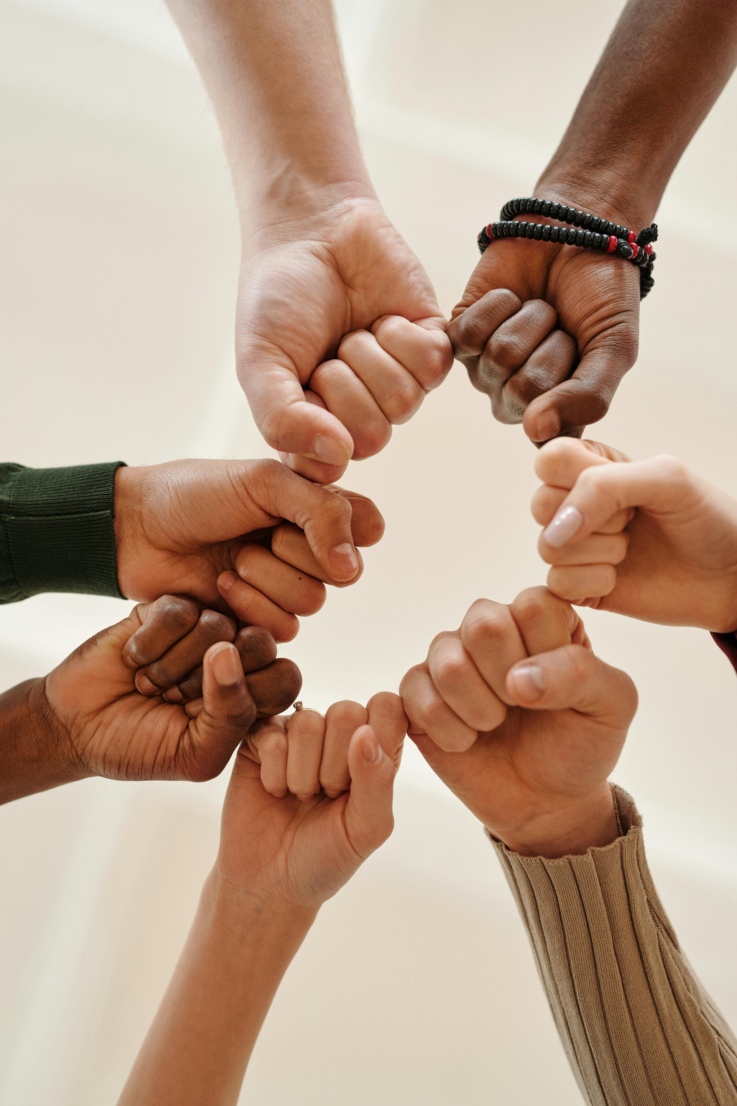
Why is Cultural Diversity Important?
Enriching Lives and Communities
Fostering Inclusivity and Respect
Advancing Social Justice and Equity
Cultural diversity brings different perspectives, ideas, and experiences that can enrich our lives and communities.
It promotes understanding, respect, and inclusivity, which are essential for building strong, harmonious communities.
It promotes understanding, respect, and inclusivity, which are essential for building strong, harmonious communities.
Cultural diversity is also important for promoting social justice, equity, and human rights, as it recognizes and values the differences and contributions of all individuals and groups.
Cultural diversity is also important for promoting social justice, equity, and human rights, as it recognizes and values the differences and contributions of all individuals and groups.
Cultural diversity brings different perspectives, ideas, and experiences that can enrich our lives and communities.
6
Understanding Cultural Diversity and Community Building

Slide 7
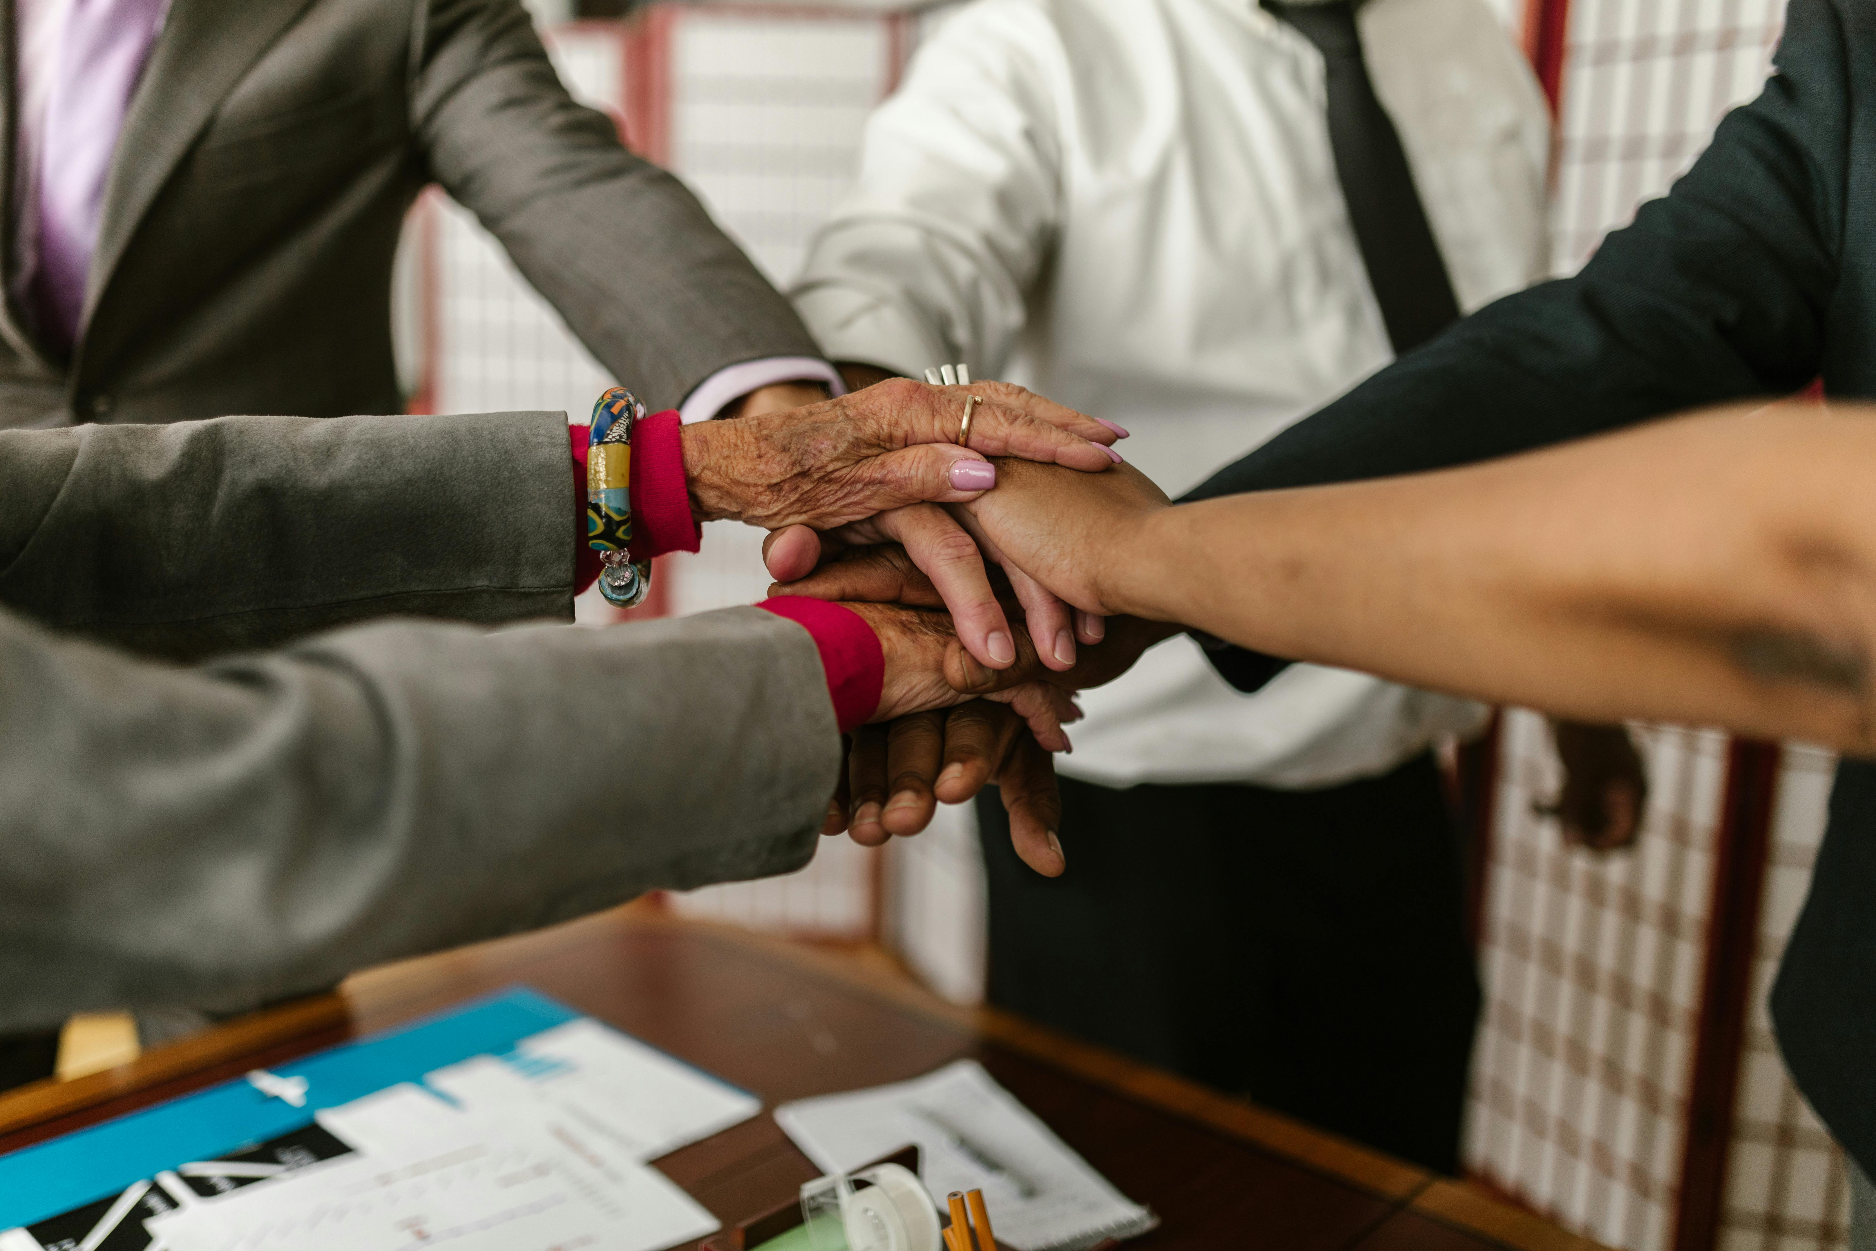
What is Community Building?
Definition of Community Building
Community building refers to the process of creating and maintaining a sense of community and social connection among individuals and groups.
It involves working together to promote social cohesion, address social issues, and improve the quality of life for all community members.
Key Elements of Community Building
Community building requires active listening, effective communication, and a willingness to collaborate.
These elements are essential for working together towards common goals.
Purpose of Community Building
The aim is to foster a sense of belonging and mutual support within the community.
This helps in addressing shared challenges and enhancing the overall well-being of its members.
7
Understanding Cultural Diversity and Community Building

Slide 8
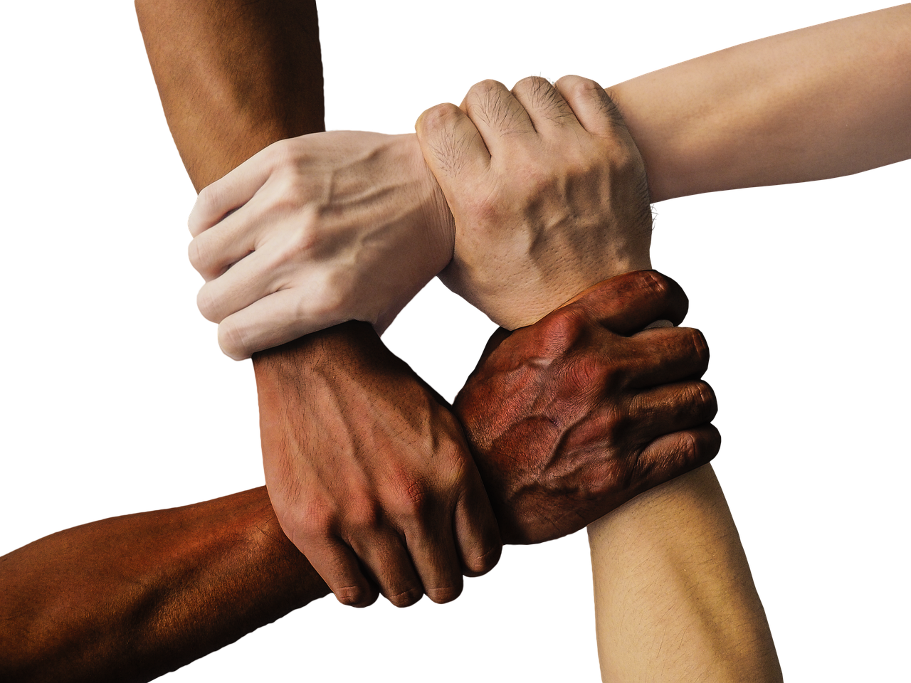
Why is Community Building Important?
Promoting Social Justice and Equity
Community building is essential for promoting social justice, equity, and human rights, as it recognizes and values the differences and contributions of all individuals and groups.
It helps to ensure that diverse voices are heard and respected, fostering a fair and inclusive society.
Building Resilient Communities
It helps to build strong, resilient, and supportive communities that can address social issues and improve the quality of life for all members.
These communities are better equipped to tackle challenges and create sustainable solutions for collective progress.
Fostering Belonging and Purpose
Community building also promotes a sense of belonging, identity, and purpose, which are essential for individual and collective well-being.
This sense of connection enhances emotional and social health, contributing to a more harmonious society.
8
Understanding Cultural Diversity and Community Building

Slide 9
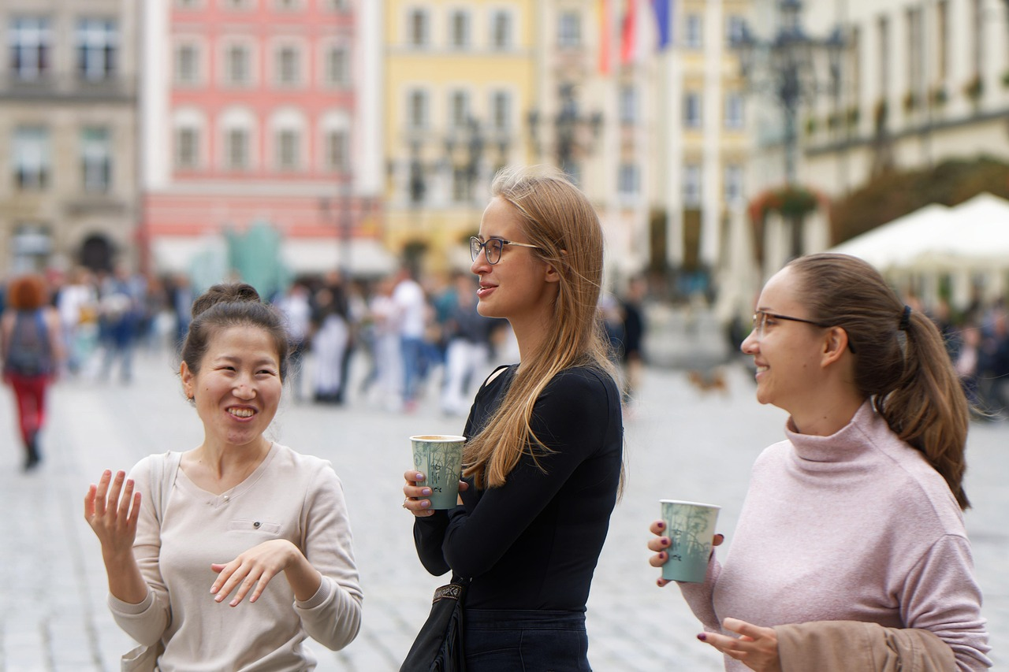
Strategies for Promoting Cultural Diversity and Community Building
Understanding Cultural Traditions
Inclusive Practices and Policies
Educate yourself and others about different cultures and traditions.
This fosters awareness and appreciation for the richness of diverse backgrounds.
Promote inclusive practices and policies that recognize and value diversity.
Such measures ensure equitable opportunities and representation for all.
Building Bridges Through Dialogue
Supporting Community Initiatives
Encourage respectful dialogue and active listening to build bridges between different cultural groups.
This approach helps to resolve misunderstandings and strengthen community ties.
Support community-based initiatives and projects that promote cultural diversity and community building.
These efforts create platforms for collaboration and shared experiences.
9
Understanding Cultural Diversity and Community Building

Slide 10
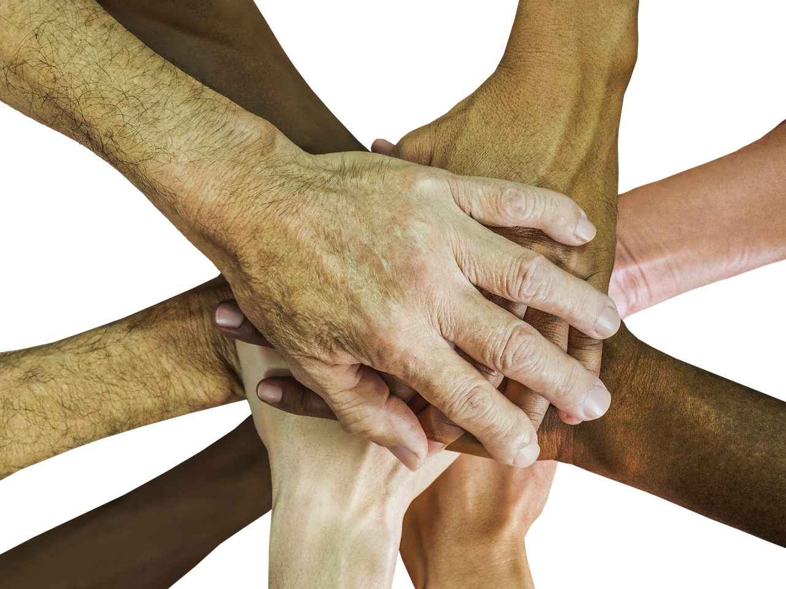
Benefits of Cultural Diversity and Community Building
Understanding and Inclusivity
Promotes understanding, respect, and inclusivity.
Encourages individuals to embrace diverse perspectives and cultures.
Community and Connection
Fosters a sense of community and social connection.
Helps build stronger relationships among people from different backgrounds.
Creativity and Progress
Encourages creativity, innovation, and progress.
Drives new ideas and solutions through diverse viewpoints.
Equity and Human Rights
Supports social justice, equity, and human rights.
Advocates for fair treatment and opportunities for all individuals.
10
Understanding Cultural Diversity and Community Building

Slide 11
Challenges to Cultural Diversity and Community Building
Barriers from Stereotypes and Biases
Impact of Power Imbalances
Consequences of Lack of Awareness
Stereotypes and biases can create barriers to understanding and inclusion.
These barriers hinder the development of mutual respect and trust within diverse communities.
Power imbalances and social inequalities can limit opportunities for marginalized groups.
This creates systemic challenges that prevent equitable participation in community building.
Lack of education and awareness can perpetuate discrimination and exclusion.
This ignorance fosters environments where diversity is undervalued and misunderstood.
11
Understanding Cultural Diversity and Community Building

Slide 12

Overcoming Challenges to Cultural Diversity and Community Building
Cultural Awareness
Inclusive Practices
Building Bridges
Educate yourself and others about different cultures and traditions.
This fosters understanding and reduces stereotypes.
Promote inclusive practices and policies that recognize and value diversity.
This ensures everyone feels respected and represented.
Encourage respectful dialogue and active listening to build bridges between different cultural groups.
This helps create a sense of community and mutual respect.
12
Understanding Cultural Diversity and Community Building

Slide 13
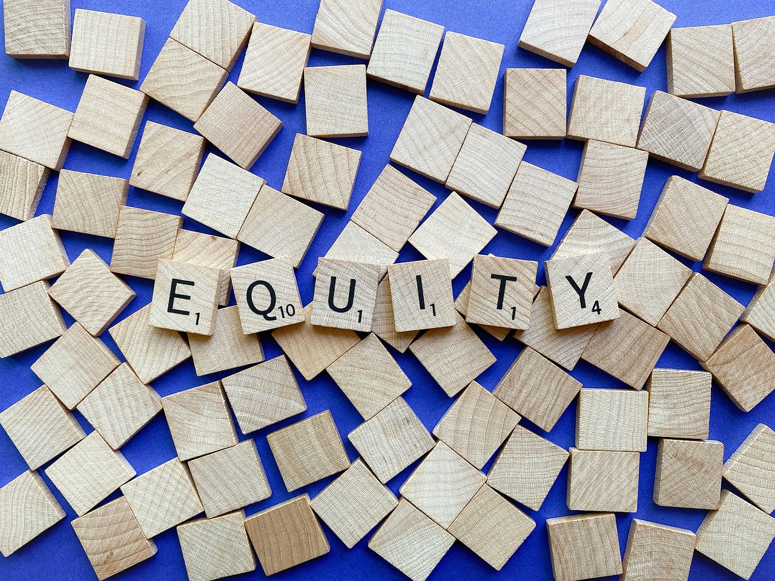
Conclusion
Cultural Diversity and Social Justice
Building Inclusive Communities
Cultural diversity and community building are essential for promoting social justice, equity, and human rights.
By understanding and appreciating cultural diversity, we can create a more just and equitable society for all.
Working together to build strong, inclusive communities is key to fostering equity and human rights.
This collaboration helps in creating a society that values and respects diversity.
13
Understanding Cultural Diversity and Community Building

Slide 14
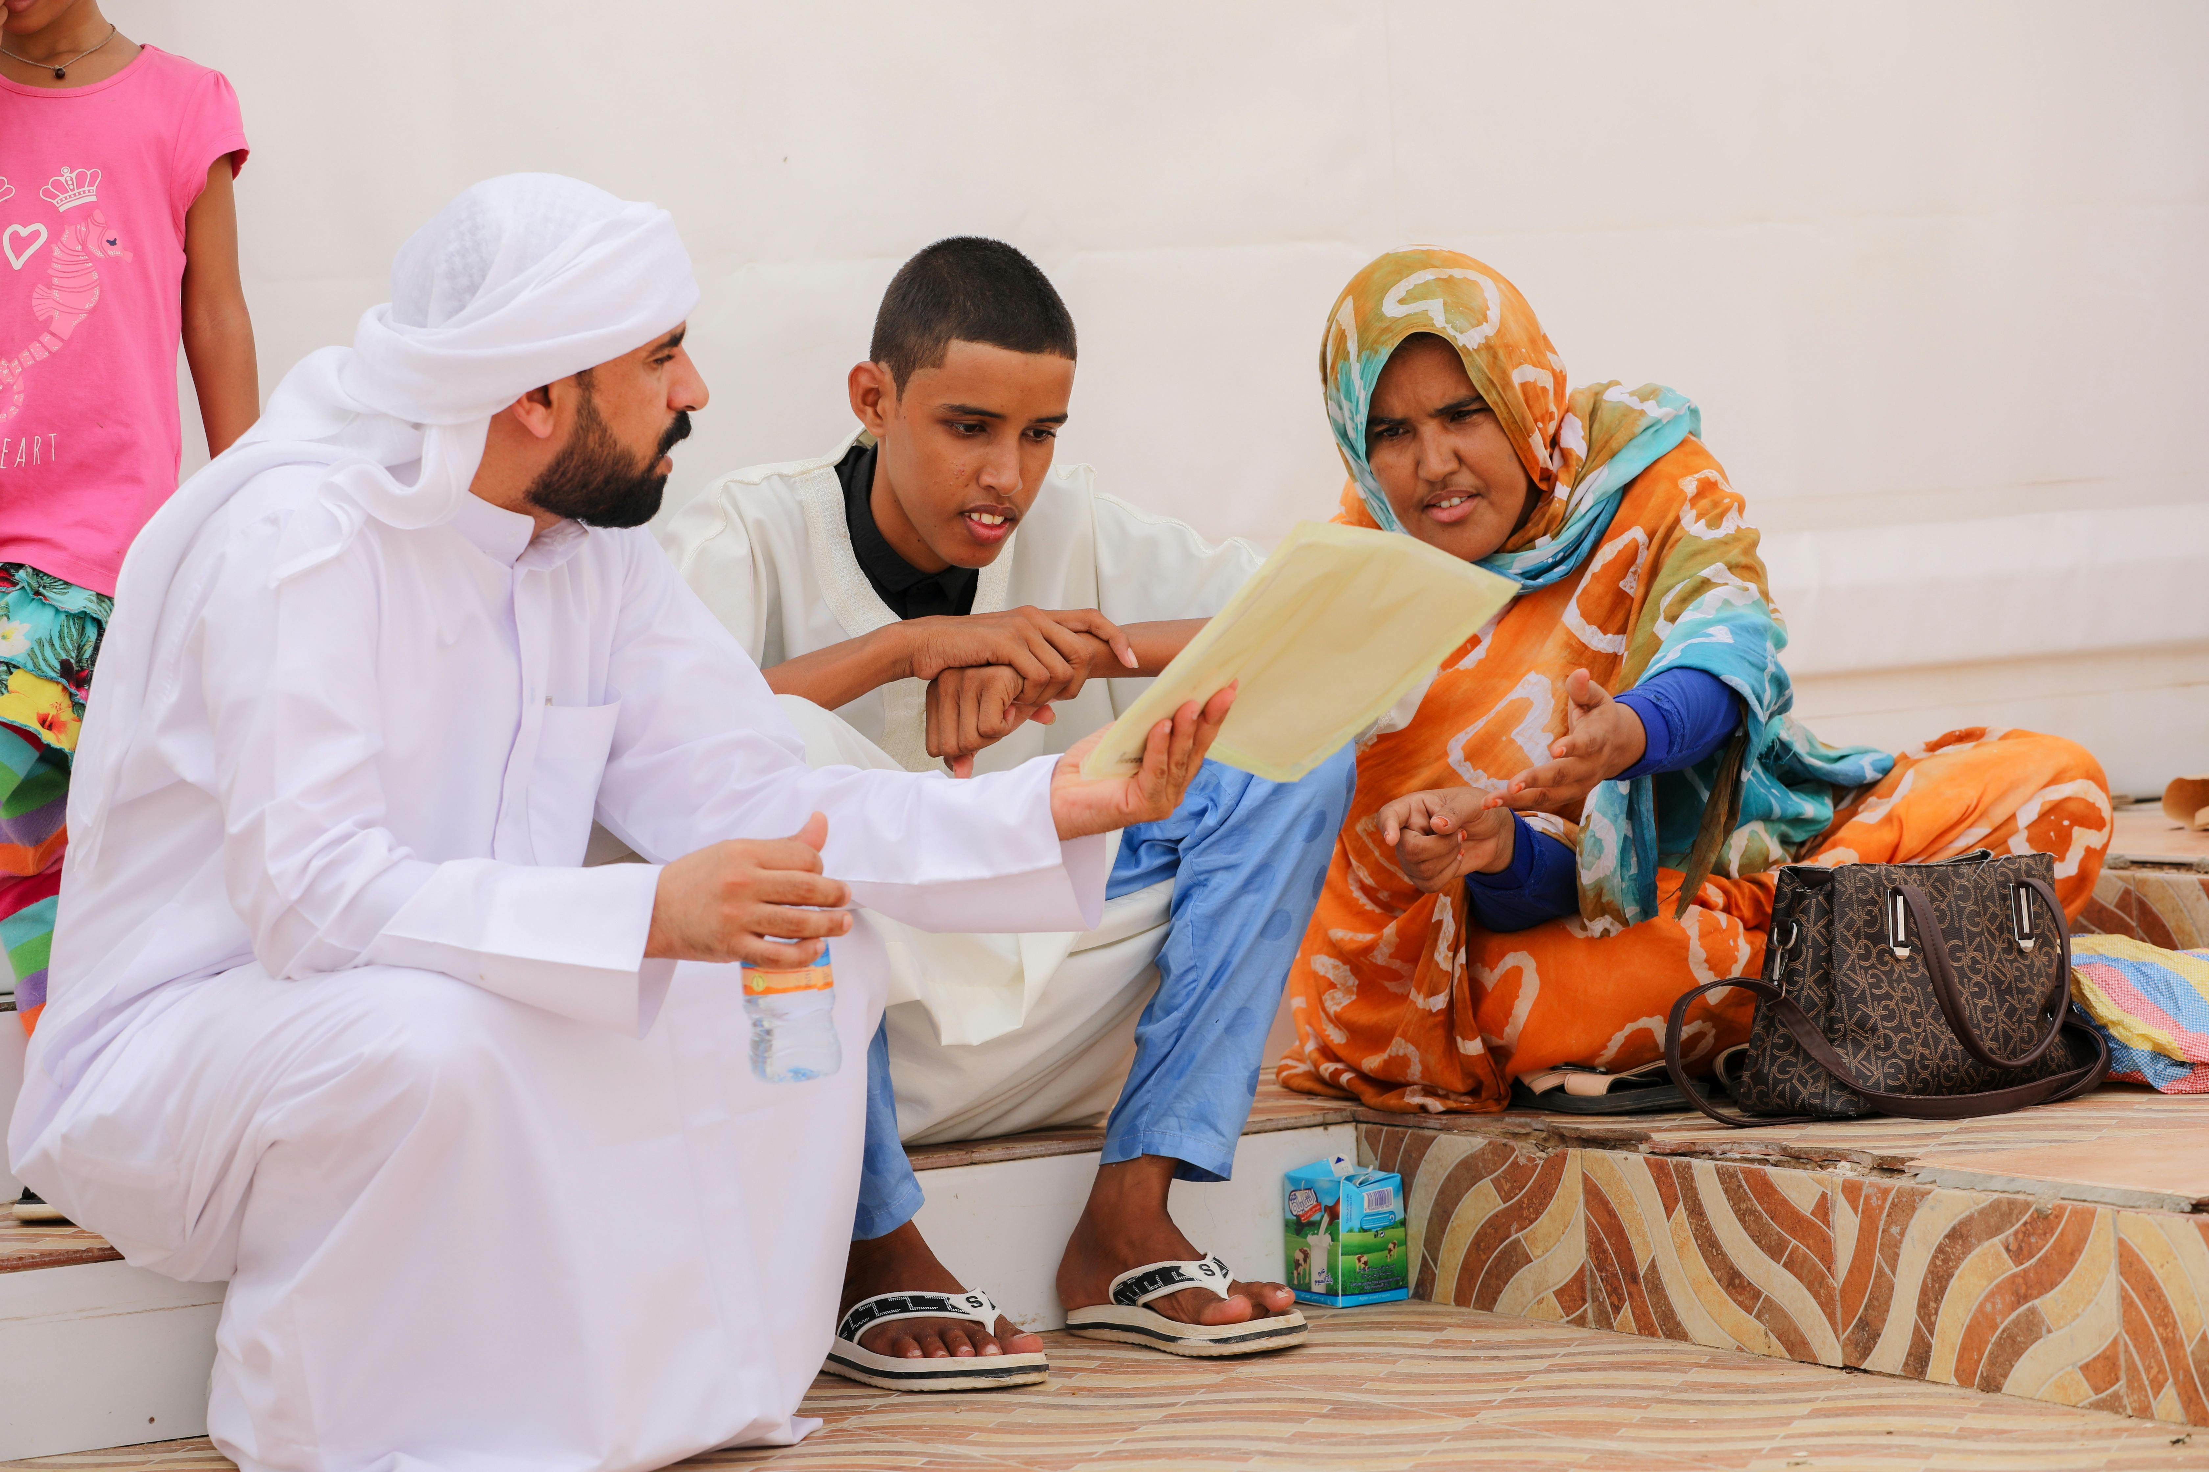
Reflection Questions
Learning from Cultural Diversity
Addressing Barriers to Diversity
Applying Strategies to Community
What did you learn about cultural diversity and community building from this lesson?
How can you apply the concepts and strategies learned in this lesson to your own life and community?
What challenges do you think are the most significant barriers to cultural diversity and community building?
How can they be addressed?
How can you apply the concepts and strategies learned in this lesson to your own life and community?
What did you learn about cultural diversity and community building from this lesson?
14
Understanding Cultural Diversity and Community Building

Slide 15

Next Steps
Cultural Education
Community Engagement
Continue to educate yourself and others about different cultures and traditions.
This helps in fostering understanding and respect among diverse groups.
Get involved in community-based initiatives and projects that promote cultural diversity and community building.
Such efforts strengthen bonds and create inclusive environments.
15
Understanding Cultural Diversity and Community Building

Slide 16
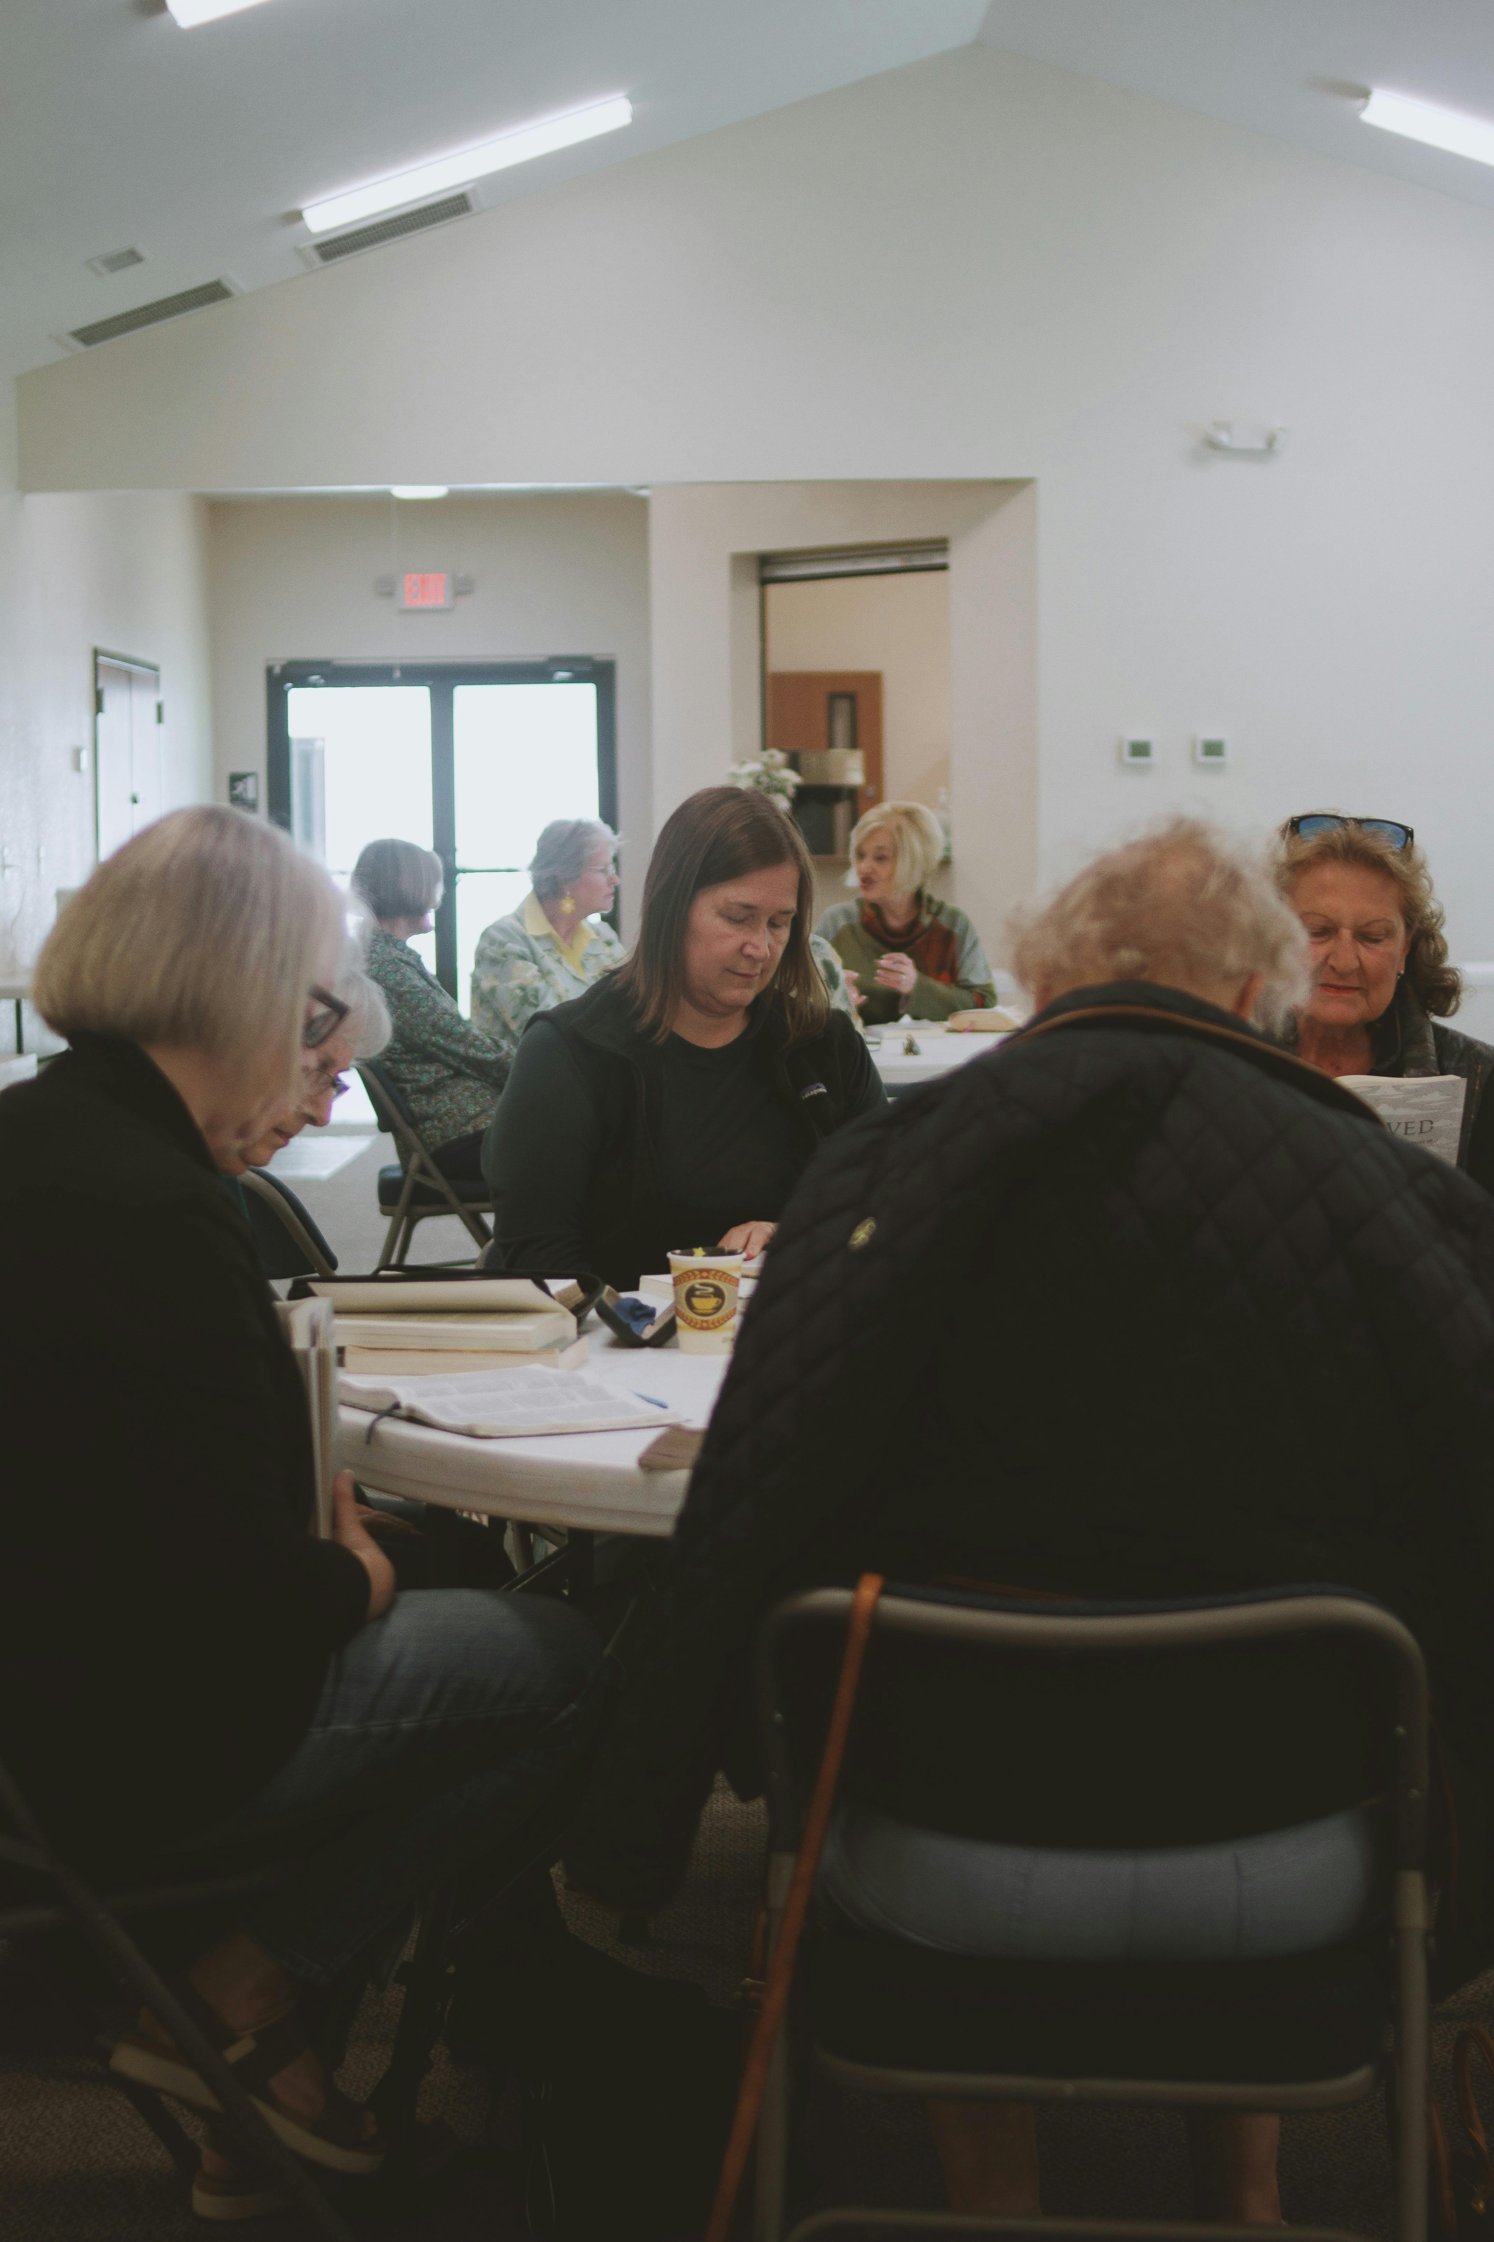
Additional Resources
Books
Websites
Organizations
"The Namesake" by Jhumpa Lahiri, "The Joy Luck Club" by Amy Tan.
These books explore themes of cultural identity and family dynamics.
Cultural Diversity and Inclusion, Community Building and Social Justice.
These websites provide valuable resources for understanding and promoting inclusivity.
Local community centers, cultural organizations, and social justice groups.
These organizations foster community engagement and advocate for social equity.
16
Understanding Cultural Diversity and Community Building

Slide 17
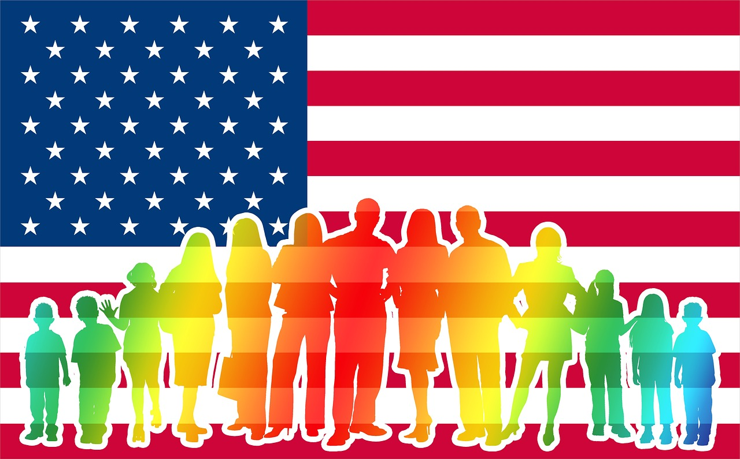
Final Thoughts
Cultural Diversity and Social Justice
Building Inclusive Communities
Cultural diversity and community building are essential for promoting social justice, equity, and human rights.
By working together to build strong, inclusive communities, we can create a more just and equitable society for all.
Cultural diversity and community building are essential for promoting social justice, equity, and human rights.
By working together to build strong, inclusive communities, we can create a more just and equitable society for all.
17
Understanding Cultural Diversity and Community Building

Slide 18
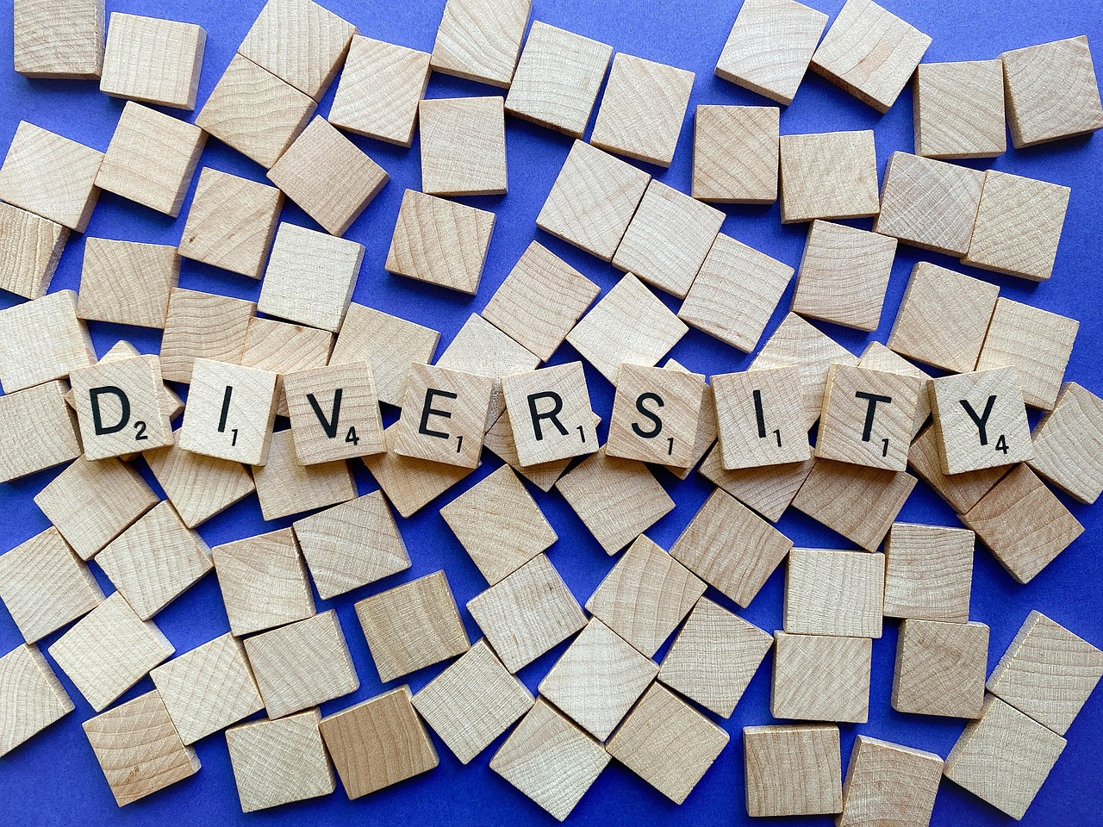
Call to Action
Promote Cultural Diversity
Build an Equitable Society
Get involved in your community and promote cultural diversity and community building.
Continue to educate yourself and others about different cultures and traditions.
Work together to build a more just and equitable society for all.
Continue to educate yourself and others about different cultures and traditions.
18
Understanding Cultural Diversity and Community Building

