Slide 1
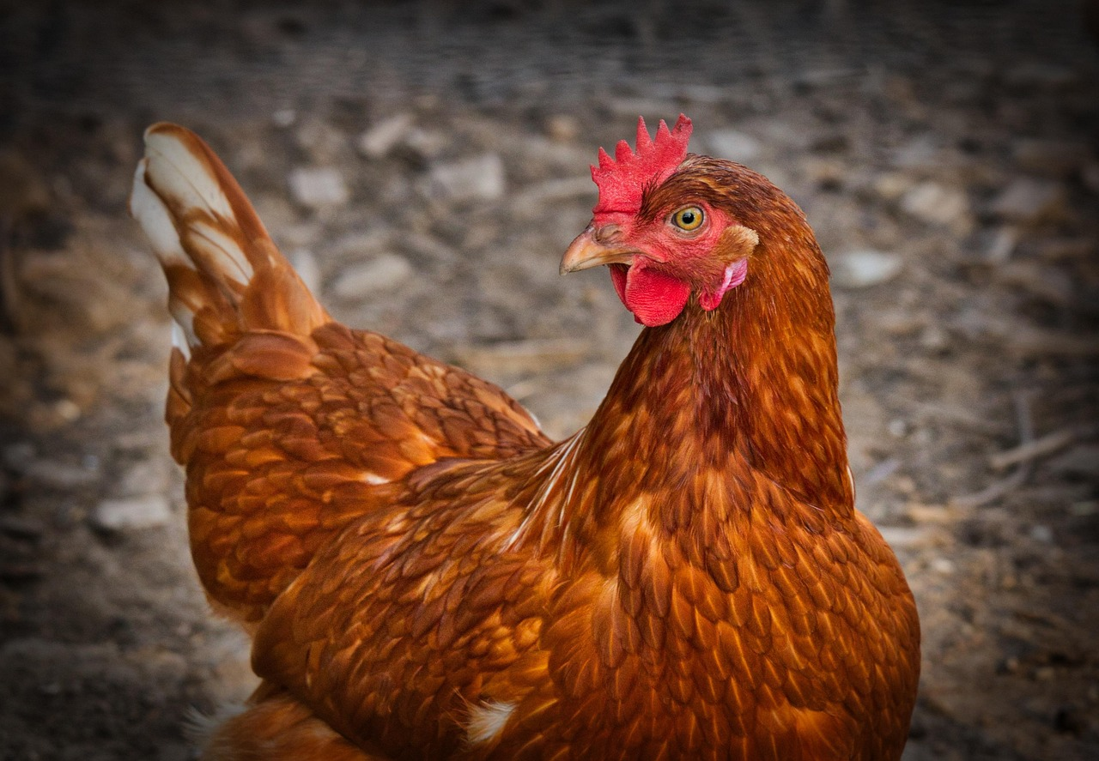

Comprehensive Guide to Poultry Health and Disease Management
Understanding, Preventing, and Controlling Poultry Diseases for Healthy Flocks and Safe Farming

Slide 2
Comprehensive Guide to Poultry Health and Disease Management
2
Table of Contents
Introduction to Poultry Diseases
Why Learn About Poultry Diseases?
Common Poultry Diseases
Signs and Symptoms of Poultry Diseases
Causes of Poultry Diseases
Prevention and Control of Poultry Diseases
Importance of Biosecurity
Poultry Health and Nutrition
Poultry Farm Management
Designing a Healthy Poultry Farm
Conclusion
Reflection Questions
Next Steps
04
05
06
07
08
09
10
11
12
13
14
15
16

Slide 3
Comprehensive Guide to Poultry Health and Disease Management
3
Table of Contents
Additional Resources
Assessment and Evaluation
Extension Activities
Parent Engagement
Safety Considerations
17
18
19
20
21

Slide 4
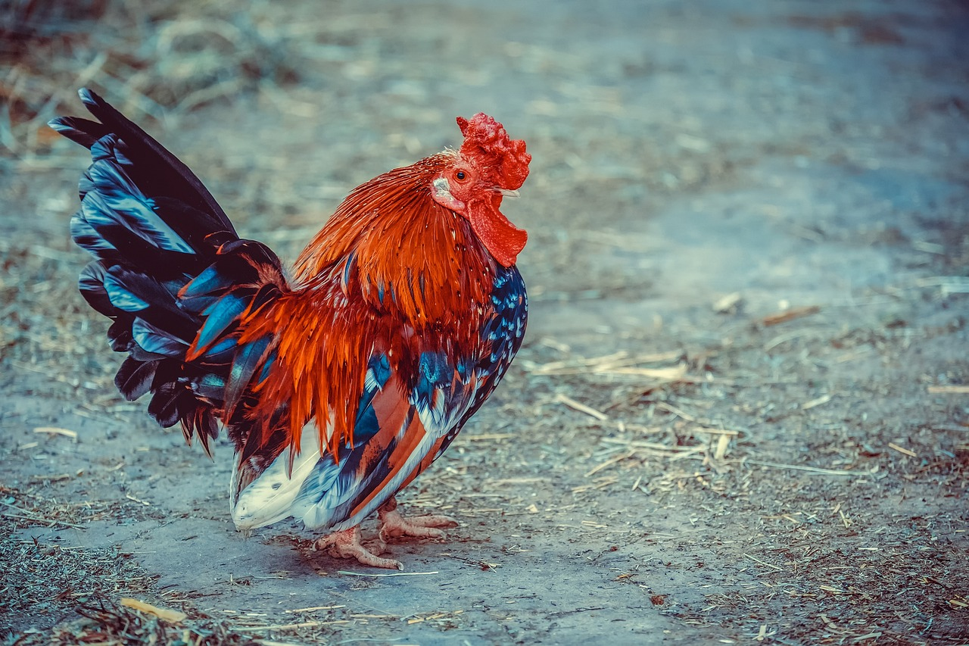
Comprehensive Guide to Poultry Health and Disease Management
4
Introduction to Poultry Diseases
Definition of Poultry Diseases
Causes and Impacts of Poultry Diseases
Importance of Understanding Poultry Diseases
Poultry diseases are conditions that affect the health of domesticated birds like chickens, turkeys, and ducks.
These diseases can be caused by bacteria, viruses, or parasites and can have significant impacts on animal health and human well-being.
Understanding poultry diseases is crucial for maintaining healthy flocks and preventing the spread of diseases.

Slide 5
Comprehensive Guide to Poultry Health and Disease Management
5
Why Learn About Poultry Diseases?
Understanding Animal Health and Welfare
Responsibility and Interconnectedness
Preventing Disease Spread
Learning about poultry diseases helps us understand the importance of animal health and welfare.
It teaches us about responsibility and the interconnectedness of human and animal well-being.
Knowledge of poultry diseases can help prevent their spread and protect both animal and human health.

Slide 6
Comprehensive Guide to Poultry Health and Disease Management
6
Common Poultry Diseases
Newcastle Disease
Avian Influenza
A viral disease that affects the respiratory and nervous systems of birds.
A viral disease that can be transmitted from birds to humans.
Coccidiosis
Salmonellosis
A parasitic disease that affects the digestive system of birds.
A bacterial disease that can be transmitted from birds to humans.

Slide 7
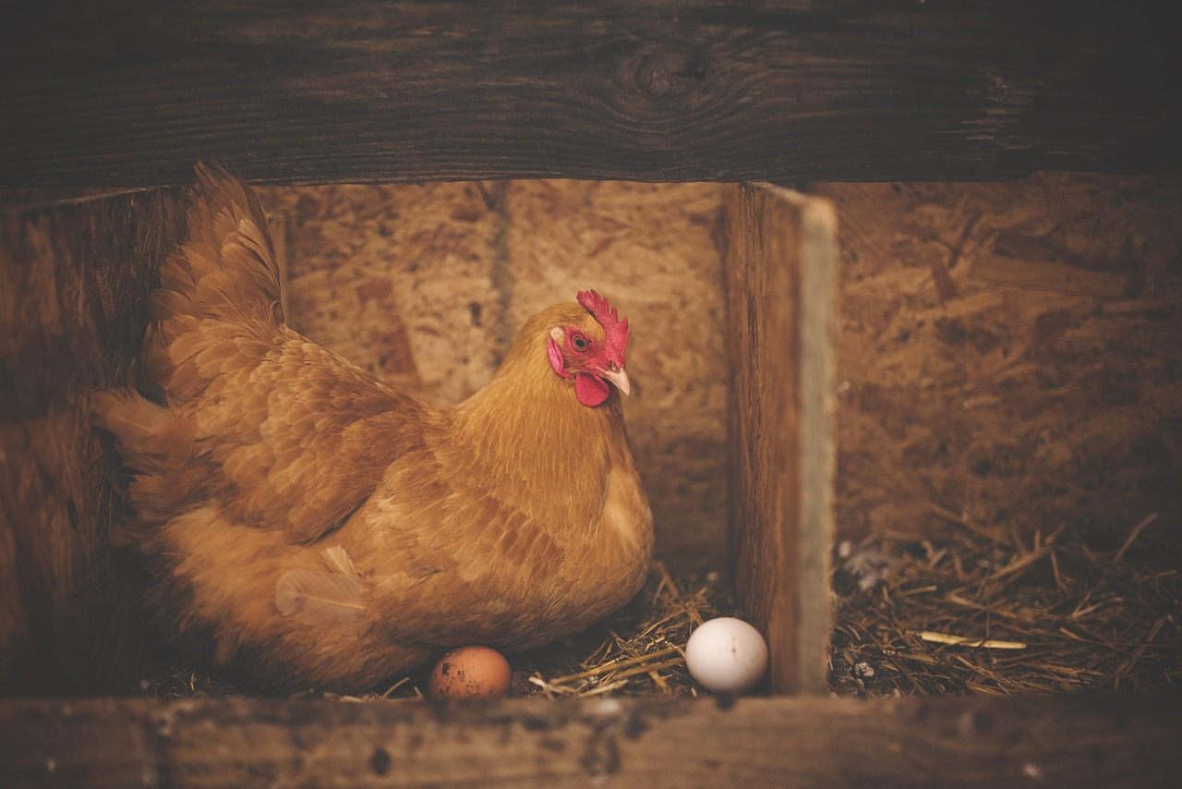
Comprehensive Guide to Poultry Health and Disease Management
7
Signs and Symptoms of Poultry Diseases
Egg Production Decline
Respiratory Issues
Decrease in egg production
Respiratory symptoms such as coughing and sneezing
Digestive and Weight Concerns
Behavioral Changes
Diarrhea and weight loss
Lethargy and loss of appetite

Slide 8
Comprehensive Guide to Poultry Health and Disease Management
8
Causes of Poultry Diseases
Biological Factors
Environmental Factors
Nutritional Factors
Bacteria
Viruses
Parasites
Poor sanitation
Overcrowding
Stress
Poor diet
Malnutrition

Slide 9
Comprehensive Guide to Poultry Health and Disease Management
9
Prevention and Control of Poultry Diseases
Vaccination
Hygiene Practices
Biosecurity Measures
Proper Nutrition
Administering vaccines to prevent disease
Maintaining cleanliness and sanitation
Preventing the introduction and spread of diseases
Providing a balanced diet

Slide 10
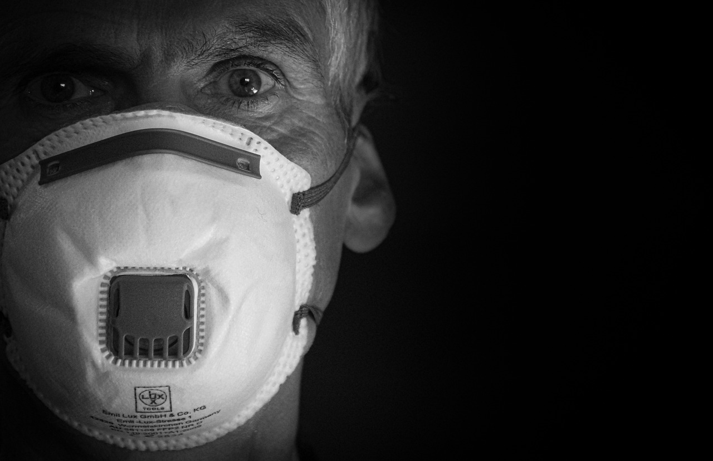
Comprehensive Guide to Poultry Health and Disease Management
10
Importance of Biosecurity
Preventing Disease Spread
Animal Health and Welfare
Human Disease Risk Reduction
Prevents the introduction and spread of diseases
Protects animal health and welfare
Reduces the risk of disease transmission to humans

Slide 11
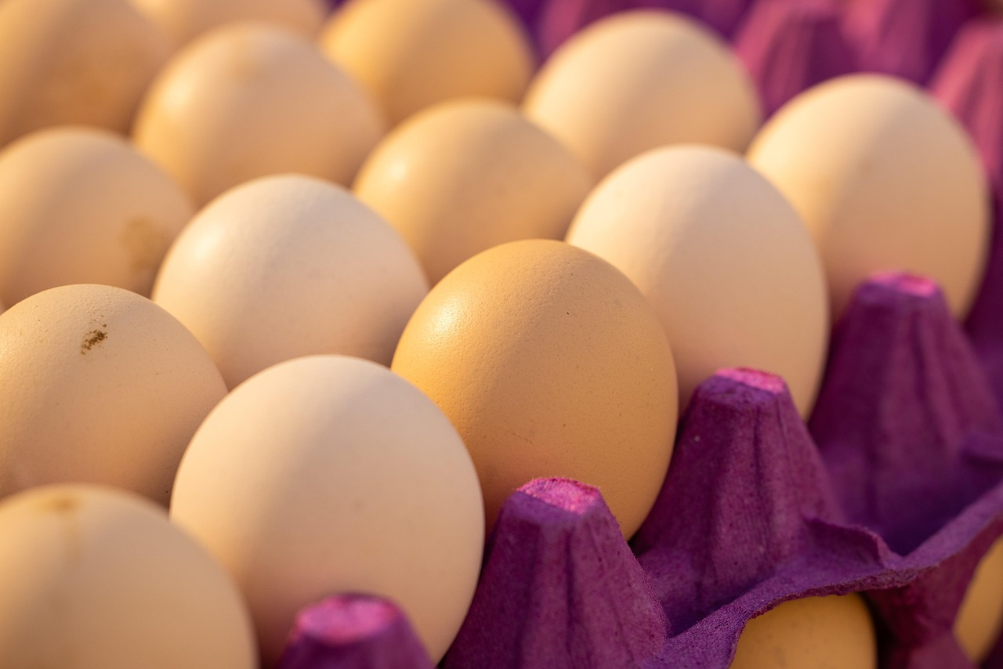
Comprehensive Guide to Poultry Health and Disease Management
11
Poultry Health and Nutrition
Importance of Proper Nutrition
Components of a Balanced Diet
Significance of Clean Water
Proper nutrition is essential for maintaining healthy poultry.
A balanced diet includes a mix of grains, proteins, and vitamins.
Access to clean water is crucial for poultry health.

Slide 12
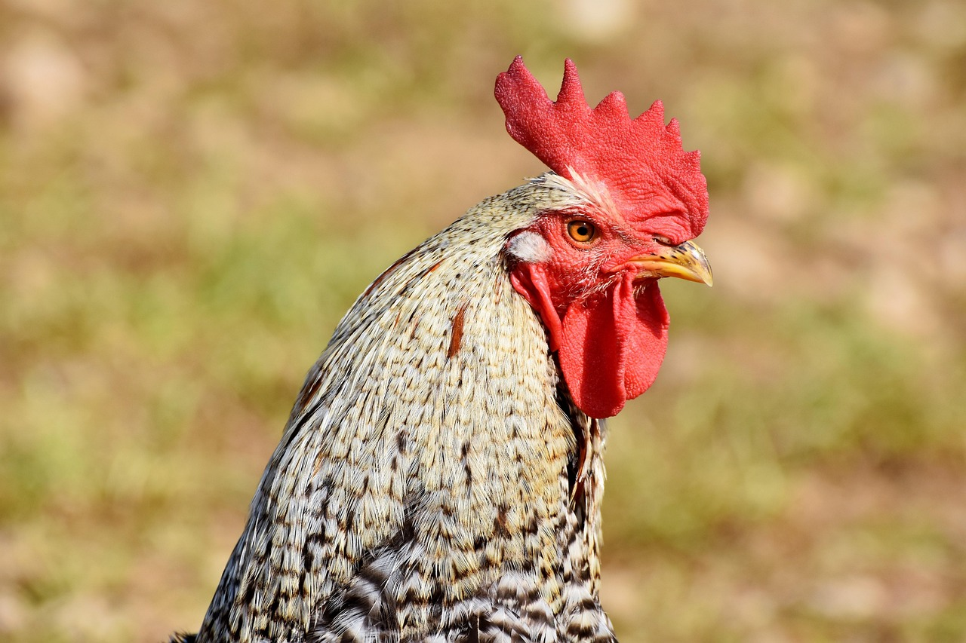
Comprehensive Guide to Poultry Health and Disease Management
12
Poultry Farm Management
Clean and Sanitary Environment
Maintaining a clean and sanitary environment
Adequate Space and Ventilation
Providing adequate space and ventilation
Monitoring Poultry Health
Monitoring poultry health and taking action when necessary

Slide 13
Comprehensive Guide to Poultry Health and Disease Management
13
Designing a Healthy Poultry Farm
Health and Safety Measures
Nutritional Advice and Planning
Ethical Farming Practices
Incorporating health and safety measures
Providing nutritional advice and dietary planning
Implementing ethical farming practices

Slide 14
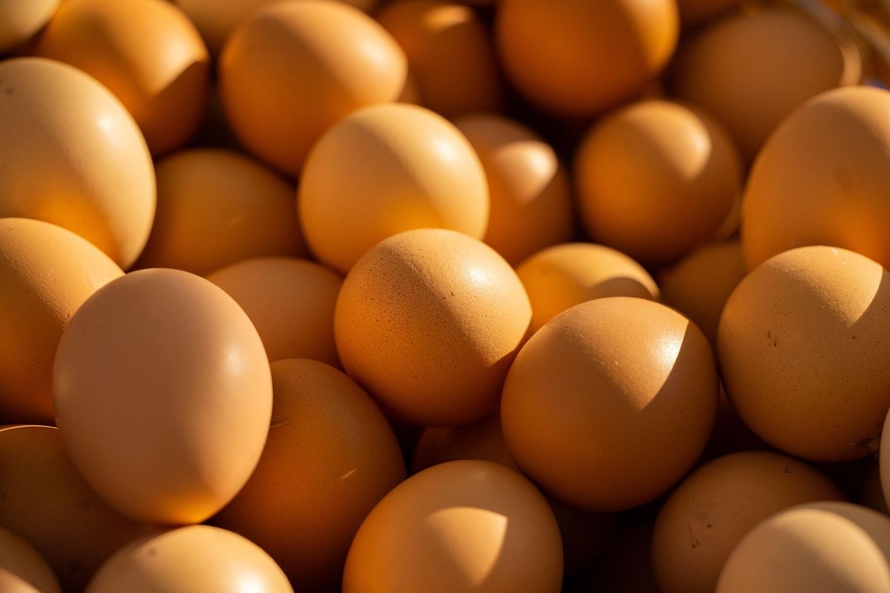
Comprehensive Guide to Poultry Health and Disease Management
14
Conclusion
Importance of Understanding Poultry Diseases
Impact on Health and Well-being
Understanding poultry diseases is crucial for maintaining healthy flocks and preventing the spread of diseases.
By applying knowledge of poultry diseases, we can contribute to the health and well-being of poultry animals and humans.

Slide 15
Comprehensive Guide to Poultry Health and Disease Management
15
Reflection Questions
Learning About Poultry Diseases
What did you learn about poultry diseases?
Applying Knowledge for Healthy Poultry
How can you apply your knowledge to maintain healthy poultry?
Challenges in Poultry Disease Management
What are some challenges in preventing and controlling poultry diseases?

Slide 16
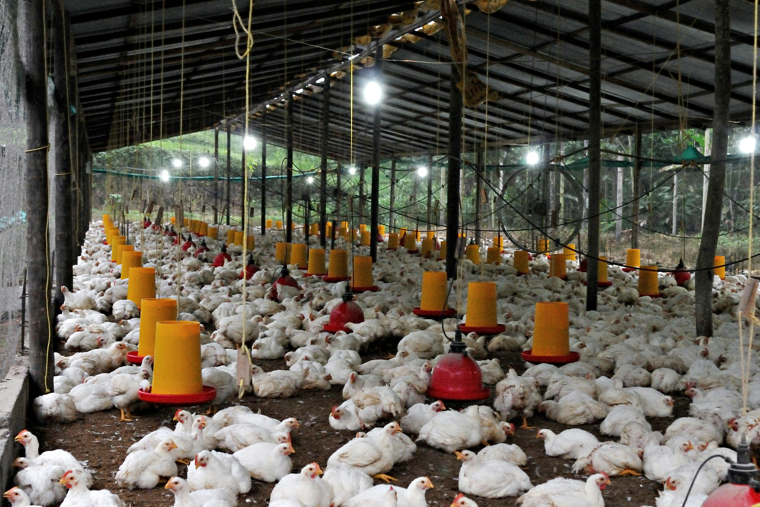
Comprehensive Guide to Poultry Health and Disease Management
16
Next Steps
Learning About Poultry Health and Nutrition
Designing and Managing a Healthy Poultry Farm
Continue learning about poultry health and nutrition
Apply knowledge to design and manage a healthy poultry farm

Slide 17

Comprehensive Guide to Poultry Health and Disease Management
17
Additional Resources
Books and Articles
Online Resources
Expert Advice
Books and articles on poultry diseases and health
Online resources and websites
Expert advice from veterinarians and poultry farmers

Slide 18

Comprehensive Guide to Poultry Health and Disease Management
18
Assessment and Evaluation
Knowledge Assessment
Understanding Evaluation
Engagement Assessment
Quizzes and tests to assess knowledge
Projects and presentations to evaluate understanding
Class discussions and participation to assess engagement

Slide 19
Comprehensive Guide to Poultry Health and Disease Management
19
Extension Activities
Designing a Poultry Farm
Public Awareness Campaign
Research on Poultry Diseases
Designing a poultry farm with health and safety measures
Creating a public awareness campaign about poultry diseases
Conducting research on a specific poultry disease

Slide 20

Comprehensive Guide to Poultry Health and Disease Management
20
Parent Engagement
Encouraging Parental Inquiry
Encourage parents to ask their children about what they learned
Inviting Parental Participation
Invite parents to participate in class discussions and activities

Slide 21
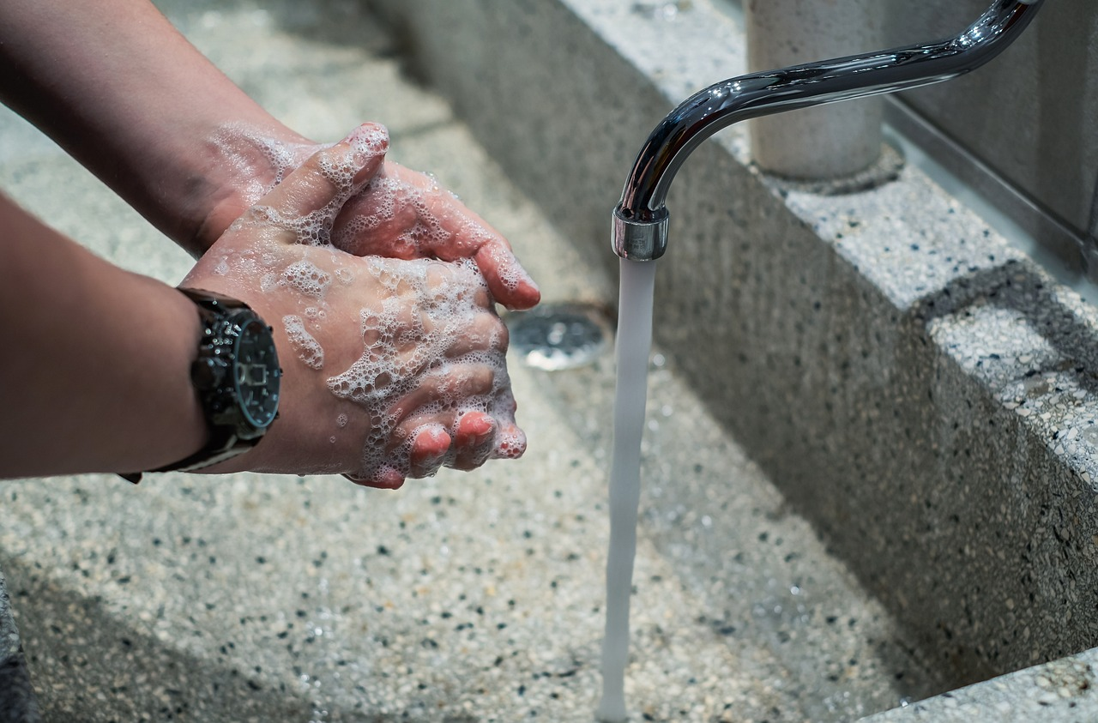
Comprehensive Guide to Poultry Health and Disease Management
21
Safety Considerations
Hand Hygiene
Animal Restrictions
Classroom Maintenance
Wash hands thoroughly before and after handling materials
Avoid bringing live poultry or animals into the classroom
Keep the classroom clean and well-ventilated

