Slide 1

Comprehensive Guide to Skin Hygiene and Care
Understanding the Importance, Practices, and Myths for Healthy Skin

Slide 2
Table of contents
Introduction to Skin Hygiene
Why is Skin Hygiene Important?
Structure and Function of the Skin
Common Skin Issues
Importance of Nutrition and Hydration
Stress and Skin Health
Proper Skin Care Routine
Choosing the Right Skin Care Products
Importance of Hand Hygiene
Common Myths and Misconceptions
01
02
03
04
05
06
07
08
09
10

Slide 3
Table of contents
Conclusion
Additional Resources
Reflection Questions
Next Steps
Final Thoughts
References
11
12
13
14
15
16

Slide 4
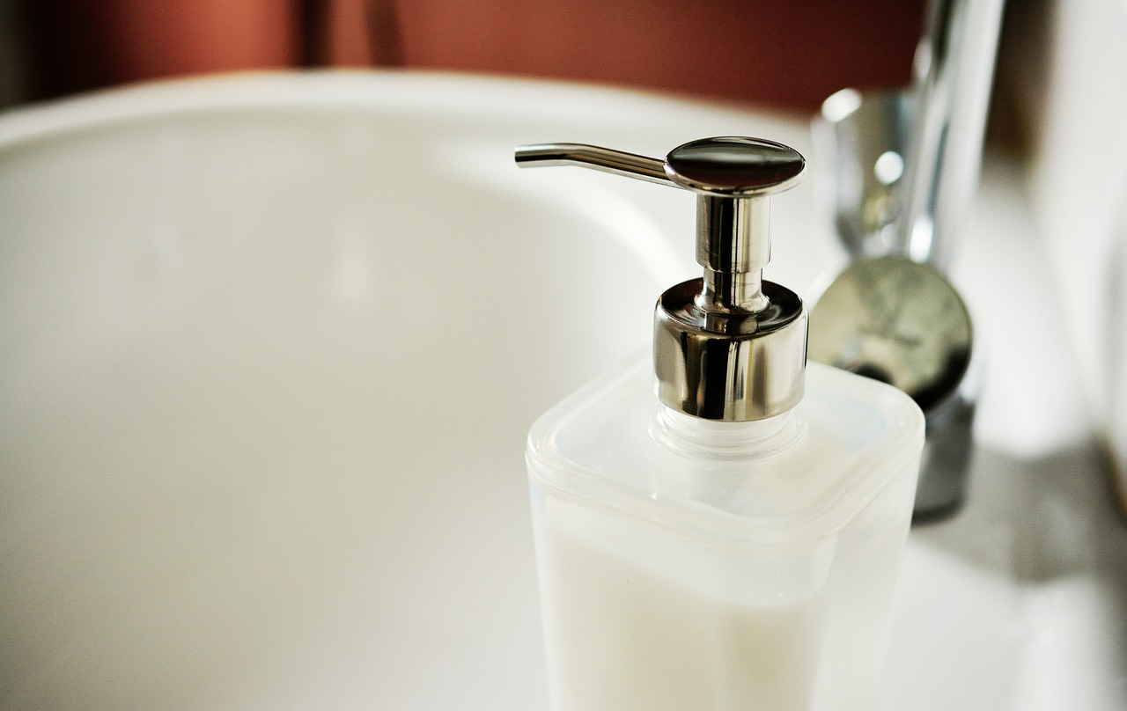
Comprehensive Guide to Skin Hygiene and Care
1
Introduction to Skin Hygiene
Health Benefits
Routine Importance
Nutrition Impact
Maintaining skin hygiene is essential for overall health.
It boosts self-confidence by promoting clear and healthy skin.
A proper skin care routine can prevent common skin issues like acne and dryness.
Regular cleansing and moisturizing are key to maintaining skin health.
Nutrition and hydration significantly influence skin health.
A balanced diet rich in vitamins and water helps keep the skin glowing.

Slide 5
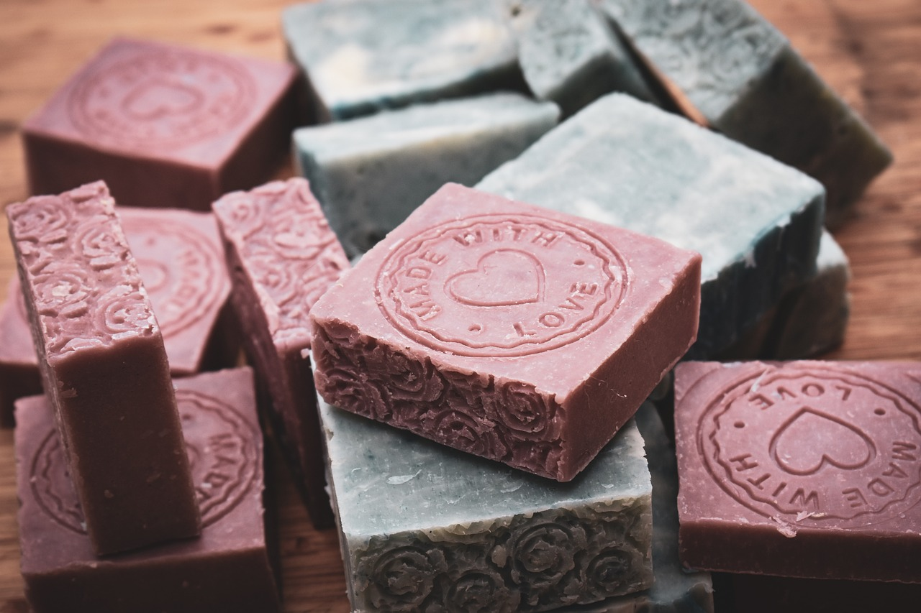
Comprehensive Guide to Skin Hygiene and Care
2
Why is Skin Hygiene Important?
Infection Prevention
Confidence Boost
Regular skin hygiene helps prevent infections and skin conditions.
It reduces the risk of bacteria and viruses affecting the skin.
Maintaining clean skin can significantly boost self-esteem.
A clear complexion often leads to increased confidence in social situations.
Health Support
Healthy Appearance
Good skin hygiene supports overall health and well-being.
It can prevent skin-related issues that may affect overall health.
Proper skin care helps maintain a healthy and vibrant appearance.
It contributes to a youthful look and can enhance personal image.

Slide 6

Comprehensive Guide to Skin Hygiene and Care
3
Structure and Function of the Skin
Largest Organ
Barrier Function
Layer Composition
The skin is the largest organ of the human body.
It covers the entire surface and plays a vital role in overall health.
The skin acts as a barrier against infection and harmful substances.
It also helps regulate body temperature through sweat and blood flow.
The skin is composed of several layers: the epidermis, dermis, and hypodermis.
Each layer has distinct functions and contributes to the skin's overall health.

Slide 7

Comprehensive Guide to Skin Hygiene and Care
4
Common Skin Issues
Acne
Dry Skin
Caused by clogged pores and bacteria, acne is a common skin issue that affects many individuals.
It can lead to inflammation and scarring if not treated properly.
Dry skin occurs when the skin lacks moisture and hydration, leading to flakiness and irritation.
Environmental factors and certain skin conditions can exacerbate this issue.
Oily Skin
Skin Infections
Oily skin is characterized by the overproduction of sebum, which can lead to a shiny appearance and enlarged pores.
This condition often requires specific skincare routines to manage effectively.
Skin infections can be caused by bacteria, viruses, or fungi, leading to redness, swelling, and discomfort.
Prompt treatment is essential to prevent complications and promote healing.

Slide 8

Comprehensive Guide to Skin Hygiene and Care
5
Importance of Nutrition and Hydration
Balanced Diet
Hydration Importance
Key Nutrients
A balanced diet rich in fruits, vegetables, and whole grains supports skin health.
Adequate hydration helps to maintain skin elasticity and health.
Certain nutrients, such as vitamin C and omega-3 fatty acids, are beneficial for the skin.

Slide 9

Comprehensive Guide to Skin Hygiene and Care
6
Stress and Skin Health
Skin Issues
Stress Reduction Techniques
Exercise Benefits
Stress can lead to various skin problems, including acne and eczema.
These conditions can worsen with prolonged stress exposure.
Techniques like meditation and deep breathing can effectively lower stress levels.
Implementing these practices can lead to improved skin health.
Regular physical activity helps reduce stress and anxiety.
Exercise also promotes better blood circulation, benefiting skin appearance.

Slide 10
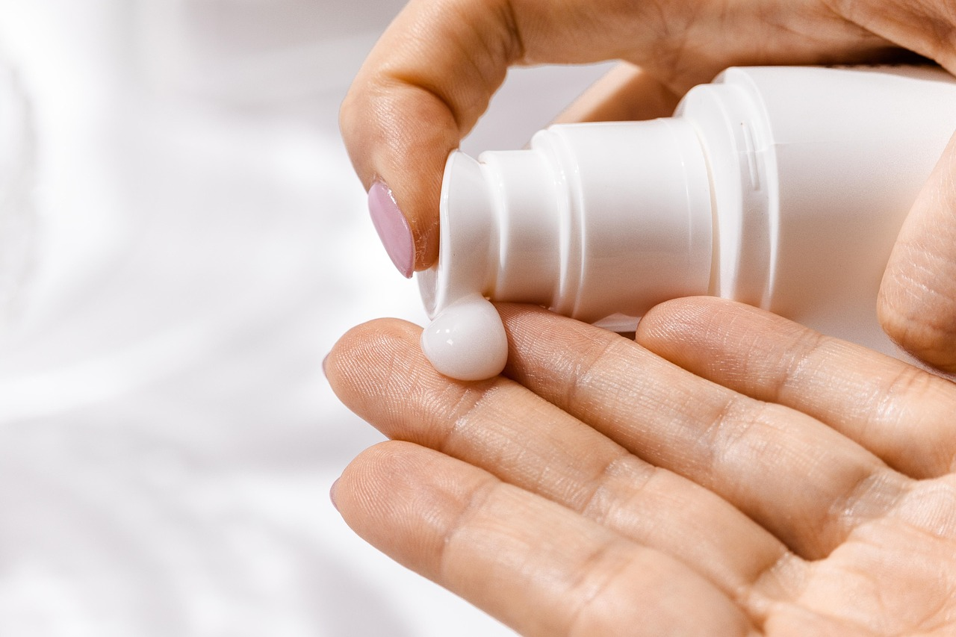
Comprehensive Guide to Skin Hygiene and Care
7
Proper Skin Care Routine
Cleanse Twice Daily
Hydrate Regularly
Use a gentle cleanser to remove dirt and impurities.
Cleansing in the morning and evening helps maintain skin health.
Moisturize daily to keep skin hydrated and elastic.
Choose a moisturizer suitable for your skin type.
Sun Protection
Regular Exfoliation
Apply sunscreen every day, even on cloudy days.
Wear protective clothing and seek shade when necessary.
Exfoliate once or twice a week to remove dead skin cells.
This helps to reveal smoother and brighter skin.

Slide 11

Comprehensive Guide to Skin Hygiene and Care
8
Choosing the Right Skin Care Products
Match Skin Type
Check Ingredients
Gentle Formulas
Identify your skin type: oily, dry, combination, or sensitive.
Choose products specifically formulated for your skin type.
Read labels carefully to avoid harsh chemicals.
Look for natural ingredients that nourish your skin.
Opt for products that are labeled as gentle or non-comedogenic.
These formulas are less likely to irritate your skin or clog pores.

Slide 12

Comprehensive Guide to Skin Hygiene and Care
9
Importance of Hand Hygiene
Regular Washing
Use Sanitizer
Infection Prevention
Washing hands with soap and water is essential to remove dirt and germs.
It is recommended to wash hands for at least 20 seconds.
Hand sanitizer is a good alternative when soap and water are not available.
Ensure the sanitizer contains at least 60% alcohol for effectiveness.
Proper hand hygiene significantly reduces the risk of infections.
It is a simple yet effective way to protect yourself and others.

Slide 13

Comprehensive Guide to Skin Hygiene and Care
10
Common Myths and Misconceptions
Daily Exfoliation Myth
Hot Water Washing Myth
Myth: You should exfoliate your skin every day.
Reality: Exfoliating too frequently can lead to irritation and dryness.
Myth: You should use hot water to wash your face.
Reality: Hot water can strip the skin of its natural oils, leading to dryness and irritation.
Irritation from Over-Exfoliation
Natural Oils Stripped
Over-exfoliation can cause redness and sensitivity.
It's important to find a balance to maintain healthy skin.
Using harsh cleansers can strip your skin of natural oils.
Opt for gentle products to preserve skin health.

Slide 14

Comprehensive Guide to Skin Hygiene and Care
11
Conclusion
Skin Hygiene Importance
Essential Care Practices
Myths vs. Facts
Skin hygiene is crucial for overall health and self-confidence.
Maintaining clean skin helps prevent infections and promotes a healthy appearance.
A proper skin care routine includes cleansing, moisturizing, and sun protection.
Nutrition and hydration play vital roles in maintaining healthy skin.
Many believe that oily skin doesn't need moisturizing, which is false.
Understanding common misconceptions can help you adopt better skin care habits.

Slide 15

Comprehensive Guide to Skin Hygiene and Care
12
Additional Resources
Web Resources
Recommended Reads
Useful Apps
American Academy of Dermatology: Reliable skin health information.
Skin Cancer Foundation: Focuses on skin cancer prevention.
"The Skin Type Solution" by Dr. Leslie Baumann: A guide to identifying your skin type.
"The Beauty of Dirty Skin" by Dr. Whitney Bowe: Explores skin and gut health connections.
SkinCare: Manages skincare routines efficiently.
Dermatology Guide: Insights into various skin conditions.

Slide 16
Comprehensive Guide to Skin Hygiene and Care
13
Reflection Questions
Skin Hygiene Insights
Daily Application
Myth Busting
Understanding the importance of maintaining clean skin to prevent breakouts and infections.
Incorporating skin hygiene practices into your daily routine for better skin health.
Recognizing that not all skin care products are suitable for every skin type.

Slide 17
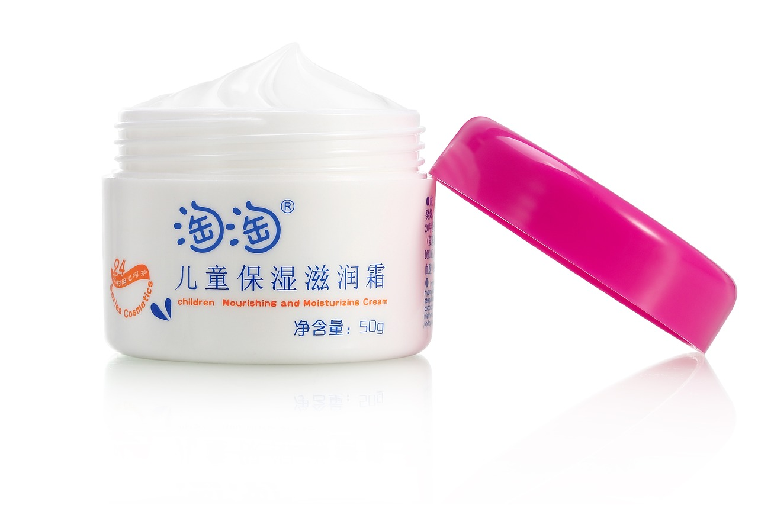
Comprehensive Guide to Skin Hygiene and Care
14
Next Steps
Skincare Routine
Consult Professionals
Educate Others
Continue to practice good skin care habits daily.
Maintain a healthy lifestyle by eating well and staying hydrated.
Seek advice from a dermatologist for personalized skincare solutions.
Address any specific concerns about your skin with a professional.
Share your knowledge about skincare with friends and family.
Promote healthy skin habits within your community.

Slide 18

Comprehensive Guide to Skin Hygiene and Care
15
Final Thoughts
Skin Investment
Healthy Skin Tips
Seek Help When Needed
Taking care of your skin is an investment in your overall health and well-being.
By following the tips and strategies outlined in this presentation, you can maintain healthy and glowing skin.
Remember to be patient and consistent, and don't hesitate to seek help if you have concerns about your skin.

Slide 19
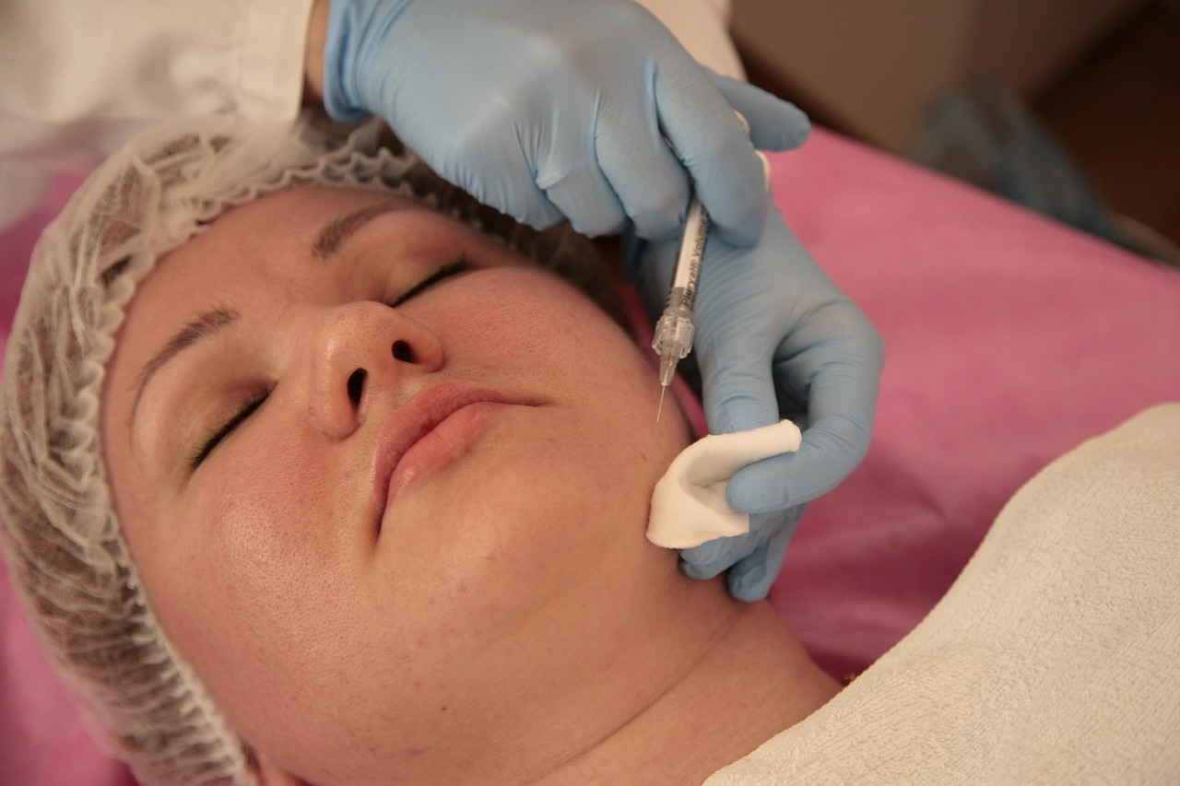
Comprehensive Guide to Skin Hygiene and Care
16
References
Dermatology Insights
Cancer Prevention
Skin Type Guide
Understanding skin conditions is essential for effective skincare. The American Academy of Dermatology emphasizes the importance of tailored skincare practices.
Regular skin checks and sun protection are vital in reducing skin cancer risk. The Skin Cancer Foundation highlights these strategies as key preventive measures.
Identifying your skin type is crucial for personalized skincare. Baumann's guide provides insights into different skin types and appropriate care routines.

