Slide 1
Building a Positive and Inclusive Classroom Community
Strategies, Activities, and Benefits for Enhancing Student Engagement and Social Skills

Slide 2
Table of Contents
Introduction to Building Classroom Community
Benefits of Building Classroom Community
Icebreaker Activities for Building Classroom C…
Implementing Icebreaker Activities
Example Icebreaker Activity: Human Bingo
Example Icebreaker Activity: The Human Knot
Assessing Student Understanding
Providing Feedback and Guidance
Creating a Positive Classroom Environment
Addressing Challenges and Conflicts
Conclusion
Next Steps
Reflection Questions
04
05
06
07
08
09
10
11
12
13
14
15
16

Slide 3
Table of Contents
Key Takeaways
Teaching Tips
Parent Engagement
Safety Considerations
17
18
19
20

Slide 4

Introduction to Building Classroom Community
Importance of Classroom Community
Role of Icebreaker Activities
Benefits of a Strong Community
Building classroom community is essential for creating a positive and inclusive learning environment.
A strong classroom community can lead to improved academic achievement, increased student engagement, and reduced bullying and conflict.
Icebreaker activities can help students develop essential social skills, such as communication, teamwork, and problem-solving.
These activities lay the foundation for a collaborative and supportive classroom environment.
A strong classroom community fosters a sense of belonging among students.
This sense of belonging contributes to both personal and academic growth.
4
Building a Positive and Inclusive Classroom Community

Slide 5
Benefits of Building Classroom Community
Enhancing Social Skills
Cultivating Empathy and Respect
Building a Sense of Belonging
Boosting Academic and Social Outcomes
Promotes social skills, such as communication, teamwork, and problem-solving.
These skills are essential for students to collaborate effectively and navigate social interactions.
Encourages empathy, respect, and kindness among students.
This helps create a positive and inclusive classroom environment.
Fosters a sense of belonging and connection among students.
A strong classroom community makes students feel valued and supported.
Leads to improved academic achievement and reduced bullying and conflict.
A harmonious classroom environment contributes to both personal and academic growth.
5
Building a Positive and Inclusive Classroom Community

Slide 6
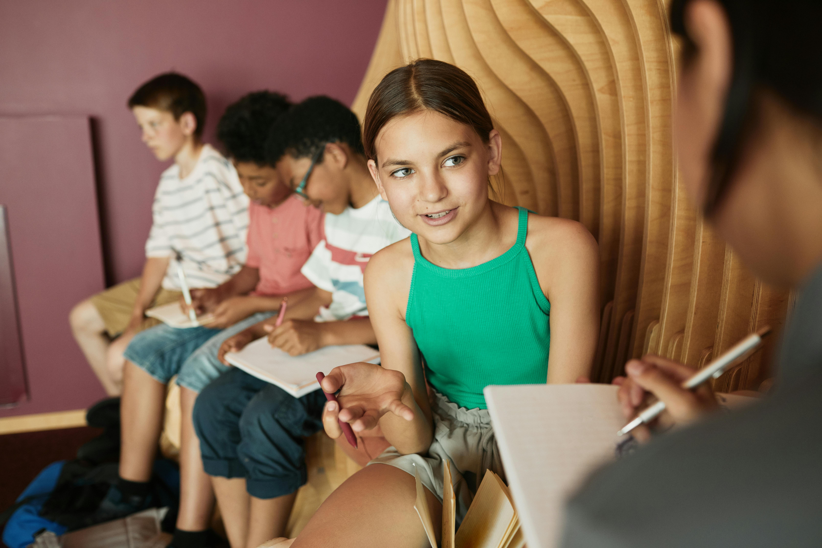
Icebreaker Activities for Building Classroom Community
Human Bingo
The Human Knot
Classroom Scavenger Hunt
Encourage students to interact with one another through a fun and engaging activity.
This game helps break the ice and fosters initial connections among classmates.
Promote teamwork and communication by challenging students to untangle themselves.
This activity emphasizes collaboration and problem-solving skills.
Encourage students to work together to find items or complete tasks.
This activity builds camaraderie and a sense of shared achievement.
Group Mural
Classroom Charter
Promote creativity and self-expression by having students create a collective artwork.
This activity allows students to showcase their individuality while contributing to a group project.
Establish a set of rules and expectations collaboratively with the students.
This activity fosters a sense of ownership and responsibility within the classroom community.
6
Building a Positive and Inclusive Classroom Community

Slide 7
Implementing Icebreaker Activities
01
Setting Expectations
Establish clear expectations and rules for behavior.
This helps create a structured and respectful environment for icebreaker activities.
02
Reflection Opportunities
Provide opportunities for students to reflect on their actions and behaviors.
Reflection fosters self-awareness and personal growth during group interactions.
03
Promoting Dialogue
Encourage active listening and respectful dialogue.
This ensures meaningful communication and builds trust among participants.
04
Inclusive Environment
Be mindful of power dynamics and ensure all students feel included.
An inclusive approach enhances participation and reduces feelings of isolation.
7
Building a Positive and Inclusive Classroom Community

Slide 8
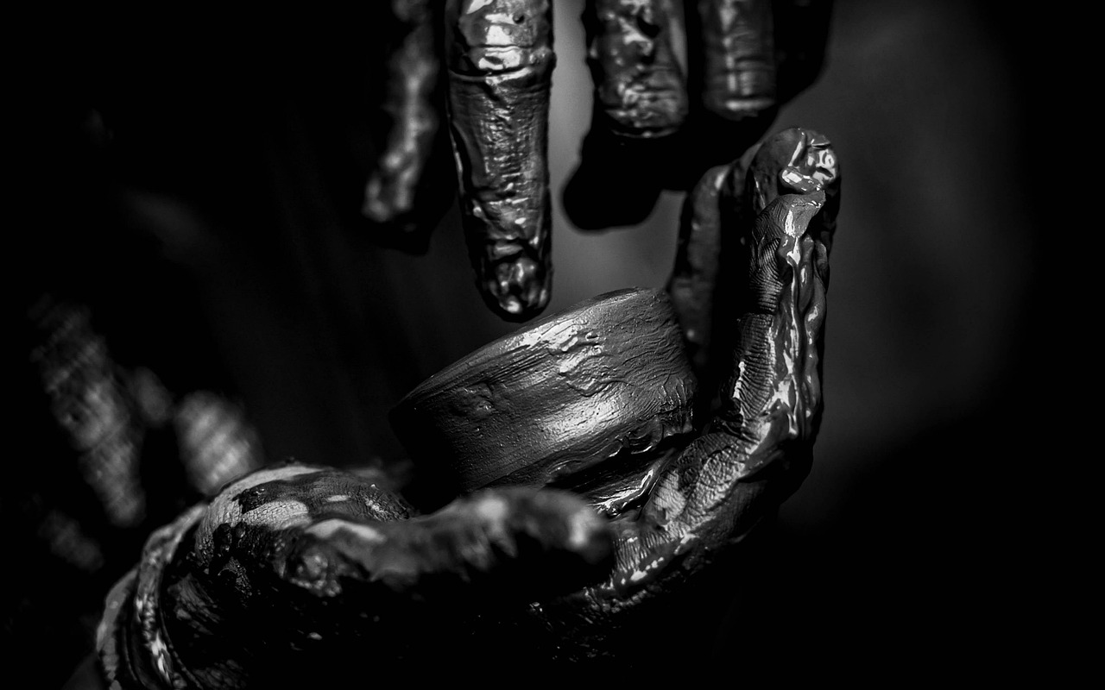
Example Icebreaker Activity: Human Bingo
Create Unique Bingo Cards
Encourage Student Interaction
Build Relationships Through Fun
Create bingo cards with different characteristics or traits.
These cards will serve as the foundation for the activity.
Have students find someone who fits each characteristic and get them to sign the corresponding square.
This promotes engagement and helps students learn about one another.
Encourage students to interact with one another and build relationships.
This activity fosters a sense of community and connection.
8
Building a Positive and Inclusive Classroom Community

Slide 9
Example Icebreaker Activity: The Human Knot
Forming the Circle
The Challenge Begins
Teamwork and Problem-Solving
Have students stand in a circle and put their hands in the center.
Each student should grab the hand of someone across from them, not next to them.
The group must work together to untangle themselves.
They must do so without letting go of each other's hands.
This activity encourages collaboration and communication.
It helps students develop problem-solving skills in a fun and engaging way.
9
Building a Positive and Inclusive Classroom Community

Slide 10
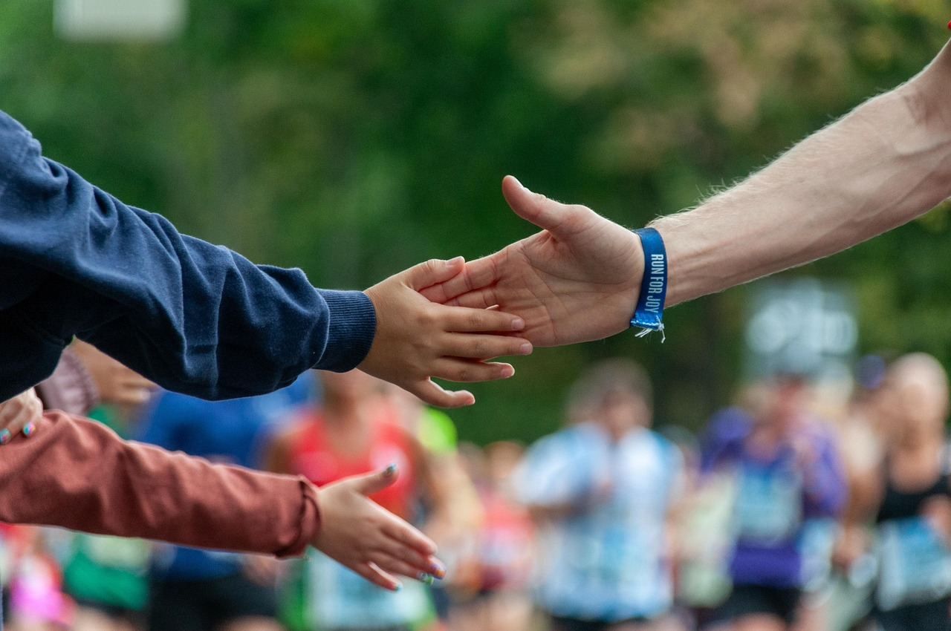
Assessing Student Understanding
Observing Participation
Exit Tickets for Understanding
Observe student participation during icebreaker activities.
This helps gauge initial engagement and comfort levels.
Use exit tickets to assess student understanding.
These provide quick insights into students' grasp of the material.
Reflection on Community Building
Self-Assessment Checklists
Have students reflect on their experiences and thoughts about building classroom community.
This encourages deeper thinking and personal connection to the topic.
Use self-assessment checklists to evaluate student learning.
These empower students to take ownership of their progress.
10
Building a Positive and Inclusive Classroom Community

Slide 11
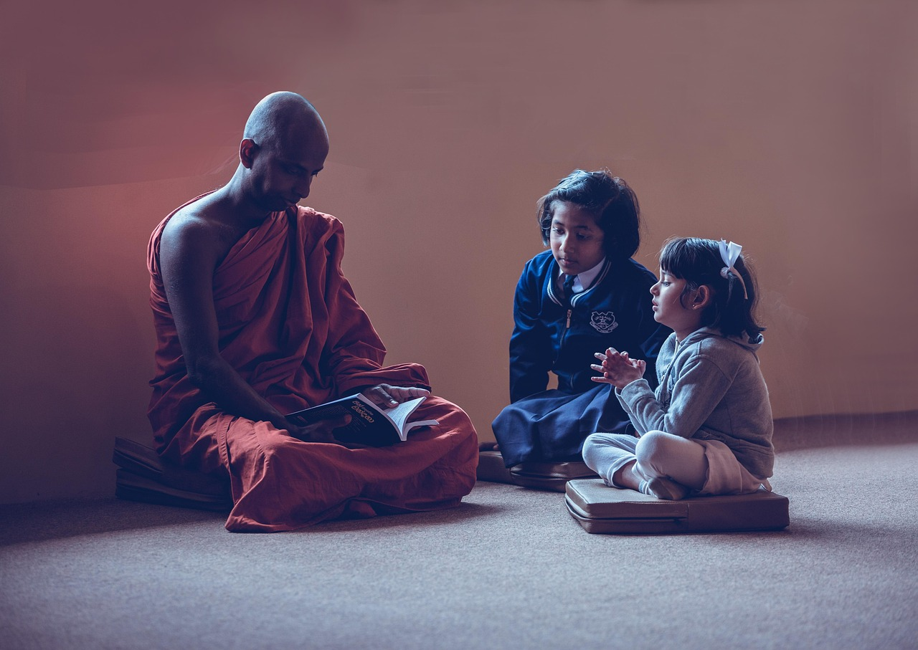
Providing Feedback and Guidance
Specific and Constructive Feedback
Encouraging Self-Reflection
Guidance and Support
Provide feedback that is specific, timely, and constructive.
This helps students understand their strengths and areas for improvement.
Encourage students to reflect on their actions and behaviors.
Reflection fosters personal growth and better decision-making.
Offer guidance and support to students who need it.
This ensures they feel valued and motivated to succeed.
11
Building a Positive and Inclusive Classroom Community

Slide 12
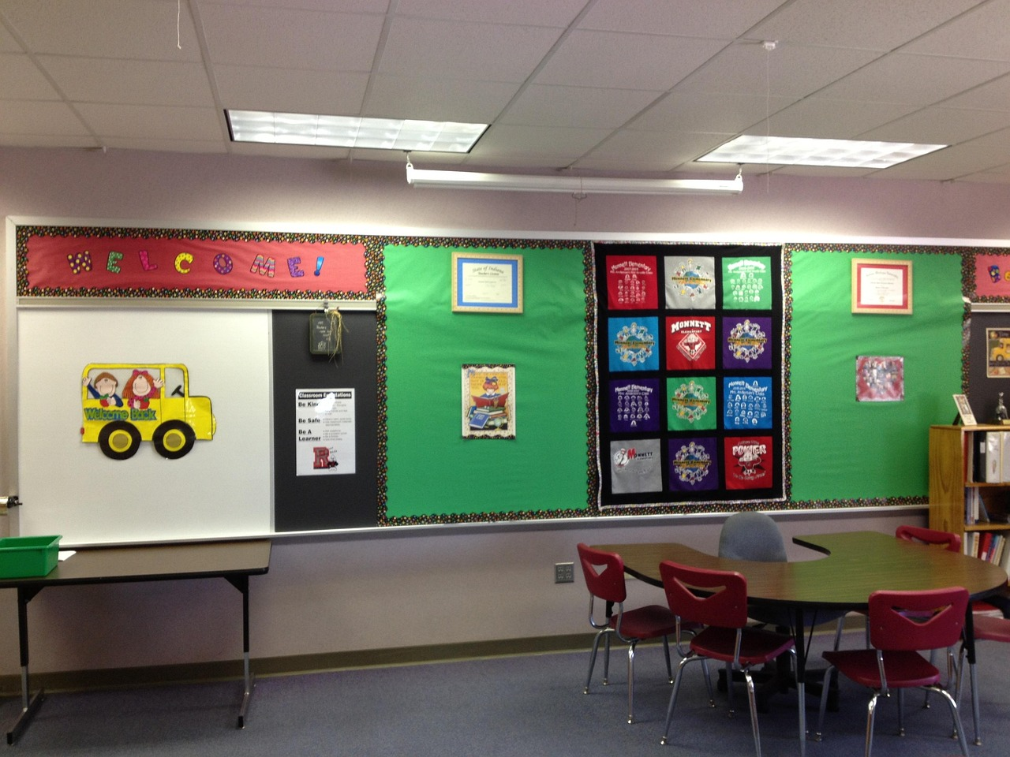
Creating a Positive Classroom Environment
Establishing Clear Expectations
Promoting Empathy and Respect
Establish clear expectations and rules for behavior.
This helps create a structured and predictable environment.
Promote empathy, respect, and kindness among students.
This encourages positive interactions and mutual understanding.
Encouraging Active Listening
Fostering Belonging and Connection
Encourage active listening and respectful dialogue.
This fosters effective communication and collaboration.
Foster a sense of belonging and connection among students.
This builds a supportive and inclusive classroom community.
12
Building a Positive and Inclusive Classroom Community

Slide 13

Addressing Challenges and Conflicts
Establishing a Conflict Resolution Process
Promoting Respectful Communication
Providing Support to Struggling Students
Establish a clear process for addressing conflicts and challenges.
This ensures that all parties involved have a structured way to resolve issues.
Encourage students to communicate respectfully and resolve conflicts peacefully.
This fosters a positive and collaborative environment for everyone.
Provide support and guidance to students who are struggling.
This helps them overcome challenges and succeed in their endeavors.
13
Building a Positive and Inclusive Classroom Community

Slide 14
Conclusion
Importance of Classroom Community
Role of Icebreaker Activities
Building classroom community is essential for creating a positive and inclusive learning environment.
It fosters a sense of belonging and collaboration among students.
Icebreaker activities can help students develop essential social skills and build relationships with one another.
These activities lay the foundation for effective communication and teamwork.
14
Building a Positive and Inclusive Classroom Community

Slide 15
Next Steps
1
2
3
Building on Learning Progressions
Encouraging Ownership and Real-World Application
Fostering Social Skills and Relationships
Plan follow-up lessons to build on the learning progressions from this lesson.
This ensures continuity and reinforces the concepts learned.
Encourage students to take ownership of their learning and apply what they have learned to real-world situations.
This fosters independence and practical understanding of the material.
Continue to provide opportunities for students to develop essential social skills and build relationships with one another.
This helps create a supportive and collaborative learning environment.
15
Building a Positive and Inclusive Classroom Community

Slide 16

Reflection Questions
Addressing Challenges in Group Work
Supporting Struggling Students
What were some of the challenges that arose during the group work activities, and how did I address them?
How did the students respond to the icebreaker activities, and what did I learn about their interests and personalities?
What adjustments can I make to future lessons to better support students who may have struggled with the group work or icebreaker activities?
How can I continue to build on the learning progressions from this lesson and provide opportunities for students to develop essential social skills?
Learning from Icebreaker Activities
Building Social Skills
How did the students respond to the icebreaker activities, and what did I learn about their interests and personalities?
What adjustments can I make to future lessons to better support students who may have struggled with the group work or icebreaker activities?
How can I continue to build on the learning progressions from this lesson and provide opportunities for students to develop essential social skills?
What were some of the challenges that arose during the group work activities, and how did I address them?
16
Building a Positive and Inclusive Classroom Community

Slide 17
Key Takeaways
Importance of Classroom Community
Role of Icebreaker Activities
Benefits of a Strong Community
Building classroom community is essential for creating a positive and inclusive learning environment.
A strong classroom community can lead to improved academic achievement, increased student engagement, and reduced bullying and conflict.
Icebreaker activities can help students develop essential social skills.
They also assist in building relationships with one another.
A strong classroom community fosters a sense of belonging among students.
It contributes to a more harmonious and collaborative learning environment.
17
Building a Positive and Inclusive Classroom Community

Slide 18
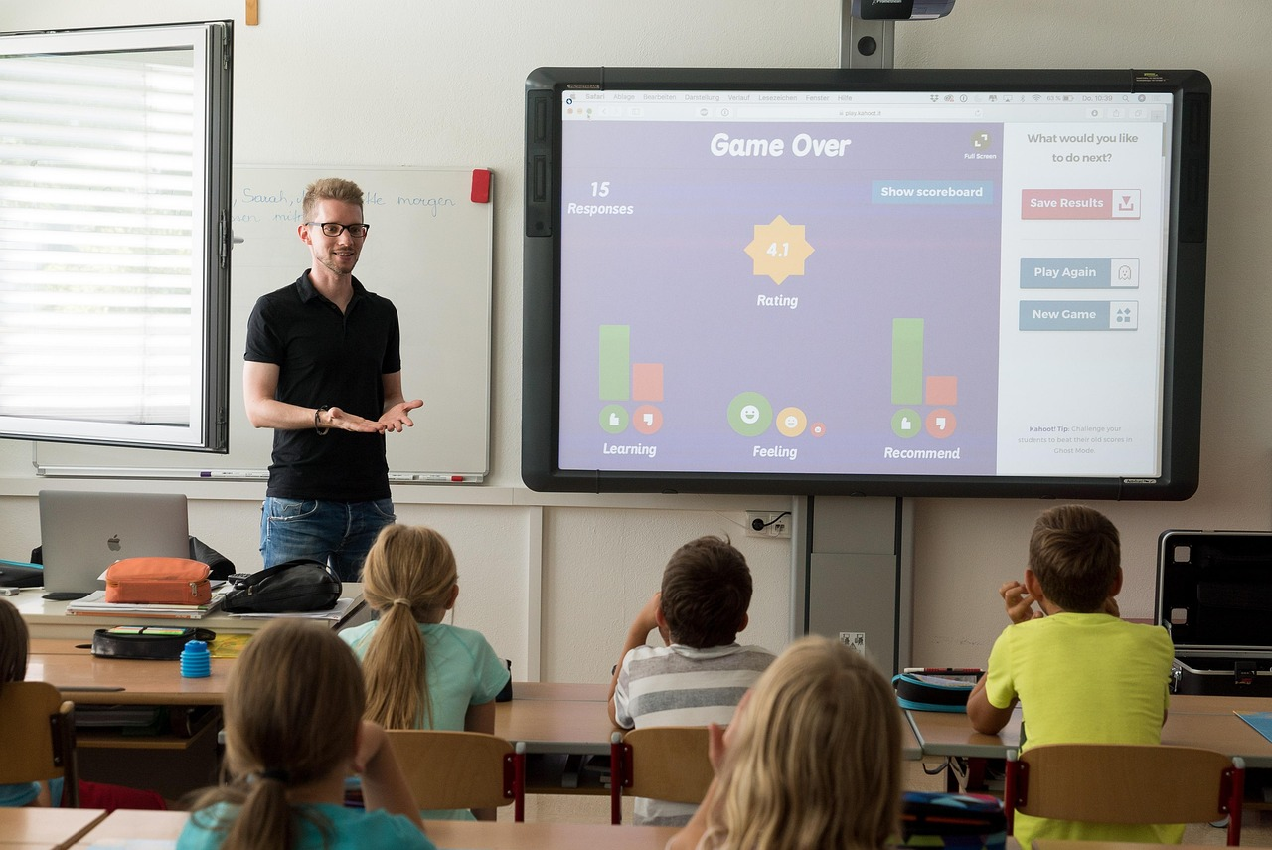
Teaching Tips
Setting Expectations
Reflection Opportunities
Establish clear expectations and rules for behavior.
This helps create a structured and respectful learning environment.
Provide opportunities for students to reflect on their actions and behaviors.
Reflection fosters self-awareness and personal growth.
Active Listening
Inclusive Environment
Encourage active listening and respectful dialogue.
This promotes understanding and collaboration among students.
Be mindful of power dynamics and ensure all students feel included.
An inclusive environment supports equity and belonging.
18
Building a Positive and Inclusive Classroom Community

Slide 19
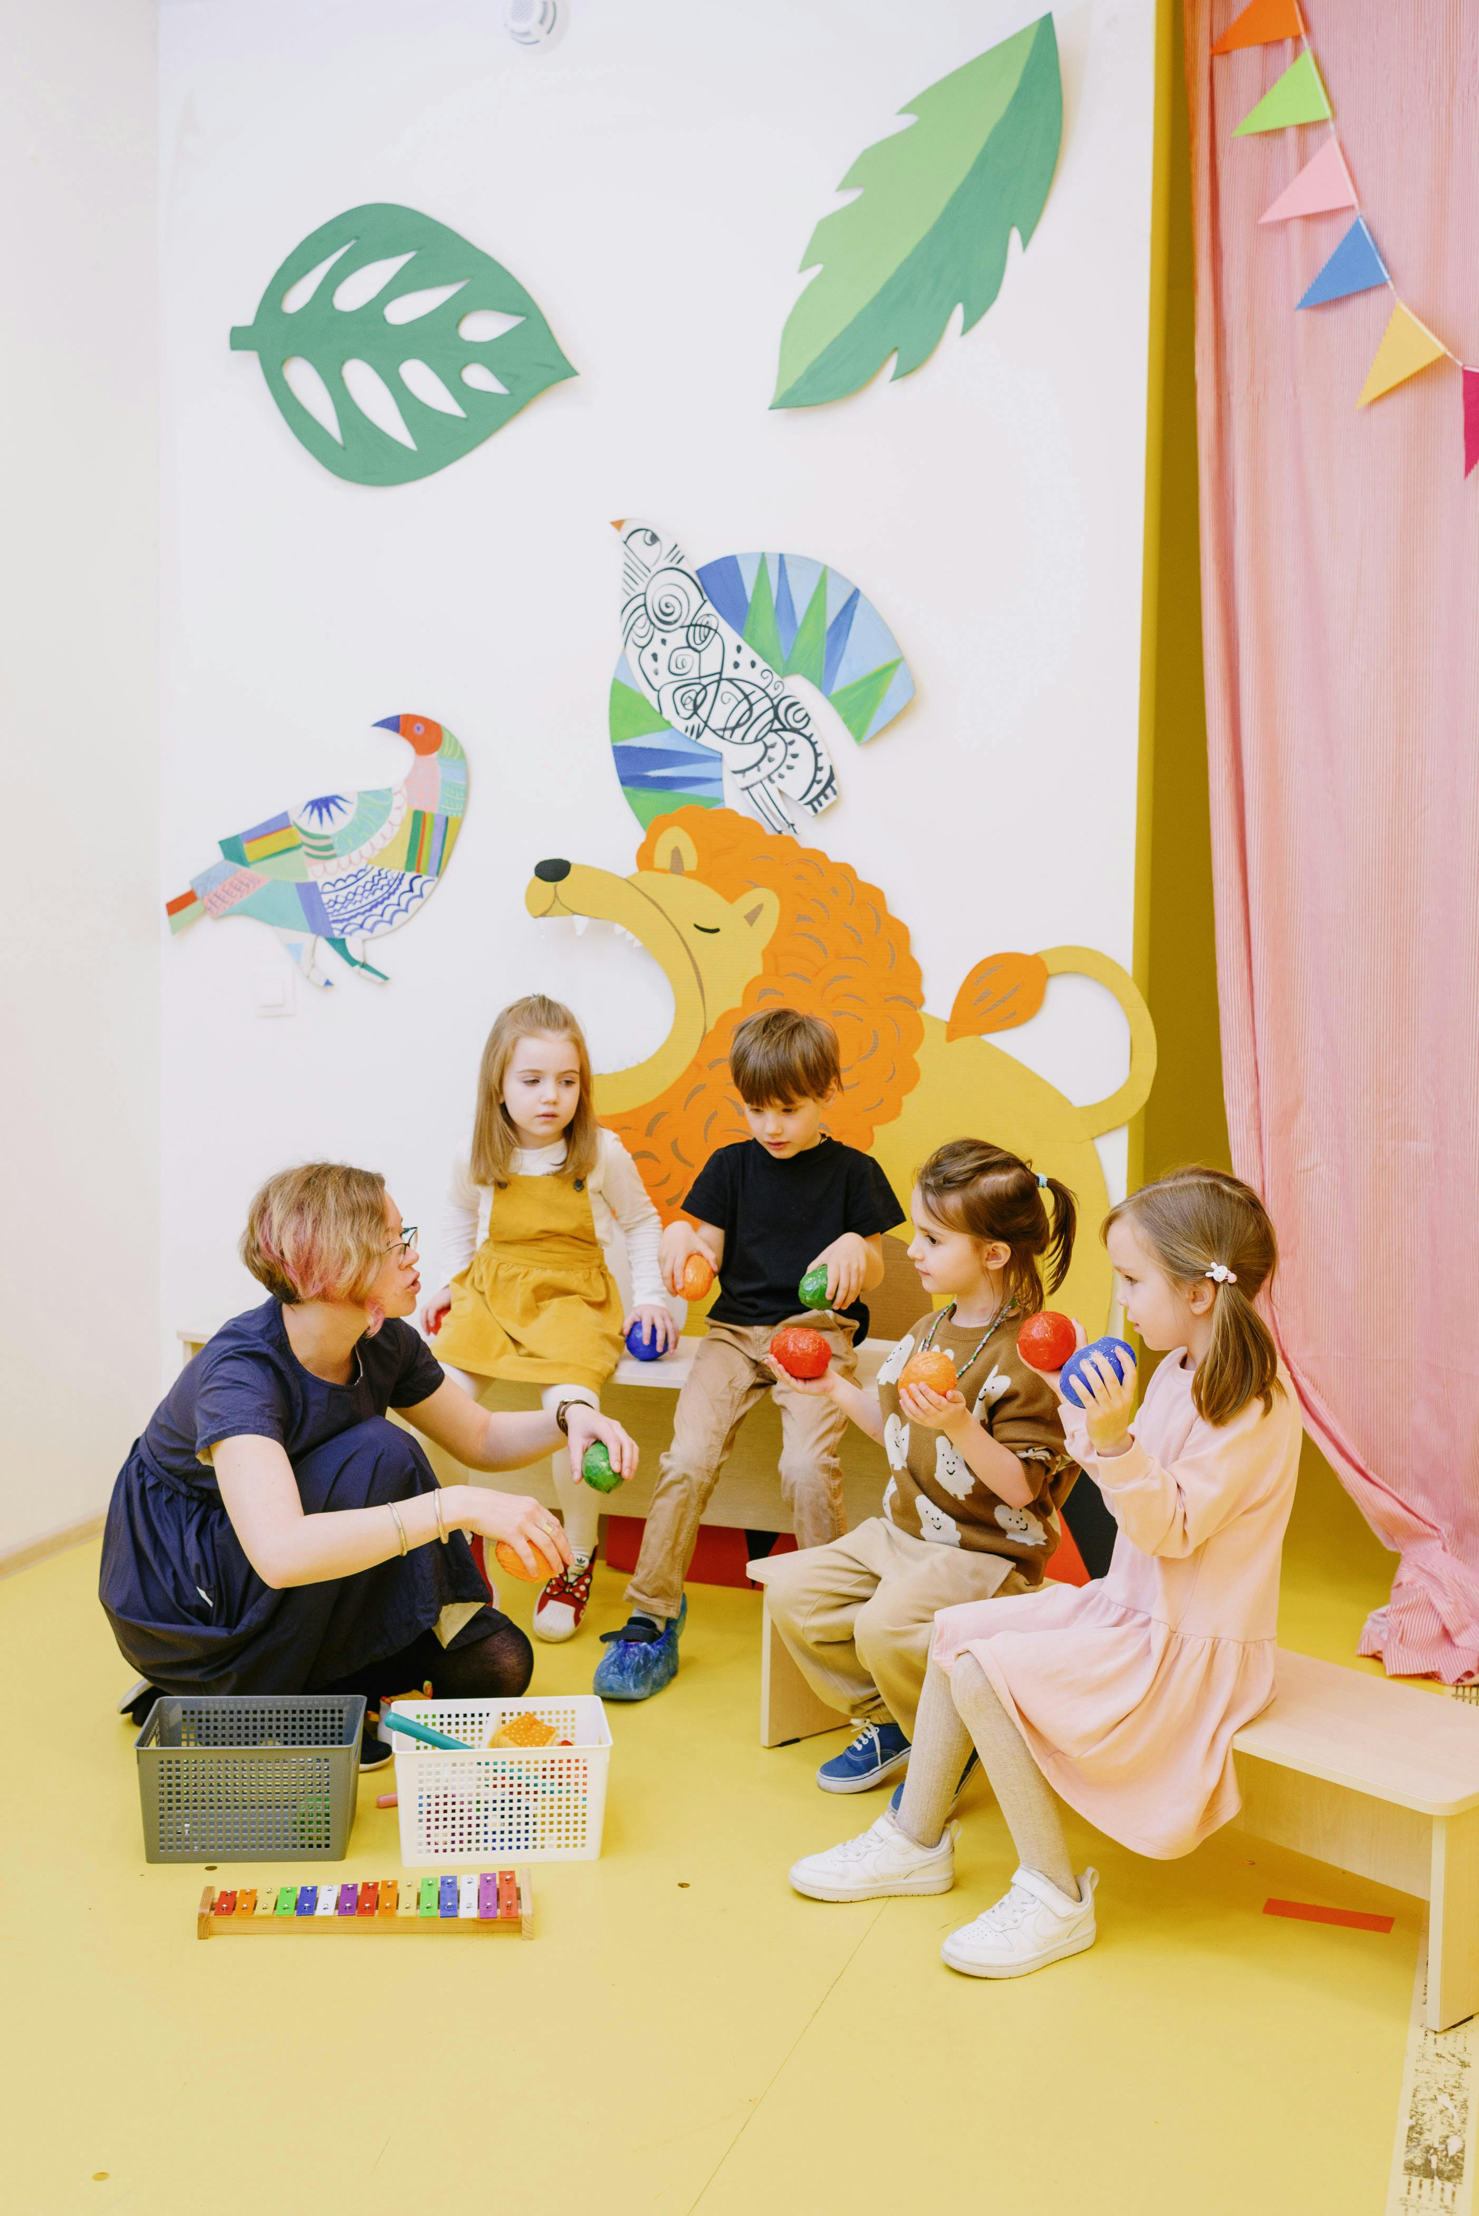
Parent Engagement
Communicating the Importance
Communicate with parents about the importance of building classroom community.
Provide opportunities for parents to engage in activities with their child that promote classroom community.
Parental Engagement Activities
Provide opportunities for parents to engage in activities with their child that promote classroom community.
Encourage parents to support their child's learning and provide guidance on how to build relationships with their child's peers.
Guidance for Relationship Building
Encourage parents to support their child's learning and provide guidance on how to build relationships with their child's peers.
Communicate with parents about the importance of building classroom community.
19
Building a Positive and Inclusive Classroom Community

Slide 20
Safety Considerations
1
Creating a Safe Environment
Ensure that all students feel safe and included during icebreaker activities.
Establish clear expectations and rules for behavior.
2
Respect and Inclusion
Be mindful of power dynamics and ensure all students feel respected and valued.
Establish clear expectations and rules for behavior.
3
Behavioral Guidelines
Ensure that all students feel safe and included during icebreaker activities.
Be mindful of power dynamics and ensure all students feel respected and valued.
20
Building a Positive and Inclusive Classroom Community

