Slide 1

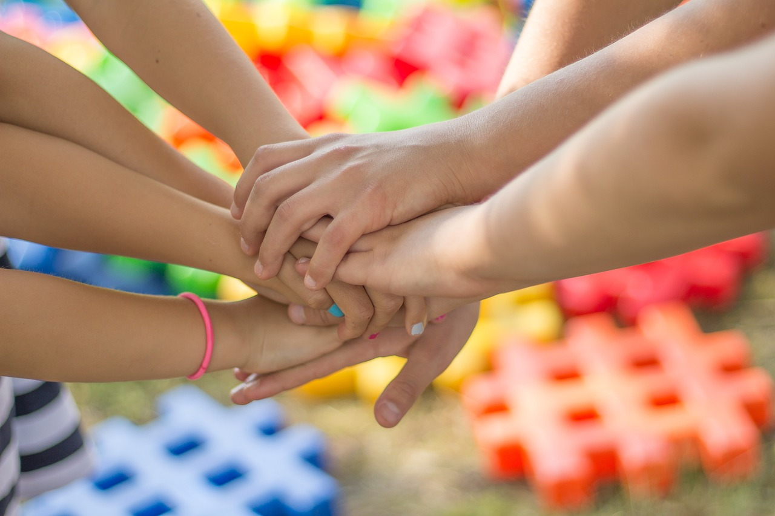
Building Social Skills and Teamwork in 9-Year-Old Students
Engaging Icebreaker Activities to Foster Community, Communication, and Collaboration in the Classroom

Slide 2
Table of Contents
Introduction to Getting to Know You Icebreaker…
Importance of Social Skills
Benefits of Teamwork
Icebreaker Activity 1: Human Bingo
Icebreaker Activity 2: The Name Game
Collaborative Mural Activity
Classroom Scavenger Hunt
Interview a Classmate
Group Activities
Digital Integration
Assessment and Evaluation
Conclusion
Teaching Tips
04
05
06
07
08
09
10
11
12
13
14
15
16

Slide 3
Table of Contents
Reflection Questions
Next Steps
Summary
Final Thoughts
References
17
18
19
20
21

Slide 4
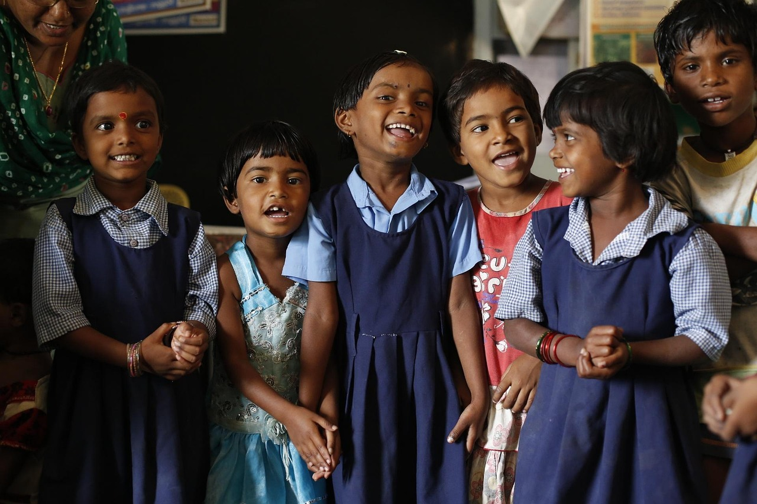
Introduction to Getting to Know You Icebreaker Activities
Welcome to Our Classroom Community
Purpose of Icebreaker Activities
Focus on 9-Year-Old Students
Welcome to our classroom community!
Icebreaker activities are an excellent way to build social skills, promote teamwork, and foster a sense of community.
Icebreaker activities help students connect with one another.
They create a positive and inclusive environment for learning.
In this presentation, we will explore fun and interactive icebreaker activities.
These activities are specifically designed for 9-year-old students.
4
Building Social Skills and Teamwork in 9-Year-Old Students

Slide 5
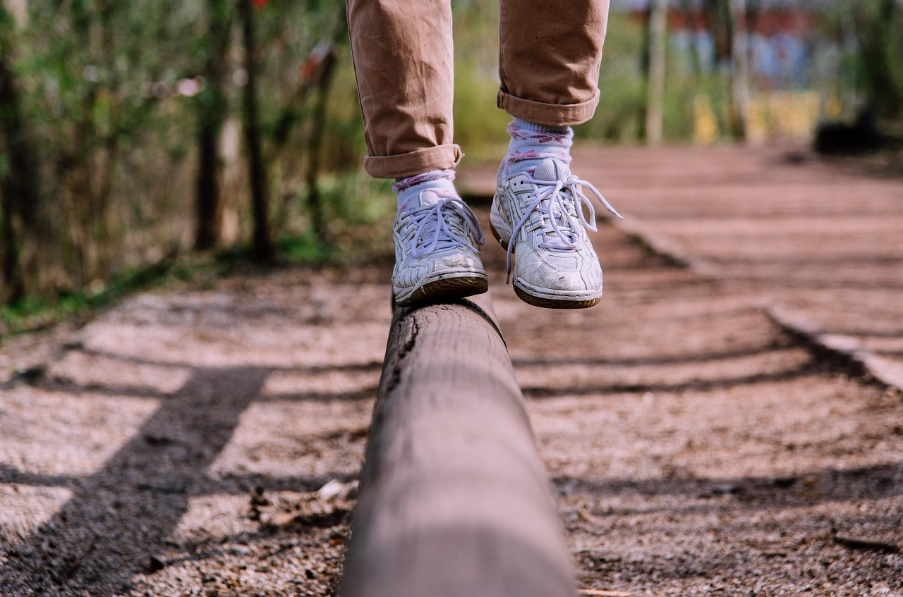
Importance of Social Skills
Essential Role of Social Skills
Icebreaker Activities for Skill Development
Social skills are essential for building relationships and achieving academic success.
These skills are crucial for building strong relationships with peers and teachers.
Icebreaker activities help students develop social skills, such as communication, active listening, and cooperation.
By participating in icebreaker activities, students can develop the social skills they need to succeed in school and beyond.
Building Relationships Through Social Skills
Impact of Icebreaker Activities
Social skills are vital for fostering connections with peers and educators.
Strong relationships are foundational for both personal and academic growth.
Icebreaker activities serve as a practical method to enhance communication and teamwork.
These activities prepare students for collaborative success in educational and social settings.
5
Building Social Skills and Teamwork in 9-Year-Old Students

Slide 6

Benefits of Teamwork
Enhancing Communication and Creativity
Building Leadership and Decision-Making Skills
Learning Through Collaboration
Teamwork promotes communication, problem-solving, and creativity.
When students work together, they can share ideas, build on each other's strengths, and learn from each other's weaknesses.
Teamwork helps students develop essential skills, such as leadership, decision-making, and conflict resolution.
These skills are crucial for personal and professional growth.
Students benefit from the opportunity to learn from each other's weaknesses.
This collaborative environment fosters mutual understanding and growth.
6
Building Social Skills and Teamwork in 9-Year-Old Students

Slide 7
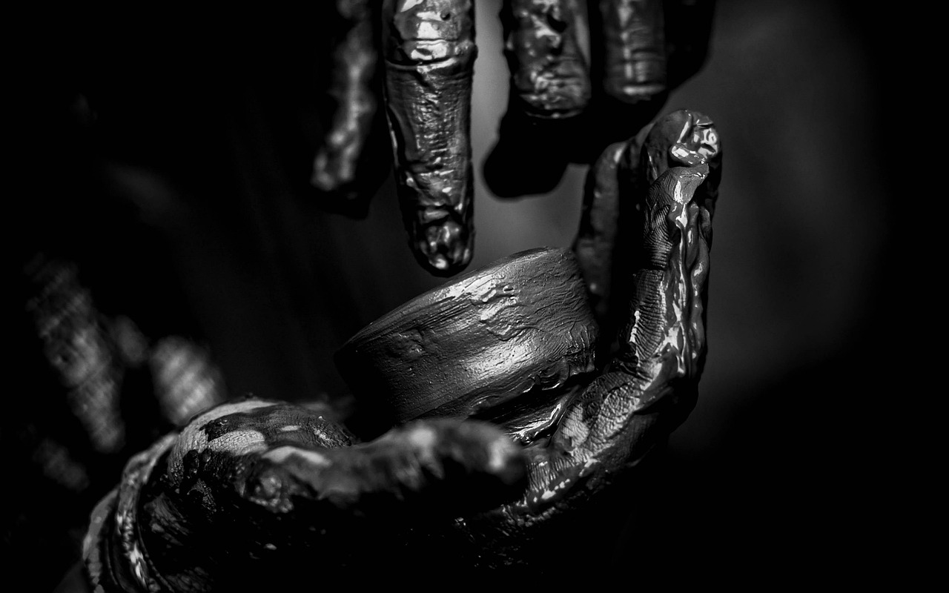
Icebreaker Activity 1: Human Bingo
Introduction to Human Bingo
Mingling and Interaction
Distribute bingo cards with different traits, characteristics, or interests.
This sets the stage for an engaging and interactive activity.
Ask students to mingle and find someone who fits each of the characteristics.
This encourages students to step out of their comfort zones and interact.
Signing the Bingo Squares
Building Connections
When students find someone, they need to get that person to sign the corresponding square.
This adds a fun and competitive element to the activity.
This activity encourages students to ask questions and build connections.
It fosters a sense of community and collaboration among participants.
7
Building Social Skills and Teamwork in 9-Year-Old Students

Slide 8
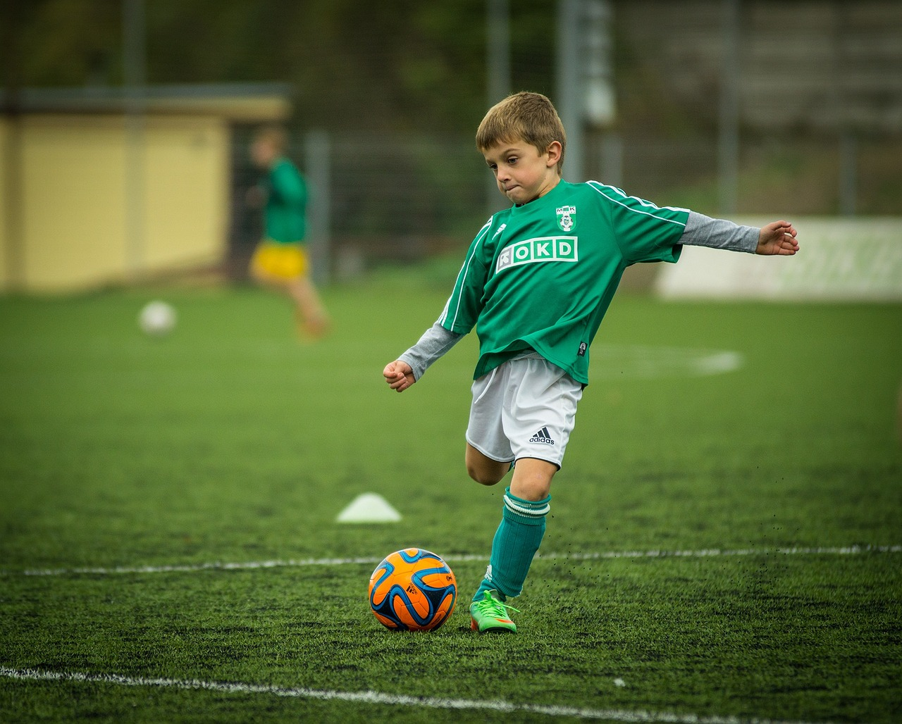
Icebreaker Activity 2: The Name Game
Introduction to the Activity
Building Connections
Activity Continuation
Students stand in a circle with a ball or small object.
The first student introduces themselves and passes the ball to another student.
The next student introduces themselves and recalls the name of the previous student.
This process helps students learn each other's names and build connections.
The activity continues around the circle with each student participating.
Students practice memory and social interaction throughout the game.
8
Building Social Skills and Teamwork in 9-Year-Old Students

Slide 9

Collaborative Mural Activity
1
Group Formation and Materials
Divide the class into small groups and provide each group with a large piece of paper, markers, and colored pencils.
This ensures that each group has the necessary tools to create their collaborative mural.
2
Creating the Collaborative Mural
Ask each group to create a collaborative mural that represents their shared interests, hobbies, or goals.
This activity allows students to visually express their collective ideas and aspirations.
3
Encouraging Teamwork and Creativity
Encourage students to work together, share ideas, and build on each other's contributions.
This fosters collaboration and enhances creativity within the groups.
9
Building Social Skills and Teamwork in 9-Year-Old Students

Slide 10
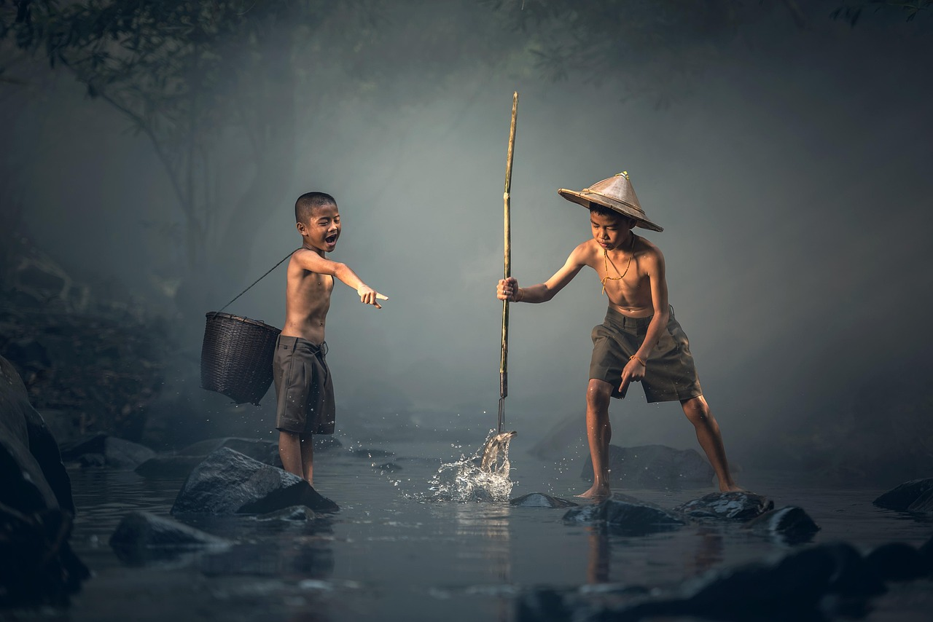
Classroom Scavenger Hunt
Creating the Scavenger Hunt List
Organizing Students into Groups
Completing the Challenges
Create a list of items or challenges that can be completed in the classroom.
This list will serve as the foundation for the scavenger hunt activity.
Divide the class into small groups and provide each group with a copy of the scavenger hunt list.
This ensures collaboration and teamwork among students.
Ask students to work together to complete the challenges and find the items on the list.
This encourages active participation and problem-solving skills.
10
Building Social Skills and Teamwork in 9-Year-Old Students

Slide 11

Interview a Classmate
Pairing Up
Pair students up with a classmate they don't know well.
This helps foster new connections and encourages interaction among students.
Conducting the Interview
Ask each student to interview their partner and find out as much as they can about them.
This activity promotes curiosity and engagement in learning about others.
Encouraging Open-Ended Questions
Encourage students to ask open-ended questions and listen actively to their partner's responses.
This approach enhances communication skills and ensures meaningful conversations.
11
Building Social Skills and Teamwork in 9-Year-Old Students

Slide 12
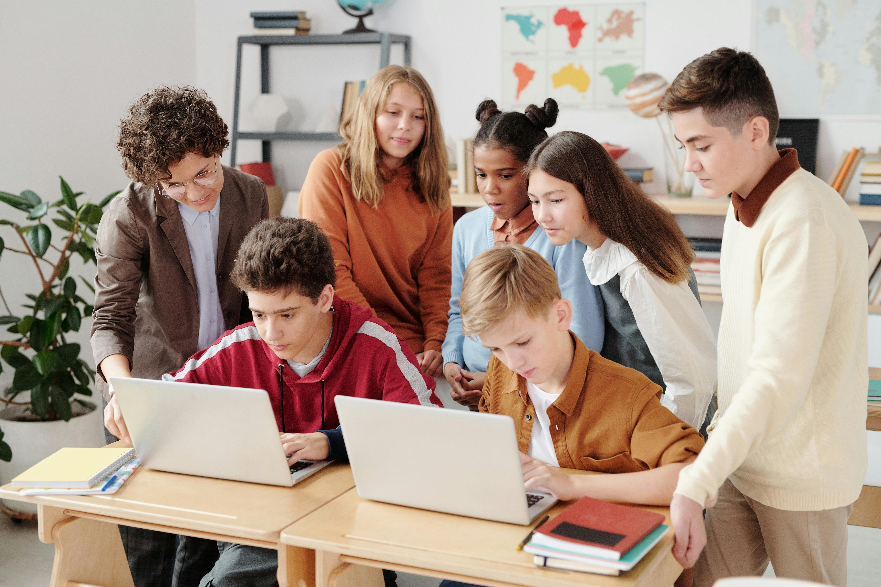
Group Activities
01
Human Knot
Divide the class into small groups and ask them to stand in a circle.
Have them put their hands in the center and untangle themselves without letting go.
02
Classroom Scavenger Hunt
Create a list of items or challenges that can be completed in the classroom.
Encourage students to work together to find or complete the tasks.
03
Group Mural
Divide the class into small groups and provide each group with a large piece of paper.
Give them markers and colored pencils to create a collaborative artwork.
04
Classmate Interview
Pair students up with a classmate they don't know well.
Ask them to interview each other to learn more about their partner.
12
Building Social Skills and Teamwork in 9-Year-Old Students

Slide 13
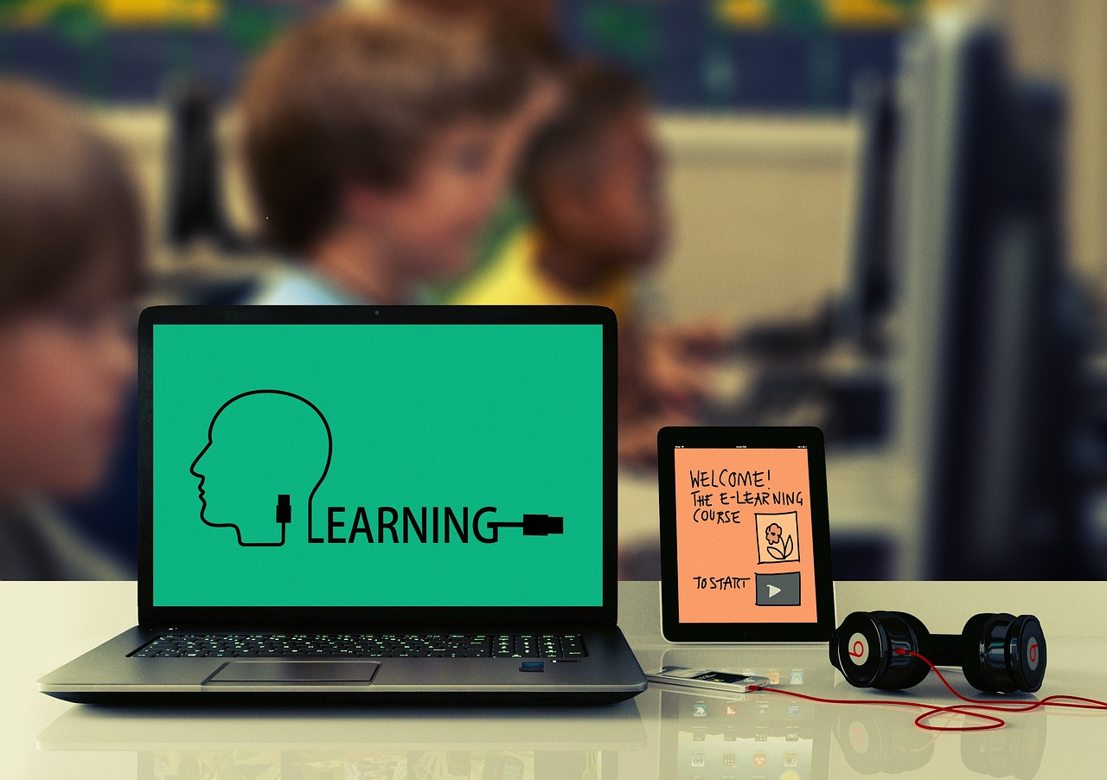
Digital Integration
1
Online Icebreaker Game
Use an online platform to create a digital icebreaker game.
This activity helps students connect and engage in a fun and interactive way.
2
Collaborative Document
Use a collaborative document tool to create a shared document where students can introduce themselves and share their interests.
This fosters a sense of community and encourages students to learn about each other.
3
Virtual Scavenger Hunt
Create a virtual scavenger hunt that takes students on a tour of the school's website or an educational platform.
This activity familiarizes students with important resources while making the process enjoyable.
13
Building Social Skills and Teamwork in 9-Year-Old Students

Slide 14
Assessment and Evaluation
Participation and Engagement
Group Work Monitoring
Self-Assessment Checklists
Observe students' participation and engagement during the activities.
This helps in understanding their involvement and interest in the learning process.
Monitor group work and provide feedback to students on their ability to work together and communicate effectively.
This ensures collaborative skills are developed and improved.
Use self-assessment checklists to evaluate students' learning and understanding.
These checklists empower students to reflect on their own progress and areas for improvement.
14
Building Social Skills and Teamwork in 9-Year-Old Students

Slide 15
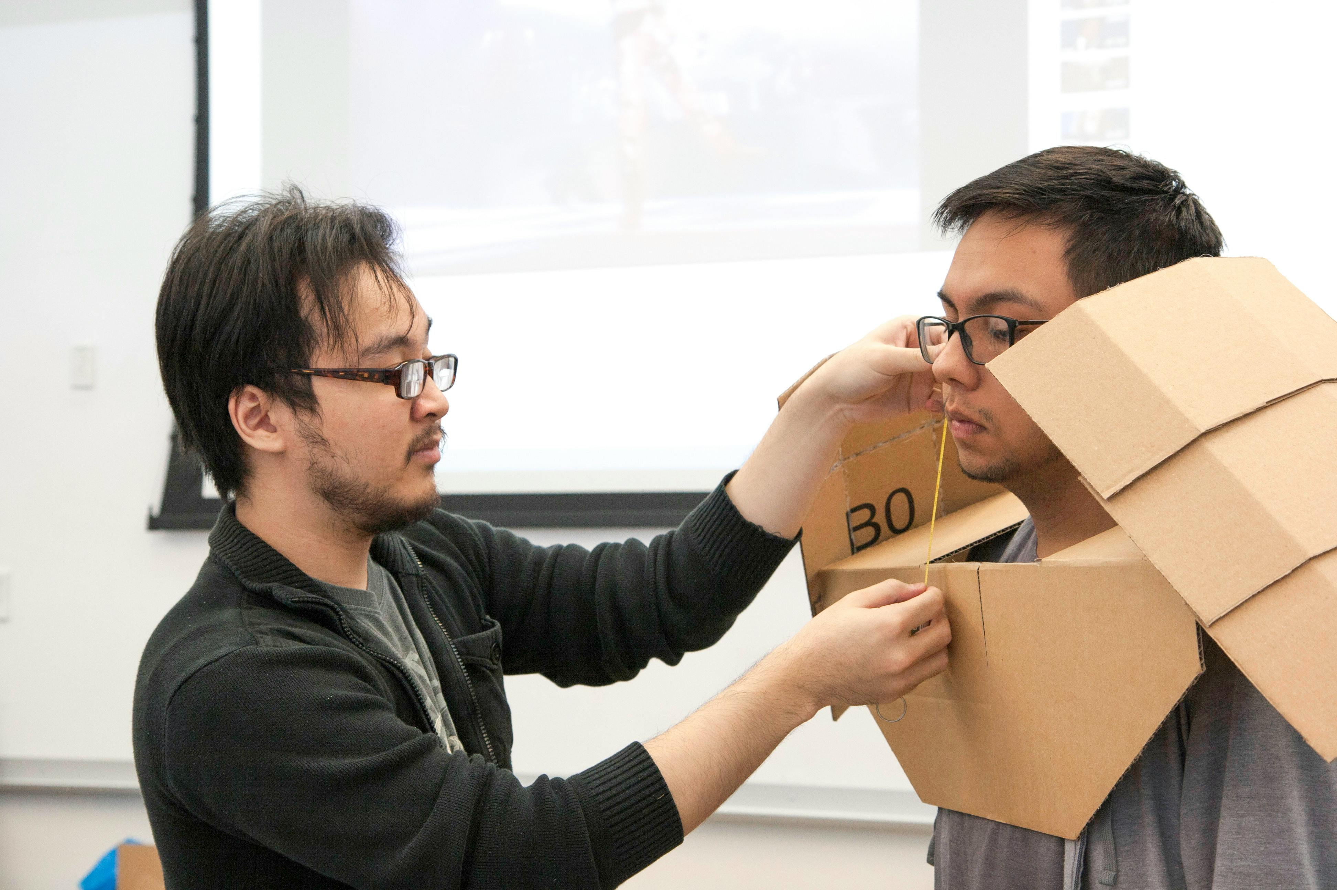
Conclusion
Building Social Skills and Teamwork
Fostering a Positive Learning Environment
Getting to know you icebreaker activities and fun games are an excellent way to build social skills, promote teamwork, and foster a sense of community.
By incorporating these activities into the classroom, teachers can create a positive and inclusive learning environment that supports the academic and social development of their students.
Getting to know you icebreaker activities and fun games are an excellent way to build social skills, promote teamwork, and foster a sense of community.
By incorporating these activities into the classroom, teachers can create a positive and inclusive learning environment that supports the academic and social development of their students.
15
Building Social Skills and Teamwork in 9-Year-Old Students

Slide 16
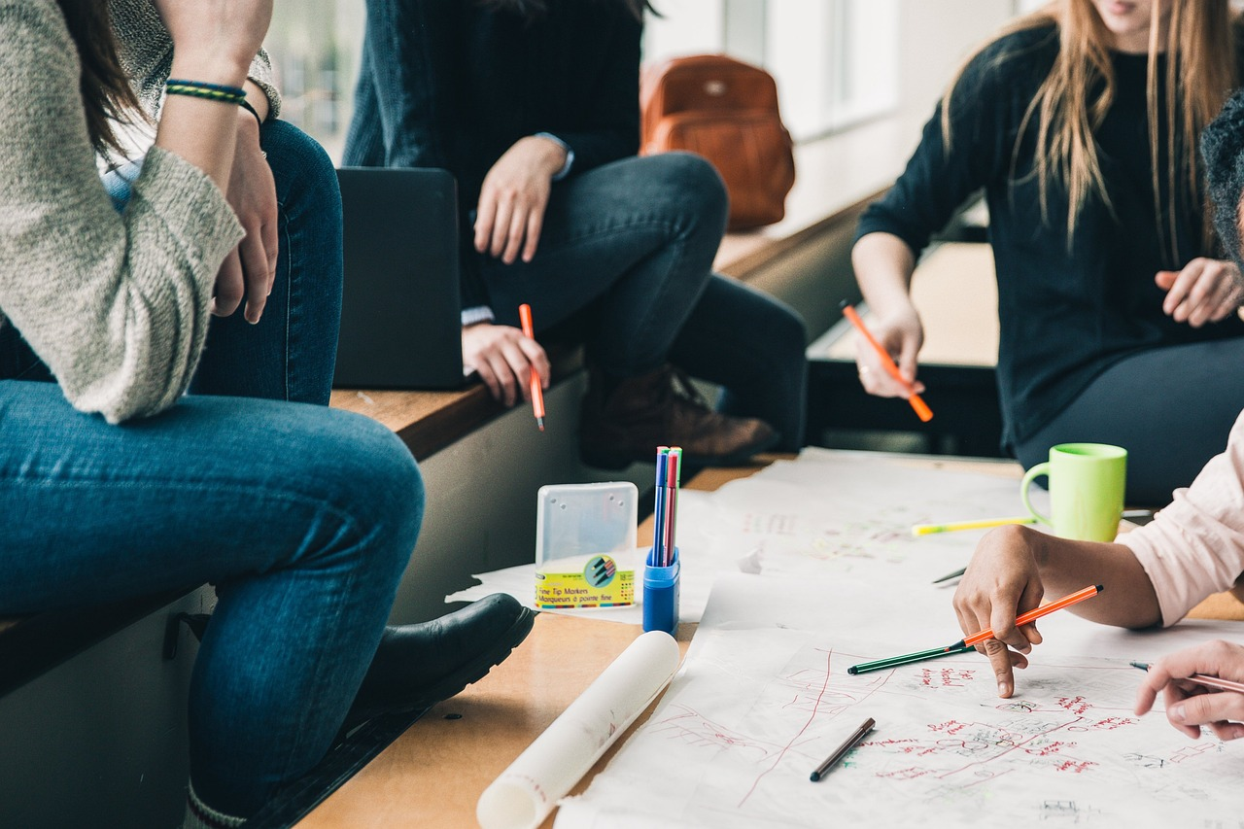
Teaching Tips
Promoting Respect and Empathy
Create a positive classroom environment by promoting respect, empathy, and kindness.
This helps students feel valued and fosters a sense of community within the classroom.
Building Relationships Through Icebreakers
Use icebreaker activities to build relationships and promote teamwork.
These activities encourage collaboration and help students connect with one another.
Encouraging Reflection and Active Listening
Encourage active listening and provide opportunities for students to reflect on their learning.
This approach enhances understanding and allows students to engage deeply with the material.
16
Building Social Skills and Teamwork in 9-Year-Old Students

Slide 17

Reflection Questions
Inclusive Classroom Strategies
Evaluating Icebreaker Effectiveness
What strategies can I use to ensure that all students feel included and valued in the classroom?
How can I create an environment where diversity is celebrated and every student feels a sense of belonging?
How can I assess the effectiveness of the icebreaker activities and games in building social skills and promoting teamwork among my students?
What methods can I use to measure the impact of these activities on student interaction and collaboration?
17
Building Social Skills and Teamwork in 9-Year-Old Students

Slide 18
Next Steps
Team-Building Challenges
Classroom Community Service Project
Lesson 2 focuses on team-building challenges.
It aims to enhance collaboration and problem-solving skills among participants.
Lesson 3 introduces a classroom community service project.
This initiative encourages students to contribute positively to their local community.
18
Building Social Skills and Teamwork in 9-Year-Old Students

Slide 19
Summary
Building Social Skills and Teamwork
Tailored for 9-Year-Old Students
Creating a Positive Learning Environment
Icebreaker activities are an excellent way to build social skills, promote teamwork, and foster a sense of community.
These activities help students connect with their peers and create a collaborative environment.
The activities and games included in this presentation are tailored to meet the needs of 9-year-old students.
They are designed to be age-appropriate and engaging for this specific group.
By incorporating these activities into the classroom, teachers can create a positive and inclusive learning environment.
This approach supports both the academic and social development of their students.
19
Building Social Skills and Teamwork in 9-Year-Old Students

Slide 20
Final Thoughts
Flexibility in Icebreaker Activities
Encouraging Student Growth
Remember to be flexible and adaptable when implementing icebreaker activities and games.
This ensures that the activities remain engaging and suitable for all students.
Encourage students to take risks, share their thoughts and feelings, and develop essential social skills.
This fosters a supportive environment for personal and social development.
20
Building Social Skills and Teamwork in 9-Year-Old Students

Slide 21

References
References Overview
List of references used in the presentation.
This slide provides a comprehensive overview of all sources cited.
21
Building Social Skills and Teamwork in 9-Year-Old Students

