Slide 1

Mastering Adverbs of Frequency: A Comprehensive Guide
Exploring Grammar, Practice Strategies, and Real-World Applications

Slide 2
Table of contents
01
02
03
04
05
06
07
08
09
10
11
Title Slide: Mastering Adverbs of Frequency
What are Adverbs of Frequency?
Grammatical Placement
Learning Objectives
Interactive Warm-Up Activity
Communicative Practice Strategies
Common Errors to Avoid
Real-World Application
Digital Learning Integration
Assessment Strategies
Parent and Family Engagement

Slide 3
Table of contents
12
13
14
15
16
17
18
Extension and Advanced Learning
Key Takeaways
Reflection Questions
Conclusion
Resources and References
Design Recommendations
Notes for PowerPoint Creation

Slide 4

1
Title Slide: Mastering Adverbs of Frequency
Mastering Adverbs of Frequency
Communication Strategies for Teenage English Learners
Mastering Adverbs of Frequency: A Comprehensive Guide

Slide 5

2
What are Adverbs of Frequency?
01
Definition
02
Key Examples
Words that describe how often an action occurs
Always (100%)
Usually (90%)
Frequently (80%)
Sometimes (50%)
Rarely (20%)
Mastering Adverbs of Frequency: A Comprehensive Guide

Slide 6
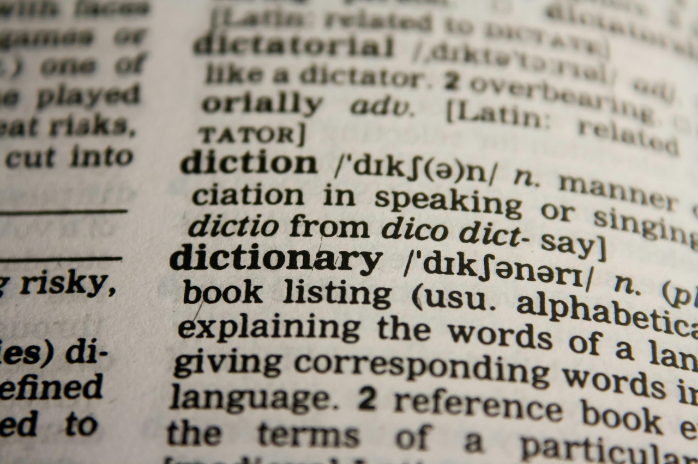
3
Grammatical Placement
01
Rule
02
Exceptions
Frequency adverbs typically come before the main verb in a sentence.
Example: "She always arrives early for class."
When the main verb is "to be," the adverb comes after the verb.
Example: "He is always late for meetings."
In present simple tense, the adverb comes after the verb "to be."
Example: "They are usually very friendly."
03
Visual Aid
Diagram illustrating correct placement of adverbs of frequency in sentences.
Mastering Adverbs of Frequency: A Comprehensive Guide

Slide 7

4
Learning Objectives
01
Understand the grammatical structure of adverbs of frequency
02
Interpret nuanced meanings conveyed by different frequency adverbs
Identify common adverbs of frequency
Learn the placement of adverbs in sentences
Differentiate between various adverbs based on frequency
Analyze subtle differences in meaning
Contextualize adverbs within sentences
Practice with examples
03
Apply adverbs of frequency in real-world communication scenarios
04
Develop linguistic creativity through the use of adverbs of frequency
Use adverbs in everyday conversations
Incorporate adverbs in writing
Role-play different scenarios
Experiment with adverb placement
Create engaging sentences
Enhance descriptive language skills
Mastering Adverbs of Frequency: A Comprehensive Guide

Slide 8

5
Interactive Warm-Up Activity
01
Frequency Ladder Concept
02
Physical Movement Activity
Engaging activity to visualize adverbs of frequency
Students physically move based on action frequency
Incorporates kinesthetic learning for better retention
Encourages active participation and energy in the classroom
03
Student Positioning
04
Example Scenario
Students stand on designated adverbs based on personal habits
Promotes self-awareness of daily routines and behaviors
"Stand on 'Always' if you brush teeth every morning"
Facilitates discussion on different habits and routines
Mastering Adverbs of Frequency: A Comprehensive Guide

Slide 9

6
Communicative Practice Strategies
01
Pair Interview Activities
02
Survey Design
Engage students in conversational practice.
Encourage interaction and speaking skills development.
Create surveys focusing on frequency of activities.
Analyze and discuss survey results for communication practice.
03
Habit Detective Challenges
04
Rotation-based Communication Exercises
Task students with identifying each other's habits.
Practice using adverbs of frequency in describing routines.
Rotate students in groups for varied interactions.
Promote diverse communication scenarios for practice.
Mastering Adverbs of Frequency: A Comprehensive Guide

Slide 10

7
Common Errors to Avoid
01
Incorrect Adverb Placement
02
Overusing Absolute Adverbs
Ensure adverbs of frequency are placed before the main verb in a sentence.
Incorrect: "She always goes to the gym in the morning."
Correct: "She goes to the gym always in the morning."
Avoid using absolute adverbs like "always" or "never" excessively.
Overusing absolutes can make your statements seem less nuanced.
Balance your use of frequency adverbs for more accurate communication.
03
Grammatical Inconsistencies
04
Tips for Correction
Maintain consistency in the use of adverbs of frequency throughout your writing.
Check for any inconsistencies in how often actions are described.
Inconsistencies can lead to confusion and misinterpretation.
Review your writing for adverb placement errors.
Practice using a variety of frequency adverbs to convey different levels of occurrence.
Seek feedback from peers or teachers to improve your usage of adverbs of frequency.
Mastering Adverbs of Frequency: A Comprehensive Guide

Slide 11

8
Real-World Application
01
Cultural Communication
02
Professional Contexts
Utilize adverbs of frequency to understand and adapt to cultural norms in different regions.
Apply appropriate frequency adverbs in workplace communication to convey consistency or variability in actions.
03
Personal Storytelling
04
Emotional Nuancing
Enhance narratives by incorporating adverbs of frequency to provide vivid details about routines or habits.
Use frequency adverbs to express emotional states or changes in feelings over time.
Mastering Adverbs of Frequency: A Comprehensive Guide

Slide 12

9
Digital Learning Integration
01
Mobile App Tracking
02
Online Collaborative Platforms
Utilize apps to monitor student progress and engagement.
Track usage patterns for personalized learning insights.
Foster virtual teamwork and communication.
Encourage peer-to-peer learning and collaboration.
03
Podcast Creation
04
Augmented Reality Simulations
Engage students through audio content creation.
Enhance listening and speaking skills in a digital format.
Provide interactive, immersive learning experiences.
Enhance understanding through visual and interactive elements.
Mastering Adverbs of Frequency: A Comprehensive Guide

Slide 13

10
Assessment Strategies
01
Written Portfolio
02
Oral Presentation
Compile a collection of written assignments showcasing the correct usage of adverbs of frequency.
Include reflections on personal progress and challenges faced in mastering these adverbs.
Deliver a speech or presentation incorporating adverbs of frequency in various contexts.
Demonstrate fluency and accuracy in using these adverbs during the presentation.
03
Interactive Communication Test
04
Comprehensive Examination
Engage in real-time conversations or role-plays where the correct placement of adverbs of frequency is crucial.
Receive immediate feedback on usage and accuracy from peers or instructors.
Participate in a formal assessment covering all aspects of adverbs of frequency, including grammar, comprehension, and application.
Demonstrate a deep understanding of the topic through various question formats.
Mastering Adverbs of Frequency: A Comprehensive Guide

Slide 14

11
Parent and Family Engagement
01
Weekly Language Newsletters
02
Family Communication Challenges
Regular updates on language learning progress and tips
Highlights upcoming events and activities for families
Engage families in language-related challenges and games
Encourage communication in English at home
03
Digital Learning Portfolios
04
Collaborative Learning Approach
Showcase student work and progress online
Provide a platform for parents to track learning outcomes
Encourage parents to participate in language learning activities
Foster a supportive learning environment at home
Mastering Adverbs of Frequency: A Comprehensive Guide

Slide 15
12
Extension and Advanced Learning
01
Extension and Advanced Learning
02
Frequency Myth Busters
03
Debate Tournaments
Opportunities for students to delve deeper into subjects of interest.
Advanced placement courses and extracurricular activities.
Debunking common myths and misconceptions.
Encouraging critical thinking and evidence-based reasoning.
Enhancing public speaking and argumentation skills.
Fostering a spirit of healthy competition and intellectual growth.
04
Community Survey Projects
05
Cross-Cultural Communication
Engaging with the community to gather valuable insights.
Developing research and analytical skills.
Promoting understanding and appreciation of diverse cultures.
Improving communication skills in a globalized world.
Mastering Adverbs of Frequency: A Comprehensive Guide

Slide 16
13
Key Takeaways
01
Understanding Frequency Adverbs
02
Correct Placement
03
Linguistic Mastery
Different levels: Always, Usually, Frequently, Sometimes, Rarely, Never
Practicing correct placement of frequency adverbs in sentences
Developing linguistic mastery through consistent usage
04
Communicative Competence
05
Autonomous Learning
Enhancing communicative competence by incorporating adverbs of frequency
Implementing autonomous learning strategies for language improvement
Mastering Adverbs of Frequency: A Comprehensive Guide

Slide 17
14
Reflection Questions
01
Understanding of Adverbs of Frequency
02
Effective Strategies
03
Areas for Improvement
Initial confusion about placement and usage.
Gradual improvement through examples and practice.
Current confidence in identifying and using adverbs of frequency.
Regular practice through writing and speaking exercises.
Using flashcards to memorize common adverbs of frequency.
Seeking feedback from peers and instructors.
Consistent placement in complex sentences.
Avoiding overuse of certain adverbs.
Enhancing variety in usage.
04
Successful Incorporation
05
Contribution to Communication
Used 'always' and 'never' accurately in a recent essay.
Received positive feedback on the clarity of frequency in actions described.
Felt more confident in verbal communication.
Helps in specifying the frequency of actions clearly.
Enhances the precision and clarity of statements.
Aids in setting expectations and understanding routines.
Mastering Adverbs of Frequency: A Comprehensive Guide

Slide 18

15
Conclusion
Conclusion
Language learning is a continuous journey of growth and development.
Mastering Adverbs of Frequency: A Comprehensive Guide

Slide 19

16
Resources and References
01
Recommended Apps
02
Learning Websites
Duolingo: A popular language learning app with interactive exercises.
Babbel: Offers language courses with speech recognition technology.
BBC Learning English: Provides free resources for improving English skills.
FluentU: Offers authentic English videos with interactive subtitles.
03
Additional Reading
04
Contact Information
"English Grammar in Use" by Raymond Murphy: A comprehensive guide to English grammar.
"Practice Makes Perfect: English Grammar for ESL Learners" by Ed Swick: Focuses on practical grammar exercises.
Email: info@languagelearning.com
Phone: +1-800-123-4567
Mastering Adverbs of Frequency: A Comprehensive Guide

Slide 20
17
Design Recommendations
01
Clean and Modern Design
02
Incorporate Language-Related Graphics
03
Consistent Color Scheme
Opt for a sleek and contemporary layout.
Use visuals that relate to language learning and communication.
Choose a harmonious color palette for visual coherence.
04
Engaging, Teen-Friendly Visuals
05
Large and Readable Text
Select visuals that resonate with a teenage audience.
Ensure text is easily readable from a distance.
Mastering Adverbs of Frequency: A Comprehensive Guide

Slide 21
18
Notes for PowerPoint Creation
01
Visually Engaging Slides
02
Use Animations Sparingly
03
Include Interactive Elements
Use a clean, modern design with consistent color schemes.
Ensure each slide is easy to read.
Animate key points or transitions for emphasis.
Enhance content delivery without overwhelming.
Incorporate quizzes, polls, or interactive exercises.
Engage the audience actively.
04
Prioritize Accessibility and Readability
05
Create a Cohesive Narrative Flow
Use large, readable fonts and high contrast colors.
Ensure all viewers can easily read the content.
Ensure a logical progression of ideas from slide to slide.
Maintain a clear and engaging storyline.
Mastering Adverbs of Frequency: A Comprehensive Guide

