Slide 1


Vygotsky's Sociocultural Play Theory in Adult Learning
Enhancing Literacy and Numeracy through Visual Storytelling and Collaborative Games

Slide 2
Table of Contents
Introduction to Vygotsky's Sociocultural Play …
Applying Vygotsky's Sociocultural Play Theory …
Collaborative Games and Vygotsky's Sociocultur…
Hands-on Activities with Visual/Images for LLN…
Benefits of Visual Storytelling and Collaborat…
Teaching Strategies for Visual Storytelling an…
Assessment and Evaluation
Conclusion
References
Appendix
Visual Storytelling Examples
Collaborative Game Examples
Hands-on Activities with Visual/Images
04
05
06
07
08
09
10
11
12
13
14
15
16

Slide 3
Table of Contents
Teaching Tips
Conclusion and Next Steps
Final Thoughts
Evaluation and Feedback
Additional Resources
References and Appendices
Final Slide
17
18
19
20
21
22
23

Slide 4

Introduction to Vygotsky's Sociocultural Play Theory
Core Concept of Sociocultural Play Theory
Role of Visual Storytelling
Collaborative Games in Learning
Vygotsky's Sociocultural Play Theory emphasizes the importance of social interaction and cultural context in the learning process.
The theory suggests that learners construct knowledge through social interactions with more knowledgeable others.
Visual storytelling is a key component of Vygotsky's theory.
It promotes social interaction, critical thinking, and problem-solving abilities.
Collaborative games are integral to the theory's approach.
They enhance social interaction and foster critical thinking and problem-solving skills.
4
Vygotsky's Sociocultural Play Theory in Adult Learning

Slide 5

Applying Vygotsky's Sociocultural Play Theory with Visual Storytelling
Enhancing Literacy and Numeracy Skills
Supportive Framework for Literacy Development
Visual storytelling can be used to enhance literacy and numeracy skills in adult learners with LLN read and write difficulties.
Examples of visual storytelling include comics, graphic novels, and infographics.
Visual storytelling can provide a supportive framework for adult learners to develop their literacy skills.
This approach helps learners engage with content in a meaningful way.
Creating Personalized Visual Stories
Applications of Visual Storytelling
Adult learners can create their own visual stories using images and text.
This activity encourages creativity and reinforces learning.
Visual storytelling serves as a versatile tool for educational purposes.
It bridges the gap between traditional learning methods and modern visual aids.
5
Vygotsky's Sociocultural Play Theory in Adult Learning

Slide 6

Collaborative Games and Vygotsky's Sociocultural Play Theory
Social Interaction and Critical Thinking
Examples of Collaborative Games
Skill Development Through Play
Collaborative games can promote social interaction, critical thinking, and problem-solving abilities in adult learners.
These activities encourage teamwork and communication among participants.
Examples of collaborative games include puzzles, brain teasers, and role-playing activities.
These games are designed to engage learners in interactive and enjoyable experiences.
Collaborative games can help adult learners develop their numeracy skills and build on their prior knowledge and experiences.
This approach fosters a deeper understanding of concepts through shared learning.
6
Vygotsky's Sociocultural Play Theory in Adult Learning

Slide 7
Hands-on Activities with Visual/Images for LLN Read and Write Difficulties
Support Through Visual Storytelling
Framework for Literacy Development
Collaborative Learning Tools
Inclusive Curriculum Access
Hands-on activities with visual/images can support adult learners with LLN read and write difficulties.
Examples of hands-on activities include visual storytelling, collaborative games, and puzzles.
Hands-on activities can provide a supportive framework for adult learners to develop their literacy and numeracy skills.
Adult learners can access the curriculum and participate fully in learning activities using hands-on activities with visual/images.
Examples of hands-on activities include collaborative games and puzzles.
These activities encourage teamwork and enhance learning experiences for adult learners.
Adult learners can access the curriculum and participate fully in learning activities using hands-on activities with visual/images.
This approach ensures inclusivity and supports diverse learning needs.
7
Vygotsky's Sociocultural Play Theory in Adult Learning

Slide 8

Benefits of Visual Storytelling and Collaborative Games
Promoting Social Interaction and Problem-Solving
Enhancing Literacy and Numeracy Skills
Visual storytelling and collaborative games can promote social interaction, critical thinking, and problem-solving abilities.
These activities create opportunities for adult learners to engage and collaborate effectively.
These activities can enhance literacy and numeracy skills in adult learners with LLN read and write difficulties.
They provide practical and engaging ways to improve foundational skills.
Building Confidence and Fluency
Developing Skills and Knowledge
Visual storytelling and collaborative games can help adult learners build confidence and fluency in reading and writing.
This approach encourages learners to practice and refine their abilities in a supportive environment.
Visual storytelling and collaborative games can provide a supportive framework for adult learners to develop their skills and knowledge.
They offer structured yet flexible methods for learning and growth.
8
Vygotsky's Sociocultural Play Theory in Adult Learning

Slide 9

Teaching Strategies for Visual Storytelling and Collaborative Games
Visual Aids for Adult Learning
Social Interaction and Collaboration
Use visual aids such as images, diagrams, and videos to support adult learners.
These tools help in simplifying complex ideas and making learning more engaging.
Provide opportunities for social interaction and collaboration.
This fosters teamwork and enhances the learning experience through shared perspectives.
Real-Life Examples for Key Concepts
Active Learning Through Hands-On Activities
Use real-life examples and scenarios to illustrate key concepts.
Such examples make the learning process relatable and easier to understand.
Encourage active learning and participation in hands-on activities.
This approach ensures learners are directly involved and retain information effectively.
9
Vygotsky's Sociocultural Play Theory in Adult Learning

Slide 10
Assessment and Evaluation
Understanding Vygotsky's Sociocultural Play Theory
Enhancing Literacy and Numeracy Skills
Diverse Assessment Strategies
Assess adult learners' understanding of Vygotsky's Sociocultural Play Theory and its application.
Explore how this theory can be integrated into adult learning environments.
Evaluate the effectiveness of visual storytelling and collaborative games in enhancing literacy and numeracy skills.
Analyze the impact of these methods on learners' engagement and skill development.
Use a range of assessment strategies, including quizzes, discussions, and observations.
Identify the strengths and limitations of each strategy in measuring learning outcomes.
10
Vygotsky's Sociocultural Play Theory in Adult Learning

Slide 11
Conclusion
Enhancing Skills Through Play
Collaborative Tools for Skill Development
Vygotsky's Sociocultural Play Theory provides a supportive framework for adult learners to develop their literacy and numeracy skills.
This theory emphasizes the importance of social interaction in learning processes.
Visual storytelling and collaborative games can promote critical thinking and problem-solving abilities.
These tools are particularly effective for adult learners with LLN read and write difficulties.
11
Vygotsky's Sociocultural Play Theory in Adult Learning

Slide 12
References
Primary Reference
Additional Resources
Vygotsky, L. S. (1978). Mind in society: The development of higher psychological processes.
This foundational work explores the development of higher psychological processes in society.
Additional resources and references can be found in the appendix.
These supplementary materials provide further insights and context.
12
Vygotsky's Sociocultural Play Theory in Adult Learning

Slide 13

Appendix
Resources for Sociocultural Play Theory
Collaborative Learning Tools
Additional resources and references for Vygotsky's Sociocultural Play Theory and visual storytelling.
Examples of collaborative games and hands-on activities with visual/images for LLN read and write difficulties.
Examples of collaborative games and hands-on activities with visual/images for LLN read and write difficulties.
Additional resources and references for Vygotsky's Sociocultural Play Theory and visual storytelling.
13
Vygotsky's Sociocultural Play Theory in Adult Learning

Slide 14

Visual Storytelling Examples
Comics
Graphic Novels
Infographics
A visual story that uses images and text to convey a message.
Comics are often serialized and cater to a wide range of audiences.
A longer, more complex visual story that uses images and text to convey a message.
They often explore deeper themes and are presented as standalone works.
A visual representation of information that uses images and text to convey a message.
Infographics are designed to simplify complex data for easy understanding.
14
Vygotsky's Sociocultural Play Theory in Adult Learning

Slide 15

Collaborative Game Examples
Puzzles
A collaborative game that requires adult learners to work together to solve a problem.
This activity fosters teamwork and critical thinking among participants.
Brain Teasers
A collaborative game that requires adult learners to work together to solve a problem.
It encourages creative problem-solving and enhances cognitive skills.
Role-Playing Activities
A collaborative game that requires adult learners to work together to solve a problem.
These activities simulate real-world scenarios to improve communication and decision-making.
15
Vygotsky's Sociocultural Play Theory in Adult Learning

Slide 16
Hands-on Activities with Visual/Images
Visual Storytelling
Collaborative Games
Puzzles for Teamwork
A hands-on activity that uses images and text to convey a message.
This activity engages learners in creative and visual communication.
A hands-on activity that requires adult learners to work together to solve a problem.
These games foster teamwork and problem-solving skills.
A hands-on activity that requires adult learners to work together to solve a problem.
Puzzles encourage collaboration and critical thinking among participants.
16
Vygotsky's Sociocultural Play Theory in Adult Learning

Slide 17
Teaching Tips
01
Visual Aids for Adult Learning
Use visual aids such as images, diagrams, and videos to support adult learners.
These tools can enhance understanding and retention of information.
02
Social Interaction and Collaboration
Provide opportunities for social interaction and collaboration.
This fosters a sense of community and shared learning experiences.
03
Real-Life Examples and Scenarios
Use real-life examples and scenarios to illustrate key concepts.
This approach makes learning more relatable and practical.
04
Active Learning and Hands-On Activities
Encourage active learning and participation in hands-on activities.
Such engagement helps learners apply knowledge effectively.
17
Vygotsky's Sociocultural Play Theory in Adult Learning

Slide 18
Conclusion and Next Steps
Framework for Adult Learning
Application and Practice
Vygotsky's Sociocultural Play Theory provides a supportive framework for adult learners.
This framework helps in developing literacy and numeracy skills effectively.
Next steps include applying the theory in real-world contexts.
Providing opportunities for adult learners to practice and apply their new skills is essential.
18
Vygotsky's Sociocultural Play Theory in Adult Learning

Slide 19
Final Thoughts
Final Thoughts
Vygotsky's Sociocultural Play Theory and visual storytelling can create a supportive framework.
Collaborative games help adult learners enhance literacy and numeracy skills.
19
Vygotsky's Sociocultural Play Theory in Adult Learning

Slide 20
Evaluation and Feedback
Effectiveness Evaluation
Evaluate the effectiveness of the lesson in enhancing literacy and numeracy skills.
Provide feedback and guidance to adult learners to support their continued learning and development.
Feedback and Guidance
Evaluate the effectiveness of the lesson in enhancing literacy and numeracy skills.
Provide feedback and guidance to adult learners to support their continued learning and development.
20
Vygotsky's Sociocultural Play Theory in Adult Learning

Slide 21
Additional Resources
Collaborative Games for LLN Challenges
Hands-On Activities with Visuals
Explore examples of collaborative games designed to address LLN read and write difficulties.
These activities incorporate visual storytelling and hands-on approaches to enhance learning.
Discover hands-on activities that utilize images to support learners with LLN difficulties.
These resources align with Vygotsky's Sociocultural Play Theory to foster engagement and understanding.
21
Vygotsky's Sociocultural Play Theory in Adult Learning

Slide 22
References and Appendices
Key Reference
Appendix Resources
Vygotsky, L. S. (1978). Mind in society: The development of higher psychological processes.
This foundational work explores the development of higher psychological processes in social contexts.
Additional resources and references can be found in the appendix.
The appendix provides supplementary materials to deepen understanding of the subject matter.
22
Vygotsky's Sociocultural Play Theory in Adult Learning

Slide 23
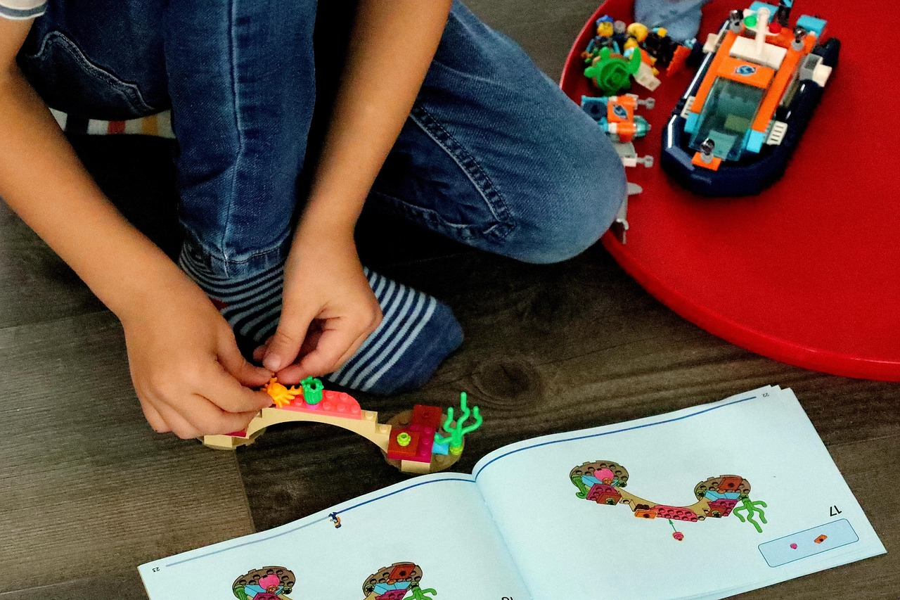
Final Slide
Final Slide
Thank you for your attention, and we hope you have a better understanding of Vygotsky's Sociocultural Play Theory.
Its application in visual storytelling and collaborative games has been explored.
23
Vygotsky's Sociocultural Play Theory in Adult Learning

