Slide 1




Enhancing Disaster Education
A Comprehensive Approach to Differentiated Instruction and Learning Strategies

Slide 2



Table of contents
Understanding Differentiated Instruction
Learning Styles Overview
Below Grade Level Activity - Disaster Discovery Jou…
Below Grade Level - Activity Details
At Grade Level Activity - Disaster Impact Analysis
At Grade Level - Research Methodology
Above Grade Level - Predictive Disaster Modeling
Above Grade Level - Advanced Techniques
Auditory Learning Enhancements
Visual Learning Supports
Inclusive Classroom Strategies
Safety and Ethical Considerations
Assessment Framework
01
02
03
04
05
06
07
08
09
10
11
12
13

Slide 3
Table of contents
Recommended Resources
Technology Integration
Student Engagement Strategies
Differentiation Success Indicators
Future of Disaster Education
Conclusion and Call to Action
Additional Learning Approaches
Interactive Learning Tools
Enhanced Learning Techniques
Global Perspective Integration
Innovative Teaching Strategies
Adaptive Learning Approaches
Engagement Measurement
14
15
16
17
18
19
20
21
22
23
24
25
26

Slide 4
Table of contents
Success Evaluation Criteria
Empowering Student Understanding
Motivational Closing Statement
Technological Advancements
27
28
29
30

Slide 5


Understanding Differentiated Instruction
Understanding Differentiated Instruction
Enhancing Disaster Education

Slide 6

Learning Styles Overview
Learning Styles Overview
Three Primary Learning Styles:
1. Auditory Learners
2. Visual Learners
3. Kinesthetic Learners
Characteristics of Each Style
Enhancing Disaster Education

Slide 7

Below Grade Level Activity - Disaster Discovery Journal
Activity Objective
Key Components
Encourage students to explore various types of disasters and their impacts through journaling.
Structured journal template for organizing thoughts and observations.
Visual reference cards to aid in understanding different disaster scenarios.
Simple disaster descriptions to provide context and background information.
Learning Outcomes
Sample Journal Layout
Improved understanding of different disasters and their effects.
Enhanced critical thinking and observational skills.
Increased awareness of disaster preparedness and response strategies.
Date and disaster type entry section.
Description of the disaster and its impact.
Personal reflections and lessons learned section.
Enhancing Disaster Education

Slide 8

Below Grade Level - Activity Details
Step-by-Step Journal Creation
Scaffolding Techniques
Introduce the Disaster Topic
Provide Structured Journal Template
Explain Disaster Descriptions
Distribute Visual Reference Cards
Use Simplified Language
Include Graphic Support
Provide Structured Templates
Assessment Criteria
Example Entries
Completion of Journal Entries
Understanding of Disaster Concepts
Creativity and Engagement
Earthquake: "Shaking ground, buildings collapse"
Tsunami: "Giant wave, floods coastal areas"
Hurricane: "Strong winds, heavy rainfall"
Enhancing Disaster Education

Slide 9

At Grade Level Activity - Disaster Impact Analysis
At Grade Level Activity - Disaster Impact Analysis
Activity Overview
Research Focus Areas:
1. Environmental impacts
2. Social consequences
3. Economic implications
Enhancing Disaster Education

Slide 10

At Grade Level - Research Methodology
Research Process Breakdown
Resource Selection Strategies
Multimedia Presentation Options
Define research objectives
Conduct literature review
Formulate research questions
Design research methodology
Utilize academic journals
Access reputable websites
Consult subject matter experts
Incorporate primary sources
Create informative slides
Develop engaging videos
Use interactive simulations
Incorporate audio elements
Peer Collaboration Techniques
Evaluation Rubric Components
Establish research groups
Conduct peer reviews
Share resources and insights
Provide constructive feedback
Clarity of research question
Depth of analysis
Use of credible sources
Presentation quality and coherence
Enhancing Disaster Education

Slide 11

Above Grade Level - Predictive Disaster Modeling
Advanced Learning Objectives
Complex Analysis Approach
Develop advanced analytical skills
Understand complex disaster scenarios
Apply predictive modeling techniques
Utilize geological modeling for risk assessment
Incorporate meteorological predictions for early warnings
Implement technological interventions for disaster mitigation
Scientific Inquiry Methods
Technology Integration
Conduct in-depth research on disaster patterns
Utilize data-driven approaches for modeling
Apply statistical analysis for predictive accuracy
Utilize advanced software for modeling simulations
Implement AI algorithms for predictive analytics
Integrate real-time data for enhanced forecasting
Enhancing Disaster Education

Slide 12

Above Grade Level - Advanced Techniques
Above Grade Level - Advanced Techniques
Enhancing Disaster Education

Slide 13

Auditory Learning Enhancements
Auditory Learning Enhancements
Utilize specialized learning strategies tailored for auditory learners
Incorporate audio-based learning resources such as podcasts, expert speaker recordings, and scientific explanations
Focus on developing listening skills and enhancing engagement through auditory stimuli
Enhancing Disaster Education

Slide 14

Visual Learning Supports
Visual Learning Supports
Data Visualization Techniques
Visual Learning Tools:
Satellite imagery
Geological maps
Infographic resources
Visual Analysis Skills
Enhancing Disaster Education

Slide 15
Inclusive Classroom Strategies
Multiple learning entry points
Flexible assessment options
Peer collaboration
Varied activities to cater to different learning styles
Options for students to demonstrate understanding in diverse ways
Allow for alternative forms of assessment
Consider individual student needs and preferences
Encourage teamwork and cooperation among students
Promote learning through shared experiences
Technology integration
Supportive Learning Environment
Utilize digital tools to support diverse learners
Incorporate assistive technology for accessibility
Foster a culture of respect and inclusivity
Provide resources for students with diverse needs
Enhancing Disaster Education

Slide 16
Safety and Ethical Considerations
Sensitive Topic Handling
Psychological Support Resources
Community Resilience Discussion
Approach with empathy and understanding
Provide a safe space for discussion
Access to counseling services
Mental health awareness initiatives
Encourage community involvement
Promote disaster preparedness
Ethical Teaching Approaches
Trauma-Informed Education Strategies
Respect diverse perspectives
Foster critical thinking and empathy
Recognize and address trauma effects
Implement trauma-sensitive practices
Enhancing Disaster Education

Slide 17
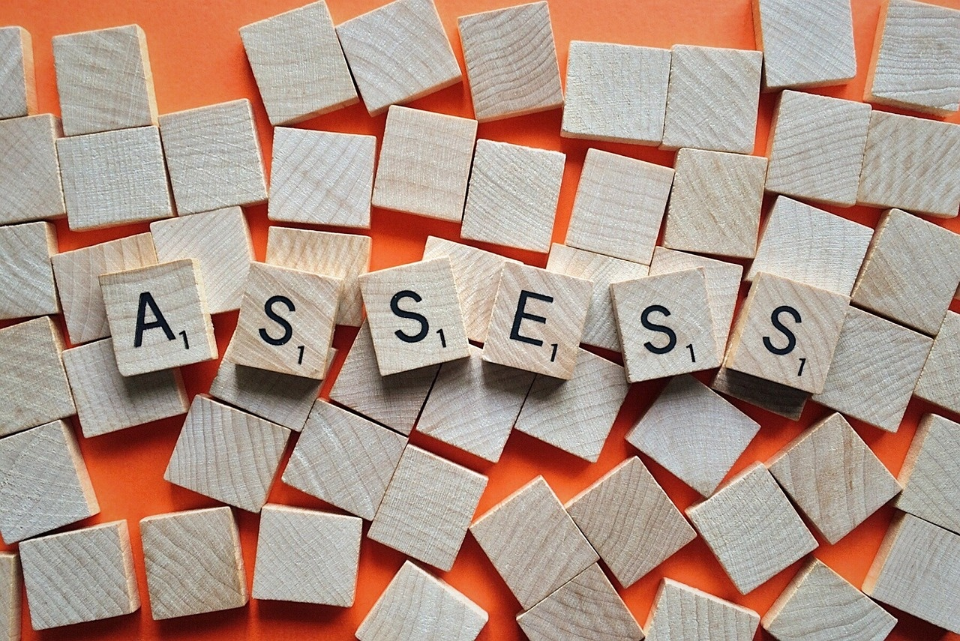
Assessment Framework
Assessment Framework
Progress Monitoring Techniques
Evaluation Methods:
Formative Assessment
Summative Assessment
Self-Reflection
Comprehensive Evaluation Approach
Enhancing Disaster Education

Slide 18

Recommended Resources
Educational Resource List
Additional Research Platforms
USGS Natural Disaster Database
National Geographic Materials
NASA Earth Observatory Resources
Online Learning Tools
Enhancing Disaster Education

Slide 19
Technology Integration
Digital Learning Tools
Online Simulation Platforms
Interactive Disaster Modeling Software
Online platforms for interactive learning experiences.
Educational apps for disaster simulations.
Virtual scenarios for hands-on learning.
Real-time disaster response simulations.
Tools for creating and analyzing disaster scenarios.
Simulation software for predicting natural disasters.
Virtual Learning Environments
Benefits of Technology Integration
Virtual classrooms for remote disaster education.
Immersive experiences for exploring disaster scenarios.
Enhances engagement and interactivity.
Facilitates real-world simulations and practical learning.
Enables access to up-to-date information and resources.
Fosters collaboration and communication among students.
Enhancing Disaster Education

Slide 20
Student Engagement Strategies
Active Learning Techniques
Interactive Classroom Activities
Motivation and Participation Methods
Incorporate hands-on activities and simulations to enhance understanding.
Encourage group discussions and peer teaching for collaborative learning.
Utilize interactive quizzes and games to make learning engaging.
Implement role-playing scenarios related to disaster preparedness.
Offer incentives for participation such as rewards or recognition.
Connect learning to real-world examples to increase student engagement.
Student-Centered Learning Approach
Engagement Measurement
Tailor lessons to student interests and abilities for personalized engagement.
Provide opportunities for student choice in projects and assignments.
Use surveys and feedback to assess student interest and engagement levels.
Monitor participation rates and interaction during class activities.
Enhancing Disaster Education

Slide 21
Differentiation Success Indicators
Student Engagement Levels
Learning Outcomes
Progress Tracking
Active participation in activities
Interest and enthusiasm during lessons
Mastery of key concepts
Application of knowledge in real-world scenarios
Regular assessments to monitor growth
Individualized feedback for improvement
Adaptation to Learning Styles
Continuous Improvement Strategies
Tailored activities for auditory, visual, and kinesthetic learners
Varied instructional approaches for diverse student needs
Reflective practices for educators
Adjustment of teaching methods based on student feedback
Enhancing Disaster Education

Slide 22
Future of Disaster Education
Integration of Virtual Reality
Utilization of Artificial Intelligence
Collaboration with Global Experts
Immersive disaster simulations
Personalized learning experiences
Diverse perspectives
Implementation of Gamification Elements
Emphasis on Interdisciplinary Studies
Engaging learning
Holistic understanding
Enhancing Disaster Education

Slide 23
Conclusion and Call to Action
Reflect on the Importance of Adaptive Learning
Encourage Implementation of Differentiated Instruction
Advocate for Inclusive Classroom Strategies
Promote Continued Professional Development
Emphasize the Role of Technology in Disaster Education
Enhancing Disaster Education

Slide 24
Additional Learning Approaches
Interactive Simulations
Role-Playing Exercises
Field Trips to Emergency Response Centers
Engage students through virtual disaster scenarios
Enhance understanding of disaster response strategies
Encourage active participation and critical thinking
Foster empathy towards disaster-affected communities
Provide hands-on experience in disaster management
Connect theoretical knowledge to real-world applications
Guest Speaker Sessions
Gamification of Learning
Invite experts to share insights on disaster preparedness
Offer diverse perspectives and career exploration opportunities
Utilize educational games to reinforce disaster concepts
Promote teamwork and problem-solving skills
Enhancing Disaster Education

Slide 25
Interactive Learning Tools
Virtual Reality Simulations
Online Interactive Quizzes
Augmented Reality Apps
Immersive experiences of disaster scenarios
Engaging assessments for understanding disaster concepts
Real-time overlays of disaster impact on surroundings
Serious Games
Simulation Software
Gamified learning experiences for disaster preparedness
Hands-on practice in managing disaster situations
Enhancing Disaster Education

Slide 26
Enhanced Learning Techniques
Interactive Simulations
Gamified Learning
Role-Playing Exercises
Utilizing virtual disaster scenarios for hands-on learning.
Incorporating game elements to engage students in disaster education.
Encouraging students to simulate disaster response scenarios.
Real-World Case Studies
Peer Teaching
Analyzing past disasters to understand their impact and response strategies.
Promoting collaborative learning through student-led presentations on disaster topics.
Enhancing Disaster Education

Slide 27

Global Perspective Integration
International Case Studies
Collaborative Projects
Analyzing disaster responses worldwide
Understanding cultural influences on preparedness
Partnering with schools in different countries
Sharing best practices and lessons learned globally
Virtual Field Trips
Cross-Cultural Communication
Exploring disaster-prone regions around the world
Engaging with experts from diverse backgrounds
Learning from global perspectives on disaster education
Enhancing empathy and understanding through international dialogue
Enhancing Disaster Education

Slide 28
Innovative Teaching Strategies
Gamification in Learning
Virtual Reality Simulations
Project-Based Learning
Incorporating game elements to enhance engagement
Rewards system for active participation
Immersive experiences for better understanding
Interactive disaster scenarios for practical learning
Real-world applications of disaster education
Collaborative projects for hands-on experience
Flipped Classroom Approach
Peer Teaching and Mentoring
Pre-learning materials for in-depth discussions
Interactive class sessions for application of knowledge
Encouraging students to teach each other
Building a supportive learning community
Enhancing Disaster Education

Slide 29

Adaptive Learning Approaches
Differentiated Instruction
Adaptive Learning Strategies
Tailoring teaching methods to individual student needs
Providing personalized learning experiences
Utilizing technology to adjust content delivery
Offering diverse pathways to mastery
Enhancing Disaster Education

Slide 30
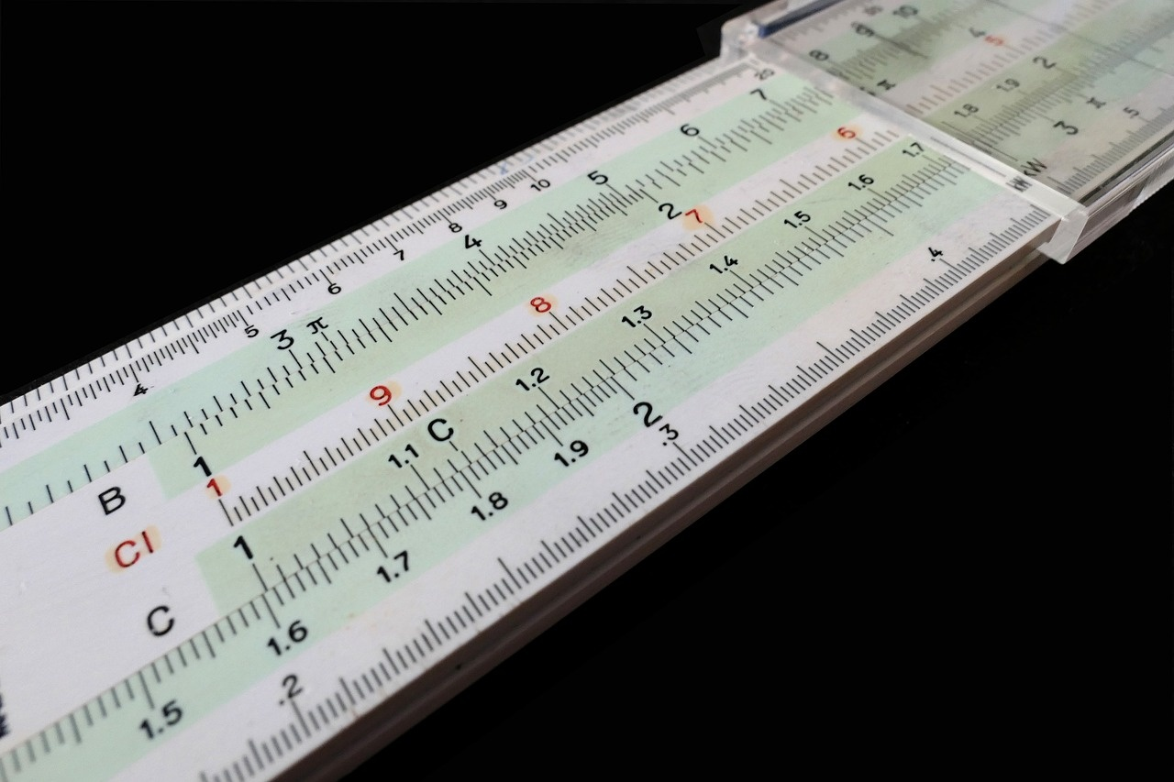
Engagement Measurement
Engagement Measurement
Pre-Activity Survey to gauge initial interest levels
Participation Tracking during group discussions and activities
Post-Activity Reflections for feedback on engagement
Quiz Scores as a measure of understanding and involvement
Enhancing Disaster Education

Slide 31

Success Evaluation Criteria
Success Evaluation Criteria
Student Engagement Levels
Learning Outcomes Achievement
Adaptation to Diverse Learning Styles
Progress Monitoring Effectiveness
Continuous Improvement Strategies
Enhancing Disaster Education

Slide 32

Empowering Student Understanding
Strategies for Student Empowerment
Cultivating Resilience and Preparedness
Promote analysis and evaluation of disaster scenarios
Foster problem-solving abilities in real-world contexts
Engage students in hands-on activities and simulations
Encourage collaboration and peer-to-peer learning
Offer a variety of learning materials such as videos, articles, and case studies
Educate students on stress management during disasters
Promote self-care practices for emotional well-being
Encourage involvement in disaster preparedness initiatives
Empower students to take leadership roles in safety awareness campaigns
Empowering Through Knowledge
Educate on the causes and effects of different types of disasters
Empower students to make informed decisions in emergency situations
Instill a curiosity for exploring natural phenomena and disaster mitigation strategies
Encourage ongoing education and awareness beyond the classroom
Enhancing Disaster Education

Slide 33
Motivational Closing Statement
Embrace Challenges
Seek Opportunities for Growth
Resilience and Determination
Challenges are opportunities in disguise.
Every challenge you face is a chance to grow and learn.
Never stop seeking opportunities to expand your knowledge and skills.
Growth comes from stepping out of your comfort zone.
Adversity is a part of life, but resilience will help you overcome it.
Stay determined and never give up, no matter how tough the journey gets.
Knowledge is Power
Be Agents of Change
Education equips you with the tools to navigate the world.
The more you learn, the more prepared you are for the future.
Use your knowledge and skills to make a difference in your community.
You have the power to create positive change.
Enhancing Disaster Education

Slide 34

Technological Advancements
Technological Advancements
Integration of Virtual Reality (VR) simulations for immersive disaster scenarios
Utilization of Augmented Reality (AR) for interactive learning experiences
Implementation of Artificial Intelligence (AI) for personalized disaster preparedness recommendations
Adoption of Geographic Information Systems (GIS) for real-time mapping and analysis
Incorporation of Drone Technology for aerial disaster assessment and monitoring
Enhancing Disaster Education

