Slide 1

Exploring LangGraph: From Architectural Principles to Real-World Applications
A Comprehensive Journey Through Language Graph Technology

Slide 2
Table of contents
01
02
03
04
05
06
07
08
09
10
11
Title Slide
Introduction to LangGraph
Core Architectural Principles
Agent Interaction Architecture
Practical Implementation Strategies
Hands-On Coding Workshop Overview
Advanced Conceptual Exploration
Real-World Application Domains
Potential Challenges and Considerations
Future Research Directions
Key Takeaways

Slide 3
Table of contents
12
13
14
15
16
17
18
19
20
21
22
Q&A and Further Exploration
Design Recommendations
Technical Notes
Clean, Modern Color Palette
Incorporate Computational/Graph-Like Design Elements
Maintain Consistent Typography
High-Contrast Color Schemes
Minimal but Impactful Graphics
Readability Across Slides
Recommended Font: Sans-Serif (Helvetica, Arial)
Color Scheme: Blues and Grays with Accent Colors

Slide 4
Table of contents
23
24
Subtle Background Textures Representing Computational Netwo…
Use Icons and Infographics to Enhance Visual Communication

Slide 5

1
Title Slide
Advanced LangGraph Workflows: State-Driven Agent Interactions
Revolutionizing Computational Agent Design
Exploring LangGraph: From Architectural Principles to Real-World Applications

Slide 6

2
Introduction to LangGraph
Introduction to LangGraph
Beyond linear language models
Dynamic state-based workflows
Adaptive computational intelligence
Exploring LangGraph: From Architectural Principles to Real-World Applications

Slide 7

3
Core Architectural Principles
01
Persistent Contextual Memory
02
Dynamic Transition Capabilities
Ensures retention of relevant information
Facilitates seamless transitions between states
Enables real-time adaptation to changing conditions
Enhances flexibility in computational workflows
03
Non-linear Interaction Pathways
Allows for complex decision-making processes
Supports diverse agent interactions
Exploring LangGraph: From Architectural Principles to Real-World Applications

Slide 8

4
Agent Interaction Architecture
01
Interconnected Agent Relationships
02
Emergent Computational Behaviors
Agents communicate and collaborate with each other.
Agents exhibit emergent behaviors through interactions.
03
Complex Communication Strategies
Agents employ sophisticated communication protocols.
Exploring LangGraph: From Architectural Principles to Real-World Applications

Slide 9

5
Practical Implementation Strategies
01
Workflow Design Principles
02
State Transition Mechanisms
Define clear objectives and states for the agents.
Establish communication protocols and data exchange formats.
Implement error handling mechanisms for robust performance.
Design state transition rules based on agent interactions.
Incorporate feedback loops for adaptive behavior.
Ensure seamless transitions between states for efficient processing.
03
Real-World Problem-Solving Approaches
04
Code Snippet
Identify specific use cases for LangGraph implementation.
Collaborate with domain experts to tailor solutions to industry needs.
Continuously iterate and improve agent performance based on real-world feedback.
# Basic LangGraph Implementation Example
class StateDrivenAgent:
def __init__(self, initial_state):
self.current_state = initial_state
def transition(self, new_state):
Exploring LangGraph: From Architectural Principles to Real-World Applications

Slide 10
6
Hands-On Coding Workshop Overview
01
02
03
04
05
Workshop Focus
Workshop Stages
Learning Objectives
Tools and Resources
Participant Engagement
Understanding practical agent development
Implementing state-driven agents
Basic state graph construction
Agent interaction scenario design
Dynamic reconfiguration techniques
Mastering workflow design principles
Implementing state transition mechanisms
Applying real-world problem-solving approaches
Integrated development environments (IDEs)
LangGraph documentation
Sample code repositories
Hands-on coding exercises
Group discussions and problem-solving
Q&A sessions for clarifications
Exploring LangGraph: From Architectural Principles to Real-World Applications

Slide 11

7
Advanced Conceptual Exploration
01
Future of Computational Linguistics
02
Adaptive Intelligence Paradigms
Advancements in natural language processing
Integration with AI and machine learning
Impact on communication and information retrieval
Self-learning algorithms
Context-aware systems
Personalized user experiences
03
Emerging Technological Frontiers
Quantum computing
Neural interfaces
Next-gen connectivity
Exploring LangGraph: From Architectural Principles to Real-World Applications

Slide 12

8
Real-World Application Domains
01
Healthcare Diagnostics
02
Financial Predictive Modeling
Applications in medical imaging, patient data analysis, and predictive diagnostics.
Used for stock market predictions, risk assessment, and financial planning.
03
Autonomous Robotic Systems
04
Natural Language Processing
Includes self-driving cars, robotic surgery, and automated manufacturing.
Applications in chatbots, language translation, and sentiment analysis.
Exploring LangGraph: From Architectural Principles to Real-World Applications

Slide 13

9
Potential Challenges and Considerations
01
Performance Optimization
02
Ethical AI Design
Balancing computational complexity with efficiency
Addressing latency issues in real-time applications
Ensuring transparency and accountability in decision-making
Mitigating bias and discrimination in algorithmic outputs
03
Resource Management
04
Error Handling Strategies
Allocating computational resources effectively
Scaling infrastructure to meet growing demands
Implementing robust error detection and recovery mechanisms
Minimizing the impact of errors on system functionality
Exploring LangGraph: From Architectural Principles to Real-World Applications

Slide 14

10
Future Research Directions
01
Quantum Computing Integration
02
Self-Evolving Agent Systems
Exploring the potential of quantum computing to enhance LangGraph's computational capabilities.
Investigating quantum algorithms for language processing and state-driven agent interactions.
Researching autonomous agents that can adapt and evolve based on environmental stimuli.
Implementing self-learning mechanisms within LangGraph for continuous improvement.
03
Cross-Disciplinary AI Applications
Collaborating with experts from diverse fields to apply LangGraph in novel domains.
Studying the impact of integrating LangGraph with fields like biology, psychology, and sociology.
Exploring LangGraph: From Architectural Principles to Real-World Applications

Slide 15

11
Key Takeaways
01
State-driven Workflows
02
Dynamic Adaptation
Revolutionize agent interactions
Crucial for advanced AI
03
Interdisciplinary Collaboration
Fuels innovation
Exploring LangGraph: From Architectural Principles to Real-World Applications

Slide 16

12
Q&A and Further Exploration
01
Q1: How can LangGraph enhance traditional language models?
02
Q2: What are the key components of state management in LangGraph?
LangGraph goes beyond linear models by incorporating dynamic state-based workflows, enabling adaptive computational intelligence.
LangGraph utilizes persistent contextual memory, dynamic transition capabilities, and non-linear interaction pathways for effective state management.
03
Q3: Can you provide examples of real-world applications of LangGraph?
04
Q4: Where can I find additional resources to further explore LangGraph?
LangGraph has been successfully applied in healthcare diagnostics, financial predictive modeling, autonomous robotic systems, and natural language processing.
Recommended reading materials, online learning platforms, research communities, and upcoming workshop opportunities are great avenues for delving deeper into LangGraph.
Exploring LangGraph: From Architectural Principles to Real-World Applications

Slide 17
13
Design Recommendations
01
02
03
04
Color Palette
Design Elements
Typography
Visuals
Utilize a clean, modern color palette
Incorporate blues and grays with accent colors for a tech-inspired look
Integrate computational/graph-like design elements
Include subtle background textures representing computational networks
Maintain consistent use of sans-serif font (e.g., Helvetica, Arial)
Ensure readability across slides with appropriate font sizes
Use high-contrast color schemes for visual impact
Include minimal but impactful graphics to enhance understanding
Exploring LangGraph: From Architectural Principles to Real-World Applications

Slide 18
14
Technical Notes
01
Font
02
Color Scheme
03
Background Textures
Sans-serif (Helvetica, Arial)
Ensure readability and modern look
Blues and grays with accent colors
Maintain a professional and tech-inspired aesthetic
Subtle textures representing computational networks
Enhance visual appeal and thematic consistency
04
Icons and Infographics
05
Graphics
Utilize for visual communication
Enhance understanding of complex concepts
Detailed state transition flowchart
Interconnected agent interaction network
Futuristic computational landscape
Complexity management framework
Exploring LangGraph: From Architectural Principles to Real-World Applications

Slide 19

15
Clean, Modern Color Palette
Clean, Modern Color Palette
Soft Blue: #6EB5FF
Light Gray: #E0E0E0
Accent Color: Vibrant Orange: #FFA500
This color palette provides a fresh and contemporary look, combining calming blues with a touch of energy from the vibrant orange accent.
The light gray serves as a neutral backdrop, enhancing readability and visual appeal.
Exploring LangGraph: From Architectural Principles to Real-World Applications

Slide 20

16
Incorporate Computational/Graph-Like Design Elements
01
Node-Based Visualization
02
Graphical User Interface (GUI)
Utilize nodes to represent computational elements
Connect nodes with edges to show relationships
Design interfaces with graph-like structures
Implement interactive graph views for user engagement
03
Algorithmic Representation
04
Data Flow Diagrams
Display algorithms using graph layouts
Highlight computational processes through graph structures
Illustrate data flow using graph-like diagrams
Visualize computational workflows with directional graphs
Exploring LangGraph: From Architectural Principles to Real-World Applications

Slide 21

17
Maintain Consistent Typography
01
Maintain Consistent Typography
02
Font Size
Font Choice
Headings: Sans-serif (Helvetica, Arial)
Body Text: Consistent font style throughout the presentation
Headings: Larger font size for emphasis
Body Text: Ensure readability with appropriate font size
03
Text Alignment
04
Color Contrast
Maintain consistent alignment (left, center, or right) for a polished look
Use high contrast between text and background for readability
Consistent color scheme for text to maintain visual harmony
Exploring LangGraph: From Architectural Principles to Real-World Applications

Slide 22
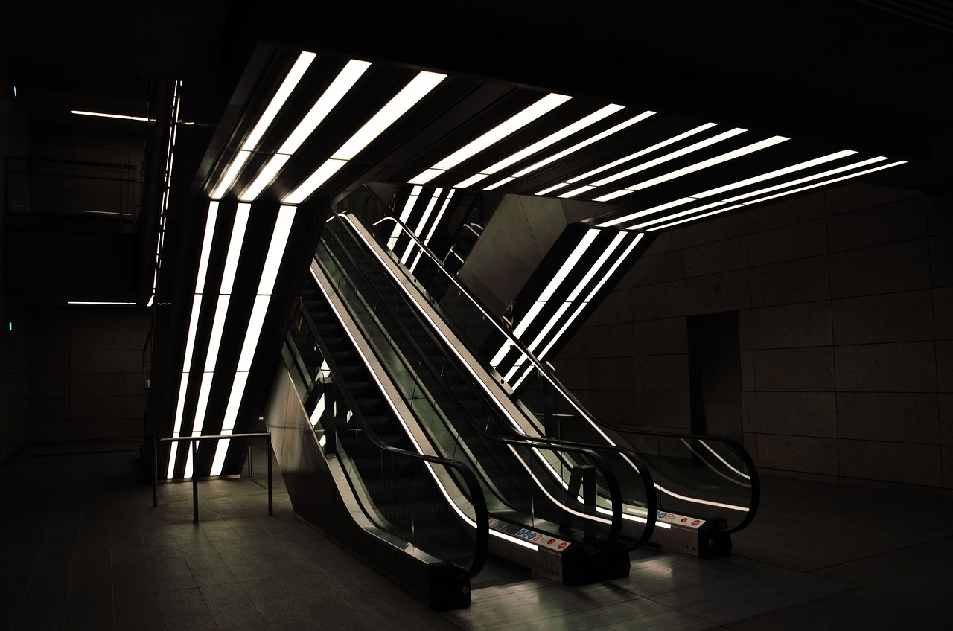
18
High-Contrast Color Schemes
01
Purposeful Selection
02
Accessibility Considerations
Choosing colors with stark contrast enhances visual appeal.
High contrast aids readability for all audience members.
03
Impactful Visuals
Bold color contrasts make key elements stand out effectively.
Exploring LangGraph: From Architectural Principles to Real-World Applications

Slide 23

19
Minimal but Impactful Graphics
01
Minimal but Impactful Graphics
02
Sleek Visual Elements
Clean lines and modern design
Tech-inspired graphics for enhanced appeal
03
Strategic Use of Color
04
Iconic Representation
High-contrast color schemes
Blues and grays with accent colors for a professional look
Utilize icons for visual communication
Minimalistic yet impactful imagery
Exploring LangGraph: From Architectural Principles to Real-World Applications

Slide 24
20
Readability Across Slides
01
Consistent Typography
02
Color Contrast
03
Minimal Graphics
Ensure uniform font style and size for all text.
Use sans-serif fonts like Helvetica or Arial for better readability.
Opt for high-contrast color schemes.
Use blues and grays with accent colors for visual appeal.
Incorporate subtle computational/graph-like design elements.
Avoid overcrowding slides with excessive visuals.
04
Text Alignment
05
Background Texture
Maintain a clean layout with well-aligned text.
Ensure text is easily readable from a distance.
Utilize subtle background textures representing computational networks.
Enhance visual interest without compromising readability.
Exploring LangGraph: From Architectural Principles to Real-World Applications

Slide 25

21
Recommended Font: Sans-Serif (Helvetica, Arial)
Recommended Font: Sans-Serif (Helvetica, Arial)
Consistent Typography: Ensure all text in the presentation follows a sans-serif font style for clarity and modernity.
Helvetica: A classic sans-serif font known for its clean lines and readability.
Arial: Widely used in digital formats for its simplicity and legibility.
Exploring LangGraph: From Architectural Principles to Real-World Applications

Slide 26

22
Color Scheme: Blues and Grays with Accent Colors
01
Color Scheme: Blues and Grays with Accent Colors
02
Accent Colors: Vibrant Yellow and Teal
Main Colors: Blues and Grays
Utilize shades of blue and gray for the overall design aesthetic.
Incorporate pops of vibrant yellow and teal to add visual interest.
03
Consistent Theme: Modern and Tech-Inspired
04
Visual Harmony: Balance and Contrast
Ensure the color scheme aligns with the clean, modern design of computational elements.
Maintain a harmonious balance between the blues and grays, with accent colors for contrast.
Exploring LangGraph: From Architectural Principles to Real-World Applications

Slide 27

23
Subtle Background Textures Representing Computational Networks
Subtle Background Textures Representing Computational Networks
Abstract geometric patterns symbolizing interconnected data nodes
Delicate lines and nodes representing computational relationships
Soft gradients mimicking data flow and network connectivity
Gradient overlays suggesting information transfer and processing
Subtle grid structures evoking computational frameworks
Exploring LangGraph: From Architectural Principles to Real-World Applications

Slide 28

24
Use Icons and Infographics to Enhance Visual Communication
01
Icons
02
Infographics
Utilize simple and recognizable icons to represent concepts or ideas visually.
Example: Using a lightbulb icon to symbolize ideas or innovation.
Example: Using a gear icon to represent processes or operations.
Combine icons, text, and visuals to convey complex information in a clear and engaging manner.
Example: Creating a flowchart infographic to illustrate a step-by-step process.
Example: Designing a comparison infographic to highlight differences between two concepts.
03
Benefits
Enhances audience understanding, engagement, and retention through visual storytelling.
Exploring LangGraph: From Architectural Principles to Real-World Applications

