Slide 1
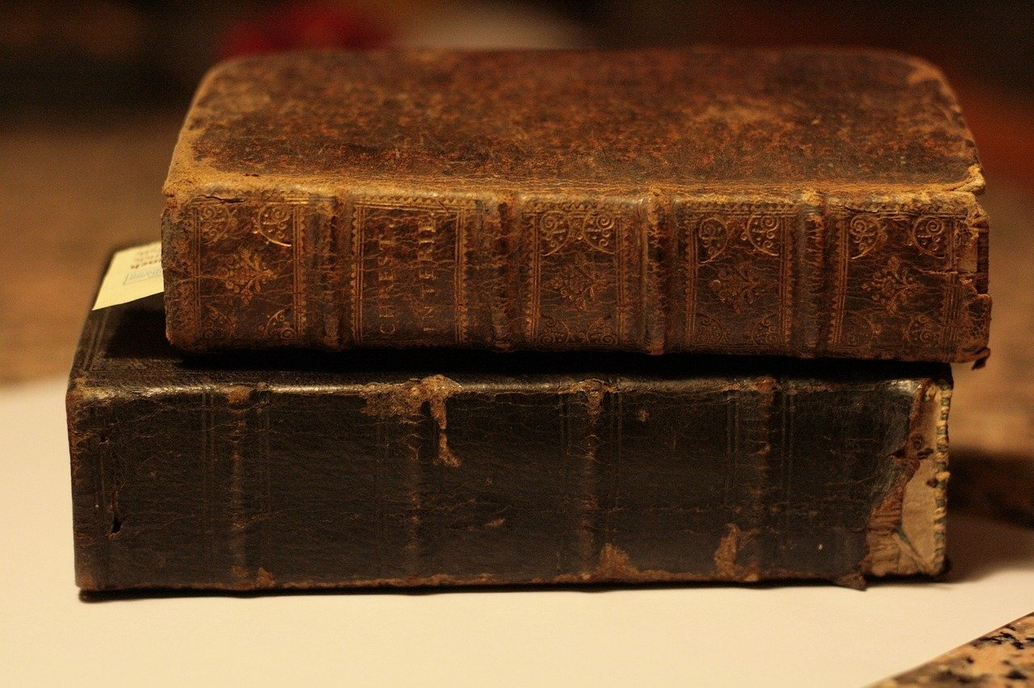
Mastering Present Simple Tense
A Comprehensive Guide to Subject Knowledge and Usage

Slide 2
Table of contents
Lesson Introduction
Subject Knowledge: Present Simple Tense
Subject Knowledge: The Verb "To Be"
Subject Knowledge: There Is/There Are
Subject Knowledge: It's
Target Audience: Adult Learners
Importance of Present Simple Tense
Usage of Verb "To Be"
Expressions: There Is/There Are
Understanding "It's"
01
02
03
04
05
06
07
08
09
10
0

Slide 3
Lesson Introduction
01
02
03
04
05
Present Simple Tense
The Verb "To Be"
Expressions "There Is/There Are"
Use of "It's"
Use of "It's"
Used for habitual actions, general truths, and routine activities.
Formed with the base form of the verb (e.g., "I play," "She works," "They study").
Describes daily routines, personal preferences, and simple facts.
Essential for identifying existence, states, or qualities.
Conjugated as "am," "is," "are" depending on the subject.
Examples: "I am happy," "She is tall," "They are students."]},{
Used to indicate existence or presence of something.
Singular: "There is a book on the table."
Plural: "There are many cars in the parking lot.
Contraction of "it is" or "it has."
Used to describe objects, animals, or weather conditions.
Examples: "It's raining," "It's a beautiful day.
Contraction of "it is" or "it has."
Used to describe objects, animals, or weather conditions.
Examples: "It's raining," "It's a beautiful day.
Mastering Present Simple Tense
1

Slide 4

Subject Knowledge: Present Simple Tense
Present Simple Tense
Used to express habitual actions, general truths, and routine activities.
Formed by using the base form of the verb (e.g., 'I play,' 'She works,' 'They study').
Crucial for describing daily routines, personal preferences, and simple facts.
The Verb 'To Be'
Indicates states of being, identity, and existence.
Conjugation in present simple tense: 'am' (first person singular), 'is' (third person singular), 'are' (plural forms).
There Is/There Are
Indicate the existence of something in a specific location.
'There is' for singular nouns, 'there are' for plural nouns.
Used to describe the presence of objects, people, or places.
It's
Contraction of 'it is' or 'it has'.
Expresses possession, characteristics, or qualities of a singular object or subject.
Commonly used in everyday conversations and written communication.
Mastering Present Simple Tense
2

Slide 5
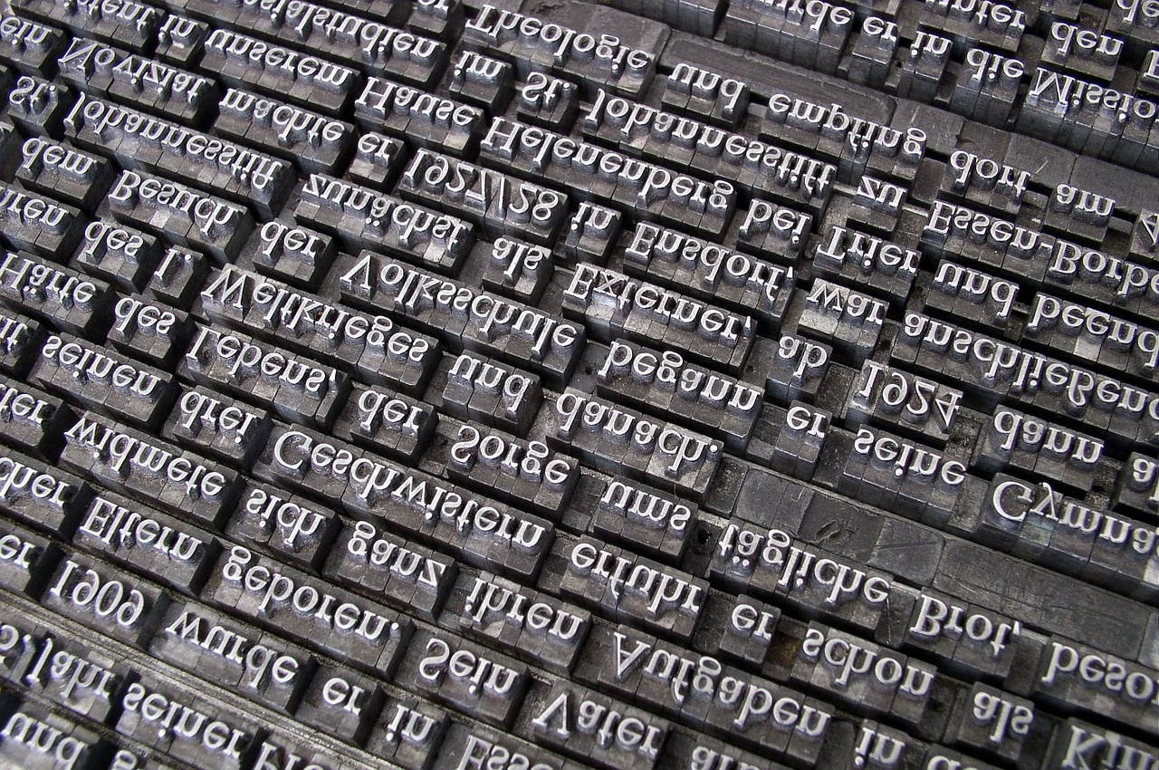
Subject Knowledge: The Verb "To Be"
Present Simple Tense
Used for habitual actions, general truths, and routine activities.
Formed with the base form of the verb (e.g., "I play," "She works," "They study").
Describes daily routines, personal preferences, and simple facts.
The Verb "To Be"
Essential for identifying the subject in a sentence.
Conjugated as "am," "is," and "are" for different subjects.
Examples: "I am happy," "She is busy," "They are students."
Subject-Verb Agreement
The verb "to be" must agree with the subject in number and person.
Singular subjects use "is" (e.g., "He is tall"), while plural subjects use "are" (e.g., "They are happy").
Contractions with "To Be"
Common contractions include "I'm" (I am), "he's" (he is), "she's" (she is), "it's" (it is), "we're" (we are), and "they're" (they are).
Mastering Present Simple Tense
3

Slide 6
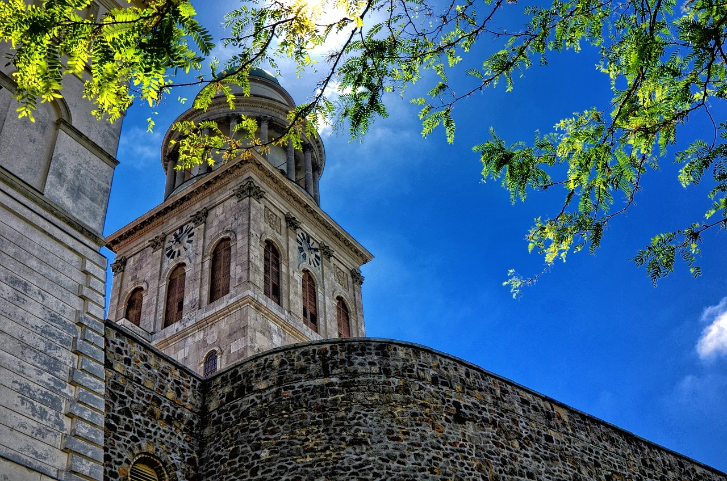
Subject Knowledge: There Is/There Are
"There Is/There Are" Usage
Used to indicate the existence of something in a specific location.
"There is" is used for singular nouns.
"There are" is used for plural nouns.
Examples: "There is a book on the table" or "There are many students in the classroom."
Positive Sentences
"There is" is used for singular subjects.
"There are" is used for plural subjects.
Examples: "There is a cat in the garden" or "There are three apples on the tree."
Negative Sentences
"There isn't" is used for singular subjects.
"There aren't" is used for plural subjects.
Examples: "There isn't a cloud in the sky" or "There aren't any pens on the desk."
Interrogative Sentences
Structure is reversed in questions.
"Is there" is used for singular subjects.
"Are there" is used for plural subjects.
Examples: "Is there a problem with the computer?" or "Are there any questions?"
Mastering Present Simple Tense
4

Slide 7

Subject Knowledge: It's
Present Simple Tense
Used to express habitual actions, general truths, and routine activities.
Formed by using the base form of the verb (e.g., 'I play,' 'She works,' 'They study').
Crucial for describing daily routines, personal preferences, and simple facts.
The Verb 'To Be'
Indicates states of being, identity, and existence.
Conjugated as 'am,' 'is,' and 'are' depending on the subject (e.g., 'I am,' 'She is,' 'They are').
Expressions 'There Is/There Are'
Used to indicate the existence of something in a specific location.
'There is' is used for singular nouns (e.g., 'There is a book on the table').
'There are' is used for plural nouns (e.g., 'There are many students in the classroom').
Use of 'It's'
A contraction of 'it is' or 'it has.'
Commonly used to express possession, describe characteristics, or provide information about a subject (e.g., 'It's raining,' 'It's my book,' 'It's been a long day').
Mastering Present Simple Tense
5

Slide 8

Target Audience: Adult Learners
Lesson Introduction
In this comprehensive English lesson, we will delve into the fundamental grammatical concepts of the present simple tense, the verb "to be," the expressions "there is/there are," and the use of "it's."
These core elements are essential for effective communication in the English language, and mastering them will provide a strong foundation for further language development.
This lesson is tailored for adult learners aged 21 and above, ensuring that the content and delivery are relevant and engaging for this target audience.
Mastering Present Simple Tense
6

Slide 9

Importance of Present Simple Tense
Present Simple Tense
Expresses habitual actions
Describes general truths
Used for routine activities
The Verb "To Be"
Indicates states of being
Shows identity or existence
Examples: I am, You are, He is, She is, It is, We are, They are
Expressions "There Is/There Are"
Indicate existence in a specific location
"There is" for singular nouns
"There are" for plural nouns
Examples: There is a book on the table, There are three apples in the basket
Use of "It's"
Contraction of "it is" or "it has"
Expresses possession or characteristics
Examples: It's raining outside, It's my favorite color
Mastering Present Simple Tense
7

Slide 10
SWOT Analysis
Strengths
Weaknesses
The verb "to be" is essential for forming the present simple tense correctly.
It serves as a linking verb to connect the subject with its complement in a sentence.
Irregular conjugation in different forms (am, is, are) can be challenging for learners.
Requires understanding of subject-verb agreement for proper usage.
S
W
O
T
Opportunities
Threats
Practice exercises and drills can help reinforce the correct usage of "to be."
Utilizing real-life examples and scenarios can enhance understanding and application.
Misuse of "to be" can lead to confusion in sentence structure and meaning.
Lack of practice and reinforcement may result in errors in communication.
Mastering Present Simple Tense
8

Slide 11
Expressions: There Is/There Are
01
02
03
04
05
Introduction to "There Is/There Are"
Examples of "There Is/There Are"
Negative Forms of "There Is/There Are"
Questions with "There Is/There Are"
Questions with "There Is/There Are"
These expressions are used to indicate the existence of something in a specific location.
"There is" is used for singular nouns, while "there are" is used for plural nouns.
There is a book on the table.
There are three apples in the basket.
There is a cat in the garden.
There are many students in the classroom.
There isn't a pen on the desk.
There aren't any chairs in the room.
There isn't a cloud in the sky.
There aren't many options available.
Is there a restaurant nearby?
Are there any shops open late?
Is there a problem with the computer?
Are there enough chairs for everyone?
Is there a restaurant nearby?
Are there any shops open late?
Is there a problem with the computer?
Are there enough chairs for everyone?
Mastering Present Simple Tense
9

Slide 12
SWOT Analysis
Strengths
Weaknesses
"It's" is a contraction of "it is" or "it has," making sentences more concise and conversational.
Commonly used in everyday English, enhancing fluency and natural language usage.
Can be confusing for non-native English speakers due to its informal nature and multiple meanings.
Overusing contractions like "it's" may lead to a lack of formality in written communication.
S
W
O
T
Opportunities
Threats
Practice using "it's" in context to improve language proficiency and communication skills.
Understanding the nuances of contractions can help in differentiating between spoken and written English.
Misusing contractions like "it's" may result in misunderstandings or misinterpretations in communication.
Incorrect usage of contractions can impact the clarity and professionalism of written documents.
Mastering Present Simple Tense
10

