Slide 1
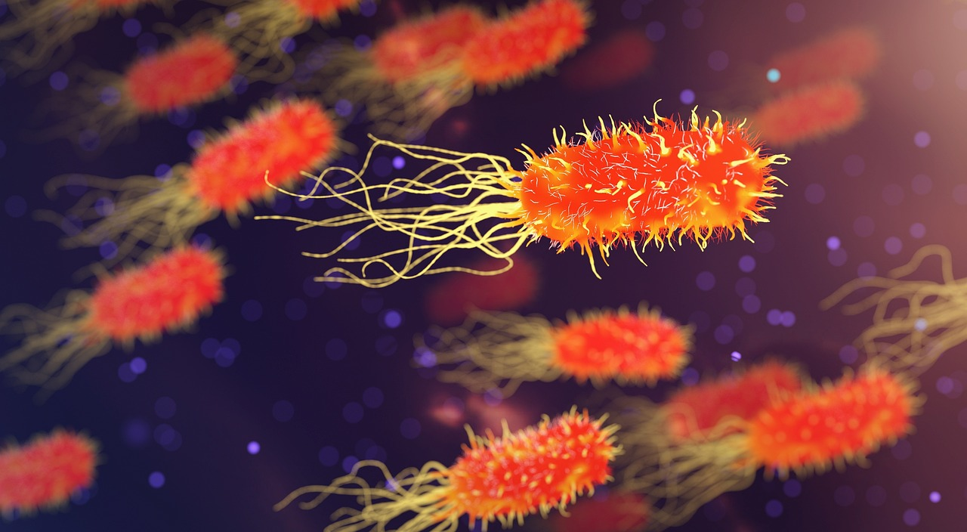
Exploring the Foundations of Science
A Comprehensive Journey Through Biology, Physics, Chemistry, and Beyond

Slide 2
Exploring the Foundations of Science
2
Table of Contents
Introduction to Science
Course Objectives
Biology Basics
Physics Fundamentals
Chemistry Essentials
Scientific Method
Lab Safety
Environmental Awareness
Science in Everyday Life
Science Careers
Conclusion
Assessment and Evaluation
Resources and References
04
05
06
07
08
09
10
11
12
13
14
15
16

Slide 3
Exploring the Foundations of Science
3
Table of Contents
Parent Engagement
Next Steps
Final Thoughts
17
18
19

Slide 4

Exploring the Foundations of Science
4
Introduction to Science
Biology Basics
Physics Fundamentals
Chemistry Concepts
Explore the fascinating world of biology.
Learn about living organisms and their ecosystems.
Learn about the principles that govern the universe.
We will cover topics like motion, energy, and forces.
Understand the building blocks of matter and their interactions.
We will discuss key topics such as chemical reactions and the periodic table.

Slide 5
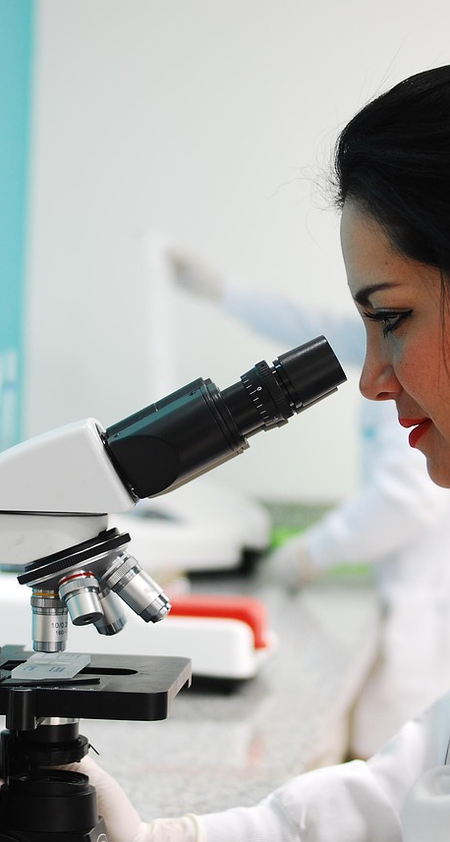
Exploring the Foundations of Science
5
Course Objectives
Scientific Foundations
Critical Skills
Understand key concepts in biology, physics, and chemistry.
Build a strong foundation in natural science principles.
Develop critical thinking and problem-solving abilities.
Enhance your capacity to analyze information effectively.
Real-World Application
Fostering Curiosity
Apply scientific concepts to everyday situations.
Bridge classroom learning with practical experiences.
Encourage exploration through hands-on experiments.
Promote inquiry-based learning to spark interest in science.

Slide 6
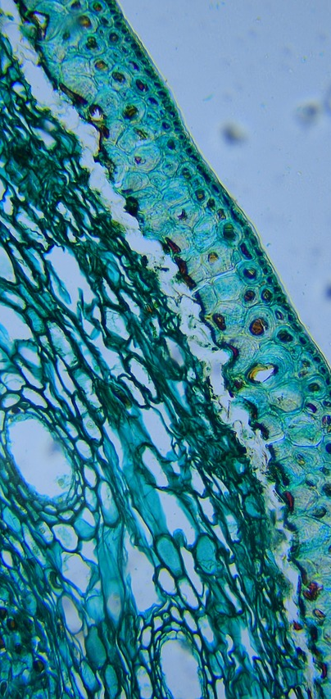
Exploring the Foundations of Science
6
Biology Basics
Item 1
Item 2
Item 3
This is the first item.
This is the second item.
This is the third item.

Slide 7
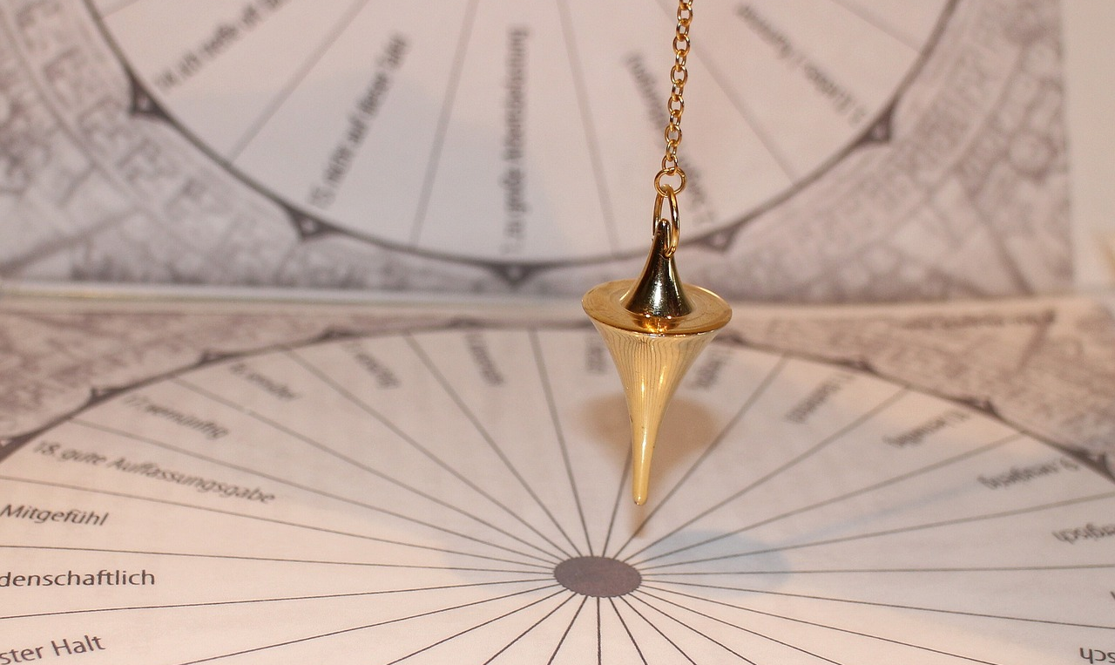
Exploring the Foundations of Science
7
Physics Fundamentals
Motion Dynamics
Force Interaction
Energy Transfer
Motion is the study of how objects move through space and time.
Understanding motion helps us predict the behavior of moving objects.
Forces are pushes or pulls that cause changes in motion.
They are responsible for making things happen in our physical world.
Energy is the capacity to do work or cause change.
Understanding energy transfer is crucial for analyzing physical systems.

Slide 8

Exploring the Foundations of Science
8
Chemistry Essentials
Matter's Building Blocks
Element Combinations
Transforming Matter
Elements are the fundamental building blocks of matter.
They cannot be broken down into simpler substances.
Compounds are formed by combining different elements.
These combinations create new substances with unique properties.
Chemical reactions involve changing matter from one form to another.
These reactions can create new compounds or break down existing ones.

Slide 9
Exploring the Foundations of Science
9
Scientific Method
Inquire
Investigate
Predict
Test
Reflect
Determine your primary research question.
What specific knowledge are you seeking?
Gather relevant data and insights.
Explore existing studies and resources that relate to your question.
Craft a hypothesis based on your findings.
What outcome do you anticipate from your research?
Implement experiments to evaluate your hypothesis.
Carefully document your observations and results.
Review the results to draw insightful conclusions.
Did your findings support or challenge your initial hypothesis?

Slide 10

Exploring the Foundations of Science
10
Lab Safety
Wear Gear
Follow Instructions
Always wear protective gear such as goggles, gloves, and lab coats.
This helps to ensure your safety while working in the lab.
Always listen to your teacher's instructions carefully.
Following directions is crucial for maintaining safety in the lab.
Handle Equipment
Clean Up
Be gentle and respectful when using lab equipment.
Proper handling prevents accidents and damage to the tools.
Always clean up your workspace after finishing your experiments.
Leaving the lab as you found it is essential for everyone's safety.

Slide 11
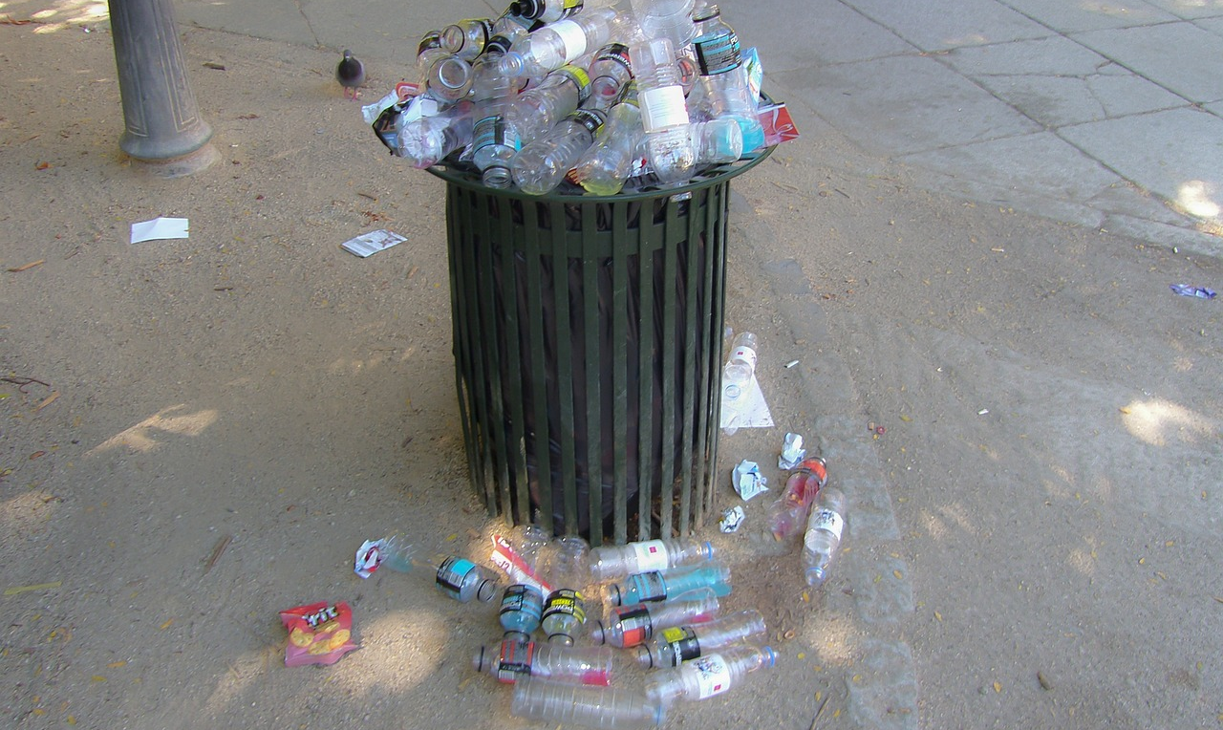
Exploring the Foundations of Science
11
Environmental Awareness
Resource Conservation
Wildlife Protection
Energy Efficiency
Reduce, reuse, and recycle to conserve resources.
These practices minimize waste and protect the environment.
Preserving ecosystems is vital for protecting wildlife.
Biodiversity is essential for a healthy planet.
Conserve energy to reduce your carbon footprint.
Using energy-efficient appliances, such as LED bulbs, significantly lowers energy consumption.

Slide 12

Exploring the Foundations of Science
12
Science in Everyday Life
Culinary Chemistry
Dynamic Physics
Cooking involves chemical reactions that enhance flavors.
Understanding these reactions can improve your culinary skills.
Physics principles govern the mechanics of transportation.
From cars to airplanes, physics is essential for movement.
Biological Healthcare
Innovative Technology
Biology plays a crucial role in medical advancements.
Understanding biological processes leads to better healthcare solutions.
Technology is driven by innovation and scientific discovery.
New technologies often stem from scientific research and experimentation.

Slide 13
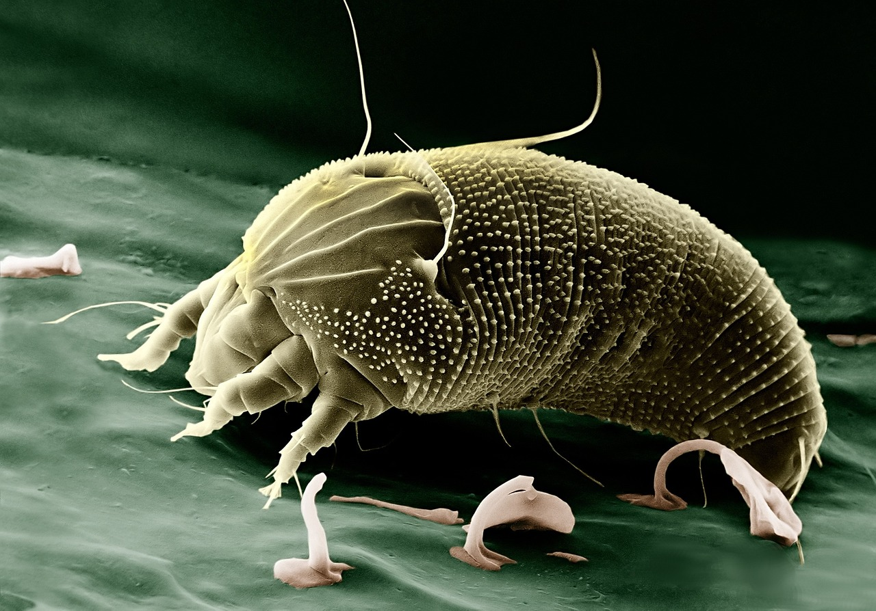
Exploring the Foundations of Science
13
Science Careers
Researcher
Designer
Healthcare
Educator
Conservationist
Scientists conduct experiments to discover new knowledge.
They analyze data to advance our understanding of the world.
Engineers create innovative solutions to complex challenges.
They apply scientific principles to design functional products.
Doctors are dedicated to enhancing patient health through expert care.
They diagnose conditions and provide effective treatments.
Teachers inspire students to explore and learn.
They guide learners in developing critical thinking skills.
Environmentalists advocate for the protection of our planet.
They work tirelessly to preserve ecosystems and promote sustainability.

Slide 14

Exploring the Foundations of Science
14
Conclusion
Science Everywhere
Exciting Discoveries
The Adventure of Discovery
Everywhere we look, science plays a role in our lives.
From the technology we use to the food we eat, it's all influenced by scientific principles.
Consider the thrill of discovering a new planet or a groundbreaking medical treatment.
These discoveries not only excite our curiosity but also improve our quality of life.
Exploring the mysteries of the universe leads to incredible insights.
Each experiment and observation opens doors to new questions and possibilities.

Slide 15

Exploring the Foundations of Science
15
Assessment and Evaluation
Knowledge Checks
Skill Showcase
Quizzes and tests are effective tools for knowledge assessment.
They help identify areas where students may need improvement.
Projects and presentations allow for skill evaluation in a practical context.
They provide opportunities for students to demonstrate their understanding and creativity.
Active Engagement
Personal Reflection
Class participation reflects student engagement and enthusiasm for the subject matter.
It encourages a dynamic learning environment where ideas can be shared freely.
Self-assessment promotes reflection and personal growth among students.
It encourages them to take ownership of their learning journey.

Slide 16

Exploring the Foundations of Science
16
Resources and References
Textbooks
Online Resources
Lab Equipment
Guest Speakers
Field Trips
Textbooks are essential for foundational knowledge.
They provide structured information across various subjects.
Online resources enhance learning with diverse materials.
They include videos, articles, and interactive tools for deeper understanding.
Lab equipment enables practical, hands-on experiences.
Students can experiment and apply theories in real-time.
Guest speakers offer valuable insights from their expertise.
They bring real-world perspectives that enrich classroom discussions.
Field trips provide opportunities to observe real-world applications.
They bridge the gap between theory and practice, enhancing learning.

Slide 17

Exploring the Foundations of Science
17
Parent Engagement
Stay Informed
Get Involved
Support Learning
Attend parent-teacher conferences to understand your child's progress.
This helps you provide better support.
Volunteer in the classroom to actively engage in your child's education.
Your involvement enhances their learning experience.
Encourage curiosity at home by exploring new topics together.
This nurtures a love for learning.

Slide 18

Exploring the Foundations of Science
18
Next Steps
Explore Science
Apply Practically
Participate in workshops and seminars focused on various scientific fields.
Engage in hands-on experiments to enhance your understanding.
Apply your skills to solve real-world challenges.
Implement scientific principles in everyday projects.
Pursue Careers
Stay Curious
Explore diverse career paths in science and technology.
Connect with professionals to explore career opportunities.
Cultivate your curiosity by exploring new topics and ideas.
Look for learning opportunities through courses and discussions.

Slide 19

Exploring the Foundations of Science
19
Final Thoughts
Endless Exploration
Continuous Learning
Science is driven by curiosity to discover the unknown.
Every experiment uncovers new wonders.
Knowledge is always evolving, and curiosity keeps us engaged.
New information reshapes our understanding of the world.

