Slide 1

Exploring Object Sizes: Understanding, Measuring, and Applying
A Comprehensive Guide to Object Sizes, Measurement Units, Problem-Solving, and Real-World Applications

Slide 2
Table of Contents
Introduction to Exploring Object Sizes
What are Object Sizes?
Hands-On Activity: Block Sorting
Everyday Objects: Size Comparison
Measurement Units
Real-World Applications
Problem-Solving Skills
Collaborative Learning
Differentiated Activities
Assessment and Evaluation
Conclusion
Extension Activities
Parent Engagement
04
05
06
07
08
09
10
11
12
13
14
15
16

Slide 3
Table of Contents
Reflection and Next Steps
Teaching Tips and Strategies
Key Takeaways
Final Thoughts
17
18
19
20

Slide 4

Introduction to Exploring Object Sizes
Understanding Object Sizes
Learning Objectives
Hands-On Exploration
Introduce the concept of object sizes and its importance in everyday life.
Explain how recognizing sizes helps in organizing and interacting with the environment effectively.
Explain the learning objectives of the lesson: to develop understanding of size relationships, spatial awareness, and problem-solving skills.
Highlight the significance of these skills in both academic and practical contexts.
Preview the hands-on activities and real-world examples that will be used to explore object sizes.
Emphasize the engaging and interactive nature of these activities to enhance learning.
4
Exploring Object Sizes: Understanding, Measuring, and Applying

Slide 5

What are Object Sizes?
Defining Object Sizes
Visual Aids for Object Sizes
Object sizes refer to the dimensions or magnitude of an object, which can be compared as larger, smaller, or equal.
This concept helps in understanding and categorizing objects based on their physical attributes.
Pictures of blocks or everyday objects can effectively illustrate the concept of object sizes.
These visual aids make it easier to grasp the differences and similarities in size.
Real-Life Applications of Object Sizes
Importance in Mathematics and Science
Object sizes play a crucial role in fields like building design and cooking.
For instance, precise measurements ensure structural integrity or the right proportions in recipes.
Understanding object sizes is fundamental in mathematical calculations and scientific experiments.
It aids in accurate measurements, comparisons, and problem-solving across various disciplines.
5
Exploring Object Sizes: Understanding, Measuring, and Applying

Slide 6
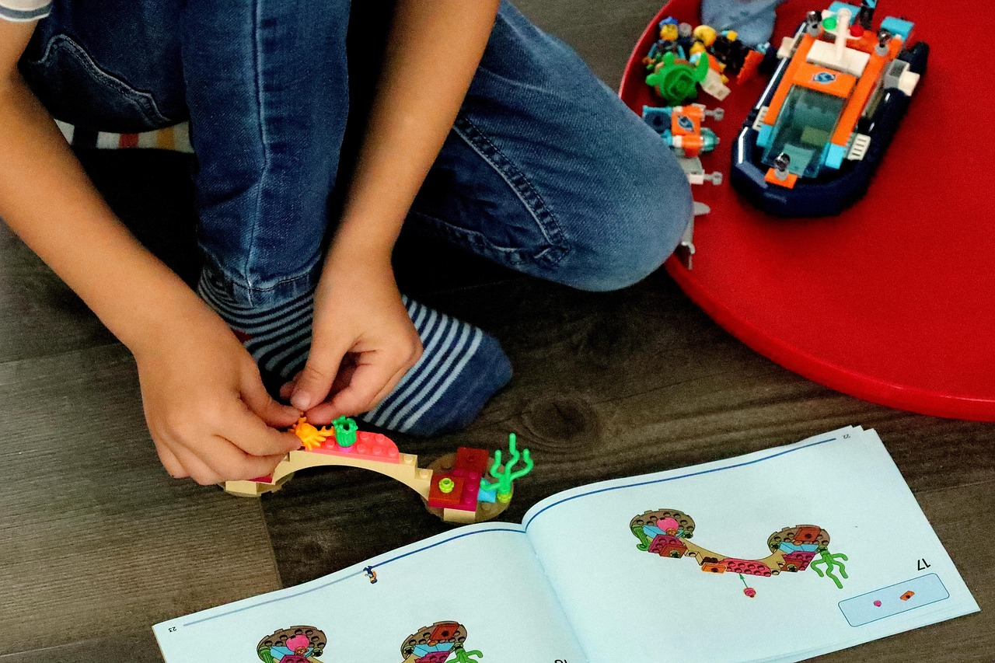
Hands-On Activity: Block Sorting
Introduction to Block Sorting
Learning Objectives
Activity Instructions
Introduce the block sorting activity and explain the instructions.
Provide examples of how to sort blocks by size, shape, and color.
Discuss the learning objectives of the activity.
Focus on developing spatial awareness and problem-solving skills.
Explain the steps to carry out the block sorting activity.
Highlight the importance of following the sorting criteria.
6
Exploring Object Sizes: Understanding, Measuring, and Applying

Slide 7

Everyday Objects: Size Comparison
Introducing Size Comparisons
Methods of Size Comparison
Introduce the concept of comparing sizes of everyday objects.
Use visual aids to illustrate the concept, such as pictures of pencils, books, and chairs.
Provide examples of how to compare sizes of everyday objects, such as measuring length or width.
Discuss the importance of understanding size relationships in real-life situations.
Visual Aids for Understanding
Real-Life Applications
Use visual aids to illustrate the concept, such as pictures of pencils, books, and chairs.
Provide examples of how to compare sizes of everyday objects, such as measuring length or width.
Discuss the importance of understanding size relationships in real-life situations.
Introduce the concept of comparing sizes of everyday objects.
7
Exploring Object Sizes: Understanding, Measuring, and Applying

Slide 8
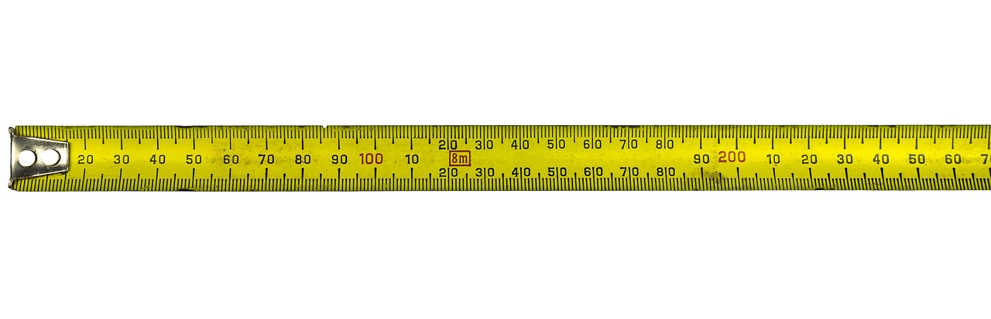
Measurement Units
1
Understanding Measurement Units
Introduce the concept of measurement units, such as centimeters or meters.
Explain how to use measurement units to compare sizes of objects.
2
Real-Life Applications of Measurement Units
Provide examples of how measurement units are used in real-life situations, such as building design or cooking.
Explain how these units help in achieving precision and consistency in various tasks.
3
Importance of Measurement Units
Highlight the significance of measurement units in everyday life.
Discuss how they facilitate communication and standardization across different fields.
8
Exploring Object Sizes: Understanding, Measuring, and Applying

Slide 9
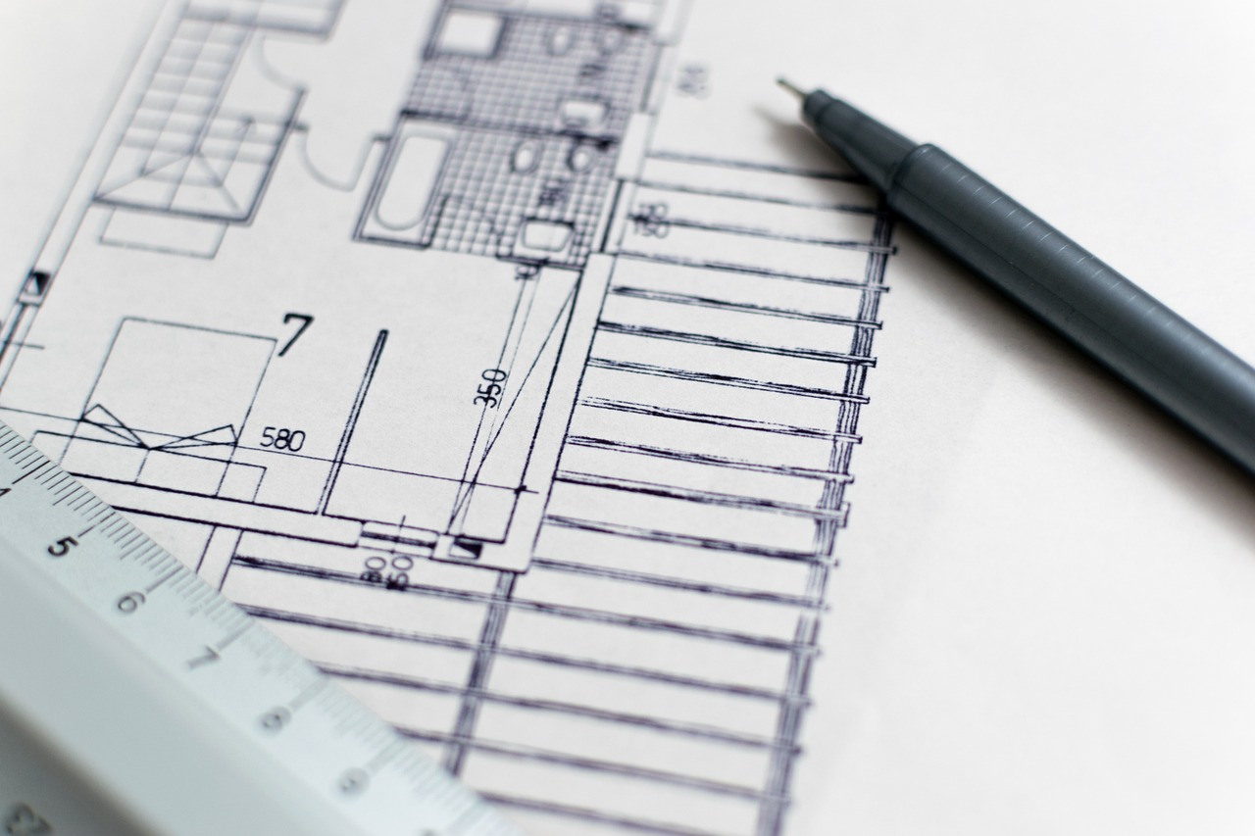
Real-World Applications
01
Applications in Architecture and Engineering
Understanding object sizes is crucial in architecture and engineering for designing structures like buildings and bridges.
Visual aids such as pictures of these structures can help illustrate the importance of precise measurements.
02
Scientific Relevance of Object Sizes
In science, object sizes play a key role in experiments and understanding natural phenomena.
Examples include measuring the dimensions of laboratory equipment or studying the scale of ecosystems.
03
Practical Uses in Everyday Life
Object sizes are essential in real-life situations like designing a room or planning furniture arrangements.
These applications highlight the importance of spatial awareness in daily activities.
04
Career Importance Across Industries
Various careers, from construction to interior design, rely heavily on understanding object sizes.
This knowledge is fundamental for success in industries that require precision and planning.
9
Exploring Object Sizes: Understanding, Measuring, and Applying

Slide 10

Problem-Solving Skills
1
Understanding Problem-Solving Skills
Introduce the concept of problem-solving skills and its importance in mathematics and science.
Explain how these skills are foundational for logical thinking and innovation.
2
Applying Problem-Solving to Real-World Scenarios
Explain how to apply problem-solving skills to real-world situations, such as building design or cooking.
Highlight the practical benefits of using these skills in everyday life.
3
Examples of Problem-Solving in Action
Provide examples of how to use problem-solving skills to solve problems involving object sizes.
Illustrate how these examples can simplify complex tasks.
10
Exploring Object Sizes: Understanding, Measuring, and Applying

Slide 11

Collaborative Learning
1
2
3
Understanding Collaborative Learning
Teamwork in Action
Benefits of Collaboration
Introduce the concept of collaborative learning and its importance in developing problem-solving skills.
Explain how to work in pairs or small groups to complete tasks, such as building a structure or solving a problem.
Provide examples of how collaborative learning can be used to explore object sizes.
Working in teams to design a bridge is one such example.
Collaborative learning fosters critical thinking and creativity.
It helps individuals develop interpersonal and communication skills.
11
Exploring Object Sizes: Understanding, Measuring, and Applying

Slide 12

Differentiated Activities
01
Understanding Differentiated Activities
Introduce the concept of differentiated activities and its importance in catering to mixed-ability groups.
Explain how these activities ensure inclusivity and address diverse learning needs.
02
Adapting for English Language Learners
Explain how to adapt activities to meet the needs of English language learners, such as using visual aids or providing additional support.
Highlight the role of tailored strategies in enhancing comprehension and participation.
03
Examples of Differentiated Activities
Provide examples of differentiated activities, such as using different types of blocks or objects, or providing additional challenges for advanced students.
Illustrate how these examples cater to varying skill levels and learning preferences.
04
Encouraging Self-Paced Learning
Discuss the importance of providing opportunities for students to work at their own pace and level.
Emphasize how this approach fosters autonomy and confidence in learners.
12
Exploring Object Sizes: Understanding, Measuring, and Applying

Slide 13

Assessment and Evaluation
Understanding Assessment and Evaluation
Formative and Summative Assessments
Using Assessment Data Effectively
Introduce the concept of assessment and evaluation and its importance in measuring student learning.
Explain how these tools help educators gauge the effectiveness of their teaching methods.
Explain how to use formative and summative assessments to evaluate student understanding, such as quizzes, class discussions, or projects.
Highlight the role of these assessments in providing ongoing feedback to both students and teachers.
Provide examples of how to use assessment data to inform instruction and adjust teaching strategies.
Discuss how data-driven decisions can enhance student learning outcomes.
13
Exploring Object Sizes: Understanding, Measuring, and Applying

Slide 14
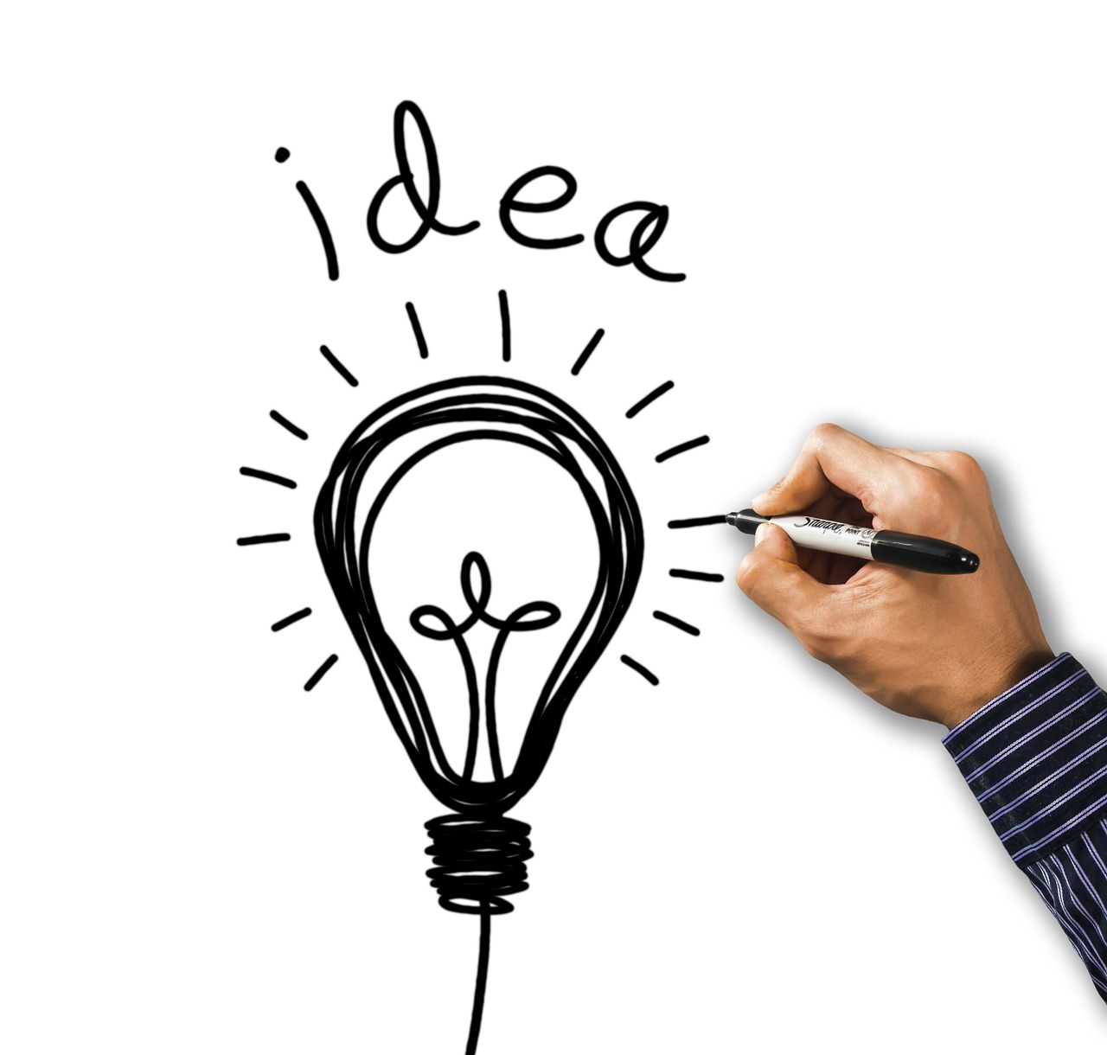
Conclusion
Key Concepts Recap
Practical Applications
Summarize the key concepts learned in the lesson, such as object sizes, measurement units, and problem-solving skills.
Emphasize the importance of understanding object sizes in mathematics, science, and real-life situations.
Understanding object sizes is crucial for solving real-world problems.
Measurement units and problem-solving skills are essential tools in various fields.
14
Exploring Object Sizes: Understanding, Measuring, and Applying

Slide 15

Extension Activities
Understanding Extension Activities
Designing and Implementing Activities
Examples of Extension Activities
Introduce the concept of extension activities and its importance in providing additional challenges and enrichment opportunities.
Explain how these activities can enhance learning experiences and foster creativity.
Explain how to design and implement extension activities, such as creating a bridge or designing a room.
Highlight the importance of aligning activities with learning objectives and student interests.
Provide examples of extension activities, such as using different types of materials or technologies.
Discuss how teamwork can be incorporated to complete a project effectively.
15
Exploring Object Sizes: Understanding, Measuring, and Applying

Slide 16

Parent Engagement
Understanding Parent Engagement
Ways to Engage Parents
Supporting Learning at Home
Introduce the concept of parent engagement and its importance in supporting student learning.
Explain how it fosters a collaborative environment for academic success.
Explain how to engage parents in their child's learning, such as through parent-teacher conferences or volunteer opportunities.
Highlight the role of communication and involvement in building strong partnerships.
Provide examples of how parents can support their child's learning at home, such as by providing additional practice or reinforcement activities.
Emphasize the impact of consistent support on a child's educational growth.
16
Exploring Object Sizes: Understanding, Measuring, and Applying

Slide 17

Reflection and Next Steps
Reflecting on Learning Progressions
Planning Future Lessons
Reflect on the learning progressions from the lesson and identify areas for further development.
Discuss next steps and future lessons, such as exploring shapes and patterns or measuring length and distance.
Discuss next steps and future lessons, such as exploring shapes and patterns or measuring length and distance.
Reflect on the learning progressions from the lesson and identify areas for further development.
17
Exploring Object Sizes: Understanding, Measuring, and Applying

Slide 18
Teaching Tips and Strategies
Importance of Teaching Tips and Strategies
Using Visual Aids Effectively
Examples of Effective Teaching Strategies
Introduce the concept of teaching tips and strategies and its importance in supporting student learning.
Explain how these strategies can enhance the overall learning experience for students.
Explain how to use visual aids, such as diagrams or charts, to support student understanding.
Discuss the role of visual aids in simplifying complex concepts for better comprehension.
Provide examples of teaching tips and strategies, such as using real-world examples or providing opportunities for student reflection.
Highlight how these strategies can make learning more engaging and relatable for students.
18
Exploring Object Sizes: Understanding, Measuring, and Applying

Slide 19
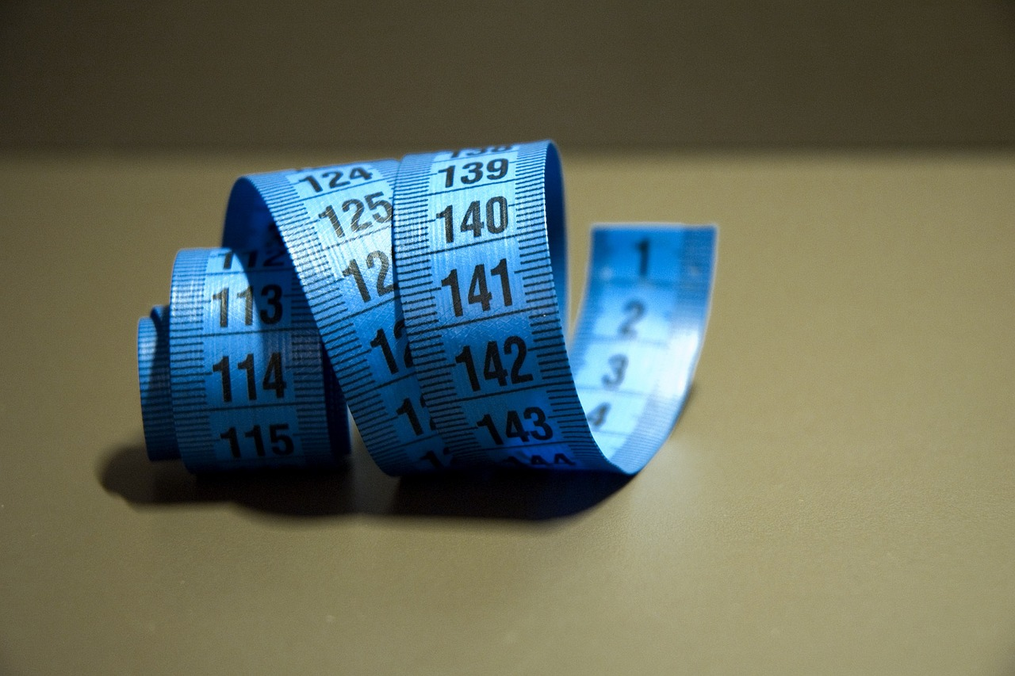
Key Takeaways
Understanding Object Sizes and Measurement Units
Applying Key Takeaways to Real-Life Situations
Developing Problem-Solving Skills
Summarize the key takeaways from the lesson, such as the importance of understanding object sizes and measurement units.
Emphasize the importance of developing problem-solving skills and spatial awareness.
Provide examples of how to apply the key takeaways to real-life situations.
Summarize the key takeaways from the lesson, such as the importance of understanding object sizes and measurement units.
Emphasize the importance of developing problem-solving skills and spatial awareness.
Provide examples of how to apply the key takeaways to real-life situations.
19
Exploring Object Sizes: Understanding, Measuring, and Applying

Slide 20
Final Thoughts
Exploring Object Sizes
Developing Problem-Solving Skills
Reflect on the importance of exploring and comparing object sizes in mathematics and science.
This practice enhances understanding of fundamental concepts and fosters curiosity in learners.
Emphasize the importance of providing opportunities for students to develop problem-solving skills and spatial awareness.
These skills are crucial for academic success and real-world applications.
20
Exploring Object Sizes: Understanding, Measuring, and Applying

