Slide 1
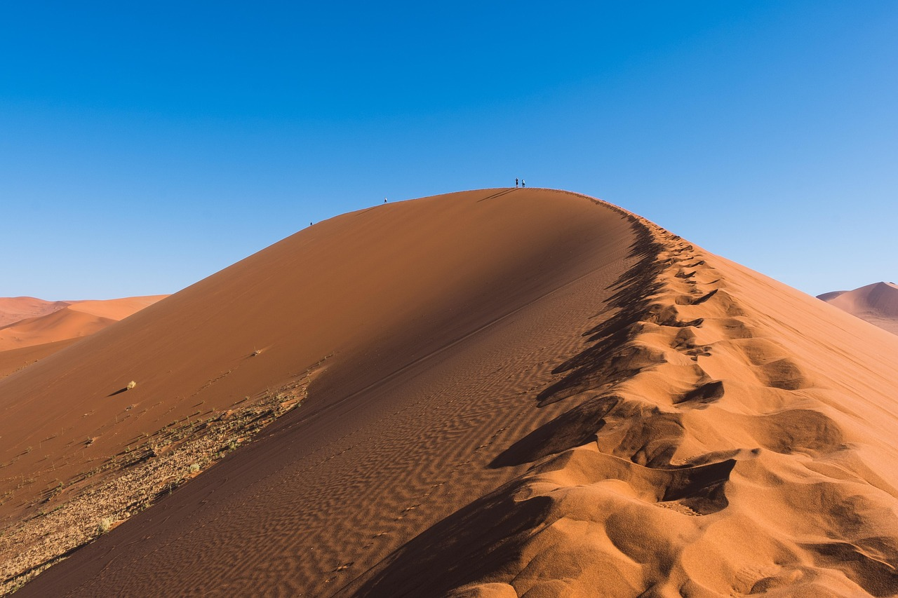
Water Conservation in Arizona: Protecting Our Precious Resource
Understanding Challenges, Strategies, and Community Efforts for Sustainable Water Use

Slide 2
Water Conservation in Arizona: Protecting Our Precious Resource
2
Table of Contents
Introduction to Water Conservation in Arizona
Why Conserve Water in Arizona?
Water Cycle and Conservation
Ways to Conserve Water
Importance of Water Conservation for the Envir…
Water Conservation in Our Community
Creating a Water Conservation Plan
Water Conservation and You
Water Conservation Tips for Kids
Water Conservation Games and Activities
Water Conservation Resources
Conclusion
Reflection Questions
04
05
06
07
08
09
10
11
12
13
14
15
16

Slide 3
Water Conservation in Arizona: Protecting Our Precious Resource
3
Table of Contents
Next Steps
Additional Resources
Final Thoughts
Assessment and Evaluation
Extension Activities
Parent Engagement
Safety Considerations
17
18
19
20
21
22
23

Slide 4
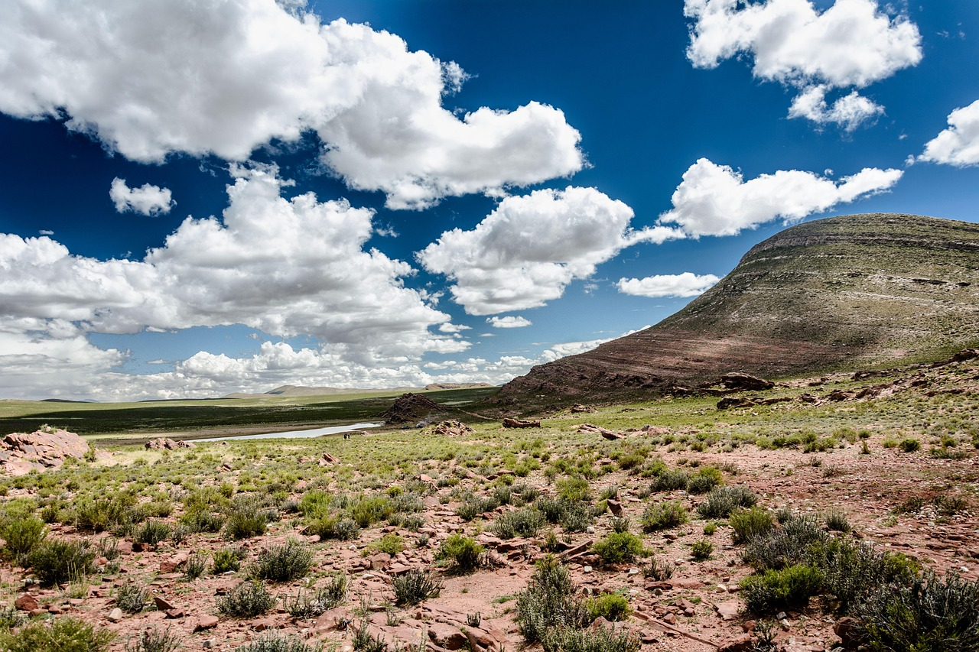
Water Conservation in Arizona: Protecting Our Precious Resource
4
Introduction to Water Conservation in Arizona
Arizona's Arid Climate
Importance of Water Conservation
Challenges in Arizona
Water conservation is crucial in Arizona due to its arid climate.
The state's water supply is limited, making conservation essential.
This lesson will explore the importance of water conservation.
It will also discuss ways to conserve water effectively.
Arizona faces unique challenges due to its limited water resources.
Conservation efforts are vital to address these challenges.

Slide 5
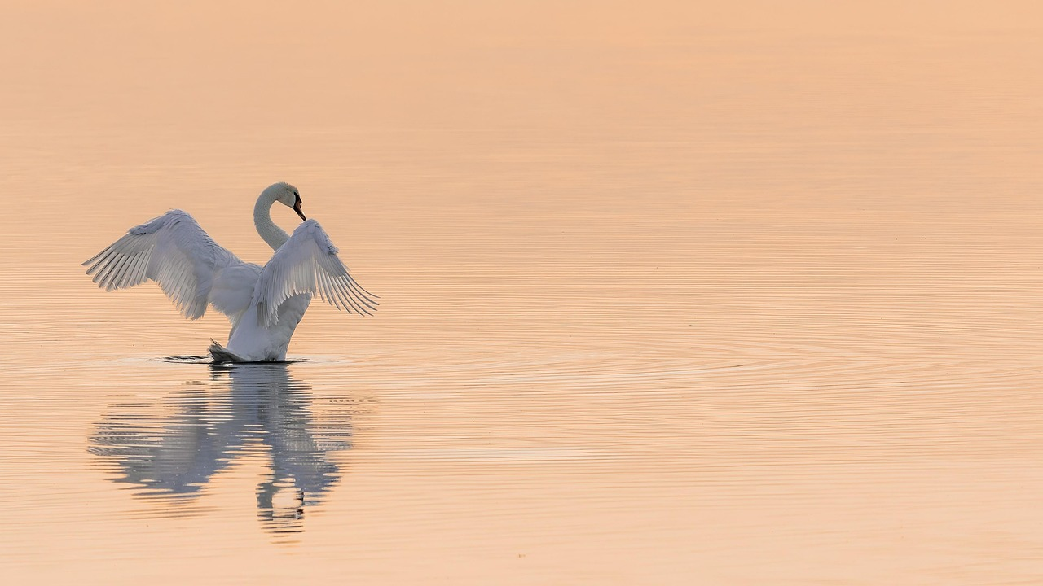
Water Conservation in Arizona: Protecting Our Precious Resource
5
Why Conserve Water in Arizona?
Arizona's Water Scarcity
Environmental Protection
Arizona is a dry state with limited water resources.
Water conservation helps ensure everyone has enough water.
Conserving water helps protect the environment and wildlife.
Small actions can make a big difference in conserving water.
Community Impact
Wildlife Preservation
Water conservation helps ensure everyone has enough water.
Small actions can make a big difference in conserving water.
Conserving water helps protect the environment and wildlife.
Arizona is a dry state with limited water resources.

Slide 6
Water Conservation in Arizona: Protecting Our Precious Resource
6
Water Cycle and Conservation
The Water Cycle Process
Importance of Water Conservation
Understanding for Effective Conservation
The water cycle is the process by which water moves from the Earth to the atmosphere and back again.
It is a continuous and essential natural phenomenon.
Conserving water helps maintain the balance of the water cycle.
It ensures the sustainability of water resources for future generations.
Understanding the water cycle is essential for effective water conservation.
Knowledge of this process aids in implementing better conservation practices.

Slide 7
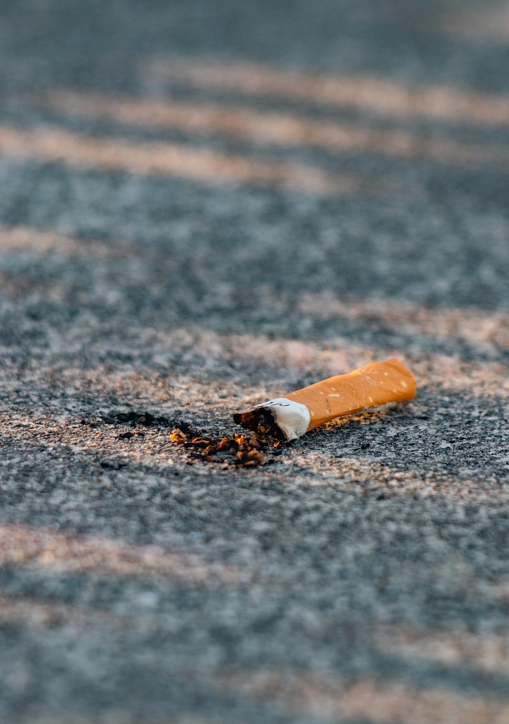
Water Conservation in Arizona: Protecting Our Precious Resource
7
Ways to Conserve Water
Turn Off the Tap
Shorter Showers
Fix Leaks and Upgrade Appliances
Drought-Resistant Gardening
Rainwater Harvesting
Turning off the tap while brushing teeth can save gallons of water daily.
This simple habit helps conserve water and reduces unnecessary wastage.
Taking shorter showers is an effective way to conserve water.
It minimizes water usage and contributes to sustainable living practices.
Fixing leaks and installing low-flow appliances can significantly reduce water consumption.
These measures ensure efficient water usage and prevent wastage.
Using drought-resistant plants in gardens helps conserve water.
These plants require less irrigation and are ideal for water-scarce regions.
Harvesting rainwater for non-potable uses is a sustainable water conservation method.
It allows for the reuse of natural resources and reduces dependency on municipal water supplies.

Slide 8
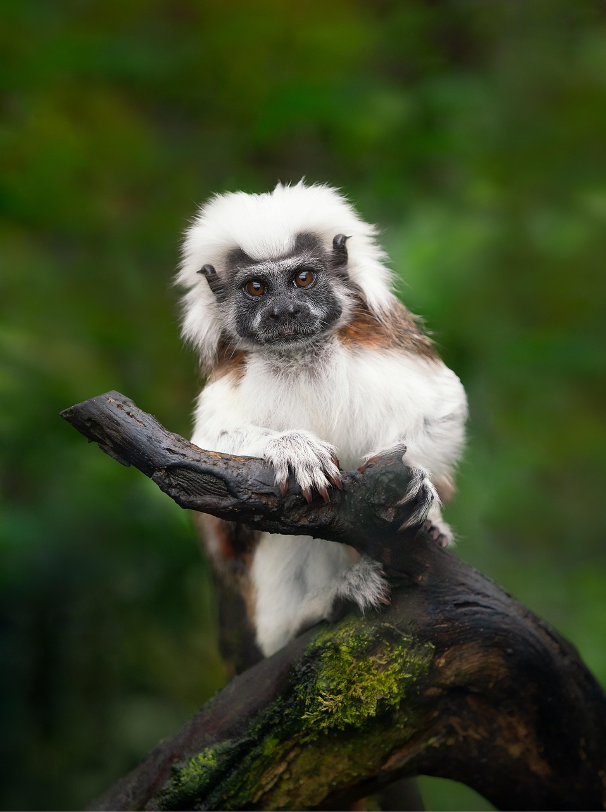
Water Conservation in Arizona: Protecting Our Precious Resource
8
Importance of Water Conservation for the Environment
Protecting Wildlife and Ecosystems
Water conservation helps protect local wildlife and ecosystems.
It ensures that animals and plants have access to the water they need to thrive.
Reducing Water Pollution Risks
Conserving water reduces the risk of water pollution.
By using water responsibly, we can prevent contaminants from entering water sources.
Maintaining Arizona's Natural Habitats
Water conservation helps maintain the health of Arizona's natural habitats.
This is crucial for preserving the unique biodiversity of the region.

Slide 9
Water Conservation in Arizona: Protecting Our Precious Resource
9
Water Conservation in Our Community
Efficient Irrigation Systems
Rainwater Harvesting Benefits
Drought-Resistant Plants
Community Education Programs
Local communities can conserve water through efficient irrigation systems.
These systems ensure optimal water usage and minimize wastage in agricultural practices.
Rainwater harvesting systems can provide non-potable water.
This method helps in utilizing natural resources effectively and reduces dependency on municipal water supplies.
Drought-resistant plants can reduce water usage in gardens.
They are ideal for sustainable landscaping and help in conserving water during dry seasons.
Community education programs can promote water conservation practices.
Such initiatives raise awareness and encourage responsible water usage among residents.

Slide 10

Water Conservation in Arizona: Protecting Our Precious Resource
10
Creating a Water Conservation Plan
Identifying Conservation Opportunities
Developing a Water-Saving Plan
Monitoring and Adjusting the Plan
Identify areas where water can be conserved.
This step involves assessing current water usage and pinpointing inefficiencies.
Develop a plan to implement water-saving measures.
This includes setting goals and outlining specific actions to reduce water consumption.
Monitor and adjust the plan to ensure effectiveness.
Regular evaluations help to refine strategies and achieve better results.

Slide 11
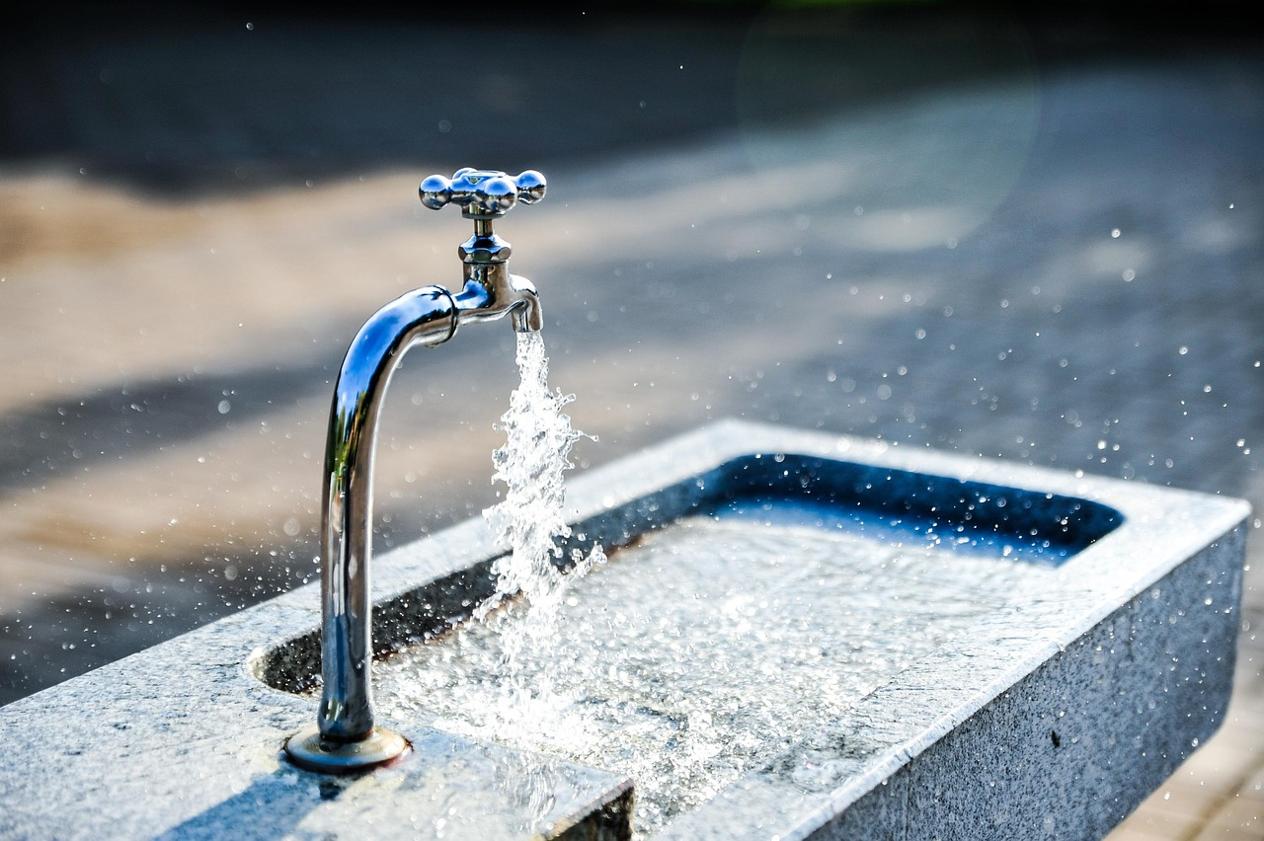
Water Conservation in Arizona: Protecting Our Precious Resource
11
Water Conservation and You
Individual Responsibility
Habit Formation
Collective Impact
Every individual can contribute to water conservation.
Small actions, such as turning off the tap, can make a big difference.
Making water conservation a habit can have a significant impact.
Small actions, such as turning off the tap, can make a big difference.
Every individual can contribute to water conservation.
Making water conservation a habit can have a significant impact.

Slide 12
Water Conservation in Arizona: Protecting Our Precious Resource
12
Water Conservation Tips for Kids
Turn Off the Tap
Take Shorter Showers
Fix Leaks and Use Low-Flow Appliances
Use a Water-Efficient Cup
Report Water Wastage
Turn off the tap while brushing teeth.
This simple action can save gallons of water every day.
Take shorter showers to conserve water.
Even a few minutes less can make a big difference.
Help fix leaks and install low-flow appliances.
These steps prevent water wastage and promote efficiency.
Use a water-efficient cup when drinking water.
This helps reduce unnecessary water usage.
Tell a grown-up if you see water being wasted.
Reporting issues can help address problems quickly.

Slide 13
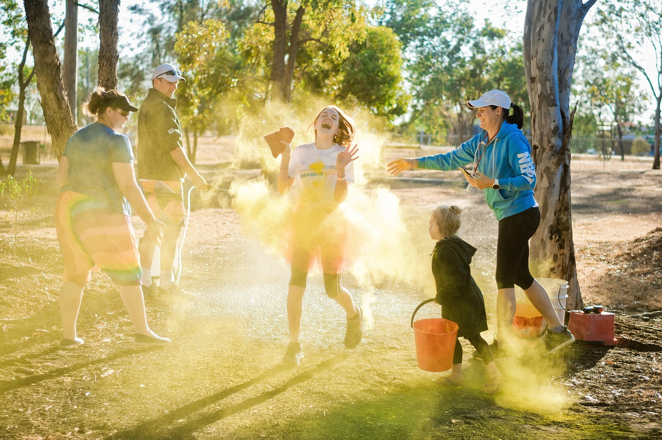
Water Conservation in Arizona: Protecting Our Precious Resource
13
Water Conservation Games and Activities
Water Conservation Matching Game
Water Cycle Sequencing Activity
Engage in a fun matching game to learn about water conservation.
Match items or concepts related to saving water to their correct pairs.
Participate in an interactive activity to sequence the stages of the water cycle.
Understand the journey of water through evaporation, condensation, and precipitation.
Conservation-Themed Crafts and Art Projects
Water Conservation Scavenger Hunt
Create art projects that highlight the importance of conserving water.
Use recycled materials to craft items that promote sustainability.
Embark on a scavenger hunt to discover water-saving tips and tools.
Explore your surroundings to find items that help conserve water.

Slide 14

Water Conservation in Arizona: Protecting Our Precious Resource
14
Water Conservation Resources
Digital Tools for Water Conservation
Educational Resources on Water Conservation
Community Initiatives for Water Conservation
Water conservation websites and apps.
These tools provide practical tips and real-time data to help users save water effectively.
Books and educational materials about water conservation.
These resources offer in-depth knowledge and strategies for sustainable water use.
Community resources and organizations promoting water conservation.
These groups foster collaboration and awareness to protect water resources locally.

Slide 15
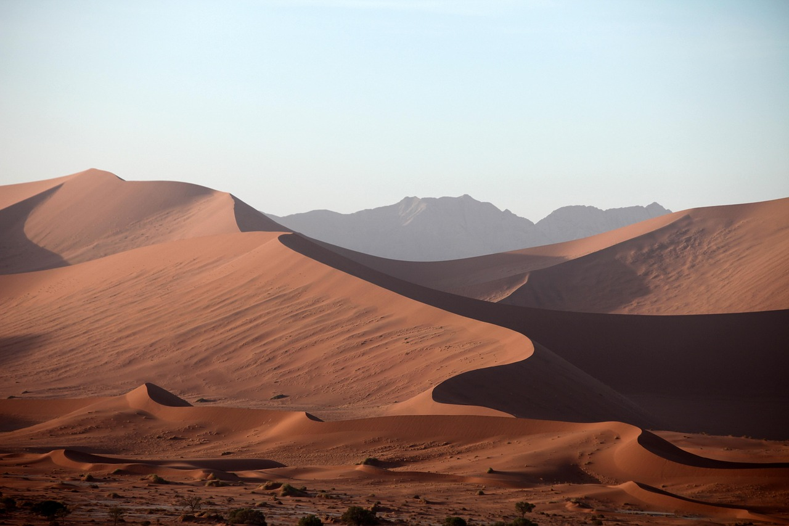
Water Conservation in Arizona: Protecting Our Precious Resource
15
Conclusion
Importance of Water Conservation
Call to Action for Individuals
Water conservation is essential in Arizona due to its limited water resources.
Every individual can contribute to water conservation and make a difference.
Water conservation is essential in Arizona due to its limited water resources.
Every individual can contribute to water conservation and make a difference.

Slide 16
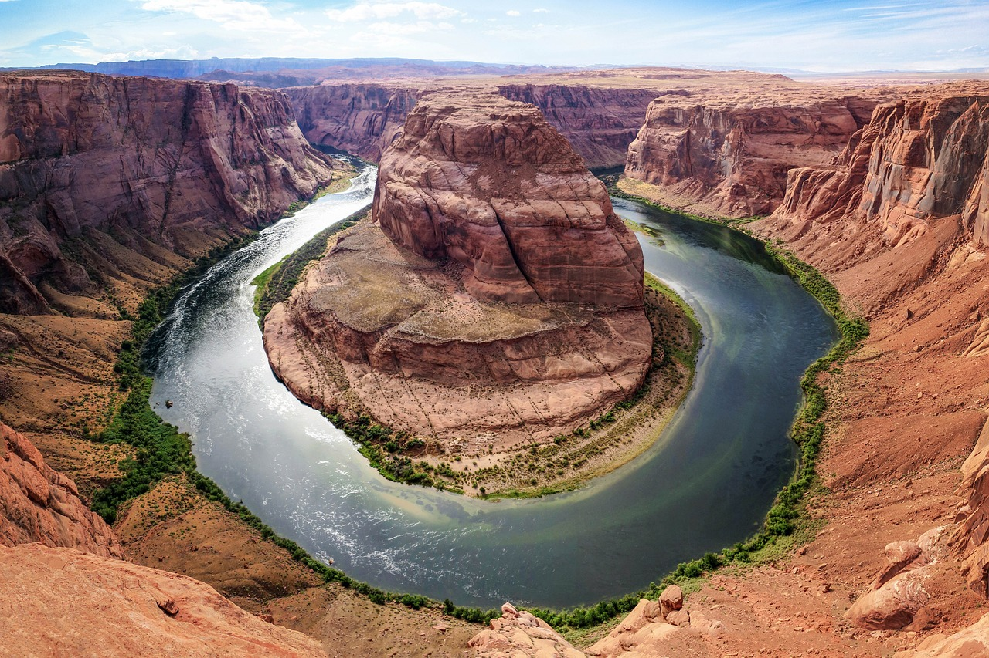
Water Conservation in Arizona: Protecting Our Precious Resource
16
Reflection Questions
Understanding Water Conservation in Arizona
Personal Contributions to Water Conservation
Community Efforts for Water Conservation
What did you learn about water conservation in Arizona?
Explore the unique challenges and strategies for preserving water in the desert environment of Arizona.
How can you contribute to water conservation in your daily life?
Identify simple actions like reducing water waste and using water-efficient appliances to make a difference.
What are some ways to promote water conservation in your community?
Consider organizing awareness campaigns and supporting local initiatives to encourage sustainable water use.

Slide 17
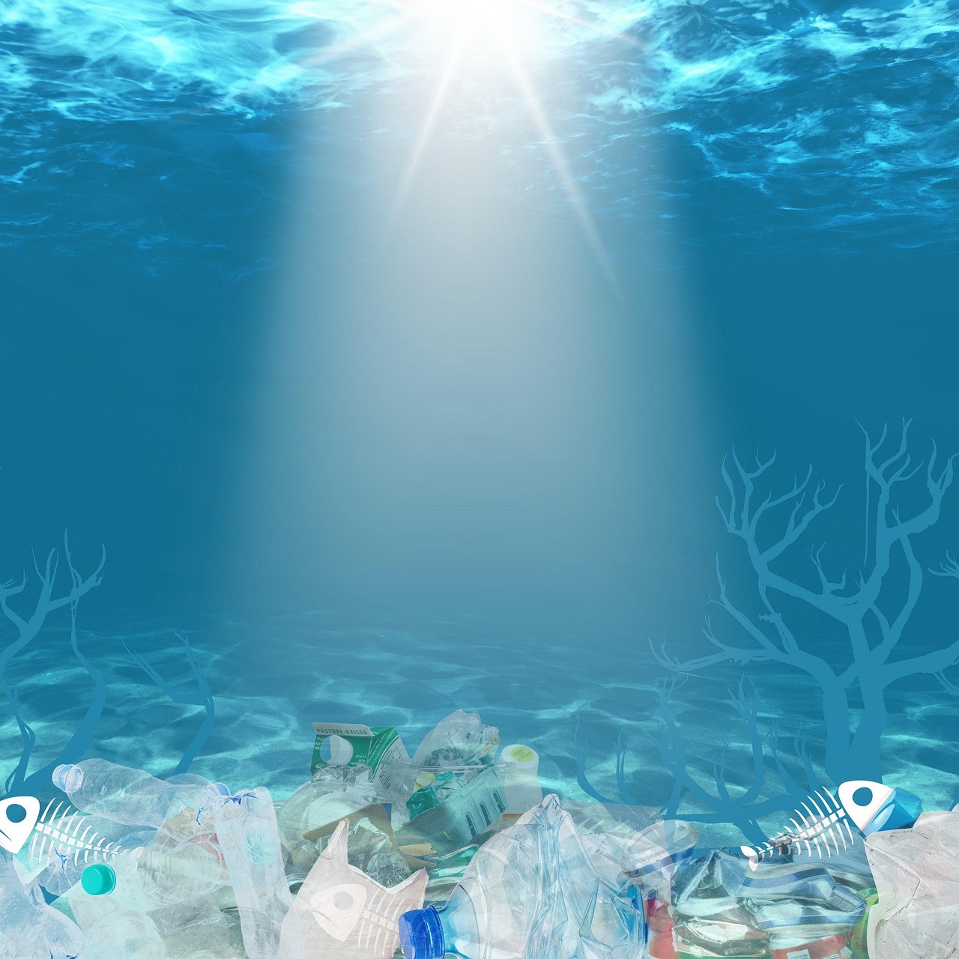
Water Conservation in Arizona: Protecting Our Precious Resource
17
Next Steps
Develop a Conservation Plan
Promote Awareness
Create a water conservation plan for your home or school.
This plan will help identify ways to reduce water usage effectively.
Share what you learned with friends and family to promote water conservation.
Encourage others to adopt water-saving practices in their daily lives.

Slide 18
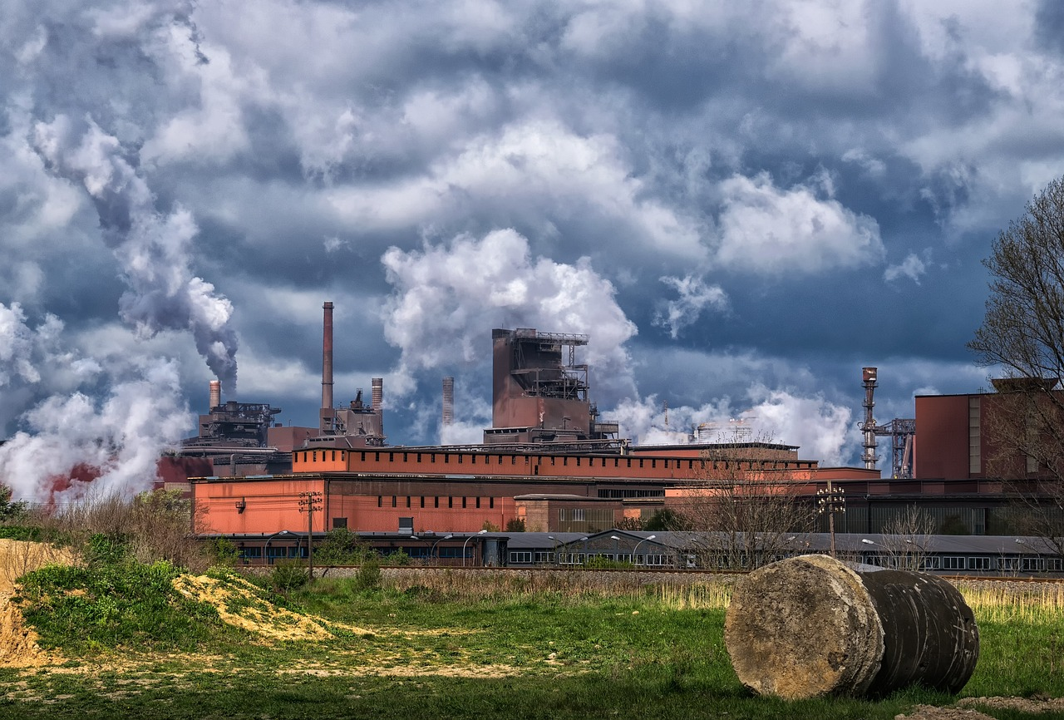
Water Conservation in Arizona: Protecting Our Precious Resource
18
Additional Resources
Arizona Department of Water Resources
Library Resources on Water Conservation
Visit the Arizona Department of Water Resources website for more information on water conservation.
Explore their resources to learn about sustainable water management practices.
Check out books from your local library about water conservation and the environment.
Discover a variety of materials to deepen your understanding of environmental stewardship.

Slide 19
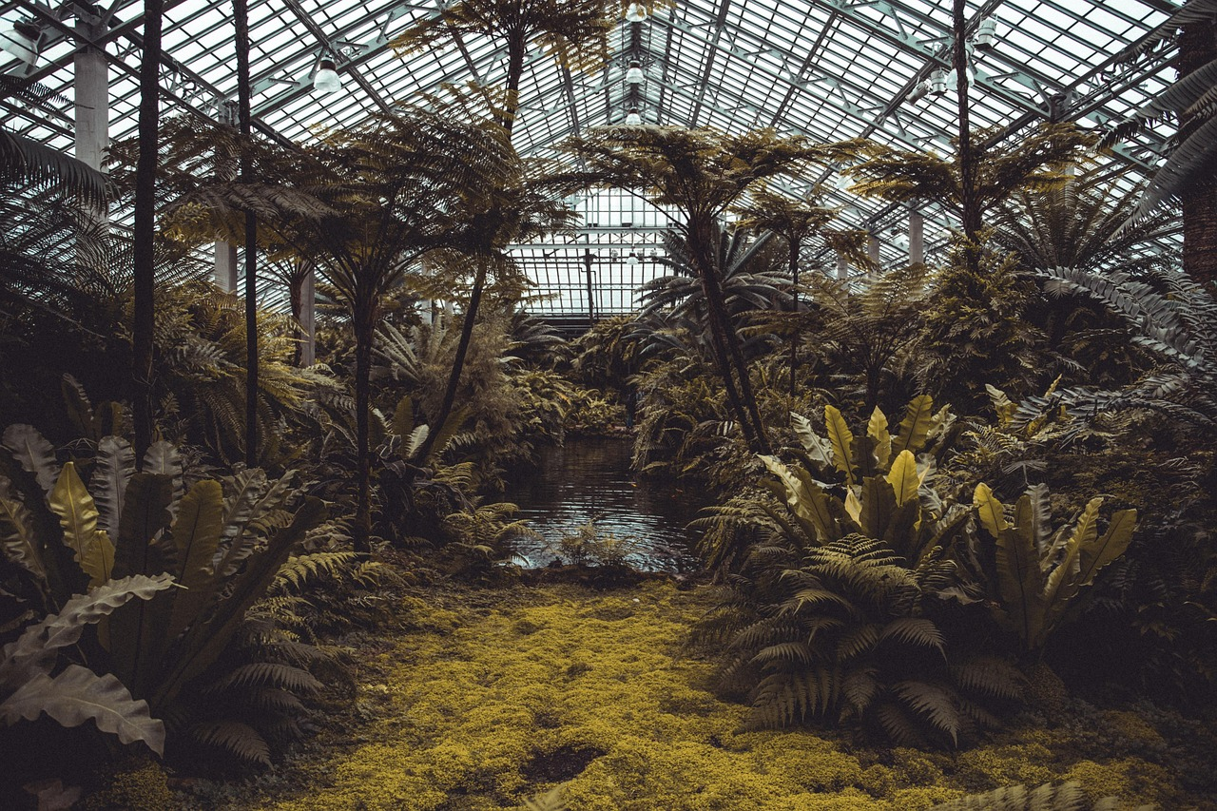
Water Conservation in Arizona: Protecting Our Precious Resource
19
Final Thoughts
Final Thoughts
Remember, every small action can make a big difference in conserving water.
Protecting the environment starts with individual efforts.

Slide 20

Water Conservation in Arizona: Protecting Our Precious Resource
20
Assessment and Evaluation
Interactive Quiz
Quiz: What did you learn about water conservation in Arizona?
This activity helps assess understanding of key water conservation concepts.
Engaging Class Discussion
Class discussion: How can you contribute to water conservation in your daily life?
Students share ideas and strategies for personal water-saving actions.
Creative Project Planning
Project: Create a water conservation plan for your home or school.
This task encourages practical application of water conservation knowledge.

Slide 21
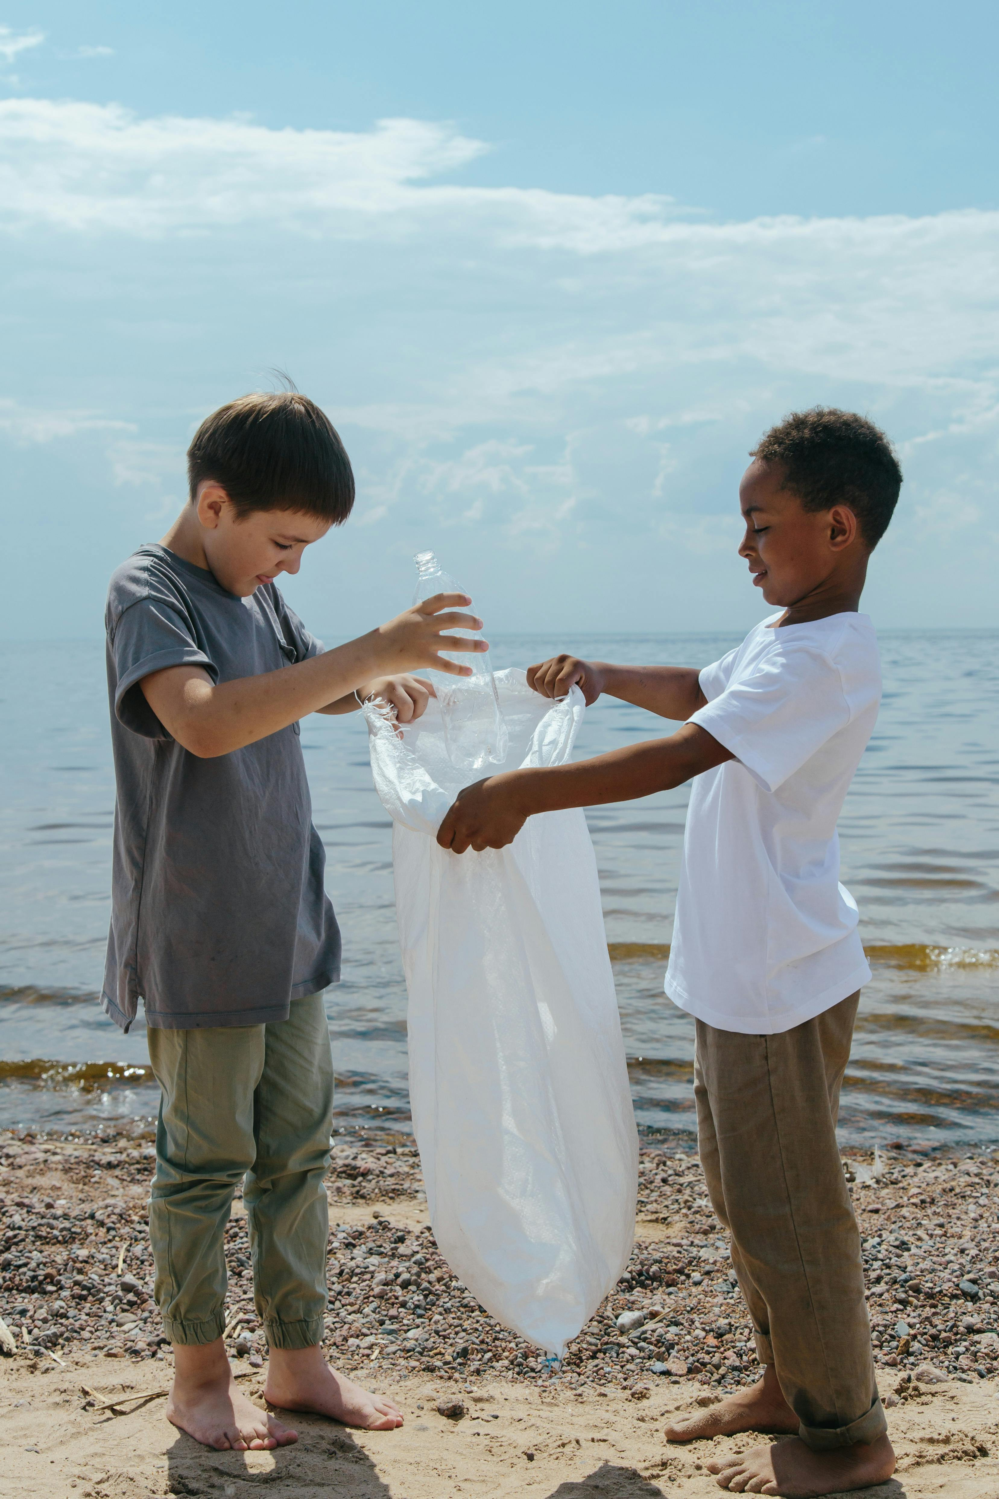
Water Conservation in Arizona: Protecting Our Precious Resource
21
Extension Activities
Creative Water Conservation Awareness
Practical Water Usage Evaluation
Educational Water Conservation Research
Create a water conservation poster or brochure.
This activity encourages artistic expression while promoting environmental awareness.
Conduct a water audit at home or school.
This helps identify areas of excessive water use and opportunities for conservation.
Research and present on a water conservation topic.
This fosters knowledge sharing and deeper understanding of water-saving practices.

Slide 22

Water Conservation in Arizona: Protecting Our Precious Resource
22
Parent Engagement
Share Learning with Parents
Engage Parents in Activities
Share what you learned with your parents and ask them to help you conserve water at home.
Encourage open discussions about water conservation to create awareness within your family.
Invite your parents to participate in water conservation activities and events.
Collaborate with them to make a positive impact on your community's water-saving efforts.

Slide 23

Water Conservation in Arizona: Protecting Our Precious Resource
23
Safety Considerations
Water Conservation Tip
Always turn off the tap while brushing teeth to avoid wasting water.
This simple habit can save a significant amount of water daily.
Preventing Accidents
Be careful when handling water to avoid slipping and falling.
Slippery surfaces can lead to serious injuries if not addressed.

