Slide 1


Exploring Literary Analysis through 'A Quilt of a Country'
Developing Critical Thinking and Interpretation Skills by Analyzing Themes, Metaphors, and Author's Claims

Slide 2
Exploring Literary Analysis through 'A Quilt of a Country'
2
Table of Contents
Introduction to Literary Analysis
Understanding "A Quilt of a Country"
Literary Devices: Metaphors
Author's Claims and Evidence
Annotating the Text
Guided Practice: Annotating the Text
Independent Practice: Analyzing Author's Claims
Conclusion and Reflection
Assessment and Evaluation
Extension Activities
Parent Engagement
Safety Considerations
Teaching Tips and Strategies
04
05
06
07
08
09
10
11
12
13
14
15
16

Slide 3
Exploring Literary Analysis through 'A Quilt of a Country'
3
Table of Contents
Key Takeaways
Reflection Questions
Next Steps
Conclusion
17
18
19
20

Slide 4
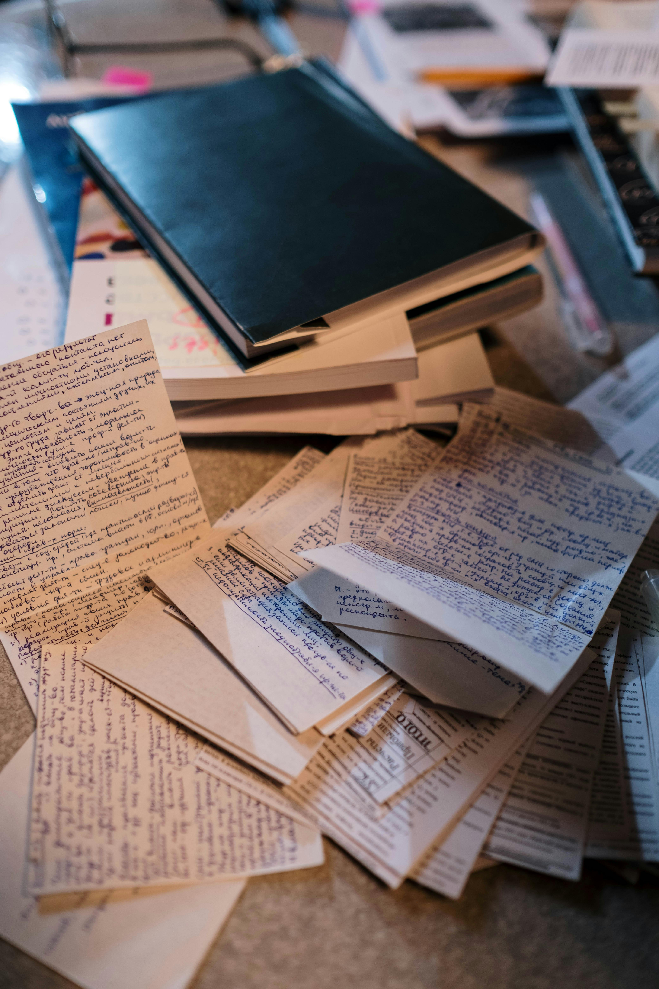
Exploring Literary Analysis through 'A Quilt of a Country'
4
Introduction to Literary Analysis
The Importance of Literary Analysis
Focus of the Lesson
Understanding Literary Devices
Literary analysis is a crucial skill for understanding complex texts and developing critical thinking.
It involves closely reading a text to identify literary devices, analyze author's claims, and understand the overall meaning.
In this lesson, we will explore the article 'A Quilt of a Country' by Anna Quindlen.
This exploration aims to develop our literary analysis skills.
Analyzing literary devices helps uncover deeper meanings within a text.
It is essential for interpreting the author's intentions and the text's impact.

Slide 5

Exploring Literary Analysis through 'A Quilt of a Country'
5
Understanding "A Quilt of a Country"
Themes Explored in 'A Quilt of a Country'
Metaphor of a Quilt
Literary Analysis and Exploration
'A Quilt of a Country' is an article that explores the themes of identity, culture, and the American experience.
The author delves into how these themes shape the narrative and understanding of American society.
Anna Quindlen uses the metaphor of a quilt to describe the diversity and complexity of American culture.
This metaphor serves as a powerful tool to illustrate the interconnectedness and individuality within the nation.
The article offers a compelling narrative that makes it an ideal text for literary analysis.
It provides a rich foundation for exploring themes of identity and culture in depth.

Slide 6

Exploring Literary Analysis through 'A Quilt of a Country'
6
Literary Devices: Metaphors
Understanding Metaphors
A metaphor is a figure of speech that compares two unlike things without using 'like' or 'as.'
Metaphors help authors create vivid and evocative language, making their writing more engaging and meaningful.
The Quilt Metaphor in Literature
In 'A Quilt of a Country,' the quilt metaphor is used to convey the idea that America is a diverse and complex entity.
This metaphor illustrates how different elements can come together to form a unified whole.
The Power of Metaphors
Metaphors enable writers to express abstract ideas in a relatable and imaginative way.
They enrich the reader's experience by adding depth and layers of meaning to the text.

Slide 7
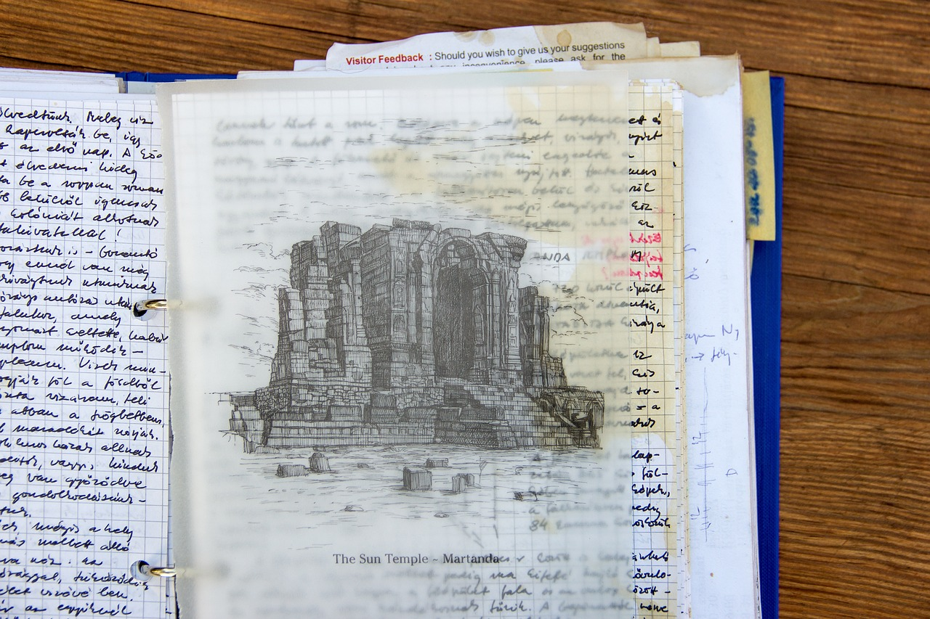
Exploring Literary Analysis through 'A Quilt of a Country'
7
Author's Claims and Evidence
Understanding an Author's Claim
The Central Claim in 'A Quilt of a Country'
Evidence Supporting the Claim
An author's claim is a statement or assertion that requires evidence and reasoning to support.
It serves as the foundation for the arguments presented in a text.
In 'A Quilt of a Country,' the author claims that America is a quilt of different cultures, experiences, and identities.
This metaphor highlights the diversity and complexity of the nation's fabric.
The author supports this claim with evidence from the text, including personal anecdotes and historical references.
These examples provide depth and credibility to the argument.

Slide 8

Exploring Literary Analysis through 'A Quilt of a Country'
8
Annotating the Text
Understanding Annotation
Purpose of Annotation
Benefits of Annotating
Annotating the text involves marking up the text with notes, questions, and observations.
Annotating helps readers engage more deeply with the text, identify key passages, and record their thoughts and insights.
In this lesson, we will practice annotating 'A Quilt of a Country' to develop our close reading skills.
This practice will enhance our ability to analyze and interpret the text effectively.
Annotation fosters a deeper connection with the material being read.
It allows readers to document their thoughts and insights for future reference.

Slide 9

Exploring Literary Analysis through 'A Quilt of a Country'
9
Guided Practice: Annotating the Text
Pair Work on Text Annotation
Class Discussion of Annotations
Objective of Guided Practice
We will work in pairs to annotate a section of 'A Quilt of a Country.'
This activity will focus on identifying key passages, literary devices, and the author's claims.
After completing the annotations, we will discuss our insights as a class.
This discussion aims to deepen our understanding of the text.
The goal is to collaboratively analyze and interpret the text.
This process enhances critical thinking and comprehension skills.

Slide 10

Exploring Literary Analysis through 'A Quilt of a Country'
10
Independent Practice: Analyzing Author's Claims
Analyzing Claims in 'A Quilt of a Country'
We will work individually to analyze a section of 'A Quilt of a Country' where the author makes a claim about identity or culture.
This activity focuses on understanding the author's perspective and the cultural implications of their argument.
Identifying Evidence and Literary Devices
We will identify the claim, the evidence provided, and the literary devices used to support the claim.
This step is crucial for breaking down the text and understanding the tools the author uses to persuade the audience.
Writing a Short Analysis
We will write a short analysis of the author's claim and how it contributes to the overall meaning of the text.
This analysis will help us connect the claim to the broader themes and messages of the work.

Slide 11

Exploring Literary Analysis through 'A Quilt of a Country'
11
Conclusion and Reflection
Developing Literary Analysis Skills
Learning Key Analytical Techniques
Applying Skills to Future Texts
We have developed our literary analysis skills by exploring 'A Quilt of a Country.'
This has enhanced our ability to engage deeply with texts.
We have learned to identify and interpret metaphors, analyze author's claims, and annotate the text.
These techniques are essential for understanding and critiquing literary works.
We will apply these skills to future texts and continue to develop our critical thinking and close reading abilities.
This ongoing practice will strengthen our analytical proficiency.

Slide 12
Exploring Literary Analysis through 'A Quilt of a Country'
12
Assessment and Evaluation
Class Participation
Written Analyses
Reflective Learning
We will be assessed on our participation in class discussions and activities.
Active engagement in these areas will contribute to our overall assessment.
We will be evaluated on our written analyses and annotations.
These evaluations will focus on the depth and clarity of our written work.
We will reflect on our learning and set goals for future improvement.
This process will help us identify areas for growth and track our progress.

Slide 13

Exploring Literary Analysis through 'A Quilt of a Country'
13
Extension Activities
Visual Project Exploration
Creative Writing on Identity
Research on American Culture
We can create a visual project that represents our understanding of the quilt metaphor.
This activity allows us to visually interpret and express the themes of identity and culture.
We can write a creative piece that explores our own experiences with identity and culture.
This encourages personal reflection and artistic expression tied to the themes discussed.
We can research and present on a specific aspect of American culture or identity discussed in the article.
This activity promotes deeper understanding and engagement with cultural topics.

Slide 14

Exploring Literary Analysis through 'A Quilt of a Country'
14
Parent Engagement
Discussing Articles
Applying Literary Analysis
Participating in Workshops
Parents can support our learning by discussing the article with us.
They can ask open-ended questions to deepen our understanding.
Parents can encourage us to apply our literary analysis skills to real-world texts and issues.
This helps us connect classroom learning to everyday life.
Parents can attend a workshop or meeting to learn more about our literary analysis skills.
These sessions provide guidance on how to support our learning at home.

Slide 15

Exploring Literary Analysis through 'A Quilt of a Country'
15
Safety Considerations
Establishing a Safe Environment
We will establish a safe and respectful classroom environment for discussion and analysis.
This ensures everyone feels comfortable sharing their thoughts.
Respecting Diverse Perspectives
We will respect each other's opinions and perspectives, even if we disagree.
This fosters mutual understanding and open dialogue.
Adhering to Classroom Norms
We will follow classroom norms and rules for discussion and participation.
This helps maintain order and fairness in interactions.

Slide 16

Exploring Literary Analysis through 'A Quilt of a Country'
16
Teaching Tips and Strategies
Modeling Literary Skills
Scaffolded Support
Enhancing Engagement with Technology
Teachers can model close reading and literary analysis skills for students.
This helps students develop critical thinking and interpretative abilities.
Teachers can provide scaffolded support and feedback to students.
This ensures that students gradually build their skills with guided assistance.
Teachers can incorporate technology and multimedia resources to enhance engagement and understanding.
This approach makes learning more interactive and relatable for students.

Slide 17

Exploring Literary Analysis through 'A Quilt of a Country'
17
Key Takeaways
Developing Literary Analysis Skills
Mastering Analytical Techniques
Applying Skills to Future Texts
We have developed our literary analysis skills by exploring 'A Quilt of a Country.'
This has enhanced our ability to engage with complex texts.
We have learned to identify and interpret metaphors, analyze author's claims, and annotate the text.
These techniques are essential for understanding and evaluating literary works.
We will apply these skills to future texts and continue to develop our critical thinking and close reading abilities.
This ensures ongoing growth in our literary and analytical capabilities.

Slide 18
Exploring Literary Analysis through 'A Quilt of a Country'
18
Reflection Questions
Effective Engagement Strategies
Understanding Literary Devices
Personal Connections to the Text
What strategies were most effective in engaging us with the text?
This question prompts reflection on the methods that captured our interest and facilitated deeper interaction with the material.
How well did we demonstrate an understanding of literary devices and author's claims?
This inquiry encourages evaluation of our ability to analyze and interpret the author's techniques and arguments.
What opportunities were provided for us to make personal connections to the text?
This question highlights the importance of relating the text to our own experiences and perspectives.

Slide 19

Exploring Literary Analysis through 'A Quilt of a Country'
19
Next Steps
Developing Literary Analysis Skills
We will continue to develop our literary analysis skills by exploring other texts.
This will help us deepen our understanding and interpretation of various literary works.
Applying Skills to Real-World Contexts
We will apply our skills to real-world issues and contexts.
This will allow us to see the practical relevance of our learning.
Reflecting and Setting Goals
We will reflect on our learning and set goals for future improvement.
This process will guide us in achieving continuous personal and academic growth.

Slide 20
Exploring Literary Analysis through 'A Quilt of a Country'
20
Conclusion
Literary Analysis Accomplished
Skill Development
Future Applications
We have completed our literary analysis of 'A Quilt of a Country.'
This marks a significant milestone in understanding the text's themes and ideas.
We have developed our critical thinking and close reading skills.
These skills are essential for interpreting and analyzing complex texts.
We will continue to apply these skills to future texts and contexts.
This ensures ongoing growth in our literary and analytical abilities.

