Slide 1

Understanding the Fundamentals of Football
A Comprehensive Guide to Rules, Regulations, and Gameplay

Slide 2


Table of contents
Introduction to Football Rules and Regulations
Objective of the Game
Basic Rules and Regulations
Player Positions
Common Penalties
Free Kicks and Penalty Kicks
Game Duration and Stoppage Time
Referee and Assistant Referees
Yellow and Red Cards
Safety and Fair Play
Conclusion
Quiz Time!
Interactive Activity
01
02
03
04
05
06
07
08
09
10
11
12
13

Slide 3
Table of contents
Additional Resources
Next Steps
Reflection and Feedback
Conclusion and Final Thoughts
14
15
16
17

Slide 4
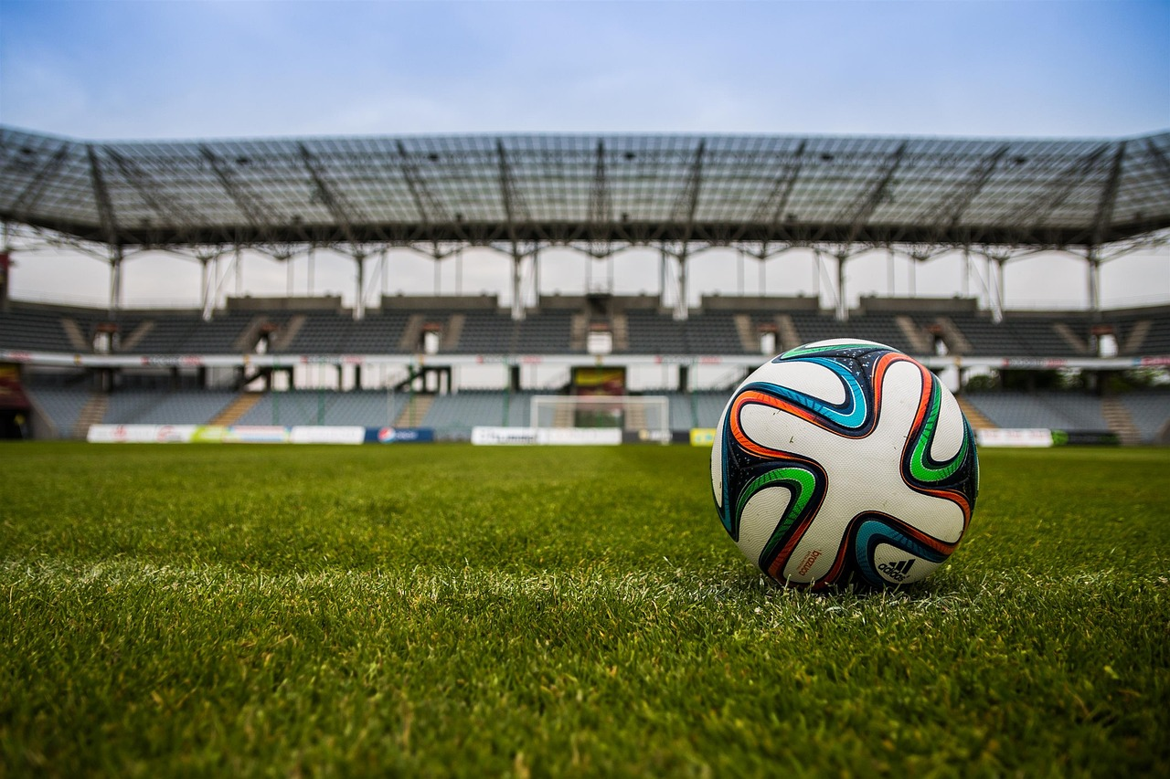
Introduction to Football Rules and Regulations
Global Popularity
Essential Rules
Game Objectives
Football is a popular sport played and enjoyed by millions of people around the world.
It transcends cultures and unites fans across different nations.
Understanding the rules and regulations is essential for beginners to enjoy the game and play safely.
Familiarity with the rules enhances the overall experience for players and spectators alike.
This presentation will cover the basic rules and regulations of football, including the objective of the game.
The main goal is to score more goals than the opposing team within the allotted time.
1
Understanding the Fundamentals of Football

Slide 5

Objective of the Game
Score Goals
Win the Game
Outscore the opposing team by kicking or heading the ball into the goal.
The team with the most goals at the end of the game wins.
Effective teamwork and strategy are essential for winning.
2
Understanding the Fundamentals of Football

Slide 6

Basic Rules and Regulations
Team Composition
Match Duration
Each game features two teams, with 11 players on each side.
A match consists of two 45-minute halves.
Ball Control Rules
Goalkeeper Privileges
Players may use any body part to control the ball, except their hands and arms.
Only goalkeepers may use their hands and arms to play the ball.
3
Understanding the Fundamentals of Football

Slide 7

Player Positions
Goalkeeper
Defenders
Midfielders
Prevents the ball from entering the goal.
Coordinates the defense during play.
Shield the goal from attackers.
Intercept passes and block shots.
Bridge the gap between defense and attack.
Dictate the pace and flow of the game.
Forwards
Team Strategy
Focus on scoring goals for the team.
Utilize positioning to create scoring chances.
Employ a specific formation tailored to the team.
Adjust tactics based on the opponent's strengths.
4
Understanding the Fundamentals of Football

Slide 8
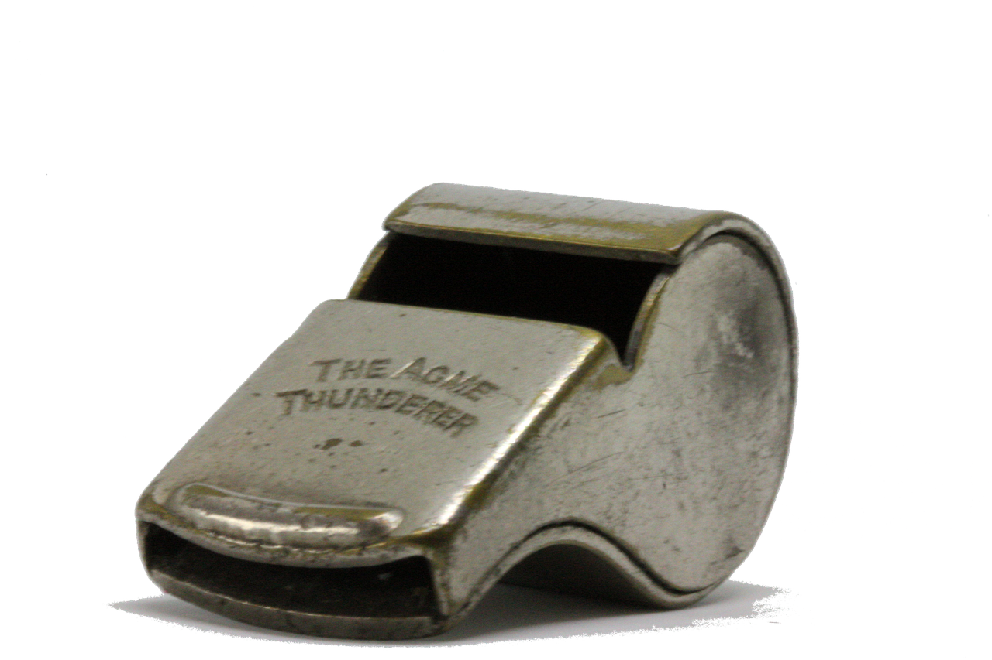
Common Penalties
Foul
Offside
Handball
A rule violation that results in a free kick or penalty kick for the opposing team.
Fouls can be committed by tripping, pushing, or holding an opponent.
A player is closer to the opponent's goal line than both the ball and the second-to-last opponent.
Being offside results in a free kick for the opposing team.
A player deliberately handles the ball with their hand or arm.
This results in a free kick or penalty kick depending on the location of the infraction.
5
Understanding the Fundamentals of Football

Slide 9
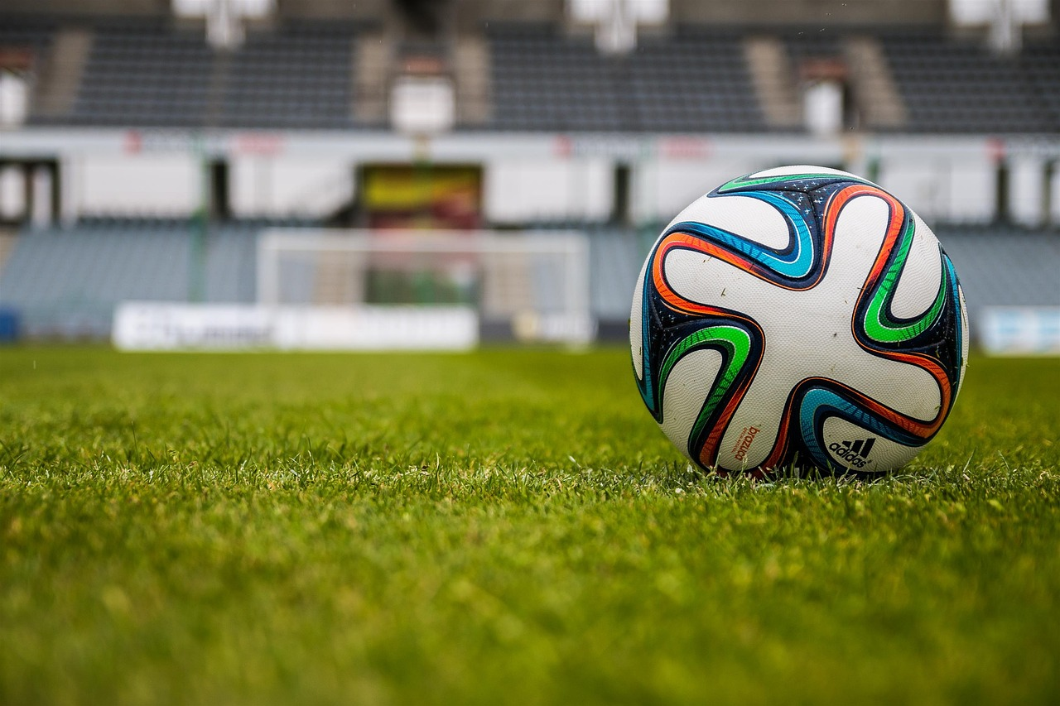
Free Kicks and Penalty Kicks
Free Kick
Penalty Kick
A free kick is taken from the location of the foul, allowing the opposing team to attempt a goal.
It can be direct, permitting a shot on goal, or indirect, requiring a teammate to touch the ball first.
A penalty kick is awarded for fouls committed inside the penalty area, providing a clear scoring chance.
The kick is taken from the penalty spot, with only the goalkeeper allowed to defend against it.
6
Understanding the Fundamentals of Football

Slide 10
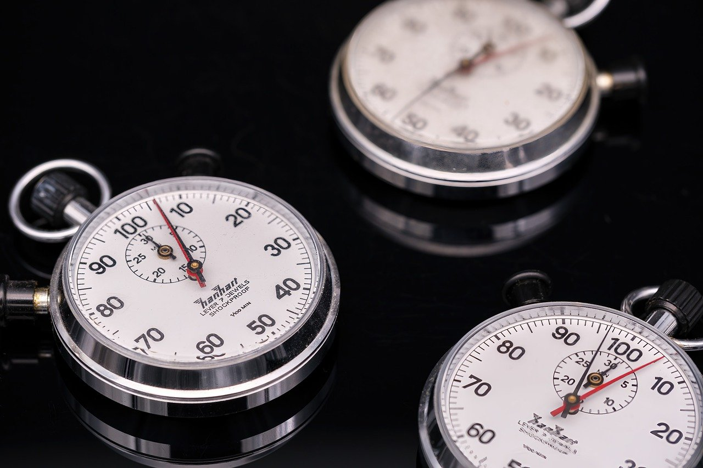
Game Duration and Stoppage Time
Game Structure
Time Management
The match consists of two halves, each lasting 45 minutes.
These halves are played continuously without interruptions.
At the conclusion of each half, stoppage time is added.
This additional time compensates for delays caused by injuries and substitutions.
7
Understanding the Fundamentals of Football

Slide 11

Referee and Assistant Referees
Rule Enforcement
Decision Support
Final Authority
The referee is responsible for enforcing the rules and regulations of the game.
They ensure fair play and maintain the integrity of the match.
Assistant referees help the referee make decisions, particularly on offside and foul play.
They provide crucial support to ensure accurate calls during the game.
The referee's decisions are final and binding.
Players and coaches must respect the referee's authority on the field.
8
Understanding the Fundamentals of Football

Slide 12
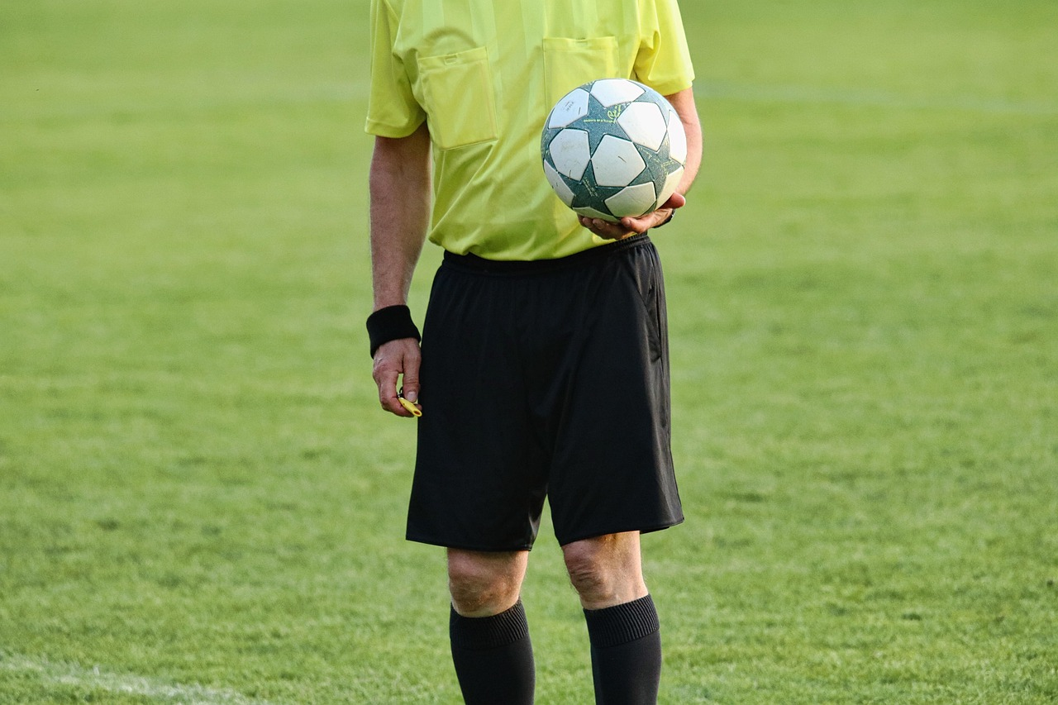
Yellow and Red Cards
Yellow Card
Red Card
A yellow card cautions a player for minor infractions and does not lead to ejection.
A red card penalizes a player for serious infractions, resulting in immediate ejection from the game.
9
Understanding the Fundamentals of Football

Slide 13

Safety and Fair Play
Respect Rules
Honor Opponents
Prioritize Safety
Players must adhere to the established rules and regulations of the game to ensure fair play.
Understanding the rules helps maintain the integrity of the sport.
Players should show respect towards their opponents, teammates, and referees at all times.
Good sportsmanship fosters a positive environment for everyone involved.
Safety is paramount; players must take necessary precautions to avoid injuries during play.
Wearing appropriate gear and following safety protocols is essential for all participants.
10
Understanding the Fundamentals of Football

Slide 14
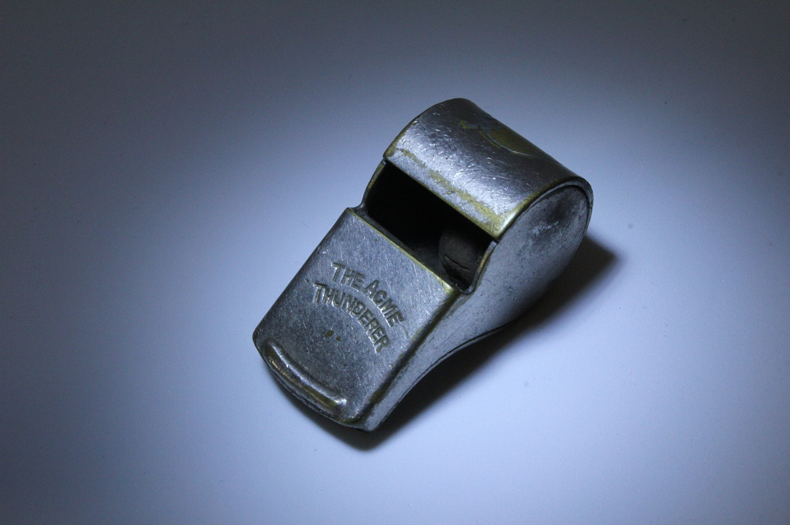
Conclusion
Game Rules
Respect and Safety
Understanding the rules and regulations of football is essential for beginners to enjoy the game and play safely.
Remember to always respect the rules, opponents, and referees, and prioritize safety and fair play.
11
Understanding the Fundamentals of Football

Slide 15

Quiz Time!
Game Objective
Goalkeeper Role
Understanding Offside
The objective of football is to score more goals than the opposing team.
Players must work together to move the ball into the opponent's goal.
The goalkeeper's primary role is to prevent the opposing team from scoring.
They can use their hands within the penalty area to block shots.
A player is in an offside position if they are closer to the opponent's goal line than both the ball and the second-last opponent when the ball is played to them.
Being offside results in a free kick for the opposing team.
Defining a Foul
Kick Differences
A foul occurs when a player commits an unfair act, such as tripping or pushing an opponent.
Fouls can result in free kicks or penalty kicks, depending on the severity and location.
A free kick is awarded after a foul and can be taken from the spot of the foul.
A penalty kick is awarded for a foul committed inside the penalty area and is taken from 12 yards away.
12
Understanding the Fundamentals of Football

Slide 16

Interactive Activity
Team Simulation
Scenario Analysis
Divide into teams and play a simulated game, applying the rules and regulations learned.
Discuss and analyze different game scenarios, making decisions based on the rules and regulations.
13
Understanding the Fundamentals of Football

Slide 17

Additional Resources
Rules Handbook
Video Tutorials
Training Sessions
A comprehensive guide to football rules that ensures fair play and understanding of the game.
A collection of online tutorials and videos for visual learners to grasp techniques and strategies.
Participate in coaching sessions to enhance your skills through practical experience.
14
Understanding the Fundamentals of Football

Slide 18
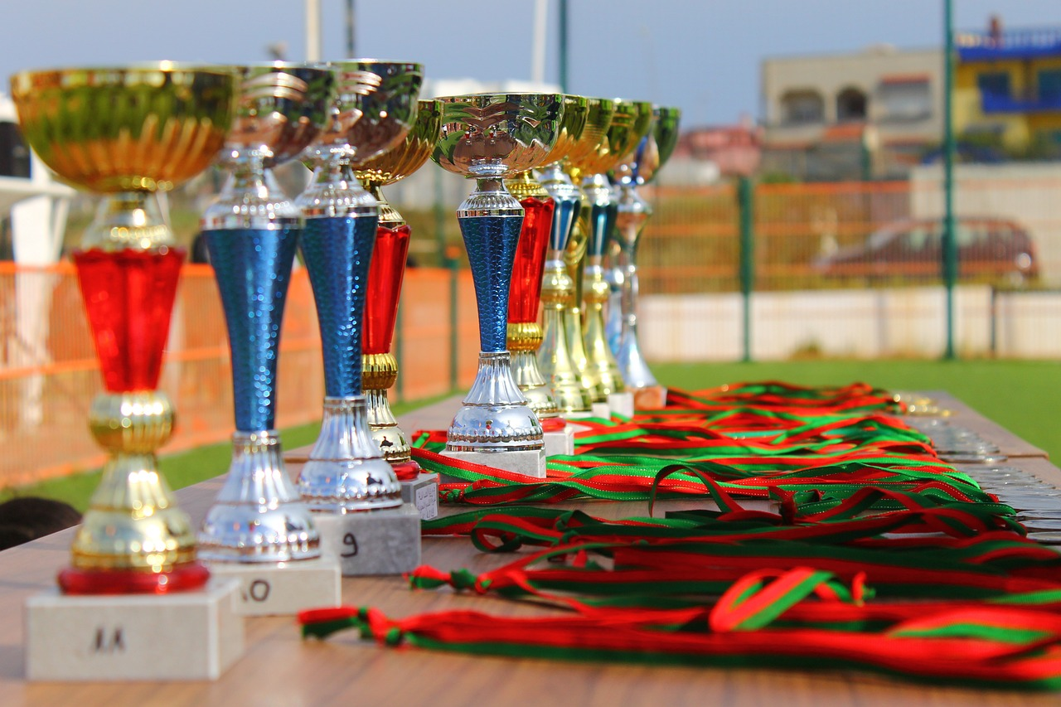
Next Steps
Game Application
Skill Advancement
Practice game rules in a simulated environment.
Participate in realistic scenarios to enhance understanding.
Advance your skills by exploring new strategies.
Join workshops to gain practical experience and learn effective techniques.
15
Understanding the Fundamentals of Football

Slide 19

Reflection and Feedback
Lessons Learned
Future Suggestions
Understanding the importance of clear communication in group activities.
Recognizing the value of feedback in enhancing learning experiences.
Incorporate more interactive elements to engage participants.
Schedule regular feedback sessions to continuously improve the learning process.
16
Understanding the Fundamentals of Football

Slide 20
Conclusion and Final Thoughts
Game Safety
Respect the Game
Understanding football rules and regulations is essential for beginners to enjoy the game and play safely.
Always prioritize safety to prevent injuries and ensure a positive experience for all players.
Remember to always respect the rules, opponents, and referees.
Fair play is crucial for maintaining the integrity of the game and fostering a positive environment.
17
Understanding the Fundamentals of Football

