Slide 1


Earth and Beyond: Exploring Sustainability and Habitability
Understanding Earth's Unique Environment, Human Impact, and the Search for Life on Exoplanets

Slide 2
Earth and Beyond: Exploring Sustainability and Habitability
2
Table of Contents
Introduction to Earth's Sustainability
What Makes Earth Habitable?
The Search for Exoplanets
Kepler-452b: Earth's Older Cousin
Designing an Exoplanet
Earth's Systems
Human Impact on the Environment
Sustainability and Conservation
Astrobiology and the Search for Life
Exoplanet Exploration
Conclusion
Reflection and Next Steps
Additional Resources
04
05
06
07
08
09
10
11
12
13
14
15
16

Slide 3
Earth and Beyond: Exploring Sustainability and Habitability
3
Table of Contents
Interactive Activities
Assessment and Evaluation
Extension and Differentiation
Conclusion and Final Thoughts
17
18
19
20

Slide 4
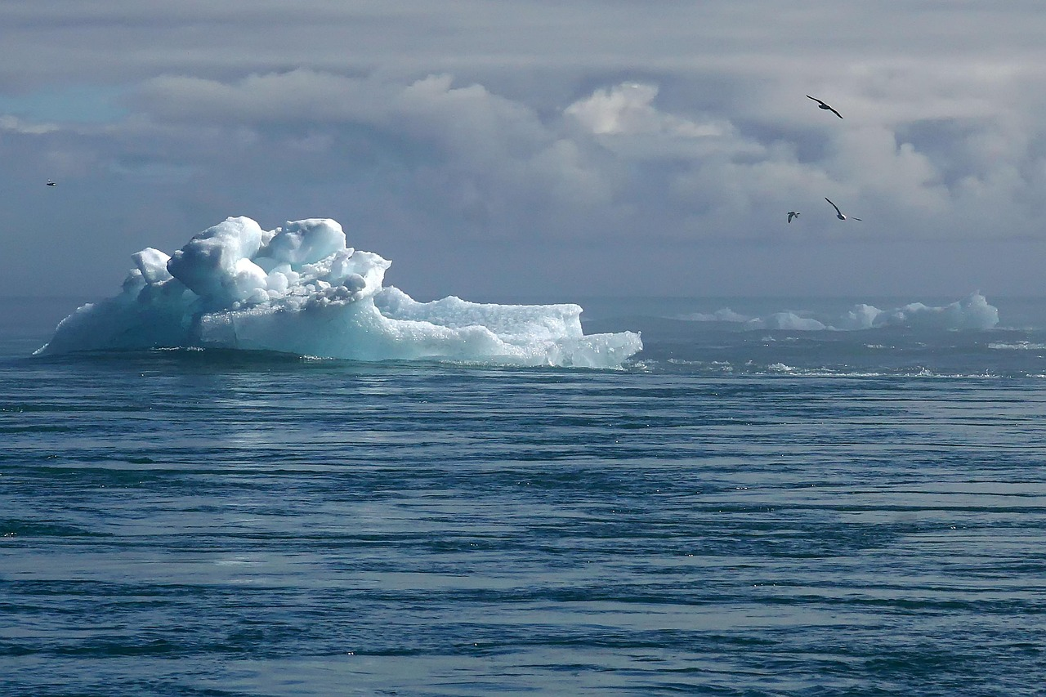
Earth and Beyond: Exploring Sustainability and Habitability
4
Introduction to Earth's Sustainability
Earth's Unique Sustainability Factors
Human Impact on Earth's Habitability
Exploring Exoplanets for Sustainability
Earth's unique combination of factors makes it an ideal planet for sustaining life.
These factors include its atmosphere, water availability, and distance from the sun.
Human activities are impacting the planet's habitability.
This includes pollution, deforestation, and climate change.
The search for exoplanets is an ongoing and rapidly evolving field.
Scientists are investigating planets outside our solar system for potential habitability.

Slide 5

Earth and Beyond: Exploring Sustainability and Habitability
5
What Makes Earth Habitable?
Distance from the Sun
Atmosphere Composition
The Earth is located in the Goldilocks zone, which is neither too hot nor too cold.
This optimal distance allows liquid water to exist, a key ingredient for life.
Earth's atmosphere has a perfect balance of gases, including oxygen and nitrogen.
This balance supports life and protects the planet from harmful solar radiation.
Abundant Water Supply
Geological Features
Water is essential for all known forms of life, and Earth has it in abundance.
It exists in liquid, solid, and gaseous states, supporting diverse ecosystems.
Earth's molten core generates a magnetic field that shields the planet from solar winds.
This magnetic field, along with tectonic activity, plays a crucial role in maintaining a habitable environment.

Slide 6
Earth and Beyond: Exploring Sustainability and Habitability
6
The Search for Exoplanets
Methods of Detecting Exoplanets
Characteristics of Habitable Planets
Notable Exoplanets
The transit method involves observing dips in a star's brightness as a planet passes in front of it.
The radial velocity method detects wobbles in a star's motion caused by gravitational interactions with orbiting planets.
Potentially habitable planets are typically Earth-sized and located in the habitable zone of their star.
Their atmospheres must support stable temperatures and contain elements like oxygen and water vapor.
Kepler-452b is often referred to as Earth's cousin due to its similar size and orbit.
Proxima b orbits the closest star to our solar system and may have conditions suitable for life.

Slide 7

Earth and Beyond: Exploring Sustainability and Habitability
7
Kepler-452b: Earth's Older Cousin
Differences from Earth
Kepler-452b shares several characteristics with Earth, including its size, orbit, and the type of star it orbits.
These similarities make it an intriguing candidate for studying Earth-like planets.
Potential for Human Habitation
Kepler-452b is larger in size and significantly older than Earth.
These differences provide insights into the evolution of planets over time.
Potential for Human Habitation
While Kepler-452b presents challenges for human habitation, it also offers possibilities worth exploring.
Understanding these challenges could pave the way for future interstellar exploration.

Slide 8

Earth and Beyond: Exploring Sustainability and Habitability
8
Designing an Exoplanet
Key Factors in Exoplanet Design
Unleashing Creativity
Overcoming Challenges
Factors to consider: atmosphere, geology, and water supply.
These elements are crucial for creating a sustainable and functional exoplanet.
Creative freedom: designing a unique exoplanet.
This allows for imaginative and innovative approaches to exoplanet creation.
Challenges and limitations: making it habitable for humans.
Ensuring human habitability requires addressing complex scientific and engineering problems.

Slide 9

Earth and Beyond: Exploring Sustainability and Habitability
9
Earth's Systems
Atmosphere
Hydrosphere
Protecting life and regulating temperature.
Essential for maintaining Earth's climate and weather patterns.
Water cycle and ocean currents.
Crucial for distributing heat and supporting aquatic ecosystems.
Geosphere
Biosphere
Plate tectonics and geological processes.
Shapes Earth's surface and provides resources like minerals.
Supporting life and ecosystems.
Interconnected with all other systems to sustain biodiversity.

Slide 10

Earth and Beyond: Exploring Sustainability and Habitability
10
Human Impact on the Environment
Climate Change
Pollution
Deforestation
Climate change refers to the long-term alteration of temperature and typical weather patterns in a place.
It is primarily caused by human activities such as burning fossil fuels, leading to severe effects like rising sea levels and extreme weather events.
Pollution encompasses various types, including air, water, and soil pollution, each with distinct consequences.
It leads to health issues, environmental degradation, and disruption of ecosystems.
Deforestation involves the large-scale removal of forests, often for agriculture or urban development.
This practice significantly impacts ecosystems and biodiversity, leading to habitat loss and species extinction.

Slide 11

Earth and Beyond: Exploring Sustainability and Habitability
11
Sustainability and Conservation
Importance of Sustainability
Conservation Efforts
Individual Actions
Preserving natural resources is crucial for future generations.
Sustainability ensures a balance between human needs and environmental health.
Protecting ecosystems and biodiversity is essential for maintaining ecological balance.
Conservation initiatives help safeguard endangered species and their habitats.
Making a difference starts with small, conscious choices in daily life.
Individual efforts collectively contribute to global sustainability goals.

Slide 12

Earth and Beyond: Exploring Sustainability and Habitability
12
Astrobiology and the Search for Life
Definition and Scope of Astrobiology
Methods of Searching for Life
Implications of Discovering Extraterrestrial Life
Astrobiology is the study of the origin, evolution, distribution, and future of life in the universe.
It encompasses the search for habitable environments in our Solar System and habitable planets outside it.
Scientists use biosignatures, which are indicators of life such as specific molecules or patterns, to detect potential life.
Direct detection involves searching for microorganisms or other forms of life through missions and experiments.
Finding life beyond Earth would have profound implications for our understanding of biology and the uniqueness of life.
It could also influence philosophical, ethical, and societal perspectives on humanity's place in the universe.

Slide 13
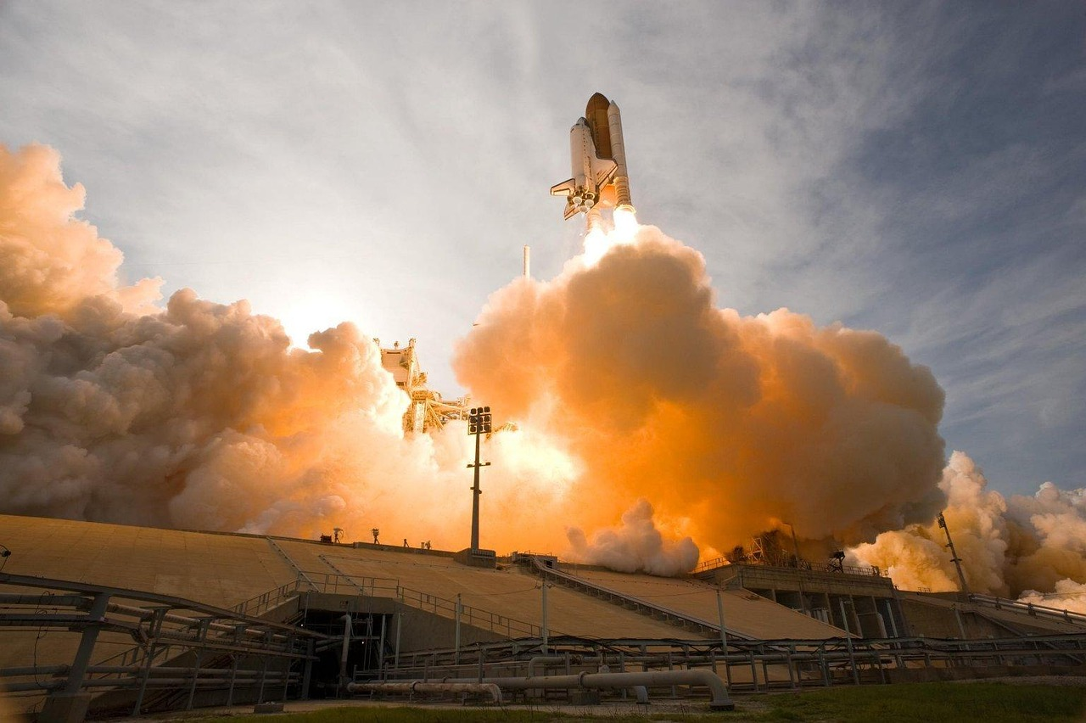
Earth and Beyond: Exploring Sustainability and Habitability
13
Exoplanet Exploration
Current and Future Missions
Kepler, TESS, and James Webb Space Telescope are pivotal in the search for exoplanets.
These missions aim to expand our understanding of distant worlds and their potential for hosting life.
Challenges and Limitations
Distance, technology, and funding pose significant hurdles in exoplanet exploration.
Overcoming these challenges requires innovative solutions and international collaboration.
Potential Discoveries
The search for habitable exoplanets and biosignatures holds immense promise.
Such discoveries could redefine our understanding of life in the universe.

Slide 14

Earth and Beyond: Exploring Sustainability and Habitability
14
Conclusion
Key Takeaways
Actionable Insights
Summary of key points: Earth's sustainability and the search for exoplanets.
Call to action: individual and collective responsibility for preserving our planet.
Summary of key points: Earth's sustainability and the search for exoplanets.
Call to action: individual and collective responsibility for preserving our planet.

Slide 15

Earth and Beyond: Exploring Sustainability and Habitability
15
Reflection and Next Steps
Reflection Questions
Next Steps
What did you learn and how can you apply it?
Consider how the insights gained can influence your future actions.
Further learning and exploration of the topic.
Identify resources and opportunities to deepen your understanding.

Slide 16

Earth and Beyond: Exploring Sustainability and Habitability
16
Additional Resources
Books and Articles
Online Resources
Educational Programs and Courses
Recommended reading for further learning.
Explore insightful books and articles to deepen your knowledge.
Websites, videos, and podcasts.
Access diverse online platforms for engaging and informative content.
Opportunities for further study.
Enroll in structured programs to enhance your expertise.

Slide 17

Earth and Beyond: Exploring Sustainability and Habitability
17
Interactive Activities
Simulations and Models
Games and Quizzes
Discussions and Debates
Exploring exoplanet environments.
Engage with realistic scenarios to understand distant worlds.
Testing knowledge and understanding.
Interactive challenges to reinforce learning.
Critical thinking and argumentation.
Encourage diverse perspectives and reasoned dialogue.

Slide 18

Earth and Beyond: Exploring Sustainability and Habitability
18
Assessment and Evaluation
Formative and Summative Assessments
Formative and summative assessments: evaluating student understanding.
Feedback and reflection: improving instruction and student learning.
Feedback and Reflection
Formative and summative assessments: evaluating student understanding.
Feedback and reflection: improving instruction and student learning.

Slide 19
Earth and Beyond: Exploring Sustainability and Habitability
19
Extension and Differentiation
Extension Activities
Differentiation Strategies
Challenging students to think critically and creatively.
Encouraging exploration beyond the standard curriculum.
Meeting the needs of diverse learners.
Adapting teaching methods to accommodate various learning styles.

Slide 20

Earth and Beyond: Exploring Sustainability and Habitability
20
Conclusion and Final Thoughts
Conclusion and Final Thoughts
Final thoughts and reflections on the topic
Encouragement to continue exploring and learning

