Slide 1

Mastering the Verb "To Be" in English Grammar
A Comprehensive Guide to Understanding, Using, and Practicing the Essential Verb Across Tenses and Contexts

Slide 2
Mastering the Verb "To Be" in English Grammar
2
Table of Contents
Introduction to the Verb "To Be"
Present Simple Form of the Verb "To Be"
Present Continuous Form of the Verb "To Be"
Past Simple Form of the Verb "To Be"
Future Simple Form of the Verb "To Be"
Using the Verb "To Be" in Context
Common Errors with the Verb "To Be"
Practice Exercises
Conclusion
Summary
Reflection Questions
Next Steps
Additional Resources
04
05
06
07
08
09
10
11
12
13
14
15
16

Slide 3
Mastering the Verb "To Be" in English Grammar
3
Table of Contents
Parent Engagement
Safety Considerations
Conclusion and Final Thoughts
Final Assessment
Certificate of Completion
References
Appendix
Glossary
Index
Feedback and Evaluation
Conclusion and Final Thoughts
17
18
19
20
21
22
23
24
25
26
27

Slide 4

Mastering the Verb "To Be" in English Grammar
4
Introduction to the Verb "To Be"
Understanding the Basics
Importance in Communication
Examples in Context
The verb "to be" is a fundamental concept in English grammar.
It is used to describe states of being, such as "I am a student" or "She is a doctor".
Mastering the verb "to be" is essential for effective communication in English.
It forms the foundation for expressing identity, condition, and existence.
Examples like "I am a student" and "She is a doctor" illustrate its use.
These examples highlight its role in describing states of being.

Slide 5

Mastering the Verb "To Be" in English Grammar
5
Present Simple Form of the Verb "To Be"
Usage of Present Simple 'To Be'
Examples of Present Simple 'To Be'
The present simple form of the verb 'to be' is used to describe permanent or general truths.
It is an essential part of everyday conversation.
Examples include: 'I am a student', 'She is a doctor', 'They are friends'.
These examples illustrate its use in describing roles and relationships.
Purpose of Present Simple 'To Be'
Significance in Communication
The present simple form is used to talk about facts, habits, and routines.
This makes it a fundamental aspect of communication.
The verb 'to be' in its present simple form is crucial for expressing identity and states.
It helps convey clear and concise information in daily interactions.

Slide 6
Mastering the Verb "To Be" in English Grammar
6
Present Continuous Form of the Verb "To Be"
Definition of Present Continuous
Examples of Usage
Temporary or Changing Situations
Common Time Indicators
The present continuous form of the verb 'to be' is used to describe actions that are happening at the moment of speaking.
It provides a way to express ongoing activities in real-time.
Examples include: 'I am studying for my exam' and 'They are playing soccer'.
These sentences illustrate how the present continuous form is applied in everyday scenarios.
The present continuous form is used to describe temporary or changing situations.
It highlights actions or states that are not permanent.
It is often used with words like 'now', 'at the moment', or 'currently'.
These time indicators help specify the immediacy of the action.

Slide 7

Mastering the Verb "To Be" in English Grammar
7
Past Simple Form of the Verb "To Be"
Definition of Past Simple Form
Examples of Usage
The past simple form of the verb 'to be' is used to describe completed actions in the past.
It provides a way to talk about events or states that have already occurred.
Examples include sentences like 'I was a student last year' and 'She was a teacher'.
These examples illustrate how the verb 'to be' is applied in past contexts.
Describing Past Experiences
Common Time Indicators
The past simple form is used to describe past experiences or events.
It helps in narrating situations or conditions that happened before now.
It is often used with words like 'yesterday', 'last week', or 'last year'.
These time indicators help specify when the past action or state occurred.

Slide 8
Mastering the Verb "To Be" in English Grammar
8
Future Simple Form of the Verb "To Be"
Definition of Future Simple Form
Examples of Usage
The future simple form of the verb 'to be' is used to describe future plans or predictions.
It helps in expressing actions or states that are expected to occur in the future.
Examples include sentences like 'I will be a doctor' and 'They will be rich'.
These examples illustrate how the future simple form conveys future intentions or outcomes.
Contextual Usage
Purpose of the Future Simple Form
The future simple form is often used with words like 'tomorrow', 'next week', or 'next year'.
These time indicators help specify when the future action or state will occur.
It is used to describe future actions or states of being.
This form is essential for discussing events or conditions that are yet to happen.

Slide 9
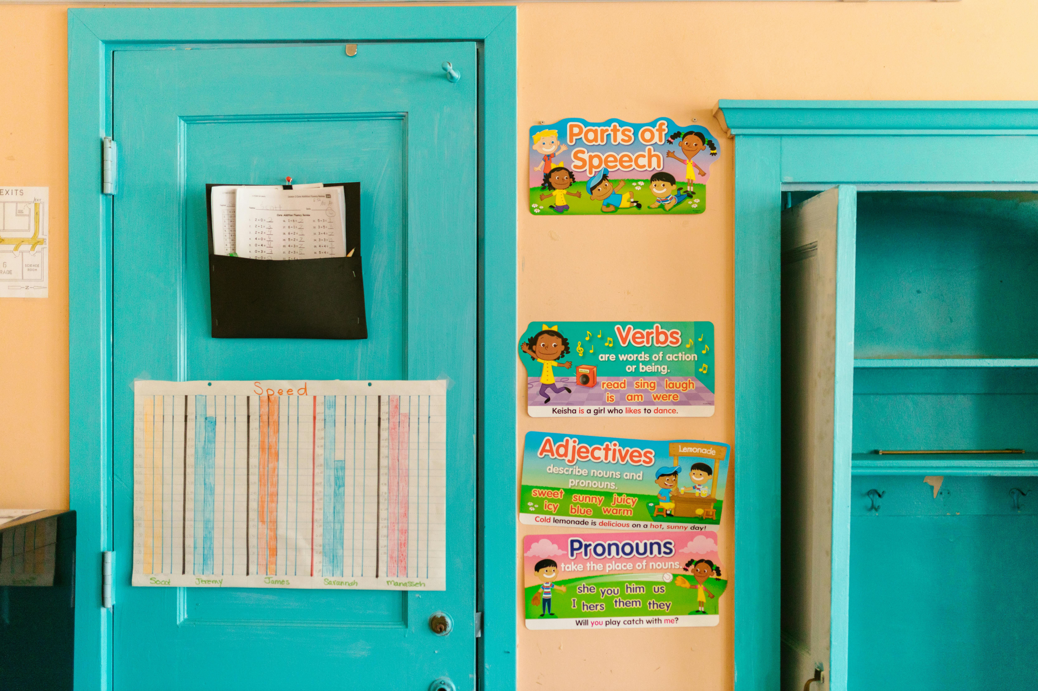
Mastering the Verb "To Be" in English Grammar
9
Using the Verb "To Be" in Context
Introduction to the Verb 'To Be'
Describing People, Places, and Things
The verb 'to be' is used in various grammatical structures, such as introductions, descriptions, and comparisons.
Examples include: 'I am a student from the USA', 'She is a great singer', 'They are better than us'.
The verb 'to be' is used to describe people, places, and things.
It helps provide essential details in communication.
Importance in Everyday Conversation
Examples of Usage
The verb 'to be' is an essential part of everyday conversation.
It is frequently used to express states of being and relationships.
Examples of the verb 'to be' include: 'I am a student from the USA', 'She is a great singer', 'They are better than us'.
These examples highlight its role in introductions, descriptions, and comparisons.

Slide 10
Mastering the Verb "To Be" in English Grammar
10
Common Errors with the Verb "To Be"
Confusion in Forms of 'To Be'
Present Perfect Tense Misuse
One common error is confusing the different forms of the verb 'to be'.
Examples: 'I am going to the store' instead of 'I am going to the store right now'.
Another common error is using the verb 'to be' incorrectly in forming the present perfect tense.
Examples: 'I have been studying English for three years, but I was not very good at it'.
Errors in Continuous Tense
Mistakes in Passive Voice
Learners often misuse 'to be' in continuous tense constructions.
Examples: 'He is play football' instead of 'He is playing football'.
The verb 'to be' is frequently misused in passive voice sentences.
Examples: 'The book was write by her' instead of 'The book was written by her'.

Slide 11
Mastering the Verb "To Be" in English Grammar
11
Practice Exercises
Sentence Completion Practice
Complete the sentences with the correct form of the verb 'to be'.
Examples: 'I ________ (be) a student', 'She ________ (be) a doctor'.
Verb Identification Task
Identify the correct form of the verb 'to be' in the given sentences.
Examples: 'I am studying for my exam' (present continuous), 'I was a student last year' (past simple).
Focus on Present Continuous
Understand how 'to be' is used in present continuous sentences.
Example: 'I am studying for my exam'.
Focus on Past Simple
Learn how 'to be' is applied in past simple sentences.
Example: 'I was a student last year'.

Slide 12
Mastering the Verb "To Be" in English Grammar
12
Conclusion
Fundamental Concept
Effective Communication
Practice and Review
The verb 'to be' is a fundamental concept in English grammar.
It serves as a cornerstone for understanding sentence structure.
Mastering the verb 'to be' is essential for effective communication in English.
It enables clear and precise expression in various contexts.
Practice and review are key to mastering the verb 'to be'.
Consistent effort ensures proficiency and confidence in usage.

Slide 13
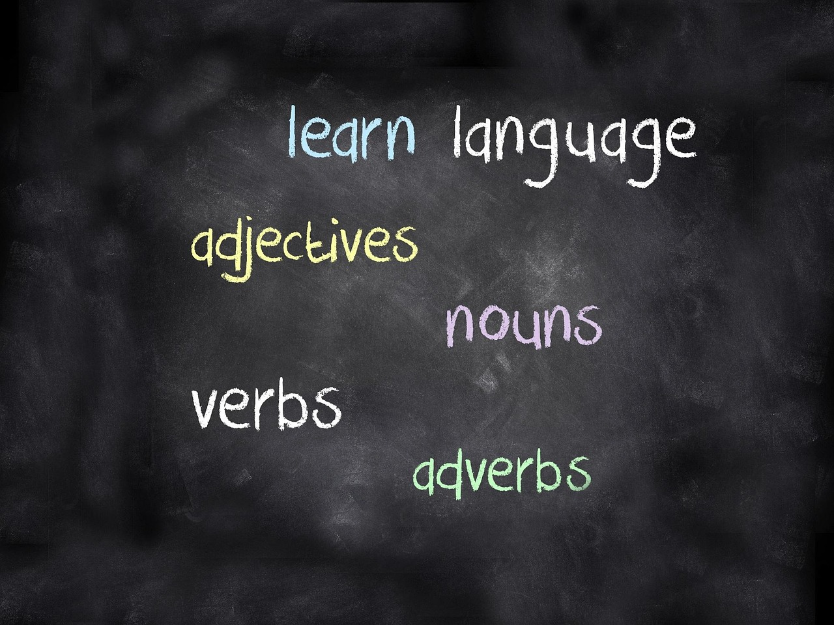
Mastering the Verb "To Be" in English Grammar
13
Summary
Forms of the Verb 'To Be'
Describing States of Being
Grammatical Structures
Common Errors
The verb 'to be' has different forms in the present, past, and future tenses.
These forms are essential for constructing grammatically correct sentences.
The verb 'to be' is used to describe states of being, such as 'I am a student' or 'She is a doctor'.
It helps convey identity, profession, and conditions effectively.
The verb 'to be' is used in various grammatical structures, such as introductions, descriptions, and comparisons.
Its versatility makes it a cornerstone of English grammar.
Common errors with the verb 'to be' include confusing the different forms.
Another frequent mistake is using it incorrectly in forming the present perfect tense.

Slide 14
Mastering the Verb "To Be" in English Grammar
14
Reflection Questions
Forms of the Verb 'To Be'
Usage in Context
Common Errors
Practice and Review
What are the different forms of the verb 'to be'?
Explore the variations such as 'am,' 'is,' 'are,' 'was,' and 'were'.
How is the verb 'to be' used in context?
Understand its role in sentences to express states, conditions, or identity.
What are some common errors with the verb 'to be'?
Identify mistakes like subject-verb agreement and improper tense usage.
How can you practice and review the verb 'to be'?
Engage in exercises and real-life applications to reinforce understanding.

Slide 15
Mastering the Verb "To Be" in English Grammar
15
Next Steps
Understanding the Present Perfect Tense
Practicing Conditional Sentences
Exploring Formal and Informal Writing
Mastering the Verb 'To Be'
Learn about the present perfect tense and how it is used to describe actions that started in the past and continue up to the present.
This tense helps in connecting past actions with their relevance to the present moment.
Practice using the verb 'to be' in conditional sentences, such as 'If I were rich, I would be happy'.
Conditional sentences are essential for expressing hypothetical situations effectively.
Learn about the use of the verb 'to be' in formal and informal writing, such as in essays, emails, and text messages.
Understanding this usage enhances communication across different contexts.
Continue to practice and review the verb 'to be' to master its different forms and uses.
Regular practice ensures proficiency in applying this verb accurately.

Slide 16

Mastering the Verb "To Be" in English Grammar
16
Additional Resources
Online Grammar Guides
Explore resources like Grammarly and Purdue OWL for improving grammar skills.
These platforms offer comprehensive tools and tips for mastering English grammar.
Language Learning Apps
Apps like Duolingo and Babbel provide interactive ways to learn English.
They are designed to make language learning engaging and accessible for all levels.
Language Exchange Websites
Websites such as italki and Conversation Exchange connect learners with native speakers.
These platforms facilitate real-time practice and cultural exchange to enhance language skills.
English Learning YouTube Channels
Channels like EnglishClass101 and LearnEnglish with Emma offer video lessons for English learners.
They provide diverse content tailored to different proficiency levels and learning goals.

Slide 17

Mastering the Verb "To Be" in English Grammar
17
Parent Engagement
Practicing the Verb 'To Be'
Providing Learning Resources
Encourage parents to practice the verb 'to be' with their child.
This helps reinforce language skills and builds confidence in usage.
Provide parents with resources and tips to support their child's learning.
These tools can include worksheets, online platforms, and practical advice.
Teacher Communication
Language Learning Events
Encourage parents to communicate with the teacher and ask questions.
This fosters a collaborative environment for the child's language development.
Invite parents to attend language learning events and workshops.
These events offer opportunities for parents to engage and learn alongside their child.

Slide 18

Mastering the Verb "To Be" in English Grammar
18
Safety Considerations
Creating a Safe Learning Space
Supporting Special Needs
Ensure a safe and inclusive learning environment.
Be aware of potential bullying or harassment.
Provide support and resources for students with special needs.
Encourage students to report any incidents or concerns.
Promoting Inclusivity
Addressing Concerns
Ensure a safe and inclusive learning environment.
Provide support and resources for students with special needs.
Be aware of potential bullying or harassment.
Encourage students to report any incidents or concerns.

Slide 19
Mastering the Verb "To Be" in English Grammar
19
Conclusion and Final Thoughts
The Importance of the Verb 'To Be'
Mastery for Effective Communication
Path to Proficiency
The verb 'to be' is a fundamental concept in English grammar.
It serves as a cornerstone for constructing meaningful sentences.
Mastering the verb 'to be' is essential for effective communication in English.
It enables students to express themselves clearly and accurately.
With practice and review, students can master the verb 'to be'.
This mastery contributes to improving their overall English proficiency.

Slide 20

Mastering the Verb "To Be" in English Grammar
20
Final Assessment
Final Quiz
Essay Writing
Complete a final quiz to assess understanding of the verb 'to be'.
This activity will test your knowledge and ensure you have grasped the key concepts.
Write a short essay using the verb 'to be' in context.
This task will help you practice applying the verb in real-life scenarios.
Role-Play Activity
Self-Assessment Checklist
Participate in a role-play activity using the verb 'to be'.
Engage in interactive learning to enhance your communication skills.
Complete a self-assessment checklist to evaluate progress and identify areas for improvement.
Reflect on your learning journey and pinpoint areas to focus on further.

Slide 21

Mastering the Verb "To Be" in English Grammar
21
Certificate of Completion
Lesson Accomplishment
Practice for Mastery
Certificate of Completion
Congratulations on completing the lesson on the verb "to be"!
You have demonstrated a good understanding of the verb "to be" and its different forms.
Continue to practice and review the verb "to be".
This will help you master its different forms and uses.
This certificate acknowledges your effort and success.
Keep up the great work in your learning journey!

Slide 22

Mastering the Verb "To Be" in English Grammar
22
References
Grammar Guides and Resources
English Language Learning Apps
Language Exchange Websites
English Language Learning YouTube Channels
Grammar guides and resources, such as Grammarly and Purdue OWL.
These tools help improve writing skills and provide comprehensive grammar rules.
English language learning apps, such as Duolingo and Babbel.
These apps offer interactive lessons and gamified learning experiences.
Language exchange websites, such as italki and Conversation Exchange.
These platforms connect learners with native speakers for conversational practice.
English language learning YouTube channels, such as EnglishClass101 and LearnEnglish with Emma.
These channels provide video lessons and tips for mastering English.

Slide 23
Mastering the Verb "To Be" in English Grammar
23
Appendix
Practice Exercises and Quizzes
Common Errors with 'To Be'
Answer Key Insights
Learning Resources
Additional practice exercises and quizzes.
Answer key for practice exercises and quizzes.
List of common errors with the verb 'to be'.
Tips and resources for further learning and practice.
Answer key for practice exercises and quizzes.
List of common errors with the verb 'to be'.
Tips and resources for further learning and practice.
Additional practice exercises and quizzes.

Slide 24
Mastering the Verb "To Be" in English Grammar
24
Glossary
Definition of the Verb 'To Be'
Examples in Context
Definition of the verb 'to be'.
Explanation of the different forms of the verb 'to be'.
Examples of the verb 'to be' in context.
List of key terms and concepts related to the verb 'to be'.
Forms of the Verb
Key Terms and Concepts
Explanation of the different forms of the verb 'to be'.
Examples of the verb 'to be' in context.
List of key terms and concepts related to the verb 'to be'.
Definition of the verb 'to be'.

Slide 25

Mastering the Verb "To Be" in English Grammar
25
Index
Topics and Subtopics
Key Terms and Concepts
Resources and References
Lesson Overview
List of topics and subtopics covered in the lesson.
Page numbers for each topic and subtopic.
List of key terms and concepts related to the verb 'to be'.
These terms are essential for understanding the lesson.
List of resources and references used in the lesson.
These materials support the lesson content.
The lesson provides a comprehensive guide to the verb 'to be'.
It includes structured topics, key terms, and supporting references.

Slide 26

Mastering the Verb "To Be" in English Grammar
26
Feedback and Evaluation
Lesson Feedback
Provide feedback on the lesson and its content.
Evaluate the effectiveness of the lesson and its materials.
Improvement Areas
Identify areas for improvement and suggest changes.
Provide recommendations for future lessons and topics.
Effectiveness Evaluation
Evaluate the effectiveness of the lesson and its materials.
Identify areas for improvement and suggest changes.
Future Recommendations
Provide recommendations for future lessons and topics.
Provide feedback on the lesson and its content.

Slide 27
Mastering the Verb "To Be" in English Grammar
27
Conclusion and Final Thoughts
The Importance of the Verb 'To Be'
Achieving Proficiency Through Practice
A Key to Effective Communication
The verb 'to be' is a fundamental concept in English grammar.
Mastering it is essential for effective communication in English.
With practice and review, students can master the verb 'to be'.
This will significantly improve their overall English proficiency.
Understanding the verb 'to be' lays the foundation for clear expression.
It is a cornerstone of English language mastery.

