Slide 1

Understanding Human Development
Exploring the Fundamentals of Fertilization, Development Stages, Genetic Inheritance, and Organ System Development

Slide 2
Table of contents
01
02
03
04
05
06
07
08
09
10
11
Lesson Objectives
What is Fertilization?
Stages of Early Development
Cellular Differentiation
Genetic Inheritance
Organ System Development
Hormonal Regulation
Common Misconceptions
Interactive Learning Challenge
Key Takeaways
Conclusion

Slide 3
Table of contents
12
13
14
15
16
17
18
19
20
Additional Slide 1
Additional Slide 2
Additional Slide 3
Additional Slide 4
Additional Slide 5
Additional Slide 6
Additional Slide 7
Additional Slide 8
Additional Slide 9

Slide 4

1
Lesson Objectives
01
Understand the stages of human embryonic development
02
Explore cellular transformation processes
Zygote, Blastocyst, Embryonic, and Early Fetal stages
Stem cells differentiation and genetic guidance
03
Learn about genetic inheritance mechanisms
04
Appreciate the complexity of human biological growth
23 chromosomes from each parent, unique genetic combinations
Neural, cardiovascular, and respiratory system development
Understanding Human Development

Slide 5

2
What is Fertilization?
01
Fusion of sperm and egg cell
02
Creation of a single genetic unit
The joining of the sperm cell from the male and the egg cell from the female.
Resulting in the formation of a zygote with a unique genetic makeup.
03
Begins the journey of human development
04
Combines 23 chromosomes from each parent
Marks the start of the miraculous process of embryonic growth.
Bringing together genetic material from both parents to form a complete set of 46 chromosomes.
Understanding Human Development

Slide 6
3
Stages of Early Development
01
02
03
04
Zygote Stage (First 24 hours)
Blastocyst Stage (Days 5-6)
Embryonic Stage (Weeks 2-8)
Early Fetal Stage (Weeks 9-12)
Understanding Human Development

Slide 7
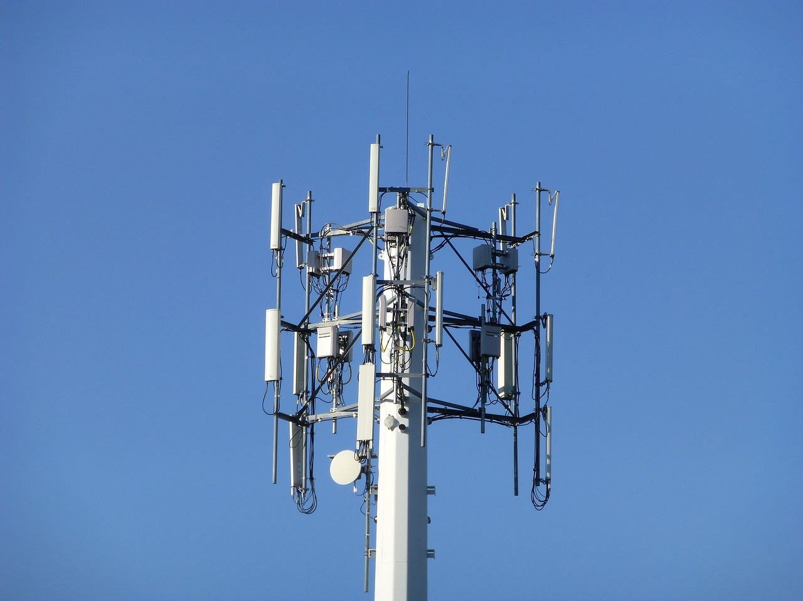
4
Cellular Differentiation
01
Stem cells transform into specific cell types
02
Genetic instructions guide cellular development
Embryonic stem cells have the potential to become any cell type in the body
Adult stem cells are more specialized and can only differentiate into certain cell types
DNA carries the instructions for cell specialization
Gene expression controls which proteins a cell produces
03
Over 200 distinct cell types emerge
04
Complex molecular signaling triggers specialization
Neurons, muscle cells, skin cells, and more
Each cell type has unique functions and structures
Signaling molecules influence cell fate
Cell-to-cell communication plays a crucial role in differentiation
Understanding Human Development

Slide 8
5
Genetic Inheritance
01
Genetic Inheritance
02
Unique genetic combination for each individual
03
Determines physical characteristics
23 chromosomes from each parent
Genetic material passed on to offspring
Determines individual traits and characteristics
Eye color, hair texture, height, etc.
04
Influences potential genetic traits
05
Diagram
Susceptibility to certain diseases or conditions
Chromosomal inheritance visualization
Understanding Human Development

Slide 9

6
Organ System Development
01
Neural System
02
Cardiovascular System
Begins developing early in embryonic stage
Forms around week 3 of development
03
Respiratory System
04
Brain and Spinal Cord
Progressively develops during fetal growth
Start forming in early stages of development
Understanding Human Development

Slide 10
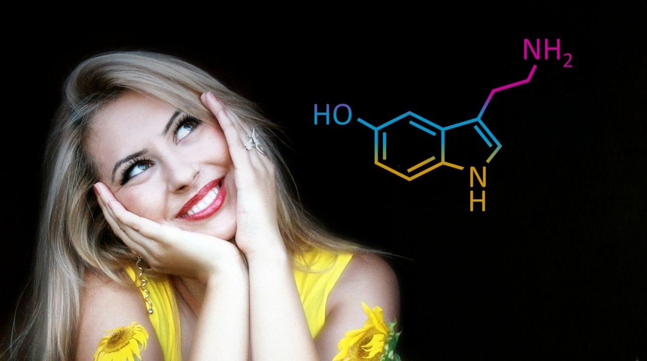
7
Hormonal Regulation
01
Human chorionic gonadotropin (hCG)
02
Progesterone
Supports early pregnancy
Maintains the uterine lining
03
Estrogen
Stimulates fetal development
Guides developmental processes
Supports embryonic growth
Understanding Human Development

Slide 11
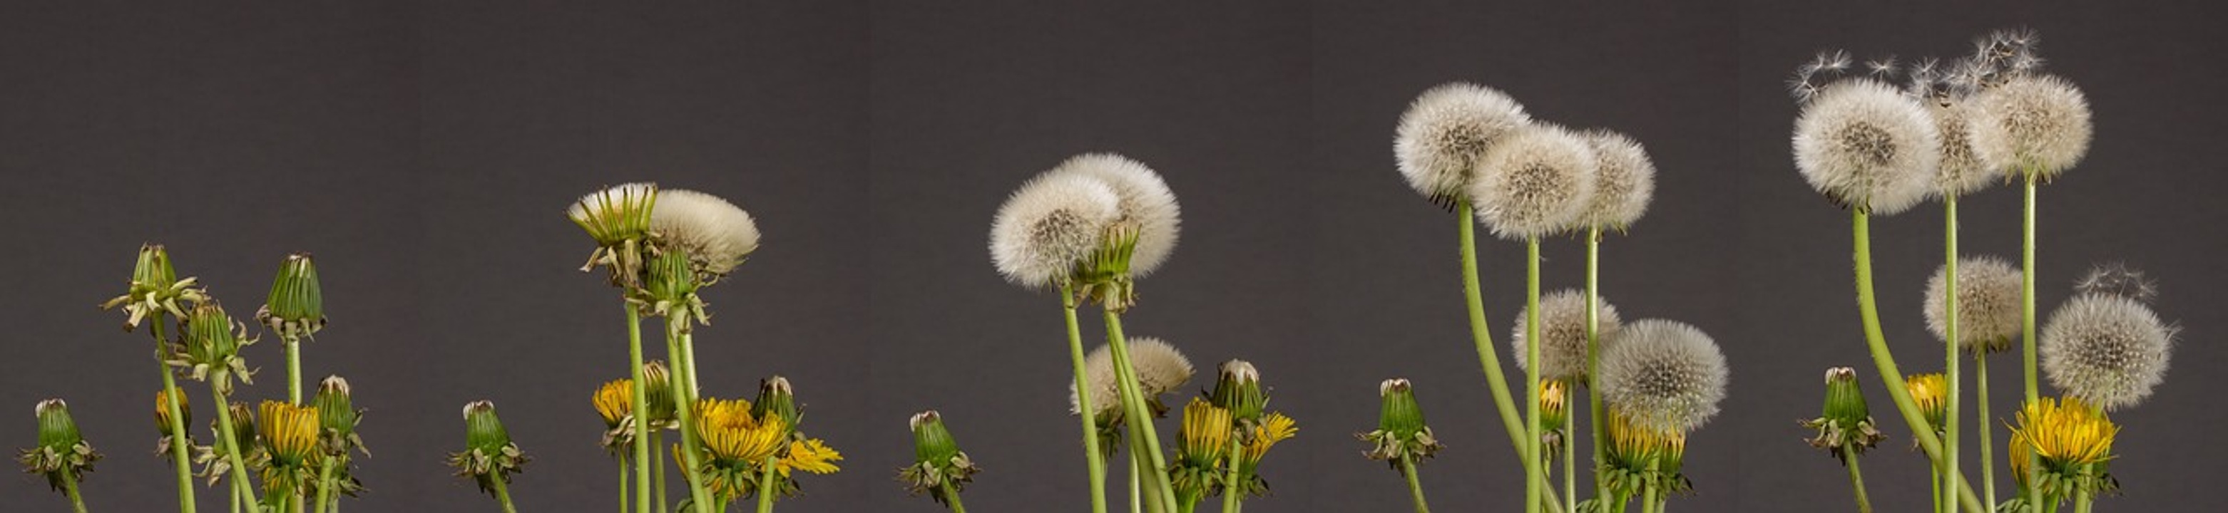
8
Common Misconceptions
01
Embryos are NOT miniature humans
02
Development is NOT instantly predictable
Development is a gradual process
Each individual's growth is unique
03
Genetic traits are COMPLEX, not simple copies
04
Cellular growth is a GRADUAL process
Inheritance involves a combination of genes
Cells differentiate over time
Understanding Human Development

Slide 12
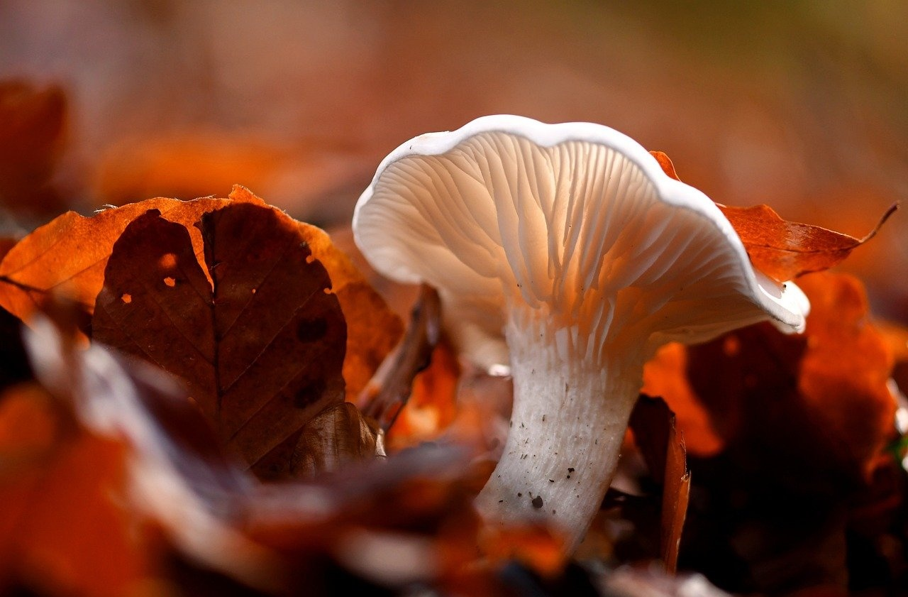
9
Interactive Learning Challenge
01
Timeline of Embryonic Growth
02
Genetic Inheritance Patterns
Week 1: Fertilization and zygote formation
Week 2: Blastocyst formation and implantation
Week 3: Gastrulation and germ layer formation
Week 4-8: Organogenesis
Week 9-12: Fetal development begins
Mendelian inheritance
Codominance
Incomplete dominance
Polygenic inheritance
Sex-linked traits
03
Cellular Transformation
04
Scientific Questions
Cell differentiation
Stem cell potency
Cell signaling pathways
Epigenetic modifications
Cancer cell transformation
How do genetic mutations affect development?
What are the ethical considerations in genetic editing?
How do environmental factors influence gene expression?
What are the latest advancements in stem cell research?
How can we prevent congenital disabilities?
Understanding Human Development

Slide 13
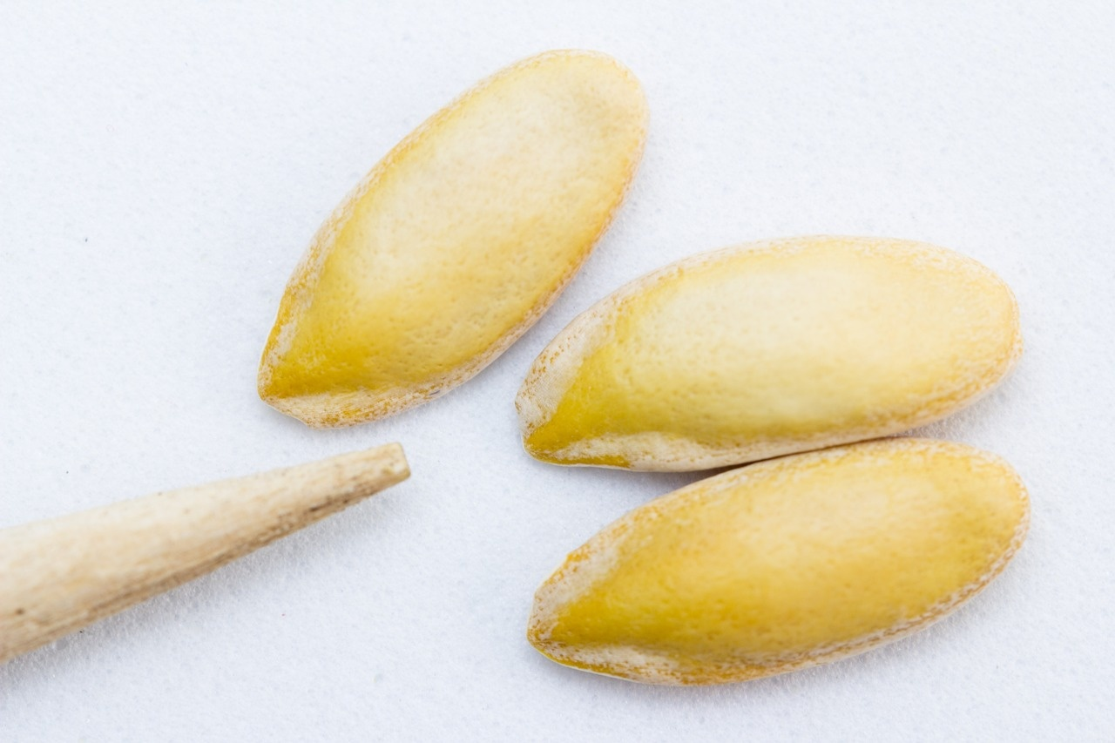
10
Key Takeaways
01
Cellular Development
02
Role of Genetics
Cellular development is incredibly complex
Genetics play a crucial role in human growth
03
Early Pregnancy
04
Understanding Our Origins
Early pregnancy involves constant biological adaptation
Science helps us understand our origins
Understanding Human Development

Slide 14

11
Conclusion
01
Human Development
02
Complexity of Life
Human development is a remarkable journey from a single cell to a complex human.
Biology showcases the amazing complexity of life and growth.
03
Curiosity and Understanding
Curiosity about scientific discoveries leads to a deeper understanding of biological processes.
Understanding Human Development

Slide 15
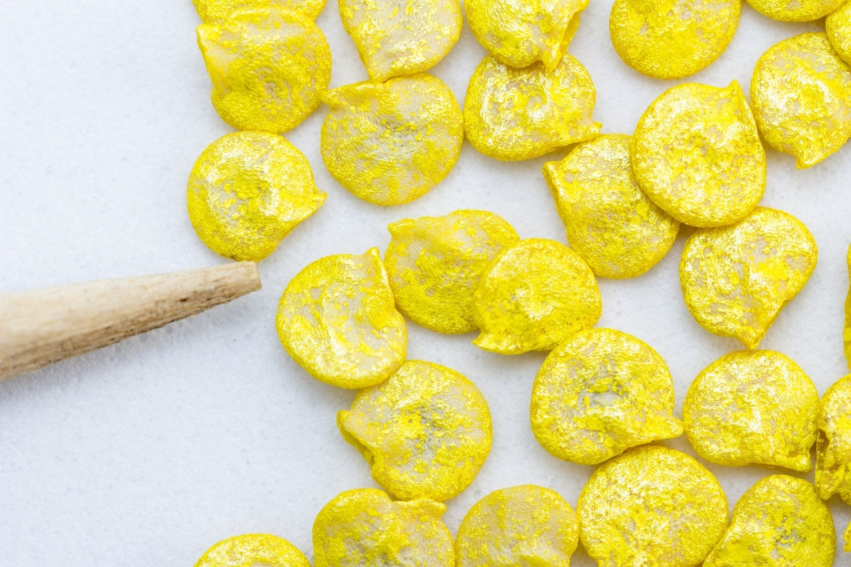
12
Additional Slide 1
01
Embryonic Stage (Weeks 2-8)
02
Early Fetal Stage (Weeks 9-12)
Rapid cell division and differentiation
Formation of major organs and structures
Growth and refinement of organs and systems
Development of limbs and facial features
Understanding Human Development

Slide 16

13
Additional Slide 2
01
Embryonic Development
02
Fetal Development
Formation of the zygote
Cell division and differentiation
Establishment of basic body structures
Rapid growth and organ formation
Maturation of body systems
Development of sensory abilities
Understanding Human Development

Slide 17
14
Additional Slide 3
Week 16
Genitals start to differentiate
Week 15
Swallowing and sucking reflexes develop
Week 14
Facial expressions begin
Week 13
Fetus can make a fist
Understanding Human Development

Slide 18
15
Additional Slide 4
01
02
03
04
Zygote Stage (First 24 hours)
Blastocyst Stage (Days 5-6)
Embryonic Stage (Weeks 2-8)
Early Fetal Stage (Weeks 9-12)
Understanding Human Development

Slide 19

16
Additional Slide 5
Cellular Differentiation
Stem cells transform into specific cell types
Genetic instructions guide cellular development
Over 200 distinct cell types emerge
Complex molecular signaling triggers specialization
Understanding Human Development

Slide 20
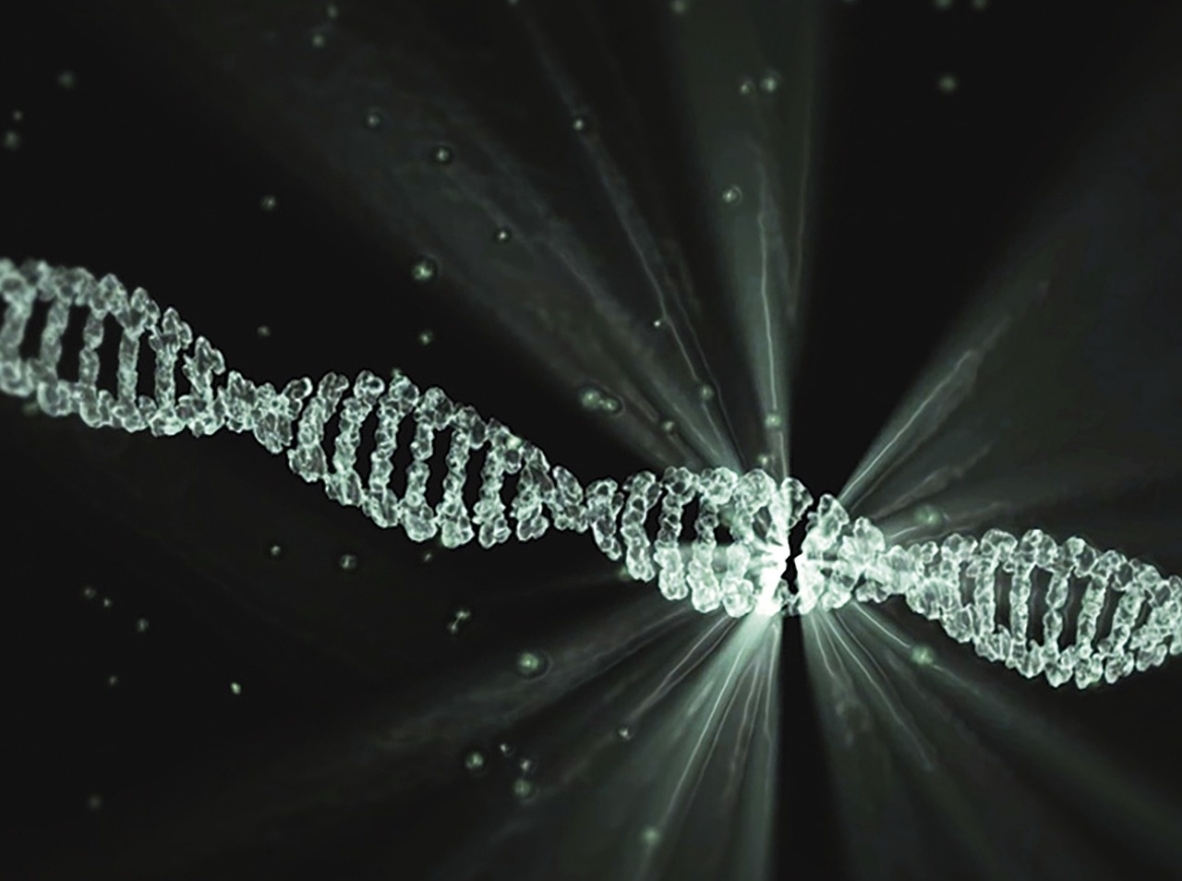
17
Additional Slide 6
Genetic Inheritance
23 chromosomes from each parent
Unique genetic combination for each individual
Determines physical characteristics
Influences potential genetic traits
Understanding Human Development

Slide 21
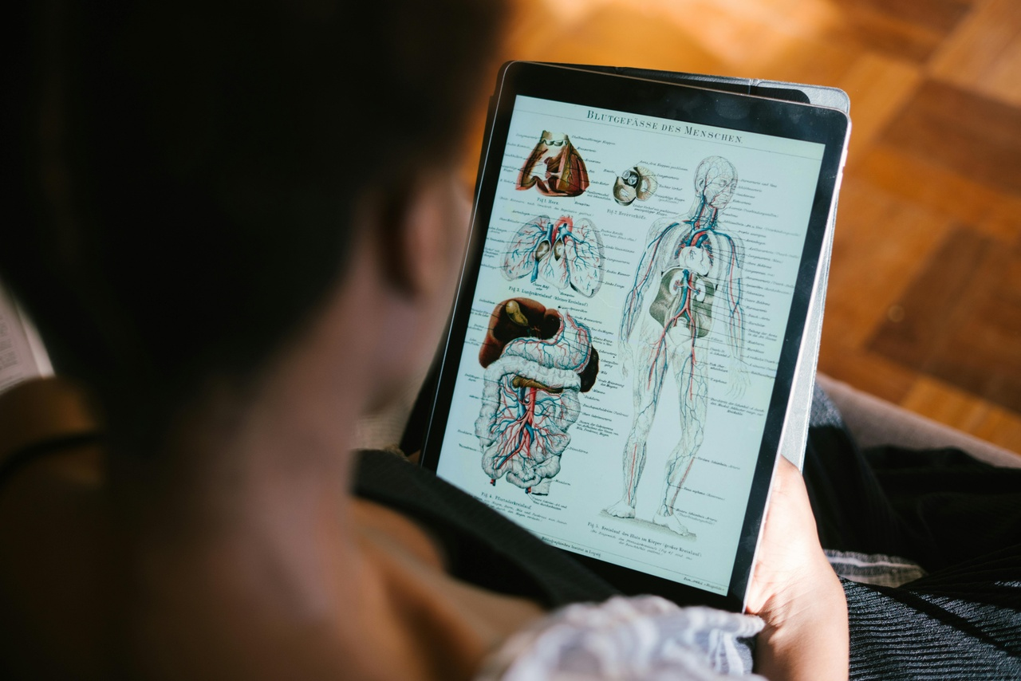
18
Additional Slide 7
Building Body Systems
Neural system begins developing early
Cardiovascular system forms around week 3
Respiratory system progressively develops
Brain and spinal cord start forming
Understanding Human Development

Slide 22
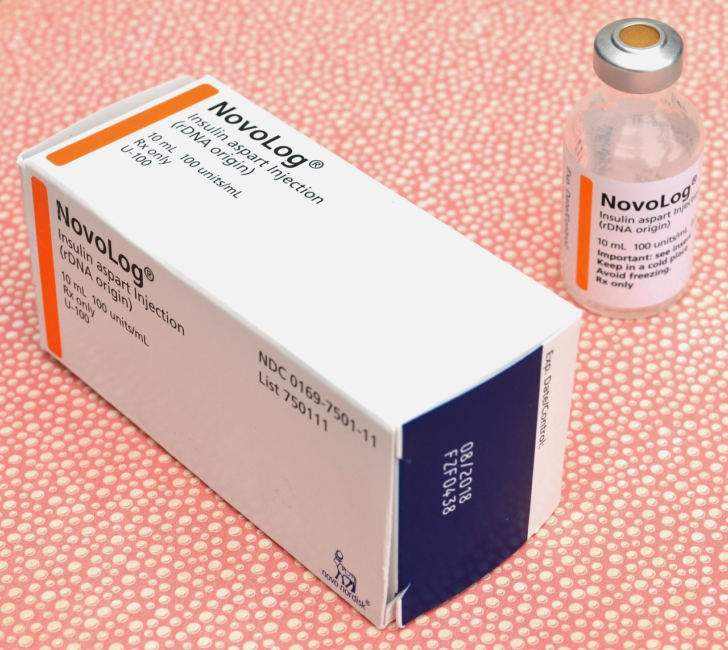
19
Additional Slide 8
Hormones: The Chemical Messengers
Human chorionic gonadotropin (hCG)
Progesterone
Estrogen
Guide developmental processes
Support embryonic growth
Understanding Human Development

Slide 23

20
Additional Slide 9
01
Embryos are NOT miniature humans
02
Development is NOT instantly predictable
03
Genetic traits are COMPLEX, not simple copies
04
Cellular growth is a GRADUAL process
Understanding Human Development

