Slide 1

Exploring Spring Constants: From Theory to Practice
A Comprehensive Journey Through Hooke's Law and Beyond

Slide 2
Table of contents
01
02
03
04
05
06
07
08
09
10
11
Title Slide: Spring Constant Exploration
Learning Objectives
What is Spring Constant?
Hooke's Law Explained
Experimental Setup
Data Collection Techniques
Mathematical Modeling
Elastic Potential Energy
Advanced Applications
Common Misconceptions
Interdisciplinary Connections

Slide 3
Table of contents
12
13
14
15
16
17
18
Digital Tools and Resources
Assessment Strategies
Extension and Challenge
Conclusion
Q&A and References
Design Recommendations
Recommended Visual Elements

Slide 4

1
Title Slide: Spring Constant Exploration
Spring Constant Exploration: Advanced Physics Mechanics
Investigating Elastic Systems and Mechanical Energy Storage
Exploring Spring Constants: From Theory to Practice

Slide 5

2
Learning Objectives
01
Develop proficiency in experimental measurements related to spring constants
02
Enhance mathematical modeling capabilities in the context of spring constants
Understand the importance of accurate data collection techniques
Learn to use precision tools for measuring spring properties
Apply mathematical equations to analyze spring behavior
Gain insights into the relationship between force, displacement, and spring constant
03
Deepen theoretical understanding of physics principles underlying spring constants
04
Improve visualization skills through iconographic representation of key objectives
Explore the theoretical framework of Hooke's Law and its applications
Grasp the concept of elastic systems and mechanical energy storage
Utilize visual aids to enhance comprehension of experimental and theoretical concepts
Enhance learning through graphical representations of spring constant exploration
Exploring Spring Constants: From Theory to Practice

Slide 6

3
What is Spring Constant?
01
Definition
02
Mathematical Representation
The spring constant, denoted as k, is a numerical measure of a spring's stiffness.
It is represented by the equation: F = -kx, where:
F is the force applied to the spring,
k is the spring constant, and
x is the displacement from the equilibrium position.
03
Key Components
04
Visual
Force (F)
Spring Constant (k)
Displacement (x)
Graphical representation illustrating the force-displacement relationship.
Exploring Spring Constants: From Theory to Practice

Slide 7

4
Hooke's Law Explained
01
Fundamental Principle of Linear Elastic Behavior
02
Mathematical Equation Breakdown
Describes the relationship between force and displacement in a spring.
F = -kx
Force (F), Spring Constant (k), Displacement (x).
03
Real-world Applications
04
Visualization: Color-coded equation explanation
Used in industries like automotive, construction, and engineering.
Graphical representation showing force, spring constant, and displacement.
Exploring Spring Constants: From Theory to Practice

Slide 8

5
Experimental Setup
Experimental Setup
Apparatus Required
Safety Protocols
Experimental Methodology Overview
Exploring Spring Constants: From Theory to Practice

Slide 9
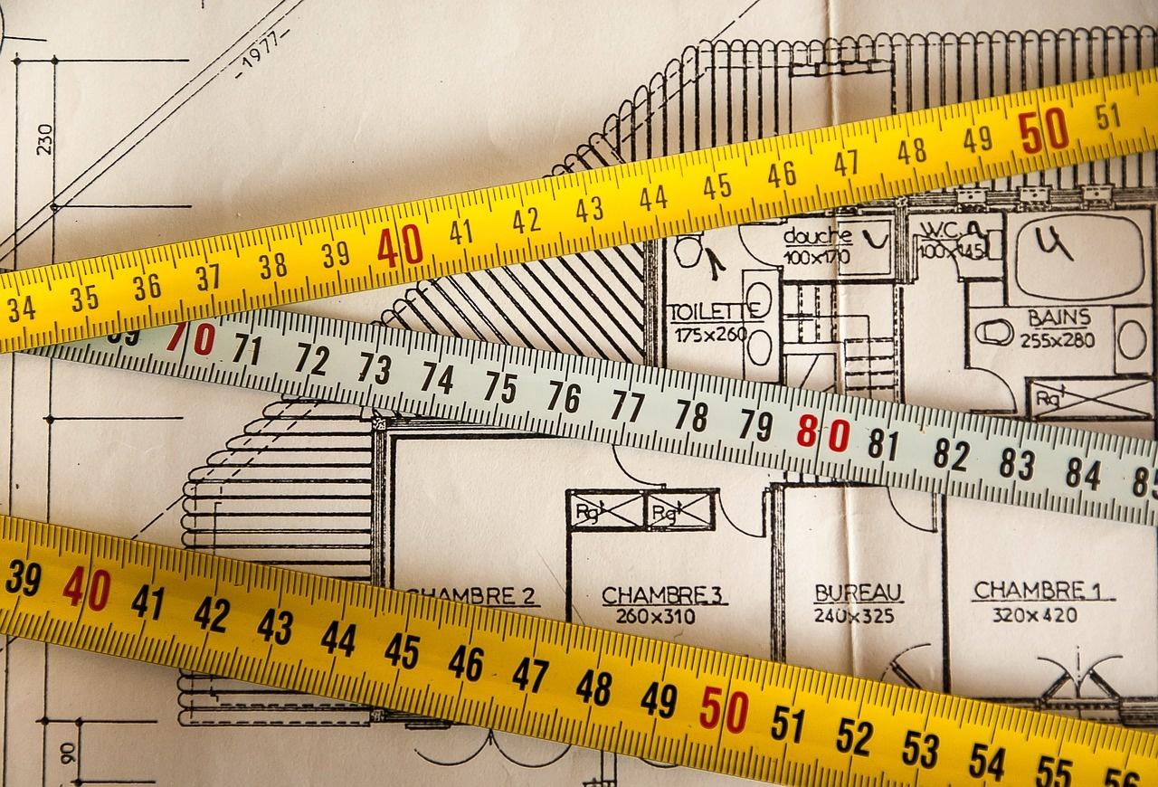
6
Data Collection Techniques
01
Systematic Measurement Protocol
02
Displacement Measurement
Establish a standardized procedure for data collection.
Ensure consistency in measurement techniques.
Use calibrated rulers or sensors to accurately measure spring elongation.
Record displacement values at regular intervals.
03
Mass Application Strategies
04
Error Reduction Techniques
Apply varying masses to the spring to observe different force-displacement relationships.
Utilize mass sets for controlled experimentation.
Minimize parallax errors by aligning measurement tools properly.
Repeat measurements to identify and reduce random errors.
Exploring Spring Constants: From Theory to Practice

Slide 10

7
Mathematical Modeling
01
Linear Regression Analysis
02
Graphical Representation Techniques
Utilized to determine the relationship between force and displacement.
Plotting force-displacement data to visualize the spring's behavior.
03
Spring Constant Calculation Methods
04
Computational Approaches
Applying mathematical formulas to derive the spring constant value.
Implementing numerical methods to model and analyze spring systems.
Exploring Spring Constants: From Theory to Practice

Slide 11

8
Elastic Potential Energy
Elastic Potential Energy
Definition: Energy stored in an elastic object when it is stretched or compressed
Formula: U = ½kx²
Significance: Represents the ability of a spring to do work when released
Units: Measured in joules (J) or newton-meters (Nm)
Visual: Energy conversion diagram showcasing the transformation of mechanical energy
Exploring Spring Constants: From Theory to Practice

Slide 12

9
Advanced Applications
Advanced Applications
Automotive Suspension Engineering
Seismic Structural Design
Precision Measurement Instruments
Biomechanical Research
Renewable Energy Systems
Exploring Spring Constants: From Theory to Practice

Slide 13

10
Common Misconceptions
01
Linear Elastic Behavior Limitations
02
Unit Interpretation Challenges
Misconception: Assuming all materials exhibit linear elasticity.
Reality: Non-linear behavior in materials under extreme conditions.
Misconception: Misunderstanding the units of spring constant (k).
Reality: Correct units are N/m for SI system and lb/in for Imperial system.
03
Constant Spring Constant Myth
04
Computational Reasoning Errors
Misconception: Belief that spring constant remains constant regardless of conditions.
Reality: Spring constant can vary with temperature, material fatigue, and stress.
Misconception: Overreliance on computational models without experimental validation.
Reality: Experimental data crucial for accurate spring constant determination.
Exploring Spring Constants: From Theory to Practice

Slide 14

11
Interdisciplinary Connections
01
Mathematics Integration
02
Engineering Design Principles
Utilizing calculus for advanced spring constant calculations
Applying trigonometry in analyzing oscillatory motion
Incorporating spring constants in structural engineering for stability analysis
Designing mechanical systems with optimized spring configurations
03
Material Science Correlations
04
Computer Science Applications
Studying material properties affecting spring constant variations
Exploring the relationship between spring materials and their stiffness
Implementing computational simulations to model spring behaviors
Developing algorithms for automated spring constant calculations
Exploring Spring Constants: From Theory to Practice

Slide 15
12
Digital Tools and Resources
01
Simulation Platforms
02
Data Analysis Software
03
Augmented Reality Visualization
Virtual environments for exploring spring constant concepts
Interactive simulations for hands-on learning
Tools for analyzing experimental results and calculating spring constants
Statistical analysis software for interpreting data accurately
AR applications for visualizing spring systems in 3D
Immersive experiences to understand spring behavior better
04
Collaborative Research Tools
05
Computational Modeling Resources
Online platforms for sharing data and collaborating on spring constant projects
Tools for remote teamwork and project management
Software for creating mathematical models of spring systems
Numerical simulation tools for predicting spring behavior
Exploring Spring Constants: From Theory to Practice

Slide 16

13
Assessment Strategies
01
Formative Assessment Methods
02
Summative Evaluation Techniques
Ongoing quizzes and checkpoints during experimentation
Peer evaluations and feedback sessions
Concept mapping exercises to gauge understanding
Final project presentations and reports
Written exams on theoretical concepts and calculations
Practical assessments measuring data analysis skills
03
Experimental Report Rubrics
04
Mathematical Modeling Portfolio
Clear criteria for data collection accuracy
Evaluation of methodology and error analysis
Communication of results and conclusions
Compilation of mathematical models developed
Comparison of predicted vs. actual results
Reflection on modeling challenges and improvements
Exploring Spring Constants: From Theory to Practice

Slide 17

14
Extension and Challenge
01
Extension and Challenge
02
Computational Modeling
Advanced Experimental Designs - Incorporating multiple springs in series and parallel configurations
Implementing non-linear spring systems for complex analysis
Utilizing software for simulating various spring constants scenarios
Implementing numerical methods to solve differential equations
03
Quantum Mechanics Exploration
04
Interdisciplinary Research Opportunities
Investigating quantum harmonic oscillators and their spring-like behavior
Exploring the concept of zero-point energy in quantum systems
Collaborating with material scientists to study novel spring materials
Partnering with biologists to analyze spring-like structures in biological systems
Exploring Spring Constants: From Theory to Practice

Slide 18
15
Conclusion
Key Takeaways
Importance of Spring Constant Understanding
Understanding the significance of spring constants in mechanical systems.
Crucial for designing efficient and stable mechanical systems.
Future Learning Pathways
Inspirational Physics-related Imagery
Further exploration of elastic potential energy and its applications.
Visual representations of energy transformations in elastic systems.
Exploring Spring Constants: From Theory to Practice

Slide 19
16
Q&A and References
01
Q&A Session
02
References
03
Additional Resources
Addressing audience questions and clarifications
Encouraging interactive discussion
Hooke, Robert. "On the Spring of the Air." Philosophical Transactions of the Royal Society of London, vol. 80, no. 1, 1670, pp. 147-153.
Young, Hugh D., and Roger A. Freedman. "University Physics." Pearson, 2012.
Smith, John. "Experimental Techniques in Physics." Cambridge University Press, 2018.
Online simulations for spring constant experiments
Physics laboratory manuals for practical guidance
Educational websites for further exploration
04
Bibliography
05
Acknowledgments
Include all sources referenced in the presentation
Properly formatted according to academic standards
Recognizing contributors and collaborators
Thanking individuals or institutions for support
Exploring Spring Constants: From Theory to Practice

Slide 20
17
Design Recommendations
01
Consistent Color Scheme
02
Modern Typography
03
High-Quality Scientific Imagery
Utilize shades of blues and grays for a cohesive visual appeal.
Choose clean and professional fonts for readability and a contemporary look.
Incorporate detailed images related to springs and physics for visual interest.
04
Minimal Text per Slide
05
Clear, Readable Graphics
Keep text concise and focused to avoid overwhelming the audience.
Use diagrams and charts that are easy to understand at a glance.
Exploring Spring Constants: From Theory to Practice

Slide 21

18
Recommended Visual Elements
Recommended Visual Elements
Physics-related background textures
Illustrations of springs and mechanical systems
Scientific patterns and designs
Scientific icons and diagrams
Icons representing force, displacement, and spring constant
Exploring Spring Constants: From Theory to Practice

