Slide 1
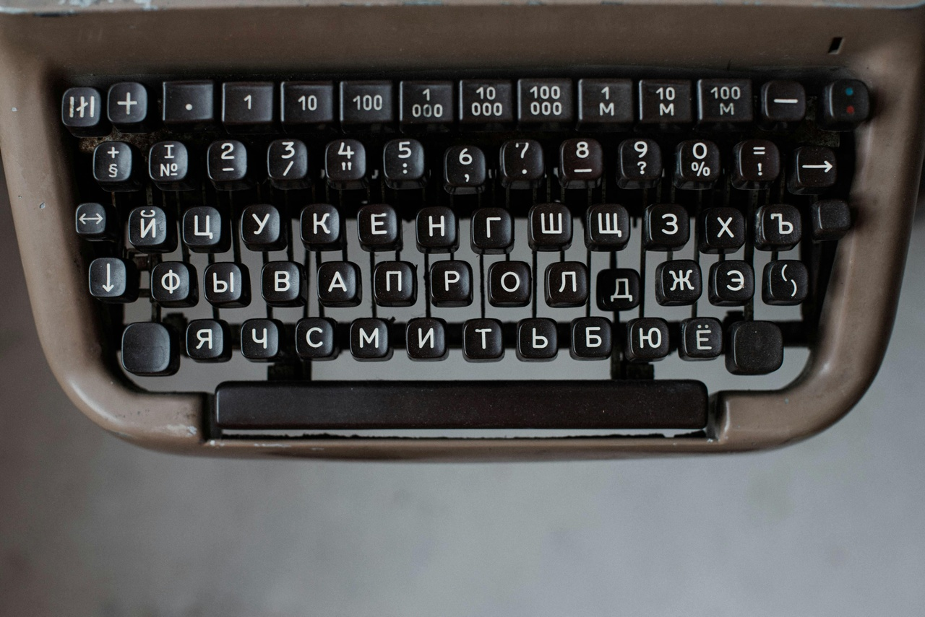
Exploring the Ukrainian Alphabet
A Comprehensive Journey Through Language and Culture

Slide 2
Table of contents
01
02
03
04
05
06
07
08
09
10
11
Title Slide: Mastering the Ukrainian Alphabet
Lesson Overview: Objectives and Key Learning Goals
Historical Context: Origins and Key Highlights
Alphabet Structural Overview: Characters and Comparison
Phonetic Pronunciation Workshop: Techniques and Guide
Comparative Linguistic Analysis: Ukrainian vs. English
Interactive Learning Challenge: Activities and Approach
Common Challenges: Misconceptions and Strategies
Practical Application: Language Usage and Skills
Digital Learning Resources: Tools and Platforms
Assessment Strategies: Evaluation Methods and Criteria

Slide 3
Table of contents
12
13
14
15
16
Differentiation Approaches: Learning Pathways and Strategies
Cultural Connections: Significance and Identity
Next Steps: Learning Pathways and Opportunities
Conclusion: Key Takeaways and Quote
Q&A and Resources: Materials and Information

Slide 4

1
Title Slide: Mastering the Ukrainian Alphabet
Mastering the Ukrainian Alphabet: A Linguistic Journey
Exploring Cyrillic Script for Teenage Language Learners
Exploring the Ukrainian Alphabet

Slide 5

2
Lesson Overview: Objectives and Key Learning Goals
01
Objectives
02
Key Learning Goals
Introduce Ukrainian Cyrillic Alphabet
Develop Phonetic Understanding
Explore Cultural Linguistic Connections
Recognize 33 Ukrainian Alphabet Characters
Understand Phonetic Pronunciation
Compare Ukrainian and English Linguistic Structures
Exploring the Ukrainian Alphabet

Slide 6

3
Historical Context: Origins and Key Highlights
01
Origins of Cyrillic Script
02
Key Highlights
Developed in 9th Century
Byzantine Missionary Influence
Cultural Significance
Saints Cyril and Methodius
Linguistic Evolution
Cultural Preservation
Exploring the Ukrainian Alphabet

Slide 7

4
Alphabet Structural Overview: Characters and Comparison
01
Ukrainian Alphabet Characters
02
Comparison with English Alphabet
Consists of 33 unique characters
Includes both vowels and consonants
Cyrillic vs. English Characters
Different visual representations
Unique pronunciation rules
Sound correspondence variations
03
Phonetic Mapping
Understanding sound correspondence
Learning unique pronunciation rules
Exploring phonetic similarities and differences
Exploring the Ukrainian Alphabet

Slide 8
5
Phonetic Pronunciation Workshop: Techniques and Guide
01
Articulation Exercises
02
Phonetic Challenges
03
Interactive Practice
Practice tongue placement and airflow control.
Focus on vowel sounds and consonant clusters.
Mastering soft and hard consonant distinctions.
Understanding vowel reduction in unstressed syllables.
Engage in tongue twisters for diction improvement.
Utilize audio guides for accurate pronunciation.
04
Mouth Positioning
05
Sound Variations
Demonstrate correct mouth shapes for specific sounds.
Emphasize the importance of lip rounding and tongue placement.
Explore nuances in vowel length and stress patterns.
Differentiate voiced and voiceless consonant pairs.
Exploring the Ukrainian Alphabet

Slide 9
6
Comparative Linguistic Analysis: Ukrainian vs. English
Alphabet Structure
Phonetic Mapping
Ukrainian: 33 unique characters
English: 26 letters
Ukrainian: Sound correspondence with characters
English: Varied pronunciation rules
Exploring the Ukrainian Alphabet

Slide 10

7
Interactive Learning Challenge: Activities and Approach
01
Alphabet Decoding Game
02
Pronunciation Practice
Collaborative activity for group engagement
Decode Ukrainian words using Cyrillic characters
Interactive workshop for mastering sounds
Focus on challenging phonetic combinations
03
Competitive Learning
Engage in friendly competition for motivation
Test pronunciation skills in a fun setting
Exploring the Ukrainian Alphabet

Slide 11

8
Common Challenges: Misconceptions and Strategies
01
Misconception 1: Ukrainian characters are identical to English characters
02
Misconception 2: Ukrainian pronunciation is simple
Explanation: Cyrillic script has unique characters that may look similar but have different sounds
Strategy: Engage in visual comparisons to understand the distinctions
Explanation: Ukrainian has specific pronunciation rules and sounds that differ from English
Strategy: Practice systematic pronunciation drills and utilize multimedia resources
Exploring the Ukrainian Alphabet

Slide 12

9
Practical Application: Language Usage and Skills
01
Real-World Language Usage
02
Cultural Communication Skills
Engage in Conversations
Practice Writing Skills
Understand Cultural Nuances
Respect Language Traditions
03
Pronunciation Confidence Building
Regular Practice Sessions
Seek Feedback and Guidance
Exploring the Ukrainian Alphabet

Slide 13

10
Digital Learning Resources: Tools and Platforms
01
Interactive Mobile Applications
02
Augmented Reality Tools
Engaging language learning apps
Interactive exercises and quizzes
Immersive learning experiences
Visualizing Cyrillic characters in real-world settings
03
Online Language Platforms
04
Pronunciation Tracking Technologies
Virtual classrooms for interactive lessons
Access to language tutors and resources
Tools for monitoring and improving pronunciation
Feedback mechanisms for language accuracy
Exploring the Ukrainian Alphabet

Slide 14

11
Assessment Strategies: Evaluation Methods and Criteria
01
Written Examination
02
Oral Pronunciation Portfolio
Assess understanding of Ukrainian Cyrillic alphabet characters.
Evaluate knowledge of phonetic pronunciation rules.
Test comprehension of linguistic structures.
Demonstrate accurate pronunciation of Ukrainian alphabet characters.
Showcase ability to apply phonetic rules in spoken language.
Provide opportunities for individualized feedback.
03
Linguistic Presentation
Present a linguistic analysis comparing Ukrainian and English structures.
Discuss cultural and historical influences on language development.
Showcase proficiency in phonetic mapping and sound correspondence.
Exploring the Ukrainian Alphabet

Slide 15

12
Differentiation Approaches: Learning Pathways and Strategies
01
Visual Learners
02
Auditory Learners
Prefer visual aids like charts and diagrams
Benefit from color-coded information
Learn best through listening and speaking
Engage well with audio resources
03
Kinesthetic Learners
Learn by doing and experiencing
Benefit from hands-on activities and role-playing
Exploring the Ukrainian Alphabet

Slide 16

13
Cultural Connections: Significance and Identity
01
Language Preservation
02
Historical Significance
Ukrainian Alphabet as a symbol of cultural heritage
Importance of language in preserving identity
Cyrillic script development in the 9th century
Influence of Byzantine missionaries on Ukrainian language
03
National Identity
04
Global Communication
Ukrainian alphabet as a reflection of national pride
Cultural significance of linguistic traditions
Connecting with Ukrainian diaspora worldwide
Promoting Ukrainian language and culture internationally
Exploring the Ukrainian Alphabet

Slide 17
14
Next Steps: Learning Pathways and Opportunities
01
Advanced Language Courses
02
Cultural Immersion Programs
03
Language Exchange Partners
Explore higher-level Ukrainian language courses for in-depth learning.
Participate in cultural immersion programs to enhance language skills and understanding.
Connect with native Ukrainian speakers for language exchange opportunities.
04
Online Language Communities
05
Language Proficiency Exams
Join online forums and communities to practice Ukrainian and engage with fellow learners.
Consider taking proficiency exams to assess and certify your Ukrainian language skills.
Exploring the Ukrainian Alphabet

Slide 18

15
Conclusion: Key Takeaways and Quote
01
Key Takeaways
02
Quote
Understanding the 33 Ukrainian Alphabet Characters
"Language is the road map of a culture. It tells you where its people come from and where they are going." - Rita Mae Brown
Exploring the Ukrainian Alphabet

Slide 19

16
Q&A and Resources: Materials and Information
01
Additional Learning Materials
02
Contact Information
Online Ukrainian language courses
Ukrainian alphabet flashcards
Ukrainian language textbooks
Language learning centers
Ukrainian cultural organizations
Online language tutors
03
Recommended Resources
04
Encouragement for Continued Learning
Ukrainian language apps
Ukrainian language websites
Ukrainian language podcasts
Join Ukrainian language study groups
Practice speaking with native speakers
Immerse yourself in Ukrainian culture
Exploring the Ukrainian Alphabet

