Slide 1

Mastering the Art of Greetings
Exploring the Importance, Techniques, and Cultural Nuances of Effective Communication

Slide 2


Table of contents
Introduction to Greetings
Why Greetings are Important
Types of Greetings
Facial Expressions
Gestures and Facial Expressions
Role-Playing Greetings
Greeting Scenarios
Eye Contact and Personal Space
Cultural Differences in Greetings
Common Errors and Remediation
Assessment and Evaluation
Conclusion
Extension Activities
01
02
03
04
05
06
07
08
09
10
11
12
13

Slide 3
Table of contents
Parent Engagement
Safety Considerations
Teaching Tips and Strategies
Key Takeaways
Reflection Questions
14
15
16
17
18

Slide 4

Introduction to Greetings
Forms of Greeting
Nonverbal Cues
Social Benefits
Greetings can be verbal, such as saying 'hello' or 'hi'.
They can also be physical, like a handshake or a wave.
Gestures and facial expressions play a crucial role in greetings.
A smile or nod can convey warmth and friendliness.
Greetings help establish connections and build relationships.
They contribute to a positive social atmosphere and can enhance happiness.
1
Mastering the Art of Greetings

Slide 5
Why Greetings are Important
Show Kindness
Create Happiness
Initiate Conversations
Greetings are a simple way to express kindness and friendship.
A warm greeting can brighten someone's day.
A friendly greeting makes others feel happy and welcomed.
It fosters a positive atmosphere and encourages connection.
Greetings serve as an effective way to start conversations.
They open the door for meaningful interactions and relationships.
2
Mastering the Art of Greetings

Slide 6

Types of Greetings
Waving
Hugging
A casual way to say hello.
Commonly used in informal settings.
A way to show love and affection.
Often shared among close friends and family.
Shaking Hands
Smiling
A formal way to greet someone.
Typically used in professional or business contexts.
A way to show happiness and friendliness.
Universal gesture that can brighten someone's day.
3
Mastering the Art of Greetings

Slide 7
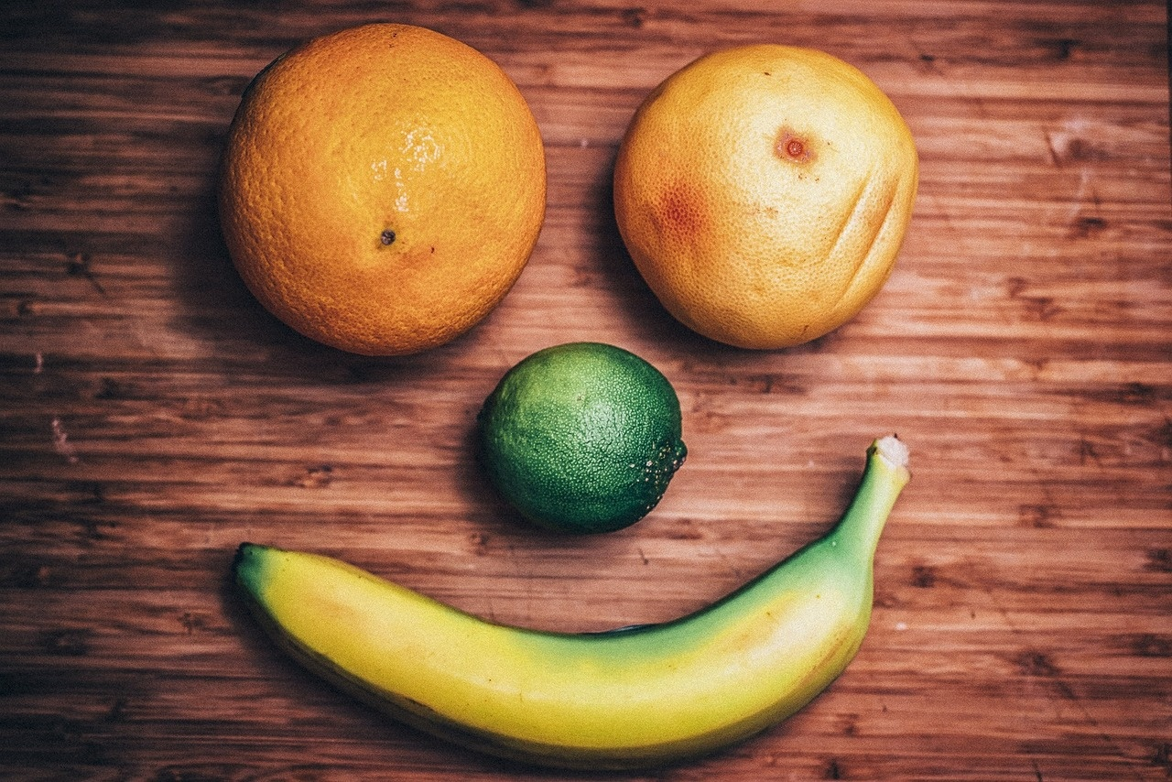
Facial Expressions
Happiness
Sadness
Surprise
Smiling is a universal sign of happiness and friendliness.
It often indicates a positive emotional state.
Frowning typically represents sadness or unhappiness.
It can reflect feelings of disappointment or loss.
A surprised expression often shows excitement or shock.
It can indicate an unexpected event or revelation.
4
Mastering the Art of Greetings

Slide 8
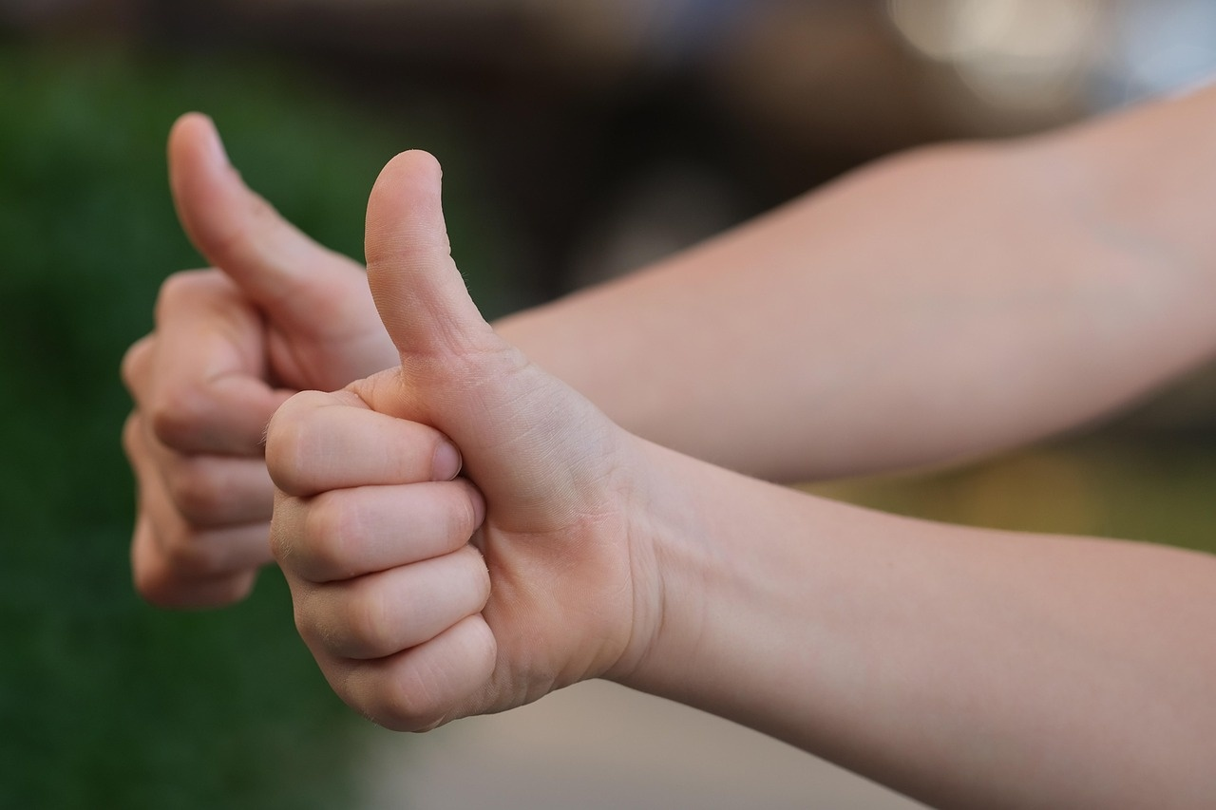
Gestures and Facial Expressions
Emotional Signals
Intent Communication
Social Greetings
Gestures and facial expressions are powerful indicators of our emotions.
They can convey feelings such as happiness, sadness, anger, and surprise.
Facial expressions and gestures help communicate our intentions clearly.
They can indicate whether we are being friendly, aggressive, or neutral.
We often use gestures and facial expressions to greet others.
A smile or wave can create a welcoming atmosphere and foster connection.
5
Mastering the Art of Greetings

Slide 9
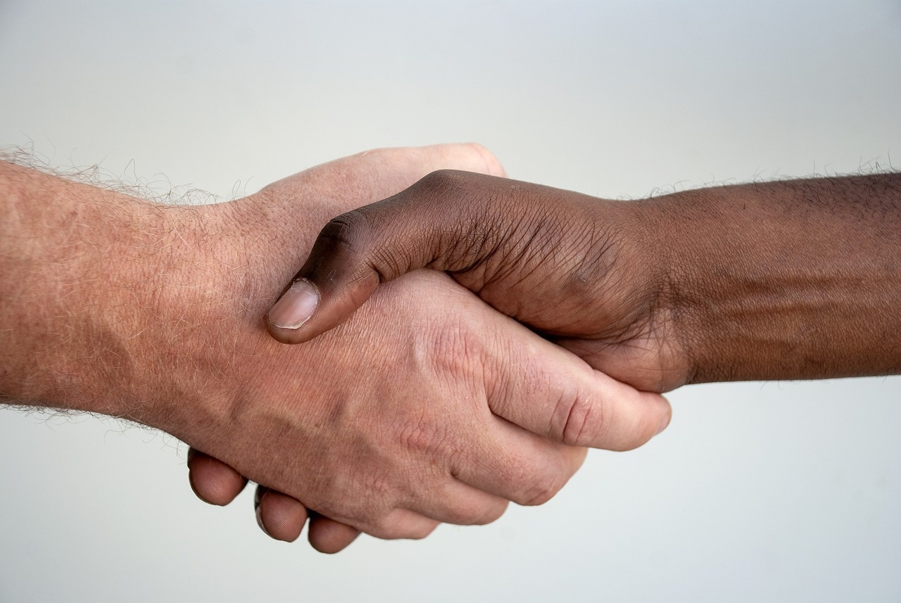
Role-Playing Greetings
Friendly Gestures
Express Kindness
Turn-Taking
Use open body language to show you are welcoming.
Smile and make eye contact to create a friendly atmosphere.
Use warm words and phrases to greet your friend.
Compliment them to make them feel appreciated.
Take turns greeting each other to practice conversation skills.
Listen actively when it's the other person's turn to speak.
6
Mastering the Art of Greetings

Slide 10

Greeting Scenarios
New Friend
Family Member
Teacher/Caregiver
Introduce yourself with a smile.
Ask about their interests to start a conversation.
Give them a warm hug or handshake.
Ask how their day has been.
Greet them politely with 'Hello' or 'Good morning'.
Express gratitude for their support and guidance.
7
Mastering the Art of Greetings

Slide 11
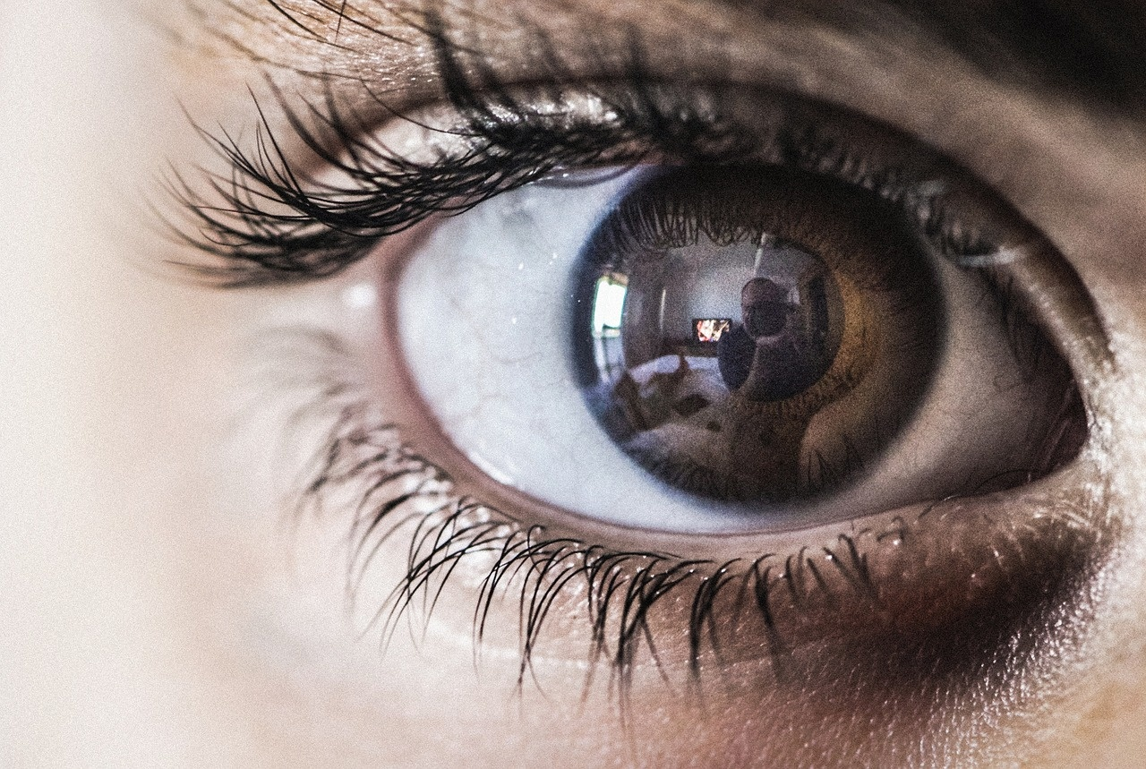
Eye Contact and Personal Space
Engagement Through Eye Contact
Importance of Personal Space
Respecting Boundaries
Eye contact shows we are interested and care about the other person.
It fosters a connection and builds trust.
Personal space is important for feeling comfortable and safe.
It varies from person to person and culture to culture.
We should respect others' personal space and boundaries.
Understanding these limits helps maintain healthy relationships.
8
Mastering the Art of Greetings

Slide 12
Cultural Differences in Greetings
Cultural Greetings
Respect Differences
Building Friendships
Different cultures have unique ways of greeting one another, such as handshakes, bows, or cheek kisses.
Understanding these customs can enhance our interactions and show respect.
It is essential to appreciate the diverse ways people greet each other around the world.
Respecting these differences fosters inclusivity and understanding in our communities.
Learning about various cultural greetings can open doors to new friendships.
By embracing these differences, we create opportunities for meaningful connections.
9
Mastering the Art of Greetings

Slide 13

Common Errors and Remediation
Eye Contact Issues
Boundary Violations
Remediation Techniques
Lack of eye contact causes misunderstandings.
Gestures should support, not substitute, verbal communication.
Disregarding personal space leads to discomfort.
Respecting boundaries fosters effective interaction.
Practice eye contact to boost confidence.
Seek feedback from peers to improve communication.
10
Mastering the Art of Greetings

Slide 14
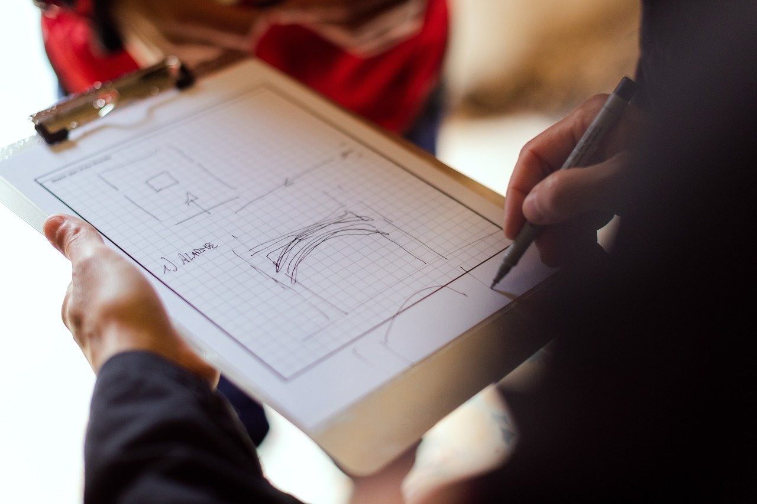
Assessment and Evaluation
Child Interactions
Assessment Tools
Progress Feedback
Observe how children greet each other and engage in play to assess their social skills.
Utilize targeted assessment tools to measure various aspects of children's development.
Regularly assess children's progress and provide detailed, constructive feedback to support their growth.
11
Mastering the Art of Greetings

Slide 15
Conclusion
Social Skills
Non-Verbal Cues
Practice Makes Perfect
Greetings are an essential social skill that fosters connections.
Effective greetings can set a positive tone for interactions.
Using gestures and facial expressions enhances our greetings.
Non-verbal communication can convey warmth and openness.
Regular practice can significantly improve our greeting skills.
Reinforcement through social interactions helps build confidence.
12
Mastering the Art of Greetings

Slide 16

Extension Activities
Greeting Chart
Role-Playing Scenarios
Greeting Video/Song
Create a colorful chart of greetings for various occasions and cultures.
Practice greetings through role-playing scenarios to enhance communication skills.
Produce a fun video or song featuring creative greetings with catchy phrases.
13
Mastering the Art of Greetings

Slide 17
Parent Engagement
Practice Greetings
Feedback & Reinforcement
Share Experiences
Encourage parents to engage in daily greeting practices with their child.
Use simple phrases and expressions to make greetings fun and interactive.
Provide constructive feedback to parents on their child's greeting skills.
Reinforce positive behavior by celebrating small successes in greeting interactions.
Encourage parents to share their experiences and challenges in practicing greetings.
Create a supportive community where parents can exchange tips and progress updates.
14
Mastering the Art of Greetings

Slide 18
Safety Considerations
Child Safety
Stranger Awareness
Active Supervision
Ensuring children's safety and well-being is a top priority.
Implementing safety measures at home and in public spaces is essential.
Teaching children about stranger danger helps them recognize potential threats.
Encouraging personal boundaries empowers children to protect themselves.
Supervising children during role-playing activities is crucial for their safety.
Engaging with children while they play helps reinforce safety lessons.
15
Mastering the Art of Greetings

Slide 19
Teaching Tips and Strategies
Greeting Techniques
Visual Storytelling
Positive Feedback
Model and demonstrate appropriate greetings to set a positive tone.
Encourage students to practice greetings in pairs or small groups.
Utilize visual aids to enhance storytelling and engage students.
Incorporate images, videos, or props to make stories more relatable.
Provide specific and constructive feedback to reinforce learning.
Encourage students by acknowledging their efforts and improvements.
16
Mastering the Art of Greetings

Slide 20
Key Takeaways
Importance of Greetings
Nonverbal Communication
Improving Skills
Greetings are essential for building social skills and fostering relationships.
They create a positive first impression and set the tone for interactions.
Gestures and facial expressions play a crucial role in conveying emotions and intentions.
They can enhance or contradict verbal messages, making them vital for effective communication.
Regular practice and reinforcement can significantly enhance greeting skills.
Engaging in social situations helps individuals become more comfortable and confident.
17
Mastering the Art of Greetings

Slide 21
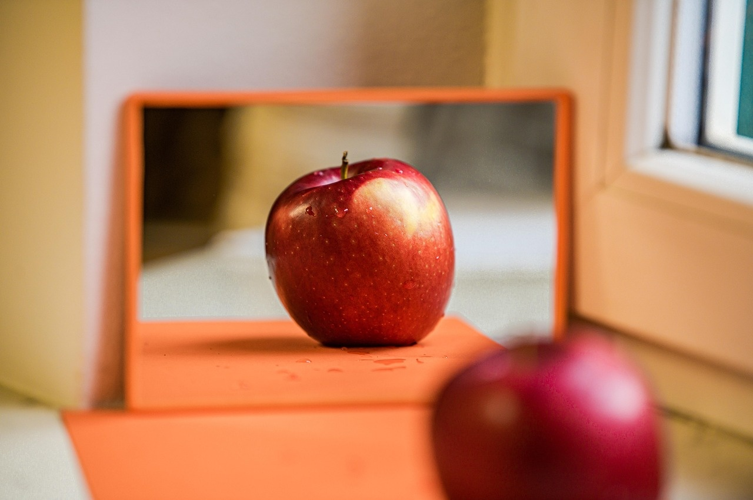
Reflection Questions
Lessons Learned
Improvement Strategies
Challenges Faced
Greetings are essential for building rapport.
A good greeting creates a welcoming atmosphere.
Practicing various greeting styles can enhance our effectiveness.
Seeking constructive feedback can help us refine our approach.
Some people may hesitate to initiate greetings due to shyness.
Cultural differences can complicate greeting interactions.
18
Mastering the Art of Greetings

